Slide 1
Introduction to Buprenorphine: Pregnancy and Parenting
Mishka Terplan MD MPH FACOG DFASAM Medical Director, Friends Research Institute Substance Use Warmline Clinician, UCSF

Slide 2
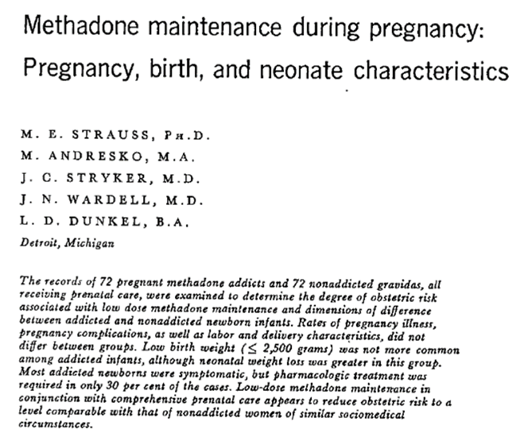
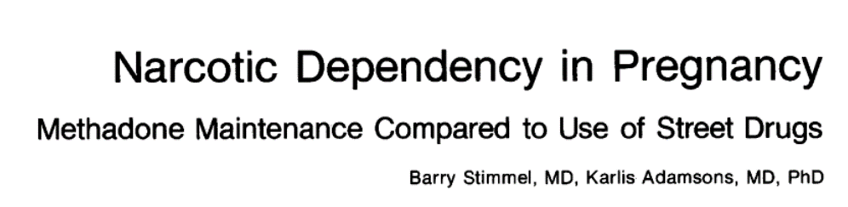
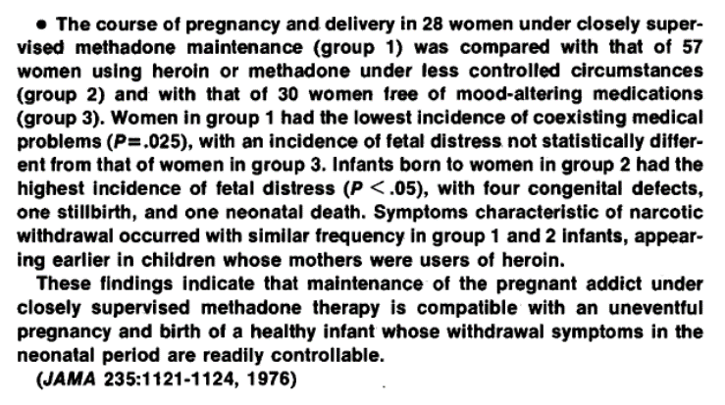
1976
1976
1974

Slide 3
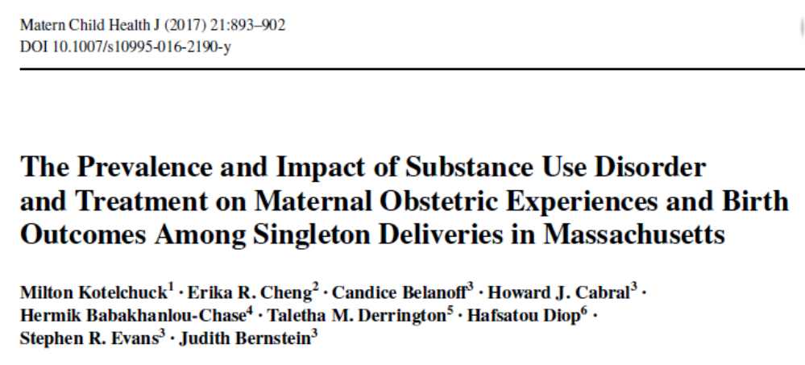
Core Principle of PNC:
Optimize maternal health via chronic disease management
Treated vs. Untreated Addiction
 | No Addiction | Treated Addiction | Untreated Addiction
Preterm Birth | 8.7% | 10.1% | 19.0%
Low Birthweight | 5.5% | 7.8% | 18.0
Fetal Death | 0.4% | 0.5% | 0.8%
Neonatal Mortality | 0.4% | 0.4% | 1.2%
Post Neonatal Mortality | 0.05% | 0.03% | 0.1%

Slide 4
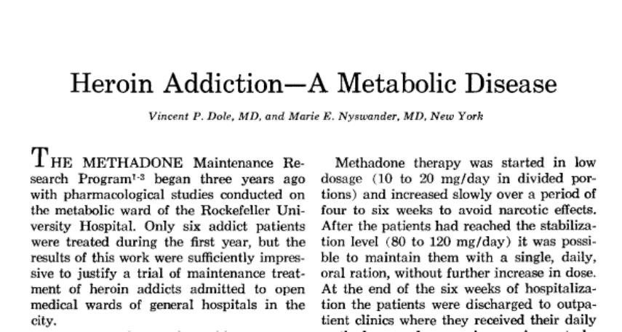
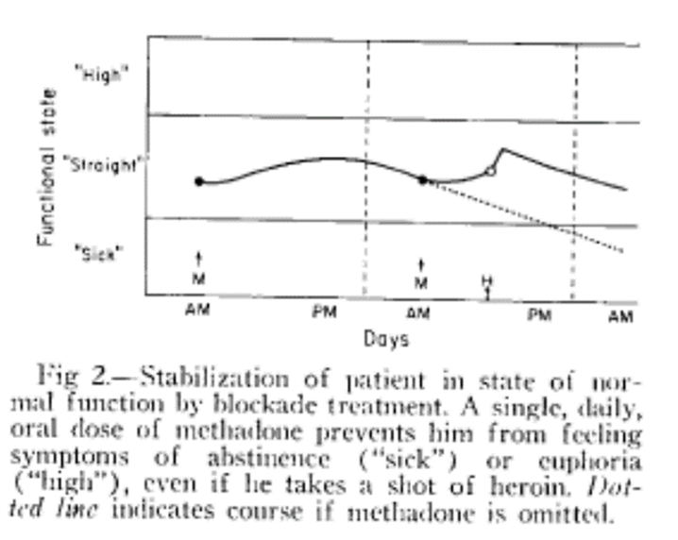
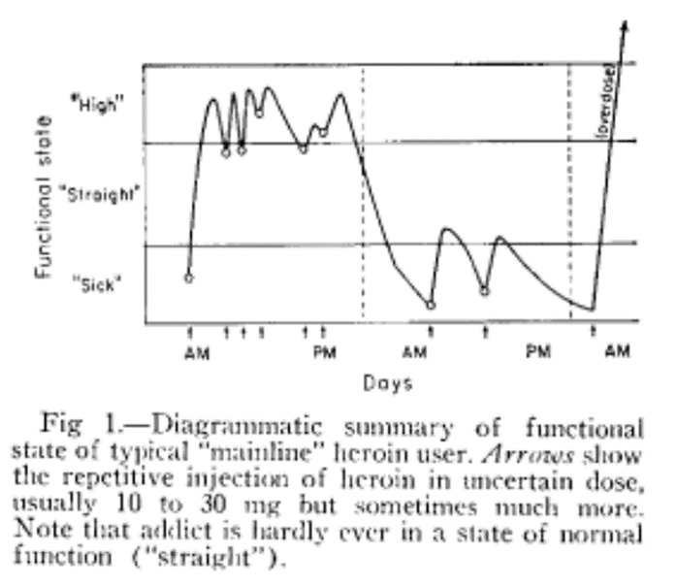
Addiction: From Reward Seeking to Relief Seeking

Slide 5
Medications for OUD (MOUD)
Maternal
70% reduction in overdose related deaths
Decrease in risk of HIV, HBV, HCV acquisition/transmission
Increased engagement in prenatal care and recovery treatment
Treatment is platform for delivery of other services
Fetal
Reduces fluctuations in maternal opioid levels; reducing fetal stress
Decrease in intrauterine fetal demise
Decrease in intrauterine growth restriction
Decrease in preterm delivery

Slide 6
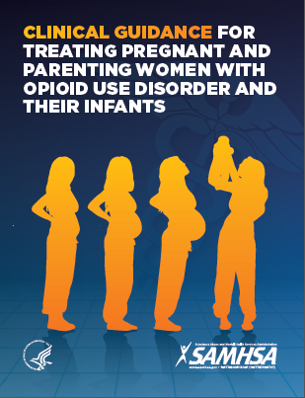
SAMHSA Clinical Guide Recommendations
Buprenorphine and methadone are the safest medications for managing OUD during pregnancy
Transitioning from methadone to buprenorphine or from buprenorphine to methadone during pregnancy is not recommended
Medically supervised withdrawal is not recommended during pregnancy

Slide 7
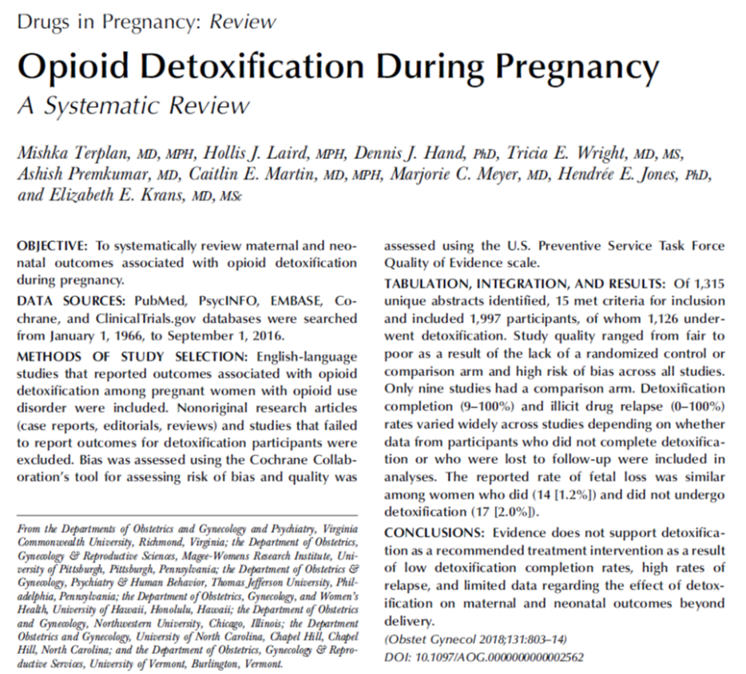
Detoxification:
No increased risk of fetal demise
No difference in NAS
Opioid use and OUD recurrence more common following detox
Detoxification: Acute Intervention for a Chronic Condition: Clinical Mismatch

Slide 8
Medication for Opioid Use Disorder in Pregnancy
Medication supported by:
CDC
WHO
SAMHSA
BOP
NCCHC
ACOG
ASAM
AAP
AAFP
Federal Guidelines for Opioid Treatment 2015
(partial list)
Medication not supported by:

Slide 9
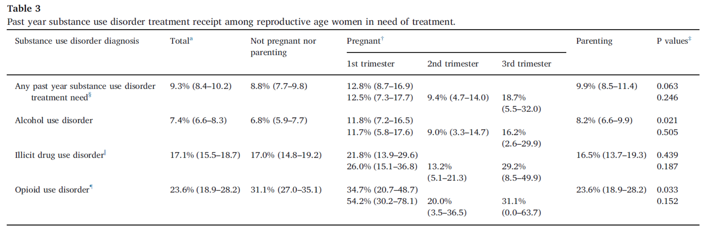
Most People Receive no Treatment in Pregnancy
Martin, 2020, DAD

Slide 10
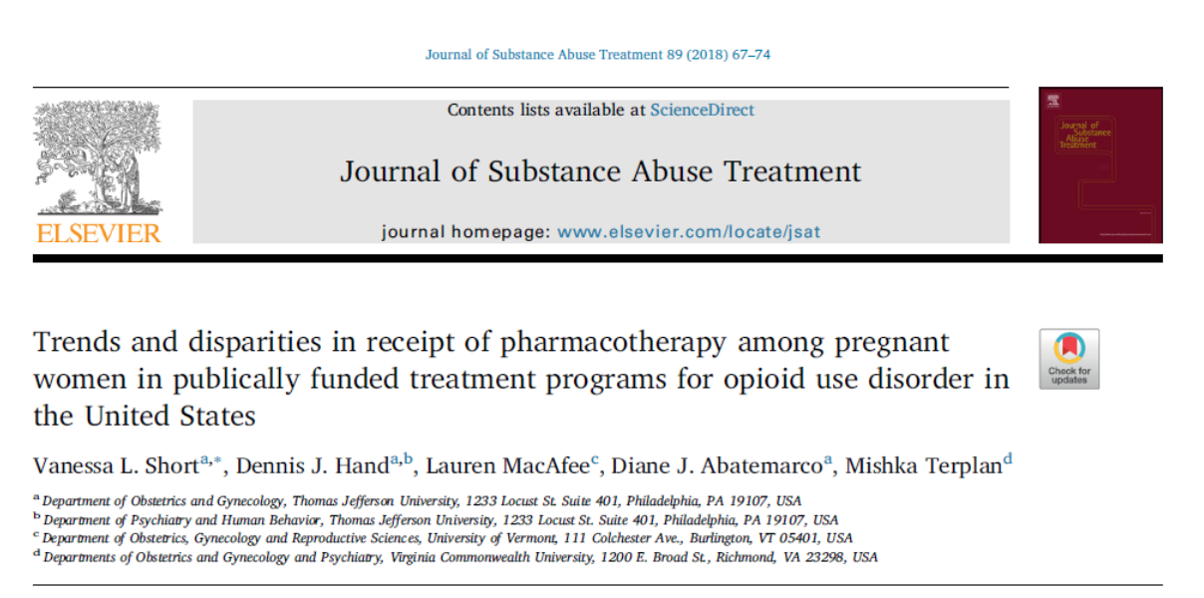

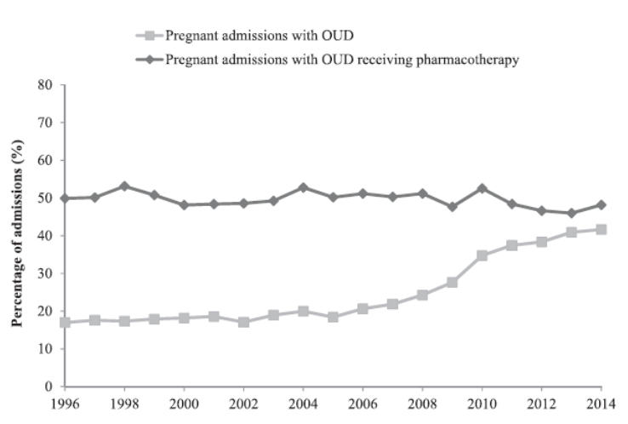
Only half of pregnant women in treatment receive pharmacotherapy

Slide 11
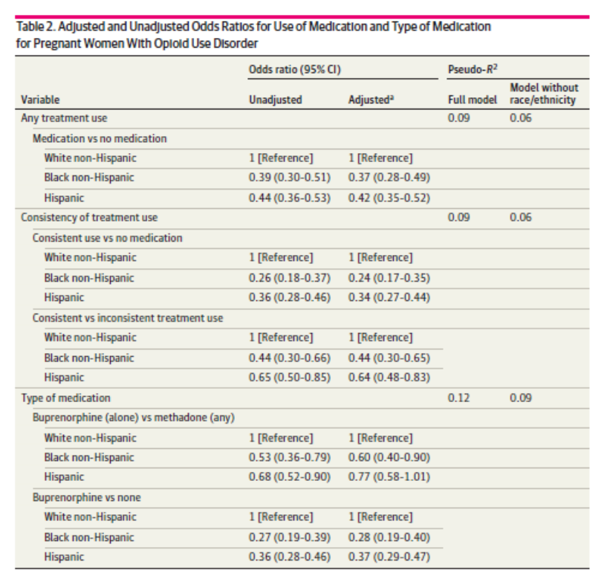
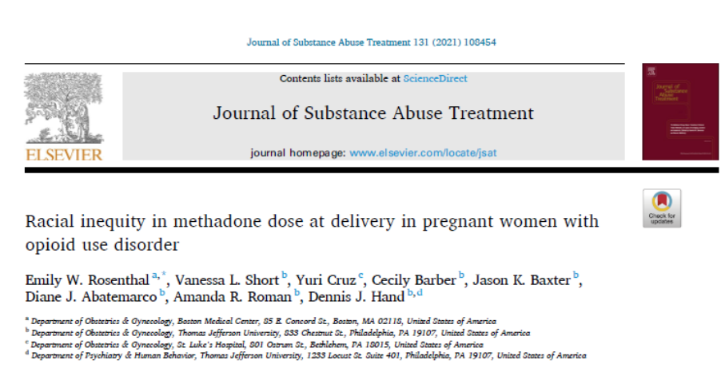
Racial Inequities in MOUD
 | White NH | Black NH | Hispanic
Methadone Dose | 144.9 | 97.5 | 129.8

Slide 12
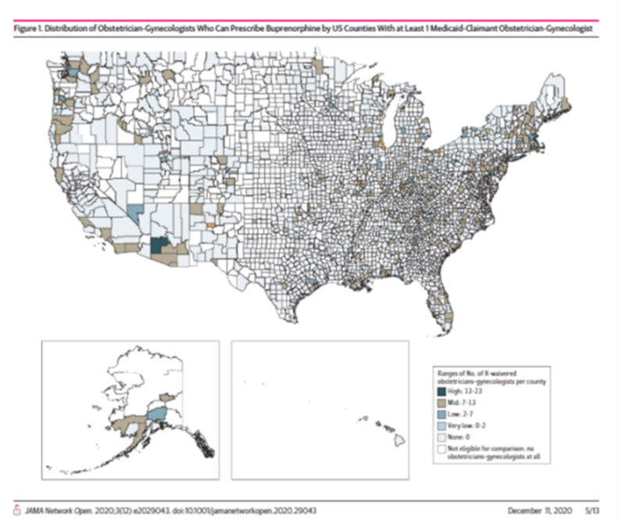
OBGYN Lacks Capacity to Treat OUD
 | N (%) X Waivered OBGYNs in US
2012 | 181 (0.4%)
2020 | 560 (1.8%)
Nguemeni_Tiako MJ et al, JAMA Network Open, 2020
Rosenblatt RA et al, AFM, 2015

Slide 13
Pregnant People with SUD
Any Treatment
Medication
Integrated Care
Comprehensive treatment and medication are rare and unavailable for most pregnant people with SUD

Slide 14
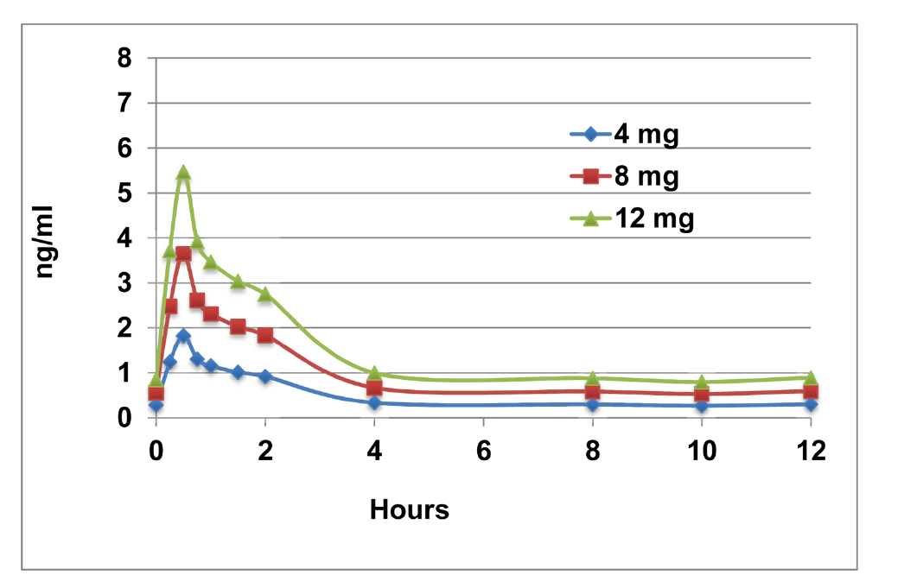
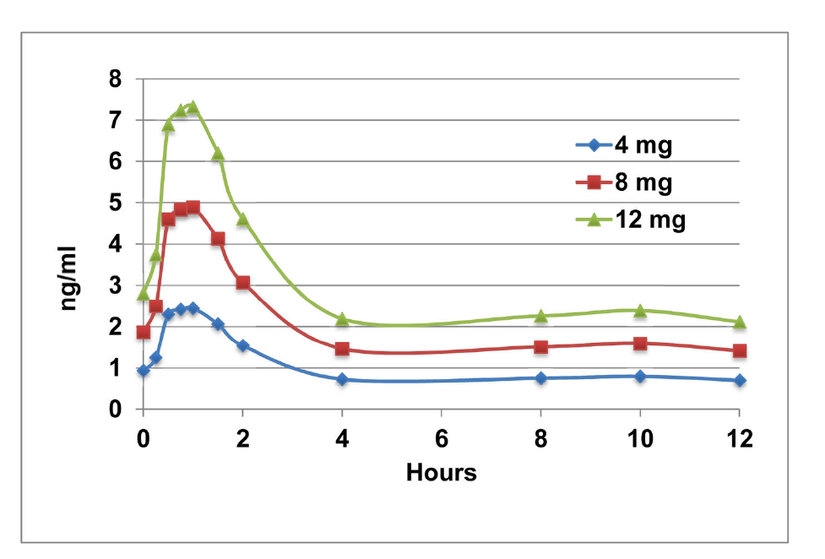
Buprenorphine and Pregnancy Dosing
Postpartum
2nd trimester

Slide 15
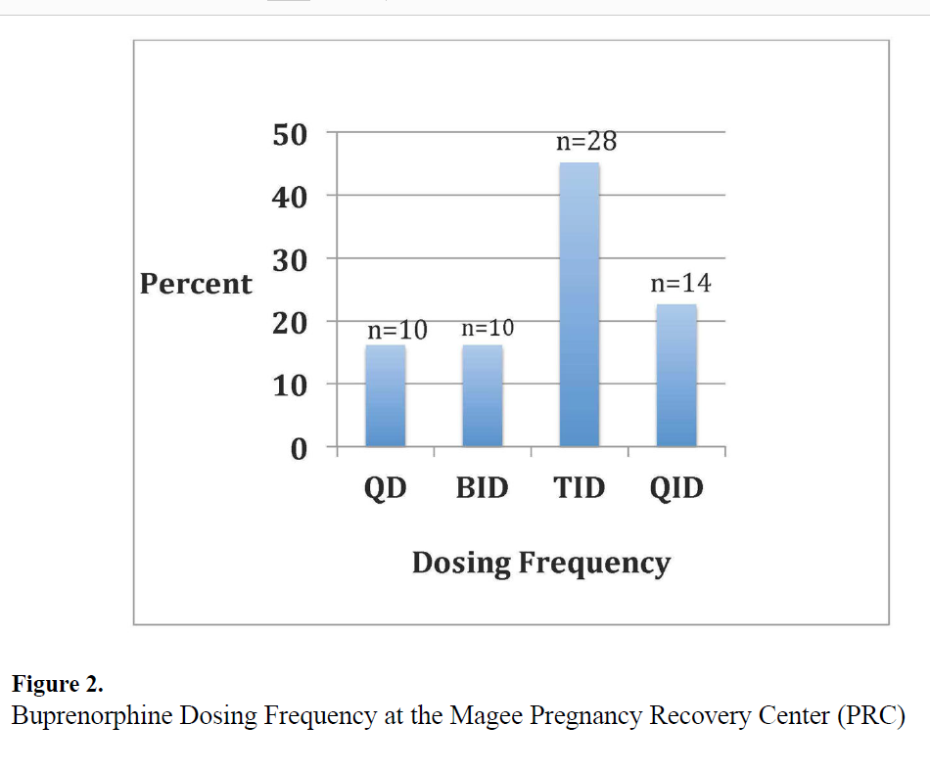
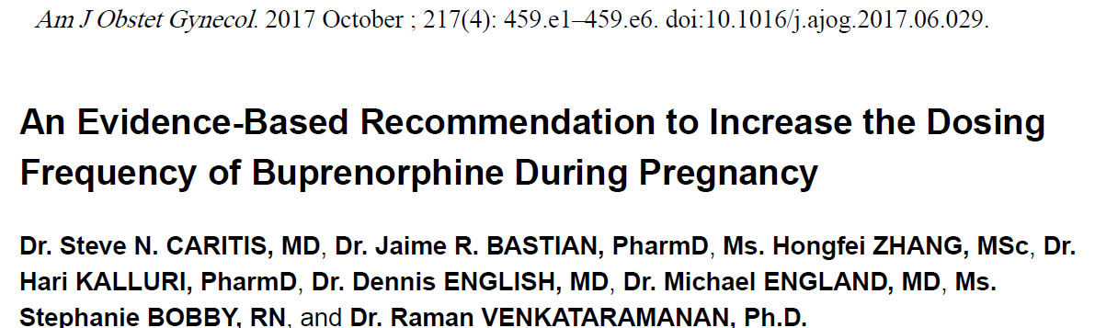
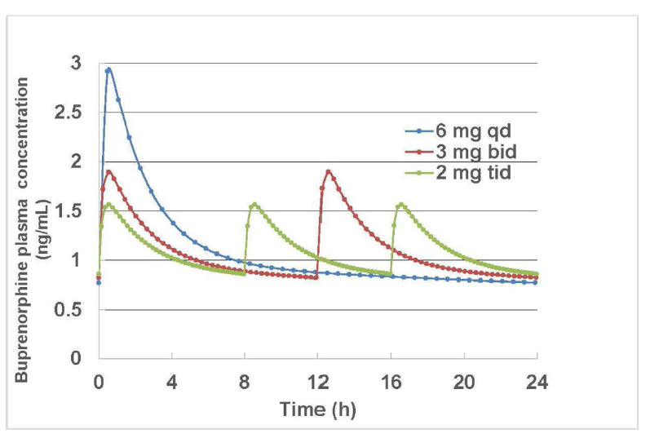

Slide 16
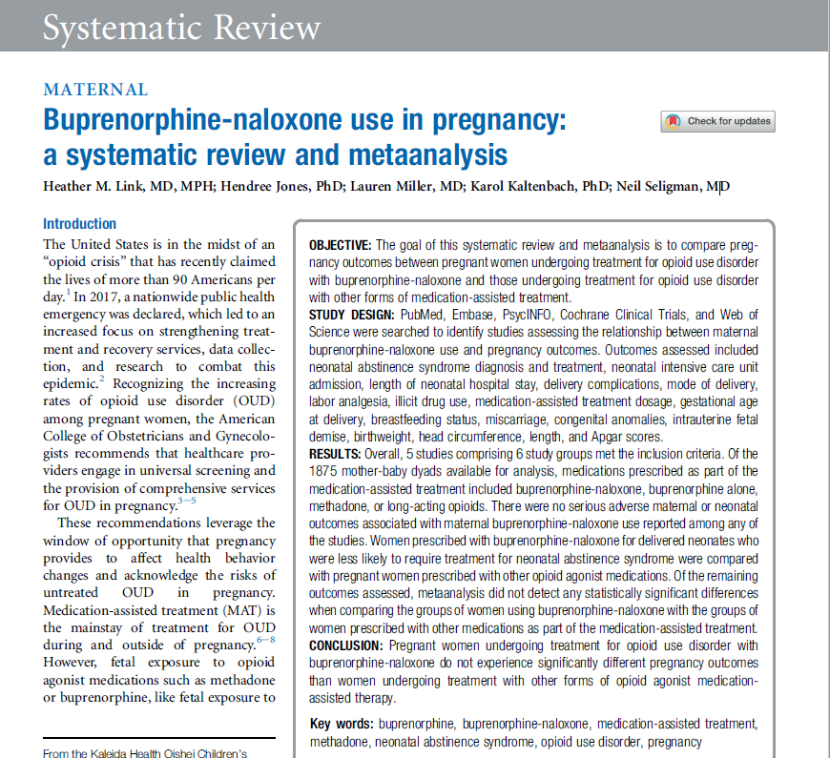
Mono vs. Combination-product
Suboxone vs. Subutex
Consideration for:
Pharmacy availability
Diverted value in context of gender-based violence and other specific forms of coercion
Transition postpartum (time of increased vulnerability

Slide 17
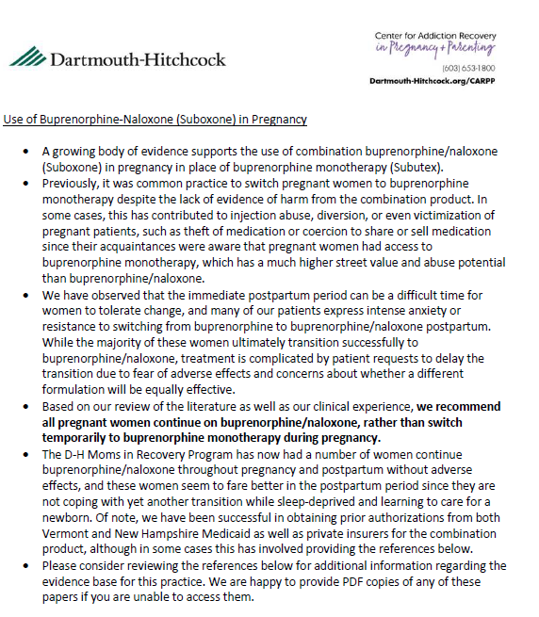

Slide 18
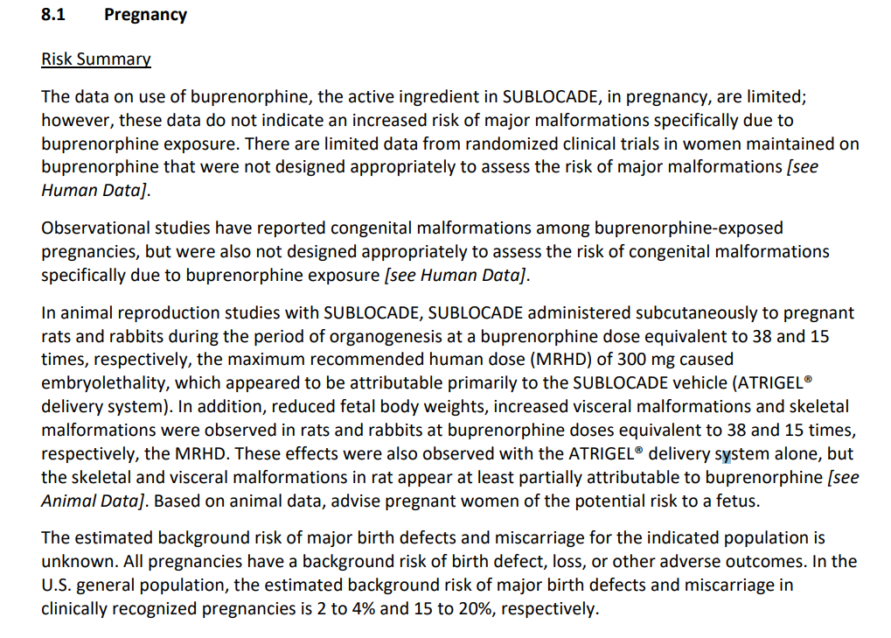
Sublocade: Pregnancy Considerations
“Expert” Recommendations:
Collaborative decision making for continuation
? Recommend against initiation
Primarily because of dose ceiling and need for supplemental SL bup

Slide 19
Brixadi and Pregnancy
Same vehicle in monthly injection
Weekly vehicle = alcohol
Study: Medication Treatment for Opioid Use Disorder in Expectant Mothers (MOMs) currently recruiting

Slide 21



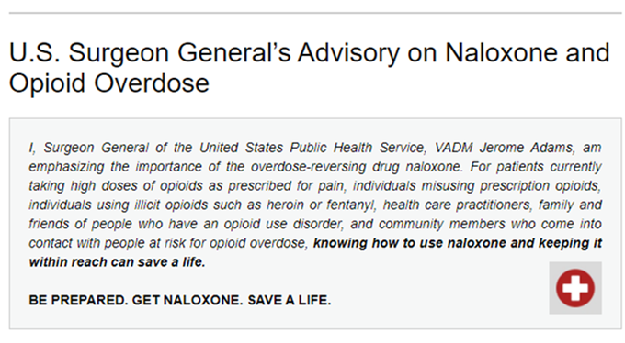
Be Prepared. Get Naloxone. Save A Life.

Slide 22
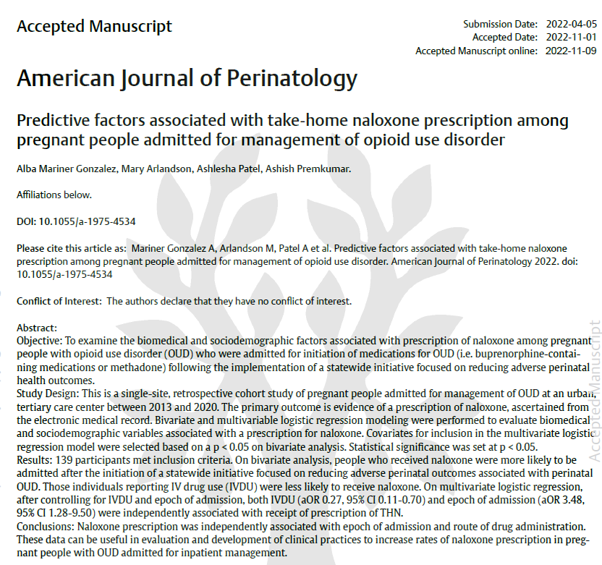

Slide 23
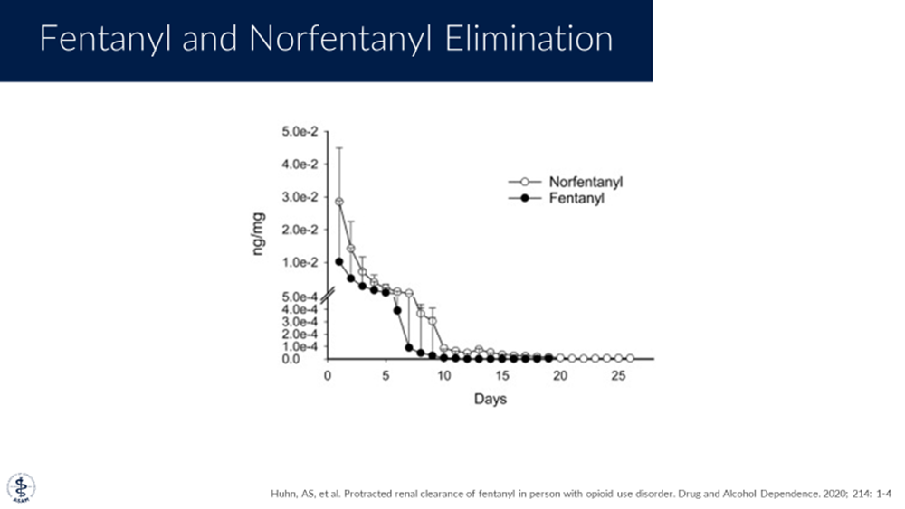
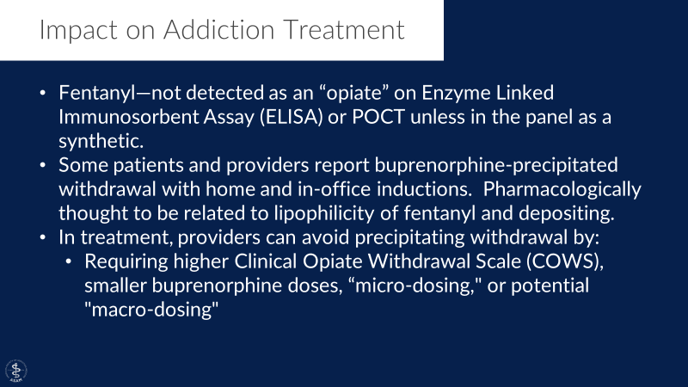
Buprenorphine in the age of Fentanyl: Fentanyl = Long-acting and Lipophyllic)

Slide 24
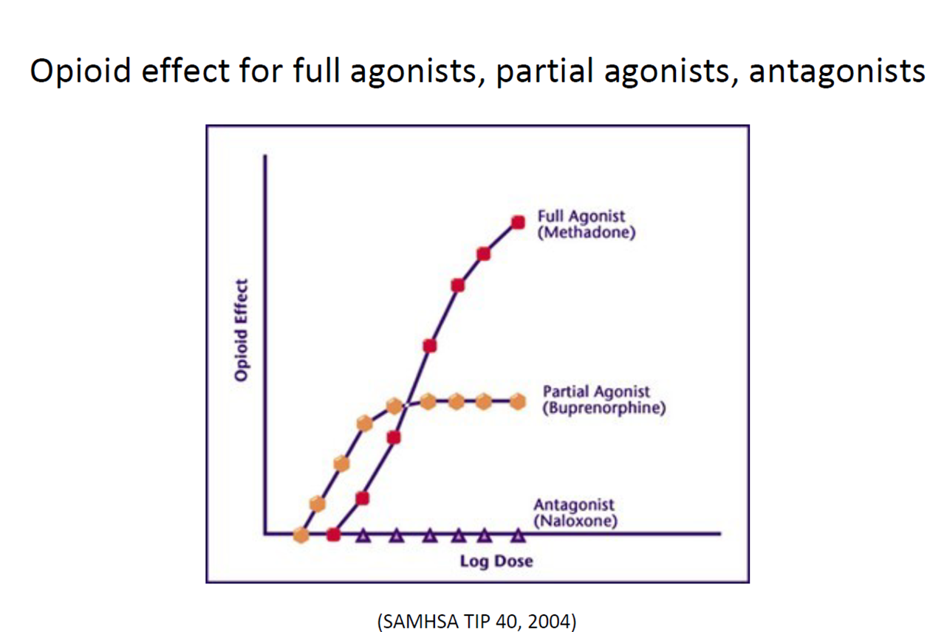
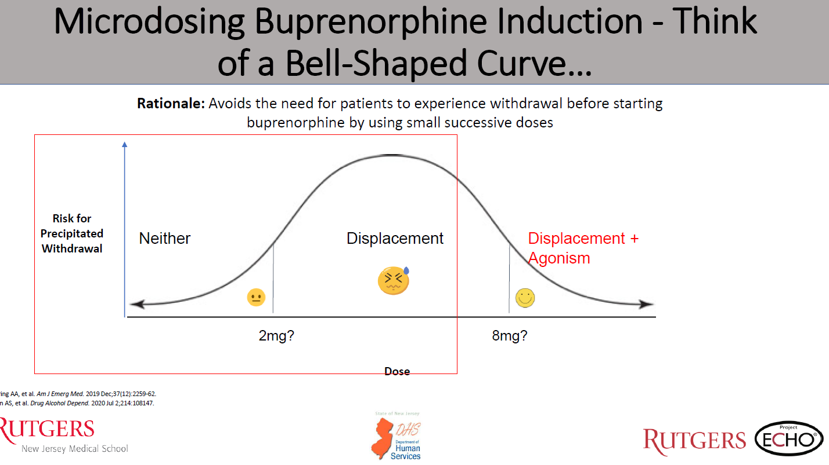

Slide 25
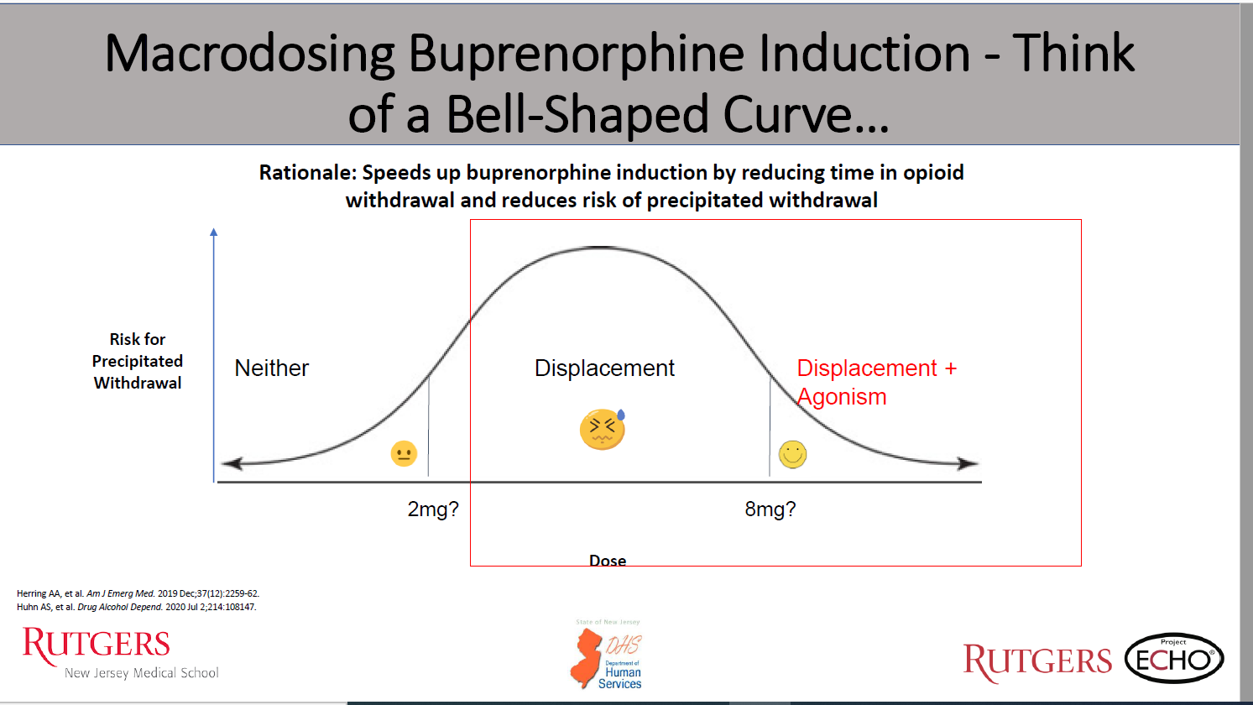
Macrodosing

Slide 26
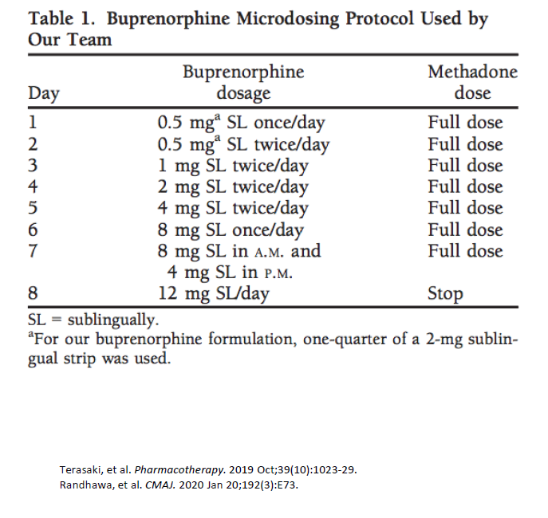
Microdosing: Bernese Method

Slide 27
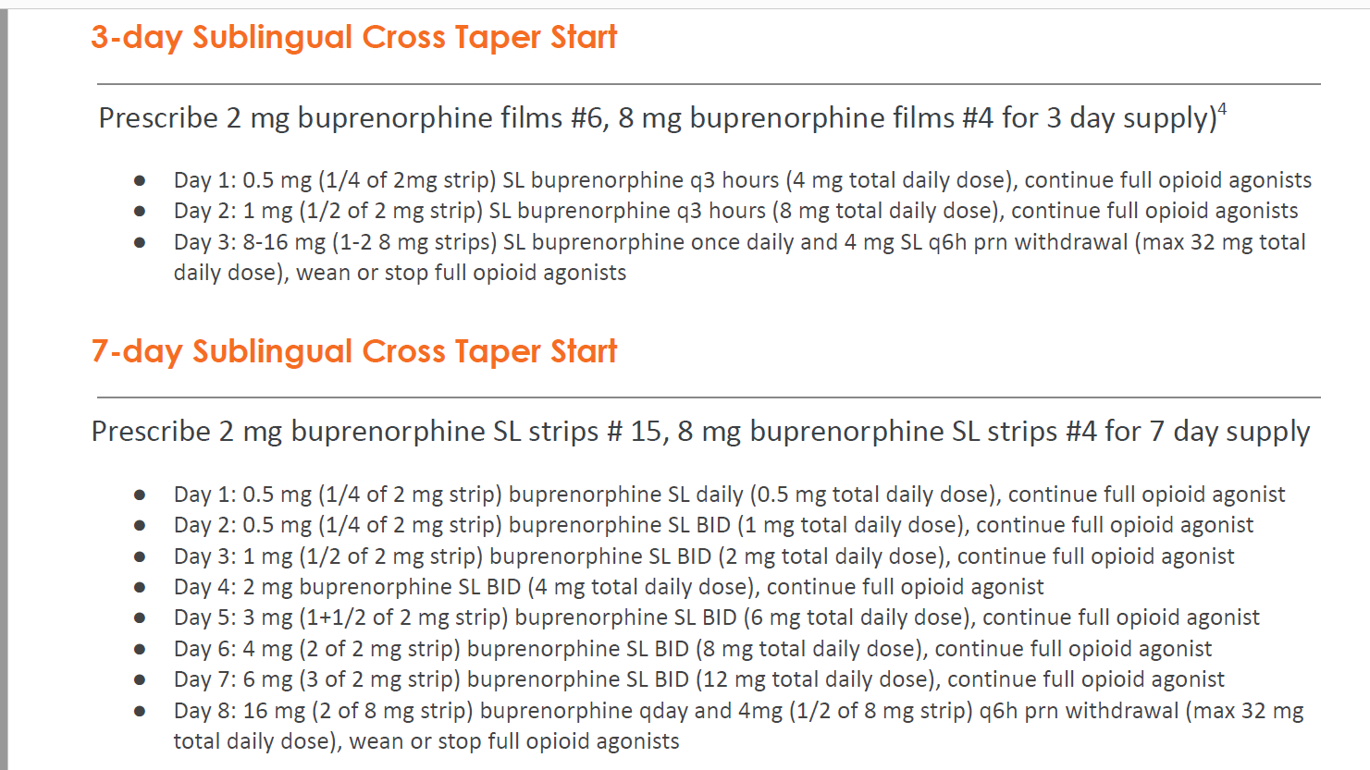
Microdosing, CABridge.org

Slide 28
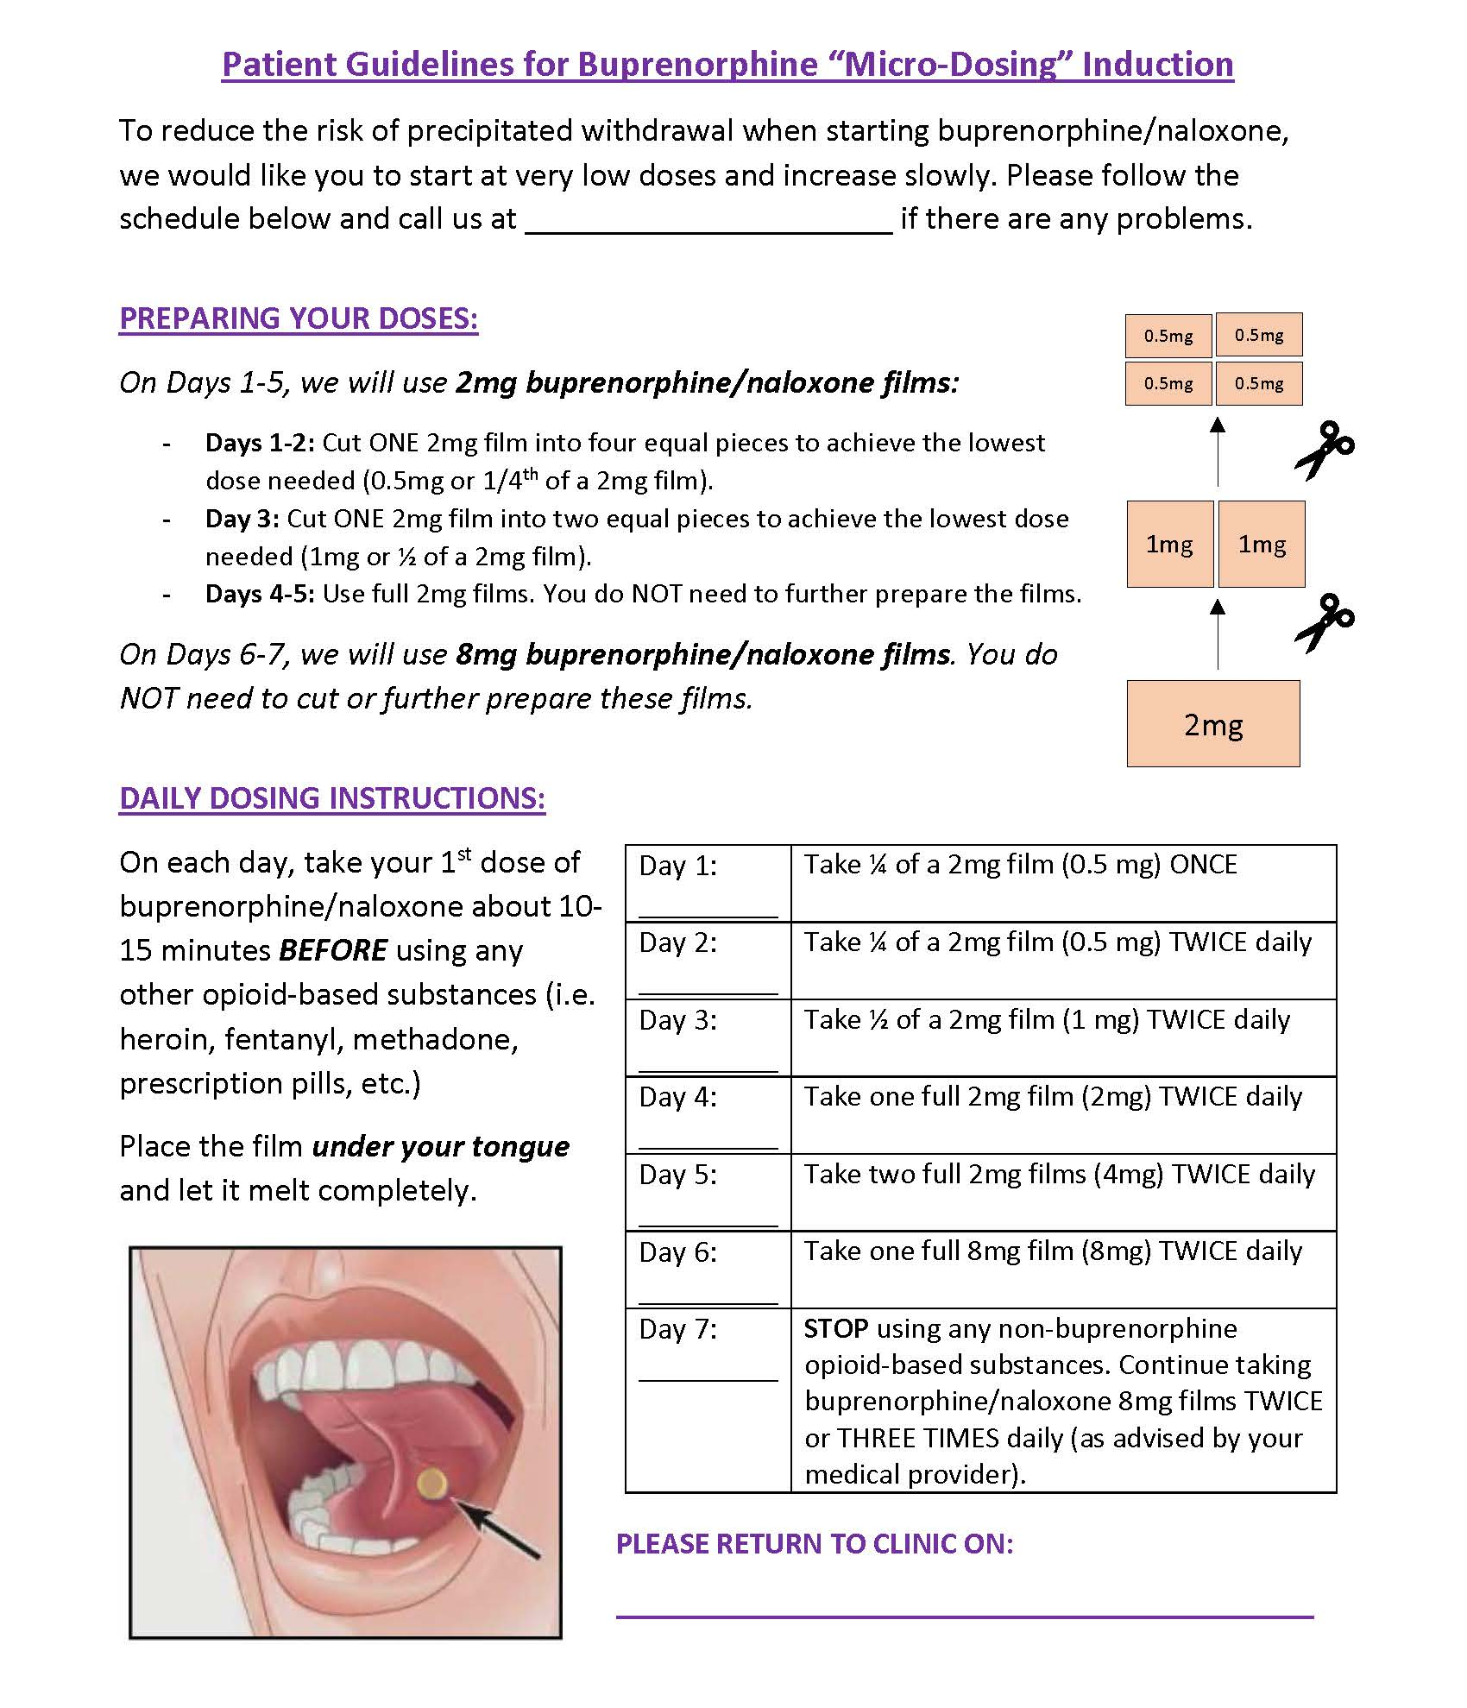
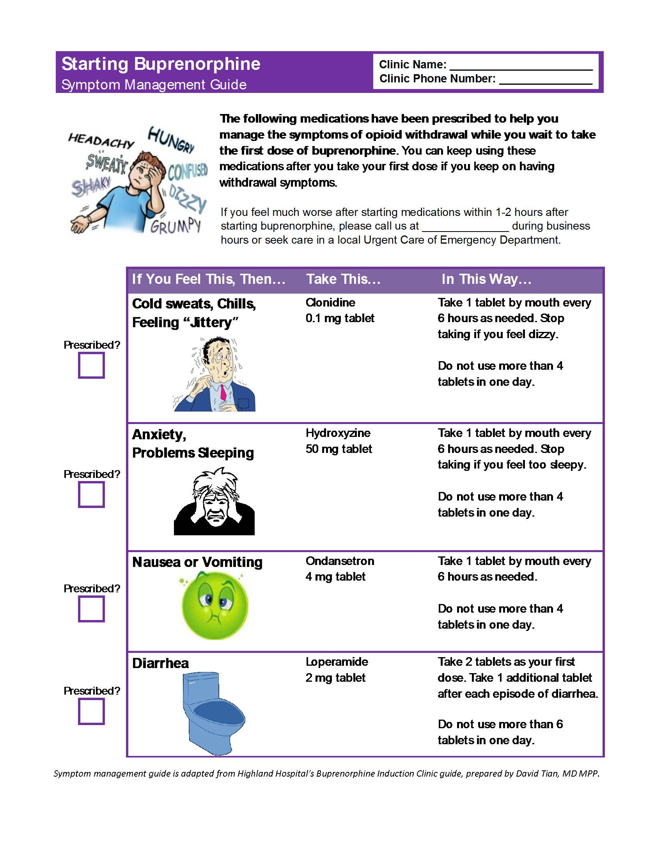

Slide 29
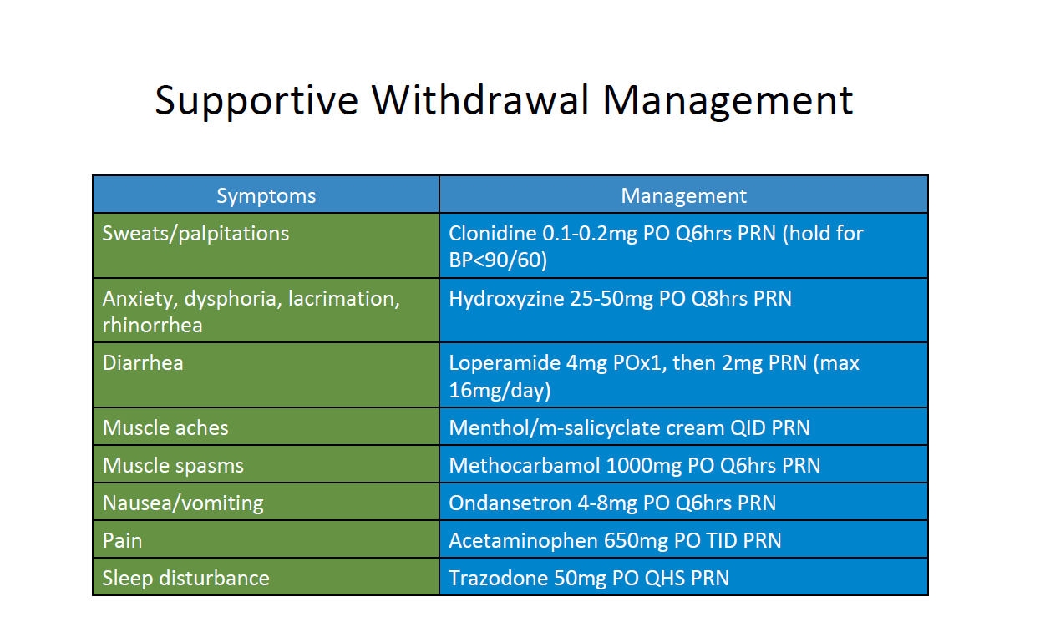

Slide 30
Conclusions
Buprenorphine (and methadone) – safe and effective in pregnancy
No benefit of mono-product and risk of harm
Micro/macro-dosing can be used in pregnancy
Increased daily dosing improves PK and likely symptoms and MOUD adherence
More research needed and underway for ER formulations
Naloxone

Slide 31
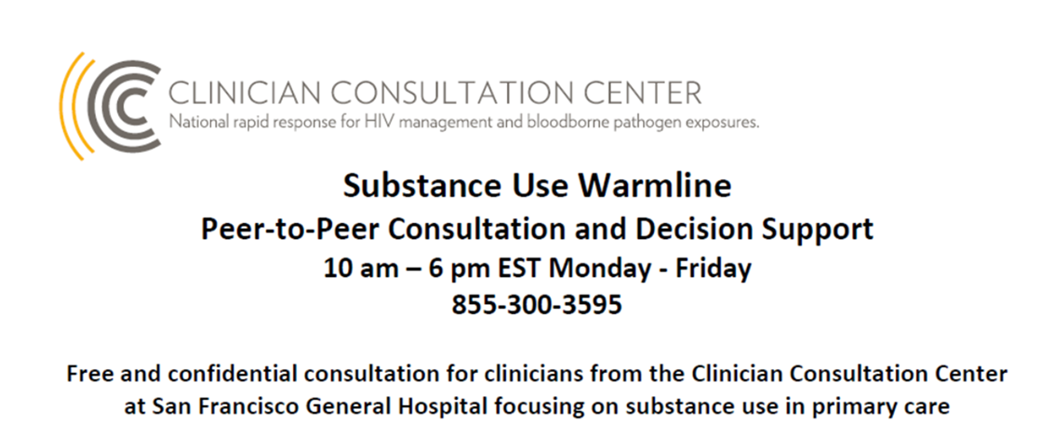
Thank you
Mishka Terplan
@Do_Less_Harm
mterplan@friendsresearch.org

Slide 32
Resources
Buprenorphine waiver training for OBGYNs ASAM https://elearning.asam.org/products/treatment-of-opioid-use-disorder-course-obgyn-focus#tab-product_tab_overview
ASAM buprenorphine mini-course https://elearning.asam.org/p/BupMini_2021#tab-product_tab_overview

Slide 33
Do you need to initiate in hospital?
What about ultrasound

