Slide 1
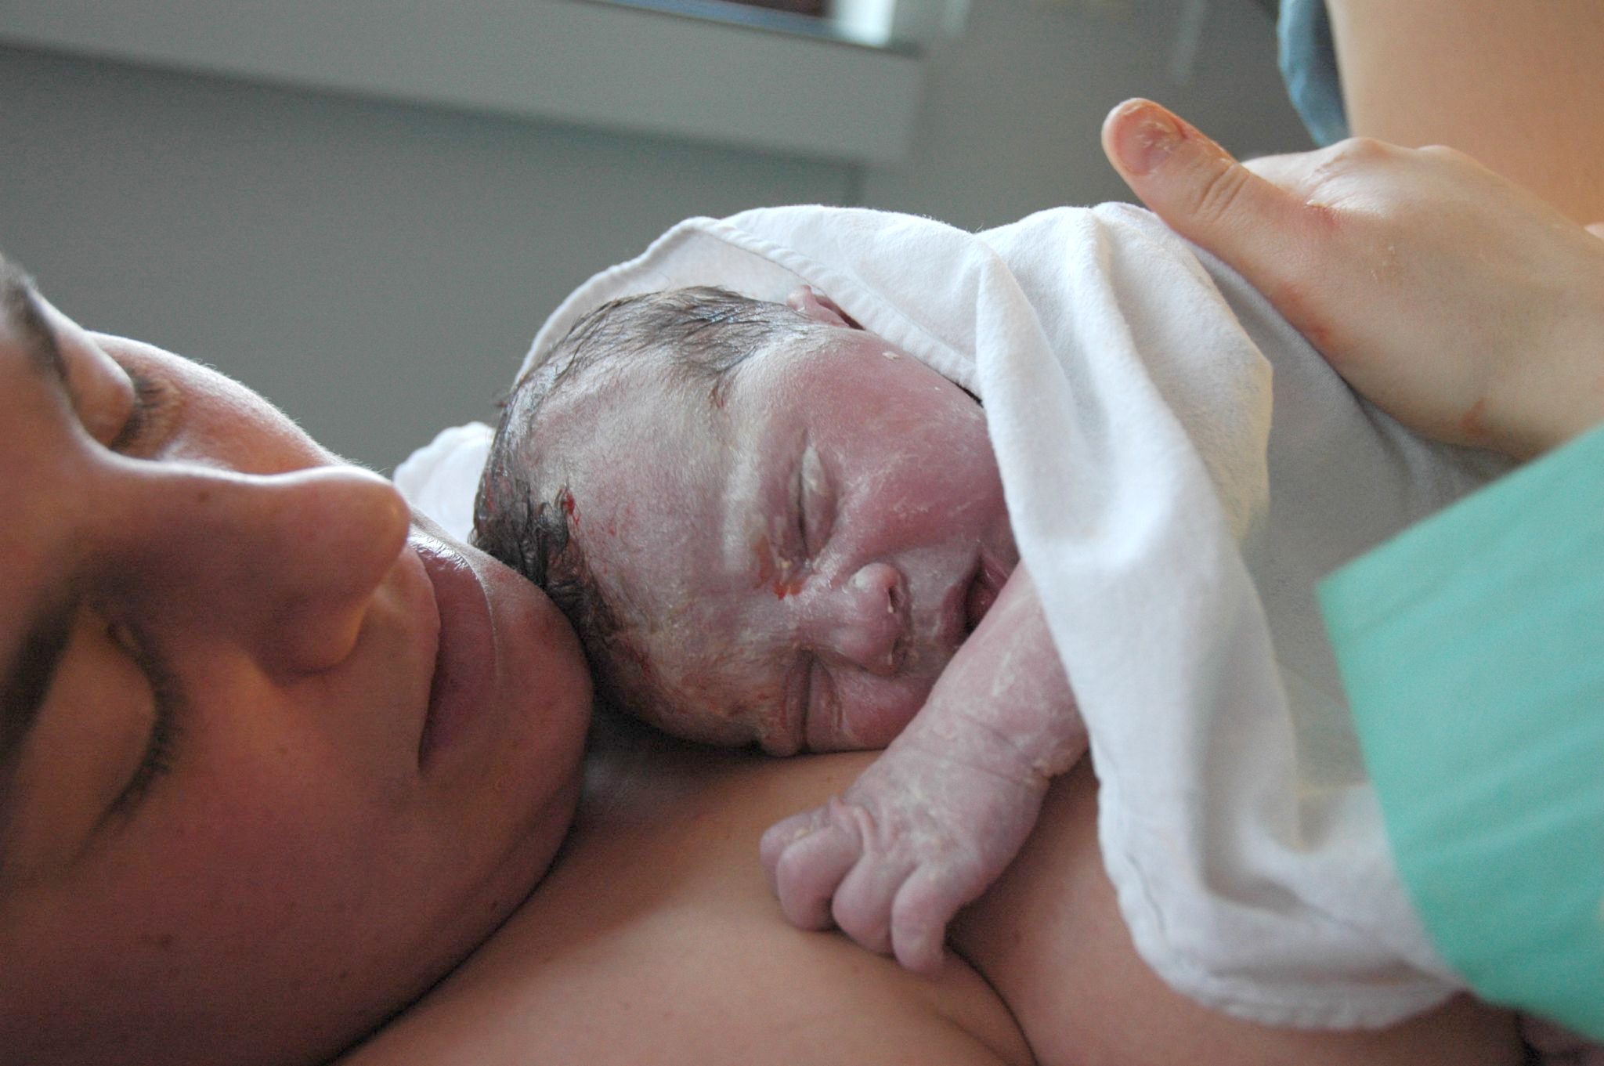
Neonatal Resuscitation

Slide 2


Slide 3
It’s OK!
It’s still just A..B..C..s
(just with some different
numbers)

Slide 4
And much like ACLS,
it has gotten less
complicated recently

Slide 5
Key points:
Prepare, prepare, prepare
Things, statistically, are ok
Ventilation is the whole key
100/60
Epi, in small amounts, after A&B

Slide 6
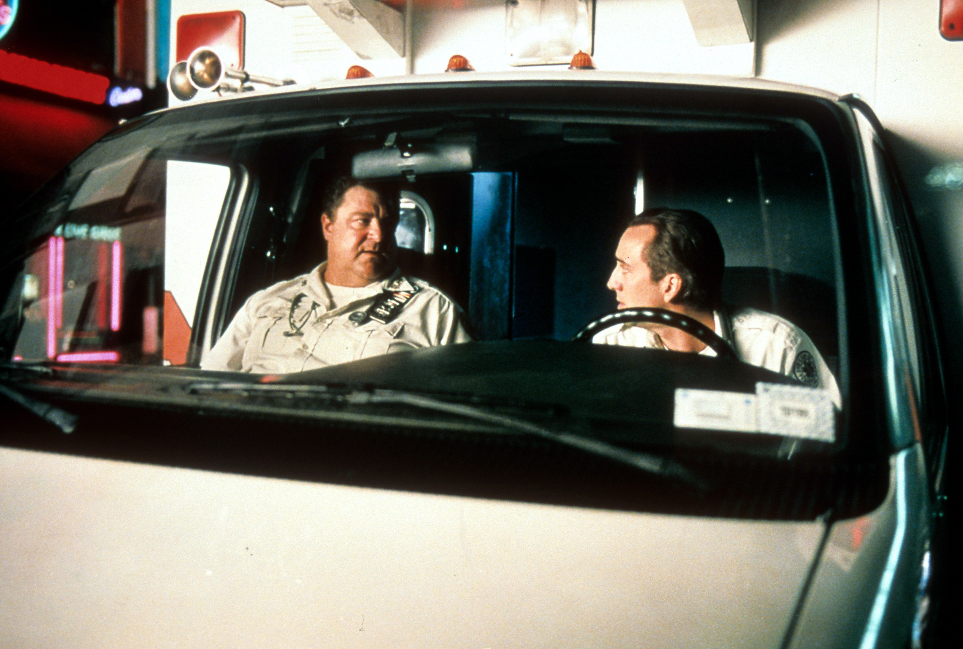
Notes:
So you are toned out to a call, 23 yof, reports to be in active labor…. How are you going to prepare your rig, and what are you going to want to know about this patient’s medical hx?

Slide 7
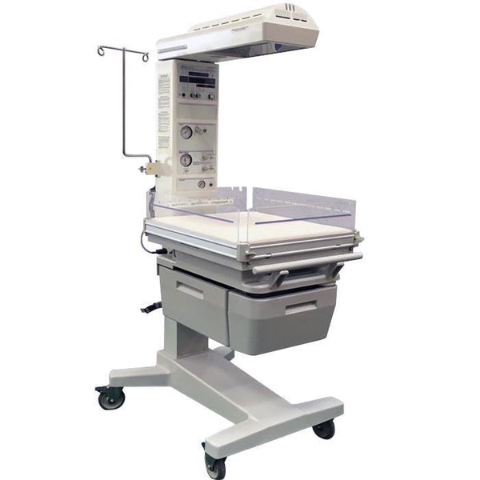


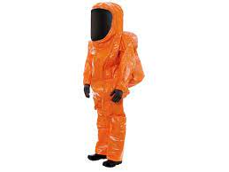
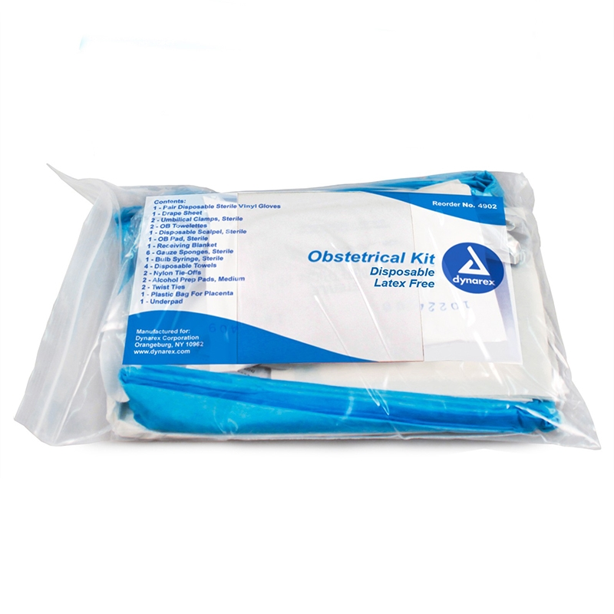
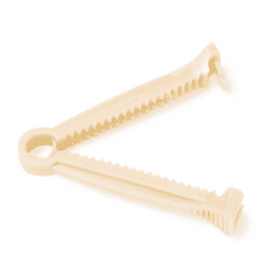

Slide 8
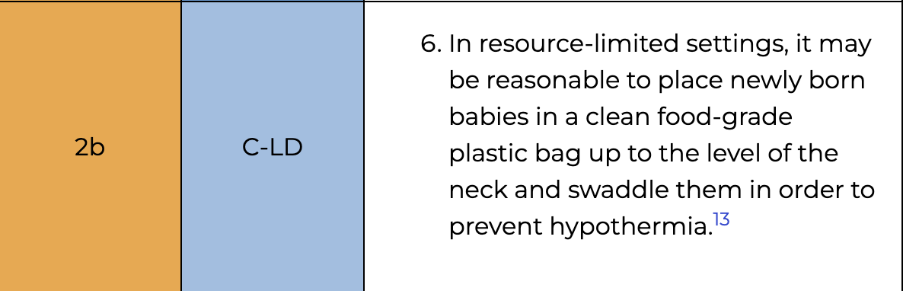

Slide 9
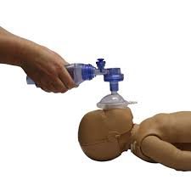
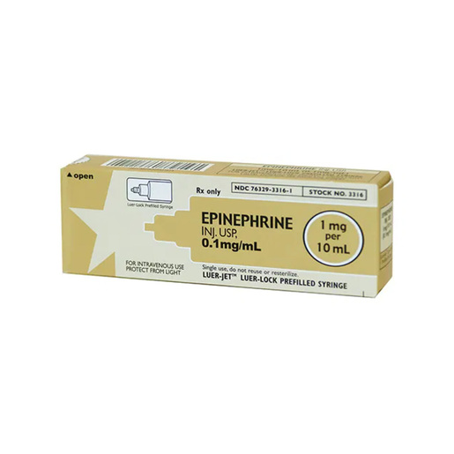
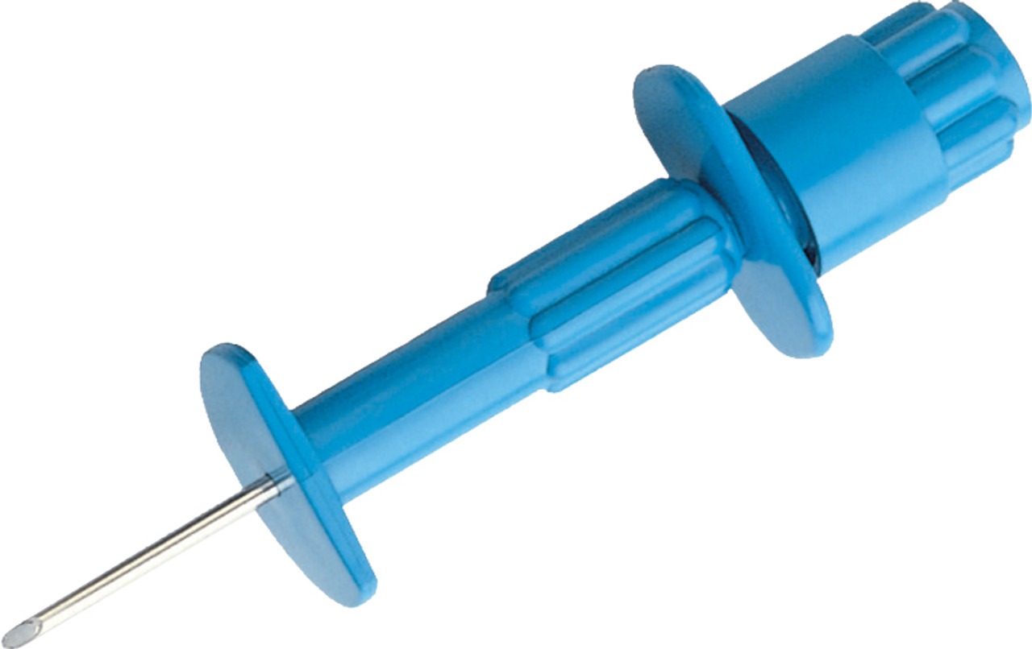
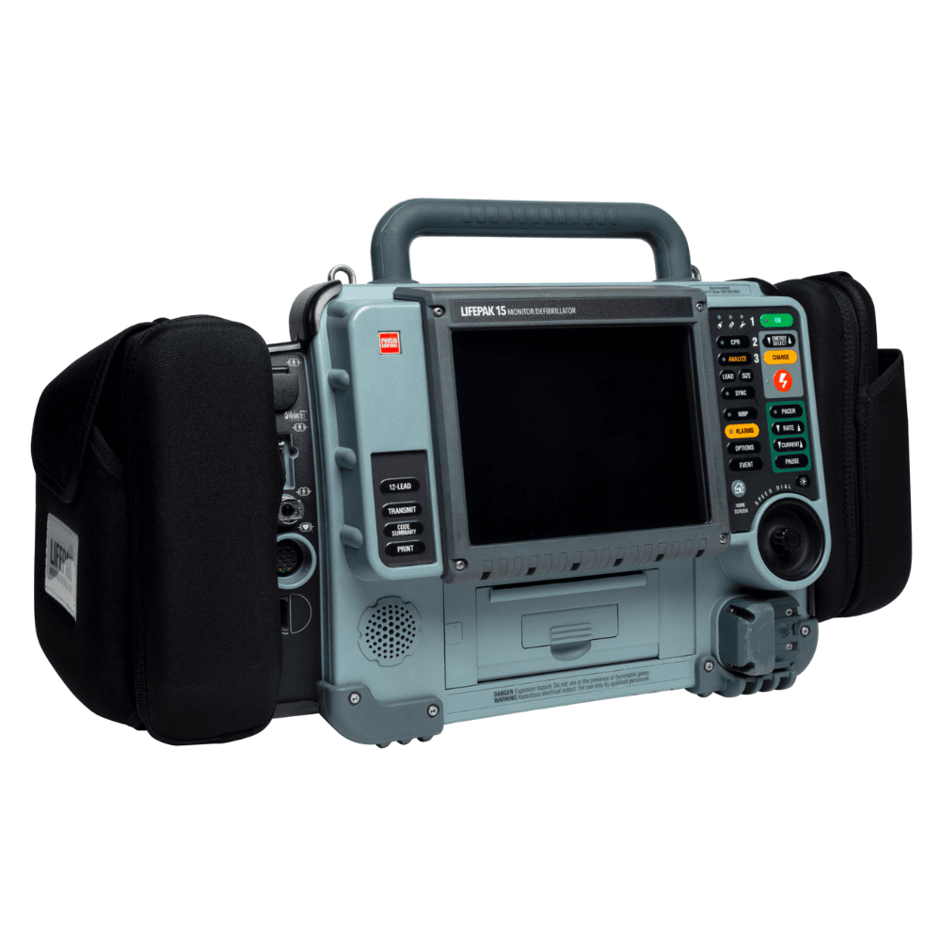
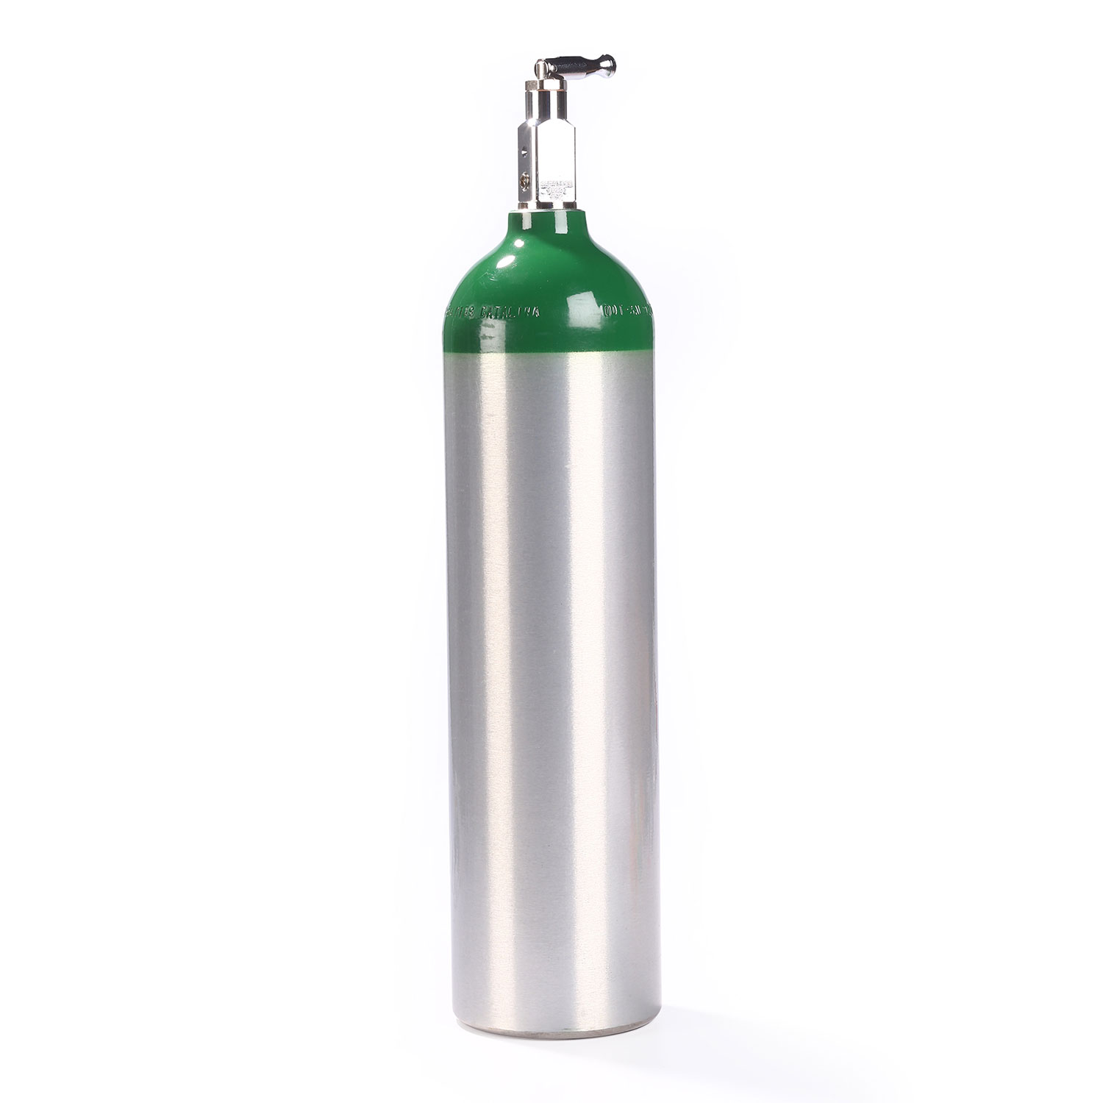
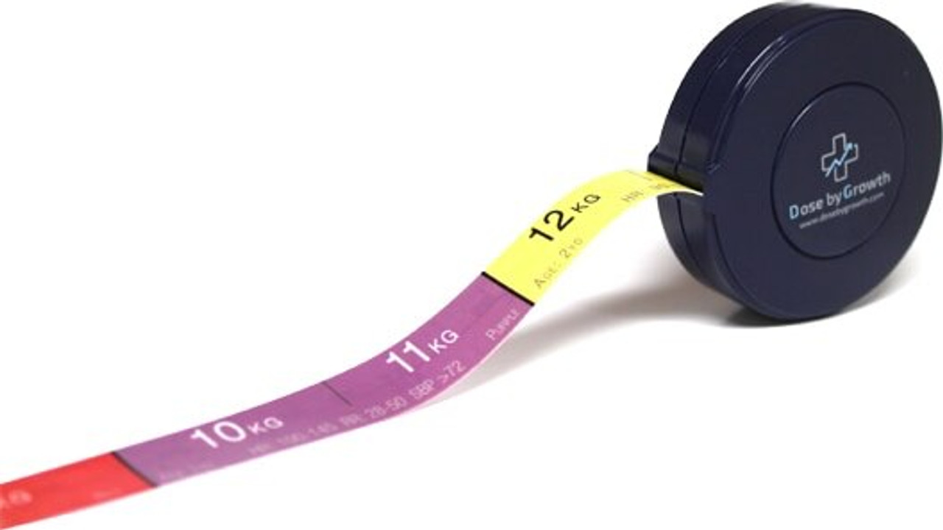

Slide 10
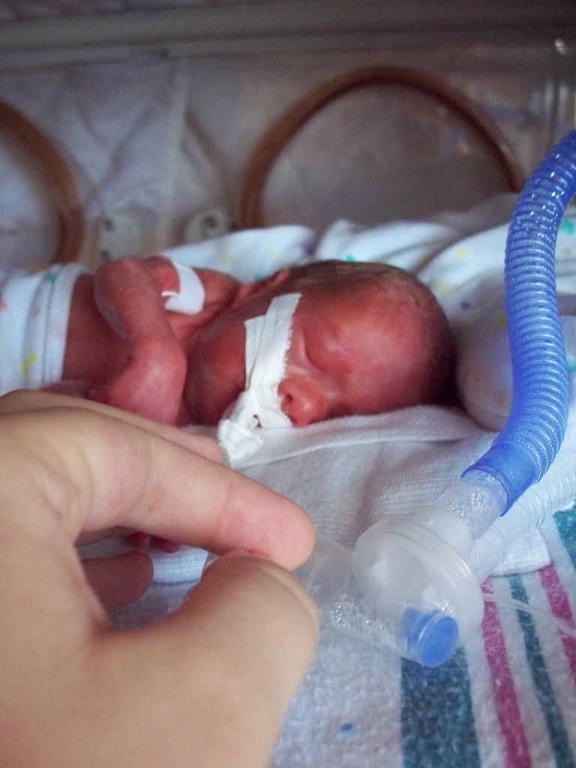
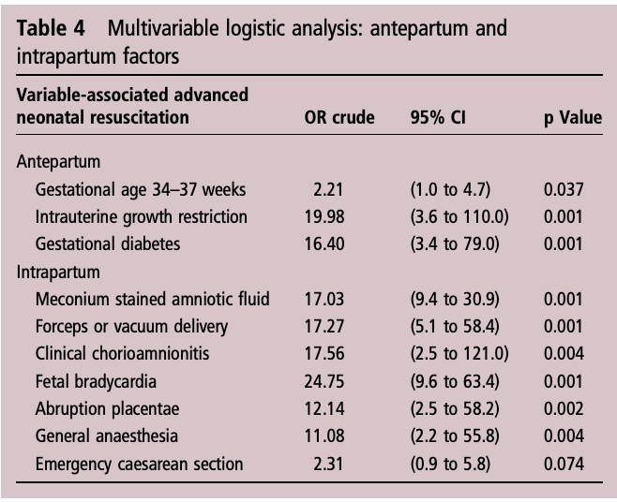


Slide 11
Only 10%
<1% !

Slide 12
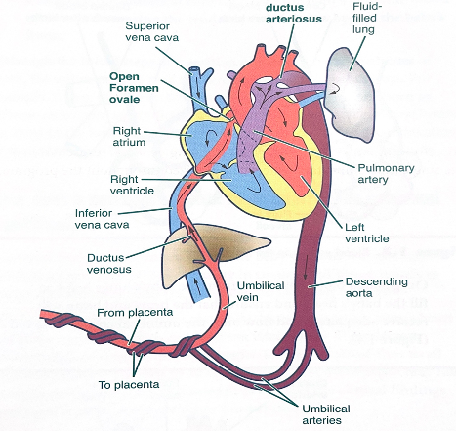

Slide 13
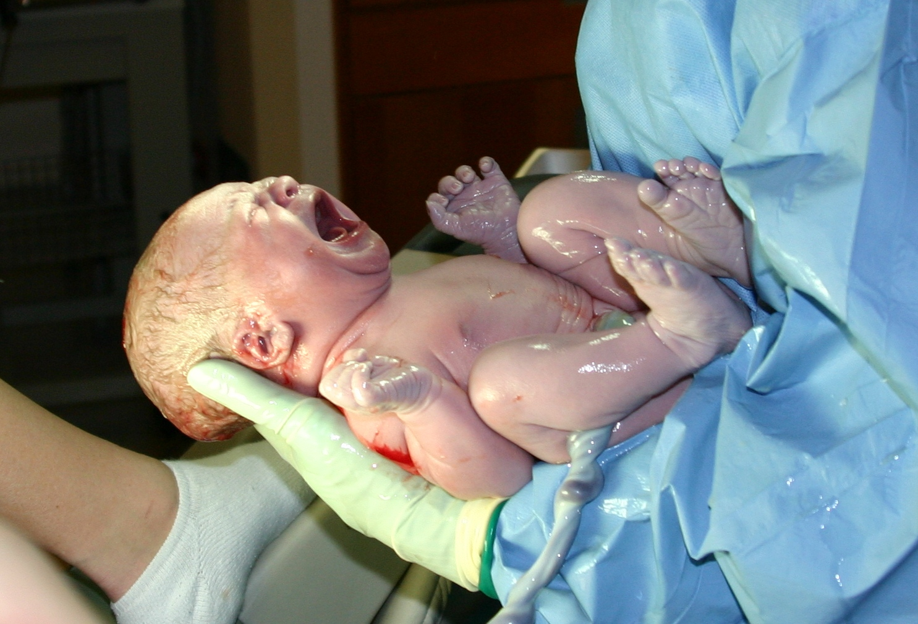

Ready?
Begin!
Time Zero

Slide 14
A is for airway
B is for breathing
Time Zero

Slide 15
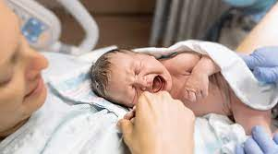

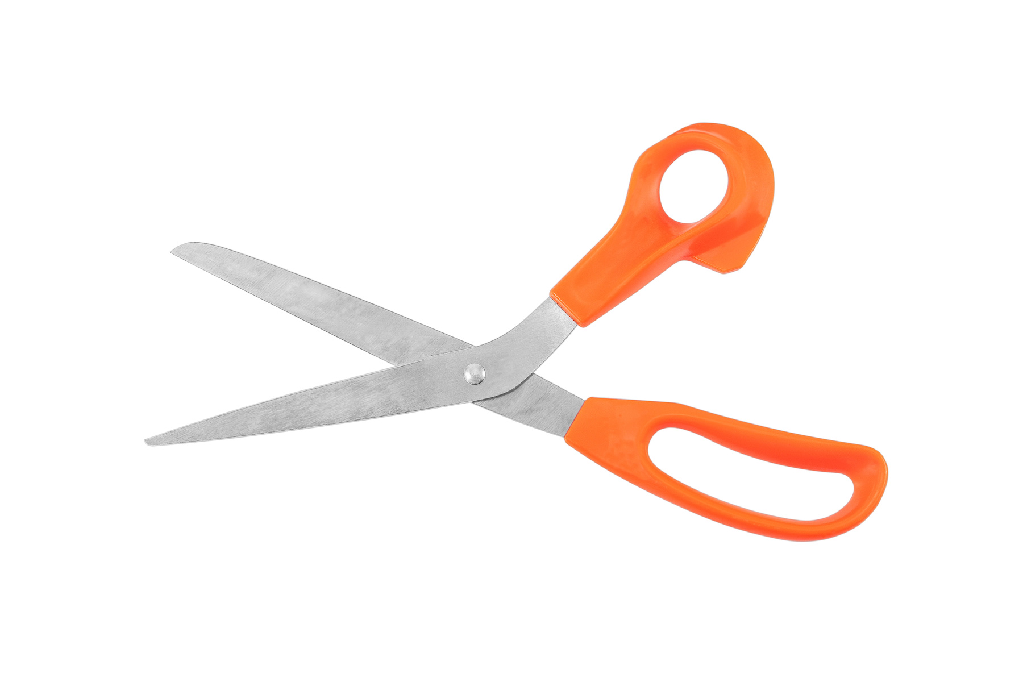
First branch/decision point
!!!
Time Zero

Slide 16
APGAR??
APGAR
ppearance
ulse
rimace
ctivity (tone)
espiration (cry)
Time Zero

Slide 17
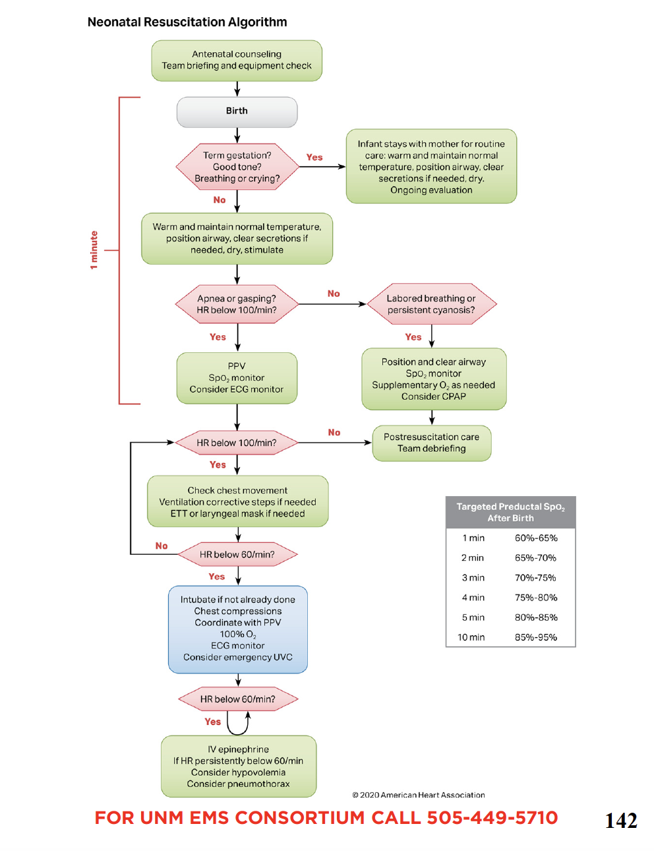

Slide 18



Slide 20
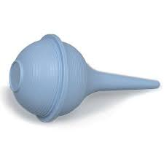
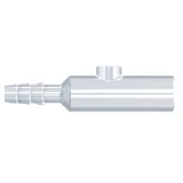
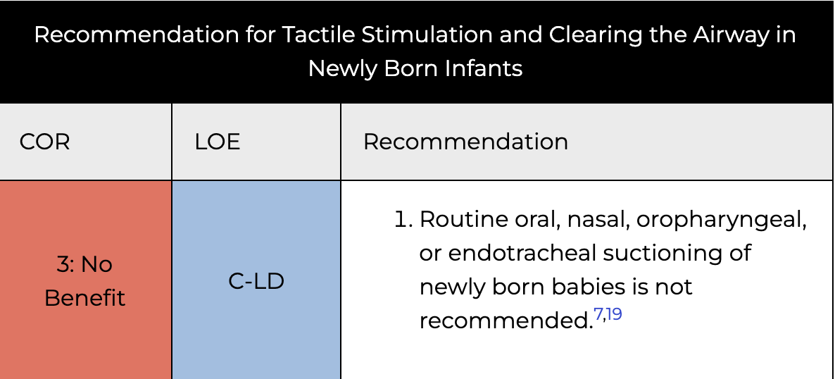
For ok babies, ok to skip, but good to
consider in anyone that isn’t pristine
(but don’t need during
birth anymore)

Slide 21

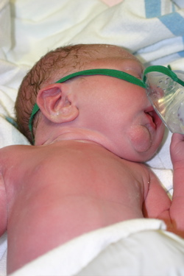
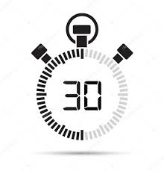
2nd branch/decision point

Slide 22
Initiating good, early PPV
in a neonoate that needs it
is the single most
important thing

Slide 23
Because:
Newborn resuscitation is
nearly always needed
because of respiratory
failure

Slide 25
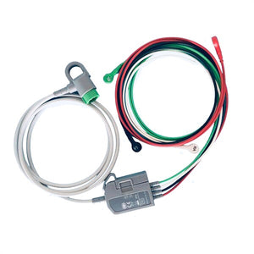
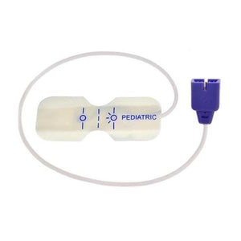

Slide 26
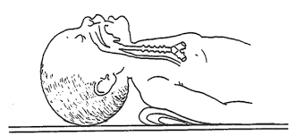
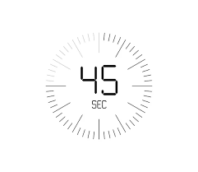
Position well: bagging is the most
lifesaving intervention

Slide 27
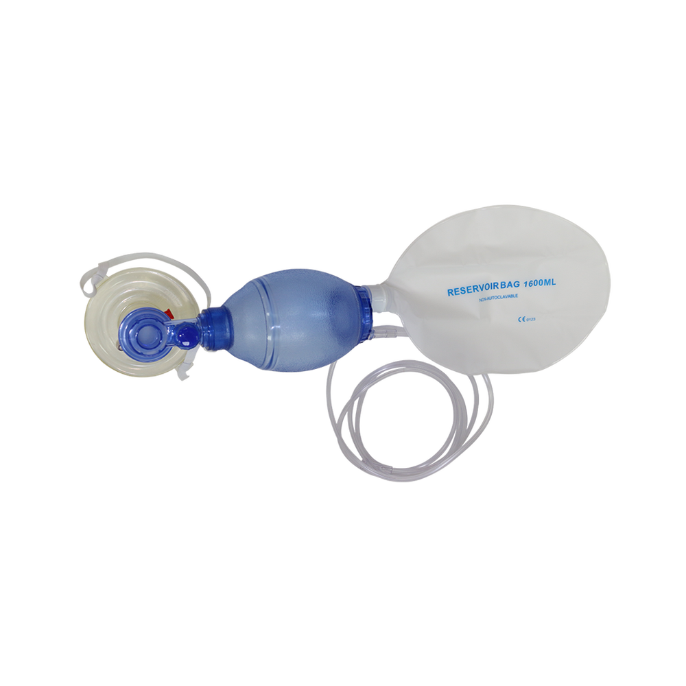
15 seconds of PPV
Rate
PEEP
Oxygen
Chest rise?

Slide 28
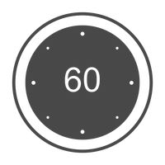
After 15-30 seconds of bagging
(around a minute after birth),
it’s time to Re-assess and
check HR

Slide 29
Make sure:
Is there chest rise?
Is there Sp02 increasing?
Is HR going up?

Slide 30
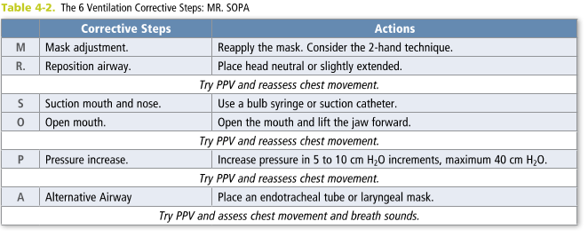
Chest rise?

Slide 31
Sp02 rising?

Slide 32
Sat probe on a neonate goes on
The right upper extremity
(preductal)

Slide 33
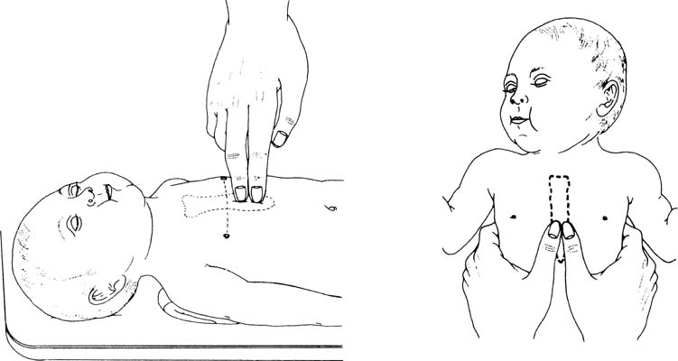
3rd branch/decision point

Slide 35
100
and
60
Keep bagging
Start
compressions
Optimize
ventilation
Notes:
This is where “100” and ”60” come in. After you’ve bagged this kid WELL for 15-30 seconds, going to look at their heart rate. If below 100, keep bagging and optimize. If under 60, start compressions

Slide 36
Heart rate below 60
Notes:
This is where “100” and ”60” come in. After you’ve bagged this kid WELL for 15-30 seconds, going to look at their heart rate. If below 100, keep bagging and optimize. If under 60, start compressions

Slide 37
Chest compressions

Slide 38
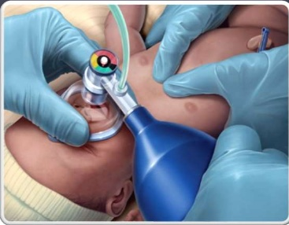
Timing (one and two and three and breathe)
120 actions per minute

Slide 39

Give 60 seconds of CPR
Breathe yourself
Evaluate bagging (Mr. SOPA)
Think through next actions

Slide 40
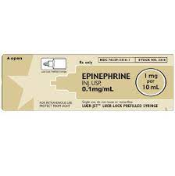

4th branch/decision point

Slide 42
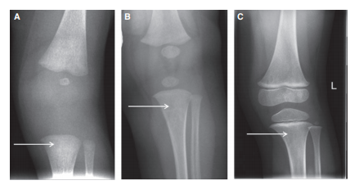
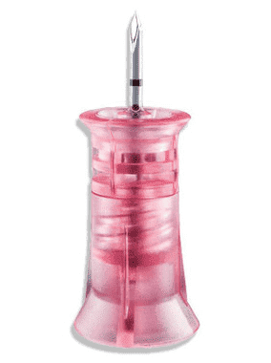

Slide 43
Epi dosing: 0.1 mg/ml (1:10) 0.01mg/kg
So likely ¼ to ½ cc
½ cc is a safe bet

Slide 44
Epi dosing: 0.1 mg/ml (1:10) 0.01mg/kg
Unlike adults, it didn’t change and is still q 3-5 mins

Slide 45
Hopefully at some point you stop having to go down the algorithm and things get better

Slide 46
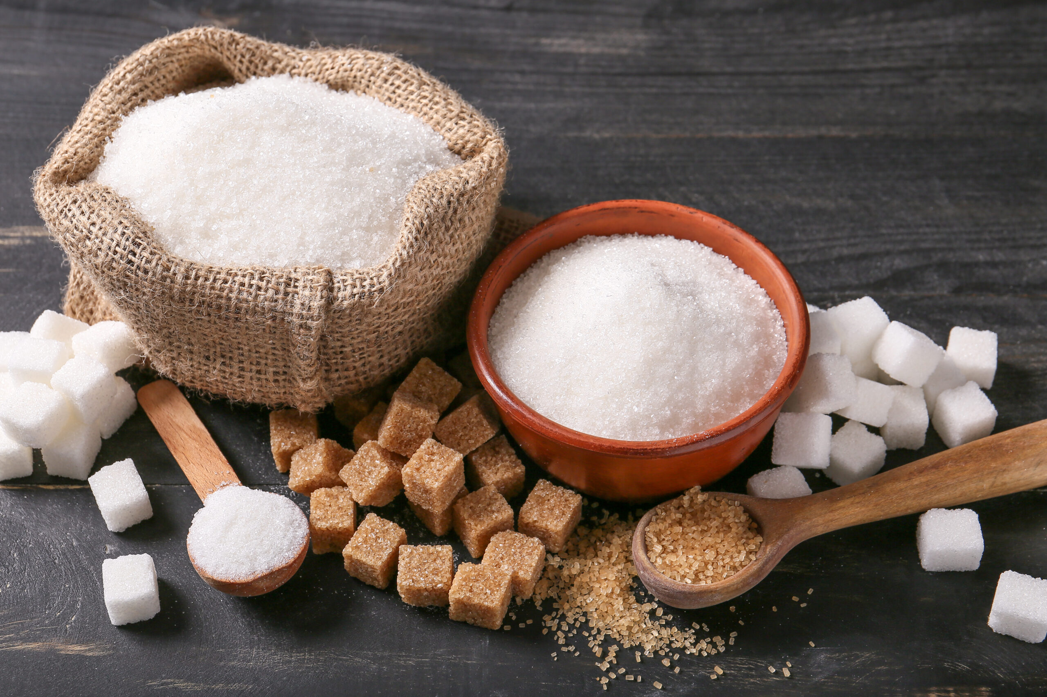
Don’t Forget, little ones are sugar dependent! (2.5 ml/kg, D10)

Slide 47
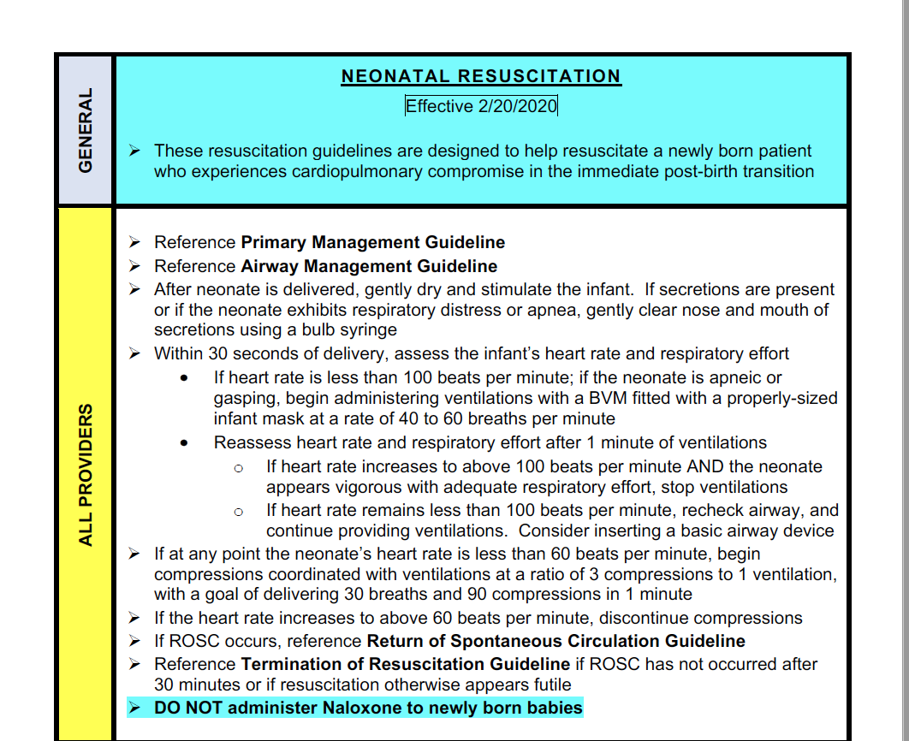

Slide 48
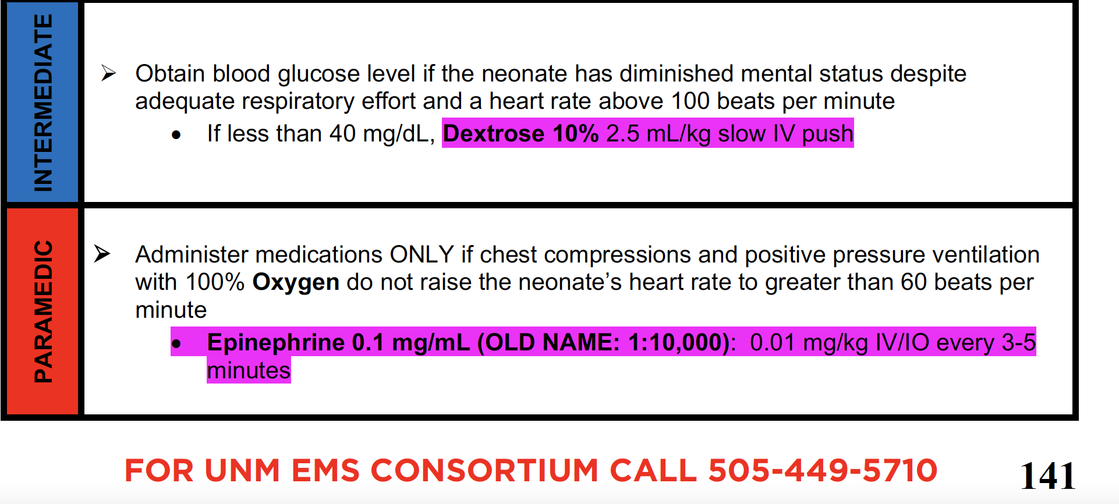

Slide 49
Please ask me
a question!

Slide 50
Key points:
Prepare, prepare, prepare
Things, statistically, are ok
Ventilation is the whole key
100/60
Epi, in small amounts, after A&B

