Slide 1
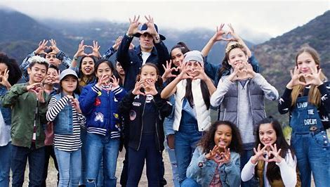
Welcome to
Reclaiming Native Psychological Brilliance Behavioral Health ECHO Series
While we are Gathering . . . enjoy this Native music video which we will start at 5 minutes before the hour.
Taboo – The Fight
The official music video for Taboo’s “The Fight“ supporting the American Cancer Society. Directed by Devinsupertramp, featuring choreography by Matt Steffanina. Get “The Fight”: http://smarturl.it/JoinTh3Fight
Notes:
05:08

Slide 2


Slide 3


Slide 4
Audience Participation Tips
We are building a community! Please introduce yourself in the Chat (select Everyone) and let your fellow participants know your name, Tribal Nation affiliation if applicable, job title, and organization.
Everyone will be muted until the Participant Reflections portion of the hour. During that segment, use the Raise my Hand icon on zoom, and the host will unmute you to offer your reflection.
You will receive a link to the recording and presentation by the end of the week.
Notes:
Due to the audience size, we encourage you to use the Chat feature for comments and questions.

Slide 5

Disclosures
This activity is jointly provided by United South and Eastern Tribes and Cardea Services​​
Cardea Services is approved as a provider of nursing continuing professional development by the Montana Nurses Association, an accredited approver with distinction by the American Nurses Credentialing Center’s Commission on Accreditation.​​
This activity has been planned and implemented in accordance with the accreditation requirements and policies of the California Medical Association (CMA) through the joint providership of Cardea and United South and Eastern Tribes. Cardea is accredited by the CMA to provide continuing medical education for physicians.​​
Cardea designates this live web-based training for a maximum of 1 AMA PRA Category 1 Credit(s)TM, Physicians should claim credit commensurate with the extent of their participation in the activity.
Notes:
There are no conflicts of interest.

Slide 6
Continuing Education Information
COMPLETING THIS ACTIVITY​​
Upon successful completion of this activity 1 contact hour will be awarded​​
​
Successful completion of this continuing education activity includes the following: ​​
  Attending the entire CE activity; ​​
  Completing the online evaluation (available at the conclusion of the meeting in the chat); ​​
  Submitting an online CE request.​​
​
Your certificate will be sent via email. If you have any questions about this CE activity, contact Paige O'Sullivan at posullivan@cardeaservices.org or (206) 729-4773

Slide 7
Disclosures
There are no relevant financial relationships with ineligible​ companies for those involved with the ability to control​ the content of this activity.​ ​
​​
​

Slide 8
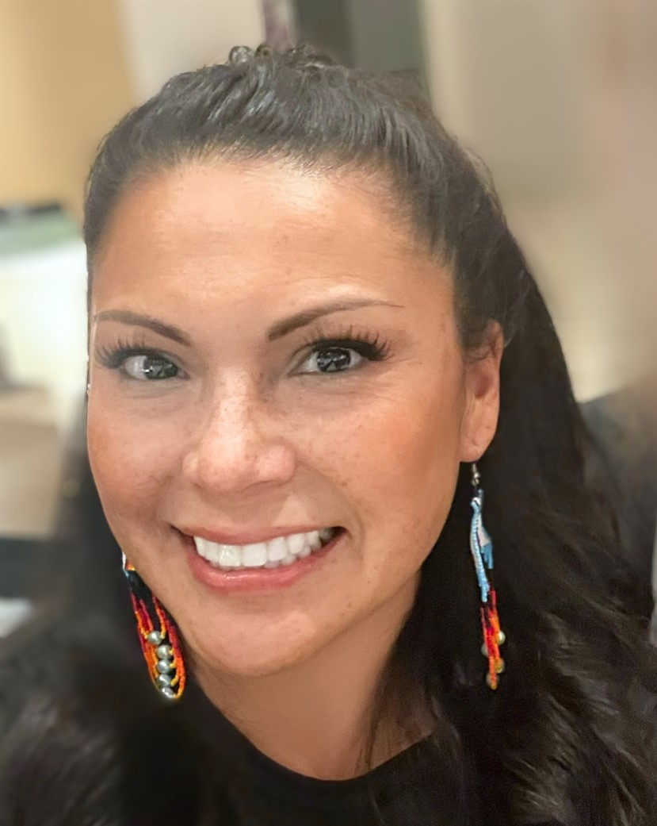
Welcome to All My Relations
"Mitakuye Oyasin"… We are all Related in the Sioux Language.
Bernice Youpee-Jordan, MPH
Citizen of the Fort Peck Sioux Nation
Public Health Program Manager
Tribal Health Program Support
United South and Eastern Tribes, Inc.
Notes:
Introduce self and position
Again, on behalf of USET we welcome you. We are excited to launch this first monthly session of Reclaiming Native Psychological Brilliance, but before we begin:
As Native people, we want to start with a Blessing and we are fortunate to have Chief of the Mohegan Tribe, Chief Malerba - - -

Slide 9
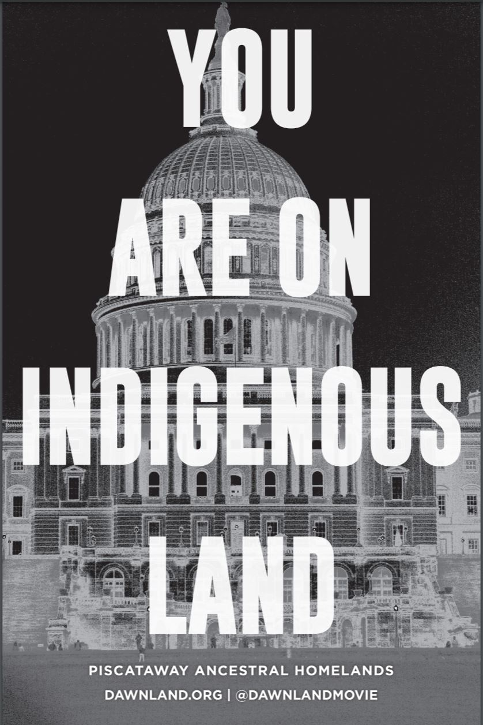
To learn and acknowledge what Tribal Nation land you and your organization are standing on, go to
https://native-land.ca/
or text your zip code or city to
(907) 312-5085.
Notes:
We respectfully acknowledge that we stand on territories where Indigenous and Tribal Nations are traditional stewards of the land.
Please join us in affirming Tribal sovereignty, and always displaying respect and gratitude for Indigenous people.
We honor and recognize the original peoples of this land.

Slide 10
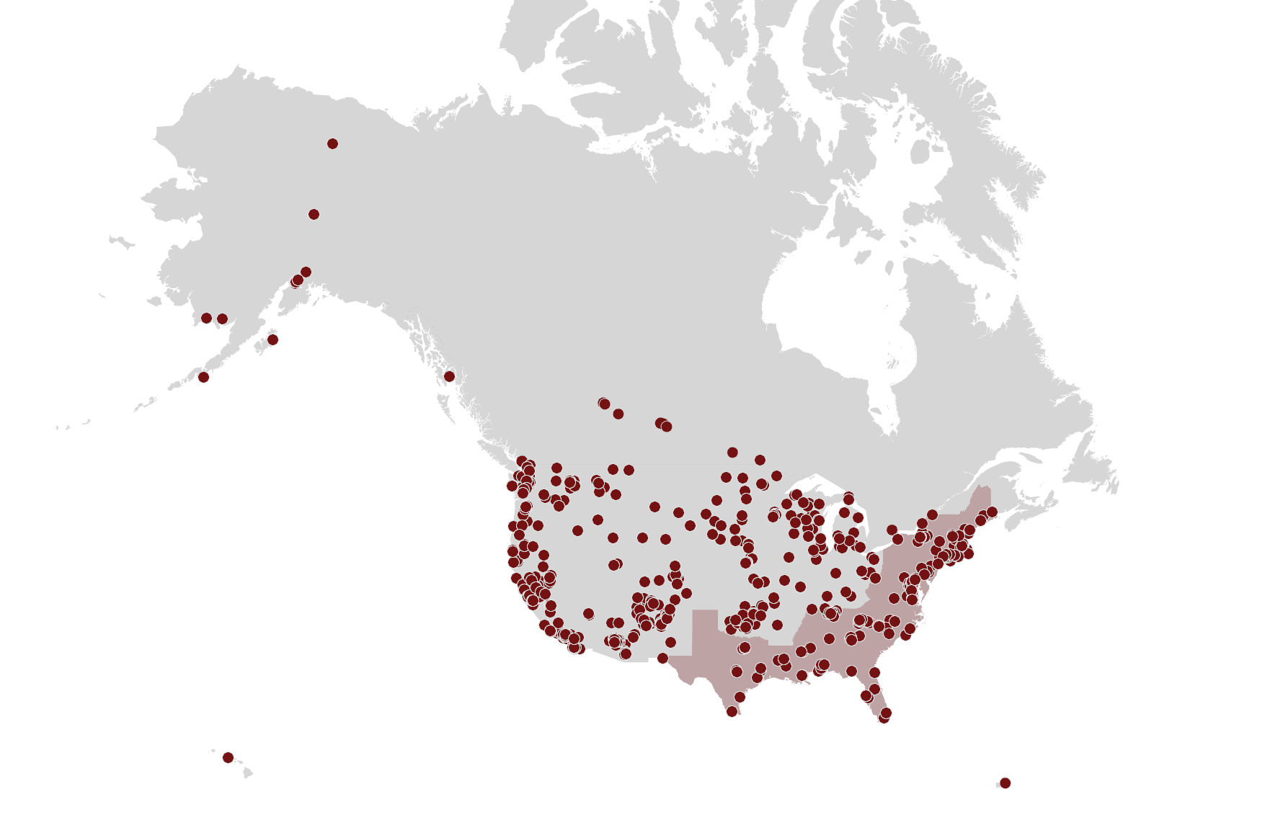
We are reconnecting our Indigenous community!
Thank you for being a part of reclaiming our collective stories.
Data is gathered from registration data

Slide 12
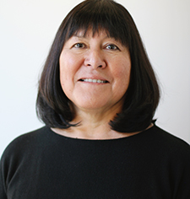
Our Past Sessions
Jan 2022 | Introduction to the Reclaiming Series
Feb 2022 | Nurturing Psychological Brilliance and Resilience in Native Young Adults
Mar 2022 | Impact of Western World View on Indigenous Behavioral Health
Apr 2022 | Native Help-declining and Help-seeking
May 2022 | Native Trauma Layers and Post-traumatic Growth
Jun 2022 | Sacred Trust: Decolonizing Screening and Assessment
Jul 2022 | Substance Use and Hungry Ghosts
Aug 2022 | Role of Indigenous Healing Practices in Native Life Re-balance
Sep 2022 | Inspiring Native life transformation plans
Holly Echo-Hawk, MSc

Slide 14
Rethinking American Indian Mental Health Services
Explorations in Alter-Native Psy-ence
October 25, 2022
Joseph P. Gone, Ph.D.
Harvard University

Slide 15
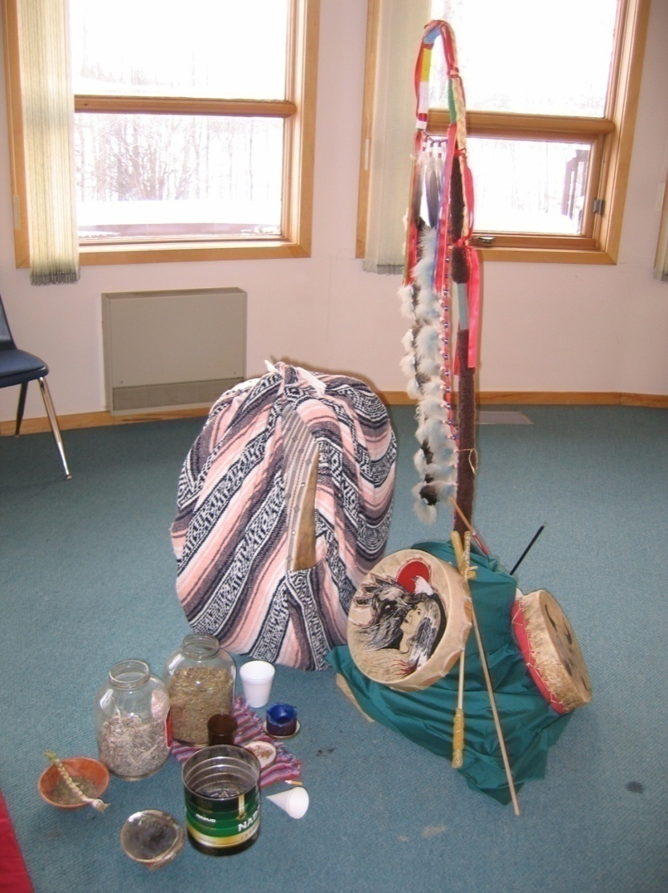
Opening
Academic Psychologist
  Clinically-Trained
  Community-Engaged
  Culturally-Attuned
Research Interests
  Coloniality & Mental Health
  Indigenous Psychologies
  Cross-Cultural Therapies

Slide 16
An Early Career Lesson

Slide 17
An Early Career Lesson
American Indian (AI) Mental Health (MH) Disparities (Gone, in press; Gone & Trimble, 2012)
  Epidemic levels of distress in many communities
  High prevalence of trauma, substance abuse, & suicide
  Underfunded community MH services
  Large unmet need

Slide 18
An Early Career Lesson
Addressing AI MH Disparities
  Pronounced MH problems
+
  Underfunded MH services
=
  Expand MH services!!! (right?)

Slide 19
An Early Career Lesson
Exploring AI Culture & Distress (Gone, 2006b, 2007, 2008c)
  Interviews on the Fort Belknap Indian Reservation
    Open-Ended & Discovery-Oriented
    Local Construals of Culture, Drinking, & Depression
  Case Study: “Traveling Thunder”
  Explanatory Model: Four Historical Eras

Slide 20
An Early Career Lesson
First Era: Paradise (Precolonial Existence)
“See there was no alcohol in this continent 500 years ago. There was no drugs. There was no problems—no domestic problems, no social problems. Everything was good because everybody lived according to custom and teachings. And there was no jails, no hospitals. There was no prisons, no insane asylums. There was none of that stuff because everybody lived according to a strict custom….”
  Perfect harmony & balance owing to strict observation of custom

Slide 21
An Early Career Lesson
Second Era: Conquest (Colonial Contact)
“But when the Whiteman came, they…forced the…Indian people, to get rid of their way. Their religious spiritual beliefs. They forced them to trade their economy, which was based on the barter system, and on living off of the land—the wildlife, fish…and herbal medicines…. Then they turned around and forced their culture on them—their religion, their beliefs, their foreign ways onto them—by taking all the young people out of the homes and putting them away in boarding schools…and forcing the Whiteman’s teachings on them…. It’s genocide.”
  Annihilation of custom

Slide 22
An Early Career Lesson
Third Era: Loss (Postcolonial effects)
“If you don’t know your own true oral history, your true oral traditions and customs and where you come from, and what’s supposed to be important to you, well, you’re gonna feel empty. You’re gonna feel like you don’t belong. Cause we don’t fit in with the Whiteman’s system. We never did and we never will…. It basically boils down to pride. If people ain’t proud of who they are, where they come from, and what they’re doing, then they’re gonna…be doing these things: alcohol, drugs. And once you’re into alcohol and drugs…you’re gonna probably get into a depression…and you’re gonna…not feel worthy of being a human being and you’re gonna want to kill yourself.”
  Anomie leads to pathology
  The “Whiteman system” as pathogenic

Slide 23
An Early Career Lesson
Fourth Era: Revitalization (Postcolonial Remedy)
“After we looked around and realized that…we left something behind…, we started going back to the hills to fast…. We started going to the sweat lodges to pray and to sweat. We started going to the elders to learn…. We never was happy…living like a Whiteman…. I would give the credit to the Creator, and to the spirit world, for pitying the people to allow us to get [our sacred traditions] back…. To me what that ceremony does is…you’re calling on the Creator, the spirit world…for life, or for good health, or for a…good clean mind. An alcohol and drug free mind. Or you’re calling on the spirit world for guidance, you know. Or for survival even. Even survival.”
  Return to sacred custom

Slide 24
An Early Career Lesson
Traveling Thunder’s Explanatory Model (Gone, 2021)
  Clear Pathological Process
    Cultural Repression → Anomie → Substance Abuse → Depression → Worthlessness → Suicide
  Little Elaboration of Personal Distress
    Relatively non-bio/psychological account
    Emphasized history, culture, & spirituality

Slide 25
An Early Career Lesson
Traveling Thunder’s Explanatory Model (cont)
  Pathogenic Aspects of the “Whiteman System”
    Colonization as cause of AI distress
    Systemic factors over intrapersonal factors
    Shared community vulnerabilities
    Cf. “Historical Trauma” (but without reference to trauma)
  Relevance of Psychosocial Interventions & MH Services?

Slide 26
An Early Career Lesson
Traveling Thunder’s View of Mental Health Services
“I guess it’s like a war, but they’re not using bullets anymore…. They want to wipe us out…. And therefore the Indian problem will be gone forever…. But they’re using a more shrewder way than the old style of bullets…. If you look at the big picture, you look at your past, your history, where you come from…and you look at your future where the Whiteman’s leading you, I guess you could make a choice. Where do I want to end up? And I guess a lot of people…want to end up looking good to the Whiteman…. Then it’d be a good thing to do: go [to the] white psychiatrists…in the Indian Health Service and say,…’Go ahead and rid me of my history, my past, and brainwash me forever so I can be like a Whiteman’…. I guess that’d be a choice each individual will have to make.”
  MH Treatment as Cross-Cultural Encounter
  MH Services as Neo-Colonial Cultural Proselytization

Slide 27
An Early Career Lesson
Expansion of MH Services? – Not so simple! (Gone, 2021)
  The Problem of Cultural Difference
    Historically distinctive cultural settings
    Persistent cultural practices (cosmology, sociality, selfhood)
    Norms, routines, & logics of the MH clinic are not those of the tribal community
  The Problem of Cultural Dominance
    Legacy of colonial subjugation
    “Kill the Indian, save the man”
    Enduring power asymmetries

Slide 28
An Early Career Lesson
The (Post)colonial Predicament (Gone, 2007, 2021)
  On one hand, urgent community needs…
    Impoverished, high-risk settings
    Documented disparities in MH status
  On the other hand, incongruent clinical services
    “Brainwash me forever so I can be like a Whiteman”
    Attested to by community anecdote & research evidence

Slide 29
An Alter-Native Psy-ence

Slide 30
An Alter-Native Psy-ence
Indigenous Community MH Discourse (Gone, 2021, in press; Gone & Trimble, 2012)
  Distinct from but Parallel to Professional Psychiatric Discourse
  Contests & Recasts Key Concepts & Approaches
  Evident Everywhere One Goes in “Indian Country”
  Four Domains
    Distress
    Well-Being
    Intervention
    Evaluation
  Just A Few More Highlights Today…

Slide 31
An Alter-Native Psy-ence
Four Domains: Distress
  Not DSM Mental Disorders…
    Radically Decontextualized (e.g., Major Depression, SUDs, PTSD)
    Selectively Incomplete (e.g., Disorders of Rage, Identity)
    Measurement Issues? (e.g., Major Depression, Internalizing Disorders)
  BUT rather Historical Trauma (Gone, 2014; Gone et al., 2019; Hartmann et al., 2019)
    Radically Recontextualized: Historical oppression + Psychological trauma
    4 Cs: Colonial, Collective, Cumulative, Cross-Generational
    Cf. Traveling Thunder’s Explanatory Model

Slide 32
An Alter-Native Psy-ence
Four Domains: Well-Being
  Not Neoliberal Individualism…
    Free agents
    Navigating free markets
    In autonomous pursuit of happiness & wealth
  BUT rather Relational Selfhood (Kirmayer, 2007; Gone, 2022a)
    Kinship roles & obligations (i.e., sociocentric self-orientation)
    Responsibility to/for nonhuman relatives (i.e., ecocentric & cosmocentric self-orientation)
    Social emotions (e.g., pity, respect, love, loneliness, jealousy, pouting, hostility, suspicion, resentment)

Slide 33
An Alter-Native Psy-ence
Four Domains: Intervention
  Not Empirically-Supported Treatments & EBP (Gone, 2022b)…
    Cultivated thru human ingenuity & technical proficiency
    Certified by distant & rarified professional expertise
    Dependent on psychological mindedness
  BUT rather Reclaimed Traditional Healing Practices (Gone, 2010, 2016)
    “Our culture is our treatment”
    Mediated by ritual leaders using prayer & ceremony
    Dependent on powerful nonhumans who circulate blessings & life

Slide 34
An Alter-Native Psy-ence
Four Domains: Evaluation
  NOT scientific outcome studies (Gone, 2011)…
    Extends rationality (i.e., cognitive prosthesis)
    Presumes mechanistic materialism
    Adopts (selective) skepticism
  BUT rather Indigenous ways of knowing
    2009 ceremonial gathering of Blackfeet Crazy Dog Society (Gone, 2012)
    Authority of narratively-conveyed personal experience (Gone, 2019b)
    Practice-Based Evidence?

Slide 35
An Alter-Native Psy-ence
Summary of Indigenous Para-Psychiatric Framework (Gone, 2021; Gone & Trimble, 2012)
  Distress: Not mental disorders, but historical trauma
  Well-Being: Not neo-liberal individualism, but relational selfhood
  Intervention: Not empirically-supported treatments, but reclaimed healing practices
  Evaluation: Not scientific studies, but Indigenous ways of knowing

Slide 36
Closing

Slide 37
Closing
For more information & to download my publications, visit my website at:
  gonetowar.com

Slide 39
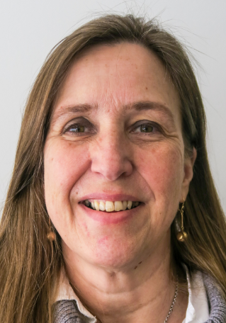
Facilitated Reflections
Facilitator: Livia Davis, MSW
C4 Innovations, Chief Learning Officer
Vice President, Recovery and Behavioral Health
Livia views herself as a non-Native guest in this Native space.

Slide 40
Summary Remarks
Holly Echo-Hawk, MSc
Senior Behavioral Health Advisor
Reclaiming Native Psychological Brilliance

Slide 41
CEU Information
Don’t forget to complete your survey!
https://survey.alchemer.com/s3/6826778/Reclaiming-Native-Psychological-Brilliance-Learner-Evaluation-October-25
Follow-up questions?
  Bernice Youpee-Jordan at bjordan@usetinc.org
  Bryan Hendrix at bhendrix@usetinc.org

Slide 42
See you in November – Same time on the 4th Tuesday
November 22, 2022 Topic:
Open Discussion: Reclaiming Native Psychological Brilliance

Slide 43
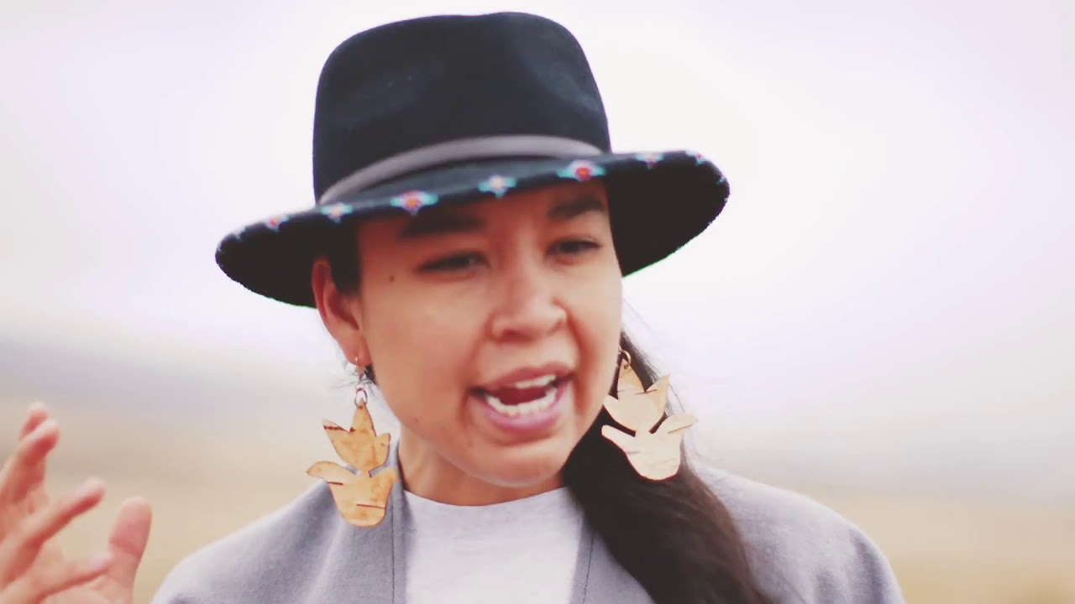
Thank you for Participating in the
Reclaiming Native Psychological Brilliance Behavioral Health ECHO Series
While we are Depart . . . enjoy this Native music video.
Lyla June
One Earth Live(Spoken Word)
Notes:
05:08

Slide 44
