Slide 1
Preventing, Monitoring and Treating Infectious Diseases in the MAT Clinic
Jorge Mera, MD, FACP
Whitney Essex, APRN

Slide 2
Infectious Diseases Associated with Substance Use Disorders
Viral infections (bloodborne)
Hepatitis C Virus (HCV)
Hepatitis B Virus (HBV)
Hepatitis A Virus (HAV)
HIV
STD’s
GC/Chlamydia
Syphilis
HIV/HCV/HBV
Bacterial Infections (soft tissue/skin) ⁴
Septicemia
Bacteremia
Cellulitis
Abscesses (staph, strep)
Endocarditis
Necrotizing fasciitis
Wound botulism
Hepatitis C is the leading cause of death among all infectious diseases ¹
The CDC estimates 41,200 acute HCV cases in the US in 2016 ¹
IDU is currently the most common risk factor for HCV in developed countries (60-80% worldwide) ³
1. Centers for Disease Control and Prevention, 2017. https://www.cdc.gov/hepatitis/hcv/index.htm
2. Centers for Disease Control and Prevention, 2018. https://www.cdc.gov/nchhstp/newsroom/2018/hepatitis-c-prevalence-estimates.html
3. Nelson, et al. 2011. https://www.ncbi.nlm.nih.gov/pubmed/21802134/
4. Collier, M., et al. 2018. https://link.springer.com/article/10.1007%2Fs10900-017-0458-9

Slide 3
National HIV & Hepatitis Overview
Injection Drug Use accounts for
~9% of new HIV cases ¹
Over 65% of HCV cases ²
Among people who inject drugs
60%-90% have HCV after 5 years
Median time to HCV transmission is ~3 years
And each year ~ 20-30% of PWID acquire HCV ³
Comorbidity
Among PWID and have HIV, 75% also have HCV
Among PLWHIV w/o IDU, 25% have HCV ⁴
Life time cost of each HIV infection is over $380,000 ⁵
Accumulated costs of HCV care over the next 20 years on this trajectory over $78 billion ⁶
1.Centers for Disease Control and Prevention, 2017. HIV Surveillance Report, https://www.cdc.gov/hiv/pdf/library/reports/surveillance/cdc-hiv-surveillance-report-2017-vol-29.pdf
2. Centers for Disease Control and Prevention, 2016, Surveillance for Viral Hepatitis – United States, 2016. https://www.cdc.gov/hepatitis/statistics/2016surveillance/index.htm
3. Grebely, J. et al. 2011. https://www.ncbi.nlm.nih.gov/pmc/articles/PMC3072734/
4. Centers for Disease Control and Prevention, 2017. HIV and Viral Hepatitis. https://www.cdc.gov/hiv/pdf/library/factsheets/hiv-viral-hepatitis.pdf
5. Centers for Disease Control and Prevention, 2017. https://www.cdc.gov/hiv/programresources/guidance/costeffectiveness/index.html
6. National Academies of Sciences, Engineering, and Medicine, 2017. https://www.nap.edu/read/24731/chapter/8

Slide 4
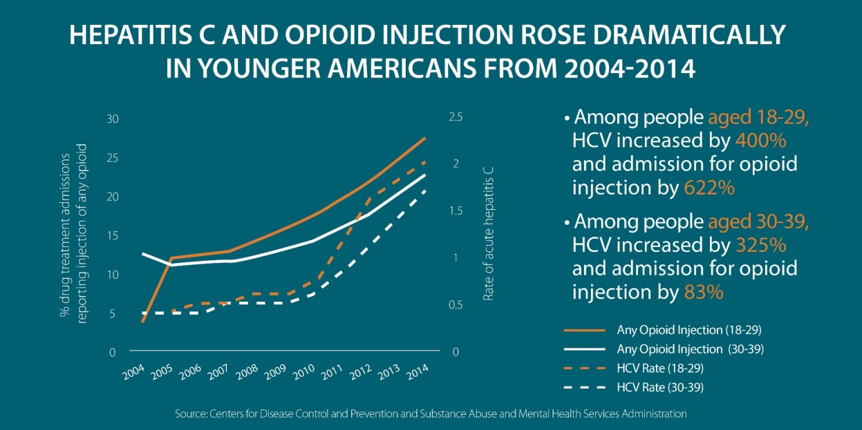
Huge Increases in HCV Related to Injection Drug Use
Among 18- to 29-year-olds, there was a
400 percent increase in acute hepatitis
817 percent increase in admissions for injection of prescription opioids
600 percent increase in admissions for heroin injection
Among 30- to 39-year-olds, there was a
325 percent increase in acute hepatitis C
169 percent increase in admissions for injection of prescription opioids
77 percent increase in admissions for heroin injection
There were also sharp increases among whites and among women
Zibbell, J., et al. 2017. https://ajph.aphapublications.org/doi/pdf/10.2105/AJPH.2017.304132

Slide 5
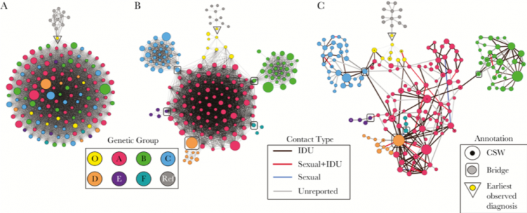
Scott County, Indiana
HIV Outbreak in Austin, Indiana (pop. 4,200) in 2015
Over 200 cases of HIV were eventually attributed to injection drug use behavior
Only had 5 reported cases of HIV in the previous decade
Within this initial outbreak 115 persons were co-infected with HCV and currently 92% are co-infected ¹
1. Peters, P. et al. 2016. https://www.nejm.org/doi/full/10.1056/NEJMoa1515195

Slide 6
The Intersection between SUD and ID
Syphilis
GC/Chlamydia
HIV/HCV/HBV
SUD
Syphilis
GC/Chlamydia
HIV/HCV/HBV
Soft Tissue Infections
Endocarditis
Septic arthritis
IDU
SUD: Substance Use Disorder
ID: Infectious Diseases

Slide 7
Infections in People with SUD: Interventions
Prevention
Vaccination
Diagnosis
Baseline/Periodic
Harm reduction
Decreasing injection use
MAT
Behavioral health
Safer injection use
Education
SSP
Safe injection sites
SUD: Substance Use Disorder

Slide 8
1st Visit: Focus on MAT Induction and Obtain Labs
Hepatitis B:
Hepatitis B surface antigen (HBsAg)
Hepatitis B surface antibody (HBsAb)
Hepatitis B total core antibody (HBcAb)
Hepatitis A total antibody
Hepatitis C antibody or RNA
HIV 4th generation test
RPR/Treponemal test
GC/Chlamydia
In urine

Slide 9
2nd Visit: Focus on MAT, Review Labs and Take Action
Test | Result | Interpretation | Action
Hepatitis B | HBsAb (-), HBsAg (-), HBcAb (-) | Never exposed | Vaccinate
 | HBsAb (+), HBsAg (-), HBcAb (-) | Immune | Celebrate
 | HBsAb (-), HBsAg (+), HBcAb (+) | Active Infection | Refer to ID*
 | HBsAb (-), HBsAg (-), HBcAb (+) | Isolated HB core Ab | Call ID
 | Any other pattern | God Only Knows | Call ID
Hepatitis C | Positive HCV Ab | Possible current infection | Order HCV RNA
Hepatitis C | Positive RNA | Current Infection confirmed | Treat or refer
Hepatitis A | Total Ab (+) | Immune | Celebrate
Hepatitis A | Total Ab (-) | Not immune | Vaccinate
* Evaluate for PrEP

Slide 10
2nd Visit: Focus on MAT, Review Labs and take Action
Test | Result | Interpretation | Action
Chlamydia | Reactive | Active Infection | Treat*
Gonorrhea | Reactive | Active Infection | Treat*
Syphilis | Reactive | Active Infection | Treat * and refer to ID
* Evaluate for PrEP

Slide 11
3rd Visit: Continue MAT, Complete Vaccination, Sexual History and Physical Exam
Review Vaccines
Hepatitis A and B
Pneumococcal 23 and 13
TdAP
Shingles
Sexual history
Evaluate for PrEP
Physical Exam
Soft tissue exam
Cardiac Murmurs

Slide 12
Comprehensive Approach
Medication Assisted Treatment
PREP for PWUDs
HCV/HIV Testing and Treatment
Naloxone, Syringe Service Programs, and Safer Injection Practices
Mental Health Services
HCV/HIV Testing and Treatment
Notes:
So to create a COMPREHENSIVE approach we need a whole range of services for people who actively using drugs
And when all of the funding goes to prevention and treatment and 80% of the people who are using drugs are in this middle range, we are going to have to get creative—extra creative—about these partnerships!
-Our services need to reflect that and be targeted at that grey area because that is where the biggest risk happens—when someone isn’t connected to services and doesn’t know how (or can’t because of legal or social barriers) to take care of themselves or their community while using substances
‘Safer injection practices’ include a range of measures that decrease the likelihood of transmission for HIV, hepatitis, and bacterial/soft tissue infections. This includes education and counselling designed to assess the current environmental and social situation of the person injecting to decrease risks to the maximum extent possible.
Potential safer injection practices can include:
always using a new/sterile syringe and injection materials;
using a personal syringe (not shared) if re-use is necessary;
if sharing is necessary, proper bleaching etiquette; improving environmental conditions to reduce contamination of injection materials and drugs; and
guidance on vein care/wound care in order to improve overall health for the client.”
For additional information and guidance on safer injection practices, check out CDC’s website: https://www.cdc.gov/injectionsafety/ip07_standardprecaution.html and https://www.cdc.gov/injectionsafety/index.html

