Slide 1




Healthcare Engagement: The Trauma-Informed Approach
Nomi Levy-Carrick, MD, MPhil
Vice Chair, Clinical Programs, Department of Psychiatry
Brigham and Women’s Hospital
Co-Chair, MGB Trauma-Informed Care Initiative
Assistant Professor, Harvard Medical School
Presentation to IHS/Bureau of Prisons
October 18, 2022

Slide 2
Outline
Introduction to Trauma-Informed Care: Principles and a Paradigm Shift
How TIC provides context to recognize, mitigate, and even prevent trauma and retriggering
Organizational implications and discussion

Slide 3

Why Consider Trauma in Health Care?
Trauma is pervasive amongst patients and staff
Trauma has significant health and mental health effects.
Trauma greatly influences how people access and experience healthcare.
Without considering trauma:
Healthcare services can be re-traumatizing,
Treatments may not be effective
Patients may not be able to engage with you
“I’m right there in the room, and no
one even acknowledges me.”

Slide 4
The Trauma-Informed Approach
Realizes the widespread impact of trauma and understands potential paths for recovery
Recognizes how trauma affects all individuals involved in an organization, including its own workforce
Responds by fully integrating knowledge about trauma into policies, procedures, and practices
Resists re-traumatization
A TI approach refers to a change in organizational culture.

Slide 5
Trauma-Informed Care: 6 Principles
Safety: Physical & psychological
Trustworthiness & transparency
Peer Support
Collaboration & Mutuality
Empowerment, Voice, Choice
Cultural Humility and Responsiveness
www.samhsa.org/TIC

Slide 6

Paradigm Shift
What’s wrong with you?
What happened to you - and how does that impact your health and engagement in care?

Slide 7
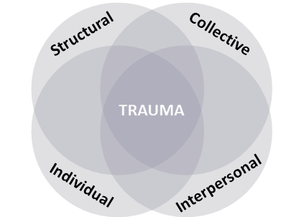
What is Trauma? (2.0)

Slide 8
Ubiquity of Trauma Exposures
WHO World Mental Health Survey (2022)
N=22 countries (>65K surveyed)
Lifetime Trauma exposure – 71%
Lifetime substance use disorder more common among those with trauma (14.5% v. 5.1%)
Interpersonal- & sexual-relationship violence associations persist long after first exposure
World Mental Health Survey Consortium (2016)
N=27 countries
Lifetime trauma exposure >70%; 30.5% >4
https://www.sciencedirect.com/science/article/abs/pii/S0376871622003118
Averse Childhood Experiences (ACE) Study (1998) N=17,377
63% at least one trauma exposure, 20% >3

Slide 9
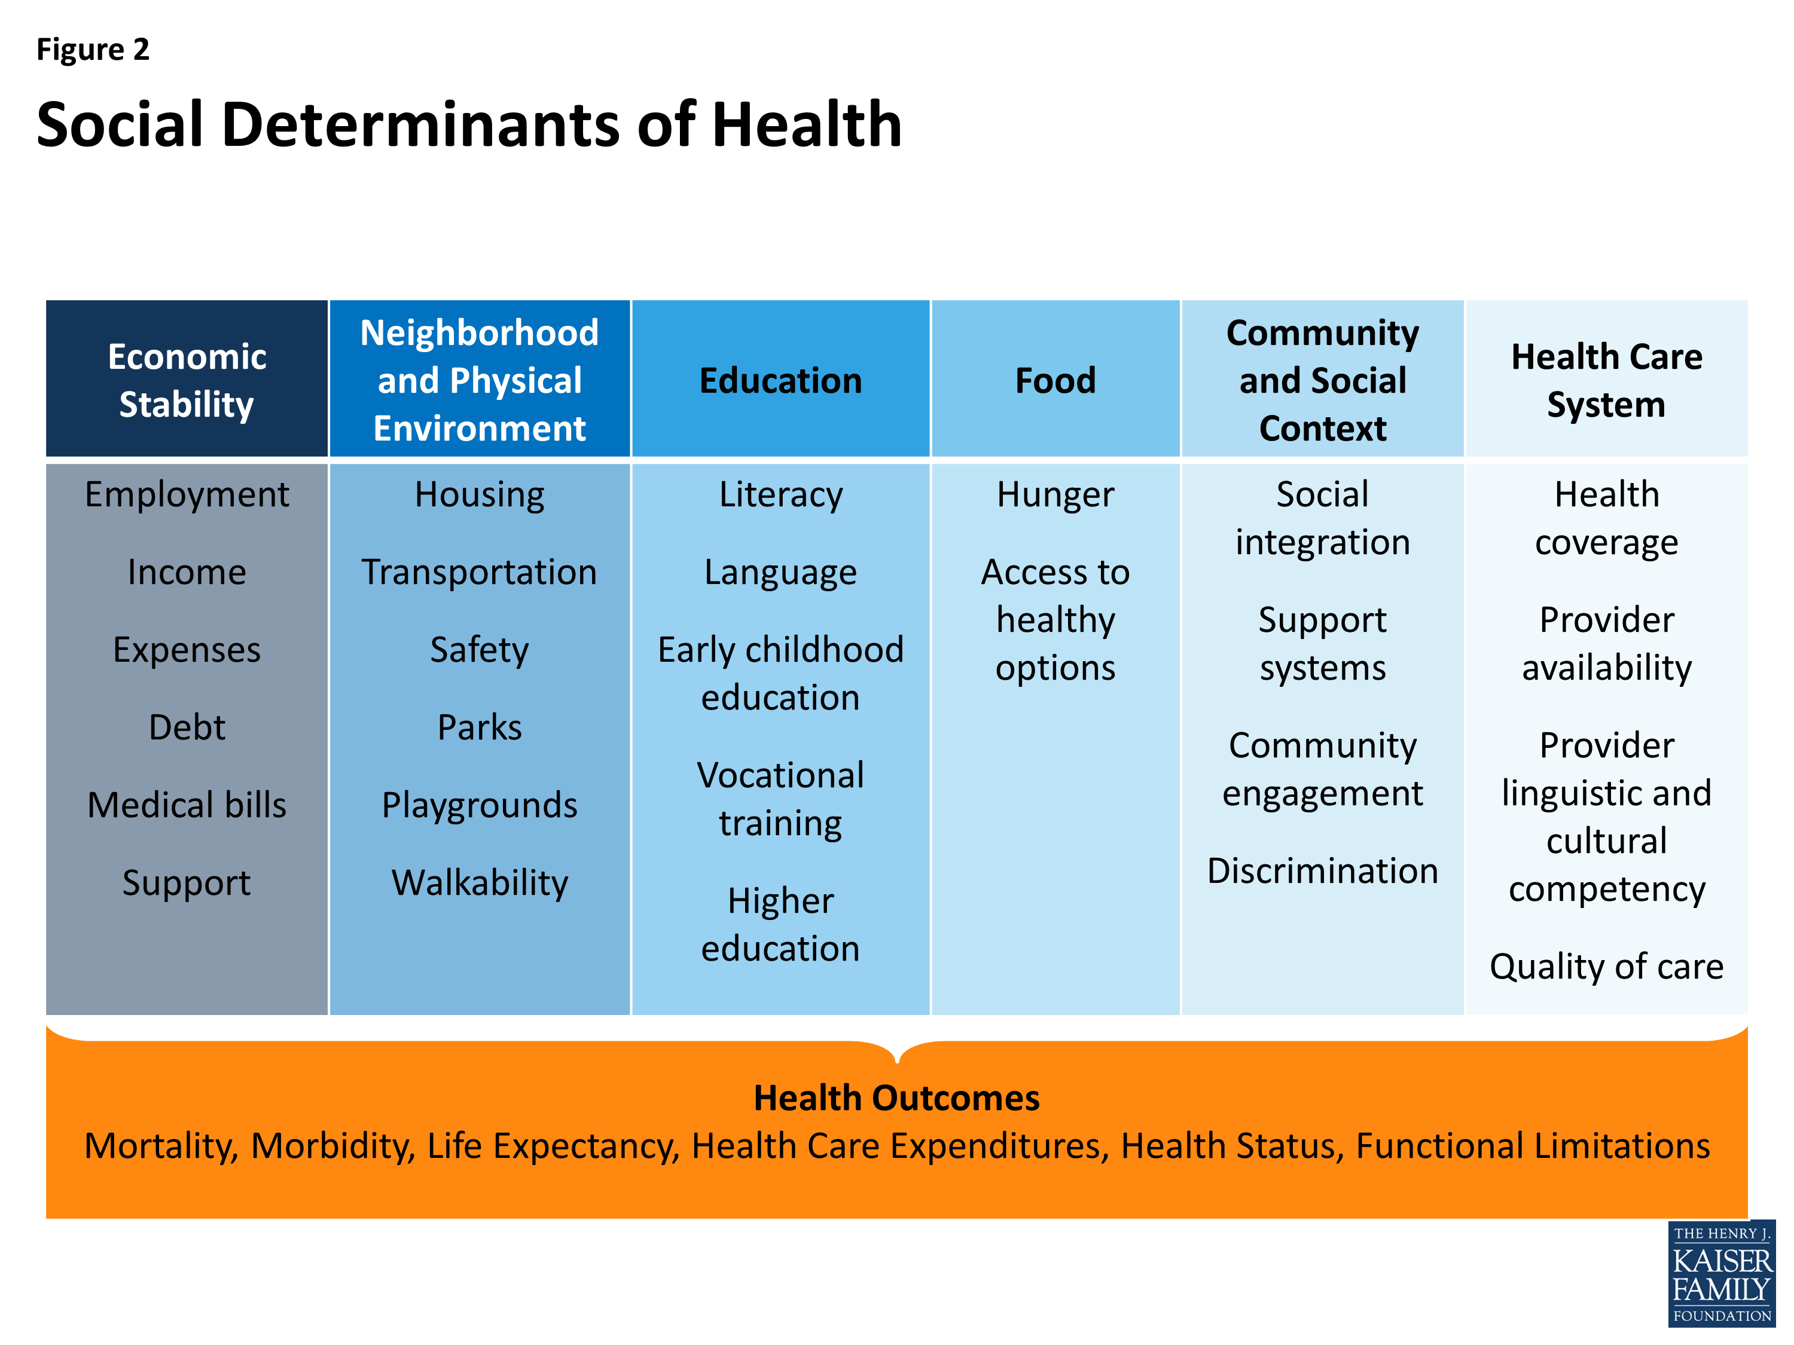

Slide 10
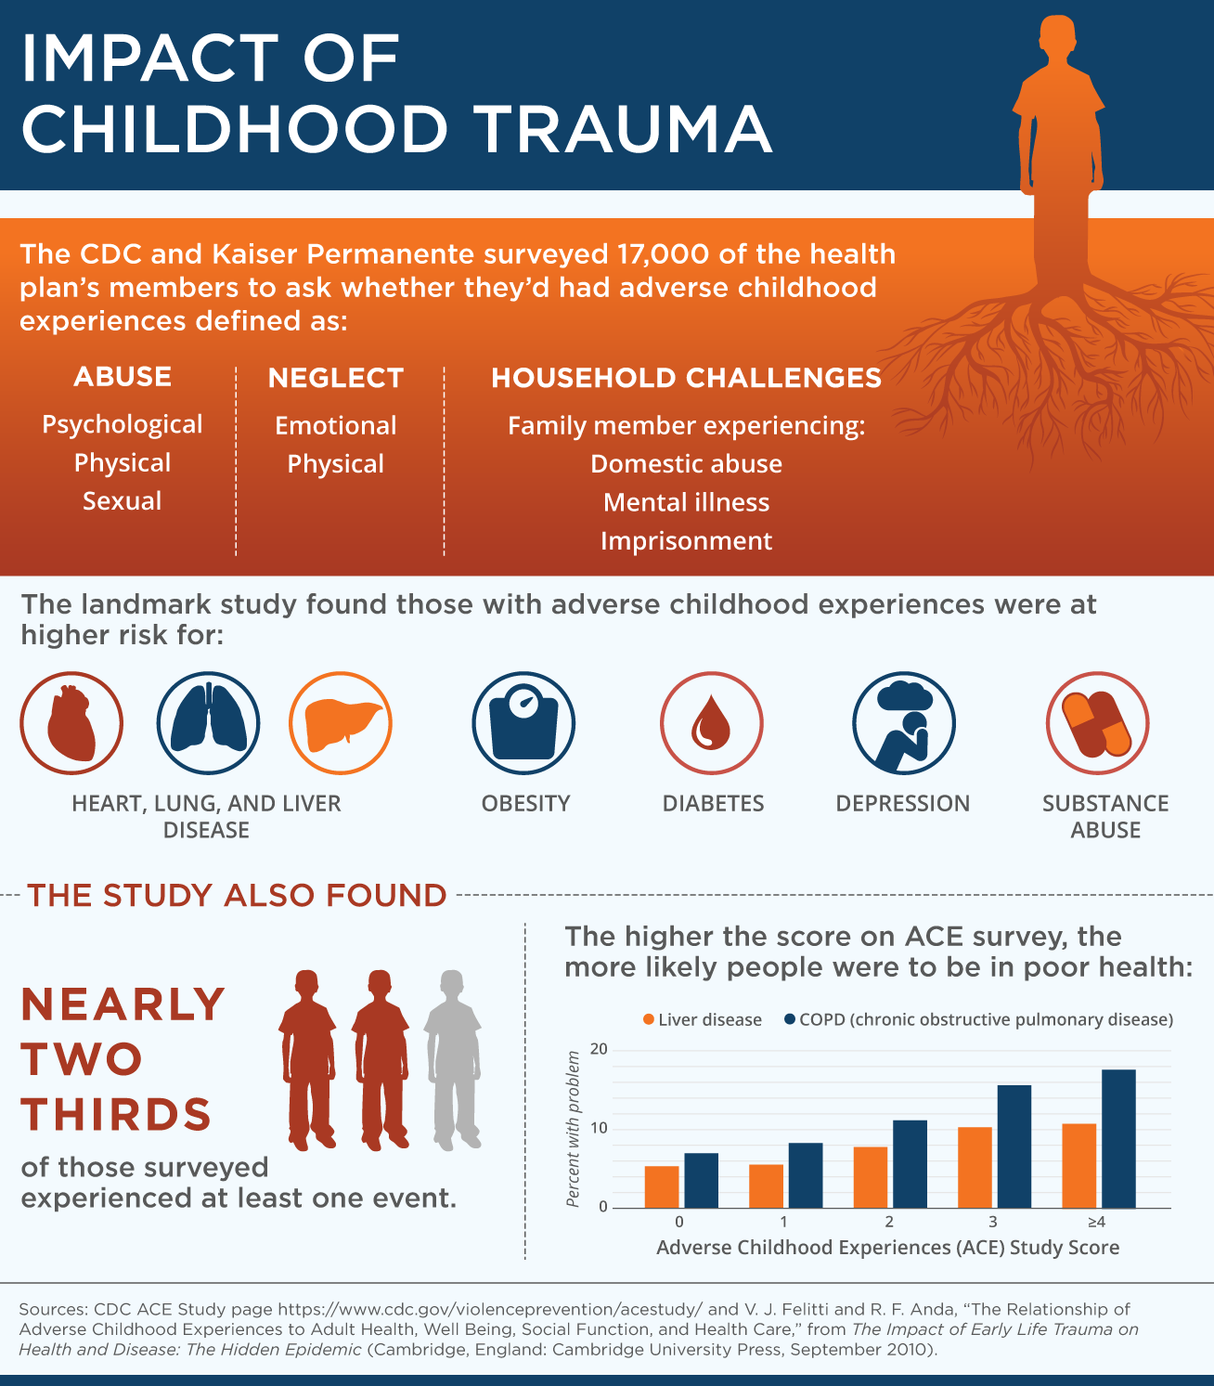

Slide 11
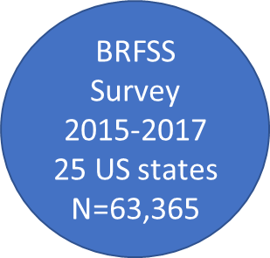
Health Impact of ACEs on Adults- 2019 MMWR
61% report at least 1 ACE
16% report 4+ ACEs
Women, AI/AN, Black, and Other
more likely to report 4+ ACEs than Men and Whites
Adjusted Odds Ratio: 4+ vs 0 ACE exposures
Obesity 1.2 Stroke 2.1 Depression 5.3
Diabetes 1.4 Asthma 2.2 COPD 2.8
CHD 1.8 Heavy drinking 1.8 Smoking 3.1
Merrick MT, Ford DC, Ports KA, et al. Vital Signs: Estimated Proportion of Adult Health Problems Attributable to Adverse Childhood Experiences and Implications for Prevention — 25 States, 2015–2017. MMWR Morb Mortal Wkly Rep 2019;68:999-1005. DOI: http://dx.doi.org/10.15585/mmwr.mm6844e1external icon.

Slide 12
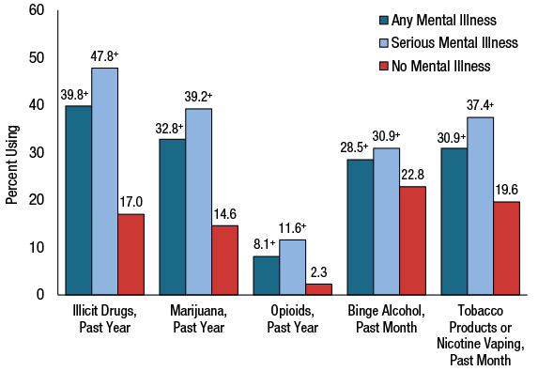
Substance and Mental Health Co-Morbidity in Adults (SAMSHA 2020)
SAMSHA 2020 - https://www.samhsa.gov/data/sites/default/files/reports/rpt35325/NSDUHFFRPDFWHTMLFiles2020/2020NSDUHFFR102121.htm#mhisud

Slide 13
Trauma-Informed Approach vs Trauma-Focused Treatment
Focus on optimizing engagement
Universal precautions
Universal framing
Avoid retriggering
Variability of role and context of care
Addressing trauma experience directly
Treatment focused on resolution of trauma-related symptoms
May require detailed trauma history as part of the treatment

Slide 14
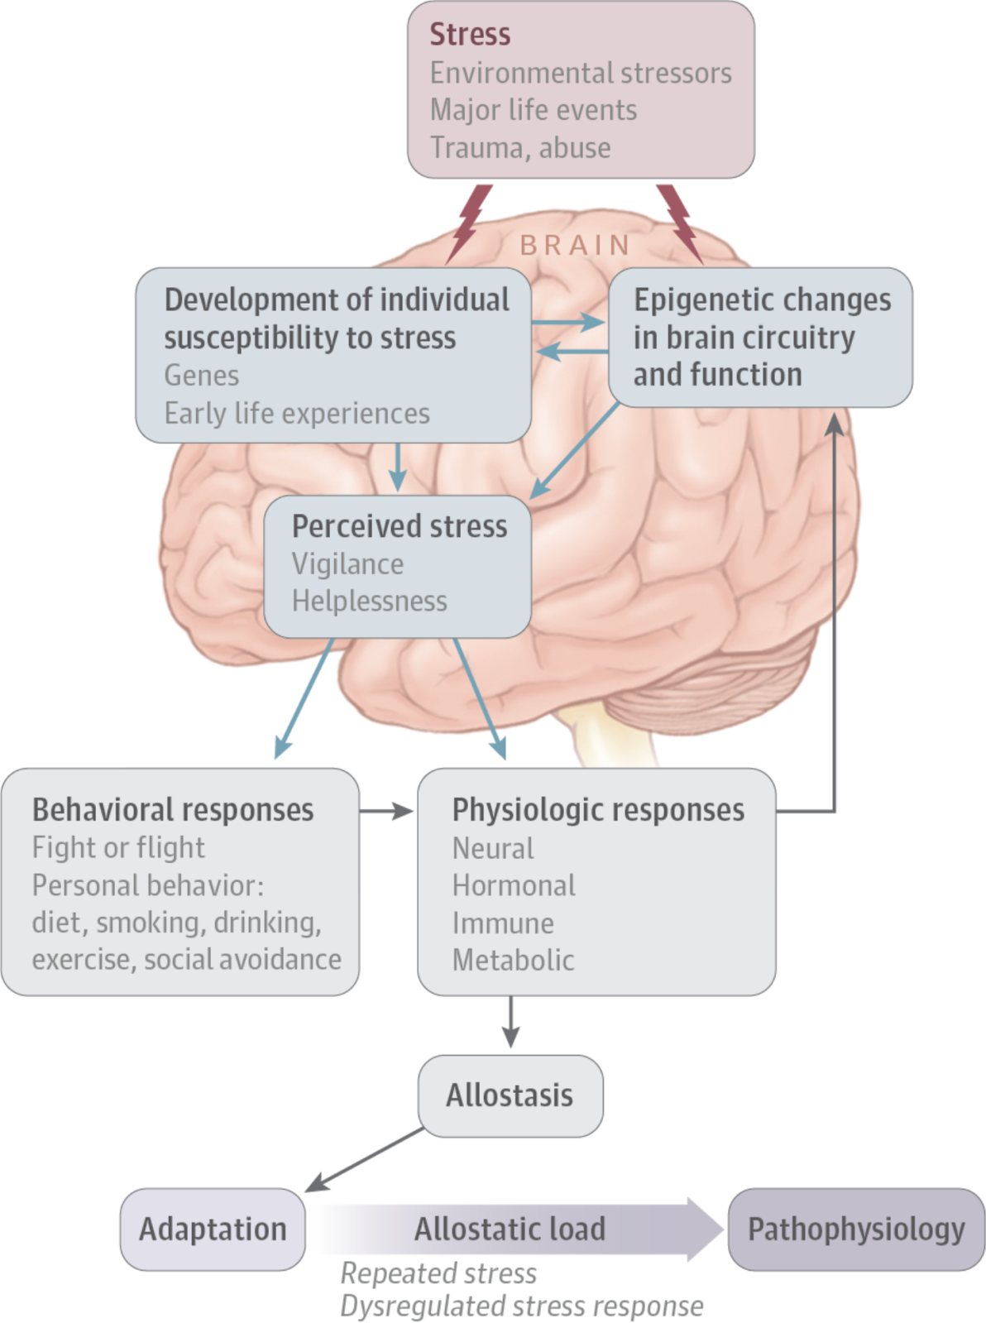
Stress response: seeking allostasis
McEwen, JAMA Psychiatry 2017

Slide 15
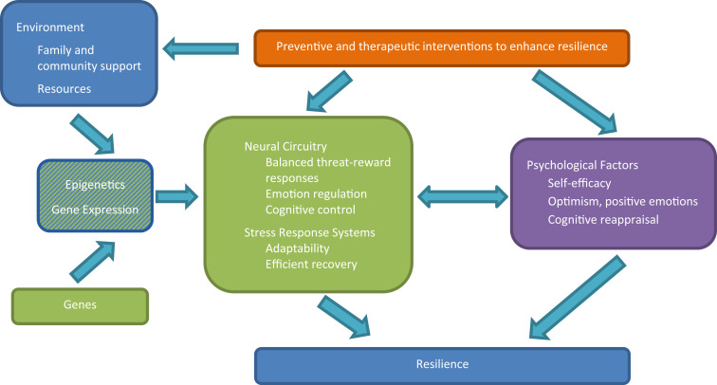
Feder A, Fred-Torres S, Southwick SM, Charney DS. The Biology of Human Resilience: Opportunities for Enhancing Resilience Across the Life Span. Biol Psychiatry. 2019 Sep 15;86(6):443-453. doi: 10.1016/j.biopsych.2019.07.012. Epub 2019 Jul 24. PMID: 31466561.
Resilience

Slide 16
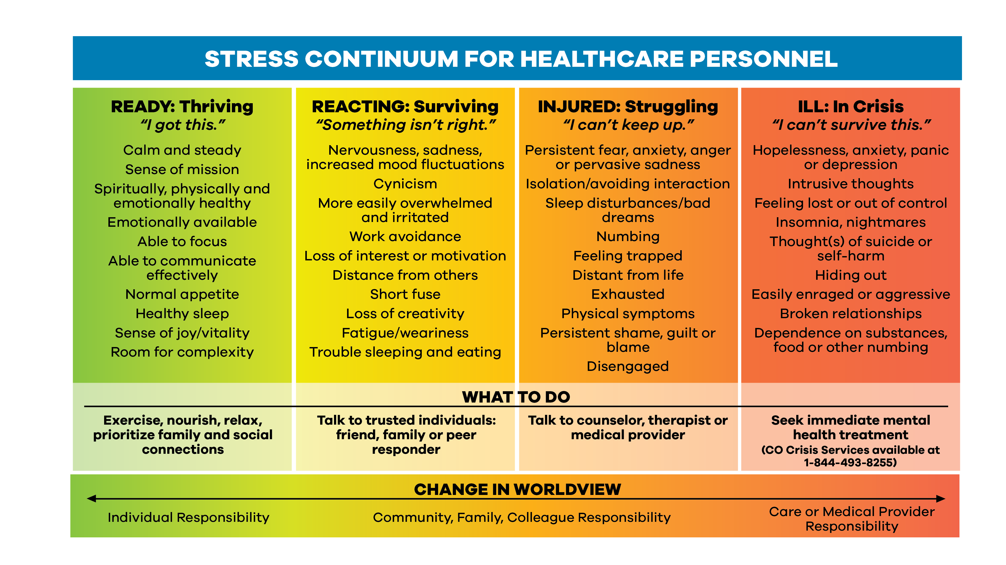
Denver Health/RISE

Slide 17
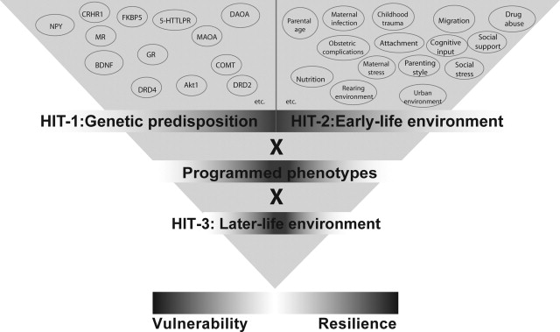
Daskalakis et al 2013

Slide 18
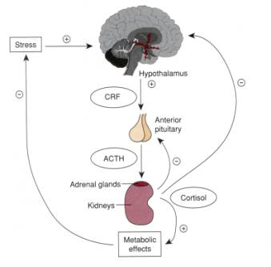
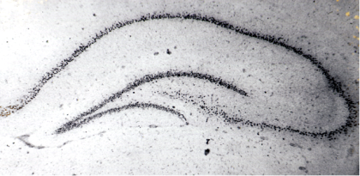
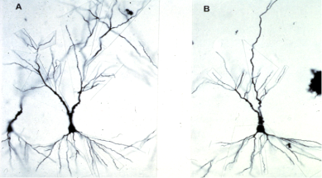
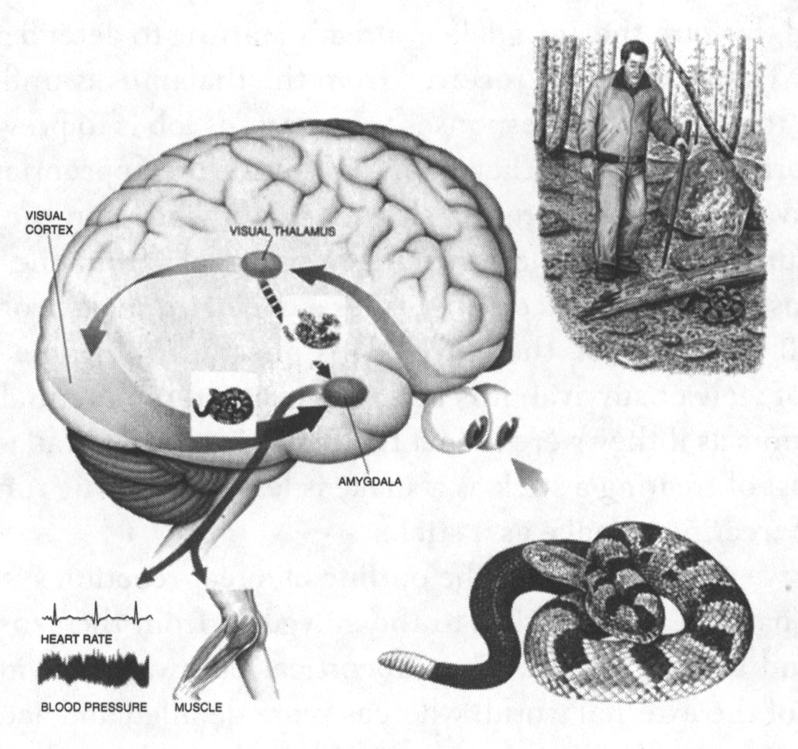
Neurobiopsychosocial perspectives
(or, sympatho-adrenergic stress responses)
Notes:
Joseph LeDoux, The Emotional Brain, 1998
Hippocampal dendritic atrophy and amygdalar dendritic arborization -- Ann N Y Acad Sci. 2001 Mar;933:265-77.
Joseph LeDoux, The Emotional Brain, 1998
Hippocampal dendritic atrophy and amygdalar dendritic arborization -- Ann N Y Acad Sci. 2001 Mar;933:265-77.
Plasticity of the hippocampus: adaptation to chronic stress and allostatic load.
McEwen BS¹. Our working hypothesis is that structural plasticity in response to repeated stress starts out as an adaptive and protective response, but ends up as damage if the imbalance in the regulation of the key mediators is not resolved. It is likely that morphological rearrangements in the hippocampus brought on by various types of allostatic load alter the manner in which the hippocampus participates in memory functions and it is conceivable that these may also have a role in chronic pain perception. The hippocampus also displays structural plasticity, involving ongoing neurogenesis of the dentate gyrus, synaptogenesis under control of estrogens in the CA1 region, and dendritic remodeling caused by repeated stress or elevated levels of exogenous glucocorticoids in the CA3 region. In all three forms of structural plasticity, excitatory amino acids participate along with circulating steroid hormones. Glucocorticoids and stressors suppress neurogenesis in the dentate gyrus
Trauma exposure activates the HPA axis, which controls reactions to stress and regulates physiology including digestion, immune system, mood, energy storage and expenditure.
Interactions with amygdala, hippocampus, prefrontal cortex facilitate activation and termination of the stress response.
Short term protective effects: “allostasis” – adaptations to acute stress needed for survival: increase cortisol to get increased energy; increase catecholamines to respond quickly to danger
Long term “allostatic load”
VaVan der Kolk 1996, DeBellis et. al., 1999, Perry 2001, Yehuda 06, Lanius et. al., 2006, 2011, Bremner 2006, Gunnar 2007, Southwick 2007

Slide 19
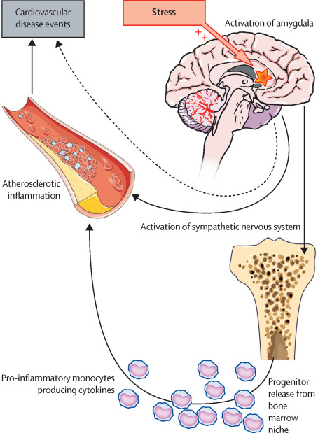
Tawakol, et al (2017)

Slide 20
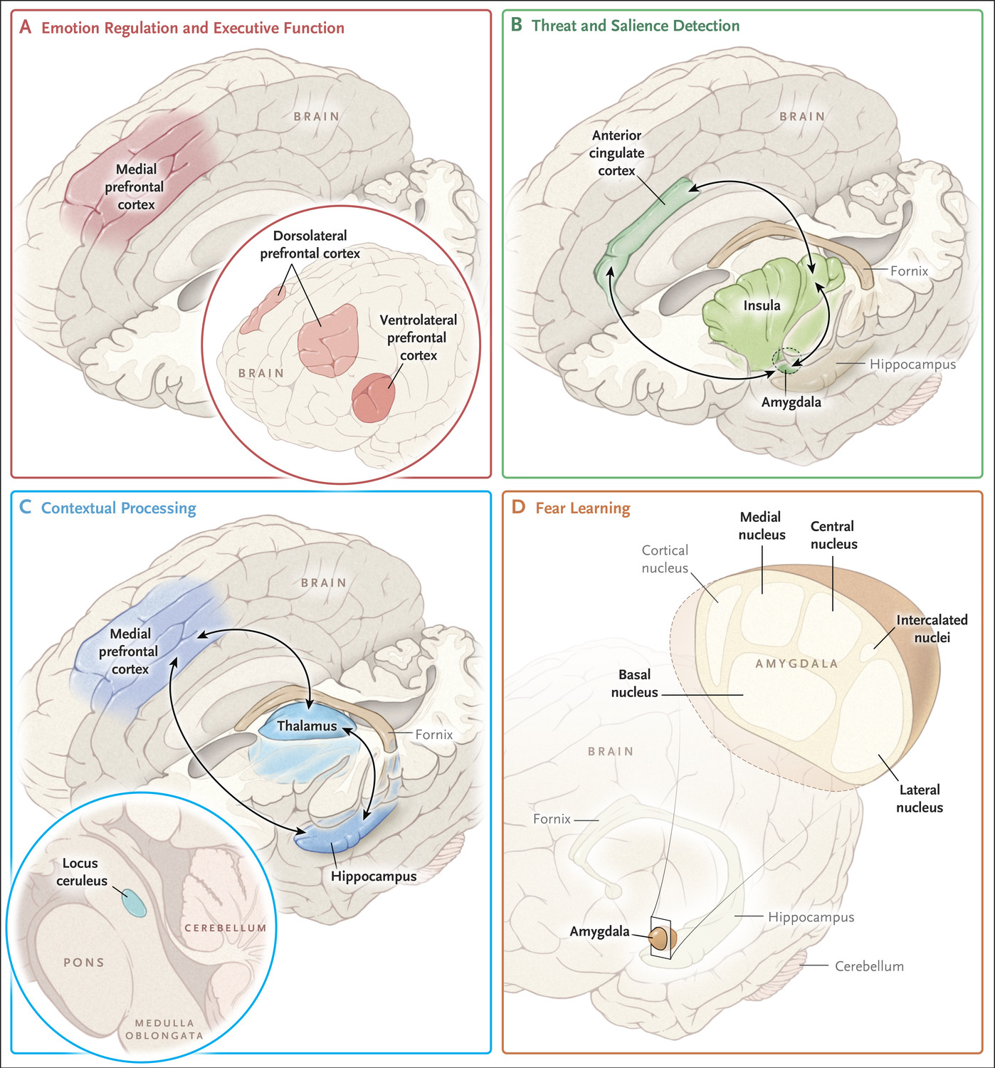
Shalev A et al. N Engl J Med 2017;376:2459-2469.
Notes:
Figure 1. Brain Regions Implicated in the Pathophysiology of Post-Traumatic Stress Disorder (PTSD). Shown are the known connectivity paths within four dysfunctional circuits that play a part in the psychopathology of PTSD: emotion regulation and executive function, threat detection, contextual processing, and fear learning.
From Admon et al 2013: These regions include the amygdala, hippocampus, insula, and various regions in the medial wall of the prefrontal lobe [including the dorsomedial prefrontal cortex, vmPFC, orbitofrontal cortex (OFC), rostral anterior cingulate cortex (rACC) and dorsal anterior cingulate cortex (dACC)]

Slide 21
Six Guiding Principles of TIC
(And corollaries to PFA Core Actions and VA’s Stress First Aid)
Safety: Physical & psychological
Trustworthiness & transparency
Safety and comfort
Stabilization (prn); info sharing
Peer Support
Collaboration & Mutuality
Connection with social supports
Contact and engagement
Empowerment, Voice, Choice
Cultural, Historical, & Gender Acknowledgment
Practical assistance,
link to services
Identify current needs, concerns
Nomi Levy-Carrick ©2020

Slide 22

Resilience in an Organization
Good, clear, timely communication, information and training
Fostering team spirit and cohesion
Promoting wellbeing through flexible, responsive resourcing
Promoting self-efficacy through skills-building/training
Psychological and wellbeing resources for staff
Voluntary huddles, not mandatory debriefing
COVID Trauma Response Working Group Rapid Guidance (www.traumagroup.org)

Slide 23
Resilience on the Front Line
Role clarity
Self-Efficacy
Empower-ment
©Nomi Levy-Carrick 2019
Notes:
Empowerment cited explicitly in the Stop the Bleed literature; role-clarity as “immediate responder”
Elements of creativity, sense of humor
Resilience is really an umbrella term that encompasses many attributes that help us bounce back cognitively and emotionally after a major stressor – to bend, not break.
The first is Role Clarity: #this is our lane; clinical practice and public health leadership are crucial to promote prophylaxis, mitigation, healing and health. And peer support can never be reinforced enough as a crucial role
Self-efficacy refers to an individual (or community’s) belief in a capacity to apply skills to produce a desired outcome –and it is a modifiable psychological trait. It can be learned and taught, modeled, mentored and nurtured
The third aspect is empowerment: the process (and it is a process) of becoming stronger and more confident in our ability to make an impact in our roles. And so the cogs of the wheel intersect and move the mechanism forward. We can easily feel overwhelmed or helpless in the face of this magnitude of communal violence and individual suffering, and while distress may be unavoidable, the ability to retain a sense of agency and purpose, of collaboration with providers and patients, and of connectivity with supports means that while PTSD is a risk, post-traumatic growth is also a possibility (and these are not mutually exclusive).

Slide 24
A PATH TO POST-TRAUMATIC GROWTH
Fear Zone
Learning Zone
Growth Zone

Slide 25
THE PATH TO POST-TRAUMATIC GROWTH
Spiritual Changes
Personal Strength
New Possibilities
Growth Zone
Relating to Others
Appreciation
for Life
https://www.phoenixtraumacenter.com/post-traumatic-growth/

Slide 26
Universal Precautions
One of the main principles of trauma-informed care is to assume,
not ask, if a patient has a history of trauma.
Option 1: Assume a history of trauma without asking
Option 2: Inquire about the impact/s of trauma instead of trauma itself
Option 3: Inquire about past trauma using open ended questions
Machtinger, Davis, Kimberg, Khanna, Cuca, Dawson-Rose, Shumway, Campbell, Lewis-O’Connor,
Blake, Blanch, McGaw, 2019. Women’s Health Issues

Slide 27
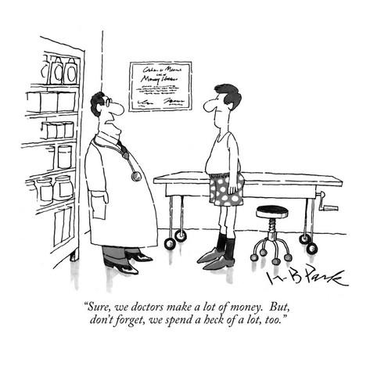
Universal Framing
Say what you will do before you do it
Explain:
What will be done
How it will be done
Why it is necessary
“What can I do to help you be more comfortable?”
“If you want me to stop and pause please ask or signal me.”
Of course I’m listening to your expression of spiritual suffering. Don’t you see me making eye contact, striking an open posture, leaning towards you and nodding empathetically?

Slide 28


Implications for the Clinical Encounter: critical awareness of role and context
Screening
Evaluation
Prevention/prophylaxis
Treatment
Treatment referrals

Slide 29
Alignment
Aligning institutional initiatives is vital to successful organizational culture transformation
Trauma Informed Systems
Quality
Improvement
United Against
Racism
Diversity, Equity, & Inclusivity

Slide 30
References
Admon R, Milad MR, Hendler T. (2013) A causal model of post-traumatic stress disorder: disentangling predisposed from acquired neural abnormalities. Trends in Cognitive Sciences, 17(7).
Amar, A., & Lewis-O’Connor, A. (2015) Trauma-Informed Care. In: Sigma Theta Tau, Nursing Knowledge International, tentatively titled, “A Practical Guide to Forensic Nursing: Incorporating forensic principles into nursing practice”.
American Psychiataric Association’s Diagnostic and Statistical Manual of Mental Disorders (2013), 5th Edition: DSM-5. Arlington VA: American Psychiatric Publishing.
Benjet C, Bromet E, Karam EG, et al. The epidemiology of traumatic event exposure worldwide: results from the World Mental Health Survey Consortium. Psychol Med. 2016;46(2):327-343
Creamer M, Burgess P, McFarlane AC. Post-traumatic stress disorder: Findings from the Australian National Survey of Mental Health and Well-being. Psychol Med. 2001;31(7):1237–1247.
Daskalakis NP, Bagot RC, Parker KJ, Vinkers CH, de Kloet ER. The three-hit concept of vulnerability and resilience: Toward understanding adaptation to early-life adversity outcome, Psychoneuroendocrinology, Volume 38, Issue 9, 2013, 1858–1873
Fallot, R., & Harris, M. (2006) “Trauma Informed Services: A Self-Assessment and Planning Protocol.” Community Connections.
Felitti, Anda et al., (1997). “Relationship of Childhood Abuse and Household Dysfunction to Many of the Leading Causes of Death in Adults: The Adverse Childhood Experiences (ACE) Study.” American Journal of Preventive Medicine, 14, 4, 245-258.
Felitti V, Anda R et al (1998) Relationship of Childhood Abuse and Household Dysfunction to Many of the Leading Causes of Death in Adults: The Adverse Childhood Experiences (ACE) Study. American Journal of Preventive Medicine. 14 (4): 245–258.
Grant BF, Chou SP, Goldstein RB, Huang B, Stinson FS, Saha TD, et al. Prevalence, correlates, disability, and comorbidity of DSM-IV borderline personality disorder: results from the Wave 2 National Epidemiologic Survey on Alcohol and Related Conditions. J Clin Psychiatry. 2008;69:533–45.
Galatzer-Levy IR and Bryan RA (2013) 636,120 Ways to Have Posttraumatic Stress Disorder. Perspectives on Psychological Science 8(6) 651-662.
Huang, L.N., Sharp, C.S., Gunther, T. SAMHSA and National Council for Behavioral Health webinar 8/6/13. “It’s Just Good Medicine: Trauma Informed Primary Care.” www.integration.samhsa.gov
Jain KM, Davey-Rothwall, et al (2018) PTSD, Neighborhood Residency and Satisfaction, and Social Network Characteristics among underserved women in Baltimore, Maryland. Women’s Health Issues, p1-8
Karam EG, Friedman MJ, Hill ED, et al (2014). Cumulative traumas and risk thresholds: 12-month PTSD in the World Mental Health (WMH) Surveys. Depress Anxiety; 31:130-42
Kessler RC, Rose S, Koenen KC, et al. (2015) How well can post-traumatic stress disorder be predicted from pre-trauma risk factors? An exploratory study in the WHO World Mental Health Surveys. World Psychiatry 13:265.
Kessler, R.C., Berglund, P., Delmer, O., Jin, R., Merikangas, K.R., & Walters, E.E. (2005). Lifetime prevalence and age-of-onset distributions of DSM-IV disorders in the National Comorbidity Survey Replication. Archives of General Psychiatry, 62(6): 593-602.

Slide 31
References
Kubzansky L, Bordelais P, Jun HJ et al. (2014) The weight of traumatic stress: a prospective study of PTSD symptoms and weight status in women. JAMA-Psych 71:1:44-51
LeDoux JL (1994) Emotion, Memory and the Brain. Scientific American.
Lewis-O’Connor, A. & Alpert, E. (2017) Caring for Survivors Using a Trauma Informed Care Framework. Human Trafficking Is a Public Health Issue: A Paradigm Expansion in the United States. Editors: Makini Chisolm-Straker, Hanni Stoklosa.
Lewis-O’Connor, A. & Chadwick, M. (2015). Voice of the patient: informing research, policy and practice on violence against women. Journal of Forensic Nursing, 11:4, 188-197.
McEwan, BS Allostasis and the Epigenetics of Brain and Body Health Over the Life Course The Brain on Stress JAMA Psychiatry. Published online April 26, 2017. doi:10.1001/jamapsychiatry.2017.0270
McEwen BS, Gray JD, Nasca C. 60 Years of Neuroendocrinology: Redefining Neuroendocrinology: stress, sex and cognitive and emotional regulation. Journal of Endocrinology 2015. 226, T67-83
Perez DL, Matin N, Barsky A, Costumero-Ramos V, et al (2017) Cingulo-insular structural alterations associated with psychogenic symptoms, childhood abuse and PTSD in functional neurological disorders. J Neurol Neurosurg Psychiatry. 2017 Jun;88(6):491-497
Perez DL et al. A Neural Circuit Framework for Somatosensory Amplification in Somatoform Disorders J Neurol Neurosurg Psychiatry 2015 doi:10.1136/jnnp-2016-314998
Roberts AL, Agnew-Blais JC, Spiegelman D, Kubzansky LD, et al (2015). PTSD and incidence of type 2 diabetes mellitus in a sample of women: a 22-year longitudinal study.
Rosen RL, Levy-Carrick NC, Reibman J, Xu N, Shao Y, Liu M, Ferri L, Kazeros A, Caplan-Shaw CE, Pradhan DR, Marmor M, Galatzer-Levy IR. (2017)Elevated C-reactive protein and posttraumatic stress pathology among survivors of the 9/11 World Trade Center attacks. Journal of Psychiatric Research 89, 14-21
Santaularia et al (2014) Relationships between sexual violence and chronic disease: a cross-sectional study. BMC Public Health 14:1286
Shalev A, Liberzon I, Marmar C. Post-Traumatic Stress Disorder. New England Journal of Medicine 2017 376;25.
Tawakol A, Ishai A, Takx RAP, Figueroa AI, Ali A, Kaiser Y, Truong QA, Solomon CJE, Calcagno C, Mani V, Tang CY, Mulder WJM, Murrough JW. Relation between resting amygdalar activity and cardiovascular events: a longitudinal and cohort study. Lancet, Volume 389, Issue 10071, 2017, 834–845. Warshaw, Carole. “Creating Trauma Informed Services and Organizations.” Faulkner Hospital Grand Rounds, October 30th, 2014.
Winning A, Gilsanz P, Koenen KC, et al. (2017) PTSD and 20-year physical activity trends among women. Am J Prev Med 52(6) 753-760.
WHO Mental Health Survey 2020 https://www.sciencedirect.com/science/article/abs/pii/S0376871622003118
https://www.ptsd.va.gov/professional/ptsd-overview/epidemiological-facts-ptsd.asp
http://www.medscape.org/viewarticle/751769_transcript
2010 National Epidemiologic Survey on Alcohol and Related Conditions
"The Adverse Childhood Experiences (ACE) Study". cdc.gov. Atlanta, Georgia: Centers for Disease Control and Prevention, National Center for Injury Prevention and Control, Division of Violence Prevention. May 2014. Archived from the original on 27 December 2015.

