Slide 1
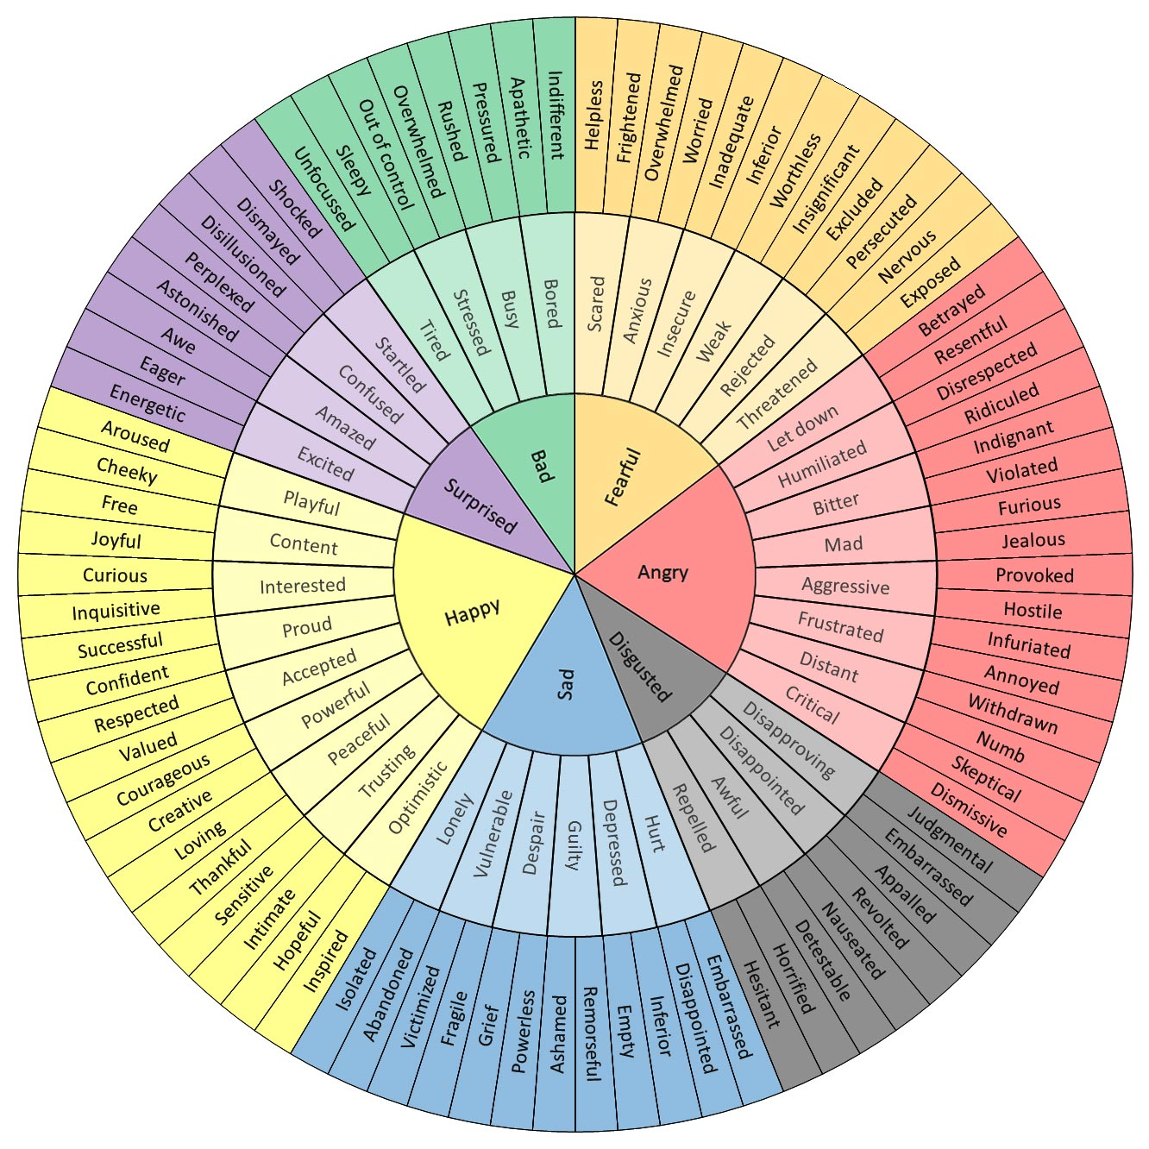
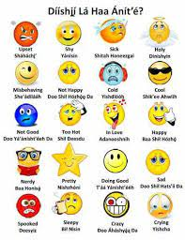
Emotional Vocab Wheel
no copyright infringement is intended
https://flowingdata.com/2020/03/20/wheel-of-emotional-words/
https://www.youtube.com/watch?v=N-ImeAGg26Y

