Slide 1
THE EMERGENT CHILD
EMS ECHO
NEEHAR KUNDURTI, MD, PEMF IiI

Slide 2
DISCLOSURE
I have no conflicts of interest or financial disclosures

Slide 3
OBJECTIVES
Understand differences in key elements of emergent presentations in a child vs adults
Recognize children who are sick vs not sick
Become adept at utilizing the pediatric assessment triangle and ABCDEs
Prepare oneself for the world of pediatrics

Slide 4

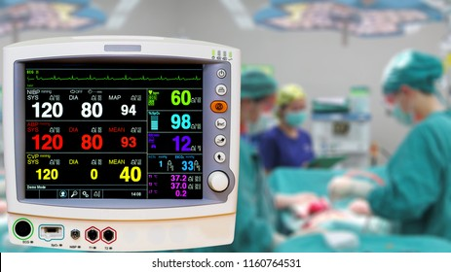
Notes:
Vital signs vary with age. Recommend reading Harriett Lane book of pediatrics or the PALS card for age-specific vital signs especially when you start your peds clerkship.
Respiratory failure is the most common cause of cardiac arrest In kids

Slide 5
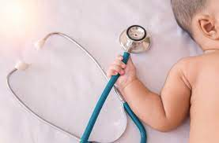
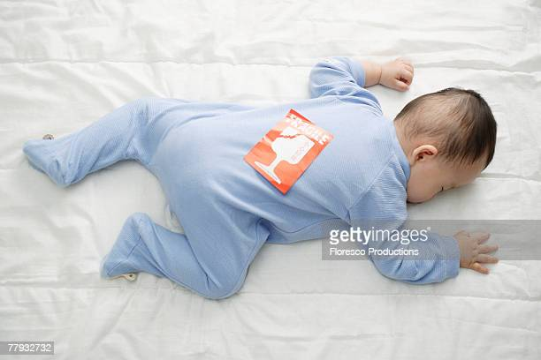

Slide 6
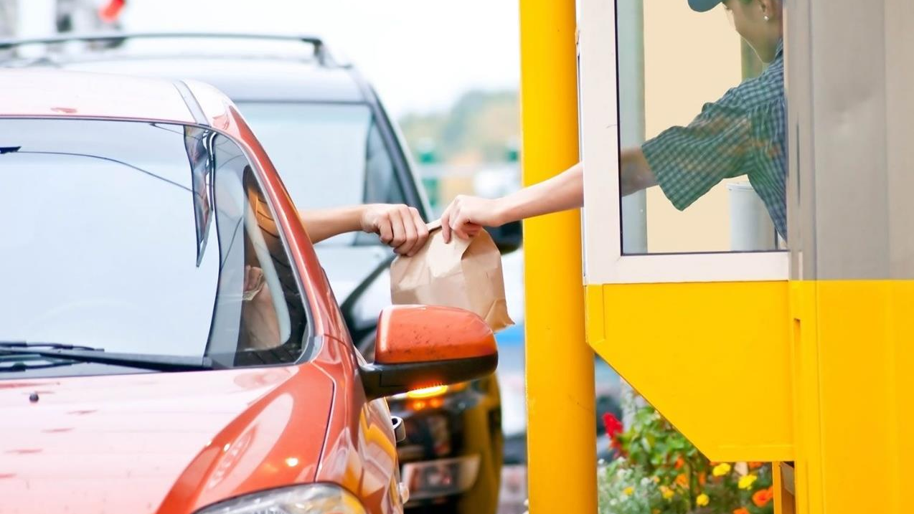
Notes:
Clinic: H&P, talk in detail, anticipatory guidance.
Inpatient setting: Like clinic but look out for signs in those children who may be sick and needs interventions.
ICU: controlled setting!
ED: Uncontrolled, chaotic.
Drive through assessments. Focused H&Ps. As a student, you can take your time taking a detailed history and performing a full physical but if there’s a need for urgent/emergent intervention, you can keep it brief! Which is why we have assessment tools that you can use to guide you in the process.
Take nursing concerns in the ER seriously! They can make quick, accurate assessments in triage and will call for a provider if they’re concerned

Slide 7
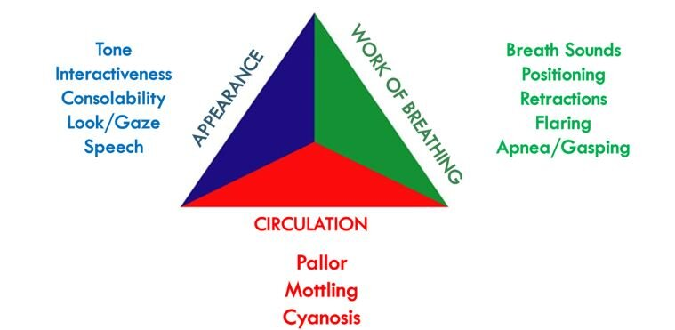
PEDIATRIC ASSESSMENT TRIANGLE

Slide 8

Notes:
Positive iPad sign

Slide 9

Notes:
Fever
They will have tachycardia and infants/toddlers can have tachypnea.
Warning signs: decreased level of mentation or lethargy (not just the ‘down in the dumps’ look, poor feeding, needs stimulation to wake up), decreased perfusion (delayed cap refill, mottling of skin, oliguria/anuria), high risk factors (cancer, central lines, indwelling catheters, cerebral palsy)
UTI is the most common bacterial cause of fevers in infants and toddlers, especially girls. Viral infections are still the leading cause in all children.
Always look at the blood pressure!

Slide 10


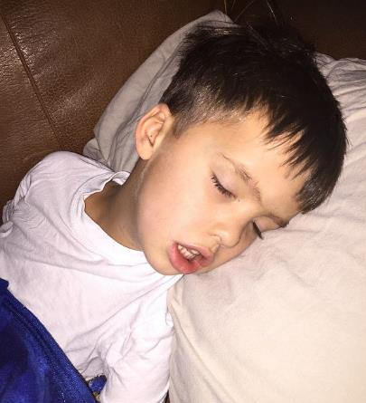

Slide 11
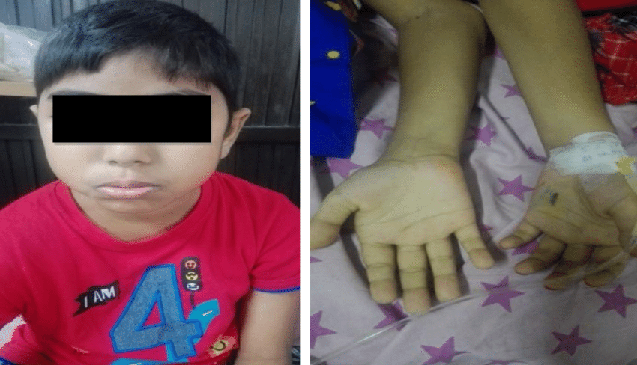
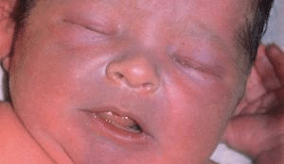
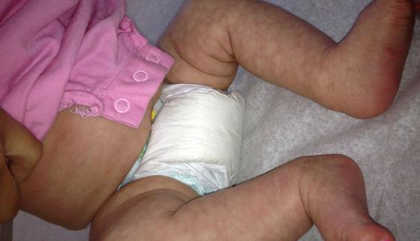
Notes:
Pallor can appear varied according to skin types. Ask the parents if they feel their child appears paler than usual. Subjective and parents sometimes overuse the terms ‘pale’ if they feel their child is sick. Pallor can be due to anemia, but can also be seen in febrile illnesses (in addition to flushed skin), in dehydration, vomiting etc.
Cyanosis is usually very obvious. Infants usually have acrocyanosis. Central cyanosis is emergent, patients need to be on pulse ox/monitor. Severely cyanotic children can appear pale and even gray/ashen.
Mottling in dehydration

Slide 12
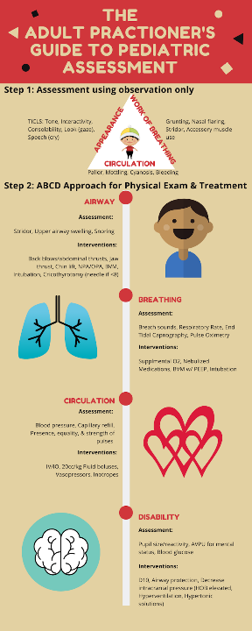
-Kids Really Are Just Small Adults: Utilizing the Pediatric Triangle with the Classic ABCD Approach to Assess Pediatric Patients; Walker, Hanna; Cureus. 2020 Mar; 12(3): e7424.

Slide 13

-Kids Really Are Just Small Adults: Utilizing the Pediatric Triangle with the Classic ABCD Approach to Assess Pediatric Patients; Walker, Hanna; Cureus. 2020 Mar; 12(3): e7424.
Notes:
Short thick neck (especially infants), anterior larynx
Head tilt-chin lift, jaw thrust Suction: Often dramatic improvement in infants
Age-specific obstructed airway support: <1 year: Back blow/chest thrust<1 year: Back blow/chest thrust >1 year: Abdominal thrust>1 year: Abdominal thrust
Advanced airway techniques
Anatomic difficult airways:
Large occiput – need shoulder roll
Large tongue – obstruction
Cephalad larynx – difficult to visualize
Soft epiglottis – use Miller blades
Smallest diameter below cords: Small airways – high resistance Anatomy
Physiologic difficult airways:
Pediatric vs Adult Higher Basic Metabolic Rate = Shorter time to Desaturation, Smaller airways = Higher Airway Resistance, Prolonged respiratory distress -> failure

Slide 14

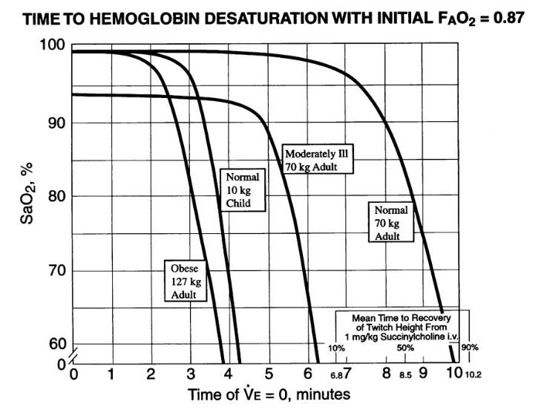
Notes:
Benumof graph from the world of anesthesia
Normal child as you can see. Infants are way worse, often worse than the obese adult. They have almost no reserves.

Slide 15

-Kids Really Are Just Small Adults: Utilizing the Pediatric Triangle with the Classic ABCD Approach to Assess Pediatric Patients; Walker, Hanna; Cureus. 2020 Mar; 12(3): e7424.
Notes:
Respiratory Rate Varies with Age Slow or fast respirations are worrisome
Breathing: Auscultation Midaxillary line, above sternal notch
Stridor: Upper airway obstruction
Wheezing: Lower airway obstruction
Grunting: Poor oxygenation; pneumonia, drowning, pulmonary contusion
Crackles: Fluid, mucus, blood in airway
Decreased / absent breath: Obstruction
Tachypnea, Stridor, Retractions, Head bobbing, Nasal Flaring, Respiratory Failure, Altered mental status, Poor resp effort, Bradypnea, Bradycardia, Apnea, Resp failure

Slide 16

-Kids Really Are Just Small Adults: Utilizing the Pediatric Triangle with the Classic ABCD Approach to Assess Pediatric Patients; Walker, Hanna; Cureus. 2020 Mar; 12(3): e7424.
Notes:
Heart Rate and BP varies by Age
Pulse : Central, peripheral pulse quality
Capillary refill: ≤ 2 sec. Children can have cold extremities, so we often warm them up if we need to do fingerstick/heelstick glucoses etc. Also for pulse ox.
B/P : Minimum = 70 + (2 X age in years)

Slide 17

-Kids Really Are Just Small Adults: Utilizing the Pediatric Triangle with the Classic ABCD Approach to Assess Pediatric Patients; Walker, Hanna; Cureus. 2020 Mar; 12(3): e7424.
Notes:
Disability (and Dextrose)
AVPU scale : Alert, Verbal: Responds to verbal commands, Painful: Responds to painful stimulus, Unresponsive
Check Dextrose (glucose) if impaired

Slide 18
EXPOSURE/ENVIRONMENT
Full exposure
Warm, ambient environment
Minimize heat loss
Monitor temp
Warm IV fluids
Notes:
Full Exposure Necessary: Evaluate physiologic function, Identify anatomic abnormalities. Look for bruises/skin findings
Maintain warm ambient environment
Minimize heat loss
Monitor temperature
Warm IV fluids

Slide 19
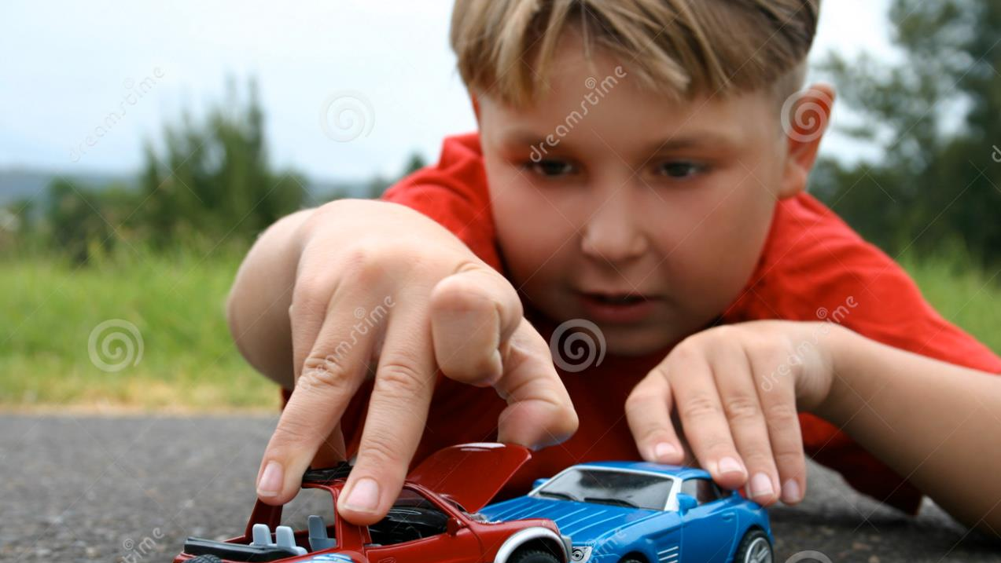
Notes:
Trauma in children
Trauma is leading cause of death and disability in children worldwide.
Most common injuries: Infants: Physical abuse
Preschoolers: Falls
School aged: Motor vehicle collision – pedestrian or bicyclist
Differences in anatomy, physiology, mechanism drive differences in injury pattern, response.

Slide 20
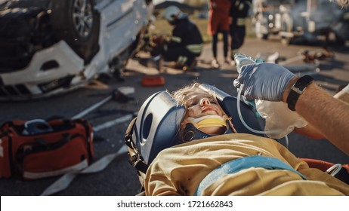
Notes:
How Trauma Differs in Pediatrics
Proportionately larger head, Large occiput and tongue
Injury Response: Higher frequency of head trauma, higher c-spine trauma, More airway obstruction

Slide 21
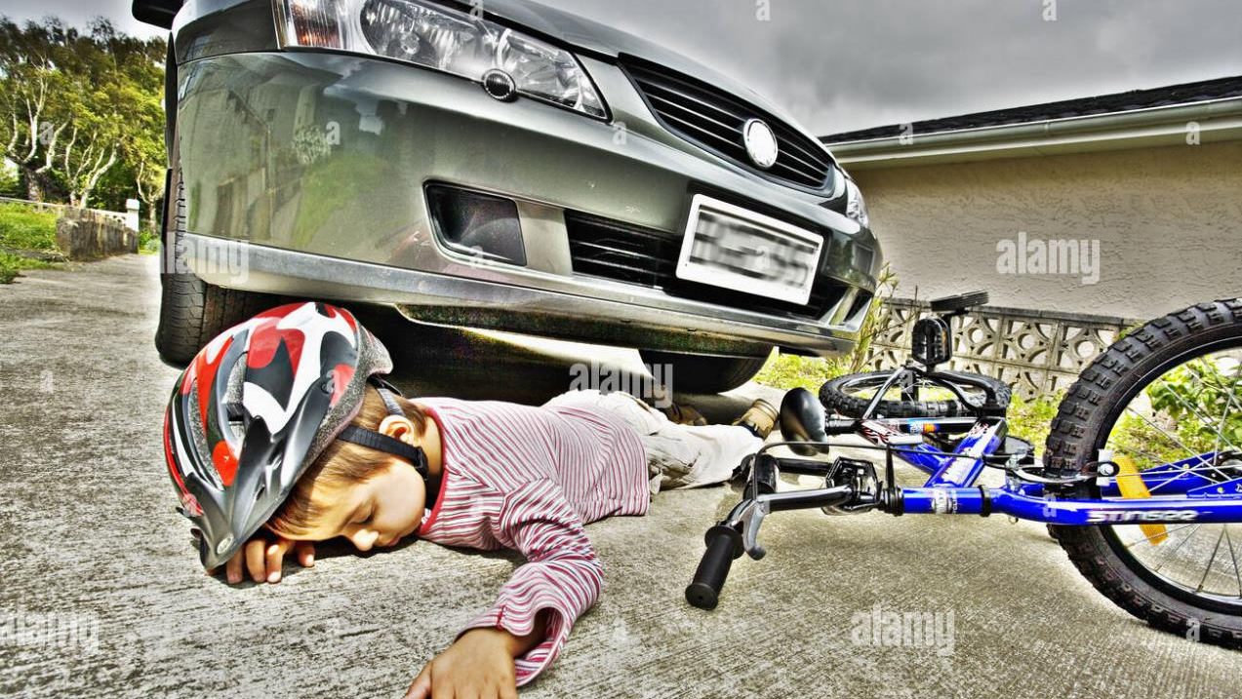
Notes:
How Trauma Differs in Pediatrics
Thinner chest wall, more flexible ribs, Horizontal ribs, weaker intercostals, more mobile mediastinum
Abdominal organs more anterior and less subcutaneous fat
Injury Response: Higher frequency of pulmonary injury, Tension pneumothorax poorly tolerated, Higher risk of intra- abdominal injury and bleeding

Slide 22
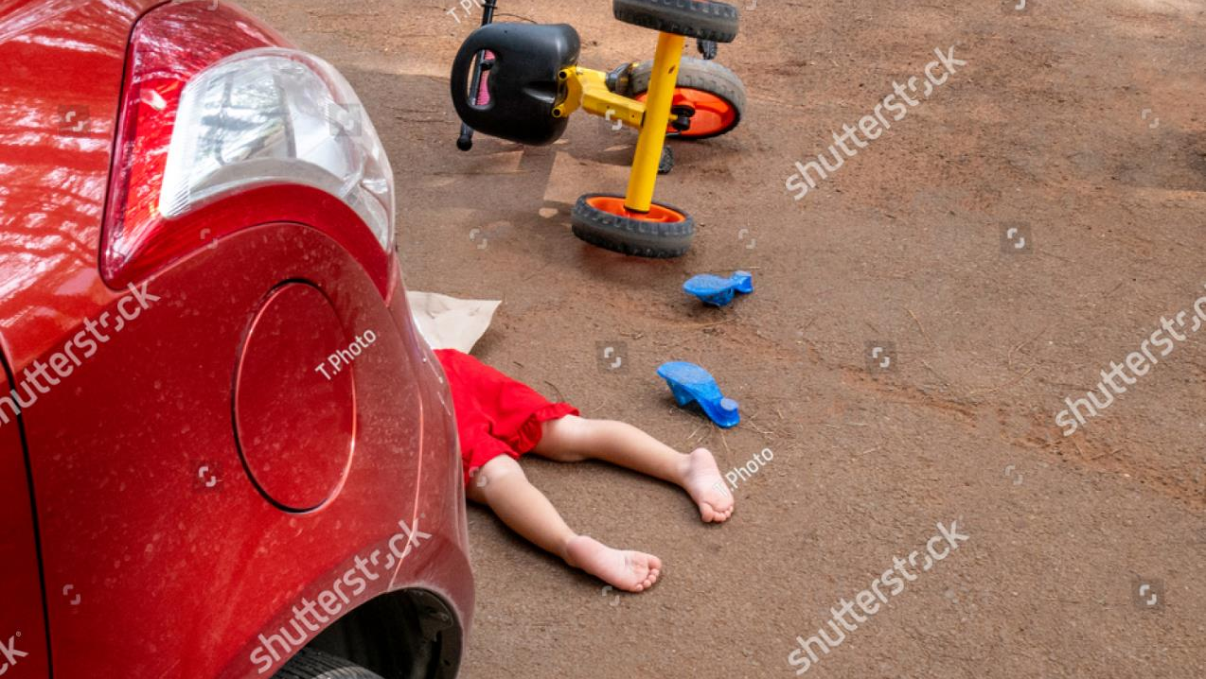
Notes:
How Trauma Differs in Pediatrics
Softer bones, thicker periosteum. Active, unfused bony growth plates, Compensatory vasoconstriction, Larger body surface area/mass ratio
Injury Response: Higher frequency of incomplete fractures, Disrupted growth after growth plate fractures, Normal blood pressure with early shock, Greater heat loss from exposed body surfaces (head)
Kids usually heal extremely well though! They are resilient

Slide 23
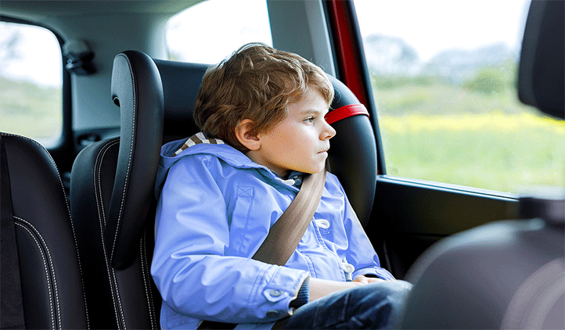
Notes:
Properly restrained Car seats/Booster seats save lives! Helmets save lives!
Do the quick PAT --> ABCDEs
Kids get hypothermic very quick including babies, after the full body assessment be cognizant of temperature
Be aware of non-accidental trauma/abuse is infants/young toddlers

Slide 24

-Kids are not just small adults
-You personally won’t break a child but children can break
-PAT followed by ABCDEs
Notes:
Bottomline: Kids are not just small adults You personally won’t break a child but children can break
PAT followed by ABCDEs is the golden ER rule
Holler if you’re worried on your PAT! Don’t wait for a full assessment/H&P
A good rule to follow :If a child can’t drink or walk out of the ER and you don’t know why, they can’t leave!

Slide 25
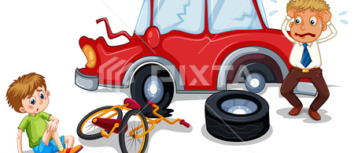
THANK YOU!

