Slide 1

Bronchiolitis and Croup
Brittany Ebbing MD, MPH
Pediatric Emergency Medicine Fellow
University of New Mexico
October 20, 2022

Slide 2
No financial disclosures

Slide 3
Objectives
Provide an overview of common causes of pediatric respiratory distress.
Recognize clinical presentations for pediatric patients with bronchiolitis and croup.
Discuss the appropriate first steps in management for patients with bronchiolitis and croup.

Slide 4
Bronchiolitis

Slide 5
Overview
Clinical presentation of respiratory distress in children <2 years old.
Can co-occur with viral induced wheezing or asthma exacerbation.
Primarily occurs due to a viral illness.
  >95% of cases of bronchiolitis caused by a viral illness.
  ⅓ are caused by two or more viral syndromes
Typically occurs in the fall and winter seasons.
Leading cause of hospitalization in children.
  Peak incidence is between 2 and 6 months of age

Slide 6
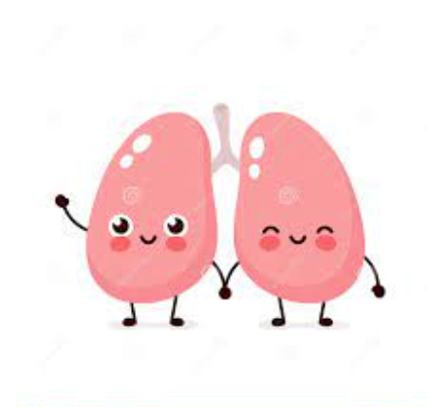
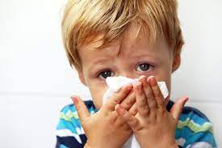
Pathogenesis

Slide 7
Risk factors for severe disease
Prematurity (gestational age ≤36 weeks)
Low birth weight
Age less than 12 weeks
Chronic pulmonary disease, particularly bronchopulmonary dysplasia (also known as chronic lung disease)
Anatomic defects of the airways
Hemodynamically significant congenital heart disease
Immunodeficiency
Neurologic disease
Living at a high altitude

Slide 8
Clinical Presentation
Clinical syndrome usually with the following symptoms:
  Fever
  Respiratory distress:
    Tachypnea
    Retractions
  Wheezing
  Crackles
Some patients may have desaturation episodes with the respiratory distress.

Slide 9
Clinical Progression
Duration of illness depends upon age, severity of illness, associated high risk condition and causative agent.
Self-limited disease.
Usually worsens on day of illness 2-3 and will peak on days 3-5 then gradually resolve.
The cough can take up to 21 days to resolve.

Slide 10
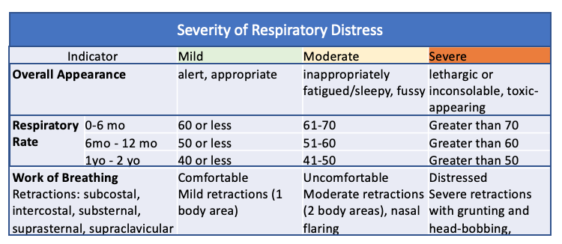
Severity of Respiratory Distress

Slide 11
Common Pathogens
RSV
  Most common and most often recognized as sole pathogen
  Usually in the fall and winter, or rainy season
Rhinovirus
  Usually in the spring and fall
Parainfluenza
Human metapneumovirus
Influenza
Adenovirus
Non-COVID coronaviruses
COVID

Slide 12
Differential
Recurrent viral triggered wheezing
Pneumonia
Airway foreign body
Congenital heart disease
  Heart failure
Pertussis

Slide 13
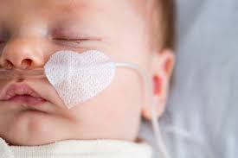
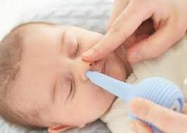

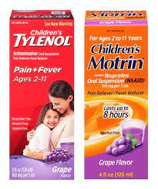
Treatment

Slide 14

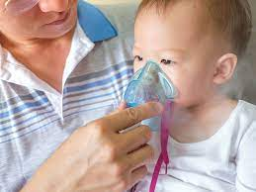
Treatment

Slide 15
Viral Croup
AKA Laryngotracheitis
Notes:
Laryngotracheitis

Slide 16
Overview
Croup is a respiratory illness characterized by:
  Inspiratory stridor
  Barking cough
  Hoarseness
Symptoms usually result from inflammation in the larynx and subglottic airway.
Commonly occurs in children 6 months to 3 years, but can occur up to 5-6 years of age.
More common in boys.
ED visits for croup are most frequent between 10pm-4am

Slide 17
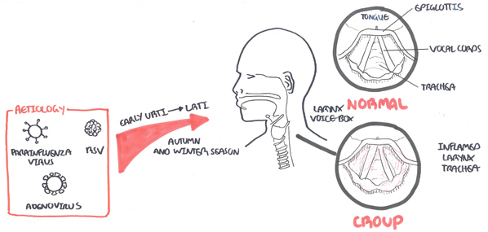
Pathogenesis

Slide 18
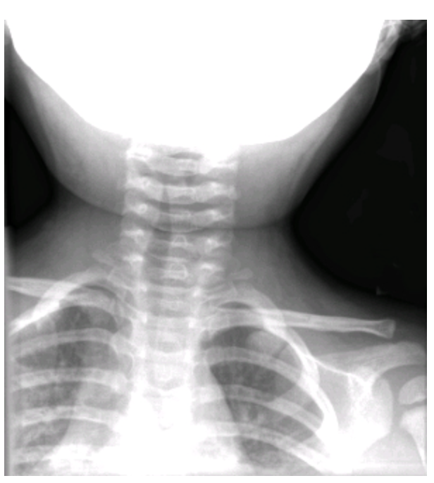
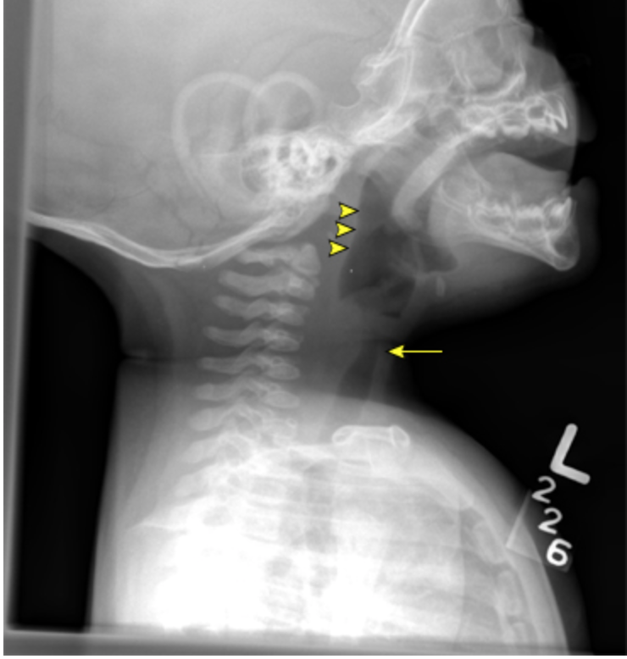

Slide 19
Clinical Presentation
Nasal discharge and congestion
Fever
Hoarseness
Barking cough
Stridor

Slide 20
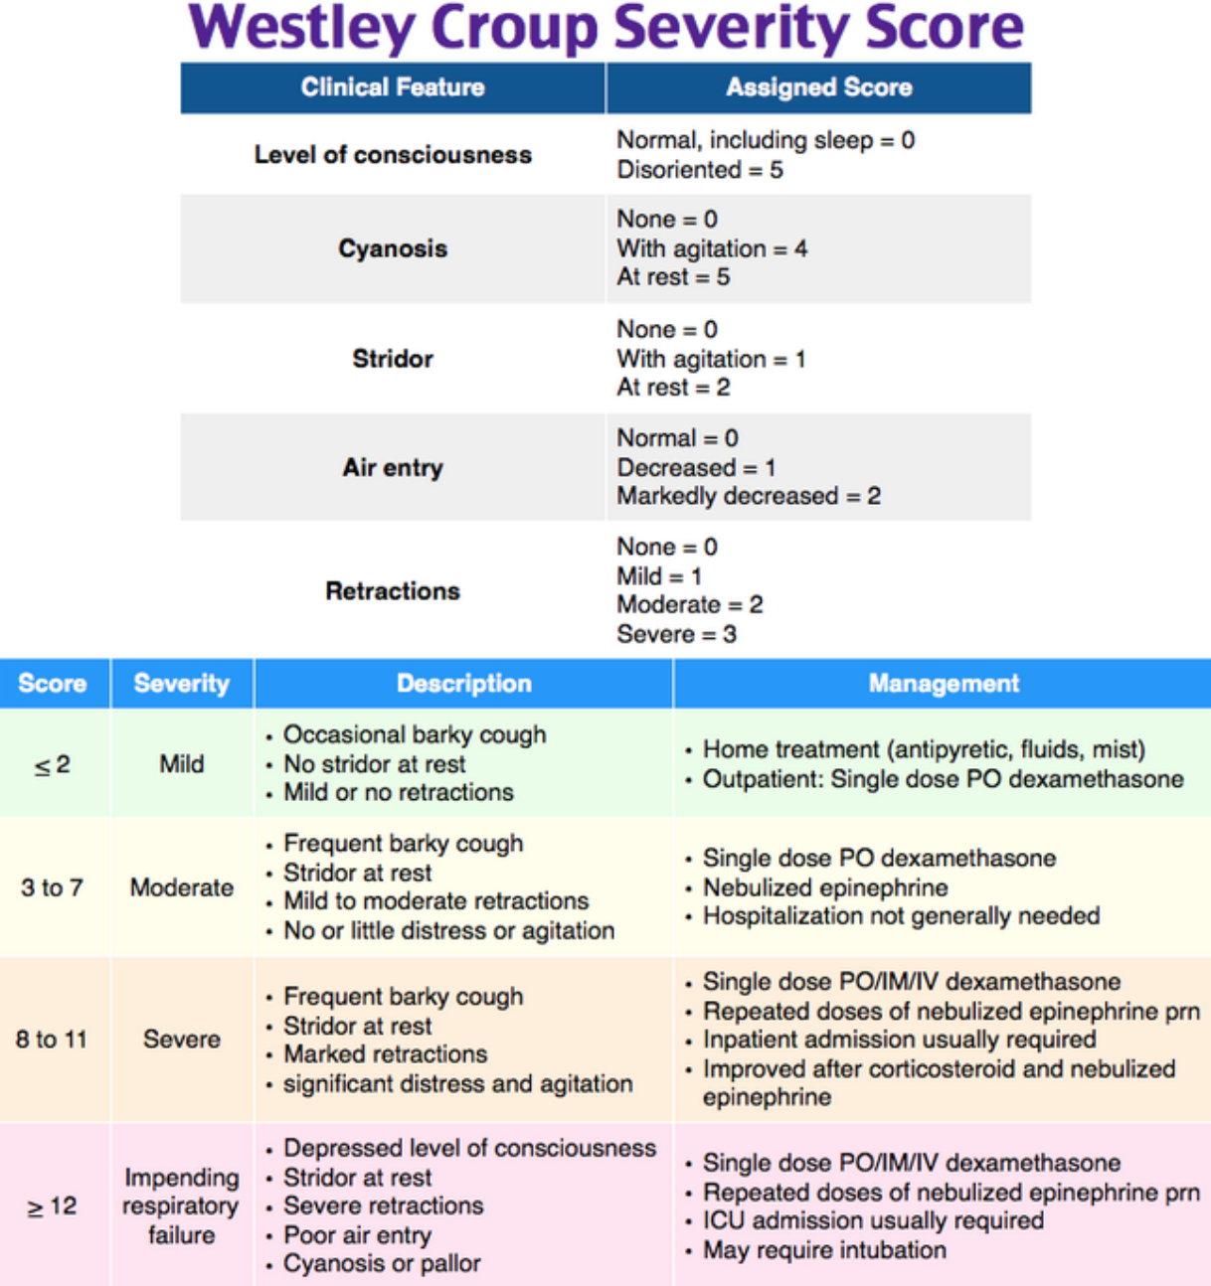

Slide 21
Common Pathogens
Parainfluenza is the most common virus causing viral croup.
COVID
RSV
Adenovirus
Influenza
Measles

Slide 22
Differential
Acute epiglottitis
Bacterial tracheitis
Peritonsillar or retropharyngeal abscess
Foreign body
Anaphylaxis
Upper airway trauma
Airway anomalies

Slide 23
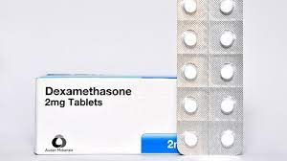
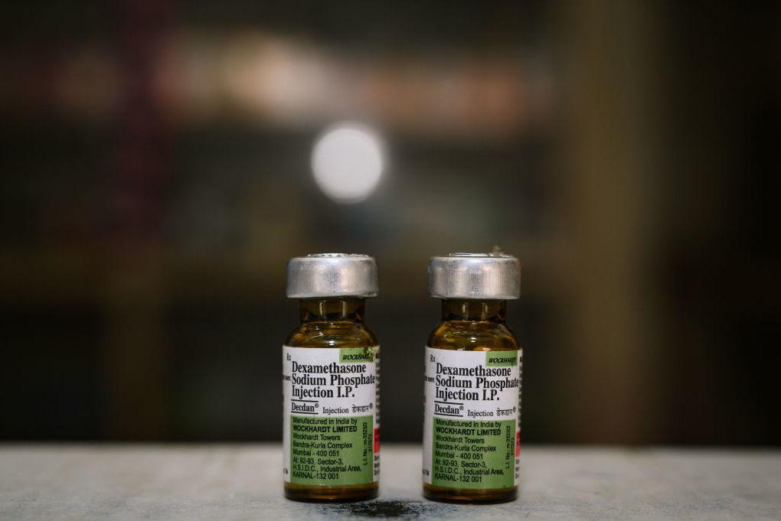
Treatment
Dosing 0.3mg/kg to 0.6mg/kg, max dose: 10mg

Slide 24
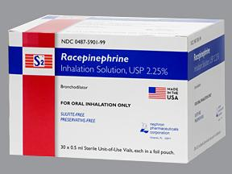
Treatment
Administer 0.05mL/kg (max dose 0.5mL) diluted with total volume of 3mL nebulized over 15 minutes

Slide 25
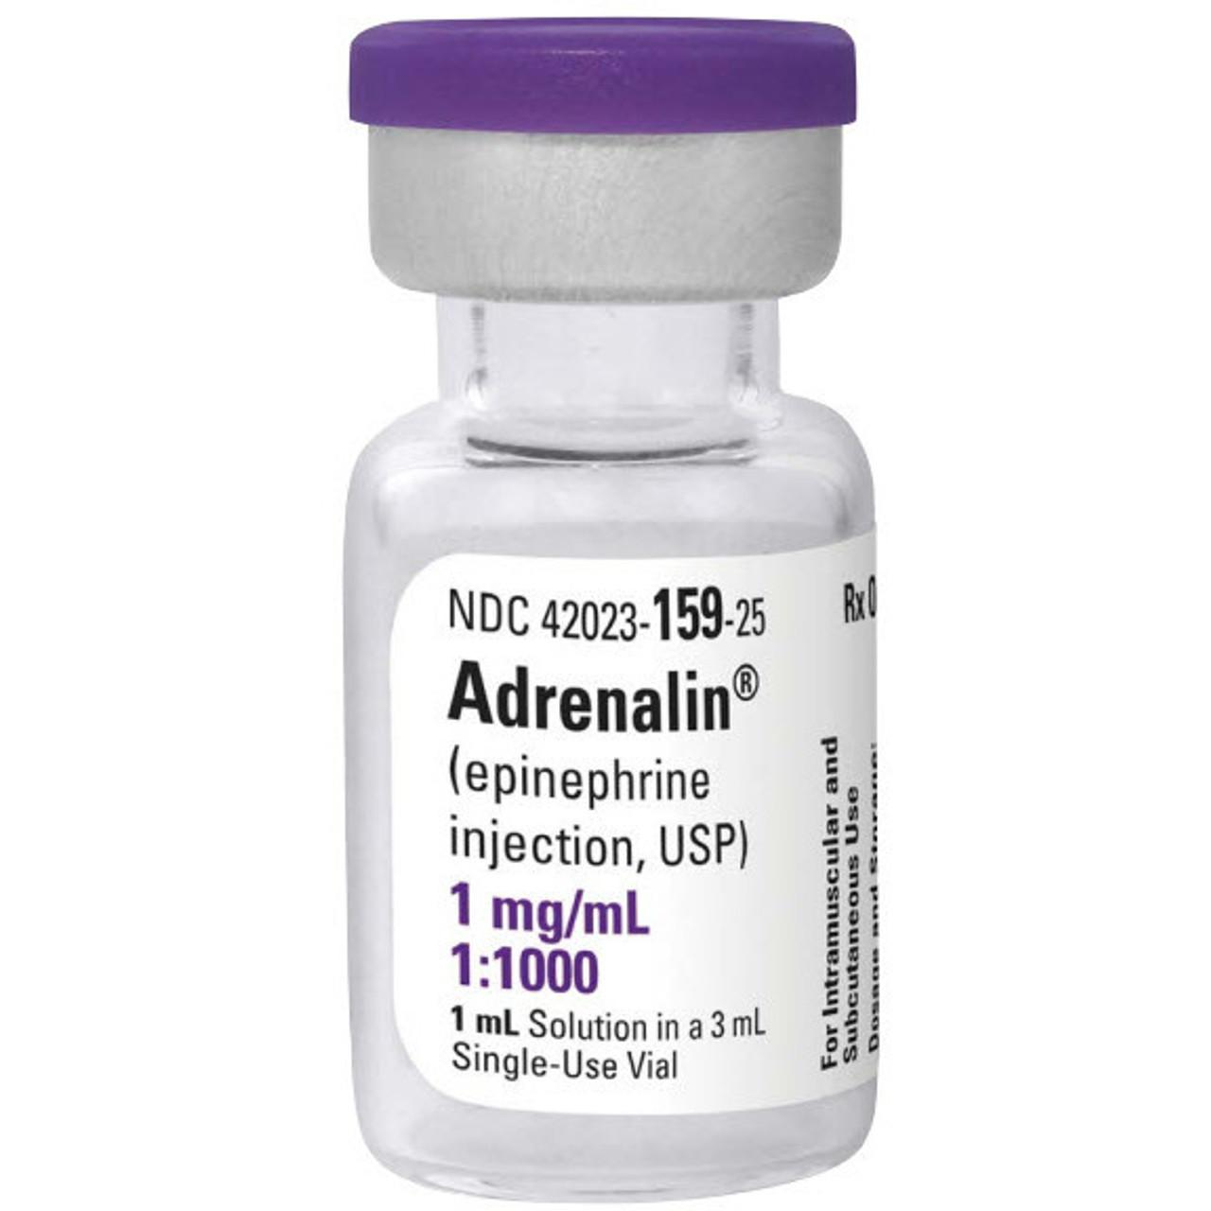
No racemic epi available, use this:
Administer 0.5mL/kg (max dose 5mL) nebulized over 15 minutes

Slide 26
Pediatric Respiratory Case Examples

Slide 27
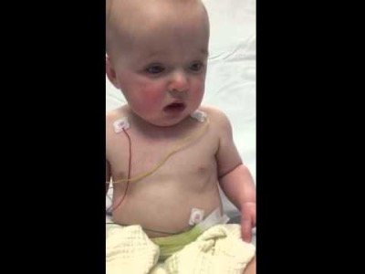

Slide 28
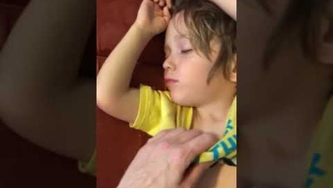

Slide 29
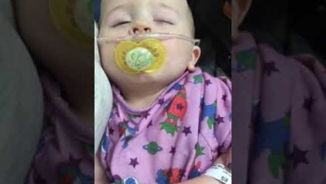

Slide 30
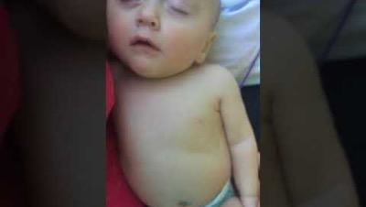

Slide 31
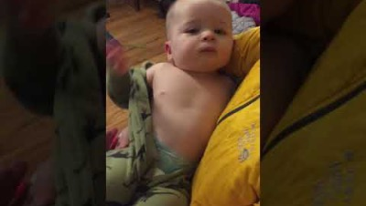

Slide 32
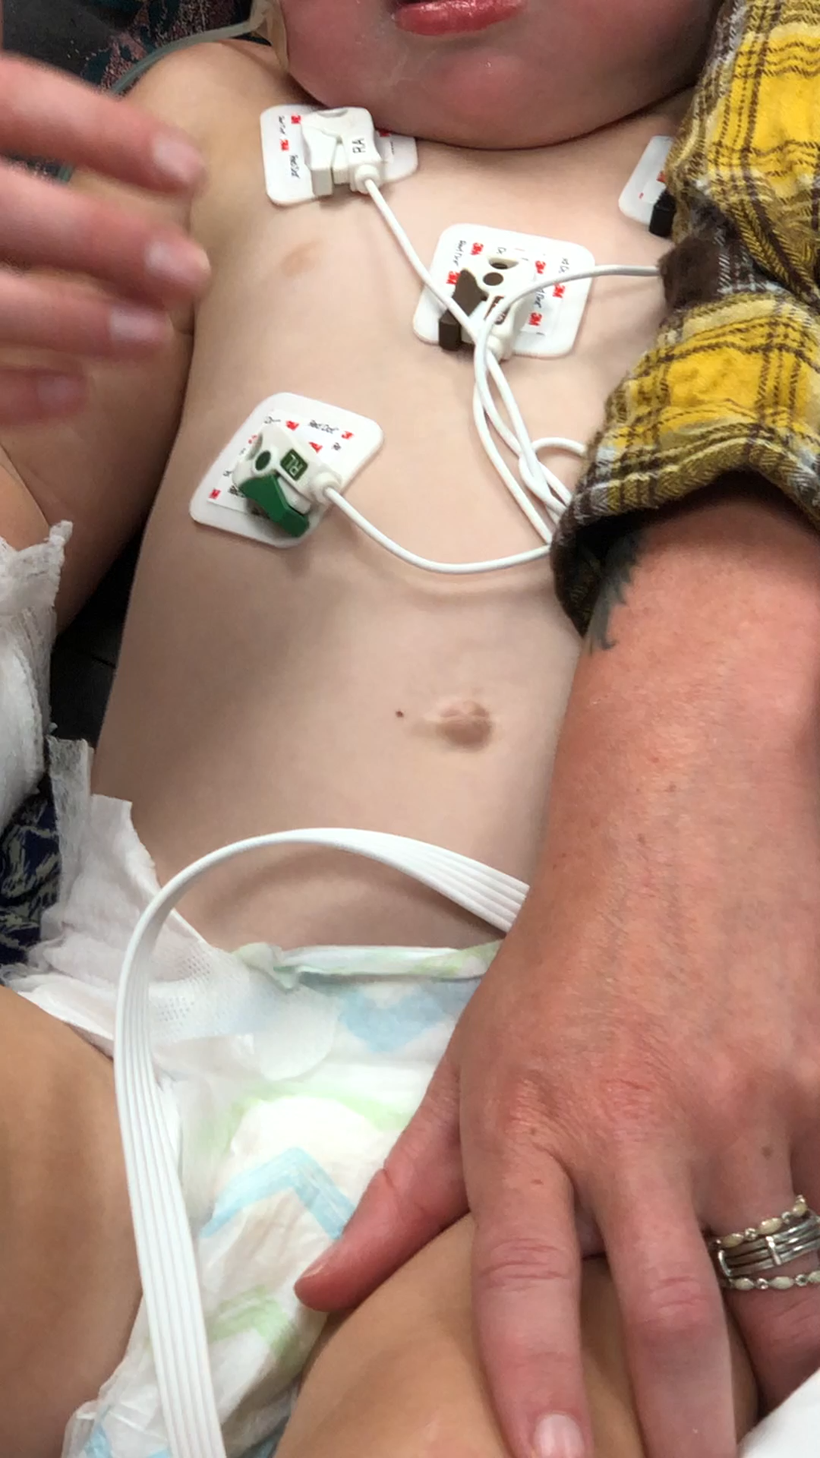

Slide 33
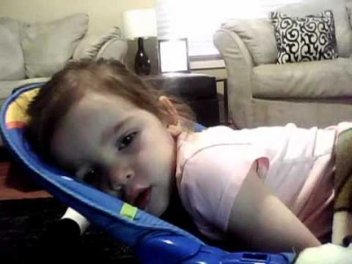

Slide 34
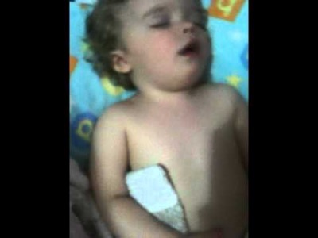

Slide 35
Summary
Suction and provide oxygen for pediatric patients with respiratory distress.
Give dexamethasone to patients with barky cough.
Use nebulized racemic (or regular) epinephrine to patient with stridor.
Provide an antipyretic and hydration to all patients with respiratory distress.

Slide 36
Thank You!
Questions?
bebbing@salud.unm.edu

