Slide 1

Early Detecton of Cognitive Impairment
September 2022
Indian Health Service
Bruce Finke, MD
With huge thanks to Soo Borson, MD

Slide 2
DSM-V: Major Cognitive Disorder (Dementia)
Evidence of significant cognitive decline from a previous level of performance in one or more cognitive domains
  Learning and memory
  Executive function
  Complex attention
  Perceptual-motor
  Social cognition
The cognitive deficits interfere with independence in everyday activities. At a minimum, assistance should be required with complex instrumental activities of daily living, such as paying bills or managing medications.
The cognitive deficits do not occur exclusively in the context of a delirium.
The cognitive deficits are not better explained by another mental disorder (e.g. major depressive disorder, schizophrenia.
Dementia is a syndrome

Slide 3
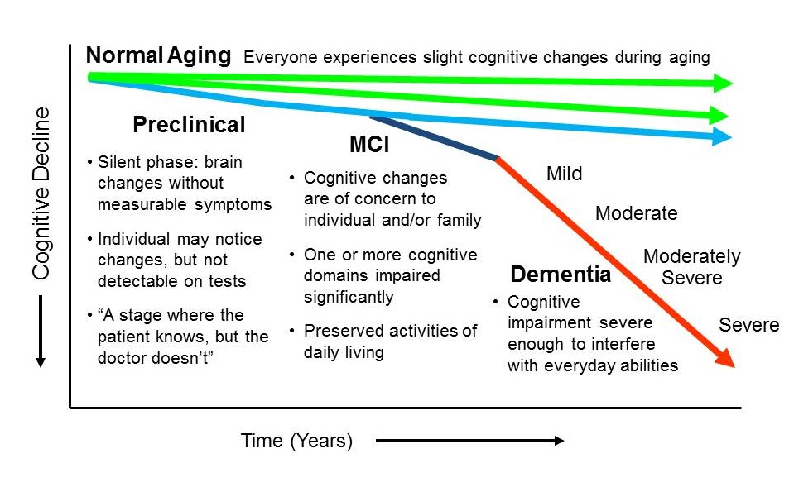

Slide 4
Disease Progression
Pre-clinical
MCI
Mild NCD
Moderate NCD
Severe NCD

Slide 5
Disease Progression
Pre-clinical
MCI
Mild NCD
Moderate NCD
Severe NCD

Slide 6
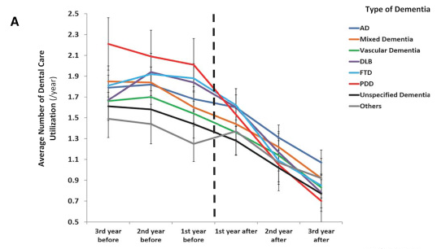
Dental care utilization in patients with dementia
Fereshtehnejad, S. M., Garcia-Ptacek, S., Religa, D., Holmer, J., Buhlin, K., Eriksdotter, M., & Sandborgh-Englund, G. (2018). Dental care utilization in patients with different types of dementia: A longitudinal nationwide study of 58,037 individuals. Alzheimer's & Dementia, 14(1), 10-19.

Slide 7
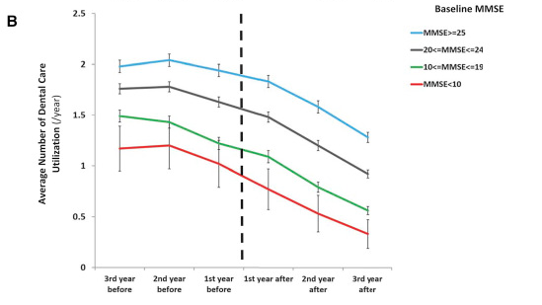
Dental care utilization in patients with dementia
Fereshtehnejad, S. M., Garcia-Ptacek, S., Religa, D., Holmer, J., Buhlin, K., Eriksdotter, M., & Sandborgh-Englund, G. (2018). Dental care utilization in patients with different types of dementia: A longitudinal nationwide study of 58,037 individuals. Alzheimer's & Dementia, 14(1), 10-19.

Slide 8
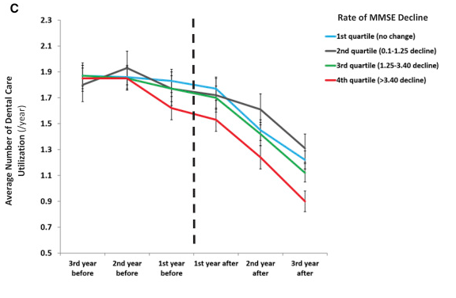
Dental care utilization in patients with dementia
Fereshtehnejad, S. M., Garcia-Ptacek, S., Religa, D., Holmer, J., Buhlin, K., Eriksdotter, M., & Sandborgh-Englund, G. (2018). Dental care utilization in patients with different types of dementia: A longitudinal nationwide study of 58,037 individuals. Alzheimer's & Dementia, 14(1), 10-19.

Slide 9
Identify and address modifiable risk factors
HTN, DM, head injury, smoking, obesity, lack of exercise, hearing impairment, social isolation
Cognitive Impairment
Detection
Optimize Function and Slow progression
Improve quality of life
Reverse Progression or halt decline
Supportive Therapy and socialization
Avoid anticholinergic and psychoactive medications
Aducanamab??? (AD only)
Support in Activities of Daily Living
Attention to safety
Control Blood Pressure Optimize DM management
Advance care planning
Respite care
Cholinesterase Inhibitors and memantine
Caregiver support
Exercise
It starts with detection
Environmental Modification
Optimize Oral Health and Nutrition

Slide 10
Screening for Cognitive Impairment at the Point of Care
Soo Borson MD
Professor of Clinical Family Medicine, Keck USC School of Medicine
Professor Emerita of Geriatric Psychiatry, University of Washington

Slide 11
Our biggest goal: to build a dementia-capable health care system, starting with early detection
Purposeful case-finding - where people are
Active partnership with families/home caregivers
Regular risk assessment
  Proactive management
Care coordination
  Across disciplines
  Across settings
  Over time
Focus on prevention: “no crisis” care
  Acute care episodes
  Caregiver crises

Slide 12
We all own dementia!
Borson S, Chodosh J. Clin Geri Med 2014; 30: 395-420.
Notes:
The exponential rise in dementia prevalence expected in the next 15 years is the product of two forces: first, the baby boom - the oldest of the boomers will be in their 80’s in 2030, an age at which at least a third of people will have clinically important cognitive impairment. The second force is the continuing marginal reduction in mortality due to the common chronic diseases that make up much of the work of the general internist, leaving more older people living with multiple chronic conditions and complex health care needs. The shortage of specialists will not be fixed in the foreseeable future, resutting in the need for generalists – including internists – to become more skilled in identifying dementia in their patients and managing the resulting complexities such as those we just encountered with our patient.
Set off below this staggering increase in dementia cases are the two specialty groups most often called upon to provide complex management of dementia patients over time – geriatricians and geriatric psychiatrists. We see that growth in both geriatric medicine and geriatric psychiatry has essentially stopped, and there is no expectation that it will begin again. Their small numbers make it obvious that the diagnosis and management of dementia will fall increasingly to generalists. Having a basic understanding of dementia, getting comfortable with identifying cognitive impairment in patients, and understanding its impact on health care and clinical decision making are all within the scope of primary care medicine.

Slide 13
Incident dementia: Potentially preventable hospitalizations
 | DEMENTIA | NO DEMENTIA | EFFECT
N | 494 | 2525 | 16%
Age at enrollment | 78 (6) | 75 (6) | p = 0.0001
Length of F/U (yrs) | 9.6 | 8 | P = NS
% w/any admit | 86% | 59% | ++
% w/any preventable admit | 40% | 17% | Adj rate ratio 1.8 (1.4-2.3)
Phelan E, Borson S, Grothaus L et al. JAMA 2012; 307: 165-172.
Notes:
In this study, we had the opportunity to isolate the effect of new cases of dementia on hospitalizations, using a unique cohort of individuals – those followed in the ACT study pioneered by Dr. Eric Larson at Group Health Cooperative nearly 20 years ago. In that study, cognitively normal older persons are enrolled in a longitudinal study of risk factors for incident dementia. Subjects are evaluated every two years. Because the study is embedded in a healthcare system with excellent data capture and analysis capabilities, we were able to look at hospitalization rates and reasons before and after the onset of dementia and compare rates with people who never developed dementia. Key findings were that dementia patients were admitted for much the same reasons as all older adults – but the rates were higher, and some reasons for admission were unique to demented individuals (dehydration, UTI). We were especially interested in potentially preventable admissions – admissions for conditions that if detected and treated early in outpatient care might never worsen to the point of requiring inpatient treatment. The reasons are informative and can tell providers something about how having dementia requires a special focus in general medical care. For CHF, UTI, and duodenal ulcer, it’s likely that diagnoses were missed or delayed in primary care, leading to greater acuity of illness when detected. This may happen because dementia patients are less able to recognize and report changes in their health status. For dehydration, dementia interferes with awareness of and appropriate response to thirst signals.

Slide 14
Mini-Cog©
Instructions for Administration & Scoring
ID: Date:
Step 1: Three Word Registration
Look directly at person and say, “Please listen carefully. I am going to say three words that I want you to repeat back to me now and try to remember. The words are [select a list of words from the versions below]. Please say them for me now.” If the person is unable to repeat the words after three attempts, move on to Step 2 (clock drawing).
The following and other word lists have been used in one or more clinical studies.¹⁻³ For repeated administrations, use of an alternative word list is recommended.
Version 1 Banana Sunrise Chair
Version 2 Leader Season Table
Version 3 Village Kitchen Baby
Version 4 River Nation Finger
Version 5 Captain Garden Picture
Version 6 Daughter Heaven Mountain
Step 2: Clock Drawing
Say: “Next, I want you to draw a clock for me. First, put in all of the numbers where they go.” When that is completed, say: “Now, set the hands to 10 past 11.”
Use preprinted circle (see next page) for this exercise. Repeat instructions as needed as this is not a memory test. Move to Step 3 if the clock is not complete within three minutes.
Step 3: Three Word Recall
Ask the person to recall the three words you stated in Step 1. Say: “What were the three words I asked you to remember?” Record the word list version number and the person’s answers below.
Word List Version: Person’s Answers:
Scoring
Word Recall: (0-3 points) | 1 point for each word spontaneously recalled without cueing.
Clock Draw: (0 or 2 points) | Normal clock = 2 points. A normal clock has all numbers placed in the cor- rect sequence and approximately correct position (e.g., 12, 3, 6 and 9 are in anchor positions) with no missing or duplicate numbers. Hands are point- ing to the 11 and 2 (11:10). Hand length is not scored. Inability or refusal to draw a clock (abnormal) = 0 points.
Total Score: (0-5 points) | Total score = Word Recall score + Clock Draw score. A cut point of <3 on the Mini-Cog™ has been validated for dementia screening, but many individuals with clinically meaningful cognitive impairment will score higher. When greater sensitivity is desired, a cut point of <4 is recom- mended as it may indicate a need for further evaluation of cognitive status.
Mini-Cog © S. Borson. All rights reserved. Reprinted with permission of the author solely for clinical and educational purposes.
May not be modified or used for commercial, marketing, or research p urposes without permission of the a uthor (soob@uw.edu).
v. 01.19.16

Slide 15
Clock Drawing
ID: Date:
References
Borson S, Scanlan JM, Chen PJ et al. The Mini-Cog as a screen for dementia: Validation in a population based sample. J Am Geriatr Soc 2003;51:1451–1454.
Borson S, Scanlan JM, Watanabe J et al. Improving identification of cognitive impairment in primary care. Int J
Geriatr Psychiatry 2006;21: 349–355.
Lessig M, Scanlan J et al. Time that tells: Critical clock-drawing errors for dementia screening. Int Psychogeriatr. 2008 June; 20(3): 459–470.
Tsoi K, Chan J et al. Cognitive tests to detect dementia: A systematic review and meta-analysis. JAMA Intern Med. 2015; E1-E9.
McCarten J, Anderson P et al. Screening for cognitive impairment in an elderly veteran population: Acceptability and results using different versions of the Mini-Cog. J Am Geriatr Soc 2011; 59: 309-213.
McCarten J, Anderson P et al. Finding dementia in primary care: The results of a clinical demonstration project. J Am Geriatr Soc 2012; 60: 210-217.
Scanlan J & Borson S. The Mini-Cog: Receiver operating characteristics with the expert and naive raters. Int J Geriatr Psychiatry 2001; 16: 216-222.
Mini-Cog © S. Borson. All rights reserved. Reprinted with permission of the author solely for clinical and educational purposes.
May not be modified or used for commercial, marketing, or research p urposes without permission of the a uthor (soob@uw.edu).
v. 01.19.16

Slide 16
Improving detection at the point of care
100
***
***
80
***
% Correct
60
Mini-Cog 0-2/5
40
Patient’s own physician
20
0
0
0.5
1
2
3
CDR Stage
NCI MCI Mild Mod Severe
Sample Size 189 94 83 74 27
*** p < .001
Borson S et al Int J Geriatr Psychiatry 2006

Slide 17
Positive Mini-Cog associated with health care use *
Service type | Incremental effect of CI (p<0.01)
Ambulatory care visits | + 15%
Phone calls | + 26%
Canceled appointments | + 22%
No shows | + 38%
ED visits | + 32%
Hospitalizations | + 58%
* 29% Mini-Cog positive vs 71% negative (n=787, primary care and neurology clinics combined).
Rosenbloom M, Barclay T, Borson S et al. JGIM 2018. Sample 95% white non-Hispanic Minnesotans.

Slide 18

Who can give the Mini-Cog?
Almost anyone, with 10 minutes of training and periodic monitoring

Slide 19
It starts with detection
Risk Factors
Age
DM
CKD
CVD
Stroke
Triggers for Screening
Poor oral hygiene
Poor understanding
Poor adherence to plan
Simple Screen (Mini-Cog)
Diagnosis
Therapeutics
Services
Clinical Management

Slide 20

How might we incorporate early detection of cognitive impairment into our work with older individuals?
Discussion:
Notes:
Never mistake a clear view for a short distance – Paul Saffo

