Slide 1
Critical Care Boarding in the (Rural) ED
Or more appropriately titled “Please let this person live until transport”
Victoria Hoch, MD
Emergency Medicine-Critical Care Medicine Fellow
Brigham and Women’s Hospital, Boston, MA
September 17, 2022

Slide 2
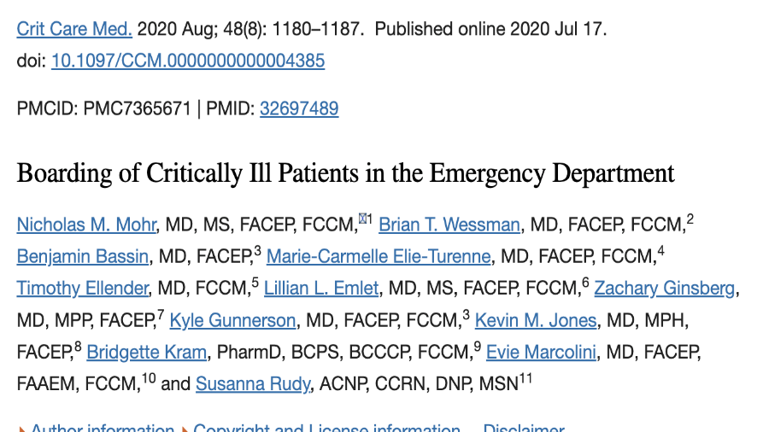




Critical care boarding
2-80% incidence
ED visits for critically ill patients are increasing
6 hours of boarding translates to outcomes
Notes:
Systematic review of 18 articles
Circle 1- 2-80% incidence of boarding in the ED
Circle 2- between 2006 and 2014 ED visits for critically ill patients increased by 80%
Circle 3- boarding is poorly defined, but 6 hours seems to be the place where outcome differences are seen

Slide 3







Critical care boarding in the rural ED

Slide 4
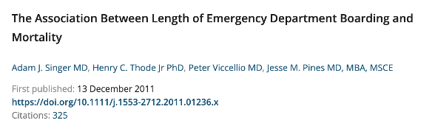
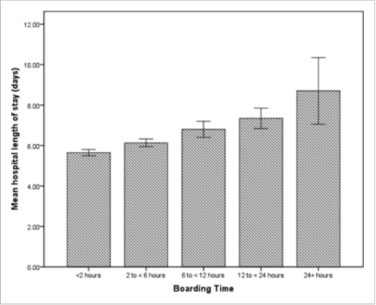
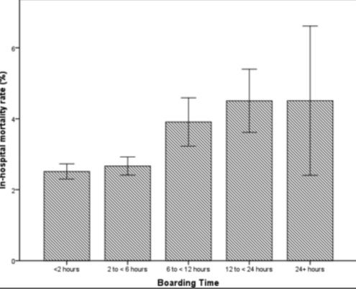
Critical care boarding
Worse clinically significant outcomes
Notes:
Increased duration of mechanical ventilation
Increased mortality (right)
Hospital length of stay (left)
Persistent organ dysfunction
42K patients in the US admitted from the ED, 13.5% stayed in the ED for 6 or more hours
Mortality from around 2% in the less than 2 hours group to around 5% in the 12 hour group
Length of stay around 6 days in patients boarded less than 2 hours
Length of stay around 9 days in patients boarding for 24 hours

Slide 5
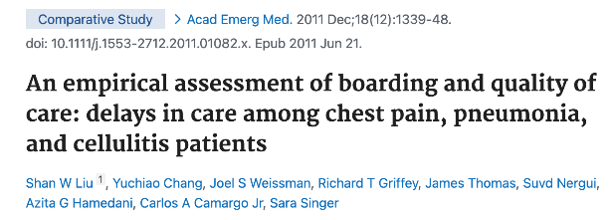



Critical care boarding
Repeat cardiac enzymes and PTTs for patients on heparin
Subsequent doses of antibiotics
Opioid pain medications
Benzodiazepines
Baclofen
Parkinson’s disease medications
Steroids
BP support (midodrine)
Clonidine
Eye drops!
Bowel regimens
Anti-platelets
Insulin
Restarting home medications
This Photo by Unknown Author is licensed under CC BY-NC
This Photo by Unknown Author is licensed under CC BY-NC
Notes:
1400 patients, boarding time at 12, 18, 24 hours
Comparison of 400 admitted not boarded, 1000 boarded patients
>70% of ED patients had no home medications restarted
Non-stastically significantly worse for antibiotics
Almost no delays to PTT/troponins, more delays on the floor
*delay > 2 hours
2004->2005

Slide 6
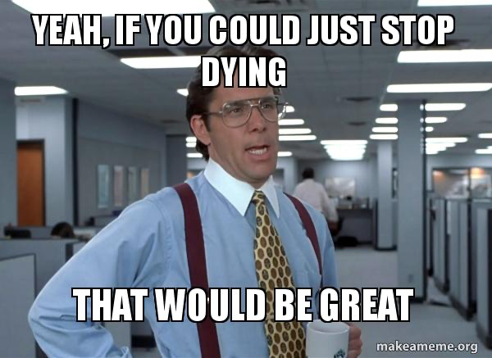
The goals of this presentation
Simple, realistic things to do to that
1.) definitely improve outcomes
2.) probably improve outcomes

Slide 7
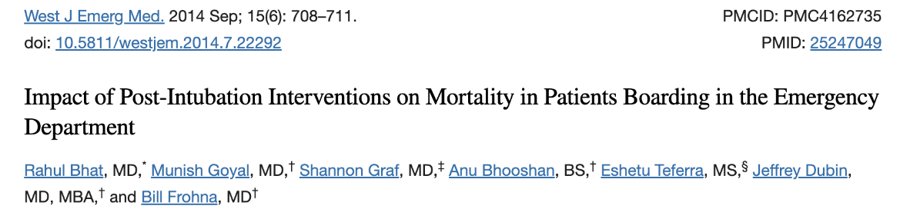
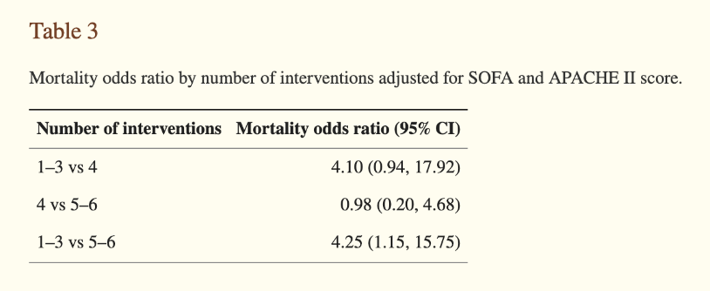
Manage the vent
Notes:
ED patients intubated in the ED and staying in the ED for >2 hours, 169 patients at large tertiary care center
Of interest, only 23.8% of patients ventilated in the ED for over seven hours had changes made to their ventilator.
We sought to determine the impact of post-intubation interventions (arterial blood gas sampling, obtaining a chest x-ray (CXR), gastric decompression, early sedation, appropriate initial tidal volume, and quantitative capnography) on outcomes of mortality, ventilator-associated pneumonia (VAP), ventilator days, and intensive care unit (ICU) length-of-stay (LOS).
The performance of a CXR and early sedation as well as performing five or more vs. three or fewer post-intubation interventions in boarding adult ED patients was associated with decreased mortality.

Slide 8
Manage the vent
Reflexively happen | Less reflexively happen
Chest x-ray post intubation | Arterial blood gas (1hr s/p intubation)
OG or NG placement | Ideal tidal volume
Early sedation | Quantitative capnography
Pick five
Mortality odds ratios
Notes:
arterial blood gas sampling, obtaining a chest x-ray (CXR), gastric decompression, early sedation, appropriate initial tidal volume, and quantitative capnography) on outcomes of mortality, ventilator-associated pneumonia (VAP), ventilator days, and intensive care unit (ICU) length-of-stay (LOS).

Slide 9
Manage the vent*
Intubate your patient
Chest X-ray
Sedation
Collect more data
ABG
Capnography
Act on the data
Titrate PEEP/FiO2
Ideal tidal volume
*This definitely improves outcomes

Slide 10
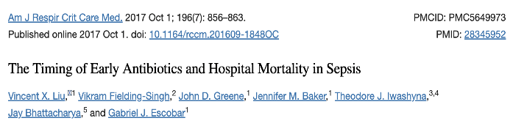
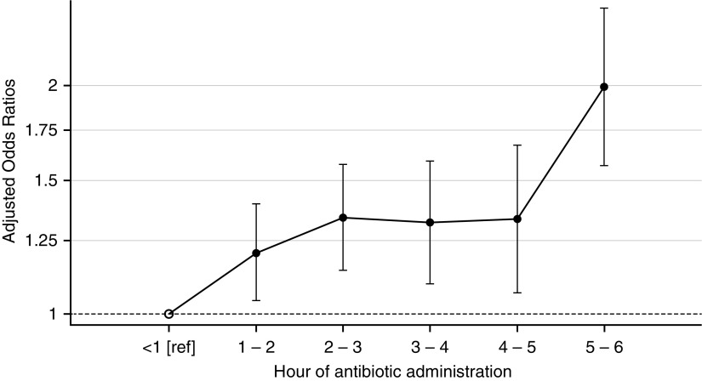
Time the antibiotics
We found that each elapsed hour between ED registration and antibiotic administration was associated with a 9% increase in the odds of mortality.
Notes:
35k inpatients with sepsis treated in EDs between 2010 and 2013

Slide 11
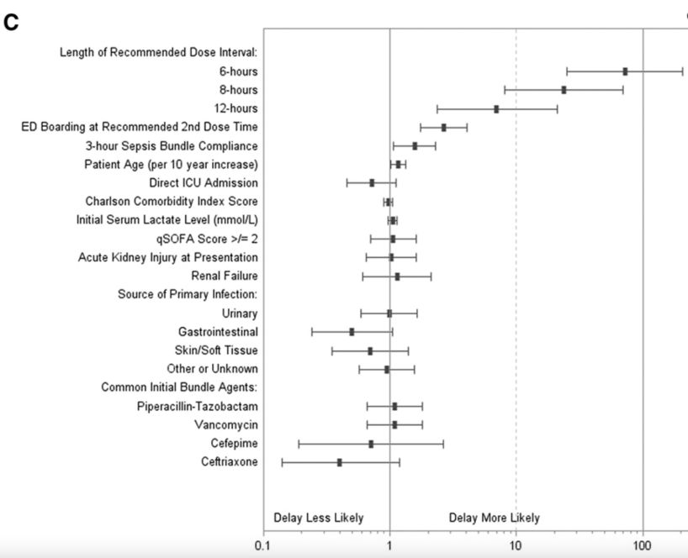
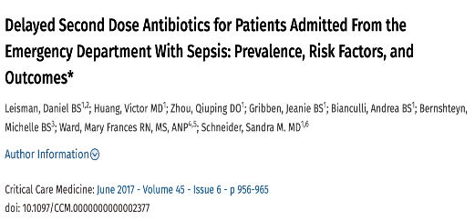
Time the antibiotics
Notes:
Study of828 patients, 33% had a major delay

Slide 12
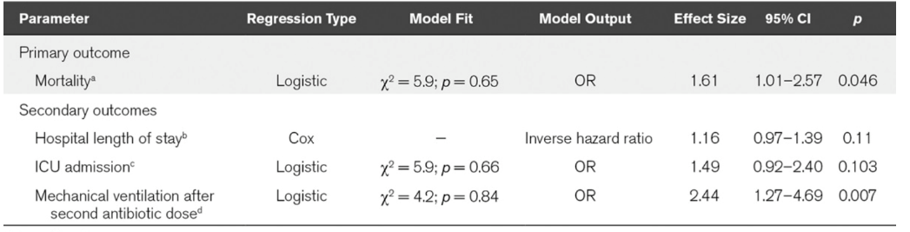
Time the antibiotics
*
*this is even more significant for patients presenting to the ED with pneumonia and septic shock

Slide 13

Time the antibiotics
50% of patients with septic shock admitted to the ICU will die in the ICU
This definitely improves outcomes

Slide 14
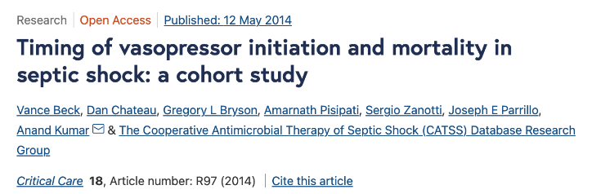
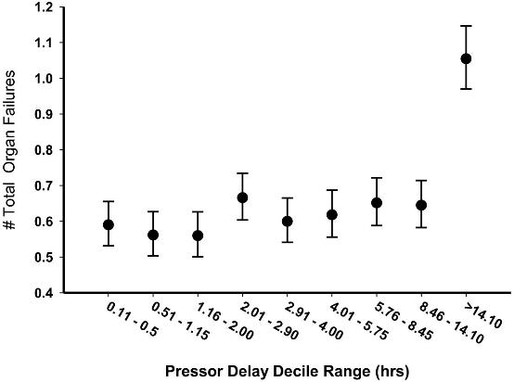
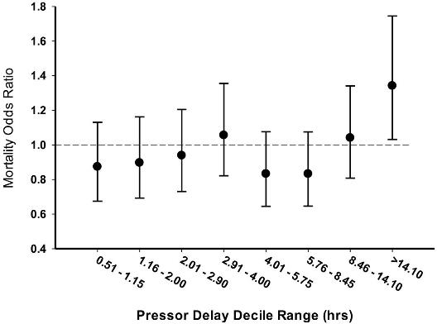
Titrate your critical care
Notes:
8,640 patients with septic shock
Delay of vasopressors after first initial documented hypotension AFTER fluid resuscitation

Slide 15
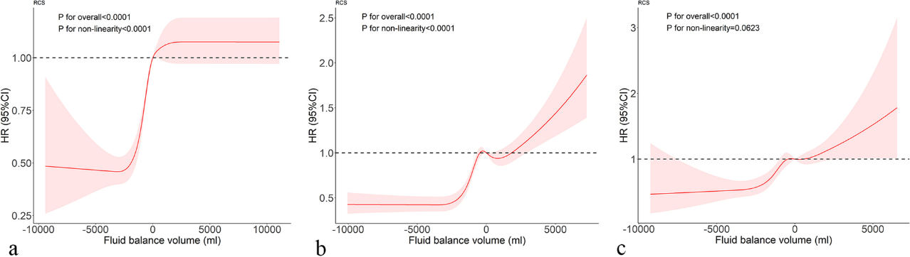
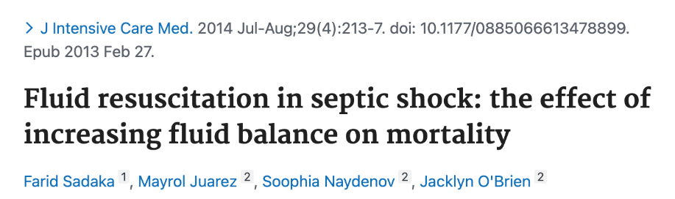

Titrate your critical care
Notes:
350 patients
First day (a)
Second day (b)
Third day ©

Slide 16

Titrate your critical care
This isn’t perfect
Don’t keep giving fluid boluses for hypotension
Stop at 30cc/kg, start pressors
*This definitely probably improves outcomes

Slide 17
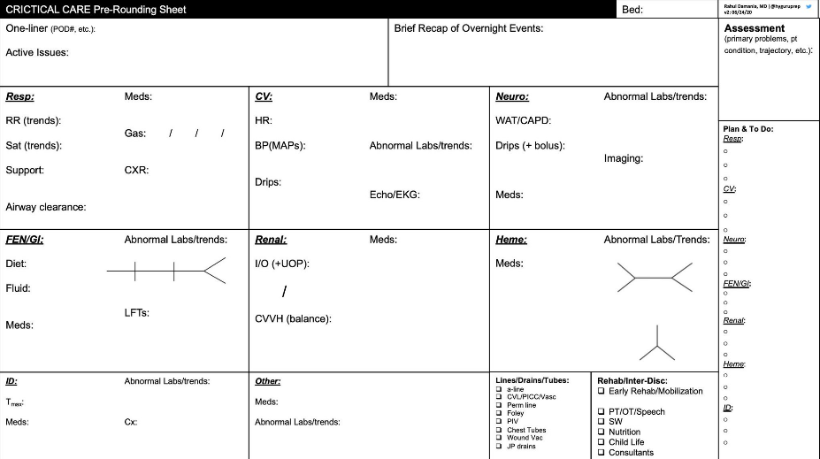
Don’t miss things

Slide 18
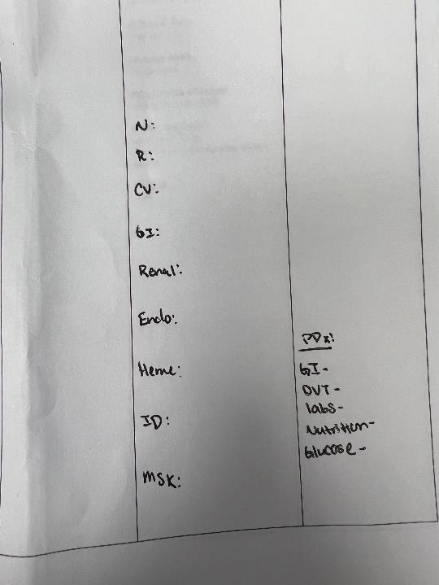
Don’t miss things
For the very complicated ICU patient, consider taking a few minutes to do a systems based sign out***
***especially for patients boarding >6hrs

Slide 19
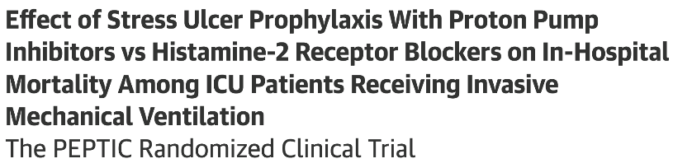
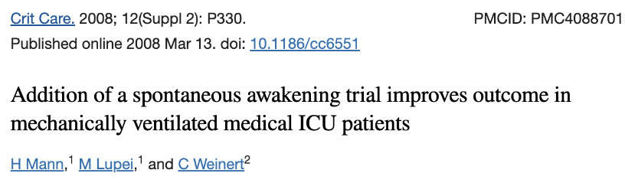
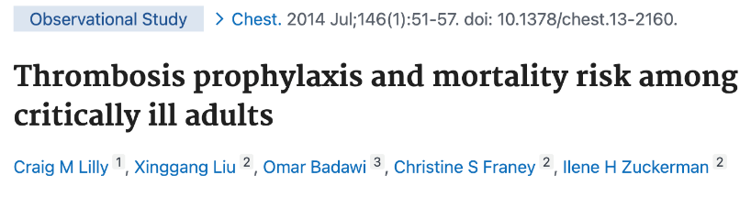
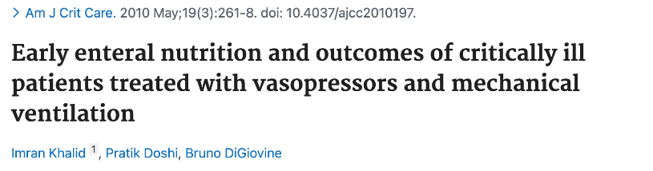
Don’t miss things
GI prophylaxis
DVT prophylaxis
Lab frequency
Nutrition
Blood sugars
SAT/SBT
HOB>30

Slide 20
Ask for help
Please.

Slide 21


Ask for help

Slide 22
The entire presentation in one slide
Critically ill ED patients show up
They board in the ED and it’s not great for anyone
You can do some things to change the outcome differences:
Time the antibiotics
Change the vent
Titrate your critical care
Don’t miss things
Ask for help

