Slide 1
Stroke & TIA in the Rural Setting
Cumara B. O’Carroll, MD, MPH
Assistant Professor of Neurology
Mayo Clinic Arizona
September 17, 2022

Slide 2
Objectives
Provide a practical, evidence-based treatment approach to TIA/stroke management
Describe the changing definition of the therapeutic window in acute ischemic stroke
Summarize novel treatment approaches:
  Endovascular intervention for Large Vessel occlusion (LVO)
  Alteplase for wake-up stroke
  Tenecteplase as a thrombolytic option
  DAPT for stroke prevention

Slide 3




64M w hx of HTN, DM presents to ED w abrupt onset R arm/leg weakness lasting 75 mins, w complete resolution. His blood pressure on arrival is 166/92. He is not on anti-thrombotics. You suspect a TIA.
Which of the following would you consider starting in this patient?
A. heparin drip
B. apixaban
C. ASA only
D. clopidogrel only
E. ASA & clopidogrel
AHA/ASA Guidelines Stroke. 2019/2021

Slide 4
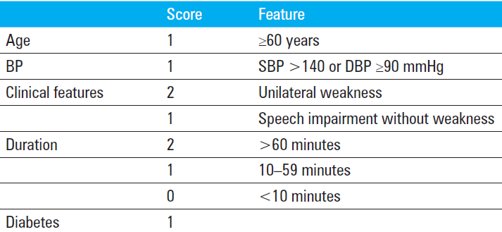
CHANCE
Clopidogrel w Aspirin in Acute Minor Stroke or TIA
Randomized 5170 pts w/in 24 hrs of minor ischemic stroke or high-risk TIA to clopidogrel & ASA x 21d vs placebo & ASA
    Clopidogrel 300 mg x1→ 75 mg/d x 90d + ASA 75 mg/d x 21d vs placebo + ASA 75 mg/d x 90d
    Minor stroke: NIHSS ≤3
    High risk TIA: ABCD2 score ≥ 4
    mRS 0-2
NEJM 2013 Jul 4;369(1):11-9.
Notes:
Clopidogrel at initial dose of 300 mg, followed by 75 mg/d for 90 days + ASA at a dose of 75 mg/d x first 21 days or to placebo + ASA 75 mg/day for 90 days

Slide 5
CHANCE
Clopidogrel w Aspirin in Acute Minor Stroke or TIA
1°outcome: stroke (ischemic or hemorrhagic) during 90 d
Results: ischemic stroke 7.9% of pts in clopidogrel–ASA grp vs 11.4% in ASA grp (HR 0.67;P<0.001)
  Rate of hemorrhagic stroke was 0.3% in each grp
Conclusion: Among pts w TIA or minor stroke who can be tx’d w/in 24 hrs after the onset of sx, the combination of clopidogrel & ASA is superior to ASA alone for reducing the risk of stroke in the first 90 days & does NOT increase the risk of hemorrhage
NEJM 2013 Jul 4;369(1):11-9
Notes:
CHANCE criticisms trial involved Chinese pts only & this population has a higher rate of stroke & more large vessel disease than USA :Limited generalizability?
polymorphisms affecting Plavix metabolism are more common in Chinese pts: Is plavix ineffective & thus lower risk of hemorrhage?
low tx of co-morbid diseases (DM, HTN) increasing stroke risk in trial population
Not as long as f/u as MATCH & charisma. How much does it matter that China has higher incidence of large artery athero? How applicable are the results to USA population? Remember China has higher rates of Plavix resistance/genetic polymorphisms that affect the metabolism of plavix.
Targeted pts at particularly high risk of recurrent ischemia & low risk of hemorrhage
High ABCD2 score, small stroke
Other trials did NOT enroll as early (w/in 24 hrs) & CHANCE suggests early intervention is important
Low tx of co-morbid diseases (DM, HTN) increasing stroke risk in trial pop

Slide 6
POINT
Clopidogrel & Aspirin in Acute Ischemic Stroke & High-Risk TIA
Randomized 4881 pts w/in 12 hrs of minor ischemic stroke or high-risk TIA to clopidogrel & ASA x 90 days vs placebo & ASA
    Clopidogrel 600 mg x1→ 75 mg/d from Day 2-90 + ASA ranged from 50-325 mg/day from Day 1-90
269 sites, in 10 countries in North America, Europe, Australia, & New Zealand (83% in the US)
1°outcome: risk of a composite of ischemic stroke, MI, or death from ischemic vascular causes (major ischemic events)
NEJM 2018 Jul 19;379(3):215-225
Notes:
Minor stroke: NIHSS ≤3
High risk TIA: ABCD2 score ≥ 4
mRS 0-2

Slide 7
POINT Results
Fewer major ischemic events occurred in clopidogrel + ASA grp (5.0%) vs ASA only (6.5%)
  HR, 0.75;95% CI, 0.59 to 0.95; P = 0.02
Fewer ischemic strokes in clopidogrel + ASA grp (4.6%) vs ASA only (6.3%)
  HR, 0.72; 95% CI, 0.56 to 0.92; P = 0.01
More major hemorrhage occurred in clopidogrel & ASA grp (0.9%) vs ASA only grp (0.4%)
  HR, 2.32; 95% CI, 1.10 to 4.87; P = 0.02
Notes:
Primary outcome was the risk of a composite of ischemic stroke, MI, or death from ischemic vascular causes (major ischemic events)
The secondary outcome of ischemic stroke occurred in 112 pts (4.6%) receiving clopidogrel plus ASA & in 155 pts (6.3%) receiving ASA alone
HR, 0.72; 95% CI, 0.56 to 0.92; P = 0.01
In a secondary analysis of the treatment effect according to time period, the benefit of clopidogrel plus ASA was greater in the first 7 days & in the first 30 days than at 90 days
In analyses of secondary safety outcomes, there were no significant differences btw groups in the rates of hemorrhagic stroke, symptomatic intracerebral hemorrhage, or other symptomatic intracranial hemorrhage considered separately
Nonfatal, nonintracranial hemorrhage accounted for most of the major hemorrhages

Slide 8
POINT Results
Benefit of clopidogrel + ASA was greater in the 1st 7 days & 30 d than at 90 d
Risk of hemorrhage w clopidogrel + ASA was greater during the period from 8-90 d than during 1st 7 d
Thus confirms (CHANCE) → limited duration of DAPT best for providing benefit while minimizing risk
Notes:
Nonfatal, nonintracranial hemorrhage accounted for most
No significant differences btw grps in hemorrhagic stroke or symptomatic ICH

Slide 9
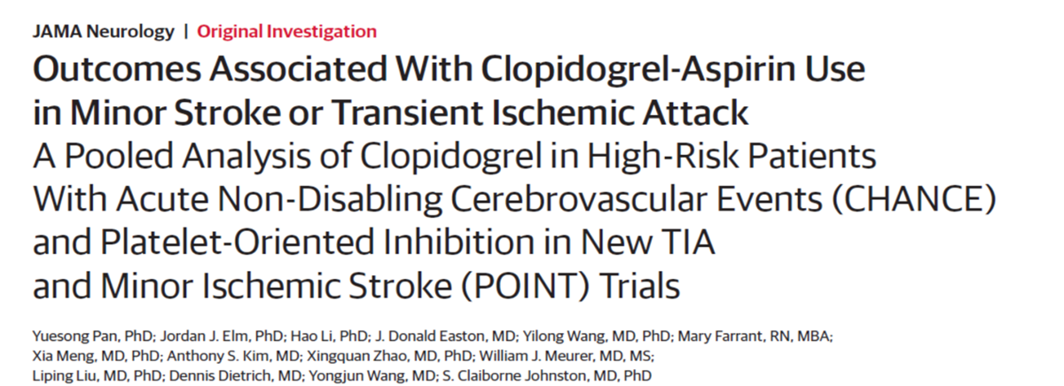
Pooled analysis of 2 RCTs: early & short-term clopidogrel-ASA was assoc w a ↓in risk of major ischemic events w/o increasing risk of major hemorrhage in pts w minor stroke or TIA
  main benefit of DAPT occurred w/in the 1st 21days
“This analysis suggests in pts w acute minor stroke or TIA, DAPT should be initiated ASAP, but preferably w/in 24hrs after sx onset & continued for a duration of 21 days”
JAMA Neurol . 2019 Aug 19;76(12):1466-1473
Notes:
Conclusion: In this analysis of the POINT & CHANCE trials, the benefit of DAPT appeared to be confined to the first 21 days after minor ischemic stroke or high-risk TIA

Slide 10
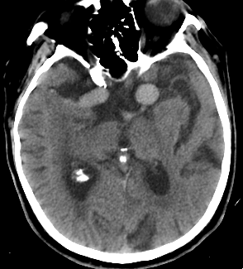
83 M w hx of CAD is seen in the ED 70 min after onset of L hemiplegia, dysarthria, & neglect, NIHSS 19. He is found to be in Afib, new diagnosis. Not on any meds. CTH w/o acute ischemia or hemorrhage, but what appear to be bilateral ICA terminus/M1 aneurysms measuring 10 & 15 mm (new dx). BP 167/89; INR, PTT, platelets wnl.
Would you administer IV tPA to this patient?
A. Yes
B. No
C. Maybe?

Slide 11
Intracranial aneurysms & tPA
For pts who are known to have a small or moderate-sized (<10 mm) unruptured & unsecured intracranial aneurysm, IV tPA is reasonable & probably recommended
Usefulness & risk of IV tPA in pts w AIS who harbor a giant unruptured & unsecured intracranial aneurysm is NOT well established
Stroke. 2018 Mar;49(3):e46-e110

Slide 12
34F presents to ED w/in 2 hrs of a thunderclap HA, neck pain, vertigo, N/V; occurring at the gym during a “squat & snatch”. Exam: R sensory loss body & incoordination of L upper & lower extremity. CT head is normal; no evidence of acute ischemic changes & no ICH. CTA head & neck reveals a vertebral artery dissection. BP 161/92. INR 1.0, PTT 27.2, platelets 256
Would you consider IV tPA in this patient?
A. Yes
B. No
Vertebral artery dissection is NOT a contraindication to receive IV tPA
Notes:
Intracranial extension of dissection is above C5 of ICA or supraclinoid or V4 level of foramen magnum of vertebral.

Slide 13
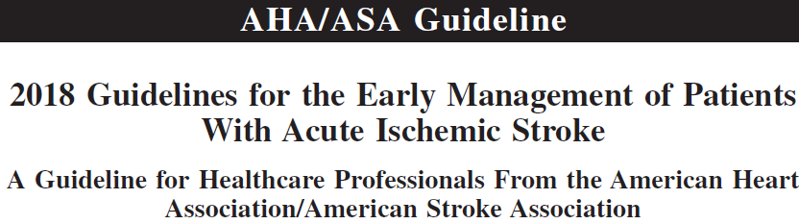
IV tPA in AIS known or suspected to be associated w extracranial cervical arterial dissection is reasonably safe w/in 4.5 h & probably recommended
Stroke. 2018 Mar;49(3):e46-e110
Notes:
Major RCTs of tPA for acute stroke did not exclude pts w dissection
effectiveness & safety of tPA in stroke 2/2 dissection is similar to pts w stroke from other causes
May theoretically cause enlargement of intramural hematoma, but effectiveness & safety of tPA for pts w ischemic stroke 2/2 dissection is similar to that seen in pts w ischemic stroke from other causes
Both IA tPA & mechanical thrombectomy are used to tx acute ischemic stroke in the setting of dissection

Slide 14
2018 AHA/ASA Guidelines
Stroke. 2018 Mar;49(3):e46-e110
 | General contraindications to IV tPA
CT | Acute ICH
 | Extensive regions of clear hypoattenuation/hypodensity
Any history of | Intracranial hemorrhage
Coagulopathy | Treatment dose LMWH within 24 hours
 | platelets <100,000/mm3, INR >1.7, aPTT >40 s, or PT >15 s
 | DOACs within 48 hours
At presentation | SAH or signs/sx consistent with SAH
 | Structural GI malignancy
 | Infective Endocarditis
 | Intra-axial intracranial neoplasm
 | Aortic arch dissection
Within 21 days | GI bleeding
Within 3 months | Prior ischemic stroke within 3 mo
 | Severe head trauma within 3 mo
 | Posttraumatic infarction
 | Intracranial /intraspinal surgery within 3 mo
Time of onset | Not recommended in pts who have unclear time &/or unwitnessed symptom onset

Slide 15
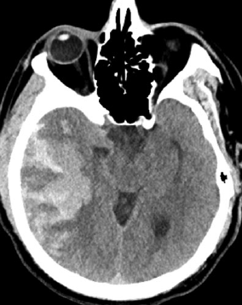
71F presents to ED 90 min after onset of L sided weakness & dysarthria. Her BP is 172/80, INR, PTT, platelets all wnl . CT head is normal w no evidence of hemorrhage. 40 mins into her IV tPA infusion she complains of severe HA & begins vomiting. Her BP is 230/110; neuro exam shows worsening L sided weakness (complete hemiplegia)
Which of the following is the most appropriate next step in treatment?
A. Stop tPA infusion
B. Cryoprecipitate
C. Obtain STAT CT head
D. Nicardipine
E. ↑ frequency neuro checks & VS

Slide 16
Management of sICH occurring w/in 24 hrs of IV tPA for AIS
Stop tPA infusion
CBC, PT (INR), aPTT, fibrinogen level, type & cross
Stat noncontrast CT head
Cryoprecipitate: 10 U infused over 10–30 min; administer additional dose for fibrinogen level of <200 mg/dL
  Fibrinogen levels should be rechecked Q 4 hrs
Tranexamic acid 1000 mg IV infused over 10 min OR ε-aminocaproic acid 4–5 g over 1 h, followed by 1 g IV until bleeding is controlled
Hematology & neurosurgery consultations
Stroke. 2018 Mar;49(3):e46-e110
Notes:
Cryoprecipitate (includes factor VIII) Supportive therapy, including BP management, ICP, CPP, MAP, temperature, & glucose control
Blood pressure monitoring Q 15 minutes
Consider repeat CT head to assess for ICH growth
Consensus decision regarding surgical and/or medical therapy
O’Carroll & Aguilar paper: Administer e-aminocaproic acid 4-5 gm IV over 1 hour, followed by 1 gm PO or IV hourly until bleeding is controlled
Fibrinogen levels should be rechecked every Q 4 hours & cryoprecipitate transfused PRN to maintain fibrinogen levels > 150 mg/dL
e-Aminocaproic acid inhibits fibrinolysis by preventing the conversion of plasminogen to plasmin and increases fibrinogen levels that are reduced in patients with SICH. Tranexamic acid is a newer analog of e-aminocaproic acid.
PCC) offers a quick way to activate both the intrinsic and the extrinsic pathways of the coagulation cascade, leading to the downstream conversion of fibrinogen into fibrin, but because r-tPA reduces fibrinogen levels, coadministration of fibrinogen to patients receiving PCC may be necessary. Importantly, the use of PCC in patients with recent ischemic stroke is associated with a low risk (approximately 1%) of thrombotic events

Slide 17
Angioedema associated with tPA
Incidence 1-2% of all tPA treated stroke
More common in pts on ACE-I
Usually starts near end of tPA infusion
Begin examining tongue 20 min before IV tPA infusion is complete & repeat several times until 20 min after tPA infusion
Look for any signs of unilateral or bilateral tongue enlargement
If angioedema is suspected….how do you manage?

Slide 18
Management of Orolingual Angioedema Assoc. w IV tPA
Stop IV tPA & hold ACEIs
Administer IV methylprednisolone 125 mg
Administer IV diphenhydramine 50 mg
Administer ranitidine 50 mg IV or famotidine 20 mg IV
If there is further increase in angioedema, admin epinephrine (0.1%) 0.3 mL SQ or by nebulizer 0.5 mL
Icatibant, 3 mL (30 mg) SQ in abdominal area; may repeat Q 6 hr not to exceed 3 doses in 24 h
Maintain airway
  Endotracheal intubation may not be necessary if edema is limited to anterior tongue & lips
  Edema involving larynx, palate, floor of mouth, or oropharynx w rapid progression (w/in 30 min) poses ↑ risk of requiring intubation
Stroke. 2018 Mar;49(3):e46-e110
Notes:
Incidence 1-2% of all tPA treated stroke; More common in pts on ACE-I; Usually starts near end of tPA infusion--Begin examining tongue 20 min before IV tPA infusion is complete & repeat several times until 20 min after tPA infusion (Look for signs of unilateral or bilateral tongue enlargement)
Awake fiberoptic intubation is optimal. Nasal-tracheal intubation may be required but poses risk of epistaxis post-IV tPA. Cricothyroidotomy is rarely needed & also problematic after IV tPA
Icatibant, a selective bradykinin B2 receptor antagonist, 3 mL (30 mg) SQ in abdominal area; additional injection of 30 mg may be admin at intervals of 6 h not to exceed total of 3 injections in 24 h; and plasma-derived C1 esterase inhibitor (20 IU/kg) has been successfully used in hereditary angioedema

Slide 19
63F w hx of HTN presents to ED w global aphasia & R hemiparesis 13 hrs after last seen normal; NIHSS 19. She lives alone & was last seen by her son at 9pm the day prior. She was found on the floor of her bedroom this AM. CT head: hyperdense L MCA, w early ischemia in the insular cortex & left frontal lobe. Her only meds are ASA & lisinopril. At baseline she is fully independent.
Which of the following is the most appropriate next step?
A. IV tPA infusion
B. Rectal ASA & admission to stroke unit
C. STAT MRI brain
D. STAT CTA/CTP

Slide 20
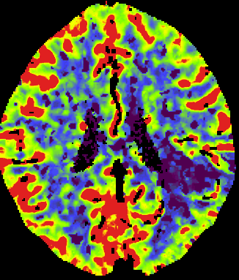
Changing Therapeutic Window for AIS
In select pts w AIS w/in 24 hrs of LKN who have a Large Vessel Occlusion (LVO) in the anterior circulation (ICA or M1) consider mechanical thrombectomy
  2018 AHA/ASA guideline recommendations
DAWN & DEFUSE-3 Trials randomized pts w LVO to thrombectomy up to 24 hrs from LKN if they had ischemic brain tissue that had not yet infarcted, as determined by CT perfusion or MR diffusion weighted imaging
  benefit in functional outcome at 90 days
NEJM 2018 Jan 4;378(1):11-21
NEJM 2018 Feb 22;378(8):708-718
Stroke. 2018 Mar;49(3):e46-e110

Slide 21
DAWN Trial
Thrombectomy 6-24 Hours after Stroke w a Mismatch between Deficit & Infarct
Randomized 206 pts w LVO presenting btw 6 -24 hrs to thrombectomy or control if they had a small infarct core in relation to their NIHSS score
  underwent CT perfusion or MR diffusion weighted imaging
demonstrated an overall benefit in functional outcome at 90 d in tx grp
  mRS score 0–2, 49% vs 13%; adjusted difference 33%
NNT 2 for lower disability
  For every 2 pts tx’d w thrombectomy, 1additional pt had better disability score at 90 d
NNT 2.8 for functional independence
  For every 2.8 pts tx’d w thrombectomy, 1 additional pt had functional independence at 90 d
NEJM 2018 Jan 4;378(1):11-21
Notes:
RG Nogueira, Uni of Pittsburgh; Thrombectomy using the Trevo. RAPID software. Rate of symptomatic ICH did not differ btw grps. Functional independence rate in thrombe grp in DAWN similar to the pooled analysis for original 5 thrombectomy trials. Func independence lower in control group than pooled analysis likely 2/2 fewer pts receiving IV tpA in DAWN.( Control tpa 14% vs 88% in pooled analysis)
Pts > 80 yrs had NIHSS >10 & a core volume < 21 mL.
Pts< 80 yrs, NIHSS >10 & a core < 31 mL or an NIHSS >20 & a core <51 mL
Data safety monitoring board recommended that the study be stopped early on the basis of a preplanned interim review of data from the first 206 patients (of a planned 500) because of benefit in the thrombectomy group
Results showed significant benefit of thrombectomy in both of the co-primary endpoints
Results showed a 2-point difference in the 90-day weighted modified Rankin Scale (mRS) score in favor of the thrombectomy group, which translated into a 73% relative reduction of dependency in activities of daily living and a number needed to treat for any lower disability of 2.0.
In addition, there was a 35% absolute increase in the number of patients achieving functional independence (mRS score, 0 to 2), with a number need to treat for this endpoint of 2.8.
The study's lead investigator, Tudor Jovin, MD, University of Pittsburgh School of Medicine, Pennsylvania, stated: "Our results show that for every 100 patients treated with endovascular therapy, 49 will have a less disabled outcome as a result of treatment, including 36 who will be functionally independent."

Slide 22
DEFUSE-3 Trial
Thrombectomy for stroke at 6 to 16 Hours w Selection by Perfusion imaging
Randomized 182 pts w LVO presenting btw 6-16 hrs to thrombectomy or control if they had ischemic brain tissue that had not yet infarcted
Trial showed a benefit in functional outcome at 90 days in treated grp
  mRS score 0–2, 45% vs 17%; P<0.0001
90-day mortality rate 14% in endovascular grp vs 26% in medical tx grp (P=0.05)
No significant difference in sICH or serious adverse events
N Engl J Med. 2018 Feb 22;378(8):708-718.
Notes:
Albers, Stanford. 38 USA centers. Rapid software
deemed eligible due to initial infarct volume under 70 mL, a ratio of ischemic tissue volume to initial infarct volume of at least 1.8, and an absolute penumbra of at least 15 ml by either CT perfusion or MRI diffusion
DAWN used somewhat narrower selection criteria, with smaller core infarctions than those in DEFUSE 3, with participants in DAWN also having more severe stroke symptoms. About 40% of DEFUSE 3 participants would not have met the DAWN selection criteria
the median from symptom onset to baseline imaging was 10 hours 29 minutes, with a quarter occurring after 11 hours 40 minutes.
In the group of 50 patients treated between 6 and 9 hours after stroke symptoms were discovered, the odds of functional independence favored thrombectomy, but not significantly so (RR 1.43, 95% CI 0.65-3.15

Slide 23
Signs of a Large Vessel Occlusion (LVO)
Aphasia
Neglect
Gaze or head deviation
Dense hemiparesis/hemisensory disturbance
Visual field cut

Slide 24
62M w hx of HTN & HLD presents to the ED at 6am after waking up w R sided weakness & dysarthria; NIHSS 7. CTH wnl, no hemorrhage & no LVO on CTA head/neck. His wife confirms he went to bed at midnight. BP 183/ 105, HR 89. Meds: ASA, atorvastatin & lisinopril.
Which of the following is the most appropriate next step?
A. STAT IV tPA infusion
B. Rectal ASA & admission to stroke unit
C. STAT MRI brain
D. STAT IV labetalol

Slide 25
WAKE-UP Trial
MRI-Guided Thrombolysis for Stroke w Unknown Time of Onset
Randomized 503 pts w unknown time of onset of stroke to either IV tPA or placebo, if ischemic lesion visible on MRI DWI but no parenchymal hyperintensity on FLAIR
  Indicated stroke had occurred w/in approx. 4.5 hrs
Favorable outcome in 53% in tPA grp vs 42% in placebo grp (OR 1.61; P=0.02)
Demonstrated benefit of IV tPA in pts w wake-up stroke using an MRI-based selection model aimed at identifying pts in the 4.5 hr window
N Engl J Med. 2018 Aug 16;379(7):611-622
Notes:
1° endpoint: favorable outcome at 90 days; mRS 0 or 1; Trial stopped early due to funding (503 of 800 planned)
Most frequent reason for an unknown time of onset of stroke symptoms was the patient had awakened from nighttime sleep with stroke sx, 89% in both grps
Median NIHSS 6 at baseline in both grps
Median stroke vol DWI: 2 ml tPA vs 2.5 ml placebo
Pts undergoing thrombectomy were excluded
Trend towards more sICH in tPA grp (2% vs 0.4%; OR 5, P= 0.15)
Trend towards more deaths in tPA grp (4% vs 1.2%; OR 3.4, P=0.07)
Parenchymal hemorrhage type 2 (ICH exceeding > 30% of infarcted area) was significantly higher in tPA grp (4% vs 0.4%; OR 10.5, p=0.03)
Trend But not statistically significant
Trial stopped early bc of discontinuation of funds, enrolling fewer pts than planned, thus limits the interpretation of the safety results because the observed trend toward a higher rate of death in the tPA group may have become significant w a larger sample size.
Despite clinical benefit of tPA, the infarct volume on MRI at 22-36 hrs was not signif different between the 2 grps. This finding is similar to the results of DEFUSE 3, in which the clinical benefit of thrombectomy. Infarct vol at 22-36 hrs was similar in the 2 grps (3ml tPA vs 3.3ml placebo)

Slide 26
AHA/ASA 2018 Guidelines
Powers et al. Stroke. 2018 Mar;49(3):e46-e110
Notes:
Favorable outcome in 53% in tPA grp vs 42% in placebo grp (OR 1.61; P=0.02)
Median mRS at 90 d, 1 in tPA vs 2 in placebo
Trend towards more sICH in tPA grp (2% vs 0.4%; OR 5, P= 0.15)
Trend towards more deaths in tPA grp (4% vs 1.2%; OR 3.4, P=0.07)
Parenchymal hemorrhage type 2 (ICH exceeding > 30% of infarcted area) was significantly higher in tPA grp (4% vs 0.4%; OR 10.5, p=0.03)

Slide 27
56M w hx of HTN, DM, HLD & tobacco presents to the ED in Tuba City AZ due to abrupt onset of R sided weakness & dysarthria 2 hrs prior. You promptly evaluate him & determine he is a candidate for IV thrombolysis; NIHSS 6, CTH: WNL, no hemorrhage; Vitals & labs WNL. You order STAT alteplase, only to be told that they do not have it, but do carry tenecteplase.
Which of the following is the most appropriate next step?
A. Administer IV tenecteplase instead
B. Transfer to the nearest stroke center for IV alteplase
C. Order a STAT CTA head & neck
D. Administer rectal ASA & recommend permissive HTN
Notes:
Alteplase binds to fibrin, converts tissue plasminogen to plasmin, which then acts to degrade fibrin in the clot (promotes fibrinolysis)
Tenecteplase is a 3-point-mutated variant of alteplase bioengineered to achieve longer half-life, higher fibrin specificity, & increased resistance towards
plasminogen activator inhibitor-1. Tenecteplase is given as a single IV bolus as opposed to the 1-hour infusion of alteplase.

Slide 28
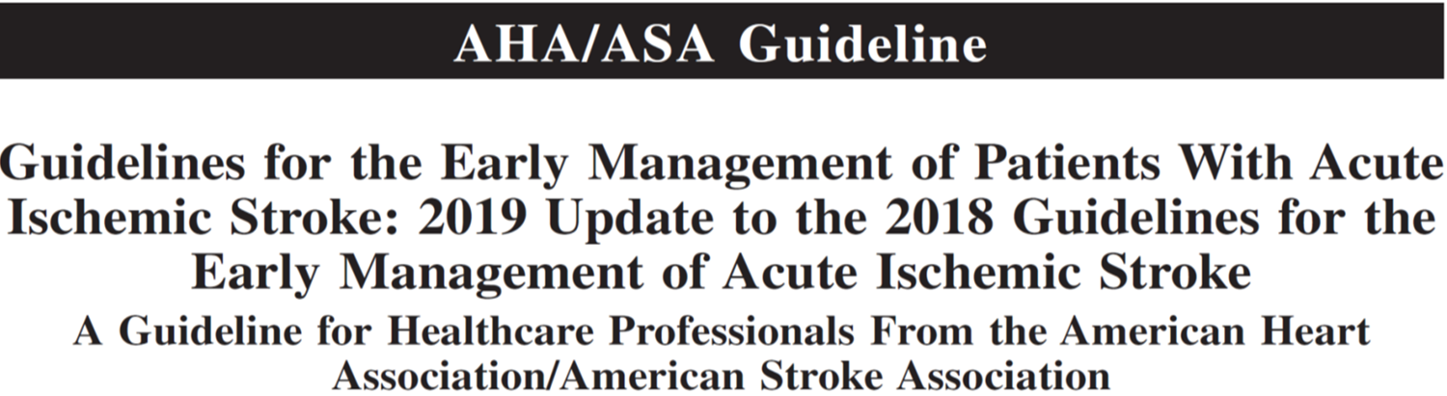
Tenecteplase administered as a 0.4-mg/kg single IV bolus has not been proven to be superior or noninferior to alteplase but might be considered as an alternative to alteplase in pts w minor neurological impairment & no major intracranial occlusion
Powers et al. Stroke. 2019 Dec;50(12):e344-e418

Slide 29
NOR-TEST (Norwegian Tenecteplase Stroke Trial)
Tenecteplase (TNK) vs alteplase (TPA) for acute ischemic stroke
Randomized 1107 pts w AIS w/in 4.5 hrs to IV TNK 0.4mg/kg vs IV alteplase 0.9mg/kg
TNK was not superior to TPA in 1°outcome mRS 0-1 at 90 d
TNK showed a similar safety profile (sICH & death)
Most pts enrolled in the study had mild stroke (NIHSS 4) & no major intracranial occlusion
  Not generalizable to pts w severe stroke
  80% pts NIHSS <7
Lancet Neurol. 2017;16:781–788
Notes:
First phase 3 RCT investigating the safety and efficacy of TNK in pts eligible for IV thrombolysis. ) 0.4mg/kg TNK previously discarded bc of safety concerns.
Max TNK is 40 mg. Also included pts who were eligible for bridging therapy before thrombectomy.
The primary outcome was achieved by 354 (64%) pts in the tenecteplase group and 345 (63%) pts in the alteplase group (OR 1·08; p=0·52).
By 3 months, 29 (5%) pts had died in the tenecteplase group vs 26 (5%) in the alteplase group.
sICH 3% tNK vs 2% tPA, OR 1.16; p=0.7
The frequency of serious adverse events was similar between groups (145 [26%] in the tenecteplase group vs 141 [26%] in the alteplase group; p=0·74).

Slide 30
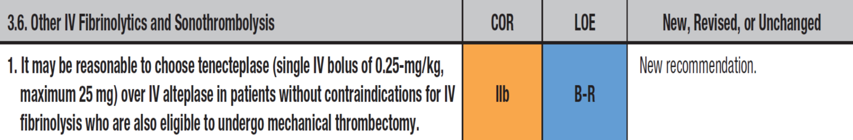
Powers et al. Stroke. 2019 Dec;50(12):e344-e418

Slide 31
EXTEND-IA TNK
TNK vs TPA before Thrombectomy for Ischemic Stroke
Randomized 202 pts w LVO to TNK 0.25mg/kg vs TPA 0.9mg/kg prior to thrombectomy & w/in 4.5 hrs of sx onset
  Median NIHSS 17
1°outcome: TNK was noninferior to TPA in restoring perfusion of >50% in the territory of artery occlusion
2°outcome:
TNK resulted in a better 90d functional outcome than TPA (median mRS 2 vs 3)
But incidence of recovery to independent function did not differ
No significant difference in sICH
N Engl J Med. 2018 Apr 26;378(17):1573-1582
Notes:
TNK max dose 25mg. Australia & New Zealand; multi-center, prospective, randomized, open-label, blinded-outcome non-inferiority trial.
Groin puncture w/in 6 hrs; median time from thrombolysis to arterial puncture was 46 min in both grps.
mRS 0-3 allowed to enroll. Higher incidence of reperfusion in TNK grp
22% in TNK grp had >50% reperfusion vs 10% in tPA grp; P=0.002 for noninferiority—Trial was powered for noninferiority, not for superiority
In an ordinal analysis of the mRS TNK resulted in a better 90d functional outcome than TPA (median mRS, 2 vs. 3; OR 1.7; P = 0.04)
There was no significant difference in the incidence of recovery to independent function (mRS of 0 to 2 or no change from baseline function) at day 90.
SICH occurred in 1% of the patients in each group

Slide 32
NOR-TEST 2, part A Trial
Aim: to establish the non-inferiority of TNK 0.4mg/kg to alteplase 0.9 mg/kg for pts w moderate to severe stroke
Randomized 1:1, pts w acute ischemic stroke presenting w/in 4.5 hr of sx onset w NIHSS ≥ 6 (median NIHSS 11)
1° outcome: mRS 0-1 at 90 days
Trial was stopped early, after enrolling only 204 pts, due to more sICH in the TNK grp compared to alteplase grp
    6% vs 1%; OR 6.57, 95% CI 0.78-55.62
TNK grp had a lower rate of a favorable outcome
    32% vs 51%; OR 0.45, 95% CI 0.25-0.80
TNK grp had a higher rate of mortality
    16% vs 5%; OR 3.56, 95% CI 1.24-10.21
Lancet Neurol. 2022 Jun;21(6):511-519

Slide 33

AcT trial
IV TNK vs Alteplase for Acute Ischemic Stroke in Canada
Randomized 1600 pts w acute ischemic stroke presenting w/in 4.5 hr of sx onset to IV TNK 0.25 mg/kg or alteplase 0.9 mg/kg
    Average NIHSS 9-10, median age 74 yrs
1° outcome: mRS 0-1 at 90-120 days
Results: IV TNK 0.25mg/kg is comparable to alteplase in terms of efficacy & safety (sICH & death)
  36.9% pts in TNK & 34.8% in alteplase grp mRS 0-1
    (unadjusted risk difference 2.1%; 95% CI 2.6 -6.9, meeting prespecified non-inferiority threshold)
  3.4% pts TNK & 3.2% in alteplase grp had sICH at 24 hr
  15.3% pt TNK & 15.4% alteplase grp died w/in 90 days
Notes:
Enrolled from 22 primary and comprehensive stroke centres across Canada
Between Dec 10, 2019, and Jan 25, 2022
Approx 25% had LVOs

Slide 34
Why consider Tenecteplase?
TNK can be admin faster, 5-10 seconds
Single bolus easier, practical benefit in transfers
TNK cheaper in most of the world
Has the highest degree of fibrin specificity & binding, thus in theory the potential to be superior in efficacy
TNK as safe as TPA
Possible better recanalization of LVO
Notes:
Tenecteplase is a 3-point-mutated variant of alteplase bioengineered to achieve longer half-life, higher fibrin specificity, & increased resistance towards
plasminogen activator inhibitor-1
EXTEND-IA TNK Part 2 looking at TNK 0.4mg/kg in pts w LVO

Slide 35
35 F who is 29 weeks pregnant & has experienced hyperemesis gravidarum is brought into the ED by her husband after the abrupt onset of “confusion” 1 hour prior. On your exam she has severe aphasia & R arm > leg weakness. NIHSS 16. BP 182/102
Which of the following is the most appropriate next step?
A. Immediately page the obstetrician on call
B. Obtain a STAT CT Head & CTA head & neck
C. Start mixing the tPA
D. Immediately page the vascular neurosurgeon on call
E. All of the above
Notes:
hemoconcentration

Slide 36
Canadian Stroke Best Practice Consensus Statement: Acute Stroke Management During Pregnancy
Diagnostic Imaging
Immediate imaging of brain & cerebrovascular system within minutes of arrival
Non-contrast CTH exposes fetus to a negligible amount of radiation
  CT of mother’s head carries fetal radiation dose exposure of 0.001mGy
  Occupational limit for fetal radiation is 5mGy; 5000x less than the allowable exposure, w negligible risks for fetus
MRI without gadolinium DOES NOT carry risk to the fetus throughout entire pregnancy, but not readily available
Int J Stroke. 2018 Oct;13(7):743-758
Notes:
mGy (milligray)
no increased risks of abortion, malformation, or other adverse pregnancy outcomes with CTH
Both CTA/CTP use IV contrast & have higher doses of radiation than a CTH.
MRI time of flight (non-contrast MR angiography or venography) can be used in place of CTA and preferred when available.
MRI at 1.5 or 3 tesla without gad does not increase fetal risk during first trimester or later
Gadolinium exposure in the 1st trimester may be associated with increased risk adverse outcomes
For breastfeeding, less than 1% of CT contrast dye is excreted in breast milk; of that, less than 1% is absorbed in infant GI tract. Continuation of breastfeeding after exposure to CT contrast dye is reasonable

Slide 37
Canadian Stroke Best Practice Consensus Statement: Acute Stroke Management During Pregnancy
IV alteplase
Decisions should be based on severity of sx, medical condition of pt, & personal values/wishes of pt & family
Tx options should be considered w an interdisciplinary team w expertise in neurology, OB/GYN, maternal-fetal med, & interventional
Limited number of case reports published
  Good clinical outcomes in all trimesters & delivery of healthy babies, w low incidence of sICH
Int J Stroke. 2018 Oct;13(7):743-758
Notes:
Generally
Risk-benefit considerations can be complex
IV alteplase is listed w FDA as pregnancy category ‘‘C’’ according to the package label, indicating ‘‘possible risk’’ only. Limited case reports (approximately 30 at time of publication) of IV alteplase in pregnancy for stroke & other conditions, but only one case of fetal demise due to abruption. Other, more common causes of fetal demise in these case reports are related to spontaneous or planned abortion which may also be related to the underlying illness.
In pregnancy, first-line medications for BP control are labetalol, methyldopa, and long acting nifedipine.
Angiotensin-converting enzyme inhibitors and angiotensin II receptor blockers—two common classes of medications used in stroke prevention—carry an increased risk of fetal complications (kidney injury) and low amniotic fluid, especially if used after the first trimester. These medications should be discontinued prior to pregnancy or as soon as a pregnancy is recognized. If they have been inadvertently taken, prompt referral to a regional center for detailed fetal structural ultrasound.

Slide 38
Canadian Stroke Best Practice Consensus Statement: Acute Stroke Management During Pregnancy
IV alteplase
Decision to administer IV tPA should be based on the maternal risks assoc. w the acute stroke
Placental abruption can occur w or w/o tPA & it is not known whether tPA increases the risk
  close monitoring important
Alteplase is a large molecule (59,000 daltons) & does NOT cross the placenta
  Not expected to pose bleeding risks to the fetus
Int J Stroke. 2018 Oct;13(7):743-758
Notes:
The safety and efficacy of IV alteplase in the early postpartum period (<14 days after delivery), especially related to risk of maternal postpartum hemorrhage, have not been well established. Case reports suggest that bleeding risk may be increased after alteplase administration & may be further increased if given following Cesarean delivery. Maternal risk of postpartum hemorrhage should be balanced with the risk of a thromboembolic event.
The literature to guide assessment of risks from epidural or spinal anesthesia after tPA administration is limited, but risks of bleeding complications may be increased.

Slide 39
Canadian Stroke Best Practice Consensus Statement: Acute Stroke Management During Pregnancy
Endovascular thrombectomy (EVT)
Pregnancy is NOT a contraindication to angiography & EVT
For pts w LVOs, proceeding directly to EVT without administering IV tPA could be considered
  If eligible & rapid access
Possible fetal risks may include radiation & contrast exposure, infections, & arterial puncture complications that could result in both maternal & fetal compromise
EVT benefits outweigh risks
Int J Stroke. 2018 Oct;13(7):743-758
Notes:
The safety and efficacy of IV alteplase in the early postpartum period (<14 days after delivery), especially related to risk of maternal postpartum hemorrhage, have not been well established. Case reports suggest that bleeding risk may be increased after alteplase administration & may be further increased if given following Cesarean delivery. Maternal risk of postpartum hemorrhage should be balanced with the risk of a thromboembolic event.
The literature to guide assessment of risks from epidural or spinal anesthesia after tPA administration is limited, but risks of bleeding complications may be increased.

Slide 40
References
Powers WJ, Rabinstein AA, Ackerson T, Adeoye OM, et al; American Heart Association Stroke Council. 2018 Guidelines for the Early Management of Patients With Acute Ischemic Stroke: A Guideline for Healthcare Professionals From the American Heart Association/American Stroke Association. Stroke. 2018 Mar;49(3):e46-e110.
Powers WJ, Rabinstein AA, Ackerson T, Adeoye OM, et al; Guidelines for the Early Management of Patients With Acute Ischemic Stroke: 2019 Update to the 2018 Guidelines for the Early Management of Acute Ischemic Stroke: A Guideline for Healthcare Professionals From the American Heart Association/American Stroke Association. Stroke. 2019 Dec;50(12):e344-e418. doi: 10.1161/STR.0000000000000211
Kleindorfer DO, Towfighi A, Chaturvedi S, Cockroft KM, Gutierrez J, et al. 2021 Guideline for the Prevention of Stroke in Patients With Stroke and Transient Ischemic Attack: A Guideline From the American Heart Association/American Stroke Association. Stroke. 2021 Jul;52(7):e364-e467. doi: 10.1161/STR.0000000000000375
Wang Y, Wang Y, Zhao X, Liu L, Wang D, Wang C, et al; CHANCE Investigators. Clopidogrel with aspirin in acute minor stroke or transient ischemic attack. N Engl J Med. 2013 Jul 4;369(1):11-9. doi: 10.1056/NEJMoa1215340. Epub 2013 Jun 26. PMID: 23803136
Johnston SC, Easton JD, Farrant M, Barsan W, Conwit RA, Elm JJ, Kim AS, Lindblad AS, Palesch YY; Clinical Research Collaboration, Neurological Emergencies Treatment Trials Network, and the POINT Investigators. Clopidogrel and Aspirin in Acute Ischemic Stroke and High-Risk TIA. N Engl J Med. 2018 Jul 19;379(3):215-225. doi: 10.1056/NEJMoa1800410. Epub 2018 May 16. PMID: 29766750; PMCID: PMC6193486.
Pan Y, Elm JJ, Li H, Easton JD, Wang Y, et al. Outcomes Associated With Clopidogrel-Aspirin Use in Minor Stroke or Transient Ischemic Attack: A Pooled Analysis of Clopidogrel in High-Risk Patients With Acute Non-Disabling Cerebrovascular Events (CHANCE) and Platelet-Oriented Inhibition in New TIA and Minor Ischemic Stroke (POINT) Trials. JAMA Neurol. 2019 Dec 1;76(12):1466-1473. doi: 10.1001/jamaneurol.2019.2531
Nogueira RG, Jadhav AP, Haussen DC, et al. DAWN Trial Investigators. Thrombectomy 6 to 24 hours after stroke with a mismatch between deficit and infarct N Engl J Med. 2018 Jan 4;378(1):11-21
Albers GW, Marks MP, Kemp S, Christensen S, et al.; DEFUSE 3 Investigators. Thrombectomy for stroke with perfusion imaging selection at 6–16 hours. N Engl J Med. 2018 Feb 22;378(8):708-718.
Ladhani NNN, Swartz RH, Foley N, Nerenberg K, et al. Canadian Stroke Best Practice Consensus Statement: Acute Stroke Management during pregnancy. Int J Stroke. 2018 Oct;13(7):743-758. doi: 10.1177/1747493018786617. Epub 2018 Jul 18.
Thomalla G, Simonsen CZ, Boutitie F, Andersen G, et al; WAKE-UP Investigators. MRI-Guided Thrombolysis for Stroke with Unknown Time of Onset. N Engl J Med. 2018 Aug 16;379(7):611-622. doi: 10.1056/NEJMoa1804355. Epub 2018 May 16
Logallo N, Novotny V, Assmus J, et al. Tenecteplase versus alteplase for management of acute ischaemic stroke (NOR-TEST): a phase 3, randomised, open-label, blinded endpoint trial. Lancet Neurol. 2017;16:781–788.
Burgos AM, Saver JL. Evidence that Tenecteplase Is Noninferior to Alteplase for Acute Ischemic Stroke. Stroke. 2019 Aug;50(8):2156-2162.
Notes:
Given the very high morbidity & mortality assoc w acute ischemic stroke due to LVO, EVT benefits outweigh risks
To date, there are 4 reported cases of women treated with mechanical thrombectomy during pregnancy, all of which occurred during the third
trimester. Second-generation devices were used in all cases. The maternal outcomes were good in three cases (mRS scores 0-1), with greater residual
disability in the fourth case (mRS 2). The pregnancy was ongoing in one published report, while 3 women delivered healthy babies. There were no cases of sICH.

