Slide 1
Cultural Safety: Bridging Historical Trauma, Trauma Informed Care and Structural Change for American Indian/Alaskan Native Healthcare
Jennifer S. Nanez, MSW, LMSW (Acoma Pueblo)
Senior Program Therapist
University of New Mexico Health Sciences
Department of Psychiatry and Behavioral Science
Division of Community Behavioral Health
jenanez@salud.unm.edu
September, 17, 2022
Notes:
EH

Slide 2




Cultural Safety
Bridging Historical Trauma, Trauma Informed Care and Structural Change for American Indian/Alaskan Native Healthcare

Slide 3
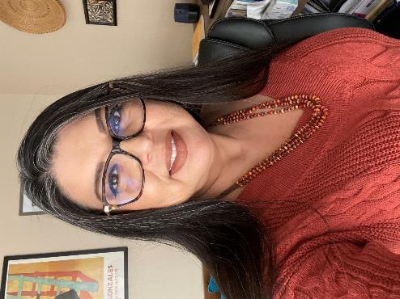
Introduction
Jennifer S. Nanez, MSW, LMSW currently serves as a Senior Program Therapist at the University of New Mexico, Department of Psychiatry and Behavioral Science, Division of Community Behavioral Health. Ms. Nanez is an enrolled tribal member of the Pueblo of Acoma, New Mexico. Ms. Nanez has been in the social work and education fields for over 25 years with an emphasis in serving the American Indian population. Ms. Nanez’s interests lie in suicide prevention and mental health treatment support, working within a healing from Historical Trauma framework.

Slide 4
Land Acknowledgement
We come to you today from the base of the San Francisco Peaks, mountains sacred to the Dine, Hopi and Pueblo peoples of New Mexico including my home, Acoma Pueblo.
We acknowledge and challenge you to remember that wherever you are sitting today, sharing in this space and time with us, you are sitting on Indigenous land, that has been taken via settler colonialism; and our sovereignty that has never been ceded. We also acknowledge this Land, this Earth, our Mother; with her two-legged, four-legged, winged ones and ones that swim—all the creatures that reside on this earth; for their caretaking and nourishment of us, and the blessing they provide us daily; and that supports our resilience through connection.
Da’waa’eh

Slide 5
Disclosures
This presenter has no financial or commercial disclosure for this presentation.

Slide 6
Recognition of Audience Today
Gratitude for your work!
High stress environment exacerbated in last two years due to COVID-19
Seeing patients often at some of the worst and most stressful moments of their lives
Seeing patients who haven’t had consistent access to care
Often working in environments with limited resources
Da’waa’eh!
Notes:
You are appreciated and you are needed!

Slide 7
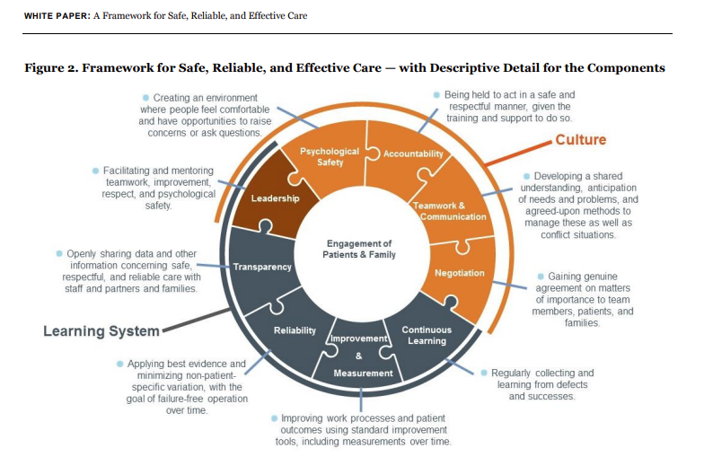
Culture of Safety in Healthcare
Frankel A, Haraden C,, et. Al (2017) outlined the framework for patient safety to improve quality in healthcare.
Notes:
So before we begin, this is not a presentation on the culture of safety in healthcare, nor does it discount it either. Many here are familiar with the framework for improving safety and healthcare service delivery, just culture and quality improvement that was developed to address safety in health. Healthcare service delivery as a culture to be examined and improved upon via learning and leadership, shared understanding and accountability.
Creation of Just Culture as well in accountability
https://hcifonline.org/wp-content/uploads/2019/04/IHI-White-Paper_FrameworkSafeReliableEffectiveCare.pdf

Slide 8
Culture of Safety in Healthcare
At the IHI’s National Forum in December 2016, Derek Feeley, President and CEO proposed six patient safety “resolutions” outlined in the 2017 white paper:
1. Focus on what goes right as well as learning from what goes wrong;
2. Move to greater proactivity;
3. Create systems for learning from learning;
4. Be humble — build trust and transparency;
5. Co-produce safety with patients and families; and
6. Recognize that safety is more than the absence of physical harm; it is also the pursuit of dignity and equity.
    This is where we can begin to examine the role of Cultural Safety as the underpinning for the Culture of Safety.
Notes:
When proposed via Institute for Healthcare Improvement in 2017, IHI’s CEO proposed 6 patient safety resolutions. The 6th is where we are going to spend some time today talking about a concept called cultural safety and how it is the underpinning for the Culture of Safety and also Trauma informed care.

Slide 9
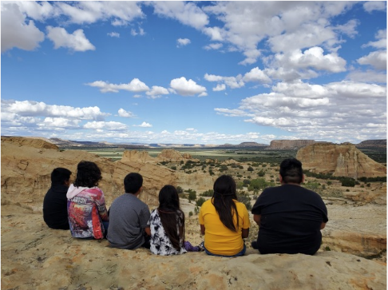
Indigenous View of Health
Relational, Collective, Familial, Inter-Generational
Anchored in Identity, Culture including historical and traditional knowledge, language, ceremony, tradition, belief, story, art
Tied to the land and environment.
Notes:
Greenwood, M and Lindsay N. (2019) A commentary on land, health, and Indigenous knowledge(s) Global Health Promotion. 2019;26(3_suppl):82-86. doi:10.1177/1757975919831262
https://journals.sagepub.com/doi/full/10.1177/1757975919831262
Before we get started, let’s first touch base on the Indigenous view of health.
Include notes by Cajete…In Indigenous ways of being, the life cycle is tied to the land, food, environment and evolved into a continuum and incorporated into itself the full body of traditional philosophy an understanding of the human place in the greater natural world. Illness was associated with a kind of disharmony with key elements of the natural environment, so the healing rituals and ceremonies involved a re-establishment of harmony. Everything in balance.
The western medical model reflects the dominant western worldview of health and healing in the United States and is based on physiology almost exclusively, and pathology specifically.. The bottom line however, is that it superseded an Indigenous health and healing system that was holistic and highly functional.
Much of modern pharmacology comes from Indigenous knowledge of plant medicine. Indigenous models of health look not just at the body, but also the heart and spirit, and whether a person is living in balance.
Indigenous lifeways and cultural traditions surrounding health and healing are often not known or misunderstood by non-Indigenous people. Therefore when an Indigenous person seeks health care from a Western medicine doctor, (who is almost always not Indigenous since only 0.3% of medical doctors in the U.S. are Indigenous) there is a great potential for misunderstanding or judgment which could lead to ineffective care and possibly a negative or even traumatic experience receiving health care. This could lead to a number of negative impacts and create more barriers to seeking and receiving health care in the future.
Indigenous people are certainly not the only ones who experience being misunderstood and discriminated against in the health care setting. Unfortunately, this is a common occurrence, particularly by those from marginalized populations.

Slide 10
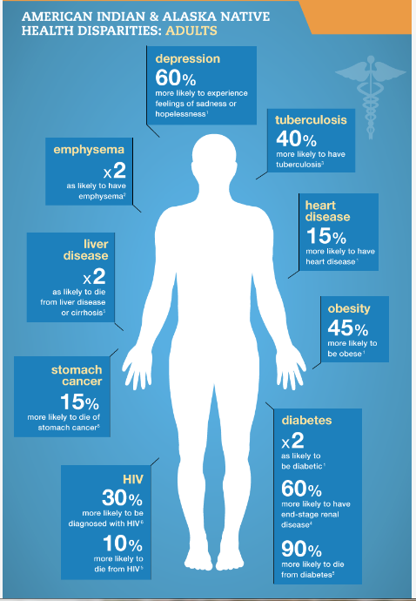
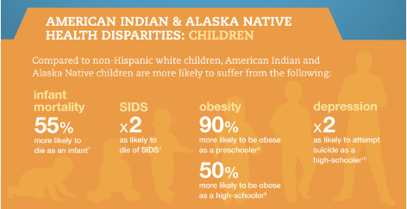
Disparities in AI/AN health are well documented.
Indigenous health post colonization has been influenced by histories of trauma, policy and institutional betrayals.
http://familiesusa.org/sites/default/files/product_documents/HSI-Health-disparities_american-indian-infographic_final_0.png
Notes:
However in today’s time, American Indian and Alaskan Native health disparities are well documented and have been influenced of course by histories of trauma, policy, legislation, funding shortages and institutional betrayals.

Slide 11
Role of Historical Trauma
Historical Trauma is defined as: The cumulative emotional and psychological wounding over the lifespan and across generations, emanating from massive group trauma
Historical trauma response: can include suicidal thoughts and acts, IPV, depression, alcoholism, self-destructive behavior, low self-esteem, anxiety, anger, and lowered emotional expression and recognition
Notes:
Historical Trauma plays a role in these health disparities in the present day. Dr. Braveheart in research defined historical trauma response as the constellation of features in response to HT that can include suicidal thoughts and acts, interpersonal violence, depression, substance use, self destructive behaviors. As we know, trauma itself contributes to overall negative health outcomes.
https://academic.oup.com/sw/article/62/1/37/2447839

Slide 12

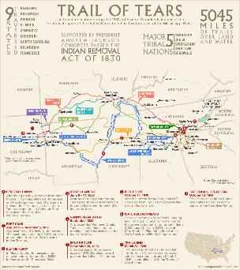
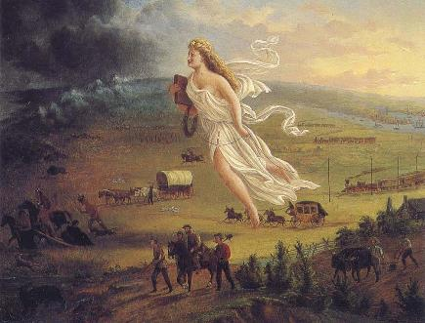
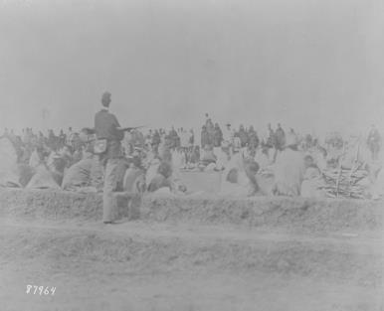
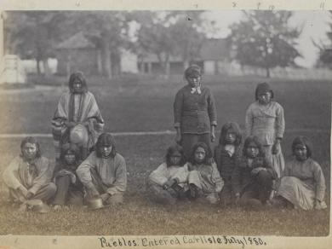
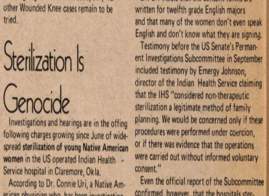
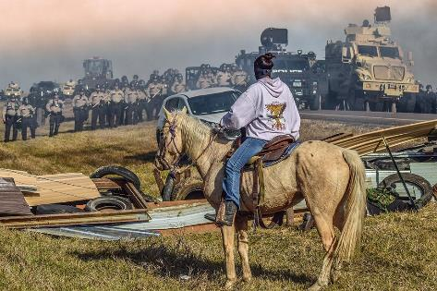
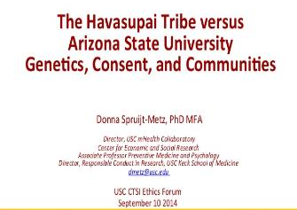
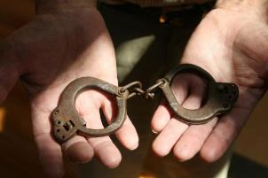
Notes:
Examples of trauma events across history to present day

Slide 13
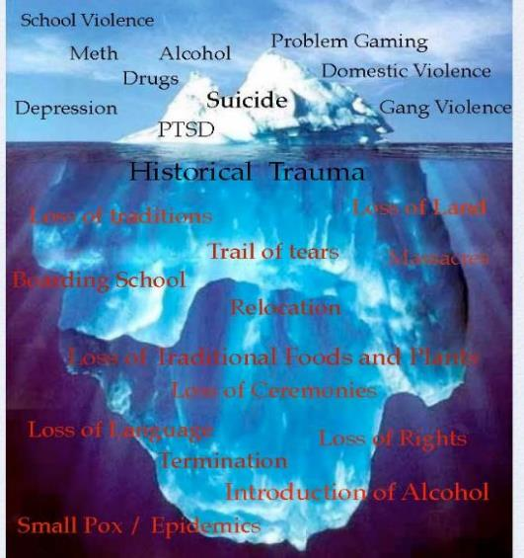
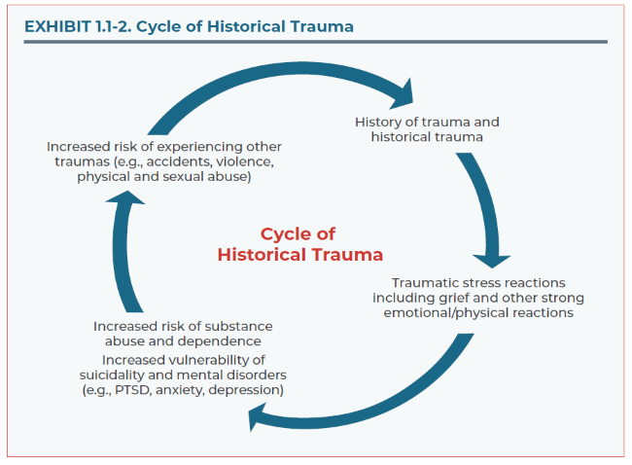
Notes:
SAMHSA TIP 61
https://store.samhsa.gov/system/files/tip_61_aian_full_document_020419_0.pdf
The first graphic depicts the cycle of historical trauma beginning with a history of historical trauma leading to traumatic stress reactions including grief and other strong emotional and physical reactions; leading to increased risk of substance abuse and dependence and increased vulnerability of suicidality and mental disorders; leading to increased risk of experiencing other traumas.
The second graphic imagines the issues of today such as school violence, drug use, alcohol use, domestic violence, gang violence, suicide and PTSD like the top of an iceberg; with the root of the iceberg being Historical Trauma and the events, policies and trauma that contributed to Historical Trauma.
Examining the cyclical nature of trauma, those trauma and stress reactions often seek coping strategies, such as substance use, aggression, violence, depression, self harm; in turn exposing others to traumas.
So what we see reflected in the data, is also rooted in this historical context of trauma.

Slide 14
Historical Oppression
McKinley and colleagues (2017) posit that Historical Trauma does not fully explain the pervasive and chronic oppression that Indigenous populations continue to experience,
The concept of historical oppression is described as
  “the chronic, pervasive, and intergenerational experiences of oppression that, over time, may be normalized, imposed, and internalized into the daily lives of many Indigenous peoples (including individuals, families, and communities)”
Historical oppression includes both historical and contemporary forms of oppression
McKinley and colleagues (2017) posit that Historical Trauma does not fully explain the pervasive and chronic oppression that Indigenous populations continue to experience,
The concept of Historical Oppression is described as
  “the chronic, pervasive, and intergenerational experiences of oppression that, over time, may be normalized, imposed, and internalized into the daily lives of many Indigenous peoples (including individuals, families, and communities)”
Historical oppression includes both historical and contemporary forms of oppression
Notes:
However, a critique of HT is that it does not fully explain the pervasive and chronic oppression experienced by Indigenous populations. The concept and theory of Historical Oppression examines HT in a socio-ecological framework, viewing the systems that impose oppression knowingly and unknowingly.

Slide 15
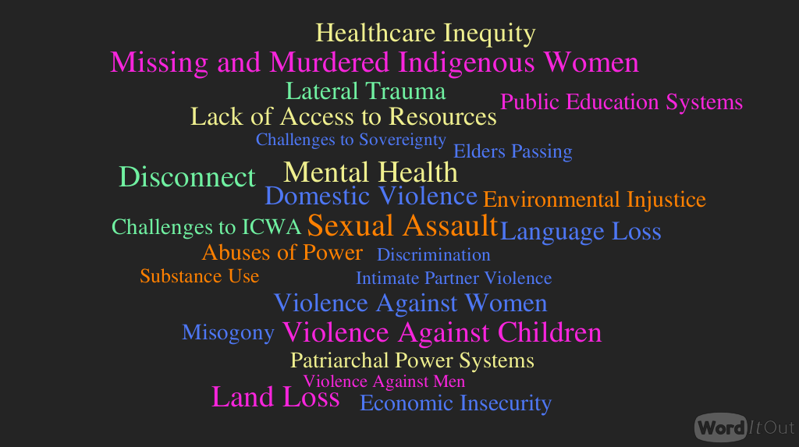
Notes:
Current stressors, traumas and challenges and oppression.

Slide 16
What is Trauma informed care:
Trauma-Informed Care (TIC) is an approach in the human service field that assumes that an individual is more likely than not to have a history of trauma.
Trauma-Informed Care recognizes the presence of trauma symptoms and acknowledges the role trauma may play in an individual’s life.
On an organizational or systemic level, Trauma-Informed Care changes organizational culture to emphasize respecting and appropriately responding to the effects of trauma at all levels.
Notes:
University of Buffalo, School of Social work: http://socialwork.buffalo.edu/social-research/institutes-centers/institute-on-trauma-and-trauma-informed-care/what-is-trauma-informed-care.html
So let’s segue for a moment to Trauma informed care. Trauma informed care recognizes the role trauma can have, an emphasizing appropriately responding to trauma at all levels.

Slide 17
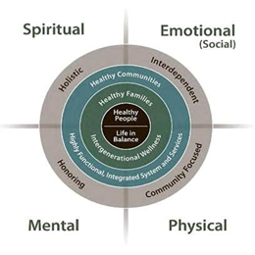
Historical Trauma Informed Care
Historical Trauma Informed Care includes integration of recognition of tribal culture and history and the impact up to the present. Both must be incorporated in assessment, rapport building and treatment approaches.
Notes:
Historical Trauma informed care includes the recognition of our history, of trauma and the historical context of that trauma and the impact up to the present.

Slide 18
CULTURAL SAFETY
Structural systemic change and Indigenous lens
Notes:
So with that basis in mind, let’s shift perspective to this idea of cultural safety.

Slide 19
Origins of Cultural Safety
Developed in 1989 by Irihapiti Ramsden, A Maori nurse researcher.
Ramsden wrote: “Maori people no longer accept that our world is a perspective on the reality of anyone else. We have our own whole, viable, legitimate reality…We insist we are not a perspective”
“This leads to the question of choices in service delivery. The data on Maori mortality and morbidity and empirical experience has made it quite clear…The health service is not and has not ever been culturally safe for Maori people.”
“The service has not been designed to fit the people, the people have been required to fit the service”
Notes:
Our perspective of health and experiences of health care treatment are not a perspective but our legitimate reality and therefore valid.
As Ramsden states, the service has not been designed to fit the people—meaning westernized medicine—the system in which dominates healthcare service delivery globally—has never been developed from an Indigenous view or lens. We are shoehorned into the system, and the system causes harm.

Slide 20
Moving towards Cultural Appropriate Treatment
Cultural Awareness
Cultural Sensitivity
Cultural humility
Cultural Competence
Incorporates a lifelong commitment to self-evaluation and self-critique; to redressing the power imbalances in the patient-physician dynamic. Entails life long learning along with respectful, inquisitive approach where practitioners seek knowledge from their clients regarding their cultural and structural influences
Acknowledges and incorporates the importance of culture and vigilance towards the dynamics of differences, the expansion of cultural knowledge and the adaptation of services to meet culturally unique needs.
Building on the awareness of difference through cultural acceptance, respect and understanding
A beginning step towards understanding that there is difference.
Curtis, E., Jones, R., Tipene-Leach, D. et al. (2019)
Notes:
Jennifer
Curtis, E., Jones, R., Tipene-Leach, D. et al. Why cultural safety rather than cultural competency is required to achieve health equity: a literature review and recommended definition. Int J Equity Health 18, 174 (2019). https://doi.org/10.1186/s12939-019-1082-3
We are also familiar with the efforts towards increasing “cultural competence’ through cultural sensitivity and cultural humility.

Slide 21
Moving towards Cultural Appropriate Treatment
Cultural Awareness
Cultural Sensitivity
Cultural humility
Cultural Safety
Cultural Competence
Legitimizes and values cultural differences to ensure no harm is caused and ultimately links understandings and actions
Incorporates a lifelong commitment to self-evaluation and self-critique; to redressing the power imbalances in the patient-physician dynamic. Entails life long learning along with respectful, inquisitive approach where practitioners seek knowledge from their clients regarding their cultural and structural influences
Acknowledges and incorporates the importance of culture and vigilance towards the dynamics of differences, the expansion of cultural knowledge and the adaptation of services to meet culturally unique needs.
Building on the awareness of difference through cultural acceptance, respect and understanding
A beginning step towards understanding that there is difference.
Curtis, E., Jones, R., Tipene-Leach, D. et al. (2019)
Notes:
Jennifer
Curtis, E., Jones, R., Tipene-Leach, D. et al. Why cultural safety rather than cultural competency is required to achieve health equity: a literature review and recommended definition. Int J Equity Health 18, 174 (2019). https://doi.org/10.1186/s12939-019-1082-3
We are also familiar with the efforts towards increasing “cultural competence’ through cultural sensitivity and cultural humility.

Slide 22
Definition of Cultural Safety
Cultural Safety is:
an outcome based on respectful engagement that recognizes and strives to address power imbalances inherent in the health care system.
Safety is defined by those receiving care, not by those who provide it.
Cultural Safety encompasses cultural humility, but also considers those historical timelines, trauma histories, inequities, and takes on an active social justice and health justice stance.
It is inherently actively Anti-Racist in its basis.
It examines the aspects of constructs that impact health outcomes; actively transfers power to the patient and seeks to create systems that support safety and equity.
Notes:
Cultural safety as a concept and framework seeks to rectify that by allowing those who receive the care, the population served, to define what safety and safe care feels like, looks like, acts like, and engages like for them, with them and by them when available.
It is anti-racist in its core, structured around conscious efforts and actions to provide equitable inclusive collaborative care.

Slide 23
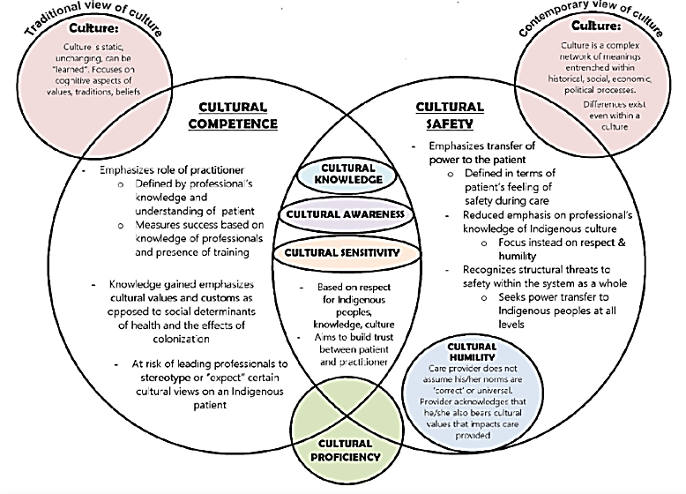

Slide 24
Health Equity and Cultural Safety
Shifting power

Slide 25
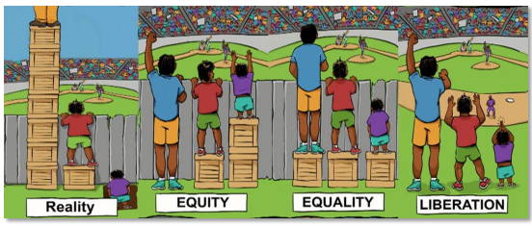
Notes:
So let’s segue for a moment to equity. We are all familiar with these graphics that depict equity vs equality vs reality---and challenge us to look at what liberation means in tearing down barriers.
https://eohhs.ri.gov/sites/g/files/xkgbur226/files/2021-03/Equity-Council-Progress-deck-091620.pdf

Slide 26
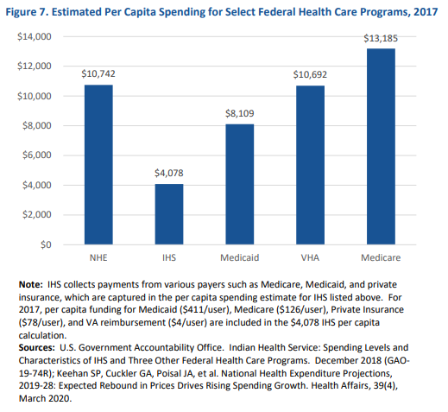
Notes:
But inequity is baked into systems at a systemic level. We often as Indigenous populations here in the US point the finger at I.H.S for inadequate care. And examples like this shows the dollar per capita spent on AI/AN healthcare is vastly smaller than other healthcare systems or payor such as medicare or the VA. Yet the budget for I.H.S. is determined annually by Congress. Despite years of lobbying, years of evidence showing poor outcomes, the funding levels have remained fairly static.
2010 workgroup example;; total estimated budget for 100% of need phased in over 10 years (present day 2022) was placed at 21.2 Billion dollars. With inflation if we were at 100% of funding today that dollar amount would likely be nearly 2x that amount. Yet current administration awarded 9B for the I.H.S.

Slide 27
American Indian and Alaskan Native Emergency Medicine and Emergency Departments
In 2014, researchers undertook a profile of the Indian Health Service system Emergency Departments.
  40 Eds (both I.H.S and 638) serving 574 Tribes.
  24 reporting as part of the survey
Bernard et all (2017) find that only 85% of EDs within the I.H.S System had 24 hour coverage and only 13% were board certified or board prepared in emergency medicine
Small and midsized EDs were more likely to be staffed with nonboard-certified or nonboard-prepared emergency physicians compared with larger-volume centers.
Bernard et al note that it is incumbent on the “Indian Health Service, local hospital leadership, and emergency medicine governing bodies to ensure that these providers are capable of delivering high-quality evidence-based ED care.”
Most interventions to improve ED staffing and quality will depend at least in part on improved revenue for Indian Health Service hospitals.
Notes:
AI/AN serving ED’s are also placed at a disadvantage by this same baked in inequity.

Slide 28
Health Equity and COVID
Trembley (2021) writes “It has been suggested that the Covid-19 is not a pandemic, but a ‘syndemic’, i.e. an epidemic that spreads synergistically with pre-existing inequitable social conditions (Horton, 2020).
In the case of Indigenous populations, this syndemic is the result of the overlay of the Covid-19 pandemic on patterns of vulnerability established by systemic racism and colonialism.”
Notes:
COVID was the perfect storm in highlighting inequity in healthcare and really all systems that interact with Indigenous populations nationwide including education, economic systems, housing, transportation, digital, etc. So Trembley notes that in reality, beyond a pandemic, for populations of color, but for especially Indigenous populations, COVID was and is a syndemic.
Cultural safety: a key concept for health promotion in times of Covid-19 and systemic racism ‘syndemic’

Slide 29
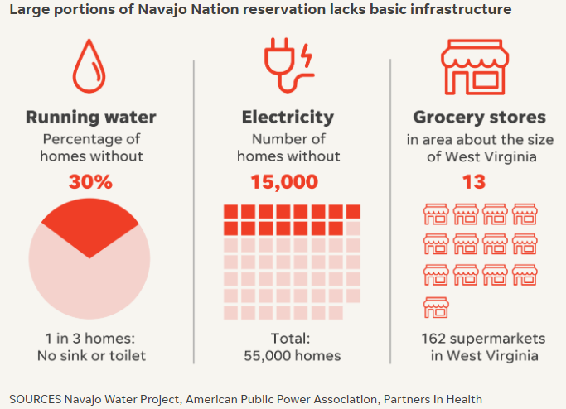
Notes:
A few examples..
https://www.usatoday.com/in-depth/news/nation/2020/10/20/native-american-navajo-nation-coronavirus-deaths-underfunded-health-care/5883514002/
Structurally we also see in Tribal communities, access issues for basic needs, fresh water, electricity, housing.

Slide 30
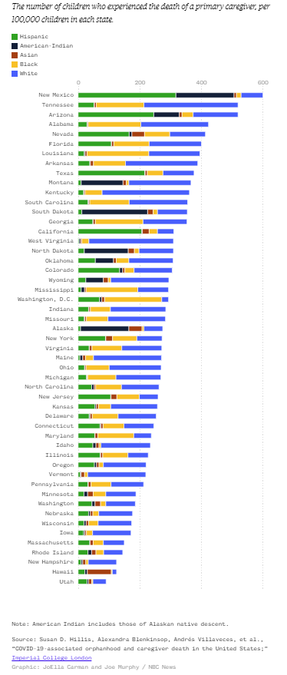
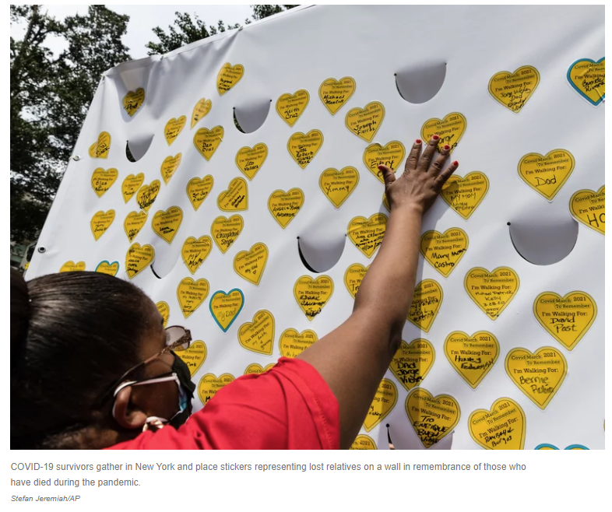
Notes:
At the end of 2021, 1 in 168 American Indian children lost a parent or caregiver to COVID from the onset of the syndemic. The rate is 3.5 times larger than the rate of losses for white children. And as a reminder AI/AN population as a whole makes up only 2% over the overall us pop.
In NM, of all the children who lost a parent or caregiver to COVID, 39% are American Indian. NM and AZ are 1 and 3 in the top five of childhood parental or caregiver loss.

Slide 31
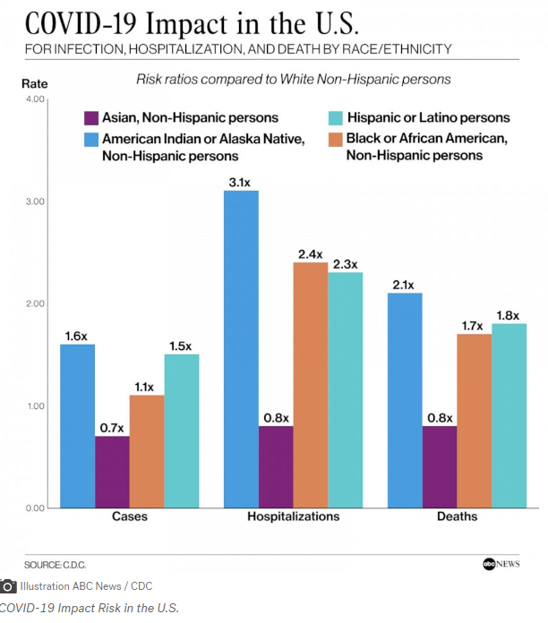

Slide 32
Examines and confronts Structural Violence in systems of care and creates equitable access
Examines and confronts institutional betrayal in systems of care.
Cultural Safety
Historical Trauma Informed Care
Trauma Informed Care
Examines and confronts power differentials and creates space free from judgement, racism, stereotyping
Examines and confronts implicit bias
Centers cultural connection as supportive and cultural knowledge of a patient as valid and important to healing
Historic and Gender Issues
Understands historical context of population and historical context of care including hurtful or detrimental issues in care.
Collaboration and Mutuality
Empowerment and Choice
Working in collaboration with a patient versus Working on.
Safety
Peer Support
Sees care in the context of the impact of trauma and the need for safety and connection
Trustworthiness/Transparency
Notes:
We can think about Cultural Safety as the underpinning of Trauma informed care. Cultural safety that actively examines social, economic, political, and power differentials in healthcare. The emphasis is not on cultural competence, but rather on the various facets of society, history, and views of gender that impact health outcomes. We seek to make every effort to understand our patient or client’s reality as deeply as possible.
We can think of it in this way
If we are providing service in a culturally safe manner by examining and confronting Structural Violence, Institutional betrayals, implicit bias and power differentials;
And work from an historical trauma informed care stance understanding the historical context of the population, and even the historical context of the care provided to the population, centering culture and connection as supportive, then we can truly work within a Trauma informed system, seeing care in the context of systems, history, policy and need for safety and connection.
We work in collaboration with the patient, versus working on.

Slide 33
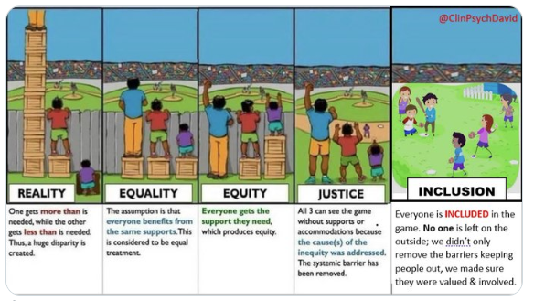
Notes:
Came across this adaptation by Dr. David Murphy, clinical psychologist and professor, University of Plymouth

Slide 34
Why does Cultural Safety matter in Emergency Medicine?
Health disparities in American Indian and Alaskan Native populations are well known and long documented.
Less is known about specific disparities for AI/AN population treatment in EDs
Owens, Hons, et al (2020) Conducted a scoping review of the literature on disparities in care in ED’s for both the US and Canada from 1990 to 2018
After review of 453 records screened, 83 studies were included and were clustered for analysis by ED Process
  Triage
  Wait times
  Analgesia
  Diagnosis
  Treatment
  Leaving without being seen (LWBS)/ Leaving against medical advice (AMA)
  Patient experiences

Slide 35
Why does Cultural Safety matter in Emergency Medicine?
25 studies found differences between racial and ethnic minority groups on at least one diagnostic process for testing and treatment for chest pain, asthma, psychiatric disorders, gastro complaints, trauma and stroke.
4 studies found LWBS/AMA more likely in minority groups than majority group patients. Minority patients Other than Indigenous patient were Not more likely that their white counterparts to LWBS after controlling for insurance status.
  AI/AN children have higher rates of leaving ED’s without complete evaluation or care.
2 studies analyzed patient trust in ED providers. Both found non-white patients had lower trust scores for providers than white patients.
Owens, Hons, et al (2020) found:
7 Studies for triage scores found differences between racial and ethnic minority v. majority culture despite similar presenting complaints or pain ratings
12 studies examined waiting times, and 11 found minority groups waited longer on average to be assessed than white patients
24 studies in analgesic admin. 15 of 24 found differences in analgesic admin between racial and ethnic groups. 6 studies found minorities were less likely to receive any analgesics compared to the majority culture.
Notes:
Essentially, all studies included in the review criteria found bias in treatment of minority populations in ED visits.

Slide 36

Cultural Safety creates safe care
Individuals seeking care are coming sometimes at the most vulnerable moments of their lives.
Yet perceptions of biases, power differentials, and history of betrayals in care keep our relatives from sharing information about their health struggles
  And their loss of health can create trauma
Creating safe, respectful spaces for healthcare can create generations of impact

Slide 37
Operationalizing Cultural Safety: Turning to our Relatives for support.

Slide 38
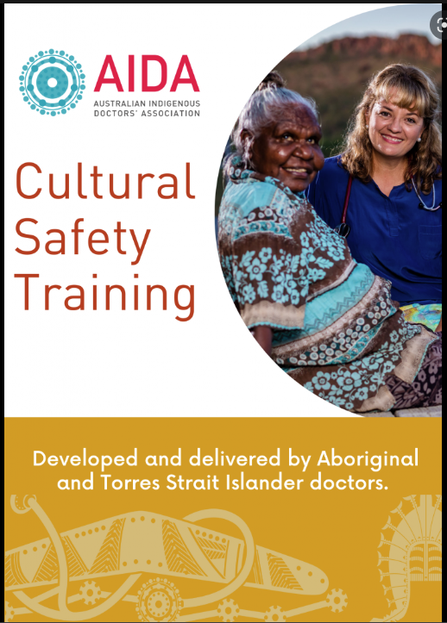
Notes:
Australia, origination of Cultural Safety

Slide 39
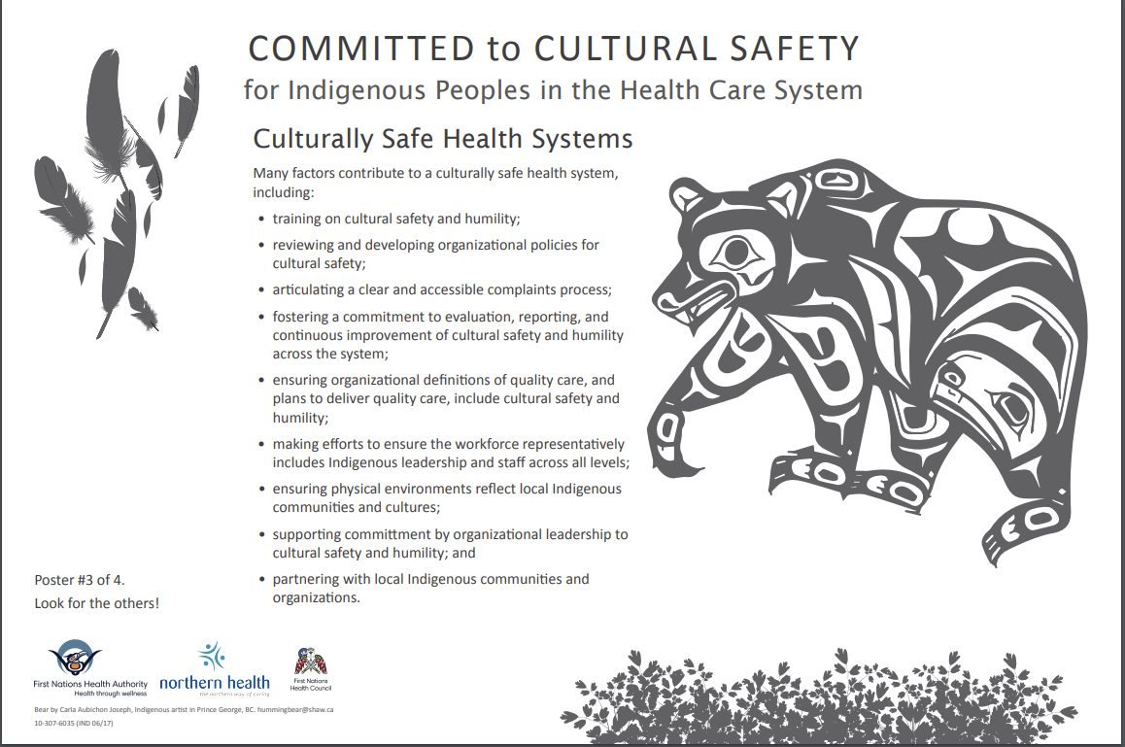
Notes:
https://www.indigenoushealthnh.ca/sites/default/files/2017-06/Posters-Cultural-Safety.pdf
Example from Northern Health, British Columbia

Slide 40
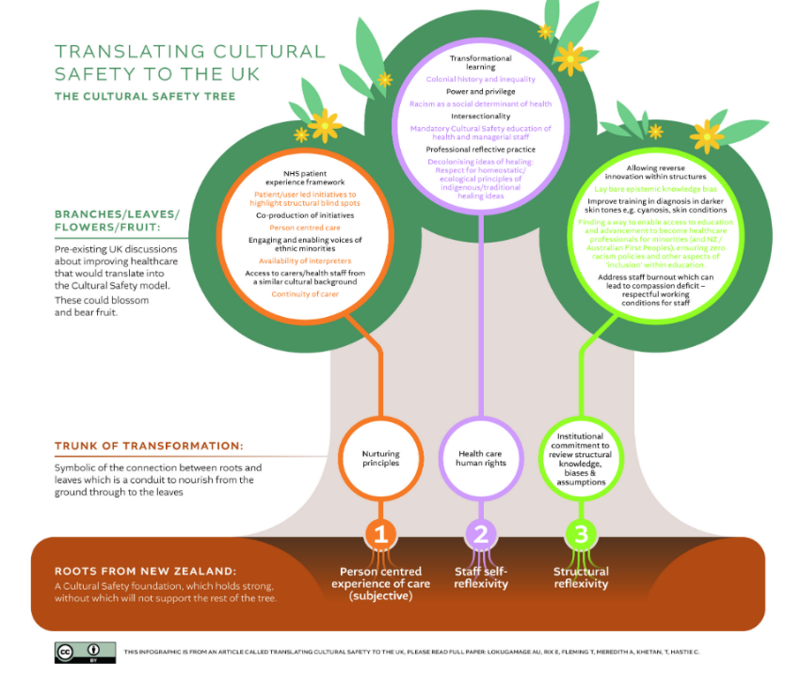
Notes:
https://blogs.bmj.com/medical-ethics/2021/07/22/what-is-cultural-safety-and-how-could-it-dissolve-structural-racism-in-the-uk/
Adaptation in the UK

Slide 41
Operationalizing Cultural Safety: Turning to our Relatives for support.
Dell, Firestone et al (2015) draw on previous work in Canada and Australia to pose four overarching principles and possible resulting actions to address cultural safety in ED care.
  The patient’s way of knowing and being is valid
  The patient is a partner in the healthcare decision making process
  Recognize the impact of complex intergenerational traumas on health and access to health services
  The patient determines whether the care they have received is culturally safe
The Canadian Association of Emergency Physicians (2021) worked to develop 16 recommendations to address racism/colonialism and create cultural safety in emergency medicine focusing on four areas:
  Patient care
  Hospital and departmental commitment to Equity, Diversity and Inclusion through incorporation in patient safety and quality improvement measures and patient reported outcome measures
  Physician advancement measures
  Professional development and medical education

Slide 42
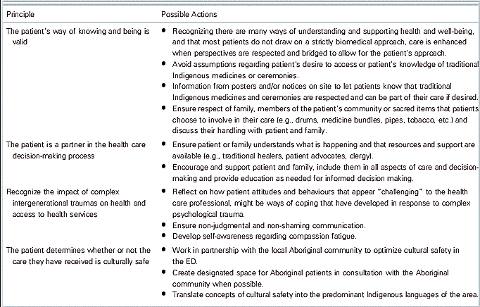
Operationalizing Cultural Safety: Turning to our Relatives for support.
Notes:
Dell, E., Firestone, M., Smylie, J., & Vaillancourt, S. (2016). Cultural Safety and Providing Care to Aboriginal patients in the Emergency Department. CJEM, 18(4), 301-305. doi:10.1017/cem.2015.100

Slide 43
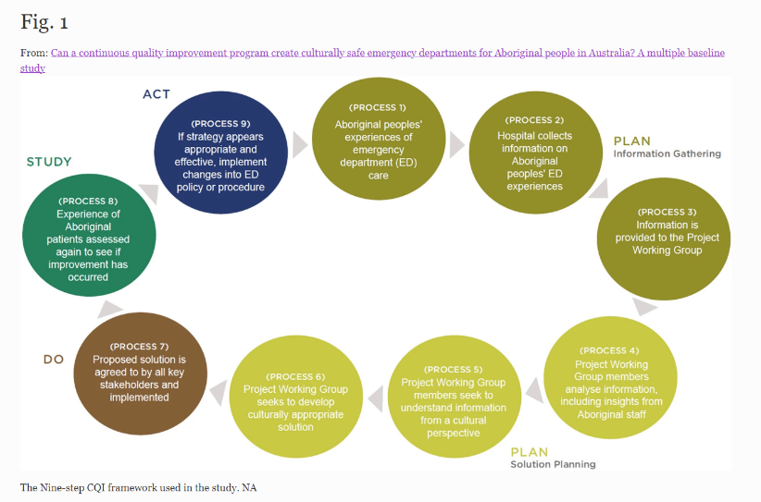
Operationalizing Cultural Safety: Turning to our Relatives for support.
Gadsden, Wilson, et al. (2019) utilized a Continuous quality improvement program (PDSA) to examine cultural safety improvement in EDs.
Notes:
Gadsden, T., Wilson, G., Totterdell, J. et al. Can a continuous quality improvement program create culturally safe emergency departments for Aboriginal people in Australia? A multiple baseline study. BMC Health Serv Res 19, 222 (2019). https://doi.org/10.1186/s12913-019-4049-6
Studying Aboriginal peoples experience of ED care. Information gathered, analyzed, presented to stakeholders, implemented solution, restudied experience based on intervention.

Slide 44
Intersection of Cultural Safety, Trauma Informed Care and Culture of Safety.
CULTURE OF SAFETY: how we create safety in healthcare service delivery in the day to day processes and procedures (Service Delivery Change)
HISTORICAL TRAUMA INFORMED CARE/TRAUMA INFORMED SYSTEMS OF CARE: How we recognize the intersection of a population and the history and present day interaction with the health care system and other systems of care. (System change)
CULTURAL SAFETY: How we examine and create systems of care that actively create safety, cultural inclusion, collaborative relationship with patients both in service delivery and in service creation, and minimize power differential (Structural Change)
Notes:
And to tie back to where we started, we can think of Cultural Safety as the underpinning as well for HT and TIC care, as well as the Culture of Safety—our day to day processes and procedure in how we provide service delivery.
https://journals.sagepub.com/doi/full/10.1177/0840470418807948

Slide 45
Intersection of Cultural Safety, Trauma Informed Care and Culture of Safety.
CULTURE OF SAFETY: how we create safety in healthcare service delivery in the day to day processes and procedures (Service Delivery Change)
HISTORICAL TRAUMA INFORMED CARE/TRAUMA INFORMED SYSTEMS OF CARE: How we recognize the intersection of a population and the history and present day interaction with the health care system and other systems of care. (System change)
CULTURAL SAFETY: How we examine and create systems of care that actively create safety, cultural inclusion, collaborative relationship with patients both in service delivery and in service creation, and minimize power differential (Structural Change)
Notes:
And to tie back to where we started, we can think of Cultural Safety as the underpinning as well for HT and TIC care, as well as the Culture of Safety—our day to day processes and procedure in how we provide service delivery.
https://journals.sagepub.com/doi/full/10.1177/0840470418807948

Slide 46
How can you contribute to culturally safe care for American Indian and Alaskan Natives?

Slide 47
Our Role as Advocates
Examine and advocate for social, racial, economic, environmental, health access, justice and equity frameworks.
Meet with local Tribal, state, and national representatives to understand health needs, infrastructure support needs and impact on emergency care.
Advocate for policies that shift power differentials in patient care
Support full funding for the Indian Health Service and expansion of mental health prevention and treatment funding to Tribes and American Indian and Alaskan Native services.

Slide 48
References and Resources
Anderson, E. S., & D’Andrea, S. (2017). Emergency medicine and the Indian Health Service: overburdened and understaffed. Annals of Emergency Medicine, 69(6), 711-713.
Barnes, D., Phillips, G., Mason, T. and Hutton, J. (2022), Working towards equity: An example of an emergency department project for Aboriginal and Torres Strait Islander health and cultural safety. Emergency Medicine Australasia, 34: 644-647. https://doi.org/10.1111/1742-6723.14003
Berg, K., McLane, P., Eshkakogan, N., Mantha, J., Lee, T., Crowshoe, C., & Phillips, A. (2019). Perspectives on Indigenous cultural competency and safety in Canadian hospital emergency departments: A scoping review. International Emergency Nursing, 43, 133-140.
Bernard, K., Hasegawa, K., Sullivan, A., & Camargo, C. (2017). A profile of Indian Health Service emergency departments. Annals of Emergency Medicine, 69(6), 705-710.
Bryan, J.M., Alavian, S., Giffin, D. et al. CAEP 2021 Academic Symposium: recommendations for addressing racism and colonialism in emergency medicine. Can J Emerg Med 24, 144–150 (2022). https://doi.org/10.1007/s43678-021-00244-2
Bourgois P, Holmes SM, Sue K, Quesada J. Structural Vulnerability: Operationalizing the Concept to Address Health Disparities in Clinical Care. Acad Med. 2017 Mar;92(3):299-307. doi: 10.1097/ACM.0000000000001294. PMID: 27415443; PMCID: PMC5233668.
Christensen, L., & Damon, S. (2022). Social determinants of health and response to disease associated with health outcomes of American Indian and Alaska native patients. JAMA Network Open, 5(3), e224827-e224827.
Curtis, E., Jones, R., Tipene-Leach, D. et al. Why cultural safety rather than cultural competency is required to achieve health equity: a literature review and recommended definition. Int J Equity Health 18, 174 (2019). https://doi.org/10.1186/s12939-019-1082-3

Slide 49
References and Resources
Dell, E., Firestone, M., Smylie, J., & Vaillancourt, S. (2016). Cultural Safety and Providing Care to Aboriginal patients in the Emergency Department. CJEM, 18(4), 301-305. doi:10.1017/cem.2015.100
Frankel A, Haraden C, Federico F, Lenoci-Edwards J. A Framework for Safe, Reliable, and Effective Care. White Paper. Cambridge, MA: Institute for Healthcare Improvement and Safe & Reliable Healthcare; 2017.
Gadsden, T., Wilson, G., Totterdell, J. et al. Can a continuous quality improvement program create culturally safe emergency departments for Aboriginal people in Australia? A multiple baseline study. BMC Health Serv Res 19, 222 (2019). https://doi.org/10.1186/s12913-019-4049-6
Grace, S. G. (2020). Emergency department: A sociological perspective. Emergency Medicine Australasia, 32(5), 875-876.
Greenwood M. Modelling change and cultural safety: A case study in northern British Columbia health system transformation. Healthcare Management Forum. 2019;32(1):11-14.doi:10.1177/0840470418807948
Greenwood, M and Lindsay N. (2019) A commentary on land, health, and Indigenous knowledge(s) Global Health Promotion. 2019;26(3_suppl):82-86. doi:10.1177/1757975919831262
Horrill, T. C., Martin, D. E., Lavoie, J. G., & Schultz, A. S. (2021). Nurses as agents of disruption: Operationalizing a framework to redress inequities in healthcare access among Indigenous Peoples. Nursing inquiry, 28(3), e12394.
Lokugamage AU, Rix E, Fleming T, et al. Translating Cultural Safety to the UK. Journal of Medical Ethics Published Online First: 19 July 2021. doi: 10.1136/medethics-2020-107017

Slide 50
References and Resources
McKinley, C. E., Boel-Studt, S., Renner, L. M., Figley, C. R., Billiot, S., & Theall, K. P. (2020). The Historical Oppression Scale: Preliminary conceptualization and measurement of historical oppression among Indigenous peoples of the United States. Transcultural Psychiatry, 57(2), 288–303. https://doi.org/10.1177/1363461520909605
Mkandawire-Valhmu, L. (2018). Cultural safety, healthcare and vulnerable populations: A critical theoretical perspective. Routledge.
Owens, A., Holroyd, B. R., & McLane, P. (2020). Patient race, ethnicity, and care in the emergency department: a scoping review. Canadian Journal of Emergency Medicine, 22(2), 245-253.
Weber, T.L., Ziegler, K.M., Kharbanda, A.B. et al. Leaving the emergency department without complete care: disparities in American Indian children. BMC Health Serv Res 18, 267 (2018). https://doi.org/10.1186/s12913-018-3092-z

Slide 51
References and Resources
Cultural Safety: Respect and Dignity in Relationships (2017). Northern Health BC. https://www.youtube.com/watch?v=MkxcuhdgIwY
Indigenous Engagement and Cultural Safety Guidebook: A resource for primary care networks. British Columbia Ministry of Health. (2019) https://www.pcnbc.ca/media/pcn/PCN_Guidebook-Indigenous_Engagement_and_Cultural_Safety_v1.0.pdf
Introduction to Cultural Safety. Frontier Nursing University, Versailles, Kentucky. https://ceu.catalog.instructure.com/courses/introduction2cultural-safety
Northern Health Cultural Safety and System Change: An Assessment Tool (2020) https://www.indigenoushealthnh.ca/sites/default/files/cultural-safety/documents/NH-Cultural-Safety-System-Change-Assessment-Tool-Jan2020.pdf

