Slide 1
Choosing to start Hepatitis C Elimination at
Cass Lake IHS
Whitney Dickson, PharmD, BCPS
8.27.22

Slide 2
No disclosures
I have no financial relationships with commercial entities producing healthcare related products and/or services

Slide 3
Objectives
Understand the need for hepatitis c services
Summarize the steps taken to start Hepatitis C Elimination Program
Understand the barriers and solutions to starting a Hepatitis C Elimination Program

Slide 4
My Background
Pharmacy School: University of California San Diego
Pharmacy Practice Residency (PGY1): University of Illinois at Chicago
HIV Specialty Residency (PGY2): University of Illinois at Chicago
  Cook County CORE Center
  Illinois Department of Corrections: Hep C Telemedicine Program
  UIC Hepatitis C Clinic
  Inpatient liver service
JPS Hospital, Fort Worth Texas: Healing Wings HIV Clinic

Slide 5
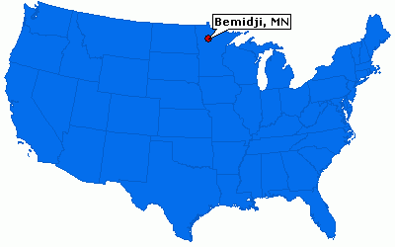
About Cass Lake IHS
Located in Northern Minnesota
Outpatient Ambulatory Care Clinic
  2 physicians
  5 nurse practitioners
Active user population of ~12,000 clients
Pharmacy also serves 4 area tribal clinics
Services provided
  24/7 emergency department
  Medical
  Dental
  Pharmacy
  Lab
  Radiology
  Physical Therapy
  Podiatry
Cass Lake, MN

Slide 6
Hepatitis C Background
More people dying of HCV than all other 60 nationally notifiable infectious diseases combined
Minnesota is one of the states that had >200% increase in HCV cases from 2007-2012
Today over 80% of new HCV transmission occurs in people who inject drugs
AI/AN are the most affected compared to other races or ethnicities
Notes:
Notifiable diseases: HIV, TB, HEP B,

Slide 7
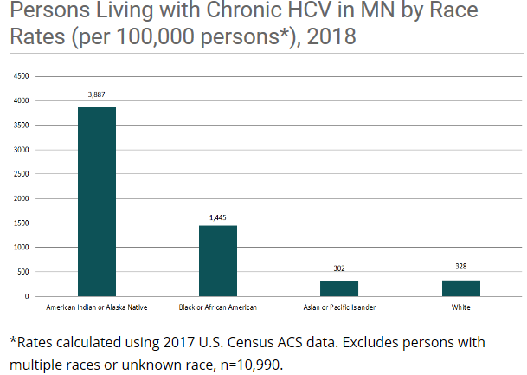
HCV in Minnesota
MN Department of Health
Notes:
Rates calculated using 2017 US Census ACS Data. Excludes persons with multiple races or unknown race n=10990

Slide 8
Previous HCV Treatment Process
Refer to outside specialist
  Typically Bemidji, Duluth, Fargo (range from 30 min-2.5 hours away)
  No further screening/testing done here after Ab/RNA positive
  Often patients referred with only Ab + (Not detectable RNA)
  Patients screened positive and lost to follow up
  Unclear what percentage of patients received care/completed treatment
  Paid for by patient’s insurance or purchased referred care
  Restrictions on substance use prior to treatment
  No medications filled at our pharmacy

Slide 9
Getting Started
1st step – getting HCV treatment on site
Notes:
Keep privileges as open as possible. Try not to force yourself into strict practice guidelines (treat per most recent guidelines, etc) monitor and make changes as appropriate

Slide 10
Pharmacist Run HCV Clinic
Patient with + HCV antibody and HCV RNA detectable
Referral to pharmacist
Initial pharmacy visit
  Assess readiness/appropriateness for treatment
  If ready/willing to be treated order required labs
Presentation to project ECHO if needed
Initiate prior authorization or Patient assistance
Start treatment
Pharmacist monitoring/follow up throughout treatment and SVR
SVR Counseling
  Risk of reinfection
  Necessary follow up (ex. Cirrhotic patients still require ultrasounds and monitoring for HCC)
Notes:
Billing through MTM CPT codes
Meds ordered under primary providers name
Use

Slide 11
Current Clinic Status
~ 130 patients have been referred- 44 presented to ECHO
  30 patients achieved SVR12
  6 patients completed tx- waiting on SVR12
  1 patient reinfected
  3 patients on tx currently
  1 meds approved- waiting to start
  Remaining patients
    Difficult to locate
    Lost to follow up
Notes:
Previously-Many patients not eligible for treatment at this time
Insurance restrictions
Actively using drugs
Waiting to meet sobriety requirements
Minnesota MA changed requirements in January 2020
~25 more with + HCV but no referral- no primary care, screened in ER or Suboxone clinic

Slide 12
Screening

Slide 13
Universal Hepatitis C Screening
USPSTF recommends screening for hepatitis C virus (HCV) infection in adults ages 18 to 79 years. (B Grade)
IHS- recommends HCV screening at least once in a lifetime for patients ≥ 18 years
HCV part of STI order set
Notes:
USPSTF- US preventative services task force
B grade- recommended- more benefit than harm
Plug for universal screening
Also part of STD lab order set

Slide 14
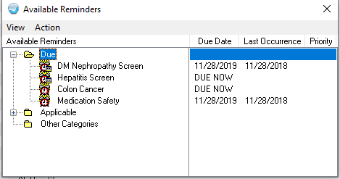
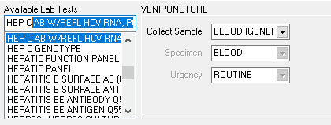
Hepatitis C Screening
New Hepatitis Screening added to alarm clock
All patients ≥ 18 years old should be screened at least once in a lifetime
Hepatitis C Ab w/reflex to HCV RNA
Patients with risk factors should be screened more often
Notes:
Takes out subjective influence of screening- everyone has it at least once
Still need to continue to screen patients with ongoing risk factors

Slide 15
Challenges
Challenge | Solution
Difficult to reach patients | Created EHR pop up if patient comes to facility for any care
Transportation issues | Limit clinic visits Phone calls when possible
Patients with current substance use | Referrals to suboxone intake if appropriate
Insurance restrictions for MN Medicaid | Harm reduction options
Medicaid does not cover HCV treatment without 2 HCV RNA levels 6 months apart | Can try for patient assistance after 2 denials from MA
Difficulty taking/remembering meds | Public Health nurse to deliver meds and set up pill boxes. 1-2 times per week
Medicaid requires specialist for patients with advanced liver disease (ex. APRI > 1.5, FIB-4 >3.25, Fibroscan >9.5 kPa) | Collaborate with a specialist to complete telemedicine visit (ECHO does not meet the requirement)
Notes:
New hurdles are for patients with advanced liver disease- try collaborating with a local specialist utilizing telemed

Slide 16
Collaboration with Opioid Treatment Program
Provided informal education/training on Hep C and treatment process to provider and nurse at Leech Lake Opioid Treatment Program (LLOTP)
Referral from LLOTP directly
Deliver medication to clinic for patient’s to receive while at Suboxone clinic
Direct line of communication with nurse/provider
Easier access to refer patient’s in need of MAT- can call directly to intake

Slide 17
Is treating patients enough?

Slide 18
Risk Factors for Hepatitis C at cass Lake ihs
11.5%
14%
2%
10.5%
78%
84%
Notes:
Other- Blood transfusion, tattoo, partner +

Slide 19
Next steps
Harm reduction program
Collaboration with Tribal Health Division

Slide 20
Harm Reduction at CLIHS
Within CLIHS pharmacy will provide harm reduction services which include
  Syringe services
  Sharps containers/syringe disposal
  Naloxone
  STI testing
  Condom distribution
  Education on safer use
  Resources for mental health and addiction

Slide 21
Harm Reduction Through Tribal Health
All services provided at Cass Lake IHS
Ability to meet people where they are at
Abscess and wound care
One full time RN and one ½ time
One community health worker
Rapid HCV and HIV testing

Slide 22
Key Takeaways
Be flexible
Your plan doesn’t have to be perfect to start treating the first patient
Some patients are not ready for hepatitis c treatment

Slide 23
Questions?

