Slide 1

STATUS EPILEPTICUS
Notes:
Case

Slide 2
Disclosures
I have nothing to disclose
(Except, I don’t know how to spell leviteracetam)

Slide 3
Status Epilepticus In One Slide
Act Decisively
Plan For Failure
The best med is the one you have on hand
The real best med is high-dose benzo
Look for (and aggressively treat) reversible causes

Slide 4
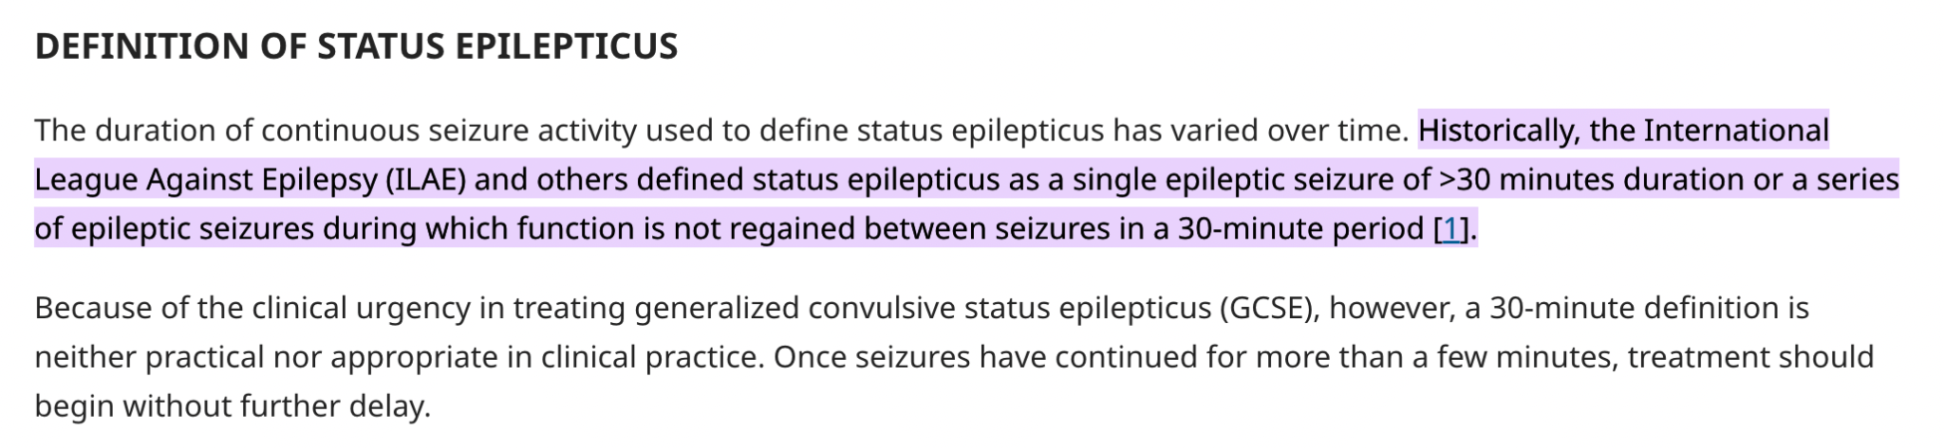
Notes:
It’s no longer defined by 30 minutes of seizure. It’s technically defined by 5 minutes or two recurrent seizures without a return to baseline.

Slide 5
“Patient Still Seizing”
Notes:
This is a handy little memory tool I use to determine if it’s status. If they were brought to you because they were seizing, and you look at them and they’re seizing, they’re in status. If they were seizing somewhere else, and now they’re seizing here, it’s status. You should treat them as such.

Slide 6
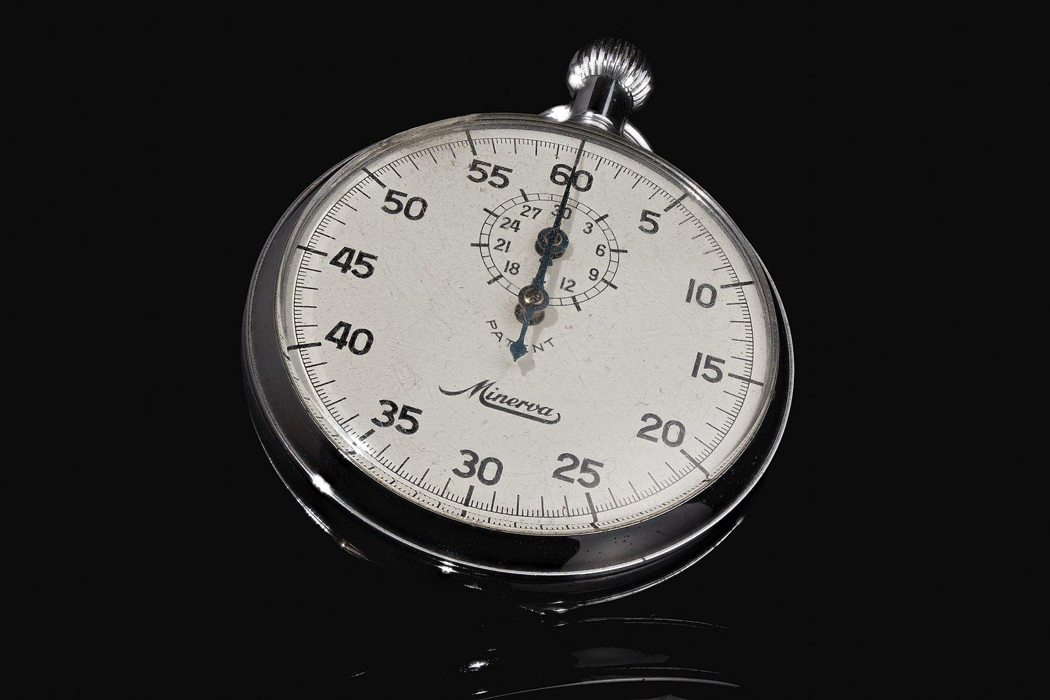
Time = 0
Go
ABCD50
Benzo - 10mg versed IM, 4-8 lorazepam IV
Notes:
Seize your way into vomiting, or to a pH low enough that you cause apnea. Intubate these people

Slide 7
ABC
D50

Slide 8
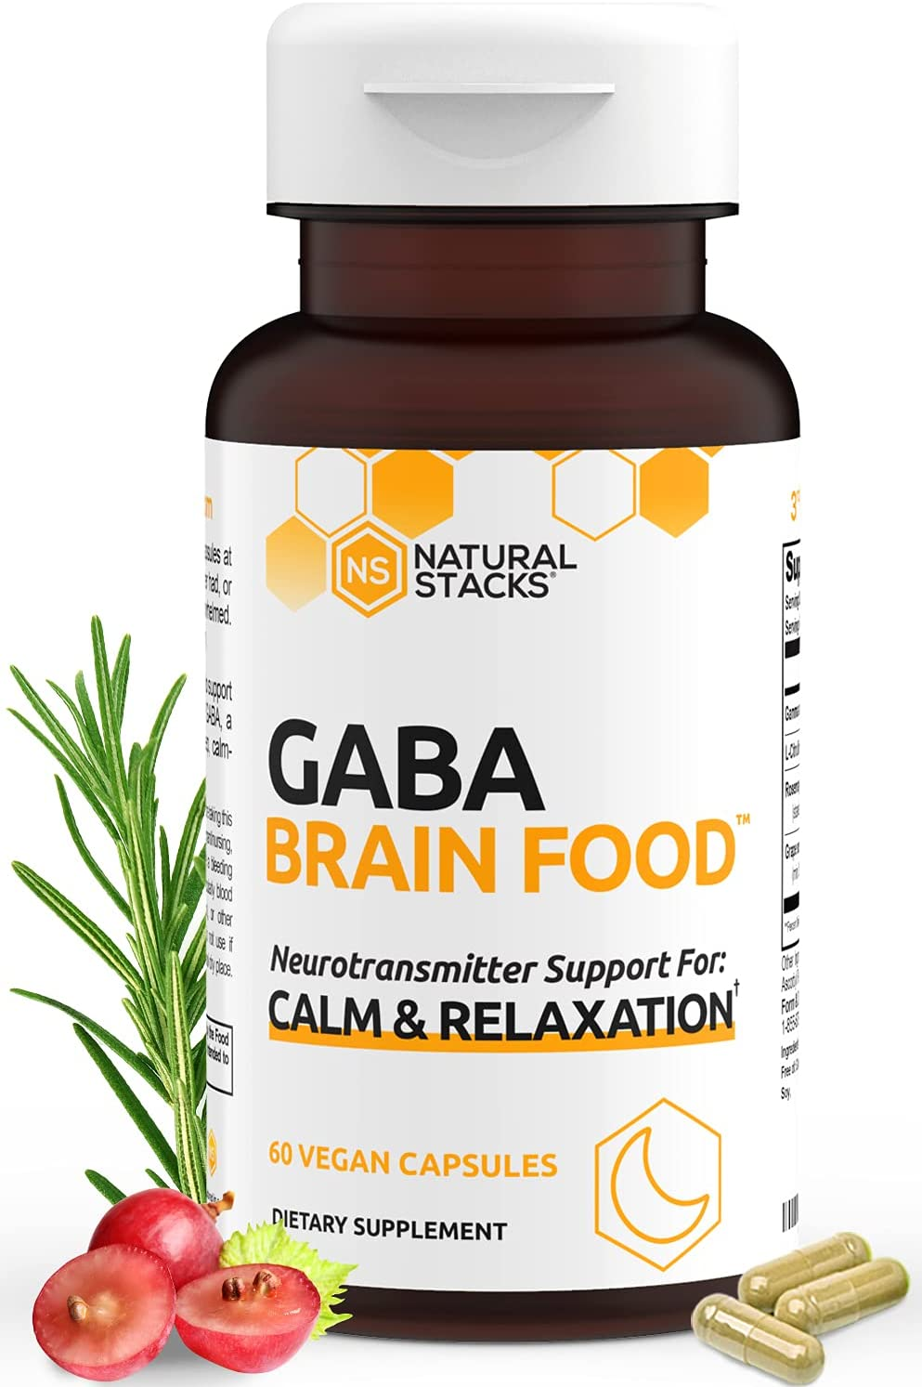
BENZOS
💪
👃👃
Notes:
Every time I’ve gotten jammed up it’s because I was afraid to give the proper dose of benzos
Benzos are going to be the mainstay of treatment here. They’re fast, they’re safe, they deal with the proximate cause of the vast majority of seizures
Don’t wait for IV access.
Nose nose double dose

Slide 9

OMIGOD
Notes:
Ok so your patient is still seizing. You pushed d50, gave 10 of midazolam IM, and the patient is still shaking.This is when I get to my favorite mnemonic. Oh My God. I love it because, whenever the time is appropriate, I invoke this mnemonic, whether or not my intent is to do higher order medical thinking.
Monitor special shout-out to the quantitative, waveform end-tidal capnometry. It will tell you about respiratory rate as well as relative co2 production and metabolic demand
IV - you can do initial management with IM meds. Don’t wait for an IV.
Transfer - If they’re still seizing in front of you, this person is going to the ICU. call for help early

Slide 10
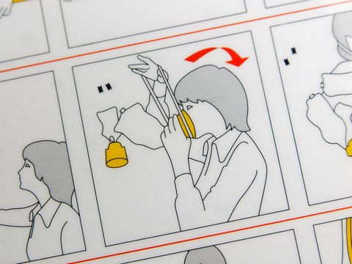
Oxygen
Notes:
Oxygen - seizure is a metabolically demanding pathology. Oxygen utilization is very very high, a lot of the complications come from downstream acidosis, anaerobic metabolism, etc. Throw on a nonrebreather, crank it up

Slide 11
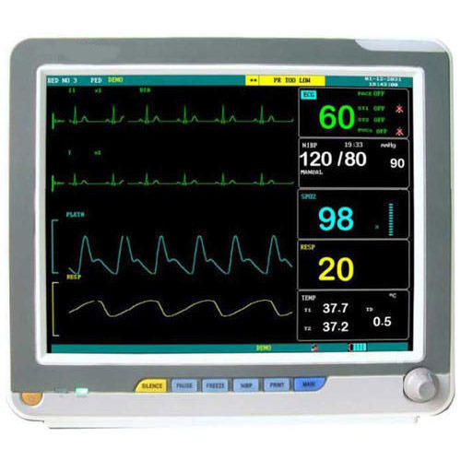
Monitor
Especially End-tidal capnometry

Slide 12

IV Access

Slide 13

Help From Above
Notes:
If you’re in a big hospital, this is omnipotent being who lives upstairs. If you’re in a rural shop, this is a pilot. In either case, there are times when the dispo decision is fraught. This is one of the other times.

Slide 14

Labs
Salicylate
Etoh, tox
Ck
Hcg
ua
Get labs - chem12, mag, calcium phos, lft, aed levels, salicylate, etoh, ck, hcg, ua
Chem8, LFTs
Mag Calcium Phos
AED Levels
Notes:
These labs are going to help someone else, but they will not help you.
I would go so far as to say you can do an excellent job treating status epilepticus without seeing a single lab value

Slide 15
Order Antiepileptic Medication
Even if the seizure breaks

Slide 16
Before 5 Minutes, you should:
Check Glucose
Give Benzos
Oxygenate
Line & Lab
Order 2nd-line medication

Slide 17
05:00
Notes:
Evidence repeatedly shows that each med is less likely to work than the last one. If they didn’t break with one, they’re less likely to break with 2, and the efficacy of a third is even smaller. So at a certain point we have to start thinking about going big. If you gave 10 of versed and another 10 of versed and 4 grams of keppra, what do you think some valproate is going to do?

Slide 18

Benzos
Again
Notes:
Benzos again!

Slide 19
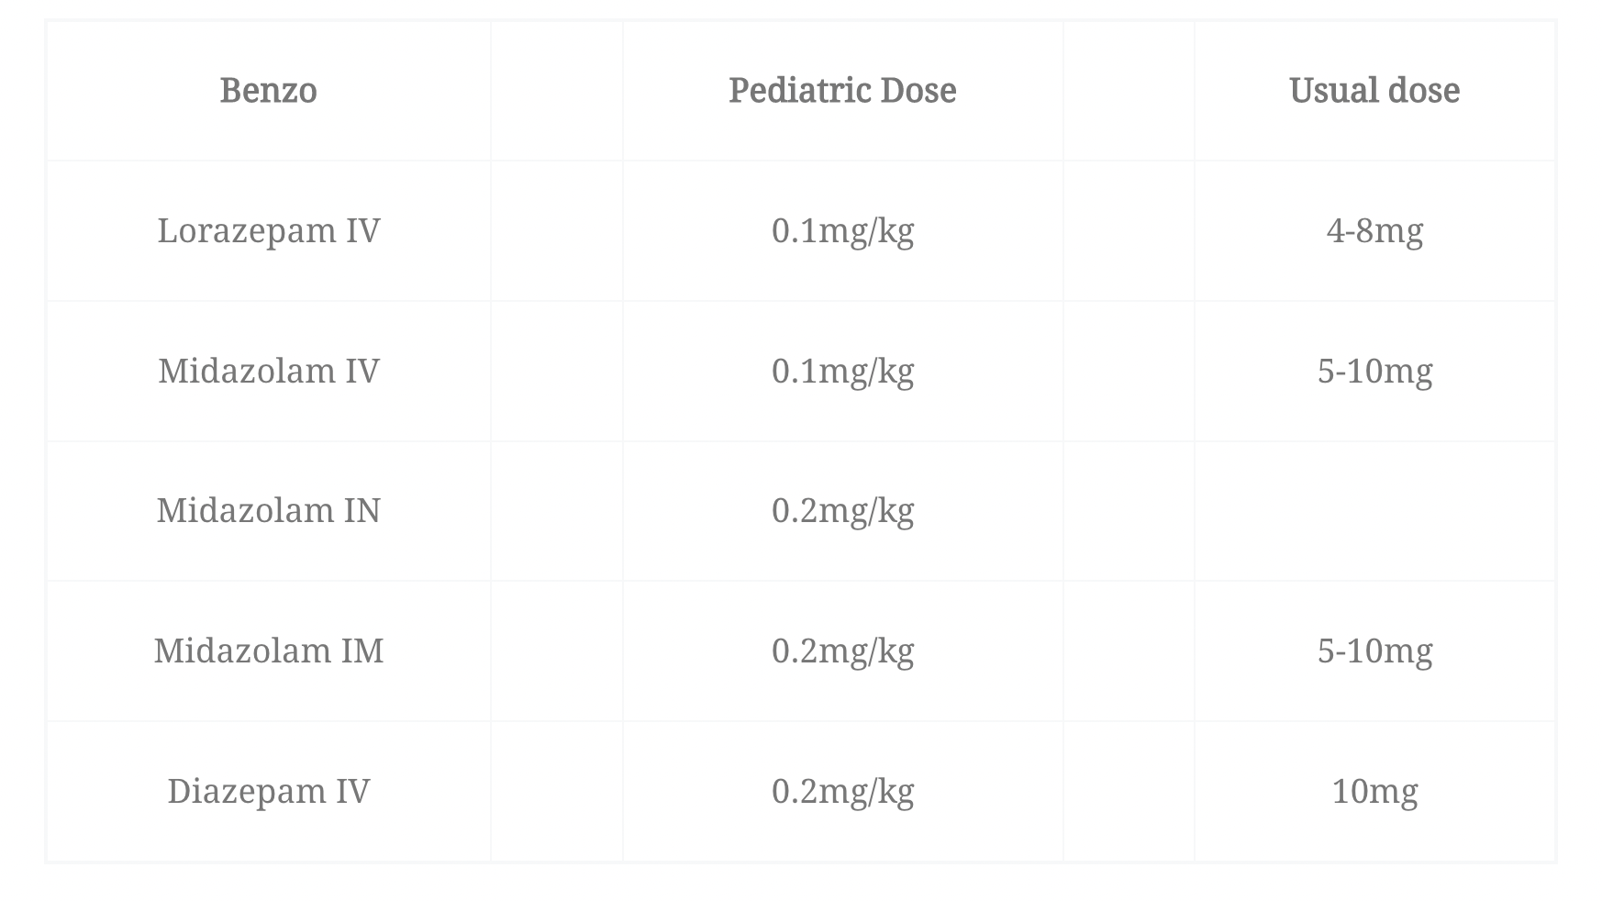
Redose Benzos
- either in this slide or the first benzo slide should be a comment on dosing with pediatric dosages, with the suggestion that we underdose
Notes:
This time we can look a little more closely at the doses we say we should be giving.

Slide 20
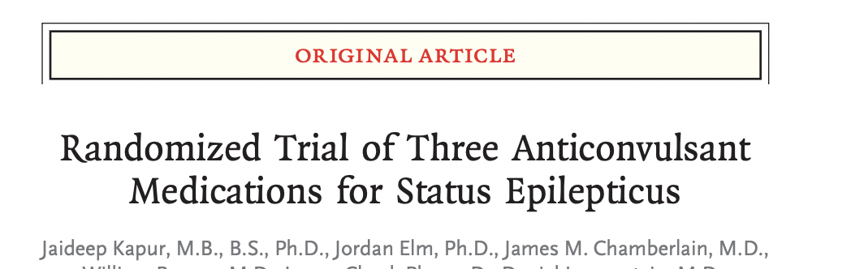
Antiepileptic Medication
Levitaracetam 60mg/kg up to 4.5g
Fosphenytoin 20mg/kg (max 150mg/min)
Contraindicated in cardiac disease
Valproate 40mg/kg
Contraindicated in pregnancy
  Doses are HIGH
  Efficacy is Mediocre
  How do you choose?
Give these, even if the seizure breaks with benzos
Notes:
ESETT trial shows these are equivalently effective. But that effectiveness shows they stopped seizures after ~ 20 minutes. So How effective, really.
I would avoid Phenytoin it’s contraindicated in cardiac patients and tox overdoses, and you just don’t know.

Slide 21
How Fast Can You Give The Meds?
Valproate: Undiluted Push dose is safe
Limdi 2007: 40 patients, no reactions, 30mg/kg/min
Leviteracetam: Undiluted push dose is safe
Hailer 2021: 953 patients, max dose 4.5 g, 4 minor local reactions
Haller JT, Bonnin S, Radosevich J. Rapid administration of undiluted intravenous levetiracetam. Epilepsia. 2021 Aug;62(8):1865-1870. doi: 10.1111/epi.16961. Epub 2021 Jun 24. PMID: 34164804.
Fosphenytoin: Slooow push (max 150mg/min)

Slide 22

Seizures Are Bad
Seizures are bad
Respiratory Depression
Neuronal Death
Kindling Effect
Notes:
Focal neurotoxicity, for example by hypoxia, radical formation, acidosis, kills neurons. Killing off GABA-ergic neurons can lead to more seizures.
Undertreated status epilepticus causes respiratory depression

Slide 23
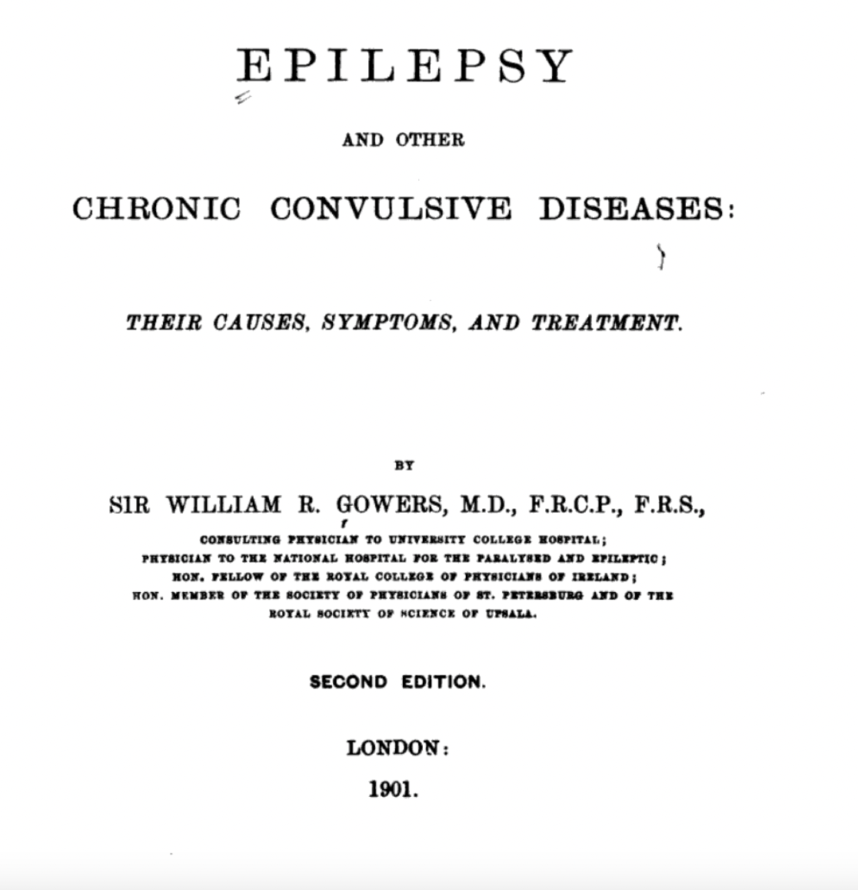
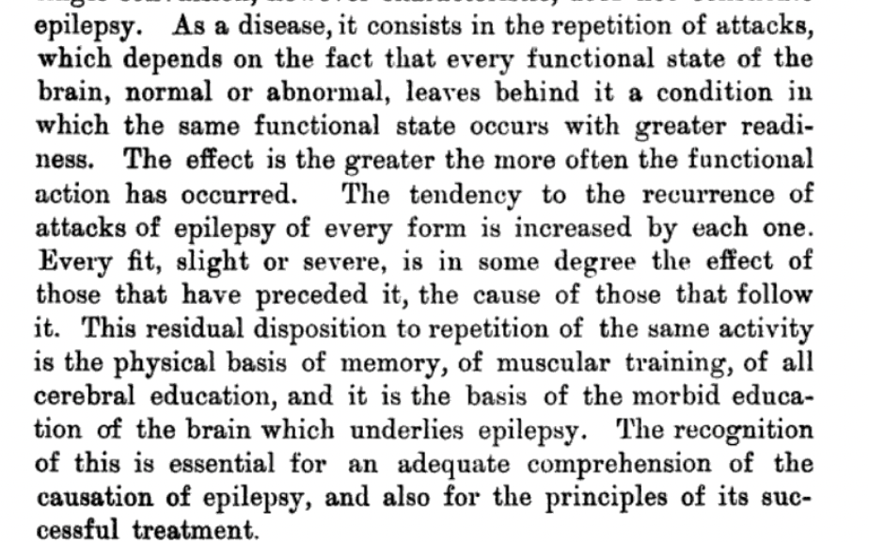

Slide 24
Seizures Are Bad
Persistent seizure
Oxygen demand
Glucose consumption
acidemia
Seizure threshold
Notes:
Focal neurotoxicity, for example by hypoxia, radical formation, acidosis, kills neurons. Killing off GABA-ergic neurons can lead to more seizures.
Undertreated status epilepticus causes respiratory depression

Slide 25
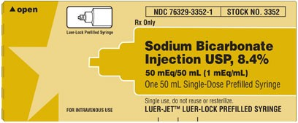
Hyponatremia
If at 10 minutes your patient is still seizing, think hard about empiric sodium-loading
Getting Na back from the lab means you’ve missed the window
Adrenal Disease
Diuretics (CHF, Cirrhosis)
Polydipsia
MDMA
Notes:
Empiric dosing is not super evidence-based.
Especially if clinical history warrants i
Our protocol dictates giving it after 10 minutes
You do not need a central line

Slide 26
Thiamine Deficiency
Children
Alcoholic Patients
Early Pregnancy (hyperemesis)
Bariatric surgery
Heart Failure
100 mg IV

Slide 27
10:00
Notes:
Evidence repeatedly shows that each med is less likely to work than the last one. If they didn’t break with one, they’re less likely to break with 2, and the efficacy of a third is even smaller. So at a certain point we have to start thinking about going big. If you gave 10 of versed and another 10 of versed and 4 grams of keppra, what do you think some valproate is going to do?

Slide 28
By 10 Minutes, you should have:
Given Benzos Twice
Given Antiepileptic Meds
Given Thiamine
Strongly thought about Sodium
Vocalized prepping for Intubation

Slide 29
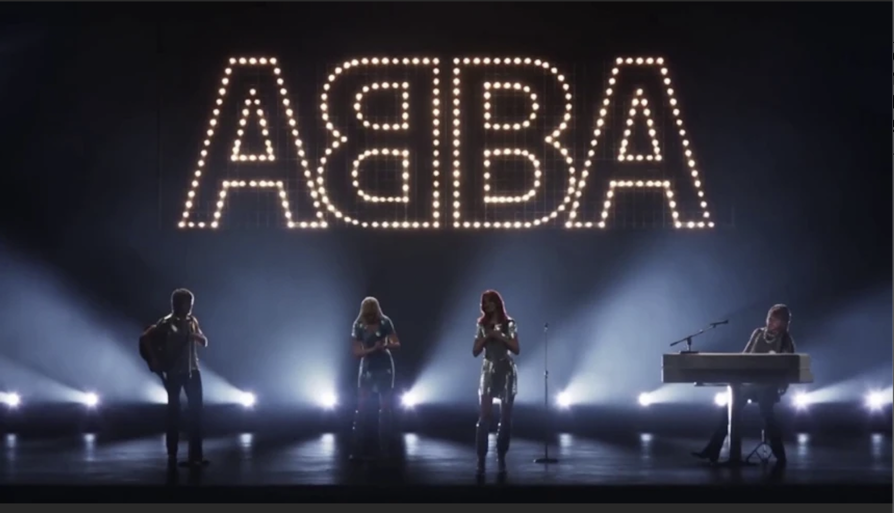
Benzos
Third dose
Notes:
Yes, this can cause respiratory depression. So does status. Also we’re about to intubate this person.

Slide 30
Consider Other Treatable Causes
Eclampsia
Salicylate
Local anesthetic systemic toxicity
Carbon monoxide
Hyperthermia
Isoniazid
Alcohol withdrawal
Infection

Slide 31
0 5m 10m 15-20m
Act
ABCD50
Oxygen
ETCO2
Access
H&P
Call Backup
Prepare for intubation
Intubate
CTH
LP
Meds
5-10mg midazolam
Keppra
Valproate
Fosphenytoin
10mg midazolam
Ketamine
Antibiotics, acyclovir
10mg midazolam
Propofol
Propofol
Treat Empirically
D50
Thiamine
(Sodium)
Magnesium
B6
Cyanide kit
Intralipid

Slide 32
Before Intubating
Have you given three proper doses of benzos?
Have you considered all reversible causes?
Glucose
Thiamine
Magnesium
B6
Sodium

Slide 33
Planning an Intubation
Excellent preoxygenation, with apneic oxygenation
Half-dose rocuronium (0.6mg/kg). Not Sux
Ketamine and/or propofol in high doses
Have pressor on hand
Push induction agents. wait
You may not need paralytic
Consider getting fancy with a tourniquet
Notes:
Paralytic masks the effect of the seizure
(#1) The ketamine and propofol will usually break the seizure. This results in an abrupt cessation of motor activity about 30-60 seconds after pushing the propofol (before the onset of paralysis). You can usually intubate the patient when that occurs – the patient is generally quite flaccid.
(#2) The ketamine and propofol fail to break the seizure. In this case, seizure movements will gradually become less pronounced as paralysis occurs. Disappearance of all movement generally occurs >60 seconds after administration of rocuronium.

Slide 34
Post-intubation
Make sure you keep propofol running at a moderate/high dose
If you need pressure, add pressors
CT, LP, EEG
Assess for non-convulsive status

Slide 35
Pearls
Detection of status despite sedation
Temp fluctuations, dilated pupils
non -GTC status
Mimics
Intubate with Roc, not Sux

Slide 36
Closing Thoughts
Inaction causes more respiratory depression than benzos
If aborting the seizures creates new problems, so be it. Fix those too.
Empirically treat reversible causes
In order to intubate by 20 minutes, you should be starting the process at 10.

Slide 37
Further Reading
Farkas, Josh. Status Epilepticus: Internet Book of Critical Care. July 6, 2022. Available at: https://emcrit.org/ibcc/sz/ Accessed 7/25/2022
Morgenstern, J. Status Epilepticus: Emergency Management, First10EM, June 3, 2019. Available at: https://doi.org/10.51684/FIRS.8669
Glauser T, Shinnar S, Gloss D, Alldredge B, Arya R, Bainbridge J, Bare M, Bleck T, Dodson WE, Garrity L, Jagoda A, Lowenstein D, Pellock J, Riviello J, Sloan E, Treiman DM. Evidence-Based Guideline: Treatment of Convulsive Status Epilepticus in Children and Adults: Report of the Guideline Committee of the American Epilepsy Society. Epilepsy Curr. 2016 Jan-Feb;16(1):48-61. doi: 10.5698/1535-7597-16.1.48. PMID: 26900382; PMCID: PMC4749120.

Slide 38
More References
ESETT: Kapur J, Elm J, Chamberlain JM, et al. Randomized Trial of Three Anticonvulsant Medications for Status Epilepticus. The New England journal of medicine. 2019; 381(22):2103-2113. PMID: 31774955 clinicaltrials.gov: NCT01960075
Gowers WR. Epilepsy and other chronic convulsive diseases: their causes, symptoms and treatment. J & A Churchill; London: 1881. [Google Scholar]
Haller JT, Bonnin S, Radosevich J. Rapid administration of undiluted intravenous levetiracetam. Epilepsia. 2021 Aug;62(8):1865-1870. doi: 10.1111/epi.16961. Epub 2021 Jun 24. PMID: 34164804.
Limdi NA, Knowlton RK, Cofield SS, Ver Hoef LW, Paige AL, Dutta S, Faught E. Safety of rapid intravenous loading of valproate. Epilepsia. 2007 Mar;48(3):478-83. doi: 10.1111/j.1528-1167.2007.00989.x. Epub 2007 Feb 22. PMID: 17319914.

