Slide 1

Introduction to the Gallup Indian Medical Center Trauma Program Operational Process Performance (TPOPP) TRAUMA OUTCOMES AND PERFORMANCE IMPROVEMENT PLAN
Chayanin Musikasinthorn, MD/MPH, FACS
GIMC Trauma Multidisciplinary Performance Improvement ProcessTeam (TM-PIP)
August 10, 2022

Slide 2
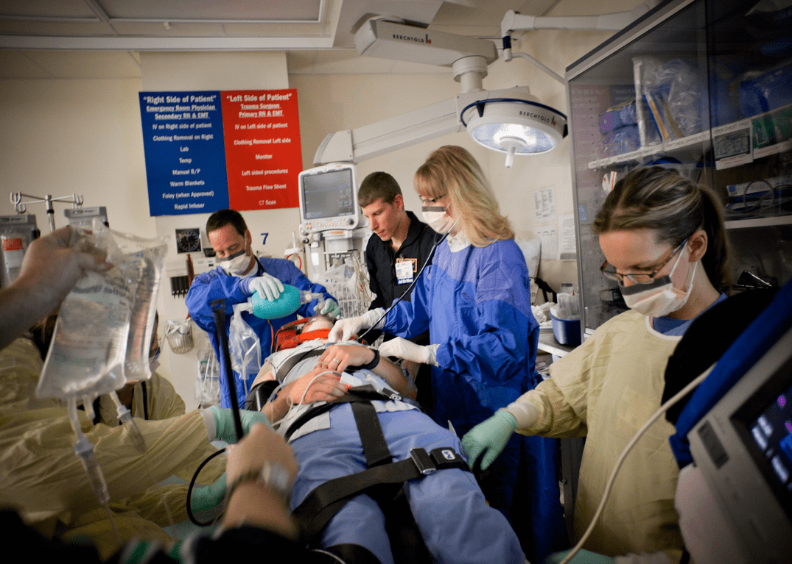
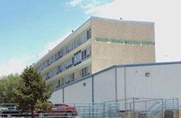
Objectives:
Explain GIMC Trauma Committee structure and the Trauma Process Improvement Program
Describe the Committee structures
Review the roles and responsibilities of members
Discuss the GIMC Trauma PI Program and the Trauma registry
Review committee planning and coordination
Discuss committee reporting structure

Slide 3
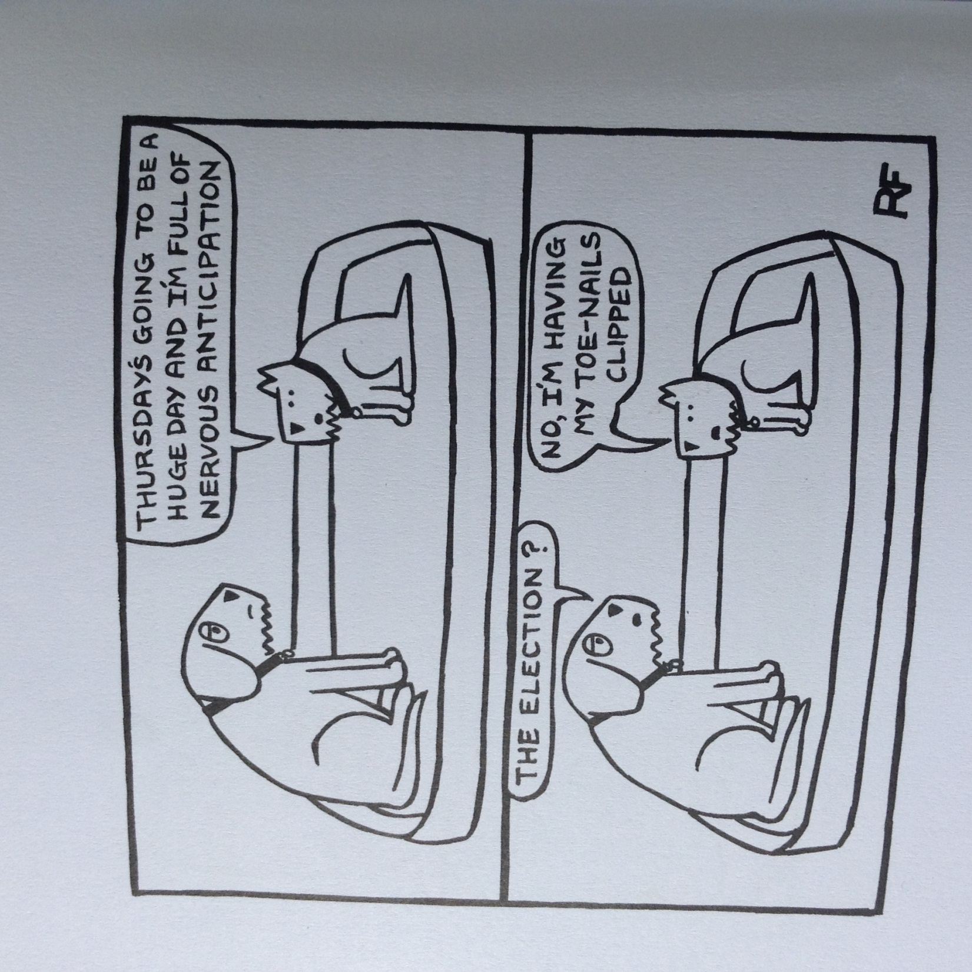

Slide 4

Trauma Committee Structure
Structure defined by trauma center level and volume
Defined by State Regulations and ACS (if applicable)
Hospital bylaws driven with medical staff and quality department endorsement
Notes:
A trauma committee structure at a hospital is defined by its trauma volume, level of trauma center, state regulations and if the trauma center is verified by the American College of Surgeons.
The purpose of these committees will be reviewed in following slides but essentially…
Authority – Trauma Medical Director, Trauma Program Manager
Scope of Responsibility of the Trauma PIPS Program – begins on EMS notification through the phases of care to end on discharge

Slide 5
GIMC Trauma Committee Structure
State-designated Level III Trauma Center (pending review)
Capable of providing promptly available trauma care on a 24-hr basis, including on-call general surgery and select specialty coverage
Capable of providing evaluation, initial stabilization, limited ongoing care and for transfer of acutely injured patients of all ages to level I or II facilities for further definitive surgical care
GIMC became level III Trauma Center on April 2009
GIMC is the only Indian Health Service (IHS) or Tribal Hospital that is also a designated trauma center in New Mexico
Notes:
A little history on the process of trauma designation of GIMC…
GIMC is part of the GSU that comprises GIMC and Tohatchi Health Center that is responsible for ~ 40000 patients that come through on an emergent and scheduled basis.
McKinley County - 5448 square miles with a population density of 13.7 per square mile, primarily rural and largely comprised of reservation land with > 2hr time to a trauma center, the push to become a trauma center first initiated the process by Dr. David Boyd (IHS National Trauma Systems Coordinator) with NAIHS facilities leaders at UNM in Aug 2008, followed by the first Trauma Director position assigned to Dr. Warren in Dec 2008, but GIMC first became a trauma center level 3 on April 2009.
The criteria of a Level 3 trauma center..

Slide 6
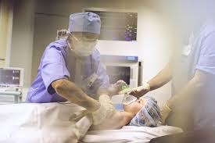

Regional Trauma Advisory Council (ReTrAC)
TASSC
ReTrAC
EMS Advisory Committee
TPIC
NM Designated trauma centers
Hospitals
IHS
Professional organizations
Health insurance industry
Other Stakeholders
Notes:
The New Mexico DOH Trauma System, under the authority of the Emergency Medical Systems (EMS) Act, is implemented and monitored by the DOH-EMS Bureau. The EMS Bureau is advised by a Trauma Advisory and System Stakeholder Committee (TASSC). TASSC is comprised of representatives from Regional Trauma Advisory Councils (ReTrAC), professional organizations, hospitals, Indian Health Services, rehabilitation, injury prevention advocates, health insurance industry, and other interested parties. ReTrACs were established in 1997 revision of the trauma system regulations. TASSC works in collaboration with the ReTrACs to maximize access for all people in New Mexico to optimal and timely trauma care in an effort to decrease morbidity and mortality associated with trauma.
There are 5 health regions in the state of New Mexico. These include Northwest, Northeast, Southwest, Southeast, and the Metro regions. There are currently 17 state verified and developing trauma centers within the state that regularly provide input to their prospective ReTrAC. GIMC reports to the (North) Western ReTrAC on the hospital’s identified trauma issues and concerns on a quarterly basis.

Slide 7

GIMC TRAUMA COMMITTEE GOALS:
Develop a culture that promotes both system and patient care improvements and aligns with the national standards.
Review performance and patient safety of the trauma center and participate in trauma registry
Provide feedback to the NM EMS Bureau and the approved ReTrAC on identified trauma issues and concerns, in compliance with NM state laws and regulations
Present factual/objective data and processes to facilitate decision making by the committee
Notes:
What are the goals of having a Trauma Committee? 1) Develop a culture of safety that aligns with national standards, (essentially transitioning from blame to opportunity) 2) obtain, collect and present factual and objective data to facilitate decision making, 3) Review GIMC performance by participating in the trauma registry, then 4) provide feedback to Western ReTrAC on identified trauma issues and concerns in compliance with NM state laws and regulations
Basic goal is essentially to drive performance improvement – or PI – to improve trauma care to our patients

Slide 8
Elements of PI Plan
Missions and Goals.
Administrative structure and Scope
Data Collection and Management
Methods of identifying PI issues
Audit filters
Types of PI Quality Indicators
Levels of PI Review
Primary, Secondary and Tertiary Reviews
Corrective Action Plan and Implementation
Trauma Committee Structure
Performance Improvement and Patient Safety (PIPS) Committee
Multidisciplinary Peer Review
Mission and Goals
Integration into Hospital Quality Program
Review of the PIPS Plan
PIPS Flow Chart
Indicators and Complications
Trauma Morbidity and Mortality Classifications
Notes:
Basic elements of any PI plan are the stated missions and goals. And like any Hospital Quality Improvement project, it requires administrative structure and scope, defined methods of identifying PI issues and Quality indicators during data collection and management. And once those PI issues are recognized, find methods of conducting reviews and providing corrective action plan and implementation.
The trauma committee PI plan can actually be integrated in to the Hospital Quality System. The Trauma committee structure breaks down into PIPS committee and multidisciplinary peer review committee with its own mission and goals.
Today we will be focusing on the trauma PI and the issues related only to the trauma patients that come through GIMC. We will review the trauma PIPS flow chart and plan along with PI indicators and complications and touch base a little bit on trauma Morbidity and Mortality conference.

Slide 9

A Trauma Process Improvement Program is Our Road Map for Trauma PI
A continuous process of monitoring, assessing, and management, directed at improving care
A clearly defined and written plan that incorporates recognition of issues, corrective actions, and loop closure!!!
What PI ISN’T….blaming, punitive or retaliatory….
Our GOAL, “to make tomorrow’s care better for our trauma patients”
Notes:
A successful trauma improvement program is a road map, a continuous process, of monitoring, assessing, management, directed at improving care.
It involves a clearly defined plan that incorporates recognition of issues, finding ways to correct the problem and obtaining loop closures.
Performance improvement again, is not meant to be blaming, punitive or retaliatory. It is a process for opportunity and improvement to make tomorrow’s care better for our trauma patients.

Slide 10
GIMC Trauma Committee Structure
Required
Multidisciplinary Trauma Peer Review
Clinical concerns at the patient level
Provider related events
Performance Improvement and Patient Safety (PIPS)
Process and System focused
Operational events
Discretionary
Pre-Hospital Trauma PIPS Committee
Morbidity and Mortality Review
Hospital Quality Program
Notes:
There are steps involved in the Trauma PI as well as there are differences in the different committees within the Trauma Committee even though the members are often interchangeable and serve in both committees
Multidisciplinary Trauma Peer Review committee – involves peers of different specialties reviewing specific cases to ensure the standard of care is provided, and whether specific patient co-morbidities were addressed. Usually the peer review committee address provider related issues. IF there are concerns/issues at the system level, this would be brought up to the Performance Improvement and Patient Safety (PIPS) review committee which addresses the organizational and operational components of the trauma center to see if system performance were followed at each specific level and all follow up actions.
Discretionary committees are defined in the Orange Book and can add value to trauma center PIPS process. Additionally, periodic M&Ms and quality improvement projects are added to the hospital quality program.
GIMC Trauma PI plan keeps record of meeting minutes, reports and attendance and provide updates to the members along with the highest level of hospital administration.
*Reference PIPS Chapter 16 in Orange Book

Slide 11
Levels of Review: PIPS start here
Defined steps in order to reach an event resolution….
Primary Review
Secondary Review
Tertiary Review
Quarternary (External) Review
Notes:
Once an issue, concern, or event is identified, it goes through a system of reviews.
An event can be system and/or patient care related.
Remember, it takes resources to accomplish this (human and electronic).
But PIPS start here.

Slide 12

Primary Review:
Performed by Trauma Program Manager, Registrar and Trauma Surgeon assigned to perform concurrent PI rounding
Devon McCabe, Tracy Denet, Dr. Musikasinthorn
It is a process to look at every patient in an organized fashion
Identification of patients through ED Manager in EHR, ED huddles
Random Chart Audits to regularly look for issues and/or trends
Review may be concurrent, often retrospective, but timely
Educate staff on care/documentation concerns (LOOP CLOSURE)
Notes:
Primary review is typically done retrospectively looking at trauma charts within the previous month to see if there are any issues involved. It is done painstakingly, looking at every patient in an organized fashion through EHR records. However, events may be brought up concurrently during surgeons sign out and/or morning rounding or ED huddles that may trigger review. Primary reviews oftentimes can be solved with education and staff feedback within the department thus obtaining loop closure in a timely matter.
One thing that we need to be doing more is random chart audits. Audit filters are a way to look at patient care and process and system issues.
Audit filters are continuously monitored, evaluated and adjusted. Sample audit filters include using trauma charts for trauma patients, ED LOS, antibiotics for open fractures…
If event is closed at primary review, we need to assure documentation in the PIPS record.

Slide 13
If the loop isn’t closed with the primary review, issues may be sent for a Secondary Review…
Secondary Review is performed with the “Green” Trauma PI Tracking Form
Secondary Review may be sent to Trauma Surgeons, ED Providers, Specialty Providers or to a Department Leader for Loop Closure
Thorough review of the Trauma Process
OR, it may be sent for Committee Review:
Trauma M&M Review
Trauma Multidisciplinary Peer Review Committee
Notes:
For issues that are validated at primary review that didn’t have a clear resolution, a secondary review may be performed and here at GIMC, we utilized the green trauma PI tracking form that is sent along with the patient’s record to members of the trauma committee. Specifically, the secondary review encompasses a complete investigation of the issues involved.
It requires thorough review of the trauma process starting at the EMS level to patient’s discharge (here or at tertiary hospital) with confirmation of all involved, a development of a timeline and review of any additional information.
Issues can be closed at this level and documentation of event resolution is essential with timely feedback to the committee.
Issues that cannot be closed may be sent for further review with the Trauma Committee and Trauma M&M conference may be initiated at this level to discuss issues/concerns.

Slide 14
Tertiary Review:
The TPM and TMD have determined this case needed to be discussed.
Typical cases “flagged” for a Tertiary Review
ISS > 20
Complicated Peds
Transfers
Mortality with and without opportunity for improvement
Action Plan Development
Notes:
Decision to send on a tertiary review is based on a co-decision of the TPM and TMD. Tertiary review is a structured group review at the multidisciplinary peer review meeting. It usually is a follow-up review of an M&M case with peer review determinations and/or decision makings. Typical cases “flagged” for a tertiary review involved multitrauma patients with ISS>20, complicated pediatric cases, transfers and mortality cases.
This level can also have forums to address system/process issues and can involve hospital level committee and risk management. Tertiary review is important because it addresses the functionality of our trauma process – efficacy, efficiency and safety of care. It looks at both system and provider errors, team performance and contributing factors with corrective recommendations and actions.
A critical feature of the tertiary level review – is the action plan development. What happens next with this issue that we discussed and assigned determinations to? Again, key to effective trauma system is close loop followup.
Quaternary review I won’t really go into too much depth, but it’s when the event is taken to a forum outside GIMC such as ReTrAC, state, or external expert reviewer.

Slide 15
Trauma Multidisciplinary / Performance Improvement & Patient Safety (PIPS) Committee :
Often looks at process issues. Include members from multidisciplinary services involved in trauma care
Meet once a month
Chaired by Trauma Medical Director (TMD) and Trauma Program Manager (TPM)
Requires administration involvement
System and process focused and data driven
Can often result in PI projects
Minutes: Actions and Responsible Person (s)
Notes:
What drives the Trauma Program Operation and Performance Process is the Trauma Multidisciplinary Performance Improvement and Patient Safety (or the PIPS) Committee.
We touched on the level of reviews by the trauma committee in the previous slides but the following slides go into the components of the PIPS Committee.
The committee is multidisciplinary and include members from the different disciplines and services and are involved in the trauma care.
The committee meets once a month.
This committee does not present individual patient cases. The issues that come from patient review or through the peer review committee that need operational and/or system input to resolve are brought to this committee.
The committee is system and process focused and data driven.
Action Item logs are created from this meeting to review system issues until they are resolved.

Slide 16
GIMC Trauma Multidisciplinary/PIPS Team
Trauma Medical Director / Assistant (TMD)
ED MD/RN representatives
Trauma Program Manager (TPM)
Ortho Rep
Trauma Registrar (TR)
Pharmacy
Administration
EMS/Prehospital
Anesthesia Rep
OR Rep
ICU Rep
Surgeons
NP/PAs involved in trauma care
Social Services
Educator
Radiology Rep
Nursing
Respiratory Therapy
Lab/Blood Bank
Quality Management
Pediatrics
Dietary
Notes:
The leaders of the Trauma multidisciplinary PIPS team are the Trauma medical director, trauma program manager along with the trauma registrar and an administrator representative.
The teams that support the trauma leadership and are vital backbone of the GIMC trauma team are listed here and have inputs to the leadership and should not be overlooked

Slide 17
Trauma Multidisciplinary Peer Review Committee:
Meet once a month following Trauma TPOPP meeting
Led by Trauma Medical Director (TMD)
PEER protected (Privileged Communication Not Subject to Disclosure per NM Statutes Section 41-9-4-NMSA 1978)
Review of selected cases, mortalities, adverse events, and selected cases
Mortality classifications: Mortality without Opportunity, Mortality with Opportunity, and Unanticipated Mortality with Opportunity
Minimum of 50% attendance requirement of Surgeons, ED providers, Orthopedic Surgeons, Anesthesia providers and Radiologists, (pediatricians and/or sub-specialists if involved in care), TPM and Trauma Registrar
ALL MINUTES MUST INCLUDE FRANK AND OPEN DISCUSSION WITH DEMONSTRATION OF LOOP CLOSURE…
Notes:
A subcommittee of the trauma PIPS committee is the trauma peer review committee.
Multidisciplinary Peer Review is typically focused on provider-specific issues. It also meets at least every other month, typically following the TPOPP meeting. It is led by the trauma director and is PEER protected. This is to allow for frank and open discussion without fear of legal repercussions.
Cases for review include but are not limited to physician-specific care issues, trauma deaths, complications, unexpected outcomes, and unusual/uncommon injuries. Again demonstration of loop closure must be documented.
Minimum of 50% attendance is required of surgeons, ED providers, orthopedics, anesthesia providers, radiologists and pediatrics/other subspecialists if involved in care, and TPM and trauma registrar.

Slide 18
Trauma Multidisciplinary Peer Review Committee Cases:
All deaths
Select occurrences
Sentinel events
Problem trends
Unusual or uncommon cases
Unexpected outcomes
Great Saves
Notes:
Again, this slide is just to reiterate the types of cases that are discussed in peer review.

Slide 19

Loop Closure: It’s HARD!!!!!
Loop Closure Tips:
Follow through – most cases are done quickly
Not every case needs an action plan
Track (and trend) progress on the Trauma Committee Agenda
Be specific with dates and times
Always document the communication with individuals involved or changes made to the process to establish paper trail for proper loop closure
Research
Don’t re-invent the wheel
Benchmarking
Perform periodic audits (ie., missing trauma charts, IV ABX open Fx, ED to OR time, LOS in ED)

Slide 20
Trauma Morbidity & Mortality
Discretionary
Trauma M&M Review filters cases which need additional examination and intervention
Feeds cases to Trauma Multidisciplinary Peer Review
Trauma deaths, unexpected outcomes are examined
Separate from Multidisciplinary Trauma Peer Review
Trauma Medical Director/Manager responsible to document organization, meeting minutes and follow up of all defined actions or prevention initiatives
Notes:
The morbidity and mortality review is usually coordinated with the trauma medical director as the lead.
This may occur in a conference format or committee structure.
The case review, discussion, determination and defined preventative/action plan, and responsible individual must be documented.
This review process can not replace the need for multidisciplinary peer review.
Cases selected for peer review by the medical director will be prepared and moved to the next level of review.
The trauma program manager/director is responsible for the follow through of each case presented.
Documentation must reflect how each case was reviewed, determination, and next step.
All issues must be tracked until closure is met.

Slide 21
Primary Review (TPM)
LINE OF AUTHORITY FOR TRAUMA PIPS PROCESS
Opportunity for Improvement/Validation
Adverse Event / Audit Filter Review
Secondary Review (TPM + TMD)
Tertiary Review
External Peer Review
Prehospital Trauma PIPS
Trauma Morbidity/Mortality
Trauma Multidisciplinary Committee
Hospital Quality Committee
Trauma Peer Review
Trauma Systems/Operations
ACTIONS
Education
Counseling
Track/Trend
Guideline Development
PIPS Teams Project
Notes:
Resources for Optimal Care of the Injured Patient. 6th ed. Chicago: American College of Surgeons, 2014, p 129.

Slide 22
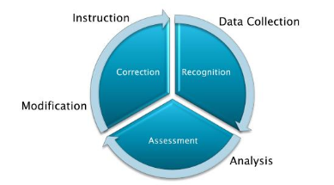
Trauma Registry
Trauma Registry
The definition of a “Trauma Patient” can be found in the American College of Surgeons: “Resources for Optimal Care of the Injured Patient”, often referred to as the new “Orange Book”. A patient that meets this definition should be entered into the Trauma Registry.
Trauma Registry Inclusion Criteria
Patients with injury codes between S80-S99.9 (with 7th character modifiers A,B,C; burns, compartment syndrome, frostbites, lightning, electrocution), with
Trauma STAT activation (including those discharged from ED)
Surgery
Admission (major/severe traumas for > 23hr – ISS ≥ 9)
Transfers (into and out)
Deaths (or dead on arrivals – DOAs)
Do include readmissions within 48 hours after discharge

Slide 23



Conclusion:
Performance Improvement (PI) for the care of the injured patient is a central element of the GIMC Trauma System
Multidisciplinary effort that focus on opportunities for improvement
We strive to be thorough and systematic
Consistency is the Key, along with keeping an open mind (don’t pre-judge a case)
Ensure that you have LOOP CLOSURE
Track and Trend findings
DOCUMENT, DOCUMENT and DOCUMENT
Notes:
Trauma Performance Improvement is the meat and potatoes of the GIMC trauma system. It requires systematic evaluation of care of each trauma patient and involves a multidisciplinary effort that focuses on improvement rather than problems. We strive to be thorough and systematic, looking at the big picture and when there’s a complication, we presume that the system has failed, not a person. Consistency is the key, with timely accurate collection and analysis of meaningful data. From data collection we need to work on solutions. We need to have loop closure. Bottom line is it’s a tracking and trending process and thus documentation is of utmost importance to achieving a good performance improvement.

Slide 24

Questions?
Notes:
Along with good document is good communication and with that this concludes my presentation for today.

