Slide 1

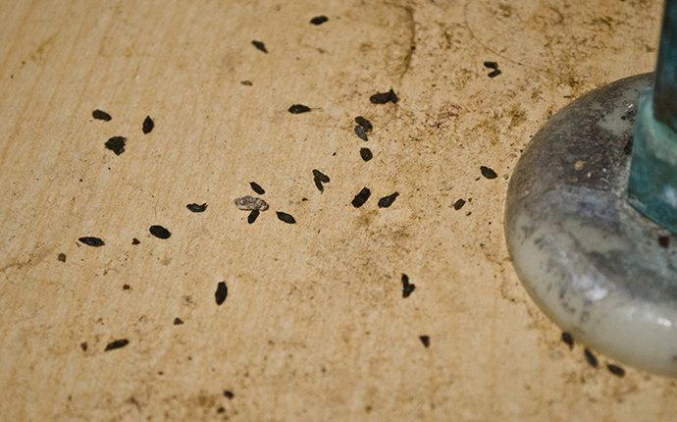
An Example Case…
Day 1: 1500 Seen in ER Fast-Track
CC: Bodyache, Fever, Chills
VS: 140/86
P 116
O2 94
RR 18
T 36.6
Credit: iconfinder.com
Credit: Romney Pest Control

Slide 2
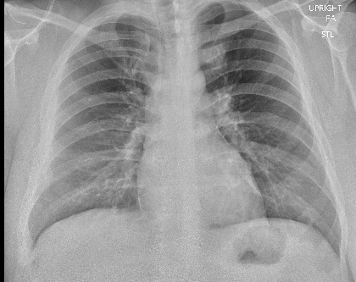
Exam:
Gen: Well appearing
HEENT: Benign
CV: tachy
Resp: clear, no wheeze
Abd: Benign
Neuro: Benign
Labs:
XR:
WBC | 9.0
Hb | 16.4
Plt | 231
Neutrophils | 78.2%
Bands | 0
Blasts | None
COVID PCR | Neg
Dx: Viral URI
Disposition: Discharge

Slide 3

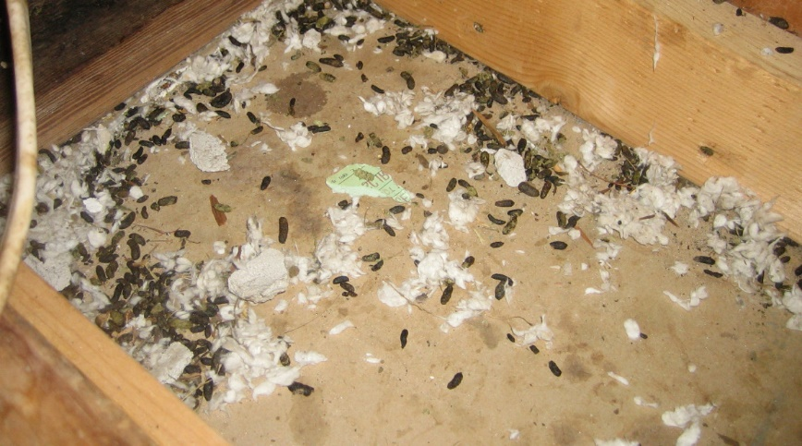
…ED Return
Day 5: EMS return to ED at 0730
CC: Abdominal Pain/Vomiting
BP 136/92
HR 120
O2 93%
RR 18
T 98.4
Credit: iconfinder.com
Credit: Romney Pest Control

Slide 4
Exam:
Gen: Well appearing
HEENT: Benign
CV: tachy
Resp: tachypneic, no wheeze
Abd: Benign
Neuro: Benign
Interventions:
IVF (2L Lactated Ringers)
Labs including Lactate
EKG
Anti-emetics
Reassessment, possible imaging
Working Dx: Viral Gastroenteritis

Slide 5
 | Day 1 | Day 5
WBC | 9.0 | 17.1
Hb | 16.4 | 19.7
Plt | 231 | 102
Neutrophils | 78.2% | 79%
Bands | 0 | 8%
Blasts | None | None
COVID PCR | Neg | Neg

Slide 6

0930 (2 hours in): BP 125/70 HR 145 RR 32 O2 75% on RA
Worsening SOB, with new hypoxia
Escalating O2, placed on NRB at 15L
Moved to Main ED Resuscitation Bay
0945
POCUS: Hyperdynamic Echo with good EF, diffuse B lines in all fields
Placed on 10/5 BiPAP at 100% with improved work of breathing
XR ordered…
Credit: iconfinder.com

Slide 7
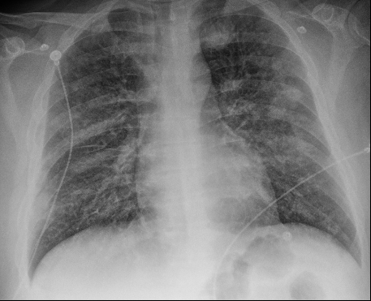
Day 1
Day 5 (after 2L IVF):

Slide 8
1015 (2:45 since arrival) - UNM ICU accepted. Recommends:
Fluid restriction
BiPAP for respiratory support
Avoid intubation if possible
1215 – Depart for UNM ICU via fixed wing on BiPAP
BP 105/65 HR 110 RR 28 O2 94% on 10/5 100% FiO2
1800 – respiratory decompensation in UNM ICU
Intubated
Placed on ECMO

