Slide 1



Review of Evidence for Treatment of Methamphetamine Use Disorder
Jasen Christensen, DO
Associate Professor
Department of Psychiatry and Behavioral Sciences
UNM School of Medicine

Slide 2
No Disclosures

Slide 3
Learning Objectives
Be aware of strength of evidence for psychosocial interventions for methamphetamine use disorder
Be aware of evidence supporting the use of specific medications for methamphetamine use disorder

Slide 4
For patients on buprenorphine for OUD who are also wrestling with Methamphetamine Use
Don’t give up on them
Resist requiring methamphetamine-free urine as a requirement to continue buprenorphine treatment
Continuing buprenorphine will reduce mortality regardless of methamphetamine use
Always co-prescribe naloxone (Narcan) with buprenorphine

Slide 5
Psychosocial Interventions for
Methamphetamine Use Disorder
Motivational Interviewing
Empathy through reflective listening, identifying discrepancies, avoiding arguments/confrontations, adjusting to resistance, supporting self-efficacy and optimism
- Strong Evidence
- reduced # of days of stimulant use
- reduced amount of stimulant used per day
https://store.samhsa.gov/sites/default/files/SAMHSA_Digital_Download/PEP20-06-01-001_508.pdf

Slide 6
Psychosocial Interventions for
Methamphetamine Use Disorder
Cognitive Behavioral Therapy
Short-term, goal-oriented, insight can lead to changes in thinking and behavior
- Strong Evidence
- reduced quantity of stimulant used per week
- reduced frequency of stimulant use
- reduced risky sexual behaviors
https://store.samhsa.gov/sites/default/files/SAMHSA_Digital_Download/PEP20-06-01-001_508.pdf

Slide 7
Psychosocial Interventions for
Methamphetamine Use Disorder
Community Reinforcement Approach
Originally developed for AUD - modified for stimulant use disorder
Identifies behaviors reinforcing use and works toward lifestyle changes (relationship counseling, job skills)
- Strong Evidence
- reduced addiction severity
- reduced number of weeks of usage
- reduced frequency per week
https://store.samhsa.gov/sites/default/files/SAMHSA_Digital_Download/PEP20-06-01-001_508.pdf

Slide 8
Psychosocial Interventions for
Methamphetamine Use Disorder
Contingency Management
Operant Conditioning - desired behaviors are reinforced with prizes, privileges or cash
- Strong Evidence
- Reduced number of days of stimulant use
- Reduced stimulant cravings
- Reduced HIV risk behaviors
https://store.samhsa.gov/sites/default/files/SAMHSA_Digital_Download/PEP20-06-01-001_508.pdf

Slide 9
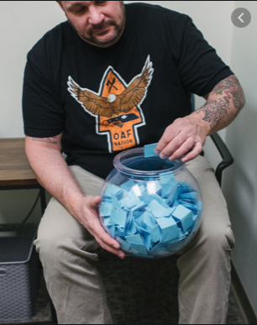
Contingency Management
Nancy Petry’s “Fishbowl technique”
Cards indicating prizes drawn from fishbowl
Based on number of methamphetamine-free urines
Escalating reward
1 card for first meth-free urine
2 cards for second sequential meth-free urine
3 cards for third sequential…etc
Start over if meth + urine

Slide 10
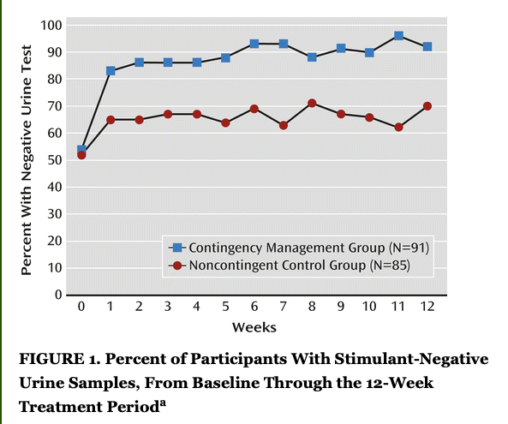
Contingency Management for Stimulant use in
Patients with Serious Mental Illness
Those in CM group were 2.4 times as likely to submit negative urine.
P<0.05
McDonell M, et al. Randomized Controlled Trial of Contingency Management for Stimulant Use in Community Mental Health Patients with Serious Mental Illness. American Journal of Psychiatry. 2013 January

Slide 11
Medications for Methamphetamine Use Disorder
VA finds (2015) there is insufficient evidence to recommend for or against use of any pharmacotherapy.
American Society of Addiction Medicine Handbook (2016):
- psychosocial interventions appear to be effective for selective individuals.
- no medical agent has consistently been shown to be effective…

Slide 12
Mirtazapine vs Placebo in 60 MSM patients with MUD
Urine Positivity decreased from 67% to 63% in placebo group
Urine Positivity decreased from 73% to 44% in Mirtazapine group
NNT to achieve a negative weekly urine test result was 3.1
Methamphetamine contributes to HIV transmission among MSM
High risk sexual behaviors significantly decreased among Mirtazapine group vs placebo:
# of male partners with whom methamphetamine was used (P=.009)
# of male partners (P=.04)
episodes of unprotected anal sex with unprotected partners (P=.003)
Colfax, et al. Mirtazapine to reduce methamphetamine use: a randomized controlled trial. Archives of General Psychiatry. 2011 Nov:68(11): 1168-75.

Slide 13
Mirtazapine 30mg vs Placebo in 120 cisgender men and
transgender women with MUD who had sex with men
 | Methamphetamine + Urine | Changes in sexual risk behaviors | Depression and Insomnia
12 weeks | RR 0.67 | No significant change | No significant change
24 weeks | RR 0.75 | Fewer partners and fewer episodes of condomless anal sex with serodiscordant partners | Depression reduction (P=.01) Insomnia reduction (P=.05)
Coffin P, et al. Effects of Mirtazapine for Methamphetamine Use Disorder Among Cisgender Men and Transgender Women Who Have Sex With Men: A Placebo-
Controlled Randomized Clinical Trial. JAMA Psychiatry 2020 March 1;77(3):246-255.

Slide 14
Bupropion 300mg vs Placebo for 12 weeks in 150
patients with Methamphetamine Dependence
Overall difference between Bupropion and Placebo was not statistically different (P=0.09)
Analysis of those with lower-level of meth use (less than 18 of last 30 days) at baseline showed reduction in use (P<0.001)
This was regardless of comorbid depression
Elkashef AM, et al. Bupropion for the treatment of methamphetamine dependence. Neuropsychopharmacology. 2008 April 33(5): 1162-70

Slide 15
Bupropion 300mg daily vs placebo for 12 weeks in 73 patients with Methamphetamine Dependence.
No effect on heavier users
Increased likelihood of methamphetamine-free week among lighter users
(Odds Ratio=2.81, p<0.001)
Shoptaw S, et al. Randomized, placebo-controlled trail of bupropion for the treatment of methamphetamine dependence. Drug and Alcohol Dependence
2008 Aug; 96(3):222-32

Slide 16
Bupropion + Naltrexone
Bupropion XL rapidly raised in 3 days to 450mg
+
Naltrexone extended-release injectable 380mg Q3 weeks
12-week trial at 8 sites
403 patients randomized
Trivedi MH, et al. Bupropion and Naltrexone in Methamphetamine Use Disorder. The New England Journal of Medicine. 2021 Jan, 384;2.

Slide 17
Bupropion + Naltrexone
Twice Weekly Utox was obtained
Response: at least 3 methamphetamine negative samples out of 4 obtained at the end of 6 weeks
Stage 1: 16.5% of naltrexone+bupropion group had response vs. 3.4% of placebo
Stage 2: 11.4% of naltrexone+bupropion group had response vs. 1.8% of placebo
Weighted average response across the two stages was 13.6% vs 2.5%
Overall treatment effect of 11.1% (P<0.001)
Trivedi MH, et al. Bupropion and Naltrexone in Methamphetamine Use Disorder. The New England Journal of Medicine. 2021 Jan, 384;2.

Slide 18
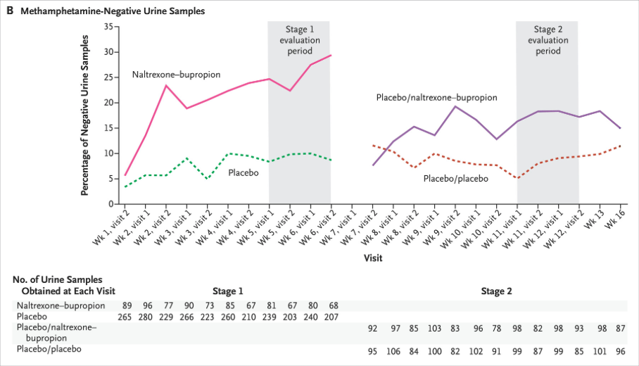
Trivedi MH, et al. Bupropion and Naltrexone in Methamphetamine Use Disorder. The New England Journal of Medicine. 2021 Jan, 384;2.

Slide 19
Aripiprazole vs placebo for 12 weeks in 90 patients with Methamphetamine Dependence
No difference reduction in methamphetamine-positive urines
No reduction in sexual risk behavior
Coffin P, et al. Aripiprazole for the treatment of methamphetamine dependence: A randomized, double-blind, placebo-controlled trial. Addiction.
2012 November 108(4).

Slide 20
Other Medications
Disulfram - some evidence
Modafinil - some evidence
Naltrexone PO - some evidence
Topiramate - not supported by evidence
Adderall XR - some evidence
Methylphenidate - some evidence
Haile C, et al. Pharmacotherapy for Stimulant-Related Disorders. Current Psychiatry Reports. 2013 October. 15(415)
Ling W, et al. Sustained-release methylphenidate in a randomized trial of treatment of methamphetamine use disorder. Addiction 2014 October. 109(9) 1489-1500.

Slide 21
Questions
Have you tried using medications to treat Methamphetamine Use Disorder?
What have you seen work / not work?

