Slide 1
Medical Cannabis and Chronic Pain Management
James J. Gasper, PharmD, BCPP
National Clinician Consultation Center
University of California, San Francisco
August 4, 2022

Slide 2

Acknowledgement
This National Clinician Consultation Center program is supported by the Health Resources and Services Administration (HRSA) of the U.S. Department of Health and Human Services (HHS) as part of an award totaling $2,633,756 with 0% financed with non-governmental sources.
The content in this presentation are those of the author(s) and do not necessarily represent the official views of, nor an endorsement, by HRSA, HHS, or the U.S. Government. For more information, please visit HRSA.gov.

Slide 3
Disclaimer
Funding for this presentation was made possible [in part, if applicable] by U1OHA30039 from the Human Resources and Services Administration HIV/AIDS Bureau. The views expressed do not necessarily reflect the official policies of the Department of Health and Human Services nor does mention of trade names, commercial practices, or organizations imply endorsement by the U.S. Government. Any trade/brand names for products mentioned during this presentation are for training and identification purposes only.

Slide 4
Disclosures
Marijuana is not FDA approved
Off-label use of FDA approved cannabinoids (dronabinol, nabilone, cannabidiol) may be discussed

Slide 5
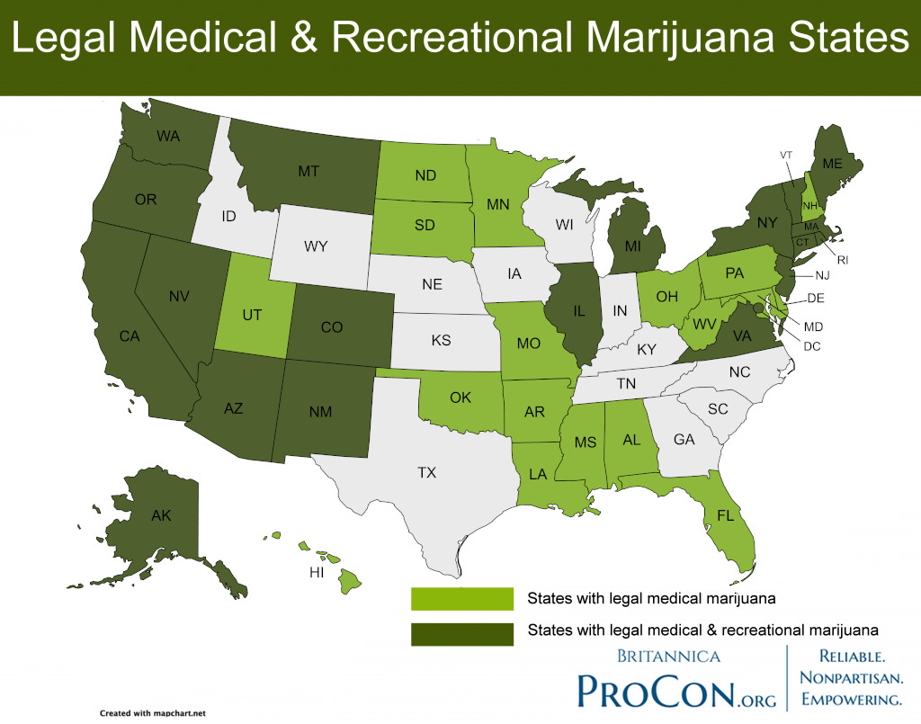
Notes:
36 states and 4 territories with medical use
16 states and 3 territories with recreational use

Slide 6
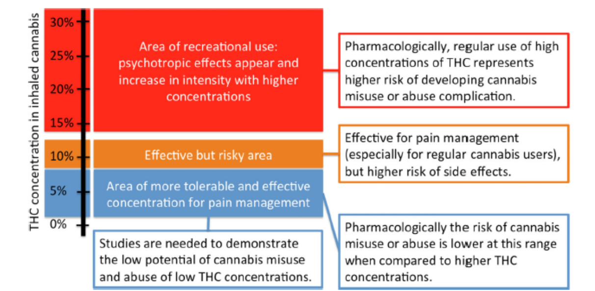
Recreational vs. Medicinal
2017
~ 17%
2008
~ 9%
Pharmacotherapy 2018;38:651-662
Eur Arch Psych Clin Neuro 2019;269:5-15
Notes:
Concentrations 1-3% demonstrate efficacy for chronic pain, similar outcomes between low and higher concentrations
Conversion to a use disorder is about 20% of those who use daily
Psychosis risk is THC and frequency dependent (young adult conversion to SCZ or bipolar is 50% for cannabis induced psychosis in young adults

Slide 7
Cannabis Formulations
FDA approved products
Dronabinol- synthetic THC
Nabilone- synthetic THC
Cannabidiol- plant derived CBD oil
Products approved in other countries
Nabiximols- plant derived THC/CBD (1:1)
Retail cannabis products
plant, creams, oils, gels, gummies, tonics, patches, etc…

Slide 8
Cannabis Pharmacology
Two primary active components
Delta-9-tetrahydrocannabinol (THC)
Cannabidiol (CBD)
Two primary receptors
Cannabinoid receptor type 1 (CB1)
Cannabinoid receptor type 2 (CB2)
Pharmacotherapy 2018;38:651-662
Notes:
Combined with terpenes comprise the entourage effect. Most studies on oral refined products.
Endogenous cannabinoids- endocannabinoids (anandamide, 2-arachidonylglycerol)
THC activates both CB1 and CB2
CBD works through other mechanisms including allosteric modulation of CB1

Slide 9
Cannabis and Chronic Pain Research
Indication | Total Number of Studies | Oral | Oromucosal Spray | Smoked | Vaporized
MS related pain | 11 | 3 | 7 | 1 | -
Neuropathic | 12 | - | 5 | 4 | 3
Cancer | 3 | 1 | 2 | - | -
Mixed Pain syndromes | 2 | 1 | 1 | - | -
Ann Intern Med 2017;167:319-331, Can Fam Physician 2015;61:e372-81
Notes:
These studies were small with rarely more than 30 patients in a treatment group
All placebo controlled or cross over for active controls (dihydrocodeine)
Many patients were on opioids or other analgesics
Chronic pain- mixed bag more reflective of patients we see in primary care settings vs neurology clinics where MS related spasticity is more common

Slide 10
Summary of Evidence
Multiple Sclerosis: no consistent effect on pain
Neuropathic: meta-analysis of 9 studies found ≥ 30% improvement in pain
Cancer: no consistent effect
Mixed pain syndromes: small improvements, limited data
Ann Intern Med 2017;167:319-331
Can Fam Physician 2015;61:e372-81

Slide 11
Neuropathic Pain and Smoked Cannabis
HIV peripheral neuropathy
Ellis et al. 2009 (1-8% THC vs placebo)
46% vs 18% with reduction in pain
Abrams et al. 2007 (3.56% THC vs placebo)
52% vs 24% with reduction in pain
Mixed neuropathic pain syndromes
Wilsey et al. 2008 (7% THC vs placebo)
61%vs 26% with reduction in pain
Ware et al. 2009 (2.5-9.4% vs placebo)
Average daily pain intensity lower with 9.4% vs placebo
Ann Intern Med 2017;167:319-331, Can Fam Physician 2015;61:e372-81
Notes:
Small studies with < 60 pts total
Some dosed to tolerability in the range given, others compared sequentially with washout in between
All allowed concurrent analgesics
Ellis and Abrams were cross overs
Ellis and Wilsey > 50% using opioids
Ellis reported opioid use which did not change from baseline

Slide 12
Neuropathic Pain: All cannabis products
Pooled Analysis of all medications:
NNTB = 20 for 50% or greater pain relief
NNTB = 11 for pt global impression change
NNTH = 25 discontinuation for adverse affects
16 studies (2 dronabinol, 2 nabilone, 10 oromucosal spray, 2 smoked cannabis)
NNTB- number needed to treat for an additional beneficial outcome
NNTH – number needed to treat for an additional harmful outcome
Cochrane 2018, Issue 3. Art No.:CD012182
Notes:
Cochrane Review cannabis based medications (herbal cannabis, plant derived/synthetic THC, THC/CBD oral mucosal spray) vs placebo for chronic neuropathic pain in adults
Pooled analysis of all medications

Slide 13
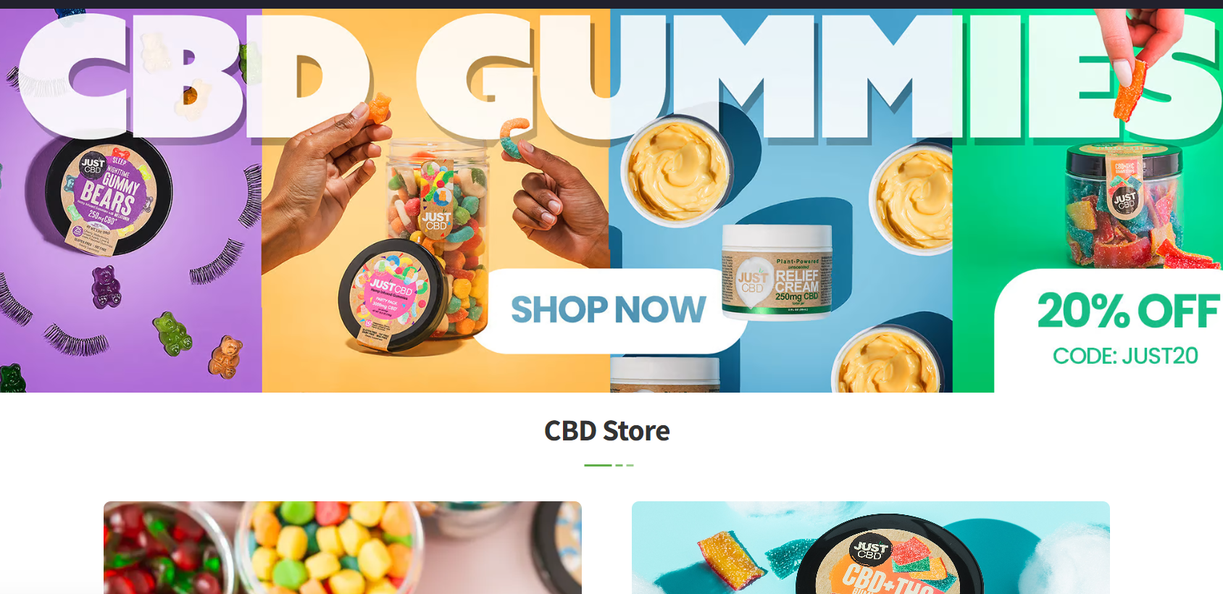
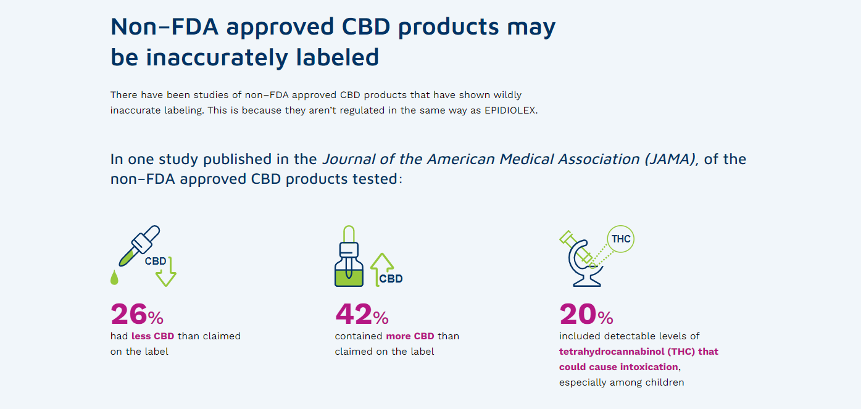
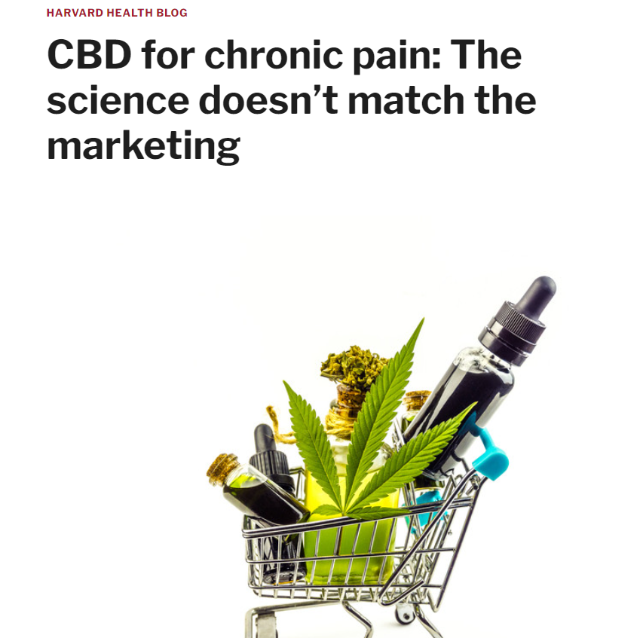
CBD and Analgesia

Slide 14
Co-administration with Opioids
Single dose dronabinol + baseline opioid
10 and 20mg doses superior to placebo for all pain measures
4 week open label + baseline opioid
Pain improved across all time points
(median MME 47.5mg for > 2 years)
Narang et al. J Pain 2008;9:254-264
Notes:
30 subjects
7 neuropathic pain, 7 nociceptive, 11 mixed neuropathic and nociceptive, 5 uncategorized
67% low back pain

Slide 15
Opioid Sparing?
Pre-clinical data meta-analysis
Effective dose of morphine 3.6 times less with THC than morphine alone (7 studies)
Effective dose of codeine 9.5 times lower with THC than codeine alone (2 studies)
Clinical data
No high-quality data is supportive
Neuropsychopharmacology 2017;42:1752-1765

Slide 16
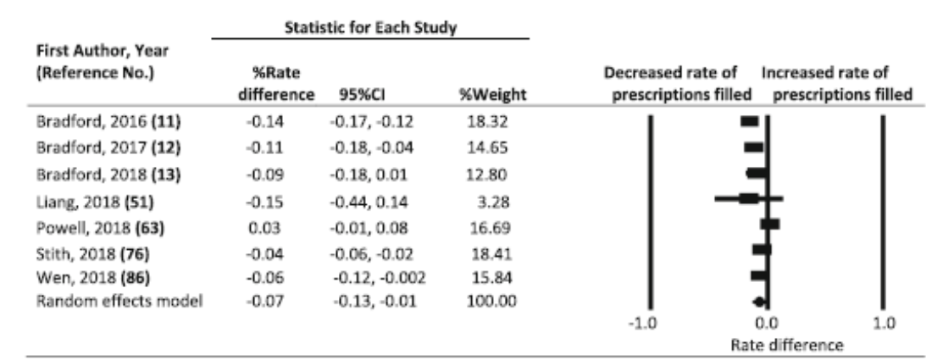
Cannabis Access and Opioid Prescriptions
No significant impact on opioid Rx’s
Injury Epidemiology 2019;6:38
Notes:
Injury Epidemiology 2019;6:38
BMJ 2021;372:m4957
Harm Reduction Journal 2017;14:58

Slide 17
Cannabis Access and Opioid Overdose Mortality
No significant impact on opioid overdoses
Injury Epidemiology 2019;6:38
Notes:
Injury Epidemiology 2019;6:38
BMJ 2021;372:m4957
Harm Reduction Journal 2017;14:58

Slide 18
Final Thoughts
Most research is on prescription products which are rarely used or preferred in practice
Less is more for the treatment of pain
Not likely to turn the tide on opioid consumption
Place in therapy?

Slide 19


The National Clinician Consultation Center is a free telephone advice service for clinicians, by clinicians.
Go to nccc.ucsf.edu for more information.
HIV/AIDS Warmline
800-933-3413
HIV treatment, ARV management, complications, and co-morbidities
Perinatal HIV Hotline
888-448-8765
Pregnancy, breastfeeding and HIV
Hepatitis C Warmline
844-HEP-INFO/
844-437-4636
HCV testing, staging, monitoring, treatment
Substance Use
Warmline
855-300-3595
Substance use evaluation and management
PrEPline
855-HIV-PrEP
HIV Pre-exposure prophylaxis
PEPline
888-448-4911
Occupational & non-occupational exposure management
This National Clinician Consultation Center program is supported by the Health Resources and Services Administration (HRSA) of the U.S. Department of Health and Human Services (HHS) as part of an award totaling $2,633,756 with 0% financed with non-governmental sources.
The content in this presentation are those of the author(s) and do not necessarily represent the official views of, nor an endorsement, by HRSA, HHS, or the U.S. Government. For more information, please visit HRSA.gov.

