Slide 1
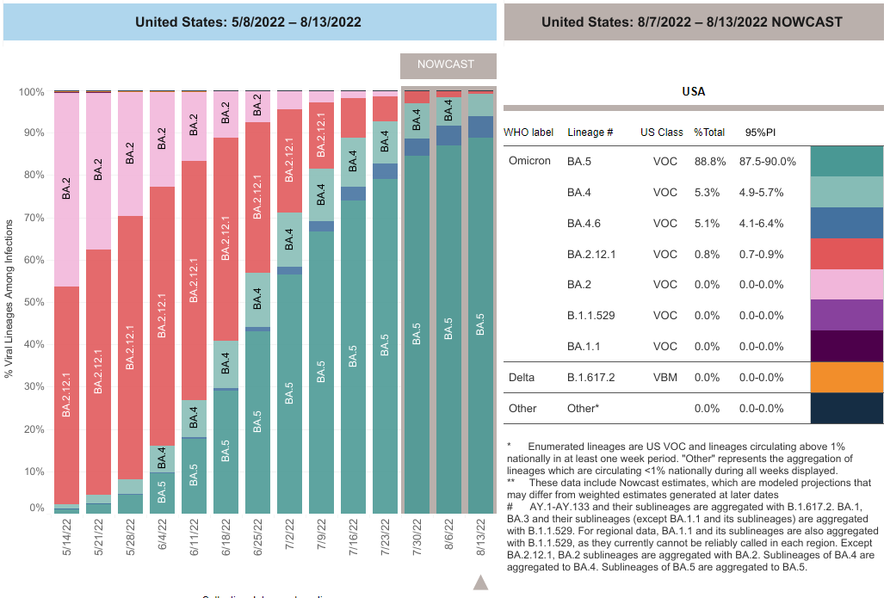
Burden of disease
  Infection has spread to more than 500 million confirmed cases worldwide
  In the US, as of Aug 6, 2022, 91.9 million cases have been reported and 1.03 million deaths
Omicron variant sublineages are associated with
  A higher risk of reinfection in individuals previously infected with other variants
  Breakthrough infection in vaccinated individuals
  Probably less severity
https://covid.cdc.gov/covid-data-tracker/#variant-proportions

Slide 2
Summary of Guidance for Minimizing the Impact of COVID-19 on Individual Persons, Communities, and Health Care Systems — United States, August 2022
Early Release / August 11, 2022 / 71
Monitoring COVID-19 Community Levels to guide COVID-19 prevention efforts. At all COVID-19 Community Levels (low, medium, and high), recommendations emphasize
Testing for current infection.
All symptomatic individuals and exposed individuals should be tested
When considering whether and where to implement screening testing of asymptomatic persons with no known exposure, consider prioritizing high-risk congregate settings, such as long-term care facilities, homeless shelters, and correctional facilities, and workplace settings that include congregate housing with limited access to medical care.
When implemented, screening testing strategies should include all persons, irrespective of vaccination status.
Managing SARS-CoV-2 exposures.
CDC now recommends case investigation and contact tracing only in health care settings and certain high-risk congregate settings
Staying up to date with vaccination
Improving ventilation,
Testing persons who are symptomatic and those who have been exposed,
Isolating infected persons.
Massetti GM, Jackson BR, Brooks JT, et al. Summary of Guidance for Minimizing the Impact of COVID-19 on Individual Persons, Communities, and Health Care Systems — United States, August 2022. MMWR Morb Mortal Wkly Rep. ePub: 11 August 2022.:

Slide 3
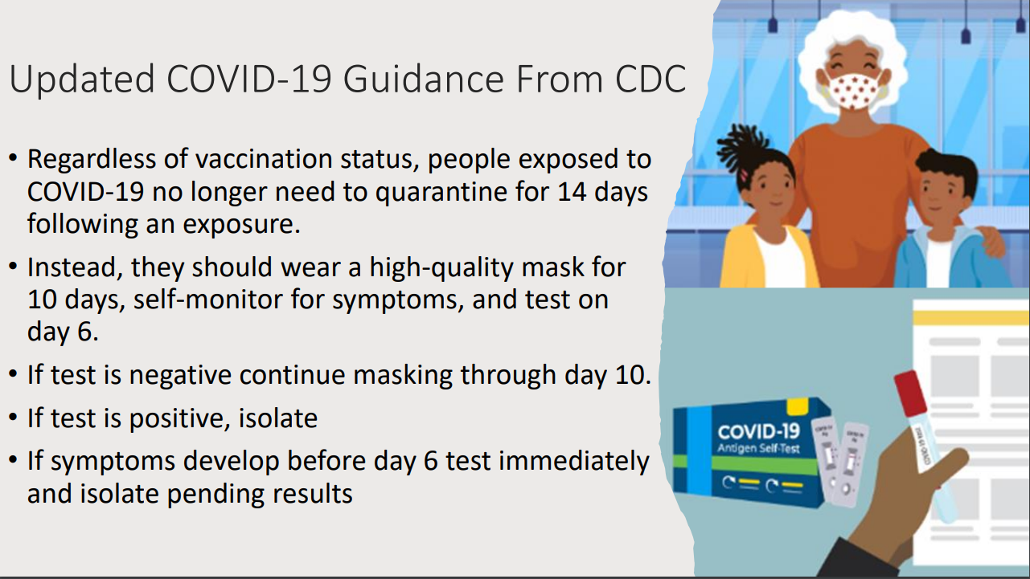

Slide 4
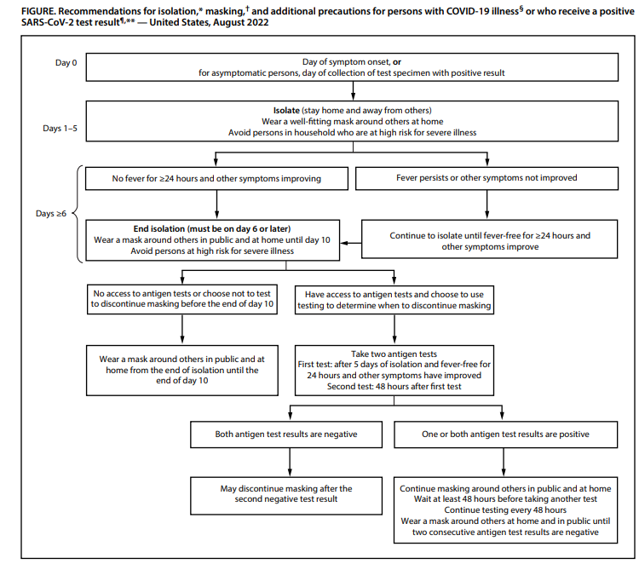
Massetti GM, Jackson BR, Brooks JT, et al. Summary of Guidance for Minimizing the Impact of COVID-19 on Individual Persons, Communities, and Health Care Systems — United States, August 2022. MMWR Morb Mortal Wkly Rep. ePub: 11 August 2022.:

Slide 5
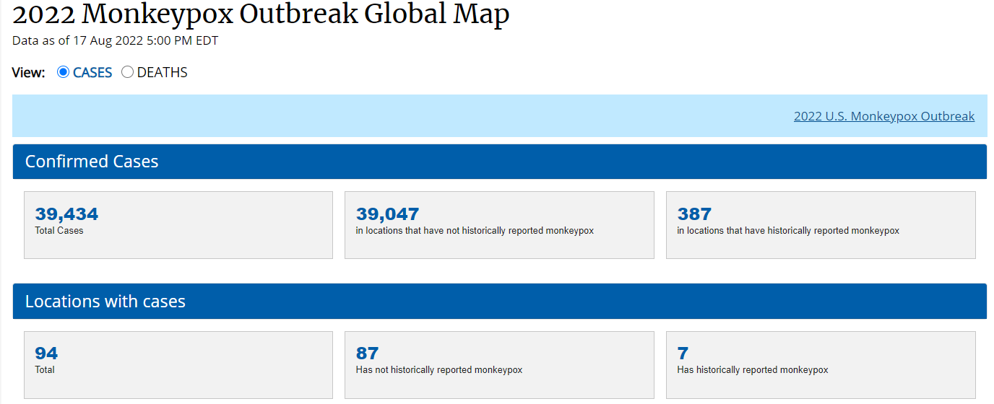
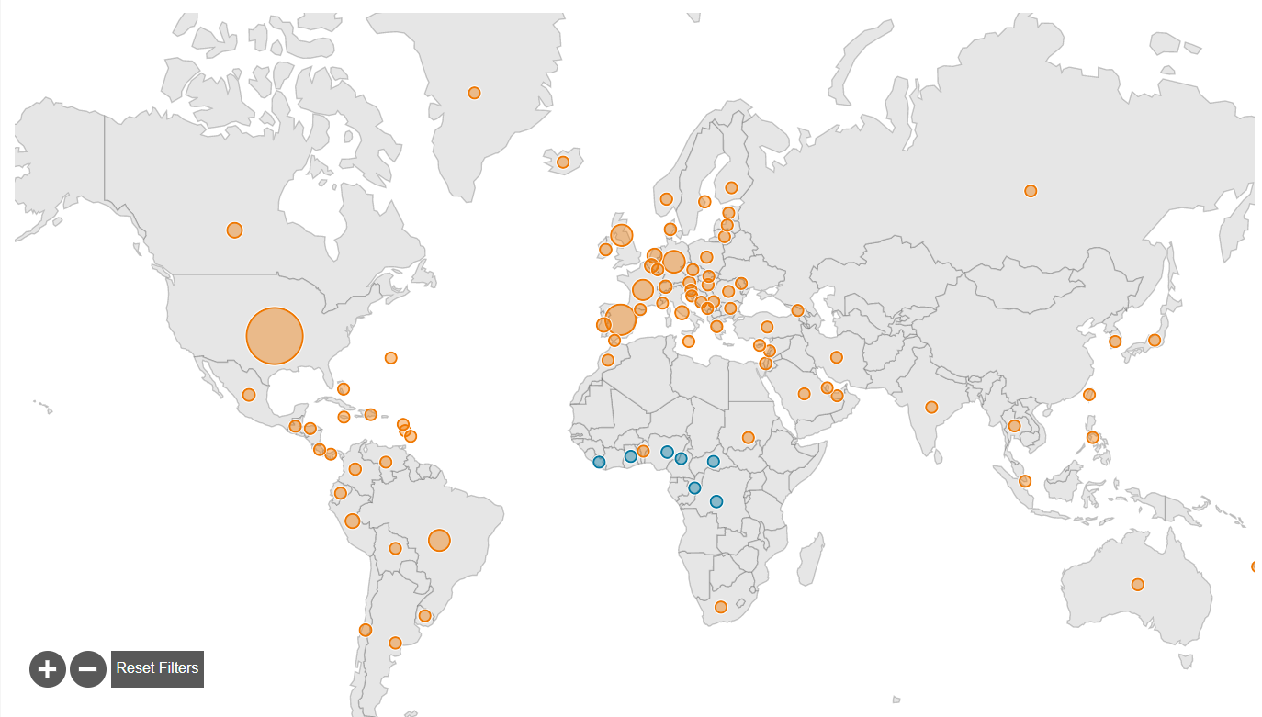
Monkeypox
The monkeypox virus is spreading mostly through close, intimate contact with someone who has monkeypox.
At this time, data suggest that gay, bisexual, and other men who have sex with men make up the majority of cases in the current monkeypox outbreak.
However, anyone, regardless of sexual orientation or gender identity, who has been in close personal contact with someone who has monkeypox is at risk.
CDC recommends vaccination for:
  People who have been exposed to monkeypox
  People who are at higher risk of being exposed to monkeypox.
https://www.cdc.gov/poxvirus/monkeypox/response/2022/index.html

Slide 6
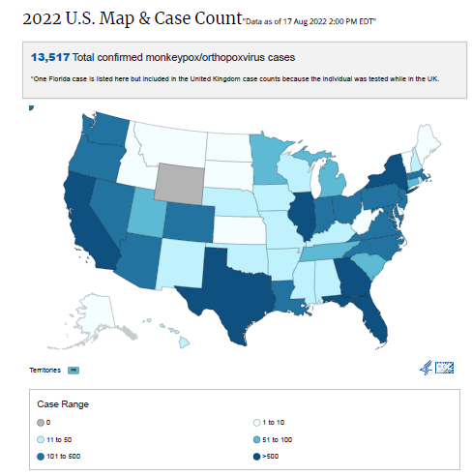
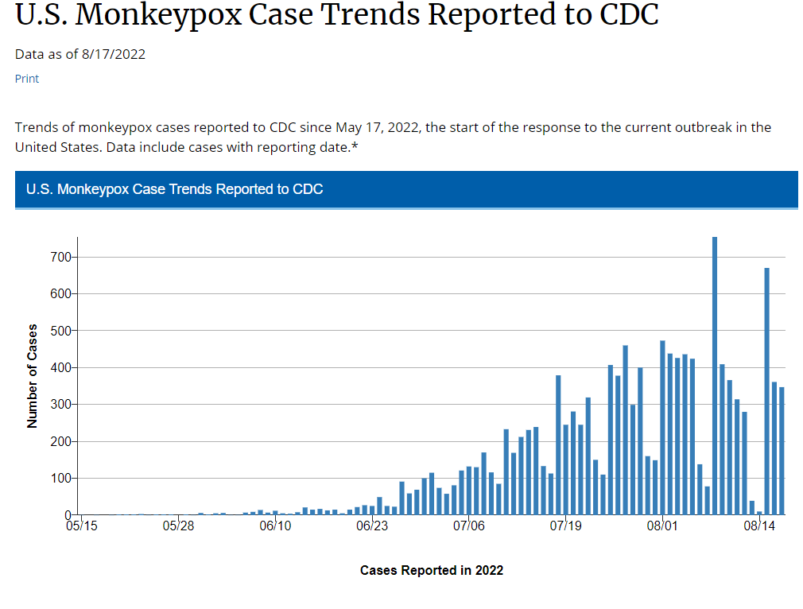
Monkey Pox Trends in the USA
https://www.cdc.gov/poxvirus/monkeypox/response/2022/index.html

Slide 7
Two Vaccines May be Used for the Prevention of Monkeypox Disease:
JYNNEOS is a third-generation vaccine based on a live, attenuated non-replicating orthopoxvirus
  Modified Vaccinia Ankara (MVA). MVA is a live virus that does not replicate efficiently in humans.
  Is used for the prevention of smallpox and monkeypox disease among people at high risk for infection
  Active immunization by intradermal injection for prevention of monkeypox disease in individuals 18 years of age and older determined to be at high risk for monkeypox infection.
  Active immunization by subcutaneous injection for prevention of monkeypox disease in individuals less than 18 years of age determined to be at high risk for monkeypox infection.
ACAM2000 is a second-generation vaccine indicated for the prevention of smallpox disease.
  It has been made available for use against monkeypox under an Expanded Access Investigational New Drug (EA-IND) protocol, which requires informed consent along with completing additional forms.
  ACAM2000 vaccine is approved for immunization against smallpox disease for people at high risk for infection.
  ACAM2000 contains a live vaccinia virus that is replication-competent in humans.
  Available evidence supporting the use of smallpox vaccine for monkeypox prevention is derived from the vaccine used during smallpox eradication,
In the context of limited vaccine supply, JYNNEOS
  Vaccine doses should be prioritized for people who are at high risk for severe disease caused by infection with the Monkeypox virus (including, but not limited to, people with HIV infection or other immunocompromising conditions, who are pregnant, or who are at increased risk for serious adverse events following ACAM2000 vaccination).
https://www.cdc.gov/poxvirus/monkeypox/interim-considerations/overview.html

Slide 8
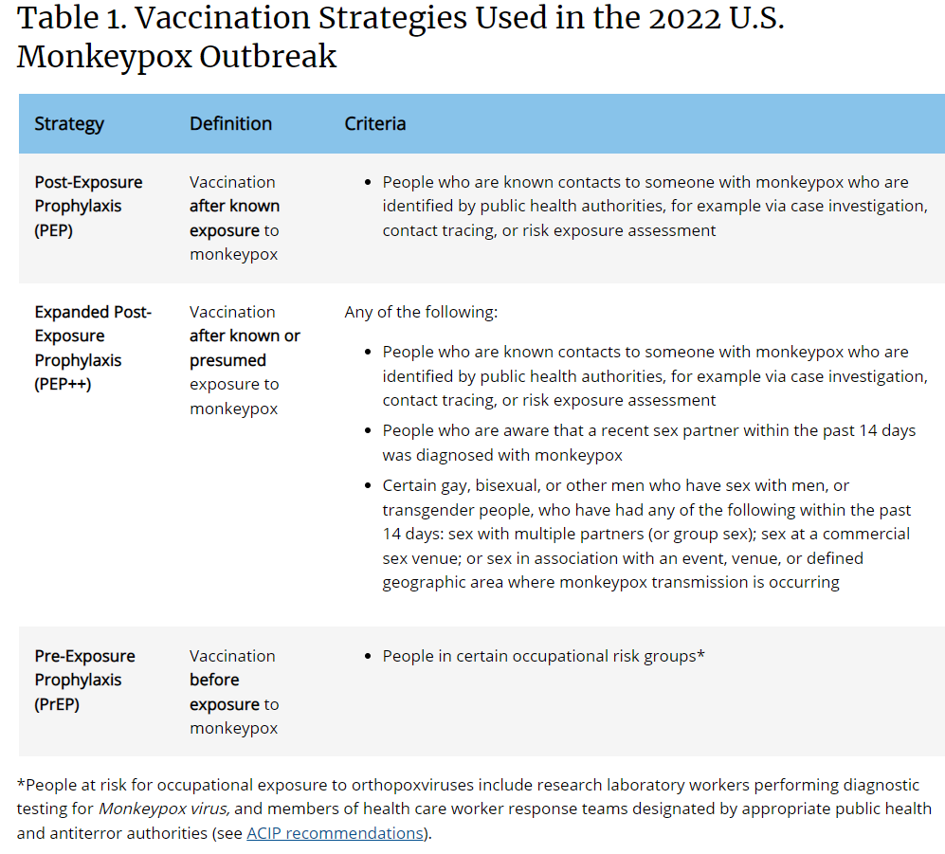
https://www.cdc.gov/poxvirus/monkeypox/interim-considerations/overview.html

