Slide 1
Narcan Access WA State

Slide 2
WA STATE STANDING ORDER
Several laws in WA State allow persons to possess and administer naloxone and provide immunity from liability when assisting in an overdose.
Possessing, using and distributing naloxone WA State law RCW 69.50.315 allows anyone “at risk for having or witnessing a drug overdose” to obtain naloxone and administer it in an overdose. This includes people who use opioids, family members, friends and professionals.
WA State’s 2015 "Naloxone law” ESHB 1671 also permits naloxone to be prescribed directly to an "entity" such as a police department, homeless shelter or social service agency. Together, these laws allow a community agency to have naloxone on site and its employees to carry and administer naloxone in an overdose event. ESHB 1671 also permits non-medical persons to distribute naloxone under a prescriber's standing order (see side box). Immunity from liability Several laws in WA State (commonly called “Good Samaritan” laws) give certain protections to laypersons trying to assist in a medical emergency.
RCW 4.24.300 provides immunity from civil liabilities when responding in a medical emergency.
RCW 69.50.315 further protects both the overdose victim and the person assisting in an overdose from prosecution for misdemeanor drug possession. The 2 injection and 2 intranasal products currently available.
In a standing order, a prescriber authorizes specific people (e.g., health educator, counselor, syringe exchange volunteer) to conduct specific tasks within specific protocols on behalf of that prescriber. For example, a medical director, advising physician or local health officer could issue a standing order to allow trained staff to distribute naloxone to clients at risk for overdose.
Notes:
Washington public health officials have been trying to get Naloxone, a medication that reverses opioid overdoses, to as many people as possible. The state’s top doctor aided this push Wednesday by making Naloxone available to anyone through a pharmacy.
Dr. Kathy Lofy, the state’s health officer, signed a “standing order” for Naloxone, also known by the brand name Narcan. The order is statewide and allows any person or organization to obtain the medication from a pharmacy without a prescription.
“Making it easier to access and distribute this lifesaving medication to people who need it is an important step in addressing the opioid crisis and reducing overdose deaths in our state,” Lofy said in a statement.

Slide 3
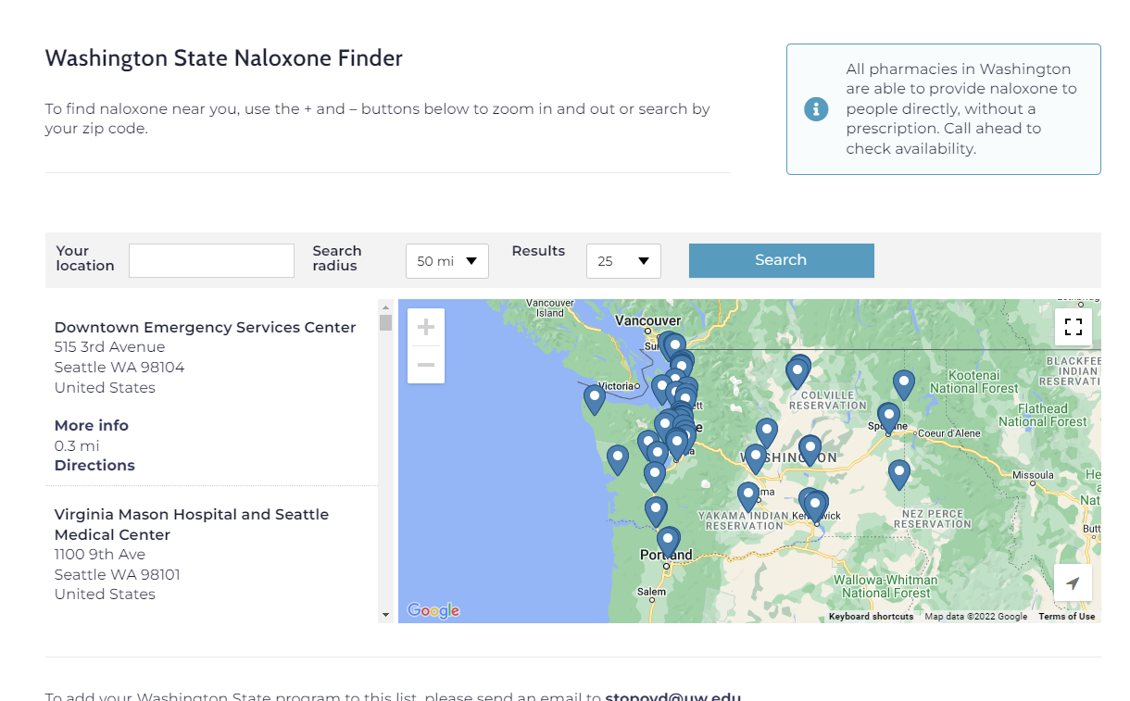
WHERE
https://stopoverdose.org/find-naloxone-near-me-washington-state/
Notes:
https://stopoverdose.org/find-naloxone-near-me-washington-state/
This tool will show WHERE Narcan can be accessed in areas near you

Slide 4
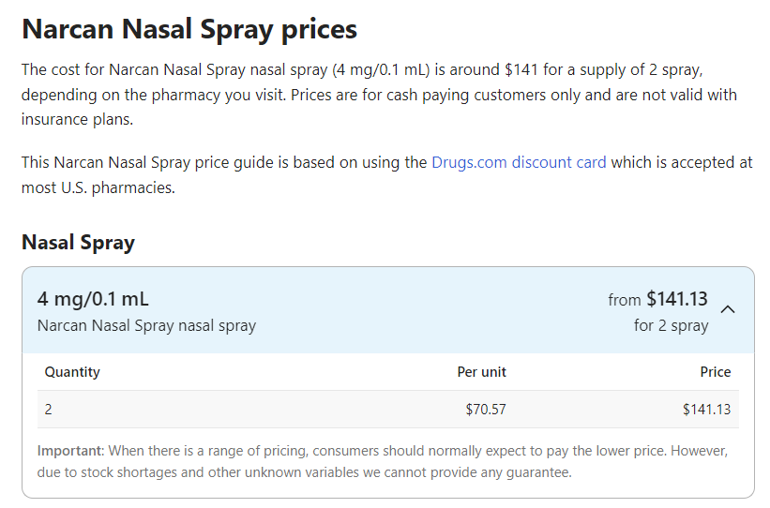
HOW
COST
If one overdose takes 4-5 doses
~$423.42 for each reversal
This is not reasonable or accessible
Notes:
https://www.drugs.com/price-guide/narcan-nasal-spray
HOW do you afford it?

Slide 5
Free access
http://phra.org/mail-order-naloxone
https://www.kelley-ross.com/polyclinic/ll/
https://docs.google.com/forms/d/e/1FAIpQLSd4Wut2Ai5SANt3ZAHj7WOC5KynstN9vcfzIXYIp9bNg6iVyw/viewform
https://docs.google.com/forms/d/e/1FAIpQLSfz0RWLF51FVtZDvrXlOAV07XctZB1AvOS7-uRwyktMXEroGg/viewform
https://stopoverdose.org/find-naloxone-near-me-washington-state/

Slide 6
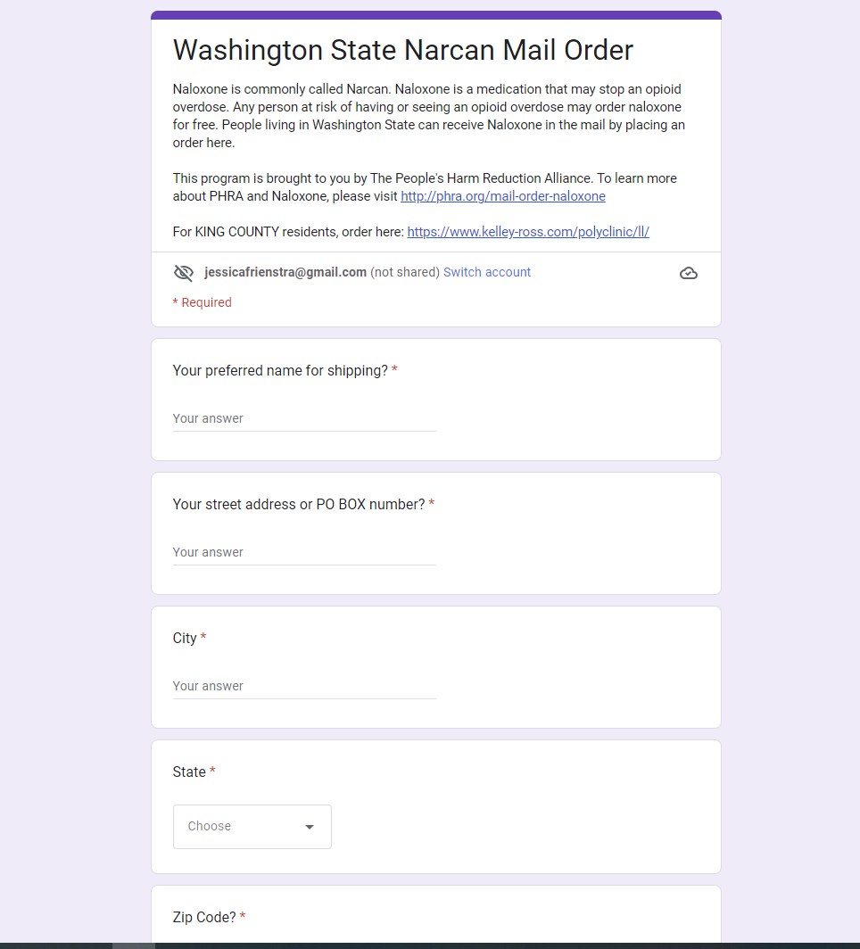
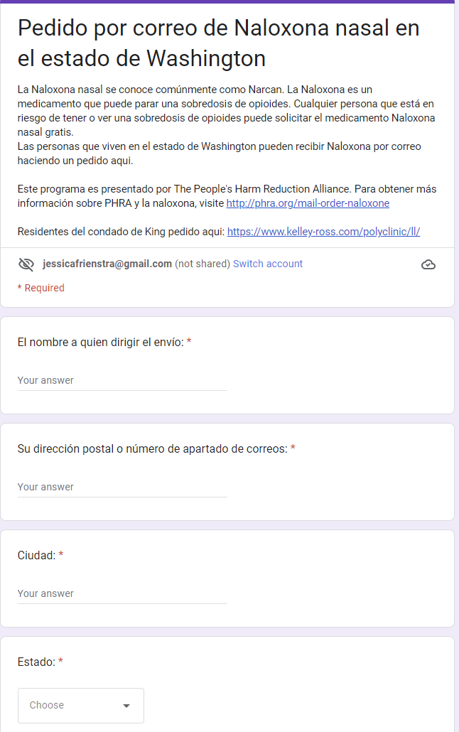
http://phra.org/mail-order-naloxone
Notes:
What about those who don’t have access to internet? Or an address to have this sent to?

Slide 7
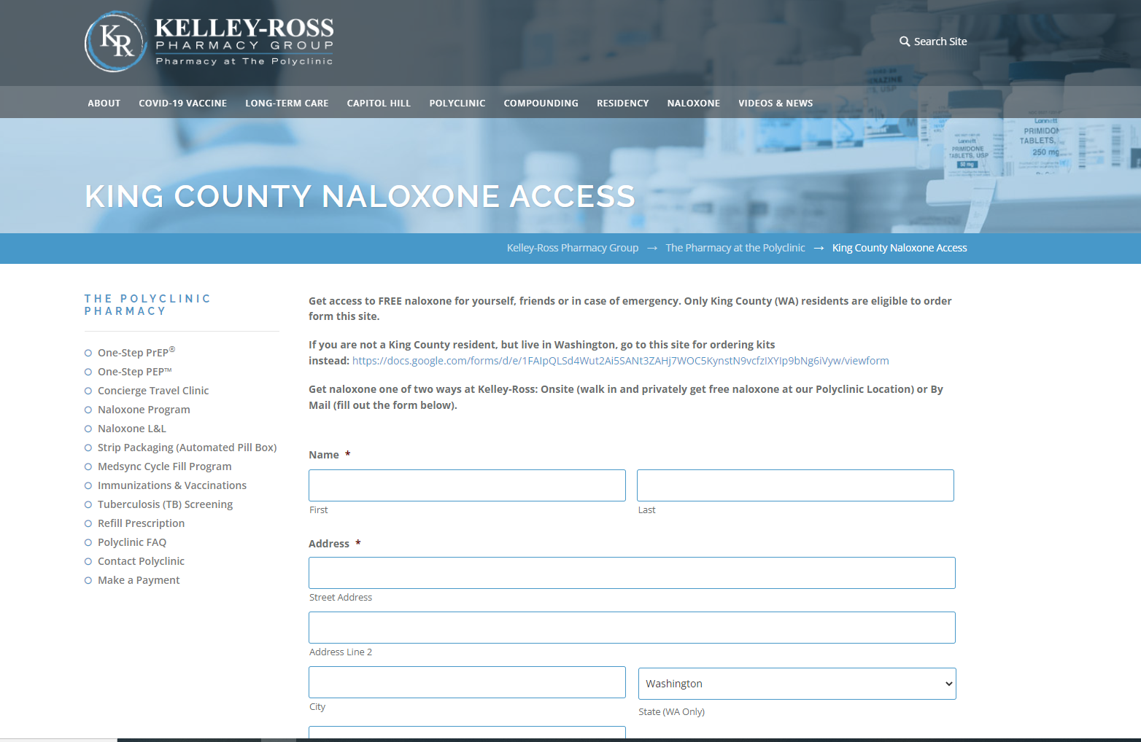
King County Only https://www.kelley-ross.com/polyclinic/ll/

Slide 8
Where else?
PCP can prescribe
Tribal health centers
SSPs
County Dohs
And?

