Slide 1
Agenda
During this meeting, participants will discuss
Naloxone Basics
  What it is and how it works
  Naloxone forms and cost
  Ordering naloxone from a buyers’ club/organization, manufacturer, distributor
Naloxone distribution strategies, challenges and questions for programs to consider
Naloxone access pathways for different areas

Slide 2

Naloxone:
What it is, how it works
Naloxone is
  A rescue medication that rapidly reverses an opioid overdose
  An opioid antagonist.
    Naloxone attaches to opioid receptors and reverses and blocks the effects of other opioids.
Naloxone can quickly restore normal breathing to a person whose breathing has slowed or stopped because of an opioid overdose.
Naloxone only works in the body for 30 to 90 minutes. It is important to seek medical care after an overdose.
More information: Naloxone DrugFacts | National Institute on Drug Abuse (NIDA) (nih.gov)
Notes:
Antagonist: A substance that interferes with or inhibits the physiological action of another.

Slide 3
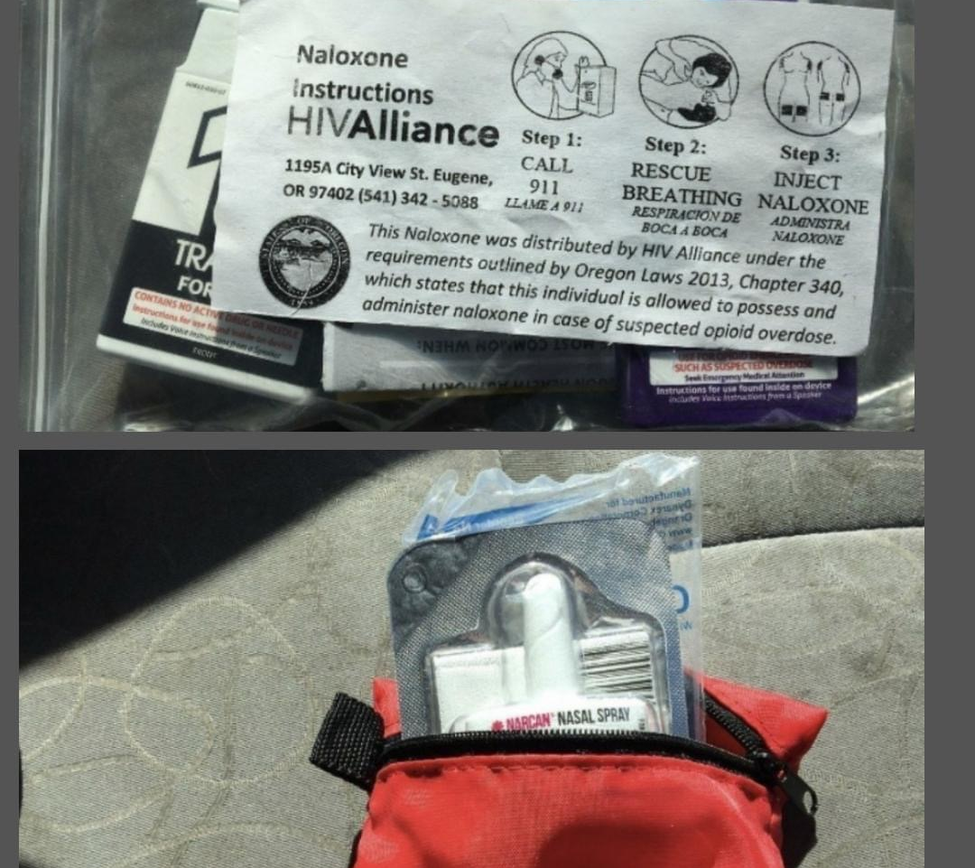
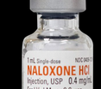
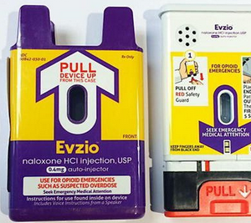
Forms of naloxone
Ordering naloxone in Oregon
Injectable $
Prepackaged nasal Spray $$
Auto injector $$$
If your organization has a MD, DO, NP or PA on staff, these clinicians may order naloxone for you to have onsite or to carry on outreach activities.
If you do not have a staff member with prescribing capabilities, a pharmacist may prescribe naloxone to a person or an organization.

Slide 4
Naloxone Distribution Start-up Tasks
Naloxone purchase/access plan [more than one source/funder]
Purchase plan for overdose reversal kit supplies
Storage plan for naloxone and kit supplies
Inventory distribution/tracking plan/system for naloxone and kit supplies
Participant/community member naloxone kit distribution tracking plan/system [lowest barrier, protects client confidentiality, and collects required information]
Overdose reversal report tracking plan [lowest barrier, protects client confidentiality, and collects required information]

Slide 5
Information and Resources for Programs
Indian Country ECHO Resources
  Indian Country ECHO Naloxone information and resources:
  Naloxone Overview Video: https://youtu.be/WwTcXVPP-8g
OHA Naloxone Resource Page
  Oregon Health Authority : Naloxone Rescue for Opioid Overdose : Opioid Overdose and Misuse : State of Oregon
Community and Non-Governmental Organizations (NGOs)
NASEN – Dave Purchase Project – Buyers Club for purchasing
Next Distro – operates in NY, CA, MI, OK, NV. There is an individual application process, individuals who live within the vicinity of a syringe access program are not eligible. https://nextdistro.org/distrootherstates
Direct Relief – extended medication access for healthcare facilities and licensed medical professionals
Oregon Specific: Save Lives Oregon for entities that provide direct services to people who use drugs and people at risk of overdose

Slide 6
Extra

Slide 7
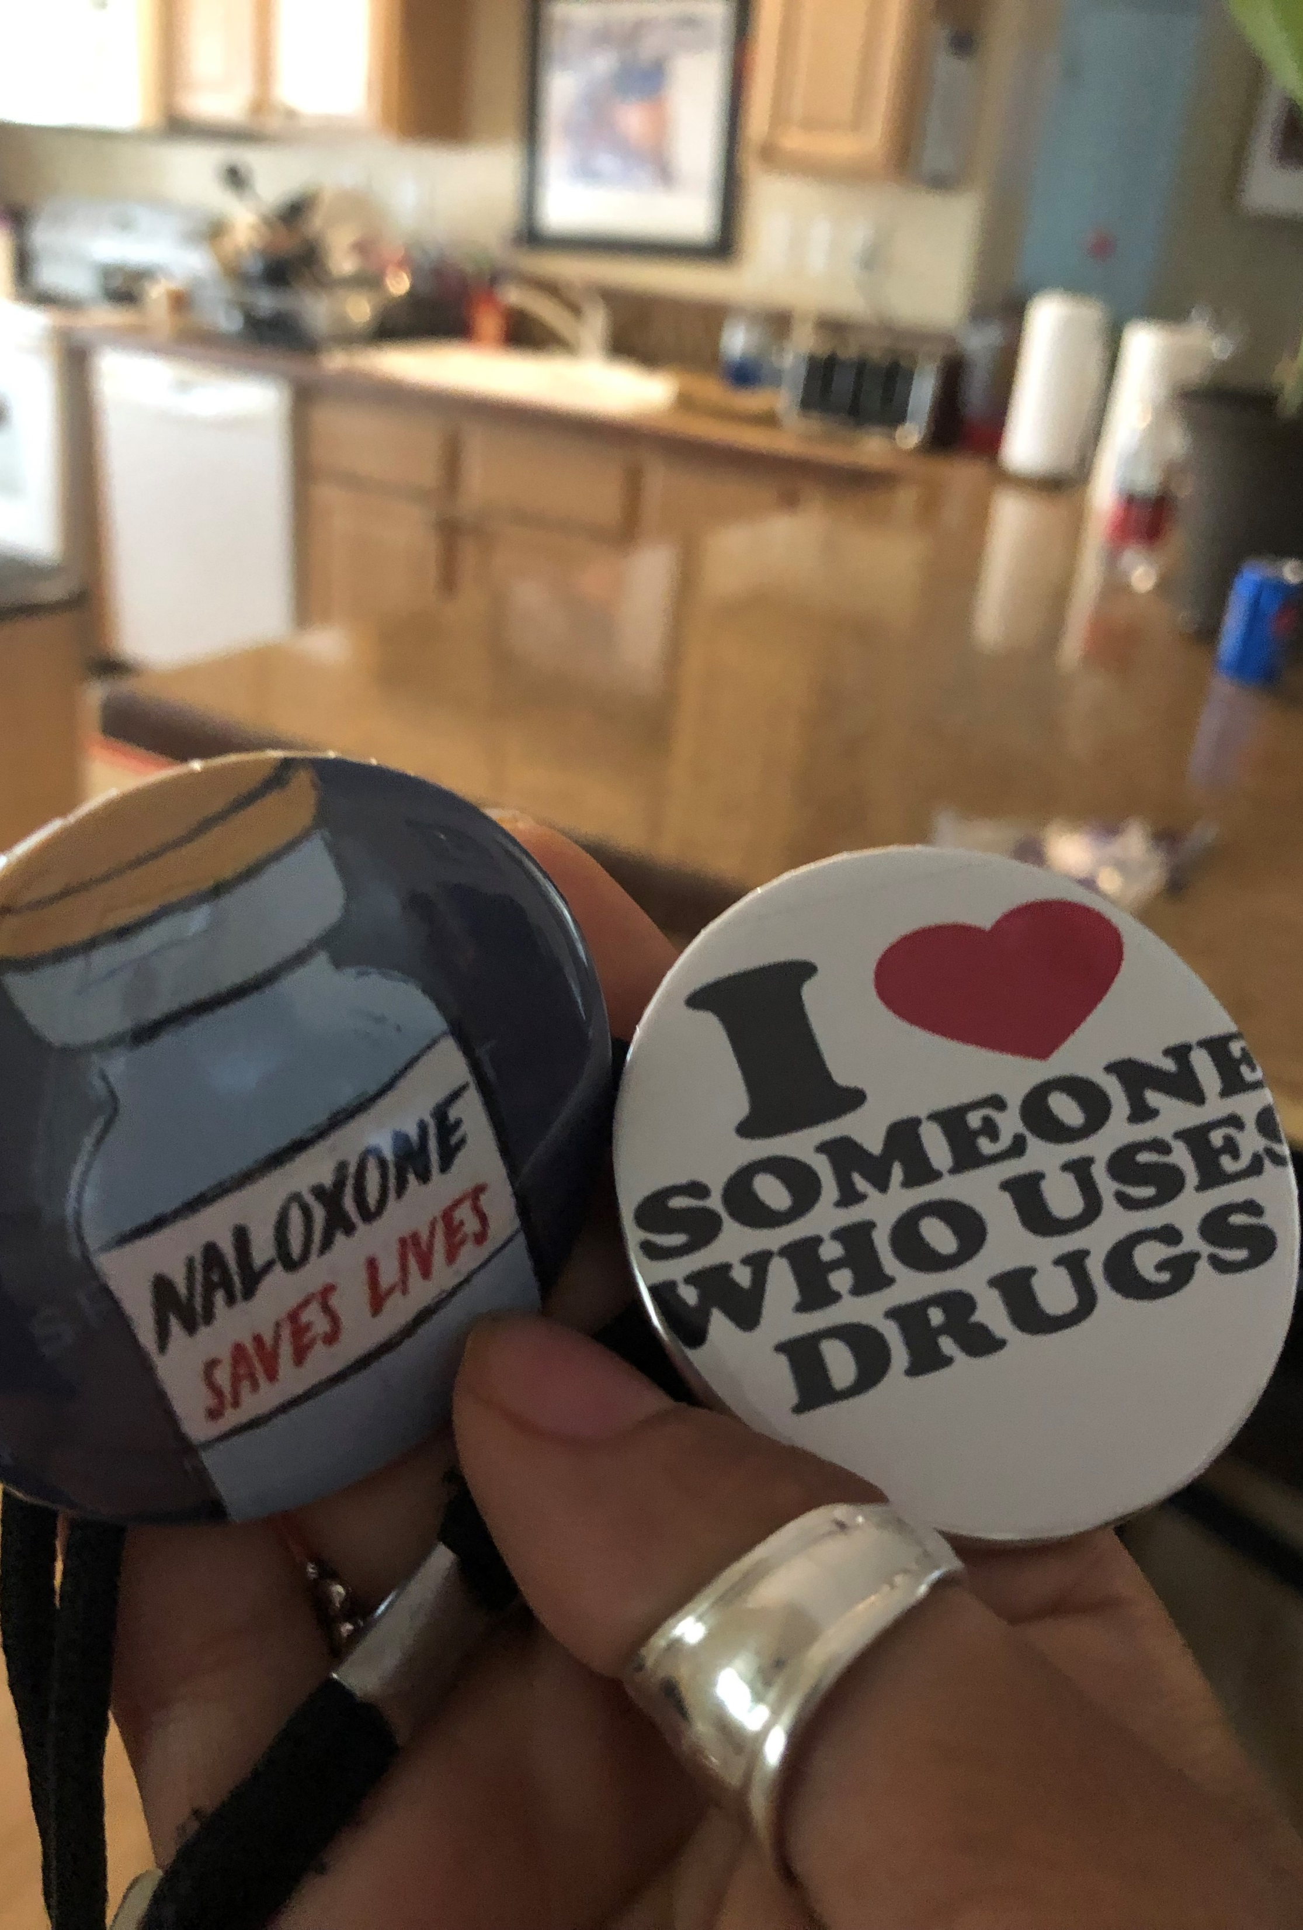
Myths and Facts
MYTH - Providing naloxone is enabling
  Fact: The use of naloxone does not lead to more or riskier drug use
  More Myth and Facts - Indiana DOH Naloxone Myth Fact Sheet
MYTH - Expired naloxone will not reverse an overdose “Any naloxone is better than no naloxone”
  Fact: Studies published in 2019 demonstrated that naloxone may retains its effectiveness for as long as 30 years past expiration date.
  Quality assessments of expired naloxone products from First Responder Supplies
  More information from Next Distro https://nextdistro.org/mightynaloxone
MYTH - When people who have been “narcanned” wake up they are typically violent.
  Fact: Confusion and disorientation are common side effects when naloxone is used to reverse an overdose. Proper training of responders, including community people about how to support a person waking up is important.
  Source: Fisher, R., O'Donnell, D., Ray, B., & Rusyniak, D. (2016). Police Officers Can Safely and Effectively Administer Intranasal Naloxone. Prehospital emergency care, 20(6), 675–680. https://doi.org/10.1080/10903127.2016.1182605

