Slide 1



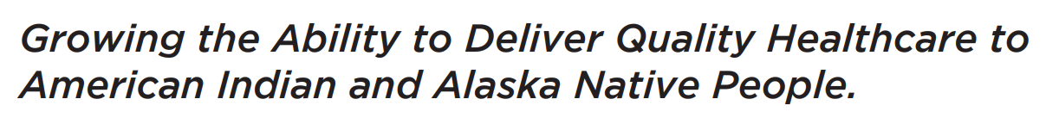
Evaluation of Infectious Diseases in People With Substance Use Disorders:
An Opportunity for Disease Elimination
July 19, 2022
Jorge Mera, MD, FACP | ECHO Medical Director | Northwest Portland Area Indian Health Board | jorge-mera@cherokee.org

Slide 2

Syndemic
  Core principles:
  Clustering of two or more conditions in a specific population
  Their synergism in producing excess burden of disease in a population
  Precipitation and propagation by large scale behavioral, structural and social forces
Structural Factors
Social Factors
Behavioral Factors
HIV
HCV
SUD
STI
Singer, M. and Clair, S. (2003), Syndemics and Public Health: Reconceptualizing Disease in Bio‐Social Context. Medical Anthropology Quarterly, 17: 423-441. https://doi.org/10.1525/maq.2003.17.4.423
HIV: Human Immunodeficiency Virus
HCV: Hepatitis C virus
SUD: Substance Use Disorder

Slide 3

Syndemic
Linkage to Care
Screening
Quality of Care
HCV/HIV/STI
SUD Behavior Risk
Harm Reduction Strategies
Access to Care
Poverty
Domestic Violence
Mental Illness
Historical Trauma*
Cultural
Disconnection
Incarceration
others
Prevention
*Maria Yellow Horse Brave Heart Journal of Psychoactive Drugs Vol. 35, Iss. 1, 2003

Slide 4
Syndemic
Linkage to Care
Screening
Quality of Care
HCV/HIV/STI
SUD Behavior Risk
Harm Reduction Strategies
Access to Care
Poverty
Domestic Violence
Mental Illness
Historical Trauma*
Cultural
Disconnection
Incarceration
others
Prevention
*Maria Yellow Horse Brave Heart Journal of Psychoactive Drugs Vol. 35, Iss. 1, 2003

Slide 5
The Intersection of SUD and ID
SUD
Syphilis
GC/Chlamydia
HIV/HCV/HBV
Syphilis
GC/Chlamydia
HIV/HCV/HBV
Soft Tissue Infections
Endocarditis
Septic arthritis
IDU
SUD: Substance Use Disorder
ID: Infectious Diseases

Slide 6
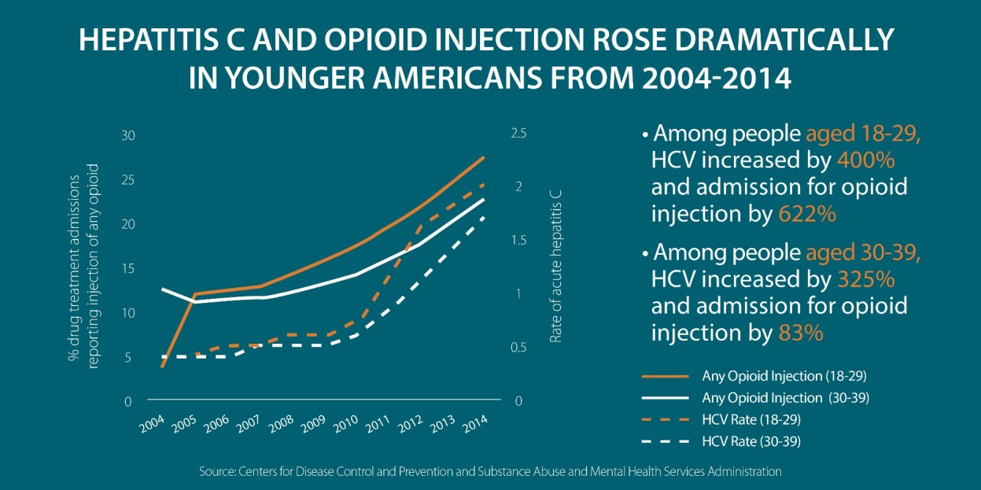
Huge Increases in HCV Related to Injection Drug Use
Among 18- to 29-year-olds, there was a
  400 percent increase in acute hepatitis
  817 percent increase in admissions for injection of prescription opioids
  600 percent increase in admissions for heroin injection
Among 30- to 39-year-olds, there was a
  325 percent increase in acute hepatitis C
  169 percent increase in admissions for injection of prescription opioids
  77 percent increase in admissions for heroin injection
There were also sharp increases among whites and among women
Zibbell, J., et al. 2017. https://ajph.aphapublications.org/doi/pdf/10.2105/AJPH.2017.304132

Slide 7
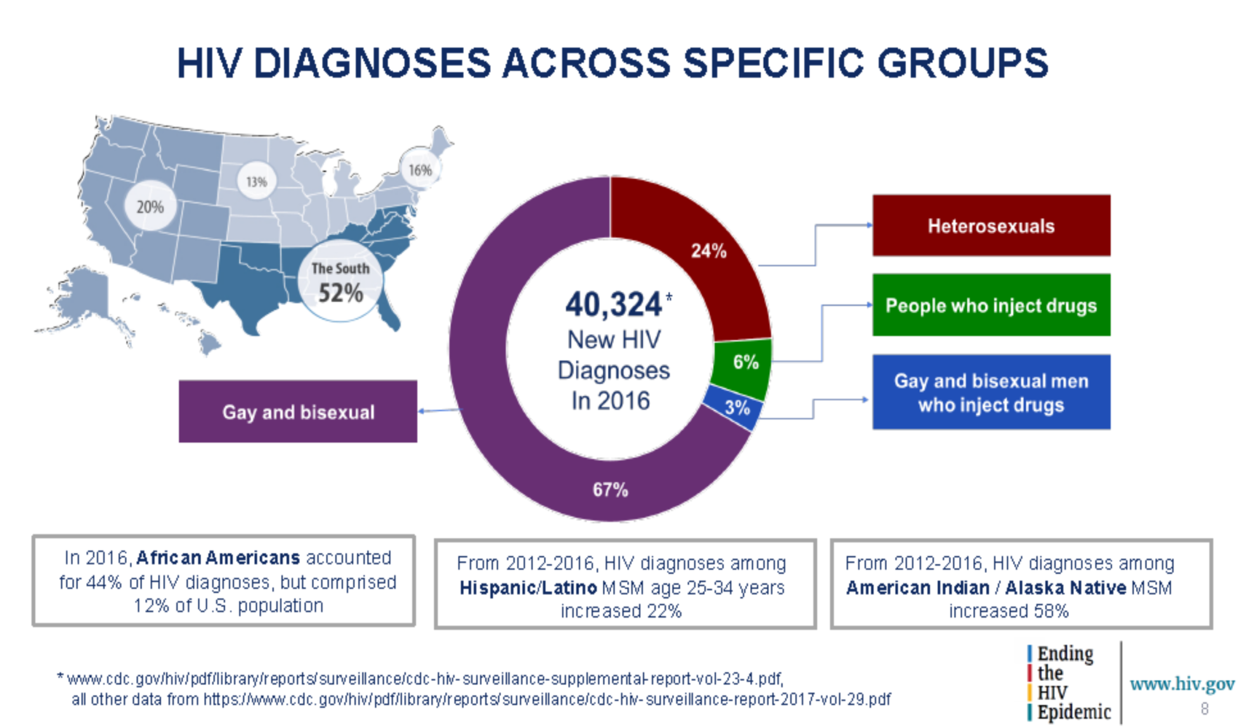
HIV: Facts

Slide 8
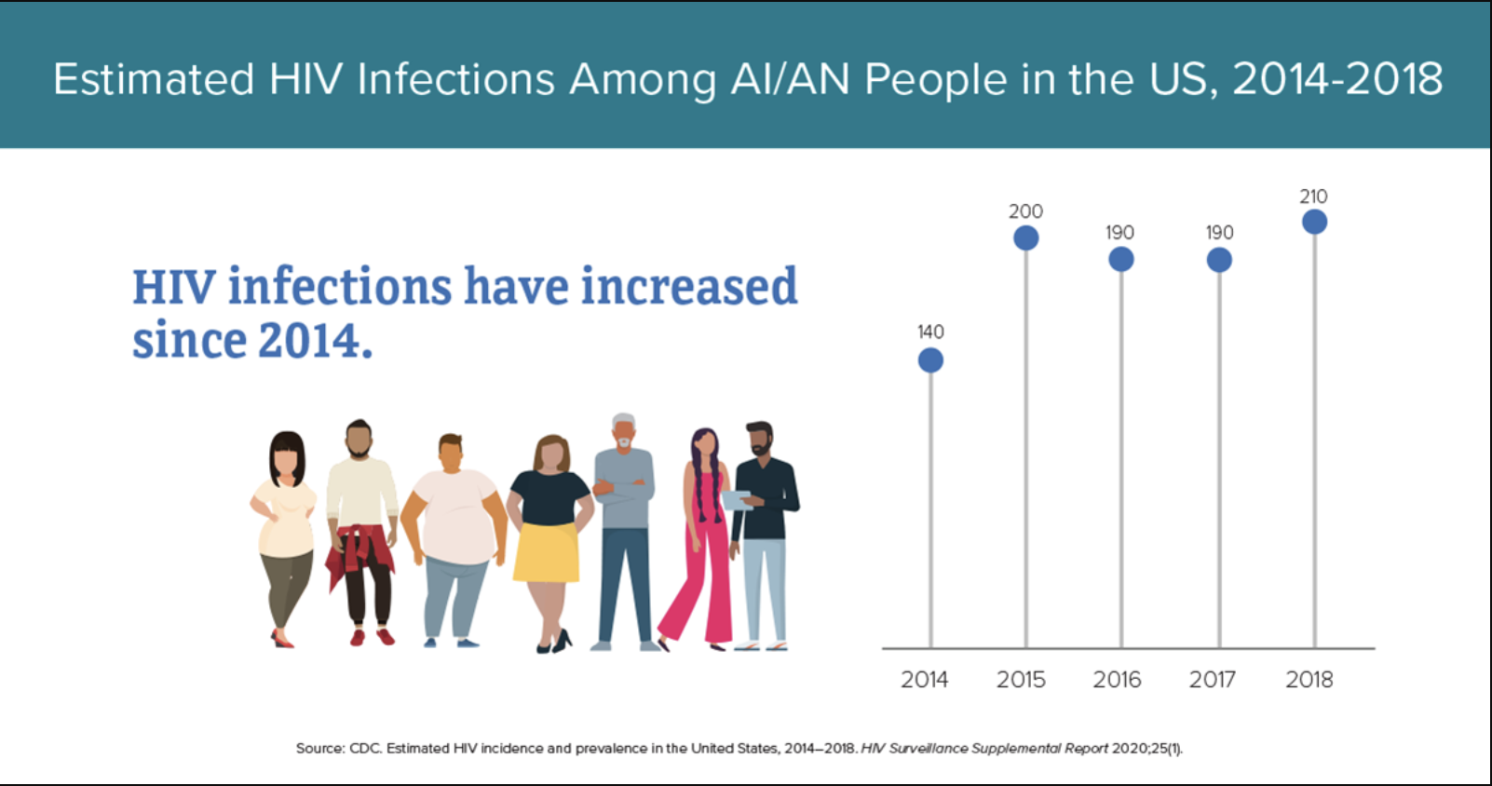
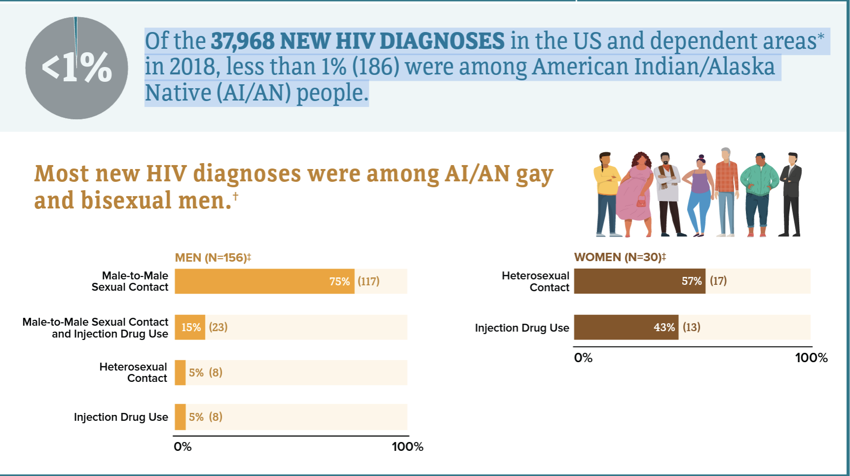
HIV in American Indian/Alaska Native Populations
In the U.S. in 2018, both male and female AI/AN had the highest percent of estimated diagnoses of HIV infection attributed to injection drug use, compared with all races/ethnicities.
Among men, 15% (23) of new HIV diagnoses were attributed to injection drug use, and 11% (21) were attributed to both male-to-male sex and injection drug use.
Among women, 43% (13) of new HIV diagnoses were attributed to injection drug use.

Slide 9

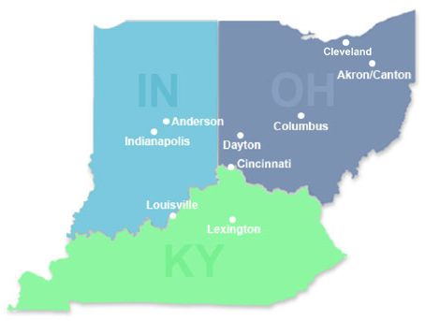
Indiana HIV/HCV Outbreak
From 2004-2013
In late 2014
By mid-January 2015
< 5 HIV infections reported annually in Austin, Indiana
3 new HIV diagnoses in Austin IN, 2 of them had shared needles
Through contact tracing ISHD identified 8 more new infections
As of June 14, 2015:
170 new HIV infections and 115 co-infected with HCV in a Community of 4200 people
All epidemiologically linked to Austin, IN
Infections were recent and from a single HIV strain
The source of infection: Injection of the opioid oxymorphone (semi-synthetic opioid analgesic)
Scott County: Among the state’s 92 counties,
ranked 92nd in a variety of health and
social indicators, including life expectancy

Slide 10
Infectious Diseases Associated with
Substance Use Disorders
Viral infections (bloodborne)
  Hepatitis C Virus (HCV)
  Hepatitis B Virus (HBV)
  Hepatitis A Virus (HAV)
  HIV
STI’s
  GC/Chlamydia
  Syphilis
  HIV/HCV/HBV
Bacterial Infections (soft tissue/skin) ⁴
  Septicemia
  Bacteremia
  Cellulitis
  Abscesses (staph, strep)
  Endocarditis
  Necrotizing fasciitis
  Wound botulism
Before 2020, Hepatitis C was the leading cause of death among all infectious diseases in the USA ¹
The CDC estimates 57,500 acute HCV cases in the US in 2019 ¹
IDU is currently the most common risk factor for HCV in developed countries (60-80% worldwide) ³
1. Centers for Disease Control and Prevention, 2019. https://www.cdc.gov/hepatitis/hcv/index.htm
2. Centers for Disease Control and Prevention, 2018. https://www.cdc.gov/nchhstp/newsroom/2018/hepatitis-c-prevalence-estimates.html
3. Nelson, et al. 2011. https://www.ncbi.nlm.nih.gov/pubmed/21802134/
4. Collier, M., et al. 2018. https://link.springer.com/article/10.1007%2Fs10900-017-0458-9

Slide 11
National HIV & Hepatitis Overview
Injection Drug Use accounts for
~9% of new HIV cases ¹
Over 65% of HCV cases ²
Among people who inject drugs
60%-90% have HCV after 5 years
Median time to HCV transmission is ~3 years
And each year ~ 20-30% of PWID acquire HCV ³
Comorbidity
Among PWID and have HIV, 75% also have HCV
Among PLWHIV w/o IDU, 25% have HCV ⁴
Life time cost of each HIV infection is over $380,000 ⁵
Accumulated costs of HCV care over the next 20 years on this trajectory over $78 billion ⁶
1.Centers for Disease Control and Prevention, 2017. HIV Surveillance Report, https://www.cdc.gov/hiv/pdf/library/reports/surveillance/cdc-hiv-surveillance-report-2017-vol-29.pdf
2. Centers for Disease Control and Prevention, 2016, Surveillance for Viral Hepatitis – United States, 2016. https://www.cdc.gov/hepatitis/statistics/2016surveillance/index.htm
3. Grebely, J. et al. 2011. https://www.ncbi.nlm.nih.gov/pmc/articles/PMC3072734/
4. Centers for Disease Control and Prevention, 2017. HIV and Viral Hepatitis. https://www.cdc.gov/hiv/pdf/library/factsheets/hiv-viral-hepatitis.pdf
5. Centers for Disease Control and Prevention, 2017. https://www.cdc.gov/hiv/programresources/guidance/costeffectiveness/index.html
6. National Academies of Sciences, Engineering, and Medicine, 2017. https://www.nap.edu/read/24731/chapter/8

Slide 12
Infections in People with SUD: Interventions
Prevention
Vaccination
HIV PEP
HIV PrEP
Harm reduction through SSP/MAT
Diagnosis
Baseline and Periodic infectious disease screening
SUD: Substance Use Disorder

Slide 13
1st Encounter with People with SUD:
Focus on the Reason for the Visit but Obtain Labs
Evaluate for HIV PrEP
Hepatitis B: HBsAg, HBsAb, HBcAb
Hepatitis C antibody or RNA
HIV 4th generation test
RPR/Treponemal test
GC/Chlamydia
Laboratory evaluation
Hepatitis A total antibody
Physical Exam
Soft tissue exam
Cardiac Murmurs
Sexual History
Injection Drug Use?
Sharing equipment?
Sex when using drugs?
Condom use?
Review Vaccines
HPV
Hepatitis A and B
Pneumococcal
TdAP
Shingles
COVID-19
Influenza

Slide 14
2nd Visit: Review Labs and Act
Test | Result | Interpretation | Action
Hepatitis B | HBsAb (-), HBsAg (-), HBcAb (-) | Never exposed | Vaccinate
 | HBsAb (+), HBsAg (-), HBcAb (-) | Immune | None needed
 | HBsAb (-), HBsAg (+), HBcAb (+) | Active Infection | Refer to ID*
 | HBsAb (-), HBsAg (-), HBcAb (+) | Isolated HB core Ab | Call ID
Hepatitis C | Positive HCV Ab | Possible current infection | Order HCV RNA
 | Positive RNA | Current Infection confirmed | Treat or refer
Hepatitis A | Total Ab (+) | Immune | Non needed
 | Total Ab (-) | Not immune | Vaccinate
Chlamydia | Reactive | Active Infection | Treat*
Gonorrhea | Reactive | Active Infection | Treat*
Syphilis | Reactive | Active Infection | Stage and Treat *
ID: Infectious Diseases
* Evaluate for PrEP

Slide 15
How often should labs be ordered in PWID?
Test | Result
Hepatitis C | Most guidelines recommend once a year but may be more frequent
Hepatitis A | Once since if negative vaccination should be offered
Hepatitis B | Once since if negative vaccination should be offered If chronic HBV present refer to specialist
GC/Chlamydia/Syphilis | Every 6 months if they are on PrEP and anytime unprotected sexual exposure is reported
PWID: People Who Inject Drugs

Slide 16
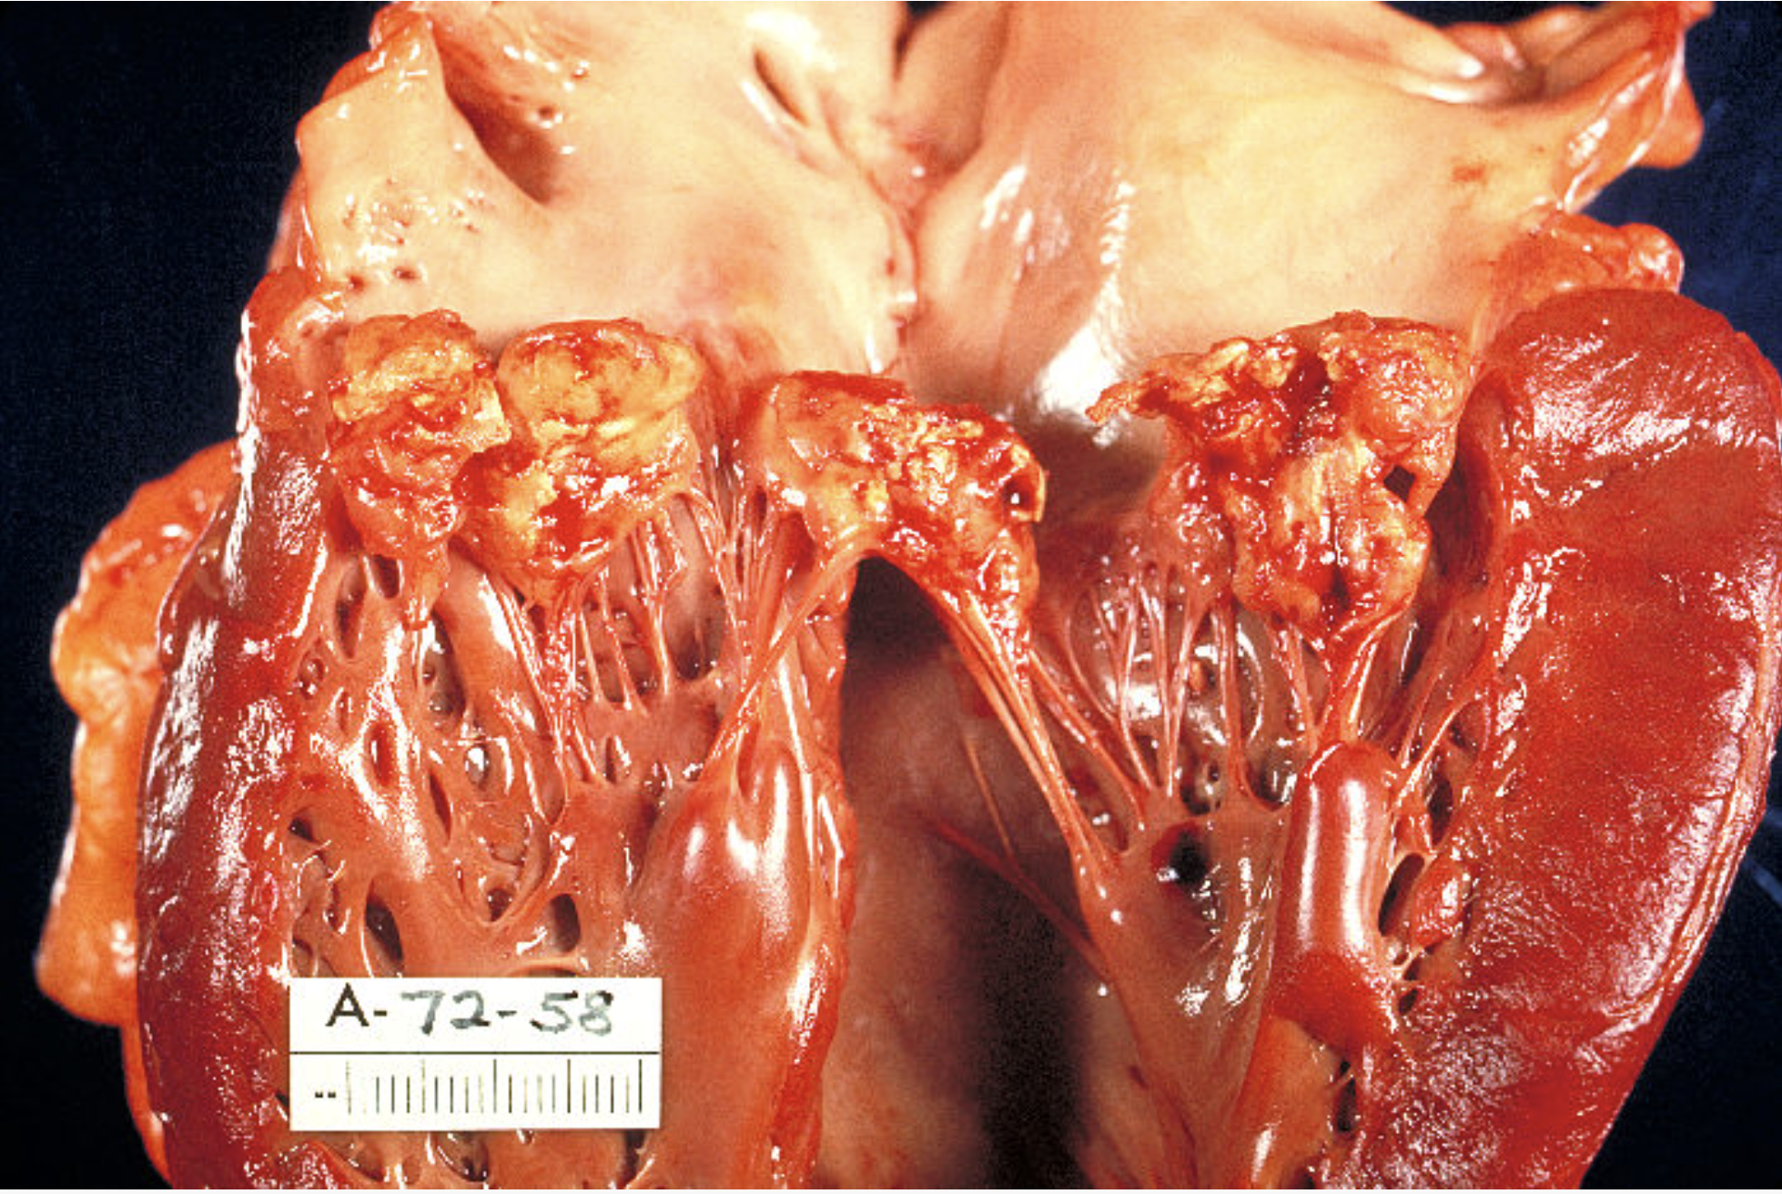
Bacterial Endocarditis in PWID
The incidence of bacterial endocarditis among PWID increased >12-fold over a 5-year period
IDU-associated endocarditis have worse outcomes at 5 and 10 years as compared to non-IDU-associated endocarditis
Anecdotal evidence suggests that surgeons are hesitant to operate on PWID who develop endocarditis due to poor long-term outcomes, recurrent substance use and limited linkage to care
A major contributor to the increase in invasive bacterial infections is the increasing prevalence of fentanyl and other short-acting synthetic opioids.
Fentanyl use is associated with higher injection frequency and with increased rates of receptive needle and syringe sharing
Heroin injection typically occurs 3–4 times per day as opposed to fentanyl injection which occurs up to 6–10 times per day
Higher frequency of injection represents an additional at-risk moment for transmission of infection and leads to higher rates of needle reuse
Infectious risk is additionally increased if needles and other injection preparation equipment are shared between individuals.
Harvey L, Boudreau J, Sliwinski SK, et al. Open Forum Infect Dis. 2022 Jan 6;9(2):ofab631
https://phil.cdc.gov/Details.aspx?pid=851

Slide 17
Preventing Bacterial Endocarditis
Harm reduction strategies are important tools for preventing infections in PWID.
Safe injection techniques can reduce incidence of infectious endocarditis by over 90%,
SSPs reduce disease transmission by
These include SSPs, safe injection facilities, immunizations, skin cleaning and safe injection strategies, and HIV PrEP
Significantly higher than is achievable with a reduction in injection frequency alone.
Decreasing the rate of needle and syringe sharing
Reducing needle reuse and the length of time that used injection materials are in circulation
Harvey L, Boudreau J, Sliwinski SK, et al. Open Forum Infect Dis. 2022 Jan 6;9(2):ofab631

Slide 18
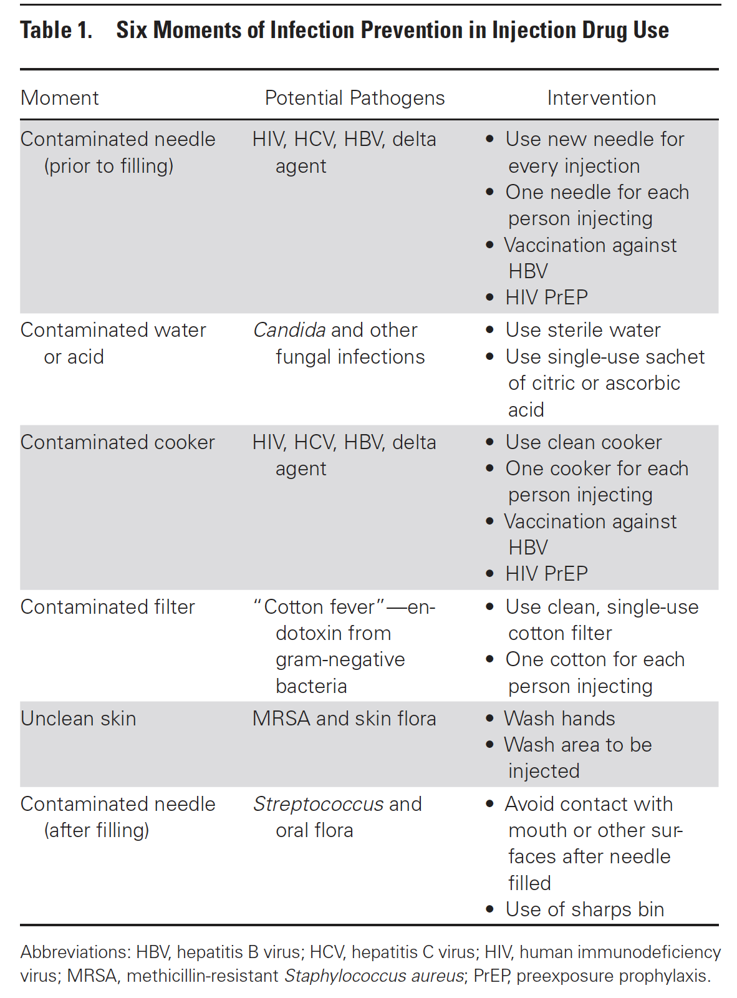
Six Moments of Infection Prevention in Injection Drug Use:
An Educational Toolkit for Clinicians
Harvey L, Boudreau J, Sliwinski SK, et al. Open Forum Infect Dis. 2022 Jan 6;9(2):ofab631
Based on the The Five Moments for Hand Hygiene developed by the WHO’s Guidelines on Hand Hygiene in Health Care.
The model is designed to highlight specific “at risk” moments and interactions that can contribute to the spread of nosocomial infection and specifies time points when hand hygiene is appropriate to break the “chain of infection.”

Slide 19
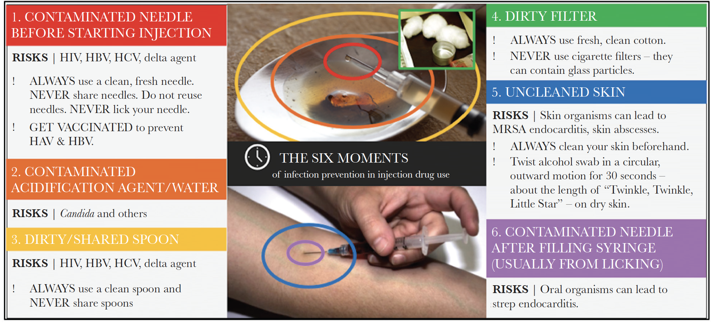
Six Moments of Infection Prevention in Injection Drug Use: An Educational Toolkit for Clinicians
Figure 1. Six Moments of Infection Prevention in Injection Drug Use Model. Abbreviations: HAV, hepatitis A virus; HBV, hepatitis B virus; HCV, hepatitis C virus; HIV, human immunodeficiency virus; MRSA, methicillin-resistant Staphylococcus aureus.
Harvey L, Boudreau J, Sliwinski SK, et al. Open Forum Infect Dis. 2022 Jan 6;9(2):ofab631

Slide 20
Comprehensive Approach
Medication Assisted Treatment
PREP for PWUDs
HCV/HIV/STI Testing and Treatment
Vaccines
Naloxone, Syringe Service Programs, and Safer Injection Practices
Mental Health Services
HCV/HIV/STI Testing and Treatment
Vaccines
Notes:
So to create a COMPREHENSIVE approach we need a whole range of services for people who actively using drugs
And when all of the funding goes to prevention and treatment and 80% of the people who are using drugs are in this middle range, we are going to have to get creative—extra creative—about these partnerships!
-Our services need to reflect that and be targeted at that grey area because that is where the biggest risk happens—when someone isn’t connected to services and doesn’t know how (or can’t because of legal or social barriers) to take care of themselves or their community while using substances
‘Safer injection practices’ include a range of measures that decrease the likelihood of transmission for HIV, hepatitis, and bacterial/soft tissue infections. This includes education and counselling designed to assess the current environmental and social situation of the person injecting to decrease risks to the maximum extent possible.
Potential safer injection practices can include:
always using a new/sterile syringe and injection materials;
using a personal syringe (not shared) if re-use is necessary;
if sharing is necessary, proper bleaching etiquette; improving environmental conditions to reduce contamination of injection materials and drugs; and
guidance on vein care/wound care in order to improve overall health for the client.”
For additional information and guidance on safer injection practices, check out CDC’s website: https://www.cdc.gov/injectionsafety/ip07_standardprecaution.html and https://www.cdc.gov/injectionsafety/index.html

Slide 21
Thank You
ᏩᏙ (Wado)
Disclaimer: All published and unpublished data and materials in this presentation and the accompanying discussion may not be used for any purpose without prior, express written permission of the authors and the Cherokee Nation IRB. No right to use the data, materials, or comments is provided or implied to any individual or entity for any purpose or in any manner.

