Slide 1
ECHO Diabetes Diabetic Eye Disease – part 2
July 14, 2022
Carol Greenlee MD

Slide 2
Pre-question
Diabetic Retinopathy
Is the least common microvascular complication in people with diabetes
Is the third most common cause of vision loss in adults ages 20-74
Is not treatable once it develops
Is associated with longer duration and higher levels of glycemia as well as blood pressure and lipids.

Slide 3
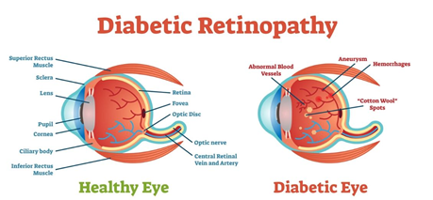
Eye Conditions associated with Diabetes
Cataracts
Risk doubled by diabetes
Diabetic Retinopathy (DR) (most common microvascular complication)
Most frequent cause of blindness in adults aged 20-74 years
95-98% preventable
Prevalence related to
Duration of diabetes
Level of glycemic, blood pressure and lipid control
Nephropathy
Smoking
Pregnancy
Glaucoma – neovascular glaucoma
Macular edema (Diabetic Macular Edema (DME))

Slide 4
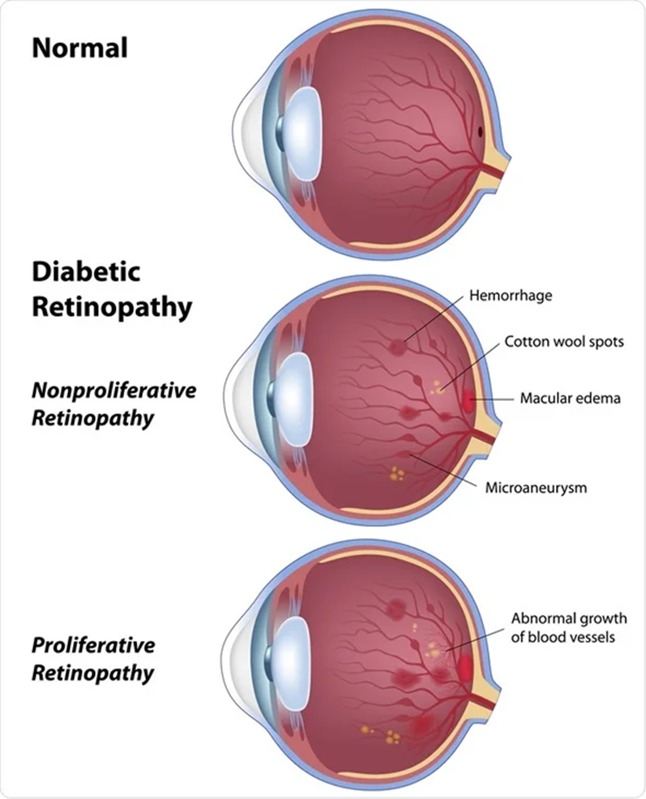
Diabetic Retinopathy
Non-proliferative DR (NPDR) *
Hyperglycemia results in endothelial damage to retinal capillaries resulting in leakage, microaneurysms & hemorrhages and capillary occlusion
Proliferative DR (PDR)
Ischemia stimulates retinal cells to release pro-angiogenic factors such as VEGF, which stimulate neovascularization to bypass damaged retinal blood vessels.
These new vessels are extremely immature, fragile, permeable and bleed very easily, originating severe complications such as vitreous hemorrhage or tractional retinal detachment.
Diabetic Macular Edema (DME)
Chronic inflammation and endothelial damage lead to increased vascular permeability of blood vessels resulting in fluid leaking into the retina and depositing under the macula.
Macular edema can occur in NPDR, but it is more common in more severe cases of DR where the increased vascular permeability is more advanced.
*Early neurodegeneration –
Neurovascular unit abnormalities
https://www.ncbi.nlm.nih.gov/pmc/articles/PMC6923675/
Notes:
https://eyewiki.aao.org/Diabetic_Retinopathy_Pathophysiology

Slide 5
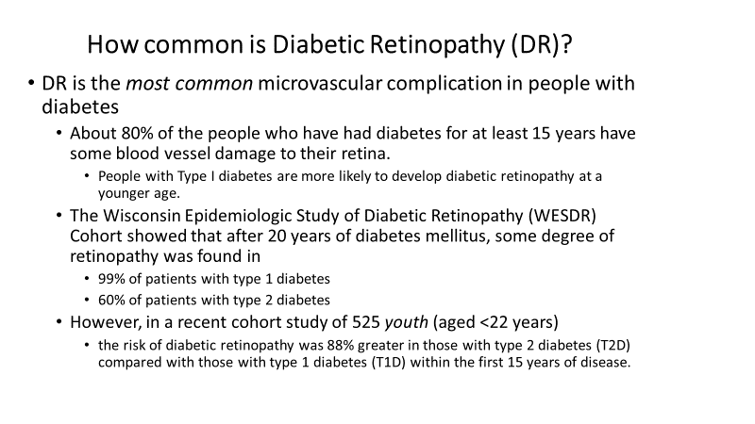

Slide 6
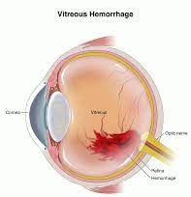
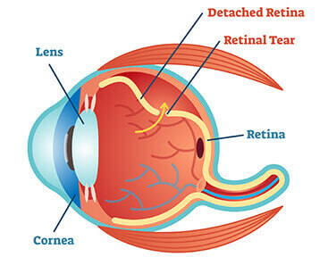
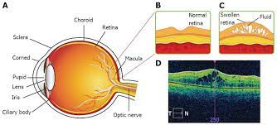
How Common is Vision Loss from DR?
Among US adults aged 18 years or older with diagnosed diabetes, crude data for 2018 indicated:
11.7% (95% CI, 11.0%–12.5%) reported vision disability, including blindness (16%)
In people with T1D, the most common cause of vision loss is PDR
The new abnormal vessels may
bleed into the vitreous or
cause a tractional retinal detachment
In people with T2D, the most common cause of vision loss is DME
Notes:
CDC statistical report on diabetes

Slide 7
Diabetic Retinopathy – American Diabetes Association Standards of Care
Prevention of Diabetic Retinopathy
Optimize glycemic, blood pressure and serum lipid control to reduce the risk or slow the progression of diabetic retinopathy. A
Prevention of Vision Loss from Diabetic Retinopathy
Screening - annual diabetic eye exams
In U.S., in 2017, adults 40 & over with diagnosed diabetes
61.72% received a dilated eye examination - Adults with low-income 55.7% vs high-income ~70%
In 2019, people with diabetes (Adults 18+) with dilated eye exam
Indian HS 59% - 20% diagnosed with DR
Portland area 52% - 16% diagnosed with DR
Various on-site screening services for Portland area
Optometrist/ ophthalmologist
Retinal camera
Mobile van
Treatment

Slide 8
Treatment Recommendations
General treatment
Systemic control of diabetes, hypertension, hyperlipidemia, hypercholesterolemia, nephropathy and other diseases are of paramount importance.
From the ADA standards of care
“Lowering blood pressure has been shown to decrease retinopathy progression
although tight targets (systolic BP <120 mmHg) do not impart additional benefit
ACE inhibitors and ARBs are both effective treatments in diabetic retinopathy.
In patients with dyslipidemia, progression may be slowed by the addition of fenofibrate
Particularly with very mild nonproliferative diabetic retinopathy at baseline.”
Notes:
https://eyewiki.aao.org/Diabetic_Retinopathy

Slide 9
Treatment Recommendations
12.9 Promptly refer patients with any level of macular edema, severe nonproliferative diabetic retinopathy (a precursor of proliferative retinopathy), or any proliferative retinopathy to an ophthalmologist who is knowledgeable and experienced in the management of diabetic retinopathy. A
12.10 The traditional standard treatment, panretinal laser photocoagulation therapy, is indicated to reduce risk of vision loss in patients with high-risk proliferative diabetic retinopathy and, in some cases, severe nonproliferative diabetic retinopathy. A
12.11 Intravitreous injections antivascular endothelial grown factor (anti-VEGF) are a reasonable alternative to panretinal laser photocoagulation for some patients with proliferative diabetic retinopathy and also reduce the risk of vision loss in these patients. A

Slide 10
Anti-VEGF or Laser photocoagulation or both?
Anti-VEGF vs Laser
Less peripheral vision loss
Fewer vitrectomies for secondary complications
Lower risk of developing DME
Require a greater number of visits and treatments
? Accelerated progression if stop treatments
Long-term successful outcomes of treatment with intravitreal anti-VEGF injections are predicated upon close follow-up.
In a large study nearly 25% of all PDR patients were lost to follow-up (LTFU) after treatment initiation. Risk factors for LTFU:
Over 4 years, the patients who received PRP had a 28% LTFU rate compared with 22.1% in the anti-VEGF group (P = .001).
Increased rates of LTFU were seen in patients with lower adjusted gross income, patients of Black or Hispanic heritage, and younger patients.
Notes:
Obeid A, Su D, Patel SN, et al. Outcomes of eyes lost to follow-up with proliferative diabetic retinopathy that received panretinal photocoagulation versus intravitreal anti-vascular endothelial growth factor. Ophthalmology. 2019;126(3):407-413.
ADA Standards of Care

Slide 11
Combination Therapy (PRP + anti-VEGF agent)
PRP can be particularly valuable in conjunction with anti-VEGF therapy for patients with high-risk PDR.
The PROTEUS study evaluated patients who were randomly assigned to treatment with
intravitreal anti-VEGF injections plus PRP versus
PRP alone
At 1 year, regression of neovascularization of the disc or neovascularization elsewhere
92.7% of patients who had combined therapy
70.5% of patients who received PRP monotherapy (P = .009).
Notes:
Figueira J, Fletcher E, Massin P, et al. Ranibizumab plus panretinal photocoagulation versus panretinal photocoagulation alone for high-risk proliferative diabetic retinopathy (PROTEUS Study). Ophthalmology. 2018;125(5):691-700.

Slide 12
“Promptly” = “Without Delay”
A delay in treatment for PDR can cause permanent visual impairment.
A delay in treating PDR with PRP by > 30 days can lead to decreased visual outcomes at 1 and 2 years after treatment compared with treatment on the day of diagnosis. Ohlhausen et al
How rapidly do your patients get in for treatment once significant DR and/or DME noted on exam or they c/o significant vision symptoms?
Spots or dark strings (webs) floating in your vision (floaters)
Retinal detachment - This can cause spots floating in your vision, flashes of light or severe vision loss.
Blurred vision
Macular Edema – This can cause blurred and distorted vision.
Glaucoma – This can cause hazy or blurred vision and the appearance of rainbow-colored circles around bright lights.
Fluctuating vision
Dark or empty areas in your vision
Vitreous hemorrhage - If the amount of bleeding is small, you might see only a few dark spots (floaters). In more-severe cases, blood can fill the vitreous cavity and completely block your vision.
Vision loss
Notes:
Ohlhausen M, Payne C, Greenlee T, et al. Impact and characterization of delayed pan-retinal photocoagulation in proliferative diabetic retinopathy. Am J Ophthalmol. 2021;223:267-274.

Slide 13
Treatment Recommendations
12.12 Intravitreous injections of antivascular endothelial grown factor (anti-VEGF) are indicated for central involved diabetic macular edema which occurs beneath the foveal center and impairs vision acuity. A
“… current data from well-designed clinical trials demonstrate that intravitreal anti-VEGF agents provide a more effective treatment regimen for central-involved diabetic macular edema than monotherapy or even combination therapy with a laser”
“…laser photocoagulation surgery was beneficial in reducing the risk of further visual loss in affected patients but generally not beneficial in reversing already diminished acuity.”
Anti-VEGF therapy improves vision and has replaced the need for laser photocoagulation in the vast majority of patients with macular edema.”
Requires monthly injections for the first 12 months with fewer injections needed in subsequent years to maintain

Slide 14
Treatment Recommendations
12.13 Macular focal/grid photocoagulation and intravitreal injections of corticosteroid are reasonable treatments in eyes with persistent diabetic macular edema despite previous anti-VEGF therapy or eyes that are not candidates for this first-line approach. A
Anti-VEGF medications should not be used in pregnant patients with diabetes due to theoretical risks to the vasculature of the developing fetus
12.14 The presence of retinopathy is not a contraindication to aspirin therapy for cardioprotection, as aspirin does not increase the risk of retinal hemorrhage. A

Slide 15
Unanswered Questions Especially regarding the underlying ischemia from vascular damage
Therapy with anti-VEGF agents usually leads to the regression of clinically apparent DR.
Hemorrhages and microaneurysms improve, and exudates slowly resolve.
Less is known about the effects of anti-VEGF agents on retinal capillary nonperfusion, the primary driver of angiogenesis.
The PERMEATE study used ultra-widefield fluorescein angiography to evaluate panretinal leakage and ischemic indices in patients receiving intravitreal anti-VEGF injections for DME and retinal vein occlusion.
The study found that, although leakage improved with regular injections, the underlying ischemic index did not improve, and in fact worsened after 12 months of regular injections.
Thus, ischemia, manifesting as peripheral nonperfusion, continues unabated in the setting of anti-VEGF monotherapy.
This is accompanied by functional loss of peripheral vision.
Although visual field loss was greater in the PRP group than the anti-VEGF group, the 5-year data demonstrated progressive field loss in the anti-VEGF arm.
Notes:
https://retinatoday.com/articles/2021-sept/treating-diabetic-retinopathy-anti-vegf-vs-prp

Slide 16
Summary
Diabetic Retinopathy (DR) is increased by longer duration and higher levels of glucose elevation as well has higher levels of blood pressure and lipids.
DR is the most common microvascular complication of diabetes.
DR is the leading cause of blindness in working-age adults in the US.
About 95-98% of vision loss from DR can be prevented.
Preventing vision loss requires screening for DR with diabetic eye exams and timely treatment of Proliferative DR and/or Diabetic Macular Edema.
Laser photocoagulation (PRP) and/or anti-VEGF for PDR
Anti-VEGF preferred treatment for DME
More research is needed regarding altering the underlying retinal ischemia induced by diabetic retinopathy.
Stay tuned for more understanding of neuronal component (neurovascular unit abnormalities)

Slide 17
Post-question
Diabetic Retinopathy
Is the least common microvascular complication in people with diabetes
Is the third most common cause of vision loss in adults ages 20-74
Is not treatable once it develops
Is associated with longer duration and higher levels of glycemia as well as blood pressure and lipids.

Slide 18
Assessing Eye Health and Eye Care Needs Among North American Native Individuals | Health Disparities | JAMA Ophthalmology | JAMA Network
In this cross-sectional study, higher condition claim rates but lower service claim rates were found for Medicare beneficiaries who were North American Native individuals vs non-Hispanic White individuals for
refractive errors;
diabetic eye diseases;
blindness and low vision;
injury, burns, and surgical complications of the eye;
orbital and external disease,
suggesting disparities in eye care among North American Native individuals, even when medical insurance coverage was similar (Medicare)

Slide 19
Assessing Eye Health and Eye Care Needs Among North American Native Individuals | Health Disparities | JAMA Ophthalmology | JAMA Network
Matching Eye Conditions With Eye Services - Researchers paired ophthalmic conditions with their related services to understand whether there was a mismatch between claim rates for ophthalmic conditions and claim rates for services used.
Many cases where there was both lower condition and lower service claim rates for North American Native individuals vs non-Hispanic White individuals, likely representing both an underdiagnosis of eye disease and an undertreatment of that disease.
Despite higher rate of diabetes – there was not a higher rate of DR suggesting underdiagnosis
North American Native individuals with several ophthalmic conditions, including refractive errors, blindness and low vision, and diabetic eye diseases, showed significantly higher ophthalmic condition claim rates but lower service claim rates compared with non-Hispanic White individuals.
Even when diagnosis made – less likely to get treatment

Slide 20
Assessing Eye Health and Eye Care Needs Among North American Native Individuals | Health Disparities | JAMA Ophthalmology | JAMA Network
There were no categories in this study where both reported claim rates for ophthalmic conditions and services were comparable between the North American Native group and non-Hispanic White group, indicating pervasive disparities.
To our knowledge, there are no known genetic bases to account for differences in rates of eye disease between North American Native individuals and non-Hispanic White individuals.
Thus, differences approximated through MFFS ophthalmic condition and service claim rates for North American Native individuals vs non-Hispanic White individuals likely highlight disparities in health care access.
Disparities may exist in part because North American Native populations are more likely to live in rural areas farther away from medical specialists, including ophthalmologists, among other contributing social factors.
Data from these studies and the present report support the inference that, even when insured, North American Native individuals have inferior access to ophthalmic services compared with that of non-Hispanic White individuals.

Slide 21
Barriers to “Timely Treatment” of DR
What are the barriers to getting screening eye exams for your patients?
Are you aware of barriers to your patients receiving “prompt” treatment of DR once it is identified?
What is the experience for your patients/ your clinic?

Slide 22
Extra slides

Slide 23
Jeng, CJ., Hsieh, YT., Lin, CL. et al. Effect of anticoagulant/antiplatelet therapy on the development and progression of diabetic retinopathy. BMC Ophthalmol 22, 127 (2022). https://doi.org/10.1186/s12886-022-02323-z
TAKE-HOME MESSAGE
This retrospective study of a large database of patients with type 2 diabetes in Taiwan revealed that
those taking antiplatelet/anticoagulant (APAC) medications had a lower incidence of nonproliferative diabetic retinopathy (NPDR; P < .001) and risk of developing NPDR than those not taking APAC medications.
the risks for proliferative DR or diabetic macular edema were not significantly different between APAC users and non-users.
The authors conclude that patients with type 2 diabetes will benefit from aspirin or dipyridamole therapy in terms of a reduced risk of developing NPDR.

Slide 24
Assessing Eye Health and Eye Care Needs Among North American Native Individuals | Health Disparities | JAMA Ophthalmology | JAMA Network
Objective To evaluate whether disparities in ophthalmic conditions and services exist between North American Native individuals and non-Hispanic White individuals in the US.
Design, Setting, and Participants This cross-sectional study used 100% Medicare fee-for-service (MFFS) enrollment data from the Vision and Eye Health Surveillance System (VEHSS) to examine ophthalmic conditions and service use in North American Native individuals and non-Hispanic White individuals in the US. In this study North American Native individuals included those who identified as American Indian, Native Alaskan, Native Hawaiian, and Pacific Islander. Data were analyzed from August 2020 to April 2021.
Interventions Claims and sociodemographic characteristics were extracted and means computed for categories of ophthalmic conditions and select ophthalmic services. Ophthalmic conditions and services were defined in the VEHSS using International Statistical Classification of Diseases and Related Health Problems, Tenth Revision, Clinical Modification (ICD-10-CM) codes. Logistic regression was used to model differences between age-adjusted mean ophthalmic condition and service claim rates among North American Native individuals and non-Hispanic White individuals for each age cohort. Matching ophthalmic condition claim rates and ophthalmic service claim rates was performed to examine disparities by racial group.
Main Outcomes and Measures Mean age-adjusted claim rates for ophthalmic conditions and services among North American Native individuals vs non-Hispanic White individuals per 100 persons.
Results Claims were identified for 177 100 Native American Native individuals and 24 438 000 non-Hispanic White individuals. In 16 of 17 ophthalmic condition categories and 6 of 9 service categories, North American Native individuals had significantly different claim rates from non-Hispanic White individuals. There were higher ophthalmic condition claim rates but lower service claim rates for North American Native individuals (vs non-Hispanic White individuals) for refractive errors (ophthalmic condition, 17.2 vs 11.1; service, 48.3 vs 49.6, respectively; P < .001); blindness and low vision (ophthalmic condition, 1.48 vs 0.75: service, 19.2 vs 20.1, respectively; P < .001); injury, burns, and surgical complications (ophthalmic condition, 1.8 vs 1.7; service, 19.2 vs 20.1, respectively; P < .001); and orbital and external disease (ophthalmic condition, 15.7 vs 13.3; service, 48.3 vs 49.6, respectively; P < .001). For diabetic eye diseases, North American Native individuals had higher ophthalmic condition claim rates (5.22 vs 2.20) but no difference in service claim rates (14.4 vs 14.8; P = .26) compared with non-Hispanic White individuals.
Conclusions and Relevance In this cross-sectional study, North American Native individuals had higher prevalence of ophthalmic conditions but no corresponding increase in services (treatment for most ophthalmic conditions) compared with non-Hispanic White individuals. These results suggest worse eye health and higher unmet eyecare needs for North American Native individuals with MFFS coverage compared with non-Hispanic White individuals with MFFS coverage.

Slide 25
Causes of Visual Impairment and Common Eye Problems in Northwest American Indians and Alaska Natives (nih.gov)

Slide 26
ADA program on diabetic eye disease - https://diabetes.org/diabetes/eye-health/professionals/educational-videos#lg=1&slide=0
Diabetic Retinopathy: Pathophysiology and Treatments (nih.gov)
Early detection, timely treatment, and appropriate follow-up care can reduce a person’s risk for severe vision loss from diabetic eye disease by 95 percent. (NEI/NIH)
People with Diabetes Can Prevent Vision Loss (nih.gov)
Reduce vision loss from diabetic retinopathy — V‑04 - Healthy People 2030 | health.gov
Diabetes and Vision Loss | Diabetes | CDC
Diabetic Retinopathy Data and Statistics | National Eye Institute (nih.gov)

Slide 27
On-line Risk Test – can use with patients to calculate risk for DR
Diabetic Retinopathy Risk Test | ADA (diabetes.org)
Fenofibrate and risk of proliferative diabetic retinopathy
https://jamanetwork.com/journals/jamaophthalmology/fullarticle/2790668?guestAccessKey=eaff6acf-c4a6-4a4f-8948-caf5959e7c51&utm_source=silverchair&utm_medium=email&utm_campaign=article_alert-jamaophthalmology&utm_content=olf&utm_term=040722
https://jamanetwork.com/journals/jamaophthalmology/fullarticle/2790666?guestAccessKey=81e244ba-01f5-46d9-a545-dfb16103420f&utm_source=silverchair&utm_medium=email&utm_campaign=article_alert-jamaophthalmology&utm_content=olf&utm_term=040722

Slide 28
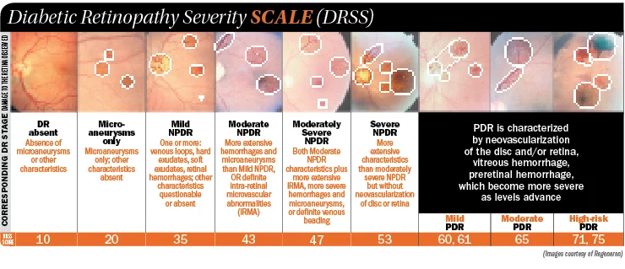

Slide 29
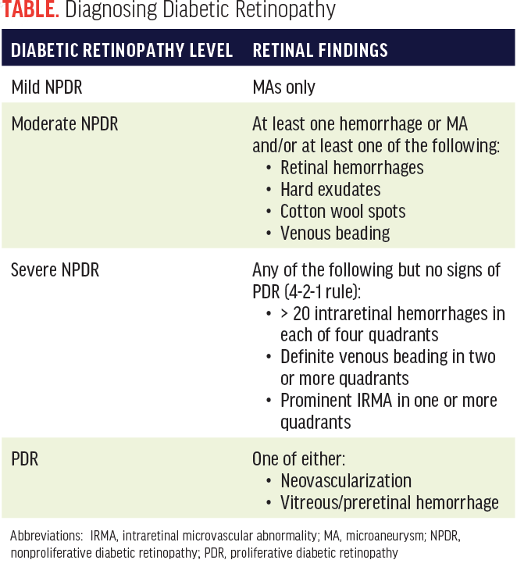

Slide 30
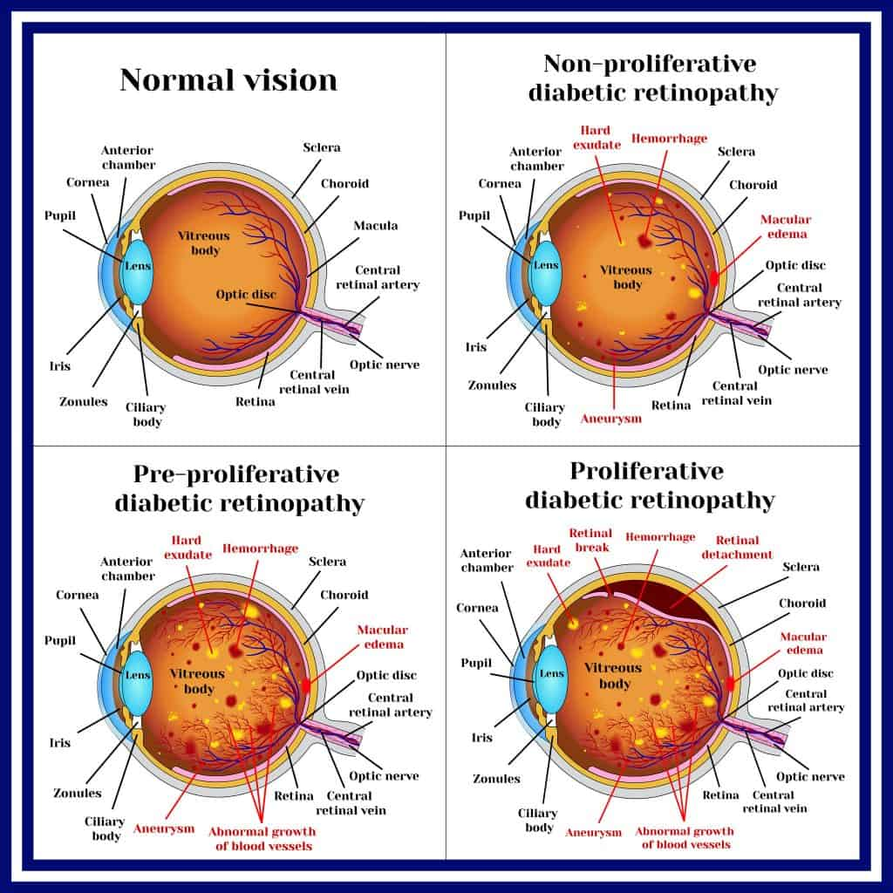

Slide 31
Info for Patients
Injecting medications into the eye. These medications, called vascular endothelial growth factor inhibitors, are injected into the vitreous of the eye. They help stop growth of new blood vessels and decrease fluid buildup.
Two drugs are approved by the U.S. Food & Drug Administration (FDA) for treatment of diabetic macular edema — ranibizumab (Lucentis) and aflibercept (Eylea). A third drug, bevacizumab (Avastin), can be used off-label for the treatment of diabetic macular edema. These drugs are injected using topical anesthesia. The injections can cause mild discomfort, such as burning, tearing or pain, for 24 hours after the injection. Possible side effects include a buildup of pressure in the eye and infection. These injections will need to be repeated. In some cases, the medication is used with photocoagulation.
Photocoagulation. This laser treatment, also known as focal laser treatment, can stop or slow the leakage of blood and fluid in the eye. During the procedure, leaks from abnormal blood vessels are treated with laser burns. Focal laser treatment is usually done in your doctor's office or eye clinic in a single session. If you had blurred vision from macular edema before surgery, the treatment might not return your vision to normal, but it's likely to reduce the chance of the macular edema worsening.
Panretinal photocoagulation. This laser treatment, also known as scatter laser treatment, can shrink the abnormal blood vessels. During the procedure, the areas of the retina away from the macula are treated with scattered laser burns. The burns cause the abnormal new blood vessels to shrink and scar. It's usually done in your doctor's office or eye clinic in two or more sessions. Your vision will be blurry for about a day after the procedure. Some loss of peripheral vision or night vision after the procedure is possible.
Vitrectomy. This procedure uses a tiny incision in your eye to remove blood from the middle of the eye (vitreous) as well as scar tissue that's tugging on the retina. It's done in a surgery center or hospital using local or general anesthesia.
Notes:
Mayo Clinic

Slide 32
Vitrectomy
Surgery and Surgical follow up
The goal of surgery is to remove blood and scar tissue from the retinal surface and to place laser treatment as needed. Intraoperatively, intraocular gas or silicone oil may be needed to maintain reattachment of the retina to the underlying layers and eyewall.
Complications
There is always the low, but real risk of infection of the eyeball (endophthalmitis) with any injection of drugs into the eye or with eye surgery. There is also the risk of cataract progression with retinal surgery. Vitrectomy accelerates the rate of cataract formation.

