Slide 1
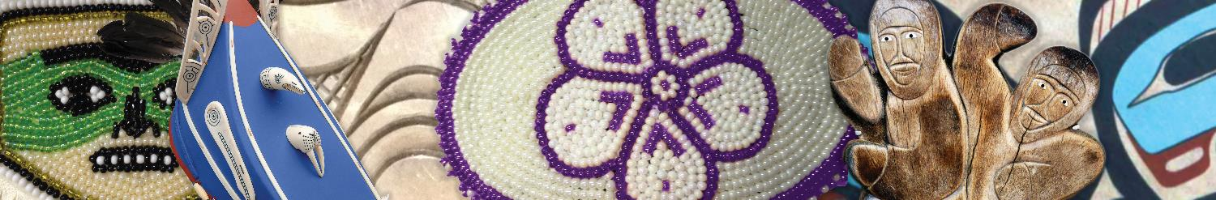
Accessing Naloxone in Alaska
Jennifer Summers, MS
Substance Misuse Prevention Program Manager
Wellness and Prevention Department

Slide 2
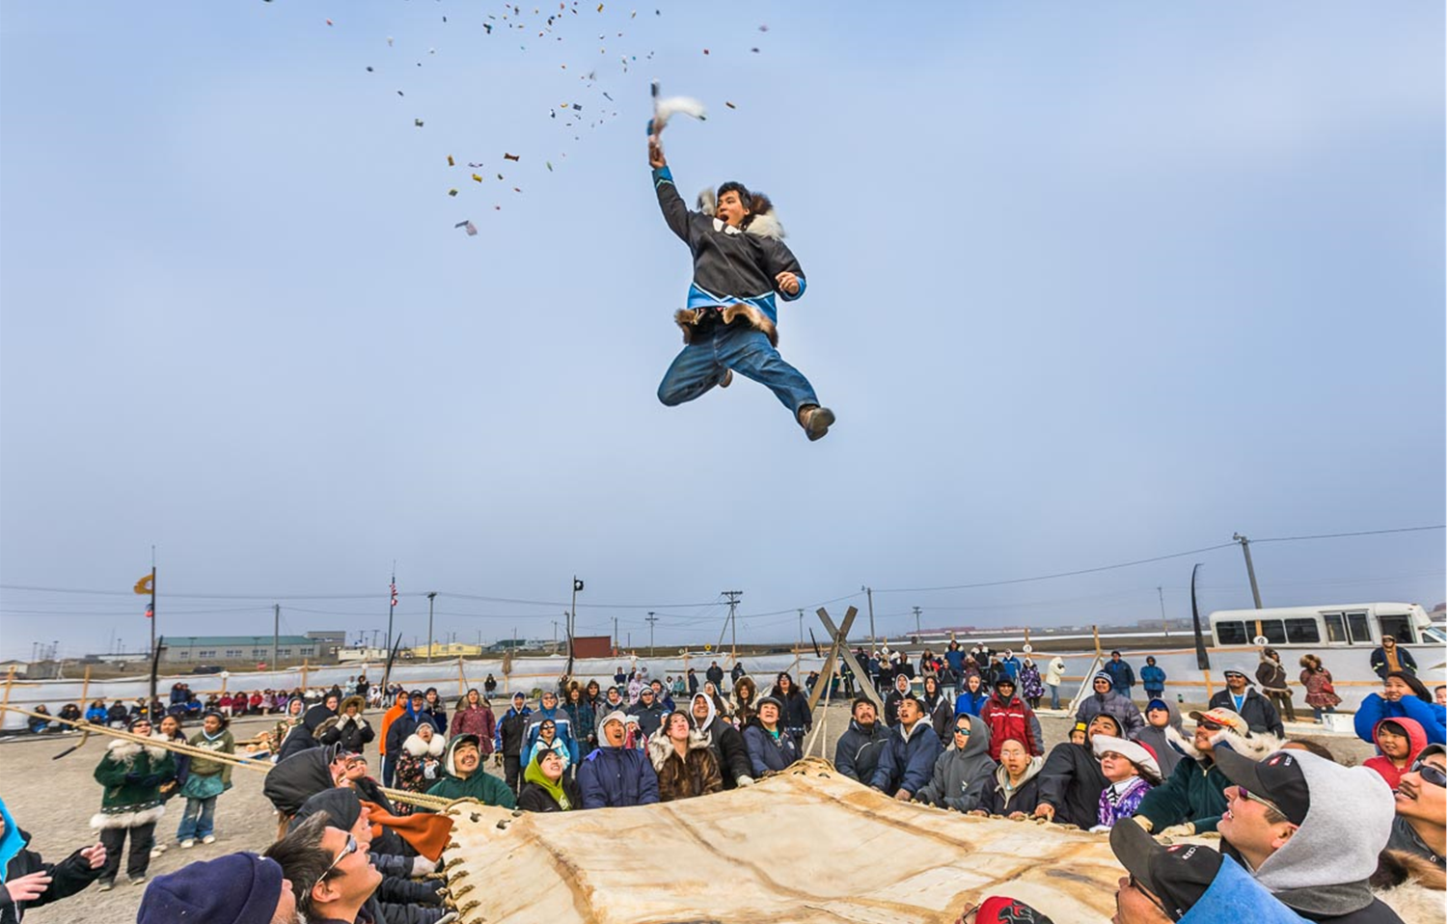
ANTHC Philosophy
Notes:
The Substance Misuse Prevention Program works in collaboration with Tribes and Tribal health organizations to prevent substance misuse and dependence in the communities we serve and encourage enhancement of healthy, supportive community environments.
Harm reduction is a public health philosophy that refers to policies, programs, and practices that aim to minimize negative health, social and legal impacts associated with drug use, drug policies and laws.
It focuses on positive change, safety and working with people without judgement, discrimination, coercion, or requiring that they stop using drugs as a precondition for support. It is an approach that meets people where they’re at.

Slide 3
ANTHC Harm Reduction Principles
Harm reduction as a philosophy and as a set of practices reflects our values and our vision of upholding Alaska Native health and wellbeing.
Harm reduction specifically aligns with our organizational values of:
  Treat with Respect and Integrity
  Compassion
Notes:
Harm reduction is a public health philosophy that refers to policies, programs, and practices that aim to minimize negative health, social and legal impacts associated with drug use, drug policies and laws.
Harm reduction focuses on positive change, safety and working with people without:
Judgement
Discrimination
Coercion
Or requiring that they stop using drugs as a precondition for support.
A few examples of harm reduction are seat belts, speed limits, syringe exchange, fentanyl testing strips, etc.

Slide 4
Opioid Overdose in Alaska
Opioids continue to make up a large proportion of drug overdose deaths across Alaska.
We saw a 165% increase during 2019-2020 for synthetic opioid OD deaths.
  Most of these synthetic opioid overdose deaths were from the substance fentanyl.
In 2020, Alaska had approximately 143 opioid-related overdose deaths.
In 2021, we saw our worst opioid overdose death rate in a decade with approximately 214 deaths.
Source:
SOA Opioid Dashboard- https://health.alaska.gov/dph/Director/Pages/opioids/dashboard.aspx

Slide 5
Opioid Response
Potentially fatal opioid overdose can be treated by administering Naloxone, a medication that reverses the respiratory depressing effects of opioids.
Naloxone is a very effective response to
an opioid overdose emergency
Naloxone is both safe and easy to use
Notes:
In October 2017, the President declared the opioid overdose epidemic to be a public health emergency.
Naloxone is a very effective drug for reversing opioid overdoses.
Police officers, emergency medical services providers, and non-emergency professional responders carry the drug for that purpose. The Surgeon General of the United States is also urging others who may encounter people at risk for opioid overdose to have naloxone available and to learn how to use it to save lives.

Slide 6
Alaska SB 23
AS 09.65.340
In 2016, Alaska passed SB23 to help reduce barriers to the provision of life saving medication naloxone.
SB 23 protects a person from civil damages resulting from an omission or commission in prescribing or providing an opioid OD drug (e.g. Narcan) IF… (read 1A, 1B, 2).
The State of Alaska Department of Health and Social Services (DHSS) developed a statewide Overdose Response Program (ORP) called Project HOPE (Harm Reduction, Overdose Prevention, and Education), that allows public and private entities the ability to distribute, dispense and administer Project HOPE opioid overdose rescue kits.
As an agency enrolled in Project HOPE, TRAINED staff are considered “volunteers/ employees of an overdose program.”
http://www.legis.state.ak.us/basis/get_bill_text.asp?hsid=SB0023Z&session=29
Notes:
Project HOPE is able to directly provide naloxone medication to Alaskans. Under the authority of AS 17.20.085 and a February 14, 2017 Declaration of Disaster Emergency, a medical standing order authorizes any approved Department of Health and Social Services Project HOPE Overdose Response Program (ORP) to maintain supplies of opioid overdose rescue kits for the purpose of distributing/administering to a person at risk of experiencing an opioid overdose or a family member, friend, caregiver, or other person in a position to administer the opioid overdose drug naloxone (i.e., Narcan ® Nasal Spray) to a person at risk of experiencing an opioid overdose.
In Feb 2022, the standing order was updated. It now includes additional (FDA approved) naloxone nasal sprays. Examples include:
- Narcan (4mg) Nasal Spray- 2 pack (the original FDA approved treatment)
Kloxxado (8mg) Nasal Spray- 2 pack
ANTHC is an ORP and will start dispersing Kloxxado in May 2022

Slide 7
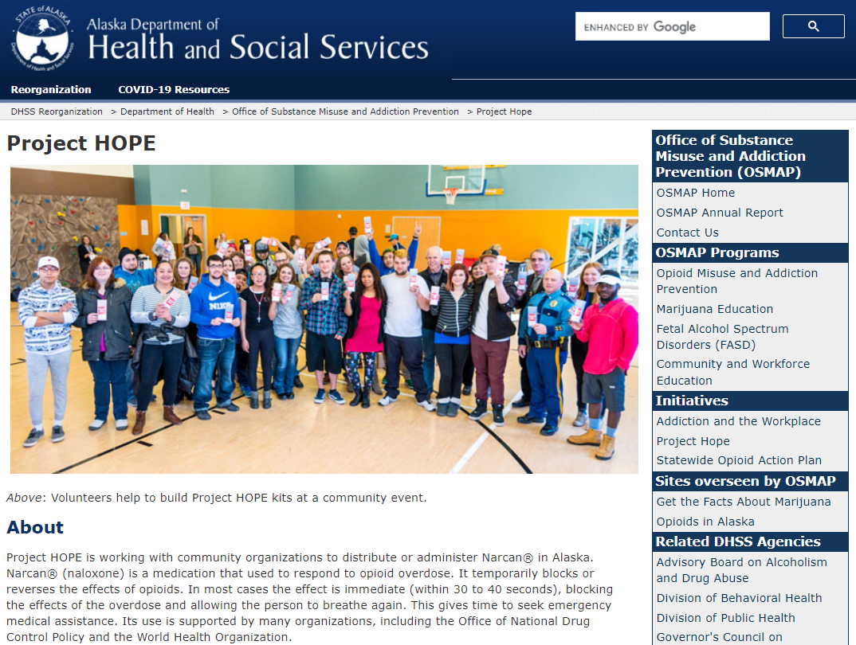
Source: https://health.alaska.gov/osmap/Pages/hope.aspx
Notes:
Project HOPE is working with community organizations to distribute or administer Narcan® in Alaska.
OSMAP’s Project HOPE distributed over 12,000 opioid-reversing naloxone rescue kits and provided training on use to first responders across the state. Project HOPE also trained and approved 29 Opioid Response Programs to help ensure rescue kit training and distribution continues at the local level.
To Find a Project Hope location near you- visit their website.

Slide 8


ANTHC Harm Reduction Initiatives
Notes:
ANTHC’s Substance Misuse Prevention Program works to prevent substance misuse and dependence in the communities we serve.
The Substance Misuse Prevention Program works in collaboration with Tribes and Tribal health organizations to prevent substance misuse and dependence in the communities we serve and encourage enhancement of healthy, supportive community environments.
One of the goals through all of our initiatives is to increase awareness of this incredible resource that has been developed.

Slide 9
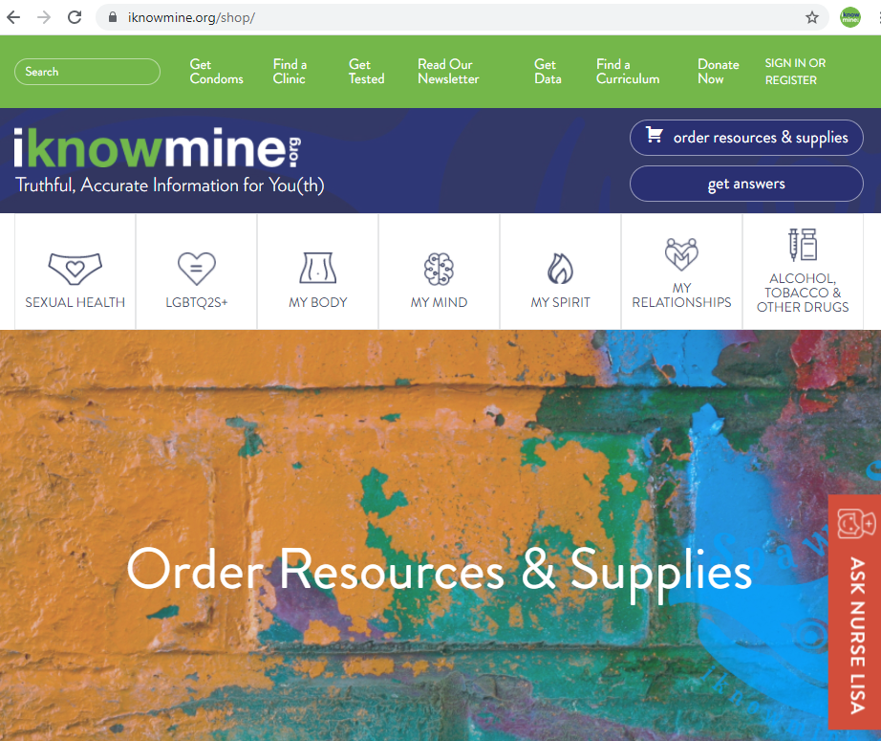
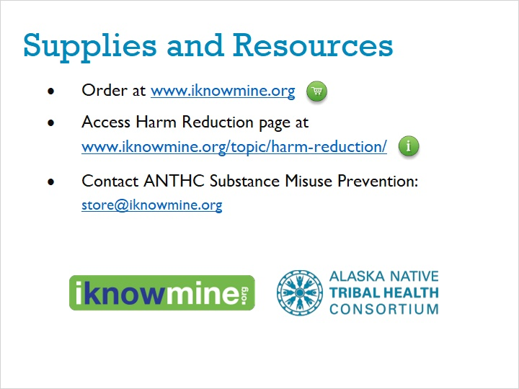
Notes:
One initiative is a collaboration with the Wellness and Prevention department HIV/STD prevention program. Together we raise awareness about harm reduction, substance misuse or HIV/STI’s and then refer them to the iKnowMine website to order free resources and access more information.
It is a youth wellness website that hosts lots of information – from sexual wellbeing to substance use to healthy relationships. Here is a screenshot of what can be ordered.

Slide 10
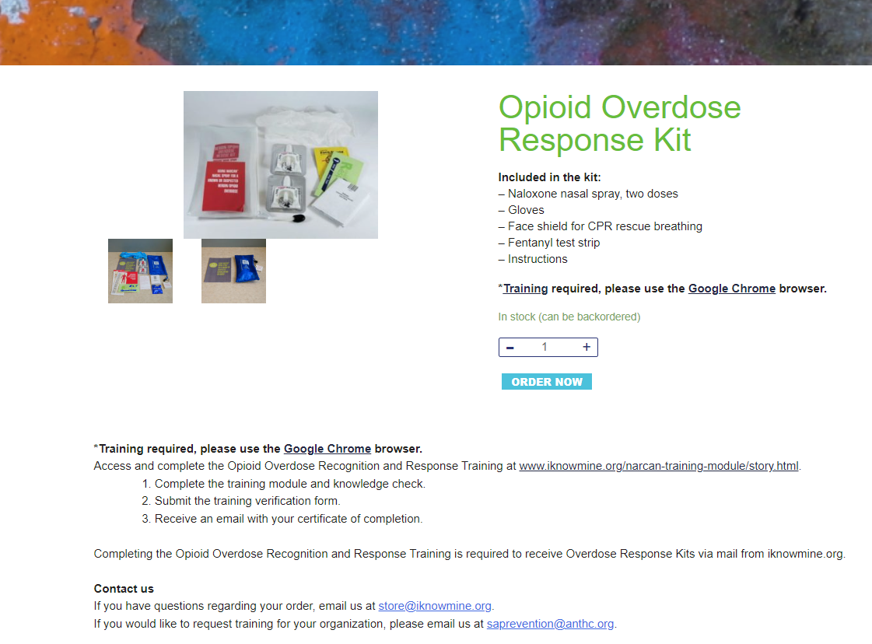
Notes:
One of the products on the website is our Overdose Response Kits (also known as Narcan kits), which are used for opioid overdose reversal and are extremely effective.
There is a required tutorial to complete before Narcan can be shipped.

Slide 11
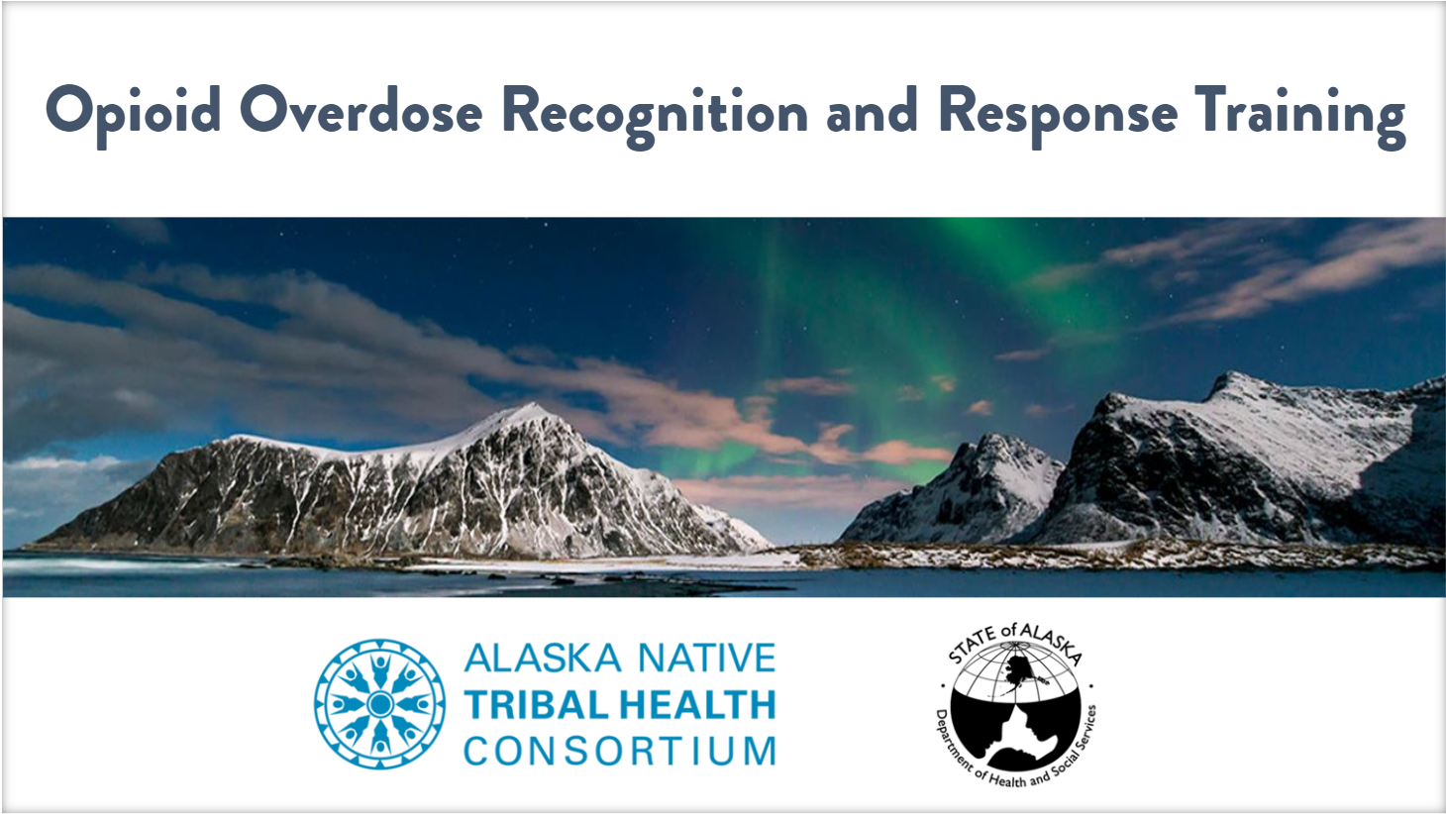
https://www.iknowmine.org/narcan-training-module/story.html
Notes:
Total training module completions: over 330 (including 3 more this morning)
And we have distributed over 1400 kits throughout Alaska

Slide 12
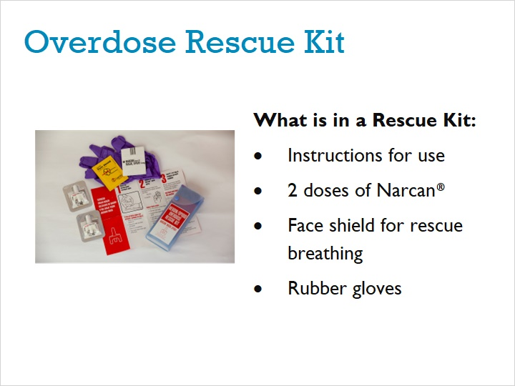
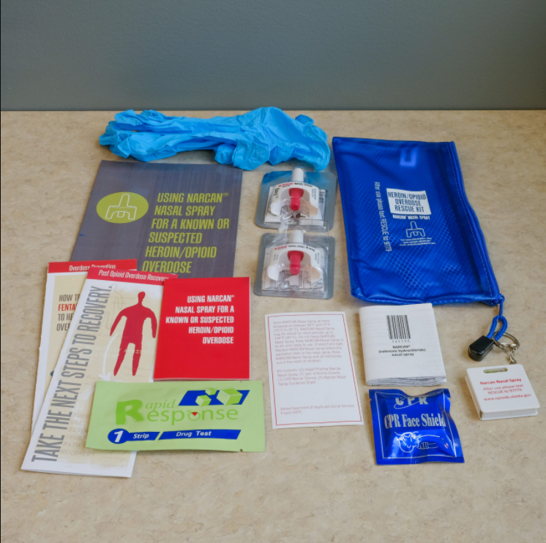
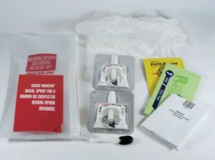
Fentanyl test strip and instructions
Notes:
The Overdose rescue kits contain several items…Pictured are two ways the kits are packaged.
-instructions for use
-2 doses of Narcan nasal spray, which is an opioid overdose-reversing drug
-a face-shield for rescue breathing
-1 pair of latex-free rubber gloves
-fentanyl test strip and instructions
https://www.iknowmine.org/product/fentanyl-test-strips/

Slide 13
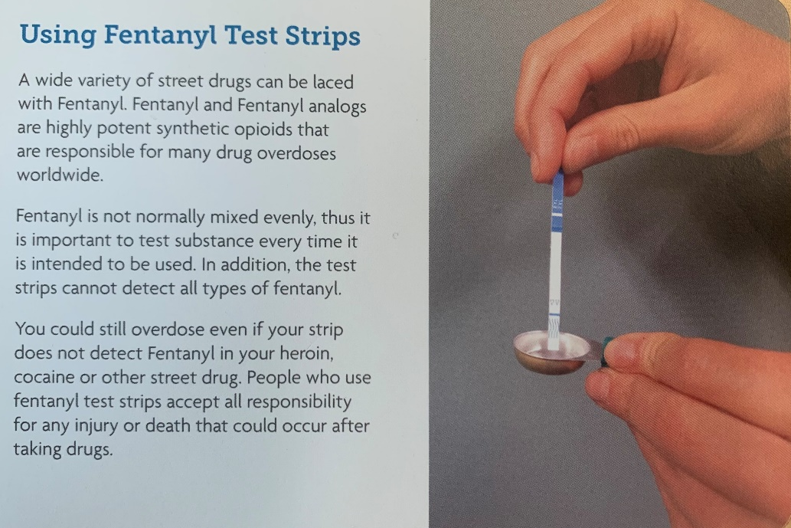
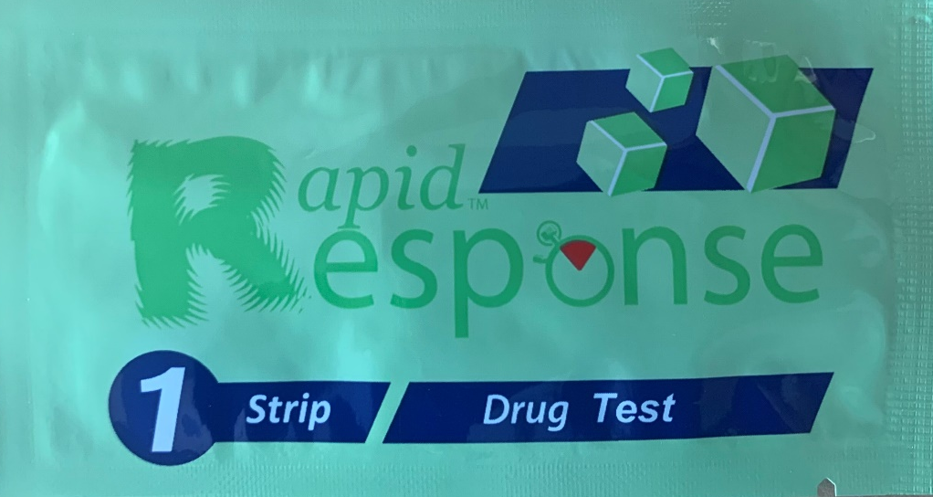
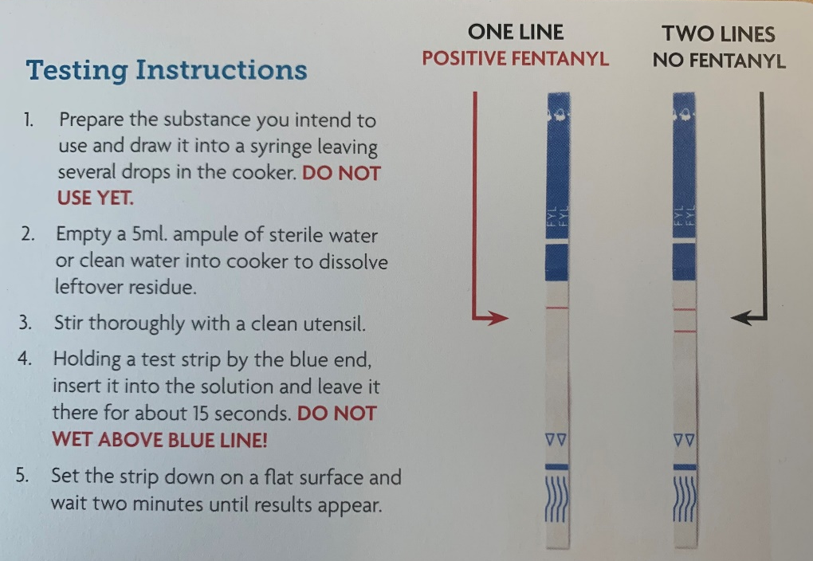
Fentanyl Test Strips
Notes:
A wide variety of street drugs can be laced with Fentanyl. Fentanyl and Fentanyl analogs are highly potent synthetic opioids that are responsible for many drug overdoses worldwide.
Fentanyl is not normally mixed evenly, thus it is important to test substance every time it is intended to be used. In addition, the test strips cannot detect all types of fentanyl.
You can still overdose even if your strip does not detect Fentanyl in your heroin, cocaine or other street drug. People who use fentanyl test strips accept all responsibility for any injury or death that could occur after taking drugs.

Slide 14
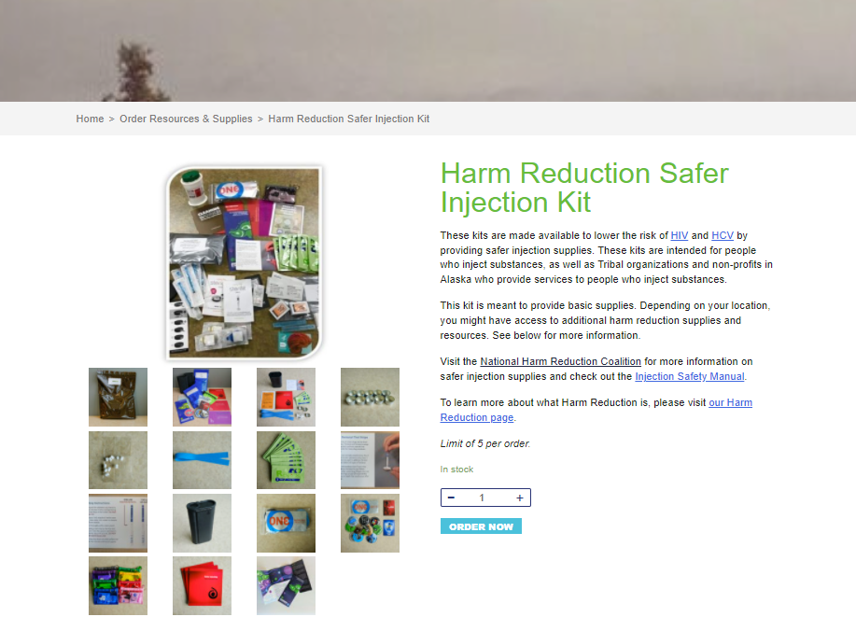

Slide 15
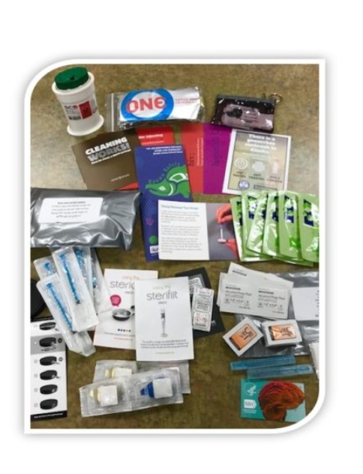
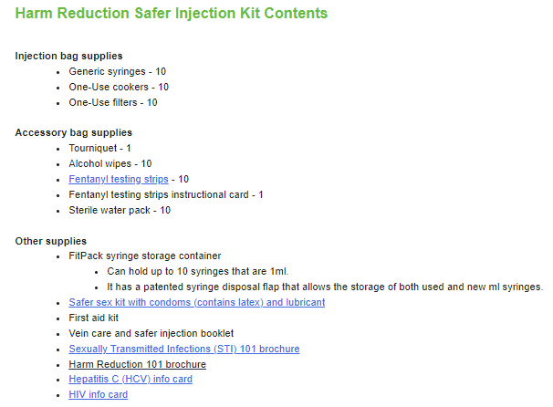
Notes:
One of the products I want to talk more about is the HR kits. They include various supplies that reduce the harm from injection drug use – syringes, cleaning supplies, fentanyl testing strips and much more.
Over 460 Harm Reduction Kits have been dispersed this year by the HIV/STD Prevention Program.
Kits have been dispersed to ANTHC providers like the HIV Clinical services and Liver and hepatitis program. As well as both individuals and providers in 18 communities in 13 tribal health organization service regions.
We are currently applying for funding for additional supplies to continue to make and provide these kits.

Slide 16
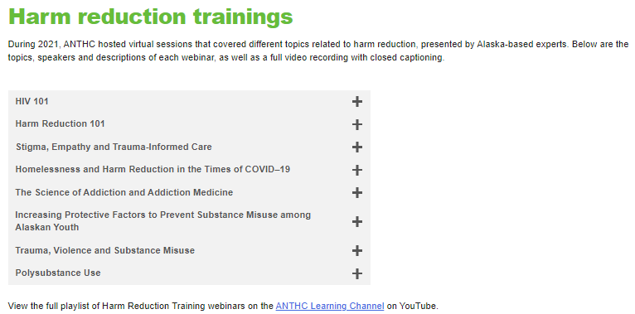
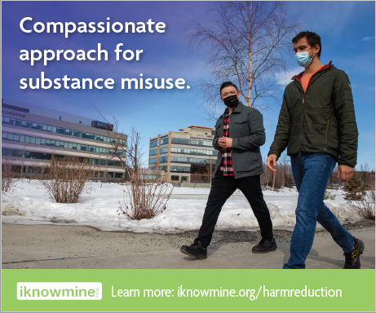
Additional Harm Reduction Initiatives
Harm Reduction Webinar Series
Harm Reduction PSA
Notes:
You can find these on Youtube
Additional resources
Addiction ECHO

Slide 17
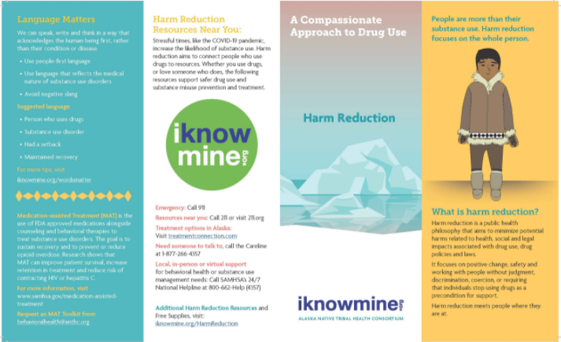
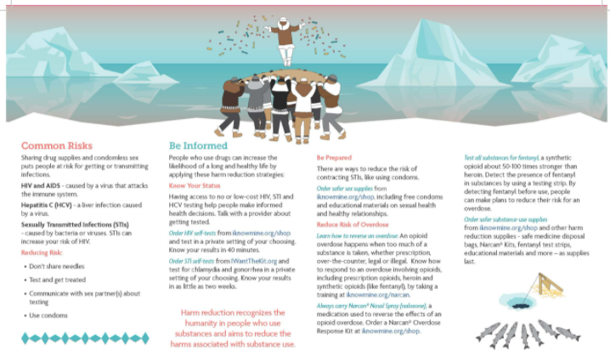
Additional Harm Reduction Initiatives
Resources
  ANTHC Harm Reduction Toolkit
  Curriculum/ class activities
  Handouts:
    Tips for Changing Your Language
    Harm Reduction 101
Notes:
Additional resources
Addiction ECHO

Slide 18
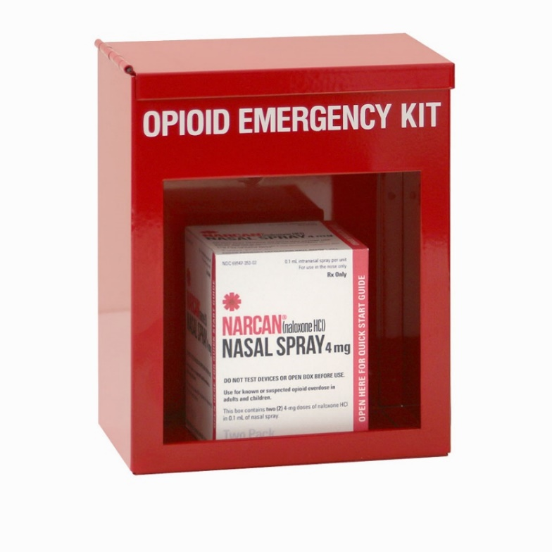
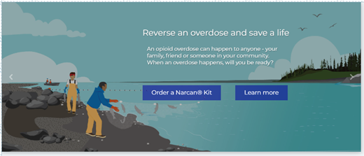
ANTHC Naloxone Workplace Program
SAMHSA First Responder: Comprehensive Addiction and Recovery Act Grant
Notes:
Begin the process for Leadership Approval
Development of Policies and Procedures
Revising training and supply systems
Developing a marketing strategy- Educational material development and distribution
Expansion of program in Years 2-4
Nine rural community partners through grant cycle
Technical assistance and workplace policy toolkit

Slide 19
saprevention@anthc.org

Slide 20
References
National Harm Reduction Coalition. (2021, May 23). Harm reduction principles. National Harm Reduction Coalition. Retrieved February 9, 2022, from https://harmreduction.org/about-us/principles-of-harm-reduction/
State of Alaska Office of Substance Misuse and Addiction Prevention. (2021, May). Retrieved February 9, 2022.
Alaska State Legislature. (n.d.). Retrieved February 9, 2022, from http://akleg.gov/

Slide 21
Jennifer Summers, Substance Misuse Prevention
EmaiL: jasummers@anthc.org

