Slide 1



TxCOPE:
Texans Connecting Overdose Prevention Efforts
Kasey Claborn, PhD
The University of Texas at Austin
Addictions Research Institute
@KaseyClabornPhD

Slide 2
Disclosures
This project is supported by Texas Targeted Opioid Response, a public health initiative operated by the Texas Health and Human Services Commission through federal funding from the Substance Abuse and Mental Health Services Administration grant award number H79TI083288.
Dr. Claborn’s effort is also supported by grant no. K23DA039037
from the National Institute on Drug Abuse.
The views expressed do not necessarily reflect the official policies of the Department of Health and Human Services or Texas Health and Human Services; nor does mention of trade names, commercial practices, or organizations imply endorsement by the U.S. or Texas Government.
No conflicts of interest to disclose.
Notes:
Jake

Slide 3

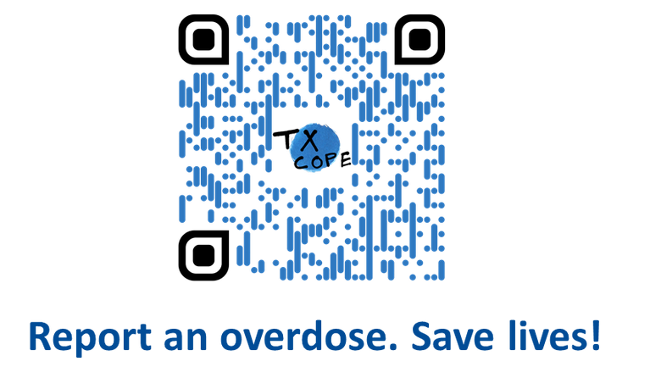


Acknowledgements
Community-Academic-Industry Partners
Community Partners:
  TxCOPE Community Advisory Board
  210 Street Reach
  ASHWell
  BAHRC
  Project Vida
  Punto de Partido
  Texas Harm Reduction Coalition
  Williamson County Mobile Outreach Team
Technology Partner:
Academic Partner:
Notes:
Jake

Slide 4
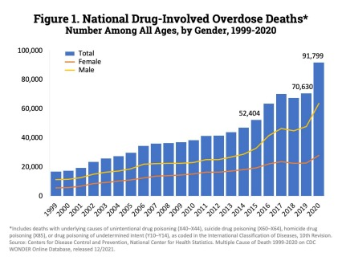
Historical Records in Overdose Deaths
Between January-December 2021, nearly 108,000 Americans died from overdose.
Overdose deaths increased 30% in the United States during 2020.
Notes:
Kasey
https://www.drugabuse.gov/drug-topics/trends-statistics/overdose-death-rates

Slide 5
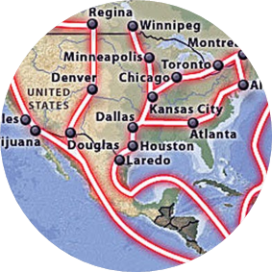


Public health infrastructure failed to
support people who use drugs
Changes in Drug Supply
Limited Harm Reduction
Services
Treatment Facilities Closed
Shortage of drugs at the retail level resulted in an increase in drug prices, a decrease in drug purity, and quality. Demand increased, supply decreased with border closures and social distancing.
Increased demand for services and naloxone, community backlash towards outreach workers for not social distancing and “spreading COVID”, closure or reduced outreach among community organizations.
Limited or no access to public transportation, mental health and substance use services, closures of publicly funded treatment facilities.
Notes:
KC

Slide 6

Drug overdose deaths in 2020 were horrifying. Radical change is needed to address the drug crisis.
Nora Volkow, MD
Director, National Institute on Drub Abuse
Notes:
KC
These data are telling us that something is wrong. In fact, they are shouting for change.
It is no longer a question of “doing more” to combat our nation’s drug problems. What we as a society are doing—putting people with drug addiction behind bars, underinvesting in prevention and compassionate medical care—is not working.
Expand digital health models

Slide 7
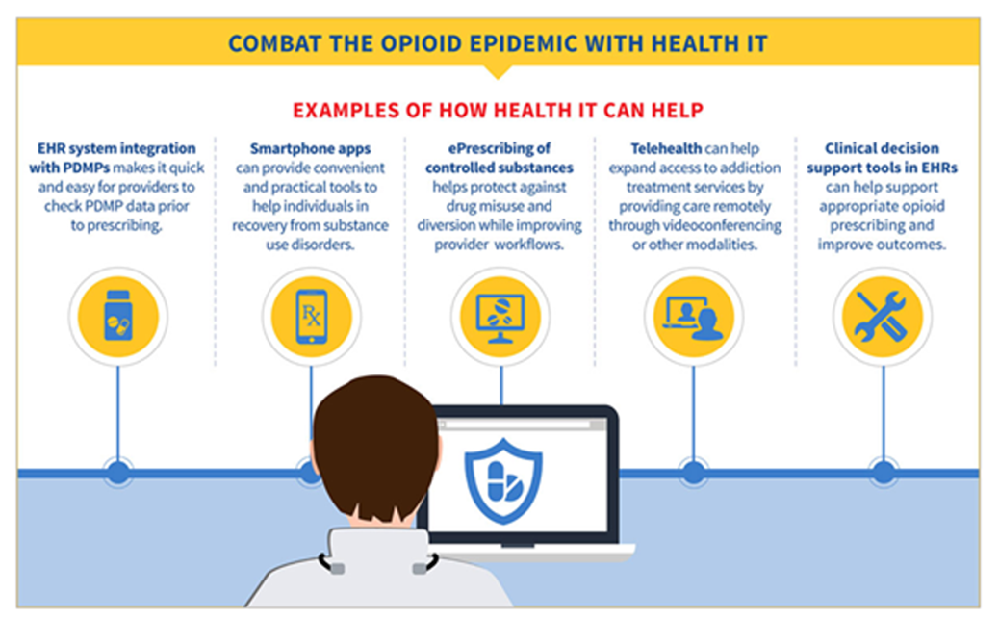
Urgently Need to Expand Health Information & Technology
The Health IT response to the opioid epidemic has been severely insufficient
  Solely focuses on the healthcare system
  Fails to reach high-risk, “hidden” populations
  Exacerbates health inequity
Traditional Surveillance Methods
  Fails to capture non-fatal overdoses
  Fails to capture community-level data
Notes:
KC

Slide 8
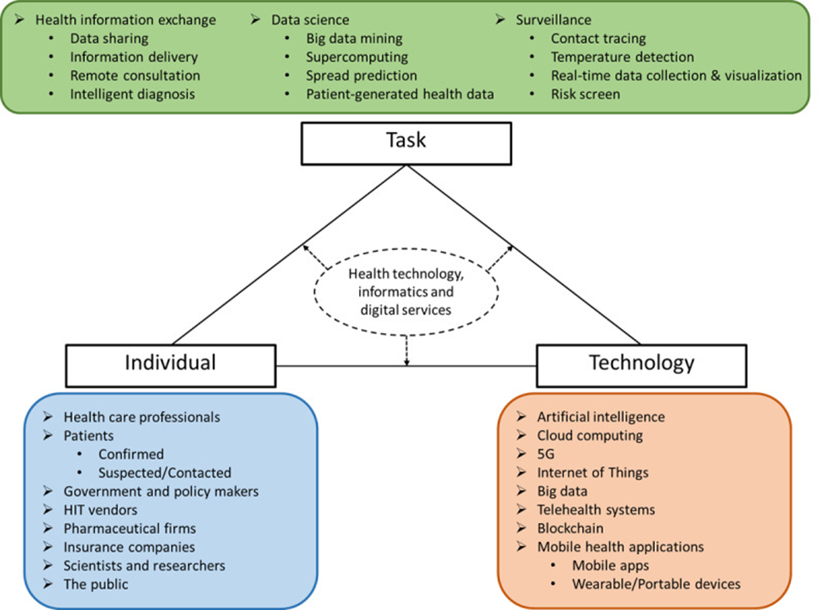
Health IT Response to COVID-19
Ye J. (2020). The Role of Health Technology and Informatics in a Global Public Health Emergency: Practices and Implications From the COVID-19 Pandemic. JMIR medical informatics, 8(7), e19866. https://doi.org/10.2196/19866
Notes:
KC

Slide 9

Need to Harness the Power of the Community and Health IT to Improve Data-Driven Overdose Prevention & Response
Notes:
KC

Slide 10

Gaps in Overdose Data
Disparate reporting systems
  EMS, Emergency Departments, Harm Reduction Orgs
Failure to track key overdose metrics
  Non-fatal overdoses
Data capture among “hidden” populations
  Naloxone administration and distribution trends
  Policies that impede data accuracy & service utilization
Lack data to drive prevention and response efforts
Claborn, K., Cance, J., Kane, H, Hairgrove, S., Conway, F. “If It Didn’t Get Reported, It Didn’t Happen”: Current Non-fatal Overdose Reporting Practices among Non-Traditional Reporters in Texas. (Under Review).
Notes:
KC

Slide 11

What is TxCOPE?
Texans Connecting Overdose Prevention Efforts
  Digital tool designed to improve community overdose response efforts
  Improve overdose data in Texas
  Use data to drive action and save lives
Notes:
Jake

Slide 12
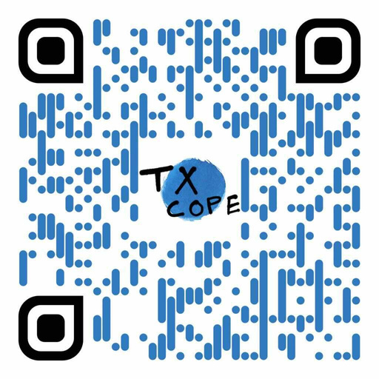



REPORT
FOLLOW
CONTACT US
Download Now
@Tx_COPE
info@txcope.org
www.txcope.org/harmreduction
Notes:
Jake

Slide 13



TxCOPE Project Aims
Together, we can save lives.
Improve Overdose Data in Texas
Develop an innovative model for data capture that improves data for hard-to-reach populations.
Data to Drive Community Response & Prevention Efforts
Use data to inform community-driven overdose response. Improve resource allocation and improve equitable distribution to areas of greatest need.
Statewide Dissemination
Develop a strategy to implement TxCOPE across Texas during 2022-2023.
Notes:
Jake

Slide 14
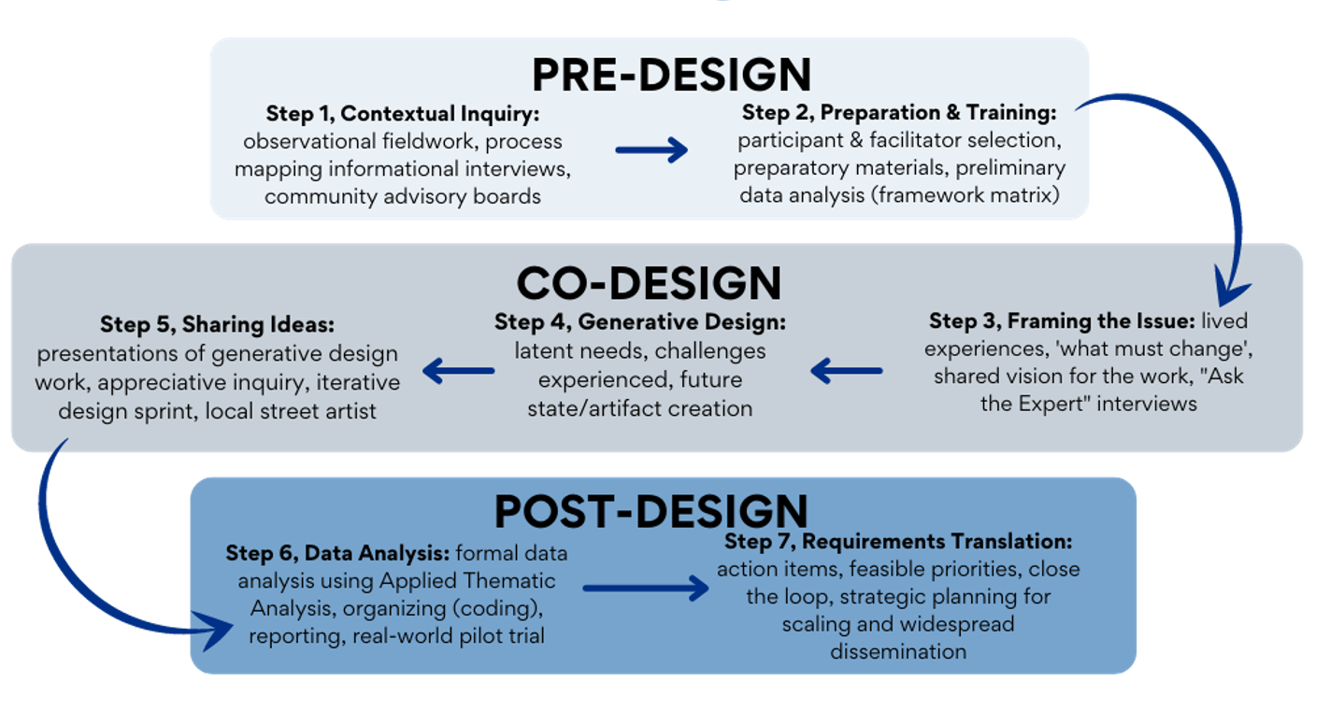
Designed by the community,
for the community
Notes:
Jake

Slide 15
Our Community Partners
TRAVIS COUNTY
ASHwell
Integral Care
Austin Travis County-EMS
Texas Harm Reduction Alliance
Austin Recovery Network
SxSW Addiction Technology-Transfer Center
Travis Co Medical Examiner
Vivent Health
EL PASO COUNTY
  BEXAR COUNTY
El Paso Harm Reduction Alliance
Alliance of Border Collaboratives
Punto de Partida
Project VIDA
El Paso Fire Department
Emergence Health Network
Mobile Integrated Health Unit, SAFD
Bexar Area Harm Reduction Coalition
Street Medicine
The Center for Healthcare Services
UT Health Sciences Center
Street Nursing
Southwest Texas Regional-
Advisory Council
WILLIAMSON COUNTY
Mobile Outreach Team, WCEMS
Community Medical Services
Peers of Faith
Bluebonnet Trails Community Services
Life Steps
Pavilion Williamson Co
Notes:
Jake

Slide 16

Ethical by Design
  Partner with harm reduction organizations
  Preserve and establish trust in the community
  Give the community a voice to inform how the data drives action
  Protect the data given by the community
Claborn K, Creech S, Whittfield Q, Parra-Cardona R, Daugherty A, Benzer J. Ethical by design: engaging the community to co-design a digital health ecosystem to improve overdose prevention efforts among highly vulnerable people who use drugs. Front Digit Health. 2022; 4. 10.3389/fdgth.2022.880849
Notes:
KC
Community involved in the design, development, and implementation.
Prioritize reach, adoption, and sustainability among vulnerable populations.
Dismantle power structures.
Community-defined evidence.

Slide 17

Phase 1:
Research & Development Process
Stakeholders included people who use drugs, harm reductionists, & first responders.
Included ride-alongs with Fire and EMS, and mobile/street outreach with harm reduction orgs.
Reviewed existing overdose surveillance technologies, state and county dashboards.
Community informed all aspects of design, development, and implementation.
Claborn, K., Creech, S., Conway, F. N., Clinton, N. M., Brinkley, K. T., Lippard, E., Ramos, T., Samora, J., Miri, A., & Benzer, J. (2022). Development of a digital platform to improve community response to overdose and prevention among harm reduction organizations. Harm Reduction Journal, 19(1), 62. doi:10.1186/s12954-022-00636-2
Notes:
KC

Slide 18
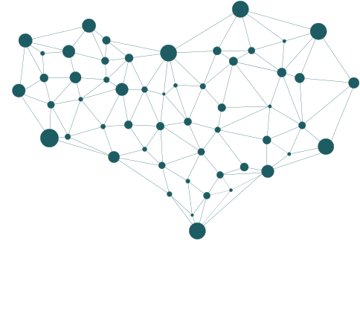


T
E
C
H
N
I
C
A
L
  UNIFIED, STANDARD SYSTEM FOR REPORTING ACROSS TEXAS
  BUILT-IN INTERNAL TRACKING SYSTEM
  FLEXIBLE DATA ENTRY METHODS
  DATA SHARING
  TRAINING FOR APP USE
  OFFLINE CAPABILITY
  USER-FRIENDLY
H
U
M
A
N
I
S
T
I
C
  NEED VERSIONS TAILORED TO USER GROUPS
  PRESERVATION OF COMMUNITY TRUST
DASHBOARD DESIGN PERSPECTIVES
  PERSON-FOCUSED LANGUAGE AND DESIGN
  WARM
  PRIVACY
  TRANSPARENCY OF DATA USAGE
Notes:
KC

Slide 19
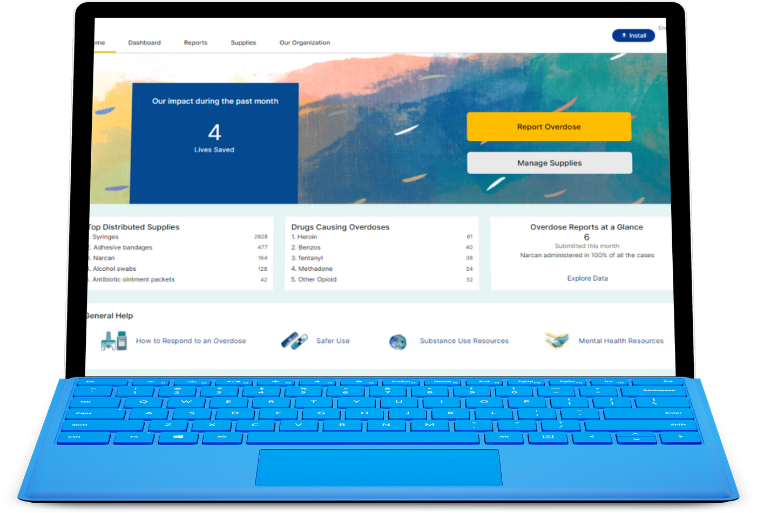
TxCOPE: Phase 1
Harm Reduction Reporting Dashboard
“Informed by the community,
for the community.”
Pilot study completed June-December 2021 across four Texas counties: Bexar, El Paso, Travis, and Williamson.
Notes:
Jake

Slide 20

Notes:
Jake

Slide 21

Phase 1: Tool for Harm Reduction Orgs
  Anonymous Overdose Report Form
  Supply Tracking and Distribution Map
  Data Dashboards at the organization and community level
Notes:
Jake

Slide 22
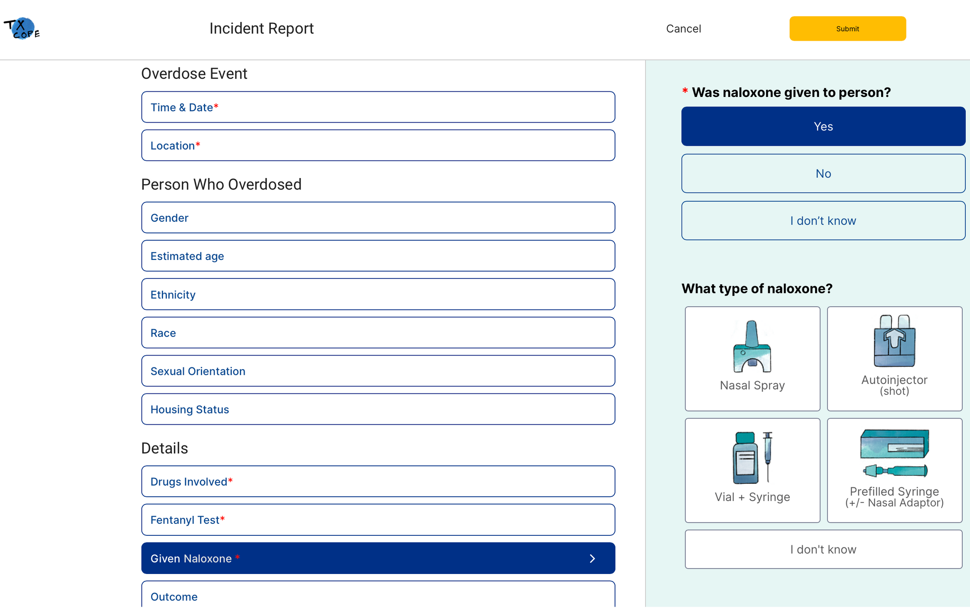
Anonymous
Quick
Easy
Notes:
Jake
OD Report Form
Key points:
-Anonymous
-easy to use
-quick (only red asterisks are required in order to detect multiple data entries)

Slide 23
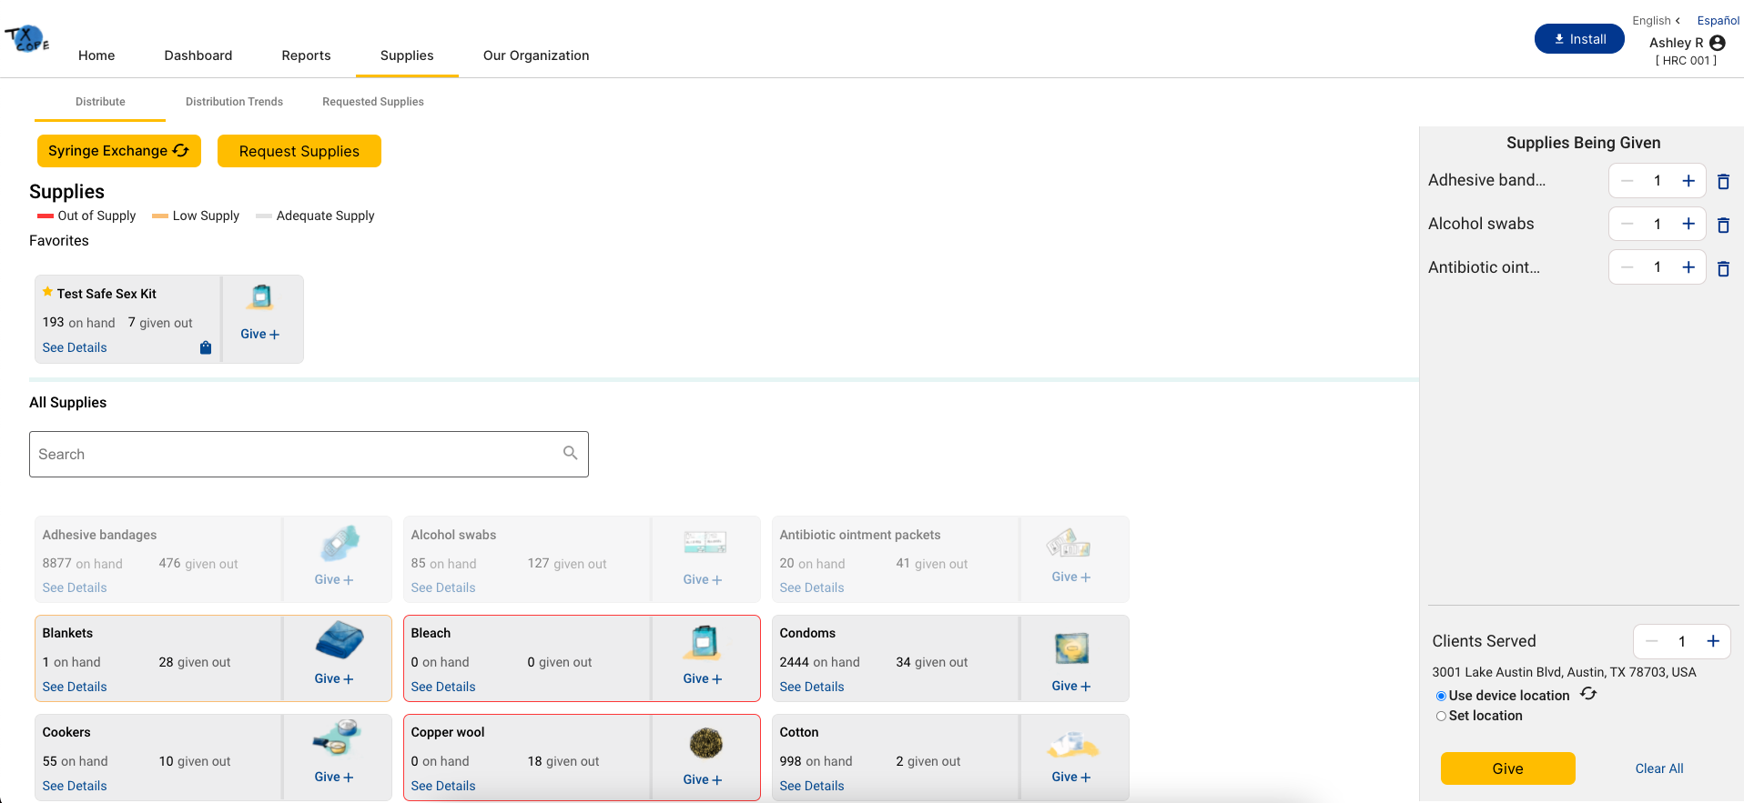
Supply Management
Notes:
Jake

Slide 24
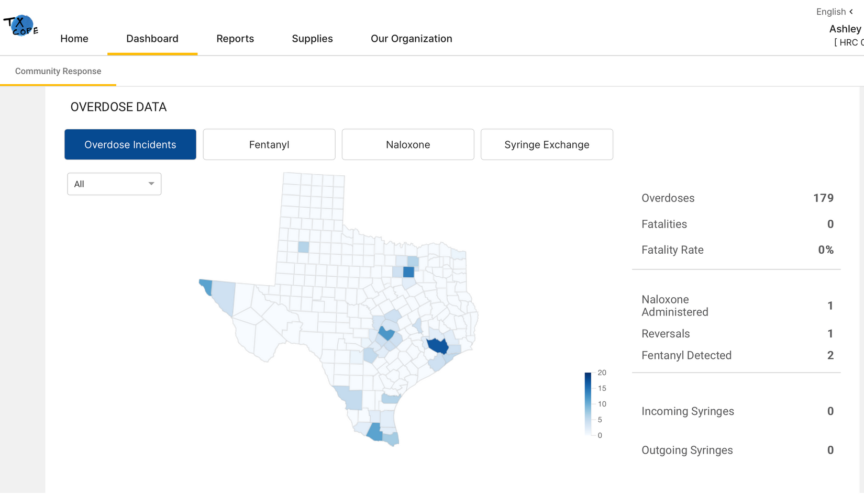
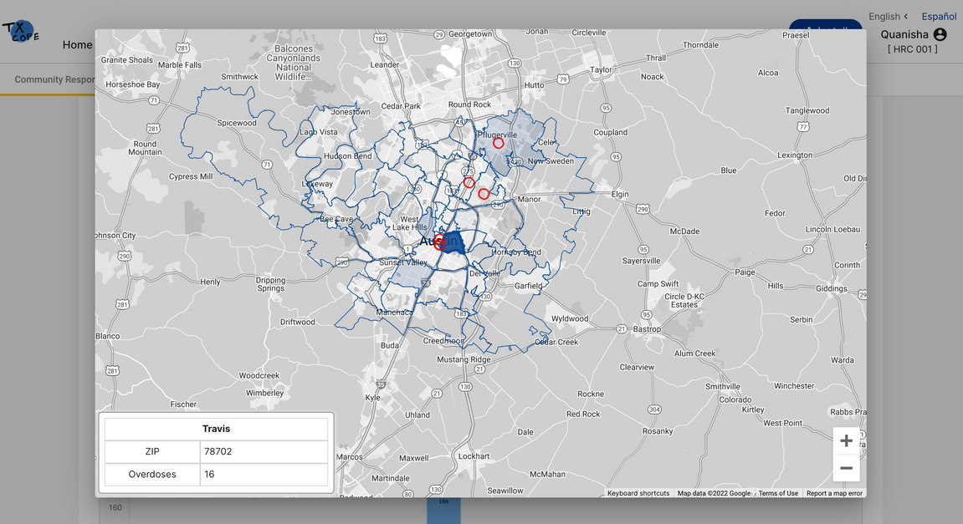
Data
Dashboards
County-level Community
Response View
Notes:
Jake

Slide 25
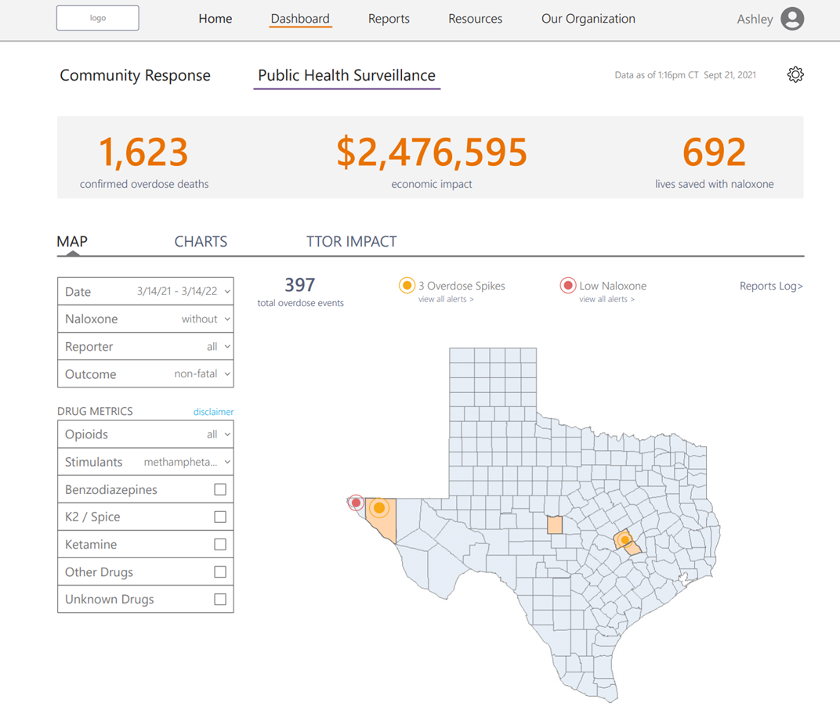
Data
Dashboards
Public Health
Statewide View
Notes:
Jake

Slide 26
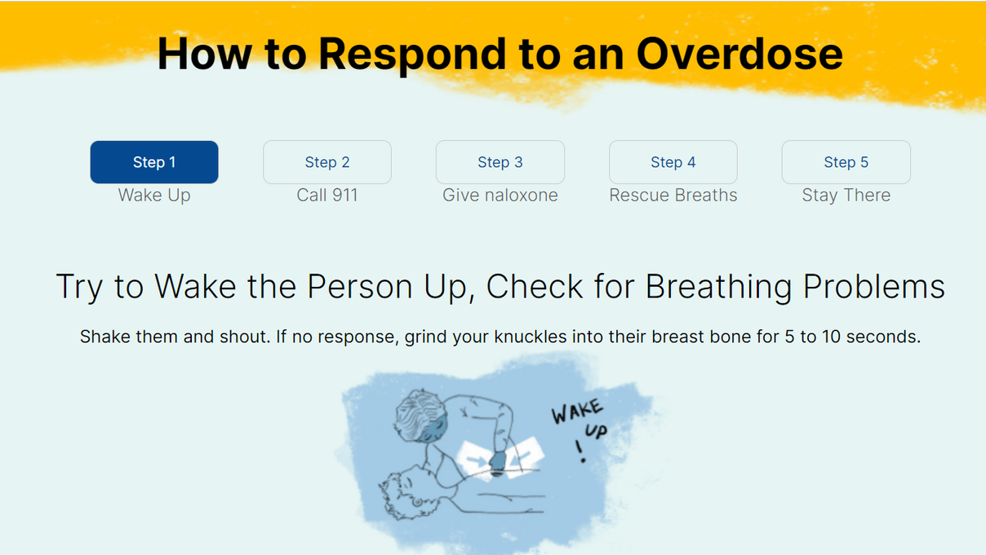
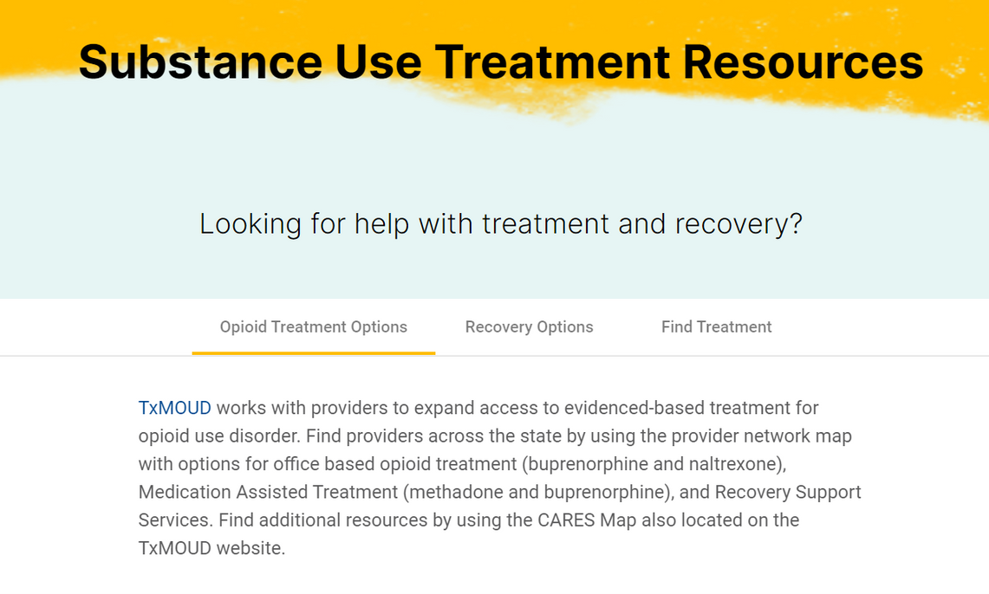
Resources
How to Respond to an Overdose
Safer Use
Substance Use Treatment
Mental Health Treatment
Notes:
Jake

Slide 27

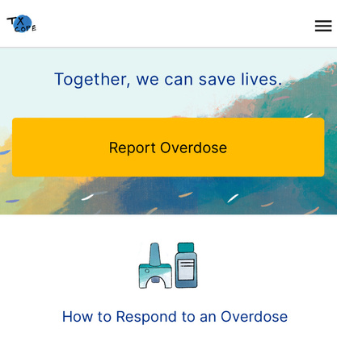

  Download the TxCOPE app
  Report overdoses
  Harm Reduction Orgs can enroll now
  Sign up for our monthly newsletter
  Help spread the word
How YOU can get involved!
Notes:
KC
Call to Action slide
How YOU can get involved
-download TxCOPE app
-report ODs when you hear about them
-if you're a HR org, contact us - we will get you enrolled
-sign up for our monthly newsletter
-help spread the word

Slide 28
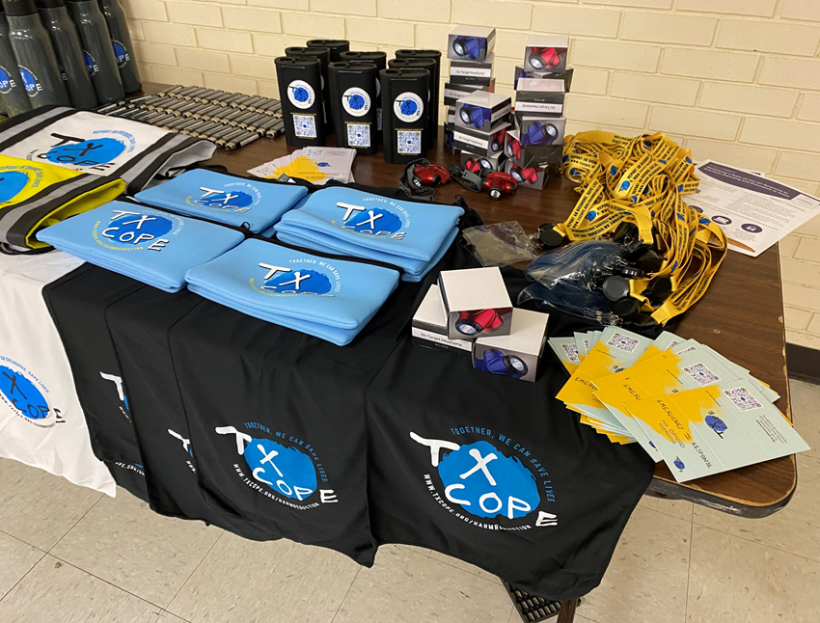
"Trust the Blue Dot"
Notes:
KC
swag and trust the blue dot

Slide 29

www.txcope.org/harmreduction
FOLLOW
@Tx_COPE
Notes:
KC

