Slide 1
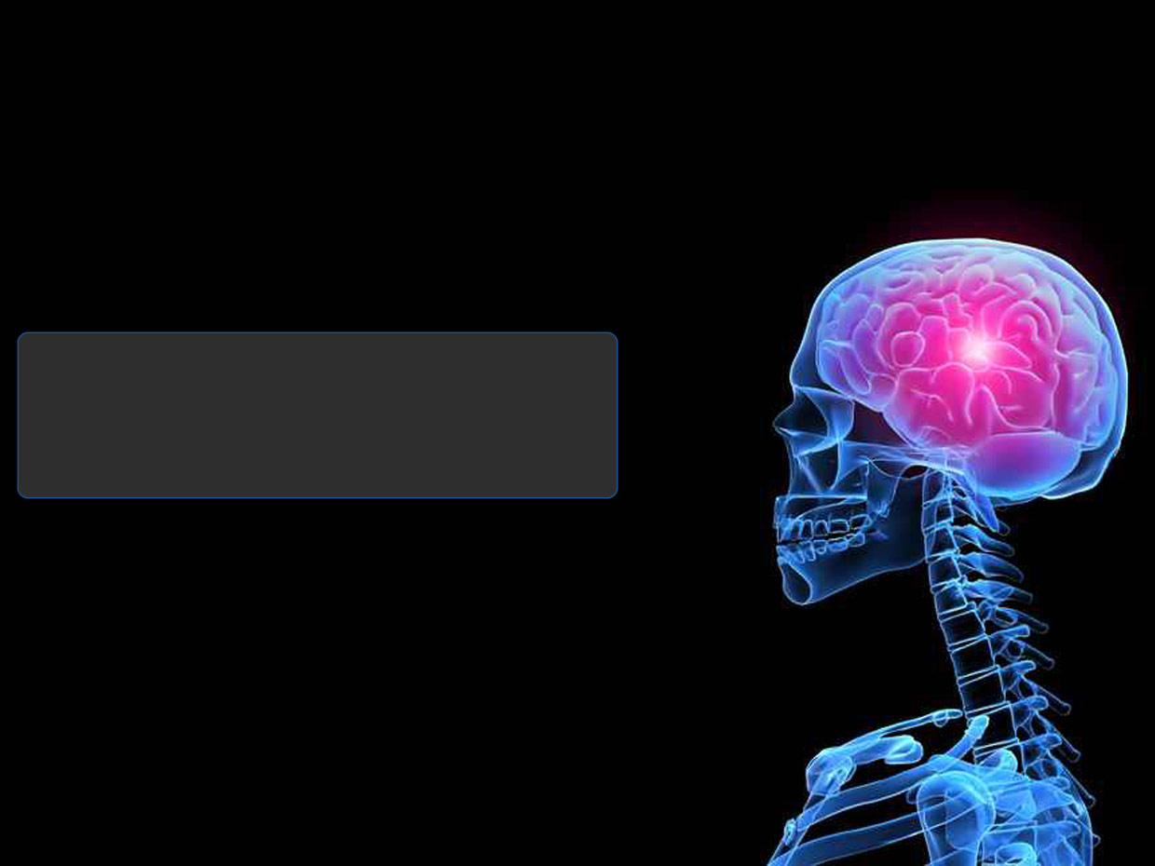

Managing Poly-Substance Use Disorder
CAPT Ted L. Hall, PharmD, BCPP, R.Ph.
DHHS/USPHS/IHS
Ho-Chunk Nation Health Department
Advanced Practice Pharmacist II
Clinical CPA Psychiatric Pharmacist Provider

Slide 2
Disclaimer:
The opinions and conclusions expressed today are those of the author and do not necessarily represent the views of the Department of Health and Human Services, US Public Health Service, the Indian Health Service or the Ho-Chunk Nation.
The speaker has no relevant financial or nonfinancial relationships within the products or services described, evaluated, or compared in this presentation.
*Off-label use of FDA approved medications discussed during practice-based evidence

Slide 3
Objectives
Discuss prevalence of poly-substance use disorder
Discuss stigma and introduction to cognitive behavioral therapy (CBT)
Present practice based evidence strategies supported by evidence-based practice
Invoke dialogue via mock patient vignette

Slide 4
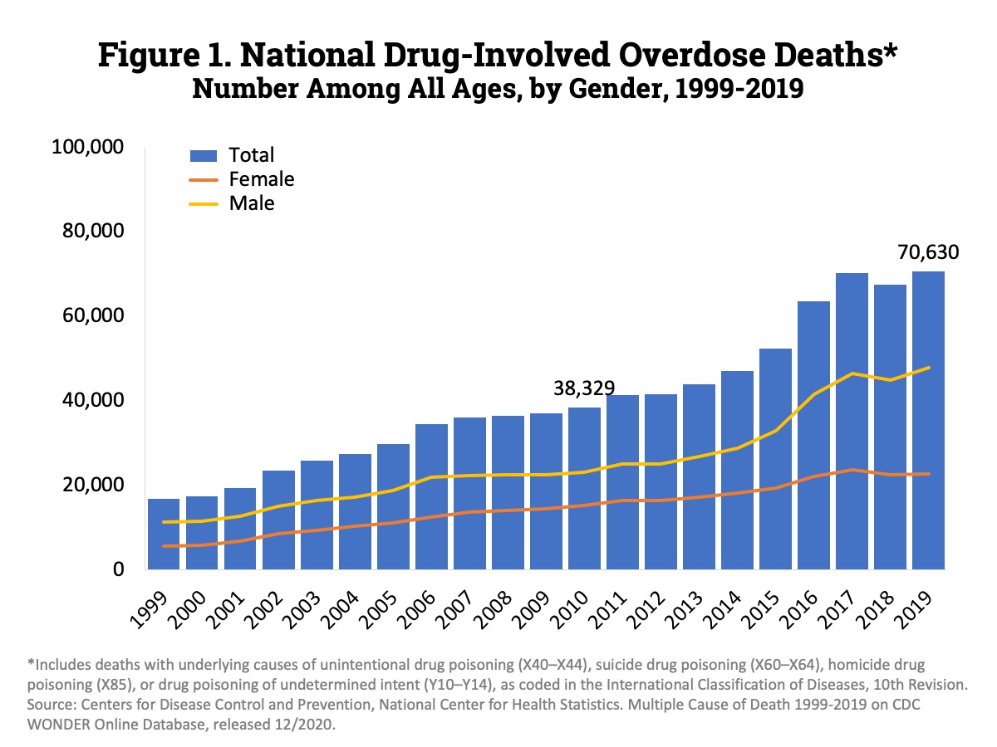
Overdose Rate
Overall overdose death rate nearly doubled since 2010
https://www.drugabuse.gov/related-topics/trends-statistics/overdose-death-rates; Revised May 2021

Slide 5
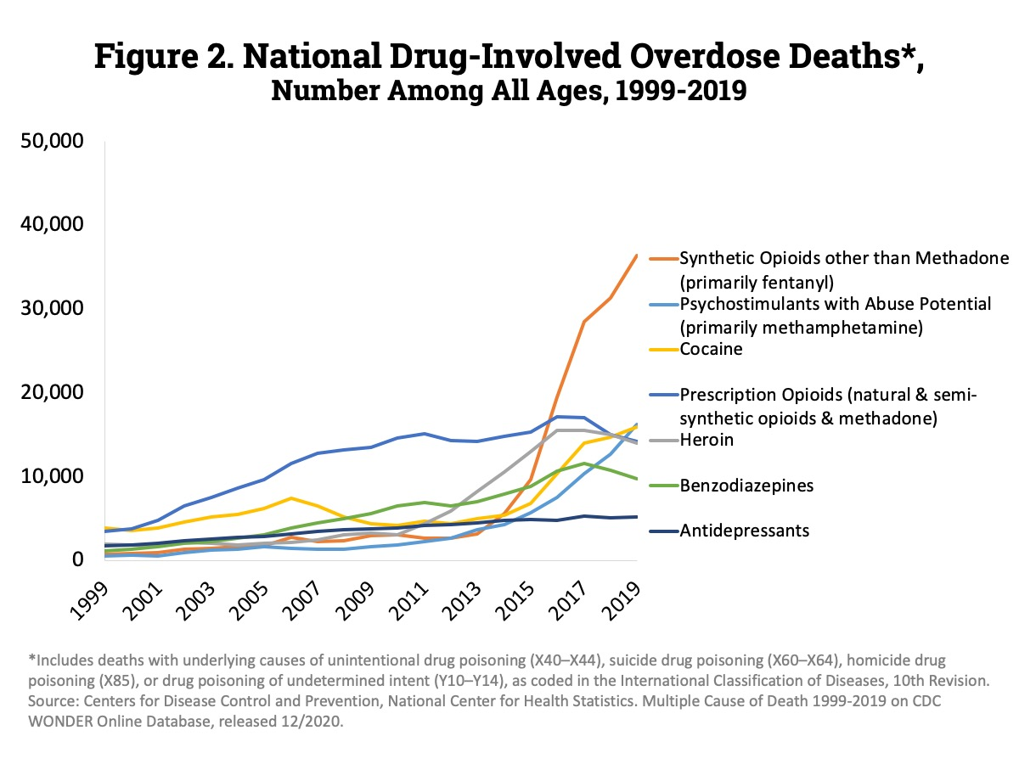
Overdose Rate
Fentanyl and psychostimulants (amphetamines) steady inclining since 2015
https://www.drugabuse.gov/related-topics/trends-statistics/overdose-death-rates; Revised May 2021

Slide 6
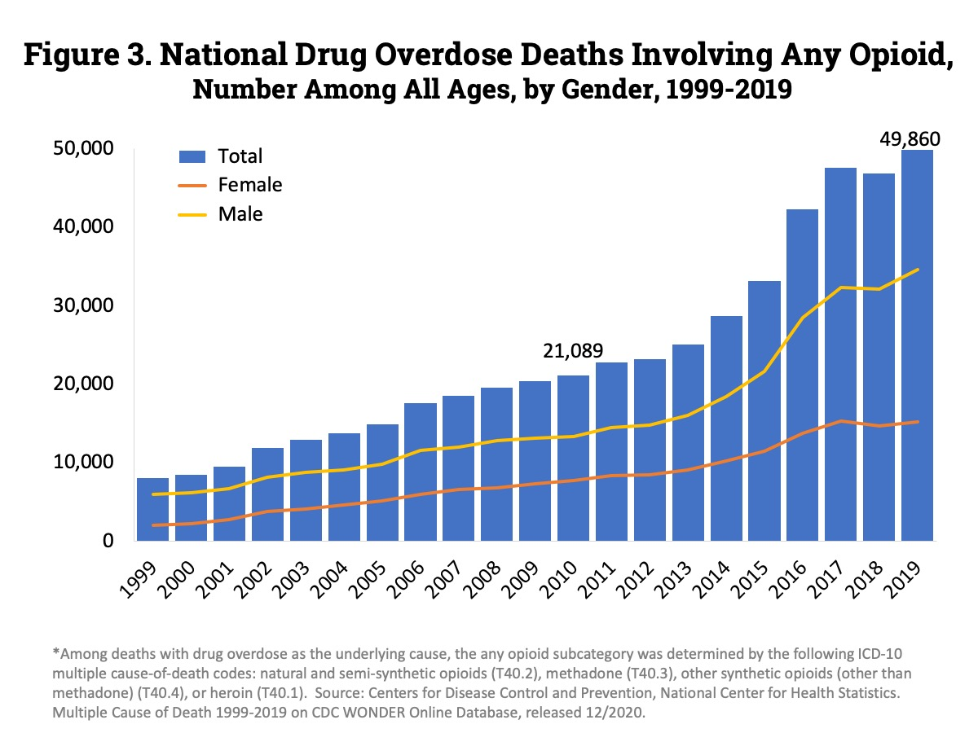
Overdose Rate
https://www.drugabuse.gov/related-topics/trends-statistics/overdose-death-rates; Revised May 2021

Slide 7
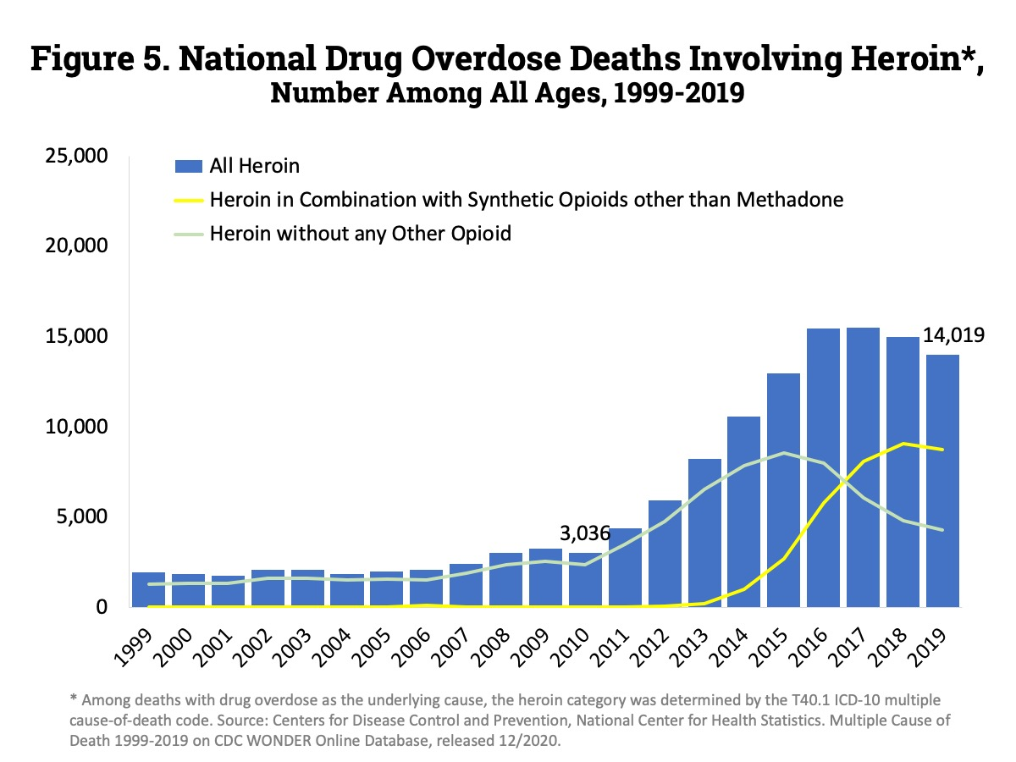
Overdose Rate
https://www.drugabuse.gov/related-topics/trends-statistics/overdose-death-rates; Revised May 2021

Slide 8
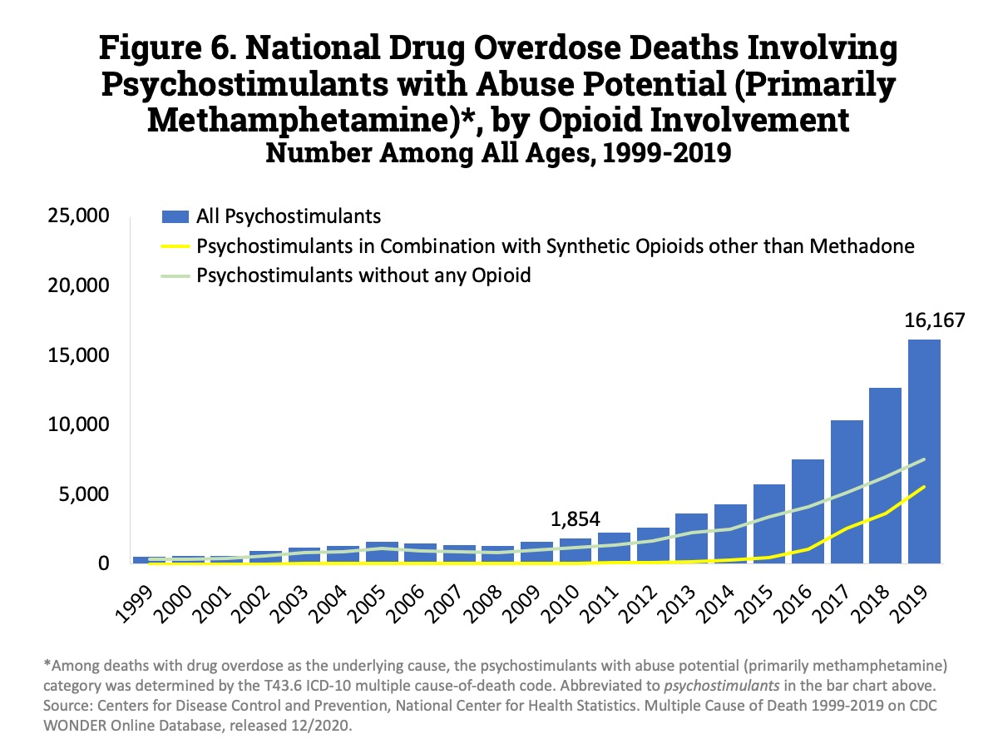
Overdose Rate
https://www.drugabuse.gov/related-topics/trends-statistics/overdose-death-rates; Revised May 2021
Notes:
1999- 547; 2018- 12,676 and 2019- 16,167, increased by 3,491 deaths

Slide 9
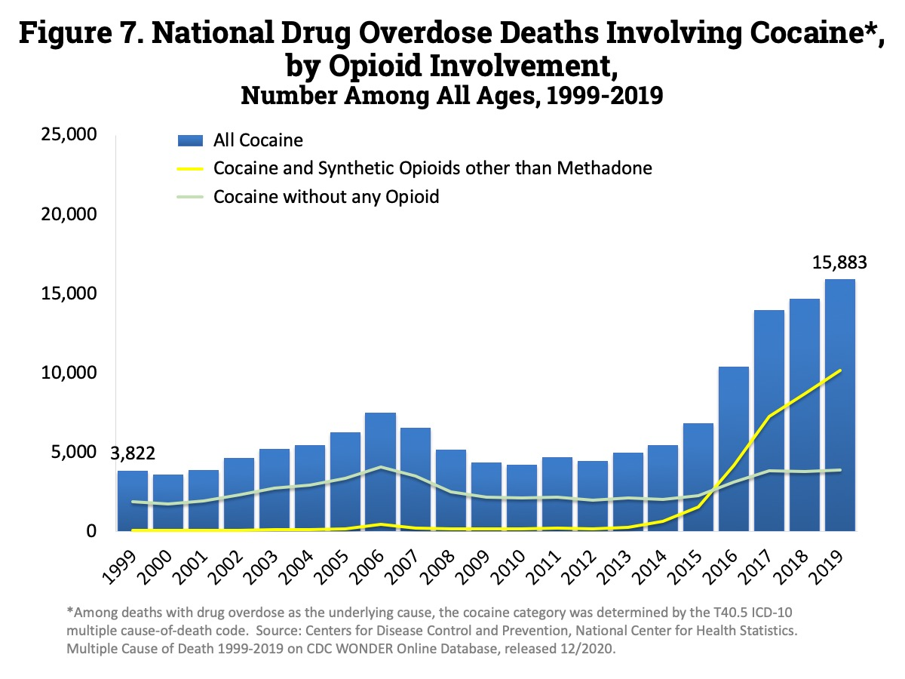
Overdose Rate
https://www.drugabuse.gov/related-topics/trends-statistics/overdose-death-rates; Revised May 2021
Notes:
1999- 3,822 and 2018- 14,666 and 2019-

Slide 10
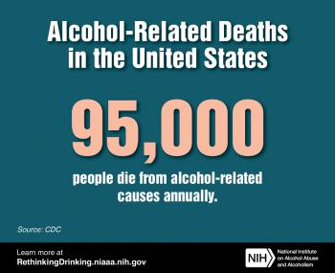
Alcohol Related Death Rate
An estimated 95,000 people (approximately 68,000 men and 27,000 women) die from alcohol-related causes annually, making alcohol the third-leading preventable cause of death in the United States. The first is tobacco, and the second is poor diet and physical inactivity.
Between 2011 and 2015, the leading causes of alcohol-attributable deaths due to chronic conditions in the United States were:
alcohol-associated liver disease
heart disease and stroke
unspecified liver cirrhosis
upper aerodigestive tract cancers
liver cancer
supraventricular cardiac dysrhythmia
AUD
breast cancer
hypertension
https://www.niaaa.nih.gov/publications/brochures-and-fact-sheets/alcohol-facts-and-statistics#:~:text=An%20estimated%2095%2C000%20people%20(approximately,death%20in%20the%20United%20States.
Notes:
1999- 3,822 and 2018- 14,666 and 2019-

Slide 11
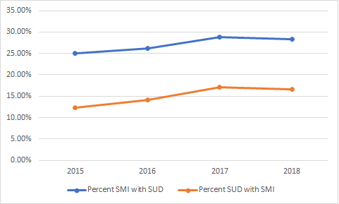
Self-Treatment of MH/Trauma
National Institute on Drug Abuse: Common Comorbidities with Substance Use Disorders Research Report (April 2020)
https://nida.nih.gov/publications/research-reports/common-comorbidities-substance-use-disorders/introduction
“Many individuals who develop substance use disorders (SUD) are also diagnosed with mental disorders, and vice versa. Multiple national population surveys have found that about half of those who experience a mental illness during their lives will also experience a substance use disorder and vice versa.^{2,3} Although there are fewer studies on comorbidity among youth, research suggests that adolescents with substance use disorders also have high rates of co-occurring mental illness; over 60 percent of adolescents in community-based substance use disorder treatment programs also meet diagnostic criteria for another mental illness.⁴”
“Around 1 in 4 individuals
with SMI also have SUD”

Slide 12
Polysubstance Use
Table 1: Comorbid Substance Use Disorders
Among individuals with: | Percentage of individuals who also have:
 | Alcohol Use Disorder | Nicotine Dependence | Marijuana Use Disorder | Cocaine Use Disorder | Prescription Opioid Use Disorder | Heroin Use Disorder
Alcohol Use Disorder | - | 23.8 | 9.5 | 3.3 | 3.9 | 0.9
Nicotine Dependence | 12.9 | - | 4.3 | 1.4 | 2.7 | 1.3
Marijuana Use Disorder | 38.7 | 32.6 | - | 4.8 | 7.9 | 1.8
Cocaine Use Disorder | 59.8 | 47.7 | 21.3 | - | 16.4 | 13.4
Prescription Opioid Use Disorder | 35.2 | 45.4 | 17.6 | 8.2 | - | 11.2
Heroin Use Disorder | 24.5 | 66.3 | 12.3 | 20.9 | 34.9 | -
Source: NSDUH 2014.

Slide 13
Stigma
Language Matters!
Changing Federal Terminology Regarding Substance Use and Substance Use Disorders Memo from Office of the White House/Office of National Drug Control Policy Director Michael Botticelli January 2017¹
“Changing the Language of Addiction Memo”- mandate to use non-stigmatizing language for substance use; using Substance Use Disorder (SUD) in place of ‘addiction’.
Research has shown:
People with SUD are viewed more negatively than people with physical or psychiatric disabilities
Even highly trained substance use disorder and mental health clinicians significantly more likely to assign blame and believe individuals should be subjected to punitive rather than therapeutic measures when case vignette was referred to “substance abuser” rather than “person with a substance use disorder”.
Avoid terms such as
Junkie, Tweaker, Addict, Druggie, Clean/Dirty Urine, etc.
Past SUD ECHO Sessions
06/15/2021: “Having Difficult Conversations: Addressing Stigma”

Slide 14
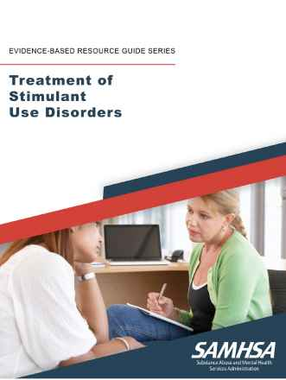
Stimulant Use Disorder Management https://store.samhsa.gov/product/Treatment-of-Stimulant-Use-Disorder/PEP20-06-01-001
SAMHSA Treatment of Stimulant Use Disorders Evidence-Based Guidebook.
Non-pharmacological interventions
Cognitive Behavioral Therapy (CBT)
Motivational Interviewing
Contingency Management
Community Reinforcement Approach
Not in Guidebook
Dialectical Behavioral Therapy- Borderline Personality Disorder Treatment effective for Substance Use Disorders

Slide 15
Cognitive Behavioral Therapy (CBT)
CBT: type of talk therapy that focuses on problem-solving and meeting specific goals
5 Problem Solving Steps:
1. Recognize the problem
2. Create a list of potential solutions
3. Evaluate each of these solutions to determine the strengths and weaknesses
4. Choose a solution to apply to the problem
5. Implement the decided-upon solution

Slide 16
Cognitive Behavioral Therapy (CBT)
Types of CBT
Mindfulness-based cognitive therapy (MBCT)
Anxiety, Depression, Bipolar Disorder
Dialectical Behavioral Therapy (DBT)
Borderline Personality Disorder, Bipolar Disorder, Substance Use Disorder, ADHD, Eating Disorders, Post-Traumatic Stress Disorder
Acceptance and Commitment Therapy (ACT)
Depression, Social Anxiety Disorder, Stress, Psychosis, Obsessive Compulsive Disorder, Pain, Substance Use Disorder
Rational Emotive Behavior Therapy (REBT)
Anxiety, Guilt, Depression, Anger, Unhealthy Eating, Aggression, Procrastination

Slide 17
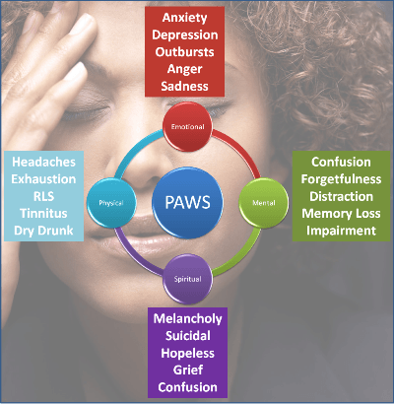
Post-acute Withdrawal Syndrome (PAWS)
PAWS is a complex syndrome with no one specific cause. There are no clearly defined timelines for post-acute withdrawal symptoms.
Theories:
Homeostatic adjustment (medical)
Physiological adaptations (medical)
Stress (behavioral health/medical)
Habit (behavioral health/social services)
Diagnosis, Screening, and Controversy
While many people may experience PAWS, it is not an official medical diagnosis. There is published research regarding PAWS, but the symptoms are largely self-reported by the people experiencing them. They are hard to measure, more like a mental health condition than an illness such as the flu. Because PAWS does not have a medical definition, whereas acute withdrawal is recognized by the medical community, the syndrome is considered controversial.
Past SUD ECHO Presentation
04/05/2022: “An Overview of Patient Assessments”
https://americanaddictioncenters.org/withdrawal-timelines-treatments/post-acute-withdrawal-syndrome
Notes:
Homeostatic adjustment: A person’s physical dependence on drugs or alcohol leads to brain chemistry changes over time; when the body does not have the chemical flowing in, triggering neurotransmitters and endorphins to release, it cannot reach equilibrium on its own. The brain can take a long time to completely reach homeostasis without chemical help, and this can manifest in mood swings, exhaustion, cravings, and other psychological signs during PAWS.
Physiological adaptations: Other parts of the body may be used to an influx of drugs to regulate functions like digestion or hormones. Withdrawal symptoms reflect this – for example, nausea, stomach cramps, and diarrhea are common opioid withdrawal symptoms – but sometimes, these can take longer than two weeks to return to normal. For example, heart rate may be more rapid after overcoming an addiction to CNS depressants.
Stress: It is psychologically stressful to stop taking a drug, especially for people who try to do it cold turkey or alone. This stress may lead to relapse, or it could lead to a prolonged experience of withdrawal symptoms, as the individual tries to make sense of life without drugs or alcohol.
Habit: Part of rehabilitation is to retrain behaviors and responses to drugs or alcohol. Recovering heroin addicts mention the ritual of cooking and injecting the drug, while people who overcame alcohol use disorder note the loss of social situations. Returning to habit leads to relapse, but the loss of the habit or tradition can enhance psychological symptoms like depression, cravings, anxiety, or exhaustion, leading to PAWS.

Slide 18
Screening and Monitoring
SUD/AUD
Two-Item Conjoint Screening (TICS)
Drug Abuse Screening Tool (DAST)
Alcohol Use Disorders Identification Test (AUDIT)
Labs:
Urine Drug Screen at every visit
CMP and CBC baseline
TSH for depression
Physical exam:
injection sites to assess infection or neurological damage (pain)
Sleep patterns (essential)
PHQ-9 for depression and suicidality
Every other visit minimum to assess anti-depressant response
Partial response: 6-8 weeks adequate dosage and 25%-50% decrease in PHQ-9 score
Full Response: >50% reduction in PHQ-9 score
Q#9 finding other than “not at all”
Columbia-Suicide Severity Rating Scale (C-SSRS) or SRA
immediate referral to BH or ER if “High Risk” or eminent danger
GAD-7 for anxiety
Every other visit minimum to assess anxiolytic medication efficacy
STI screening including Hep. C and HIV

Slide 19
Practice Based Evidence: Opioids
Core Medications
PAWS/Target Symptom Management
Buprenorphine (lowest dose induction/taper to antagonist recommended)
OR
Naltrexone (oral or injection)
Oral naltrexone “bridge therapy” prescription for Vivitrol injection:
Naltrexone 100mg: Start no earlier than 15 days after Vivitrol and continue until next injection
Naloxone
Prescribe at first dose for overdose prevention if return to use.
Anxiety/Agitation/Sleep
PRN’s: Clonidine, Baclofen, Hydroxyzine, amitriptyline (concomitant NP pain)
Gabapentin (acute withdrawal then D/C or continued for concomitant NP pain)
Misuse, Tolerance, Diversion concerns
Chronic meds (with or without depression): Lexapro or Paxil (panic)
Myalgias
NSAIDS
Nausea/Vomiting/Stomach Cramping
Ondansetron
Dicyclomine
Diarrhea
Loperamide, Lomotil (severe)
Sleep
Trazodone

Slide 20
Practice Based Evidence: Alcohol
Core Medications
PAWS/Target Symptom Management
Naltrexone (oral or injection; cravings) +
Acamprosate (abstinence)
Anxiety/Agitation/Sleep
PRN’s: Clonidine, Baclofen, Hydroxyzine, amitriptyline (concomitant NP pain)
Gabapentin (acute withdrawal then D/C or continued for concomitant NP pain)
Misuse, Tolerance, Diversion concerns
Chronic meds (with or without depression): Lexapro or Paxil (panic)
GI Symptoms
Nausea/Vomiting
PRN: Ondansetron ODT
Stomach “pain”
Proton Pump Inhibitors for 1-3 months
Wernicke Encephalopathy
Thiamine 100mg once daily

Slide 21
Practice Based Evidence: Stimulants
Core Medications
PAWS/Target Symptom Management
Naltrexone (oral or injection; craving control) +
Acamprosate (impulse control) +
Bupropion XL (NE/DA reuptake inhibitor)
Anxiety/Sleep
PRN’s: Clonidine, Baclofen, Hydroxyzine, amitriptyline (concomitant NP pain)
Gabapentin (acute withdrawal then D/C or continued for concomitant NP pain)
Misuse, Tolerance, Diversion concerns
Chronic meds (with or without depression): Lexapro or Paxil (panic)
Psychosis (hallucinations, paranoia, delusions):
2nd Gen Anti-psychotics: Quetiapine, Risperidone, Paliperidone (oral or Invega injection)
Racing Thoughts/Concentration
Guanfacine ER 2-4mg
Non-stimulant FDA approved for ADHD
Strengthens working memory, reducing distraction, and improving attention and impulse control.

Slide 22
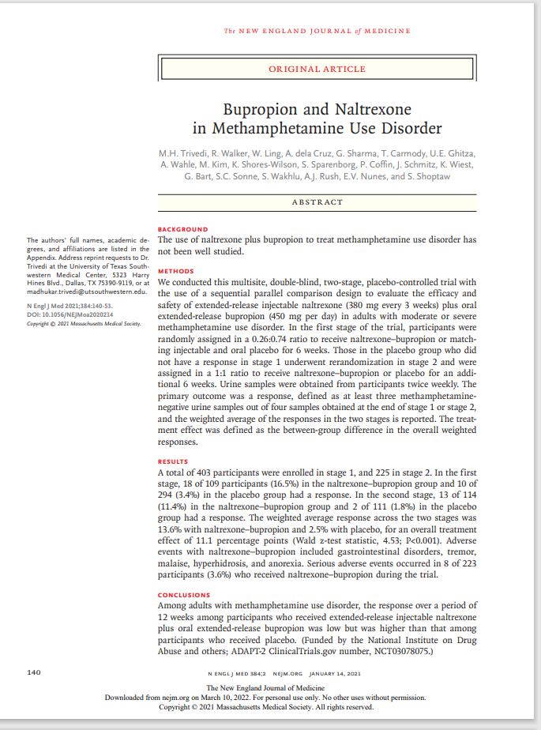
Evidence Based Studies
New England Journal of Medicine (January 2021)
“Bupropion and Naltrexone in Methamphetamine Use Disorder”
The American Journal of Drug and Alcohol Abuse (Vol. 46, Issue 5, 2020)
Executive function moderates naltrexone effects on methamphetamine-induced craving and subjective responses”
European Journal of Pharmacology (Vol. 865, December 2019)
“Inhibition of naltrexone on relapse in methamphetamine self-administration and conditioned place preference in rats”
Drug and Alcohol Dependence (Vol. 192, November 2018)
“A preliminary randomized clinical trial of naltrexone reduces striatal resting state functional connectivity in people with methamphetamine use disorder”
American College of Neuropsychopharmacology (2015)
“The Effects of Naltrexone on Subjective Response to Methamphetamine in a Clinical Sample: A Double-Blind, Placebo-Controlled Laboratory Study”
European Neuropsychopharmacology (Vol. 20, Issue 11, November 2010)
“A double-blind, placebo-controlled study of N-acetyl cysteine plus naltrexone for methamphetamine dependence”
Brain Research (Vol. 1021, Issue 2, September 2004)
“Naltrexone attenuates cue- but not drug-induced methamphetamine seeking: a possible mechanism for the dissociation of primary and secondary reward”.
Notes:
NEJM: Among adults with methamphetamine use disorder, the response over a period of 12 weeks among participants who received extended-release injectable naltrexone plus oral extended-release bupropion was low but was higher than that among participants who received placebo. (

Slide 23
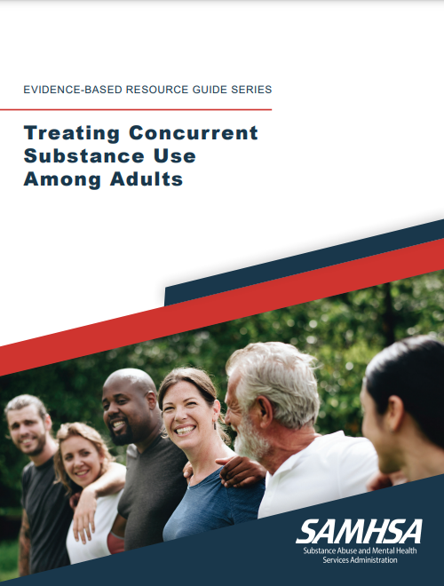
Resource Guide https://store.samhsa.gov/sites/default/files/SAMHSA_Digital_Download/PEP21-06-02-002.pdf
FORWARD: Evidence-Based Resource Guide Series Overview Introduction to the series.
1 Issue Brief Overview of current approaches and challenges to addressing CSU and concurrent SUD in communities.
2 What Research Tells Us Current evidence on effectiveness of the following practices included in the guide to address CSU and concurrent SUD: FDA-approved pharmacotherapy together with counseling; contingency management together with FDA-approved pharmacotherapy and counseling; and twelve-step facilitation therapy together with FDA-approved pharmacotherapy and counseling.
3 Guidance for Selecting and Implementing Evidence-Based Practices Considerations and practical information for clinicians and organizations to consider when selecting and implementing practices to address CSU and concurrent SUD.
4 Examples of Treatment Programs Descriptions of programs that use practices from Chapter 2 to address CSU and concurrent SUD.
5 Resources for Evaluation and Quality Improvement Guidance and resources for implementing best practices, monitoring outcomes, and improving quality.

Slide 24
Case Vignette
Patient #1 is a 35 y.o. male that presents today with a CC of insomnia.
Medical Hx: Chronic knee pain and otherwise unremarkable.
Psych Hx: ADHD previously managed with methylphenidate.
Social: Fixes cars for money. Unable to maintain employment as gas station attendant or house keeping. Lives alone in apartment. Recently ended a 3 year relationship and partner moved out.
Screening:
TICS: 2 positive responses
DAST: 19 (severe level)
PHQ-9: 17 (moderately severe depression- no SI)
GAD-7: 18 (severe anxiety)
Labs: CBC and CMP unremarkable. UDS positive for opioids (oxycontin), methamphetamine, and amphetamines.
Active Meds: Ibuprofen 800mg TID for knee pain
Inactive Meds: Hydrocodone/APAP 5mg/325mg TID PRN (D/C’d)
Methylphenidate 30mg QD (D/C’d)

Slide 25
Case Vignette
After screening, patient admits to overusing his prescription stimulants in the past and snorting methamphetamine for past few years. Also admits to purchasing non-prescribed opioid pills after his PCP discontinued his hydrocodone/APAP and Methylphenidate 6 months ago for having a UDS positive for methamphetamine and oxycodone at the ER. Denies ever using heroin. Reports that non-prescribed Lyrica 150mg helps with pain and anxiety.
Recommendations:
Sleep
Pain
Opioid abuse
Stimulant Use Disorder

Slide 26
Case Vignette
After discussion of all options for pain, SUD, and insomnia patient verbalized desire to start naltrexone therapy for opioid use disorder.
Opioid Supportive Care Plan for Vivitrol Induction:
Hydroxyzine 25mg up to TID PRN anxiety/sleep (cont’d Tx)
Gabapentin 300mg up to TID PRN anxiety/NE pain/sleep (cont’d Tx)
Clonidine 0.1mg up to TID PRN anxiety/sleep (cont’d Tx)
Naltrexone 50mg: take ¼ tab starting no earlier than 4 days after last opioid and increase by ¼ tab daily as tolerated until 50mg daily. Then, RTC for extended released naltrexone injection induction for opioid and stimulant use disorder
ADHD: Guanfacine 2mg QHS x 7 days and if tolerated increase to 4mg QHS
Stimulant Use Disorder:
Buproprion XL 150mg QD (depression and stimulant abstinence)
Acamprosate 666mg TID (stimulant cravings and abstinence)
Continue Vivitrol injections every 3 weeks.

Slide 27
“Ted Talk”
Clinical Pearls and General Concepts
Be authentic and sincere- language (words chosen), tone, body position, eye contact, active listening, genuine empathy and compassion
Speak like you are talking to your grandmother or a young child
Individuals with SUD tend to be hypersensitive to sincerity
“Meet them where they are at” attitude
Listen to their goals, hopes, and aspirations vs. imposing your treatment goals or judgments
Absolute non-judgmental mindset
Create a trusting and respectful space
Individuals with SUD often carry immense shame, guilt, self-loathing and EXPECT to get treated poorly and less than a person
Listen to their stories before jumping into treatment planning and care coordination
Trauma informed care ALWAYS
“What happened TO you” vs. “What is wrong with you”

Slide 28

Always….

Slide 29
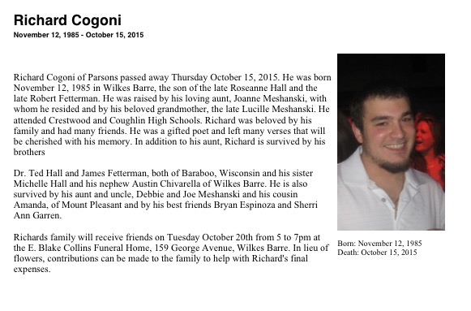

Slide 30



Contact Information
CAPT Ted L. Hall, PharmD, BCPP
S2845 White Eagle Road
Baraboo, WI 53913
(O) 608-355-1240 ext. 35582
(C) 608-301-5390
Ted.Hall@ho-chunk.com-

