Slide 1
Opioid Withdrawal Management
Advancing Pharmacist Roles in Substance Use Disorder ECHO 5/3/2022
LT Hannah Moses, PharmD
PGY-1 Pharmacy Resident

Slide 2
No conflicts of interest
No financial disclosures

Slide 3
Objectives
Define opioid withdrawal management
1
Identify signs and symptoms of opioid withdrawal
2
Identify treatment options for withdrawal management
3

Slide 4
What Is Withdrawal Management (WM)?
Treatment of withdrawal symptoms that are a result of stopping or reducing use of substances
Common for people who complete WM to relapse to substance use
  85% of individuals relapse within a year of treatment
  2/3’s of individuals return to substance use within weeks of beginning treatment

Slide 5
Opioid Withdrawal
What are opioids?
Heroin, methadone, oxycodone, hydrocodone, morphine, codeine, fentanyl
Uncomfortable and difficult
“Flu-like” symptoms
Rarely life-threatening
Manage with caution in pregnancy

Slide 6
Why Is WM Important?
Safely and successfully transition patient to medication for opioid use disorder (OUD)
Medical management is an important first step before psychosocial treatment begins
Reduces discomfort
Displays empathy

Slide 7
Opioid Withdrawal Syndrome
Short-acting opioids (heroin):
  Onset of withdrawal symptoms: 8-24 hours after last use
  Duration of symptoms: 4-10 days
Long-acting opioids (methadone):
  Onset of withdrawal symptoms: 12-48 hours after last use
  Duration of symptoms: 10-20 days
Fentanyl
  Highly lipophilic
  With regular use, can be sequestered in fat cells
  Can continue to be present in urine 7-14 days after last use

Slide 8
Situations That Warrant WM
First step in treatment for opioid use disorder (OUD)
Provider that was originally prescribing opioids for pain management is discontinuing treatment
Post naloxone administration due to an overdose
Patient prescribed maintenance methadone is being discharged from a treatment program
OUD treatment with naltrexone

Slide 9
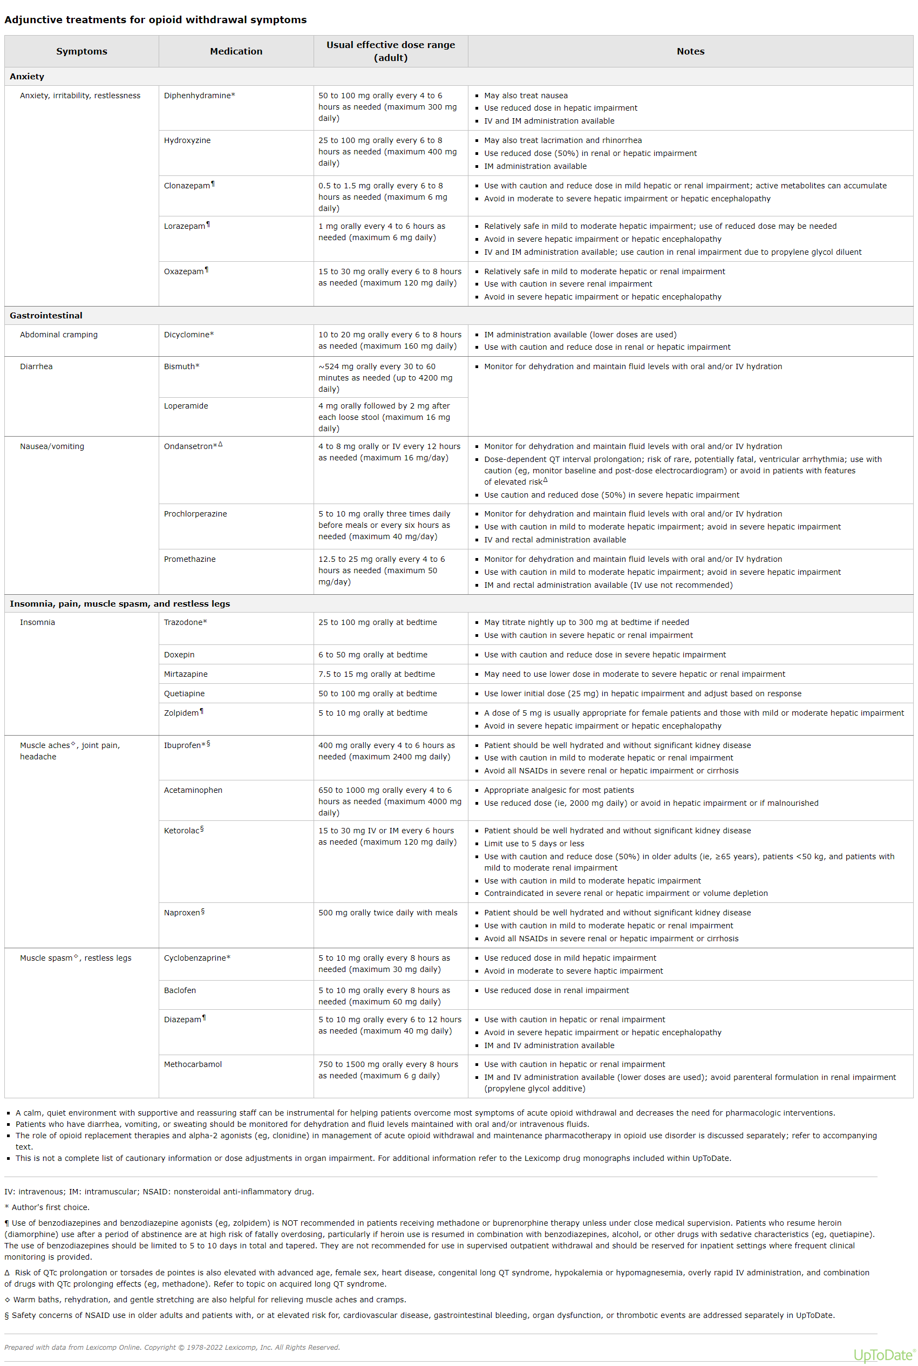
Withdrawal Symptoms and Adjunctive Medications
Medically supervised opioid withdrawal during treatment for addiction - UpToDate

Slide 10
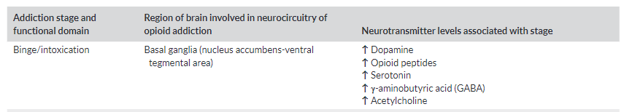
Receptor Involvement
Once opioids have been stopped, neurotransmitter levels will decrease
  Dopamine→ Anxiety, Depression
  Serotonin→ Anxiety, Depression, Chronic pain
  GABA→ Chronic pain, Anxiety, Depression, Insomnia
  Acetylcholine→ Agitation, Insomnia, Restlessness

Slide 11
Recognizing Opioid Withdrawal
No diagnostic test
Urine drug screen (UDS)
UDS is positive for most opioids for 48-96 hours after last use (besides fentanyl)
Clinical Opiate Withdrawal Scale (COWS)
Determine severity
11 common signs and symptoms
Total scores: mild (5-12), moderate (13-24), moderately severe (25-36), and severe (>37)
Score used to determine treatment options
https://www.asam.org/docs/default-source/education-docs/cows_induction_flow_sheet.pdf?sfvrsn=b577fc2_2

Slide 12
Potential Risks of Withdrawal
Neonatal Abstinence Syndrome (NAS)
Increased risk of suicide
Increased overdose risk

Slide 13
Treating Opioid Withdrawal
Essential first step in OUD treatment
Patients with severe chemical dependence often continue to use high doses of opioids to avoid withdrawal symptoms
Treatment of withdrawal by itself rarely leads to long-term recovery
FDA approved medications to treat opioid withdrawal
  Clonidine
  Buprenorphine
  Methadone

Slide 14
Clonidine
MOA: Central inhibition of the hyper-noradrenergic state (alpha-2 adrenergic agonist)
Should be used in adjunct to buprenorphine
FDA labelled medication for opioid withdrawal management
May be used as primary treatment when partial opioid agonist therapy is contraindicated or unavailable
Relieve autonomic symptoms
  Sweating, diarrhea, intestinal cramps, nausea, anxiety, and irritability

Slide 15
Clonidine Safety
Monitor blood pressure
Should be used in caution with pre-existing heart condition or those who are on antihypertensive medications
Can cause dizziness/syncope
Dosing
  Medically supervised opioid withdrawal during treatment for addiction – UpToDate
  The Centre for Addiction and Mental Health- 9cf2650a-37eb-41d0-afe5-e64cf1377c20 (495×238) (porticonetwork.ca)

Slide 16
Buprenorphine
Partial mu-opioid agonist
High binding affinity for mu-opioid receptor
Alleviates withdrawal symptoms, reduces cravings, and can prevent relapse
Slow dissociation→ long duration of action
Can cause precipitative withdrawal symptoms
Increased safety in overdose

Slide 17
Precipitative Withdrawal Symptoms
Decrease in relative opioid effects caused by the introduction of a drug that reverses the effects of full agonist
More severe than spontaneous withdrawal process
Opioids still may be found in urine for days after last use
Treatment should not be delayed if patient is experiencing mild-moderate withdrawal symptoms
Withdrawal can be determined by history, examination, or standardized scale

Slide 18
Buprenorphine Dosing
Clinic induction
Home induction
Micro-dosing strategy
Maintenance screenings
Ceiling effect
Resources with dosing guides
  Medically supervised opioid withdrawal during treatment for addiction – UpToDate
  Buprenorphine Quick Start Guide (samhsa.gov)
  The Centre for Addicition and Mental Health: Opioid withdrawal - Portico (porticonetwork.ca)
  A Patient’s Guide to Starting Buprenorphine at Home: https://www.asam.org/docs/default-source/education-docs/unobserved-home-induction-patient-guide.pdf?sfvrsn=16224bc2_0
  Substance Use Warmline- Clinician-to-Clinician Support
    https://nccc.ucsf.edu/clinician-consultation/substance-use-management/
    (1-855-300-3595) available 6am to 5pm PST (Mon – Fri)

Slide 19
Buprenorphine Safety
Dangerous to dispense take-home doses to others
Should be used in caution with alcohol, benzodiazepines, or other opioids
Increased risk for opioid overdose if relapse occurs
Naloxone distribution

Slide 20
Importance Of Buprenorphine
Harm reduction
  April 2020-April 2021: CDC reported 100,306 drug overdose deaths
  75,673 opioid overdose deaths
Buprenorphine can be used as medication assisted therapy (MAT) to help decrease cravings for opioids
Compared to patients not receiving MAT, death rates significantly decrease in patients receiving buprenorphine

Slide 21
Alternative Medications for OUD Treatment
Naltrexone
Opioid antagonist
Should not be used to treat opioid withdrawal
Should only be administered if free from opioids for at least 7 to 10 days
Methadone
Full mu-opioid agonist
Does not induce withdrawal symptoms when given if opioid agonist is present
First dose should be given when patient enters mild to moderate withdrawal in order to gauge the efficacy of initial dose
Must complete withdrawal to start medication

Slide 22
Conclusion
Medical and psychological care should both be provided to patients in order to reduce risk of relapse and prevent withdrawal symptoms
Harm reduction is important to increase patient safety
Individualized care
Opioid withdrawal can be discomforting and should be treated with partial opioid agonists and symptomatic management medications

Slide 23
Everyday Resources
  Medically supervised opioid withdrawal during treatment for addiction – UpToDate
  Buprenorphine Quick Start Guide (samhsa.gov)
  A Patient’s Guide to Start Buprenorphone at Home: https://www.asam.org/docs/default-source/education-docs/unobserved-home-induction-patient-guide.pdf?sfvrsn=16224bc2_0
  Opioid withdrawal - Portico (porticonetwork.ca)
  Substance Use Warmline- Clinician-to-Clinician Support
    https://nccc.ucsf.edu/clinician-consultation/substance-use-management/
    (1-855-300-3595) available 6am to 5pm PST (Mon – Fri)

Slide 24
References
Withdrawal Management - Clinical Guidelines for Withdrawal Management and Treatment of Drug Dependence in Closed Settings - NCBI Bookshelf (nih.gov)
Drug Addiction Recovery Statistics | Ashley Addiction Treatment (ashleytreatment.org)
Fentanyl and Norfentanyl Detected in Urine for 7 or More Days After Regular Use | Alcohol, Other Drugs, and Health: Current Evidence (bu.edu)
A Practical Guide to Urine Drug Monitoring - PMC (nih.gov)
Novel Buprenorphine Induction Strategies. James J. Gasper, PharmD, BCPP (UCSF) ECHO Presentation. Slide 1 (uclaisap.org)
Consensus Recommendations on the Treatment of Opioid Use Disorder in the Emergency Department – ScienceDirect
Drug Overdose Deaths in the U.S. Top 100,000 Annually (cdc.gov)
Buprenorphine Therapy for Opioid Use Disorder - American Family Physician (aafp.org)
Opioid withdrawal symptoms, a consequence of chronic opioid use and opioid use disorder: Current understanding and approaches to management (wiley.com)

Slide 25


Slide 26
Discussion Questions

Slide 27
What barriers to withdrawal management or OUD treatment have you seen within your facility?

Slide 28
What are the main access points for opioid withdrawal presentation that have been observed in your facility?

Slide 29
How can the pharmacist play a role in the treatment and management of opioid withdrawal that is within our scope of practice?

