Slide 1
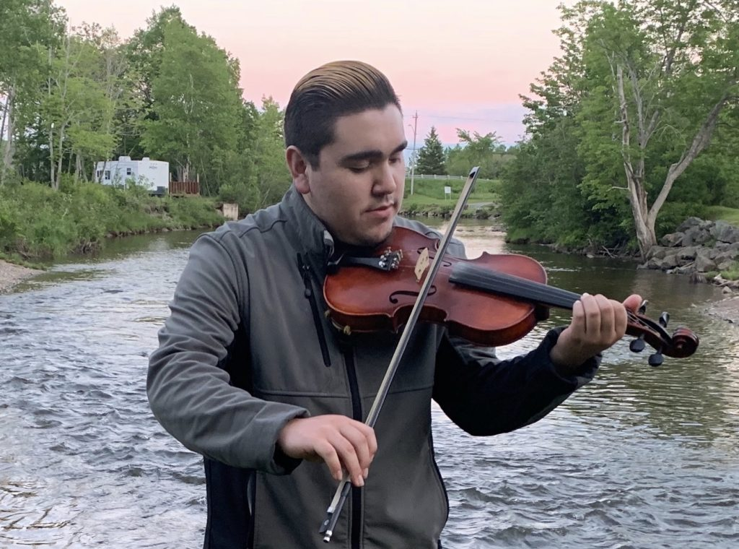
Welcome to
Reclaiming Native Psychological Brilliance Behavioral Health ECHO Series
While we are Gathering . . . enjoy this Native music video which we will start at 5 minutes before the hour.
Ko’Jua – Morgan Toney
“Ko’Jua" by traditional. This modern arrangement has caught the attention of CBC, CTV, Cape Breton Post, and various radio stations to as far as Erin, Ontario.
This Music Video was shot in the Mi’kmaq Community of Eskasoni First Nation, on Goat Island.
Musicians:
Morgan Toney - Fiddle/Vocals
Shawnee Paul - Fiddle
Carter Chiasson - Guitar
Keith Mullins - Banjo/Vocals
Ko’jua Dancers:
Joanie Lafford
Jermaine Doucette
Beverly Jeddore
Notes:
05:08

Slide 2
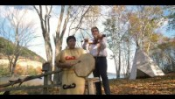

Slide 3


Slide 4
Audience Participation Tips
We are building a community! Please introduce yourself in the Chat (select Everyone) and let your fellow participants know your name, Tribal Nation affiliation if applicable, job title, and organization.
Everyone will be muted until the Participant Reflections portion of the hour. During that segment, use the Raise my Hand icon on zoom, and the host will unmute you to offer your reflection.
You will receive a link to the recording and presentation by the end of the week.
Notes:
Due to the audience size, we encourage you to use the Chat feature for comments and questions.

Slide 5

Disclosures
This activity is jointly provided by United South and Eastern Tribes and Cardea Services​​
Cardea Services is approved as a provider of nursing continuing professional development by the Montana Nurses Association, an accredited approver with distinction by the American Nurses Credentialing Center’s Commission on Accreditation.​​
This activity has been planned and implemented in accordance with the accreditation requirements and policies of the California Medical Association (CMA) through the joint providership of Cardea and United South and Eastern Tribes. Cardea is accredited by the CMA to provide continuing medical education for physicians.​​
Cardea designates this live web-based training for a maximum of 1 AMA PRA Category 1 Credit(s)TM, Physicians should claim credit commensurate with the extent of their participation in the activity.
Notes:
There are no conflicts of interest.

Slide 6
Continuing Education Information
COMPLETING THIS ACTIVITY​​
Upon successful completion of this activity 1 contact hour will be awarded​​
​
Successful completion of this continuing education activity includes the following: ​​
  Attending the entire CE activity; ​​
  Completing the online evaluation (available at the conclusion of the meeting in the chat); ​​
  Submitting an online CE request.​​
​
Your certificate will be sent via email. If you have any questions about this CE activity, contact Paige O'Sullivan at posullivan@cardeaservices.org or (206) 729-4773

Slide 7
Disclosures
There are no relevant financial relationships with ineligible​ companies for those involved with the ability to control​ the content of this activity.​ ​
​​
​

Slide 8
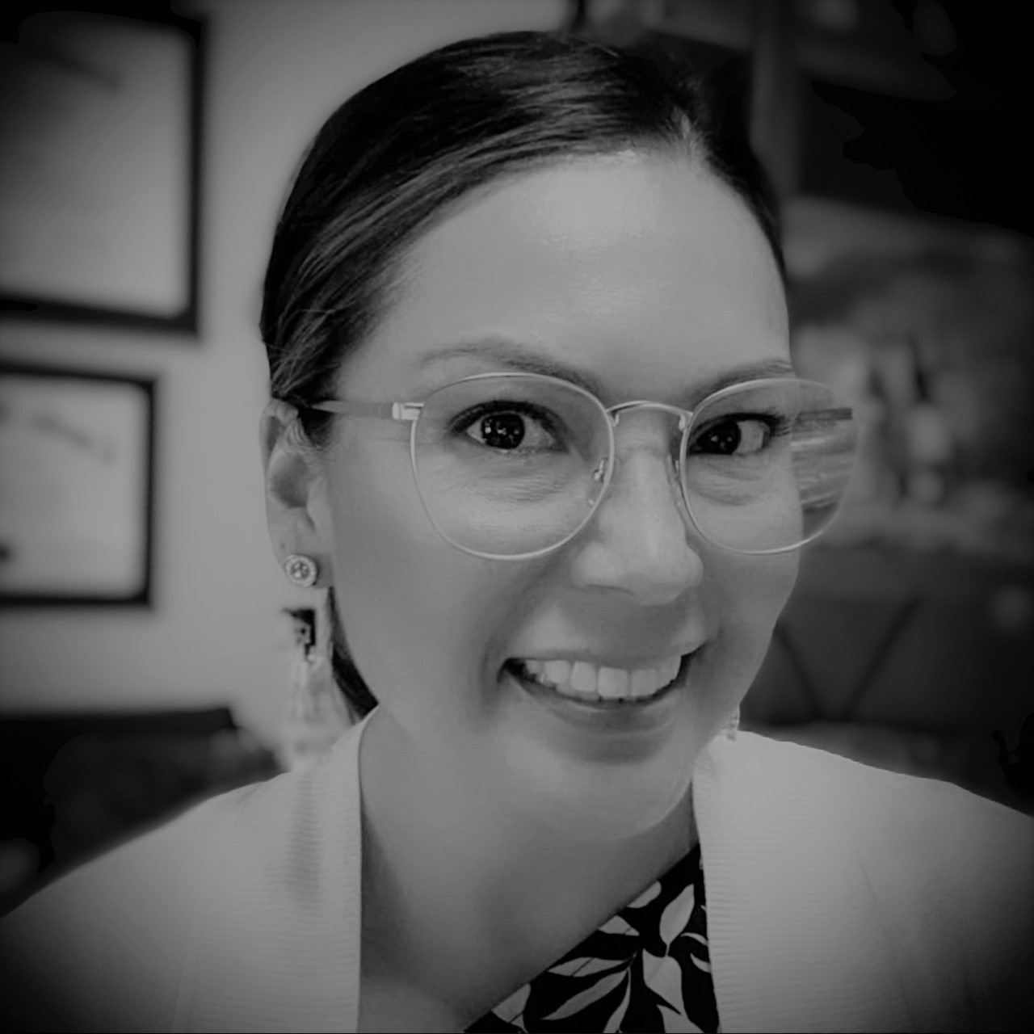
Welcome to All My Relations
"Mitakuye Oyasin"… We are all Related in the Sioux Language.
Bernice Youpee-Jordan, MPH
Citizen of the Fort Peck Sioux Nation
Public Health Program Manager
Tribal Health Program Support
United South and Eastern Tribes, Inc.
Notes:
Introduce self and position
Again, on behalf of USET we welcome you. We are excited to launch this first monthly session of Reclaiming Native Psychological Brilliance, but before we begin:
As Native people, we want to start with a Blessing and we are fortunate to have Chief of the Mohegan Tribe, Chief Malerba - - -

Slide 9
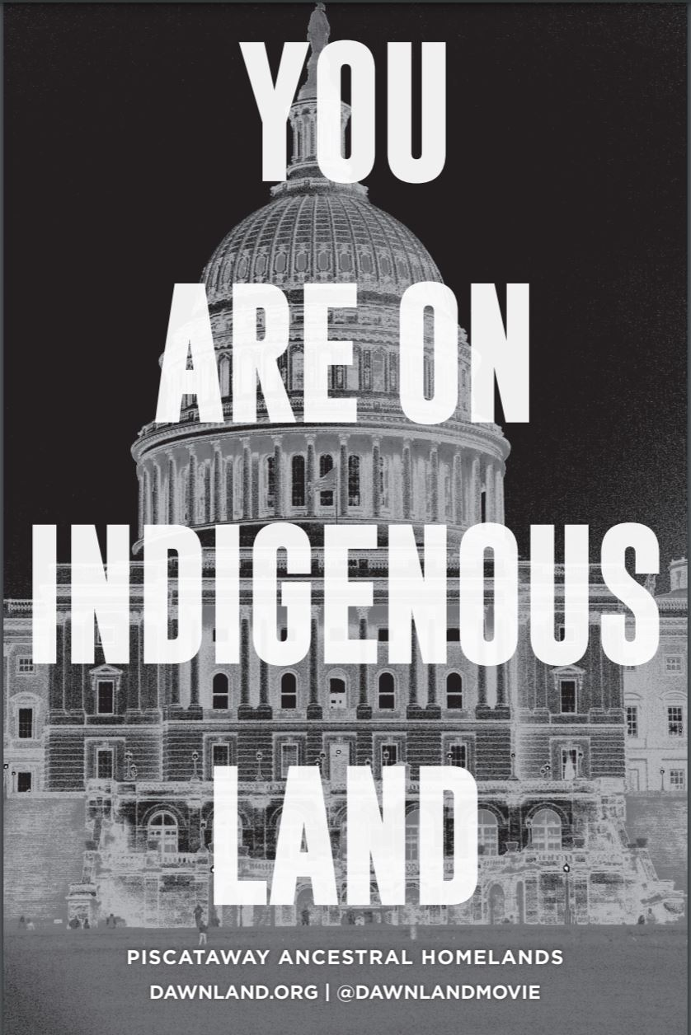
To learn and acknowledge what Tribal Nation land you and your organization are standing on, go to
https://native-land.ca/
or text your zip code or city to
(907) 312-5085.
Notes:
We respectfully acknowledge that we stand on territories where Indigenous and Tribal Nations are traditional stewards of the land.
Please join us in affirming Tribal sovereignty, and always displaying respect and gratitude for Indigenous people.
We honor and recognize the original peoples of this land.

Slide 10
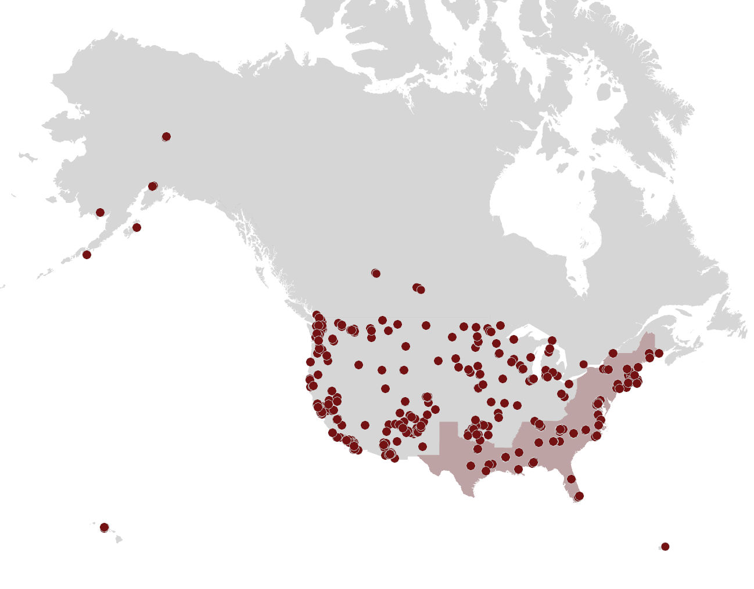
We are reconnecting our Indigenous community!
Thank you for being a part of reclaiming our collective stories.
Data is gathered from registration data

Slide 12
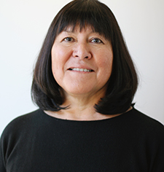
Our Past Sessions
Holly Echo-Hawk, MSc
January 2022 Session: Introduction to the Reclaiming series
February 2022 Session: Nurturing psychological brilliance and resilience in Native young adults
March 2022 Session: Impact of western world view on Indigenous Behavioral Health

Slide 13
Native Help-Declining
and Help-Seeking
April 26, 2022

Slide 14
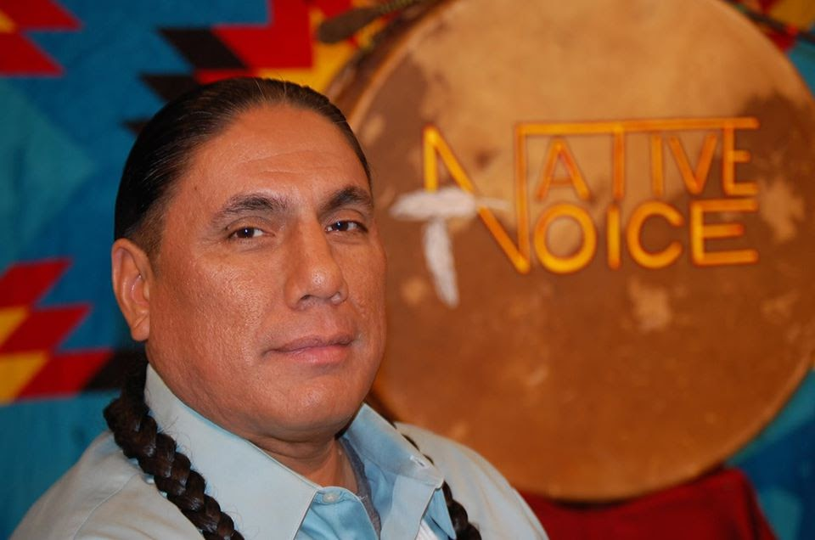
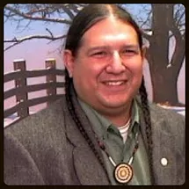
Sharing insights on
Native Help-Declining and Help-Seeking
Mike Duncan, CEO Native Dads Network
Member of Round Valley Indian Tribes
Art Martinez, Clinical Psychologist
Chumash Tribal Member

Slide 15
Mike Duncan - CEO Native Dads Network
Enrolled member of Round Valley Indian Tribes in the state of California, tribal heritage is Maidu/ Wailaki / Wintun and Western Band Shoshone
Native Dads Network (NDN) - grassroots, non-profit organization based in Sacramento, California and primarily focused on the importance of fatherhood within the context of family constellations
  NDN mission is to actively preserve and/or restore physiological, psychological, sociological, and spiritual wellness of California Indigenous/Native communities
Mr. Duncan uses personal stories to examine barriers and encourages Native traditional teachings as solutions

Slide 16
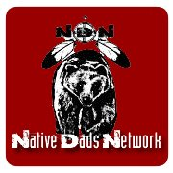
Native Dads Network
Program services to California Tribal communities in Northern California including:
  Educational activities: Narcan education and distribution
  Conferences: Addressing Historical Trauma, Stigmas, Mental Illness, and Resilience; Boys with Braids; and Healing Together (April 2022)
  Family and youth gatherings: Native Men’s Wellness Gathering, and Native Sisters Circle
  Weekly support groups: Fatherhood/Motherhood is Sacred
  Building trust and bringing services directly to reservations: Road Tours

Slide 17
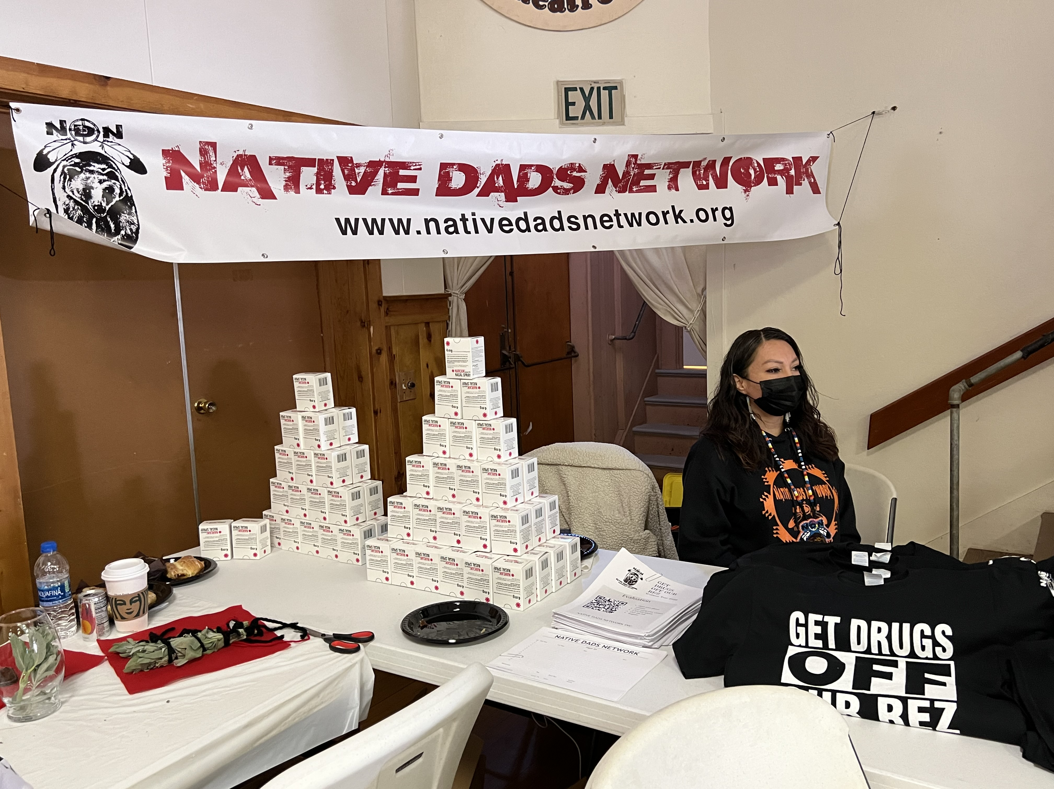

Slide 18
Art Martinez, PhD
Tribal Clinical Psychologist
Member of the Chumash Tribe
Board member of Native Dads Network
Co-Director, Center for Native Child and Family Resilience
Nationally known consultant in Native American Family Dynamics, Indian Child Welfare, Native American Child Development, and Native American Traditional values and health interventions
Dr. Art brings both cultural and clinical experiences

Slide 19

Center for Native Child and Family Resilience
Prevention. Intervention. Respect
The Center works in partnership with Tribal communities to:
Honor effective Tribal community and practice-based models of prevention
Promote awareness and use of culturally relevant child maltreatment prevention services that are supported by practice-based evidence in Tribal child welfare systems
Improve holistic services for American Indian/Alaska Native (AI/AN) children affected by child abuse and neglect
Develop models of cultural, community, and trauma resilience
Build the evidence-base of Tribal child welfare knowledge and practice through evaluation
Transfer knowledge from project findings to the field

Slide 20
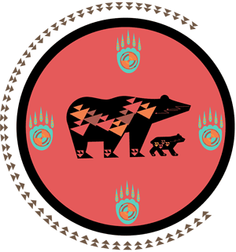
The Two Bears Logo of the Center for Native Child and Family Resilience
In the ways of many Tribal Nations and Native people, the bear is a symbol of both healing and nurturance. The bear represents teachings that describe and prescribe the bear in both medicine and the healing of wounds—for it is the bear that teaches the medicines of healing wounds and injury. The Center logo invokes the concept of the bear’s medicine in the healing of wounds in individuals, families, and communities.
The Two Bears logo depicts a healing of family: the mother bear and cub symbolize the very essence of parenting, the power of women, and the power of new life. The logo recognizes the strengths of our mothers and grandmothers in guidance of the family, which carried the family ways and traditions throughout the generations. The walk of the bears signifies maternal guidance and resilience moving the family forward in the survivance and nurturance of resilience, which is the driving force of the Center for Native Child and Family Resilience.
The designs on the bears represent the passage of family patterns and designs, which we see on baskets and in lodge designs and ledger art. The two paths of lightning on the bears represent the medicine of lightning, indicating the power of family responsibilities and ways of caring for one another. To pass this power, many cradle boards are made of a tree split by lightning. The four paws of the logo represent the four directions or winds, which feed the life of the family as teachings, medicine, traditions, and purity of heart. The patterns on the paws represent the symbols emanate from great traditions of our people: the creation stories, songs, and teachings that serve as a foundation our family and people. The red clay background of the logo symbolizes the red earth, the red medicine that is so vital to our ties to the earth and our mother of origin.
The patterns around the logo symbolize the traditions of family and the caring of community as handed down throughout our nations. The circle of patterns around the edge is incomplete, in recognition of the children and families that are missing from their rightful place in our communities and cultural responsibilities due to the historical tragedies we have survived and the removal of children from their cultural ways of family. The solid circle around the red background symbolizes the unbroken resolve and resilience of our cultural ways of caring for family and one another, which will never end. That is our commitment. This is the shared vision of the Center for Native Child and Family Resilience.

Slide 21
Today’s Discussion
  What was Tribal traditional approach to help seeking?
  Why do some Native people delay or decline help for assistance with drugs or alcohol?
  What motivates Native people to seek help and who do they turn to?
  What helps a Native person stay on the healing path of treatment and recovery?

Slide 22
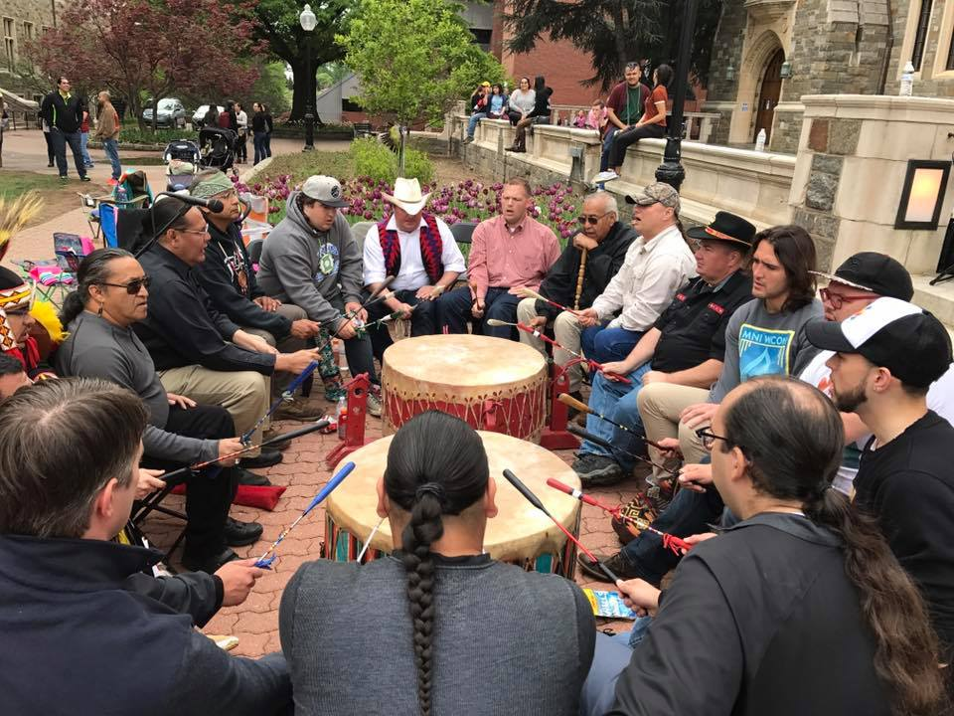
Native Culture and Help Seeking
Traditional way of being was to “seek help” when needed
How did or does traditional help-seeking happen now?

Slide 23
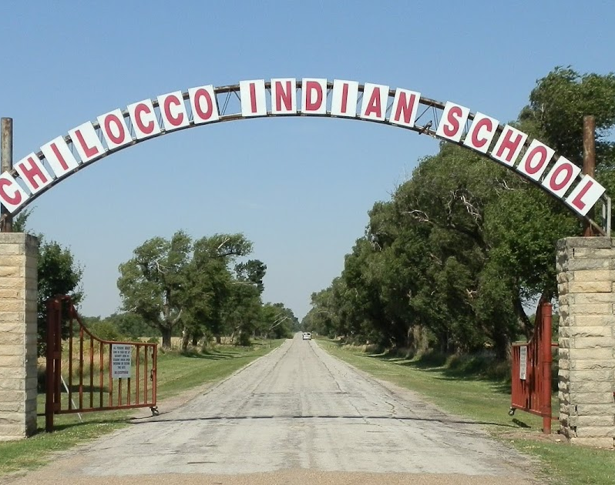
Institutions and Agencies of Care
Trauma of criminal justice settings, schools, churches and hospitals - too frequently places where violent trauma is perpetuated rather than eliminated
Tribes and Native agencies are not exempt, and were often targeted
When we identify with the aggressor, we breed aggression
In this work that we choose, we give up the right to judge

Slide 24
Response to Trauma
Trauma can be family and personal life-altering, especially if multiple trauma events are experienced
Trauma exposure can result in some believing untrue message that they are fundamentally flawed
“Treatment” can be viewed by some Native people as not safe

Slide 25
Trauma history influences how Native people approach potentially helpful relationships
People with trauma history are often reluctant to engage or, or may quickly drop out of, support services
State of vigilance and suspicion are important self-protective mechanisms to cope with trauma experiences, but can make it difficult for trauma survivors to accept help

Slide 26
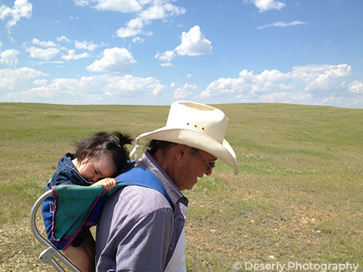

Slide 27
What are factors that influence the decision of Native men to decline help, or to delay seeking assistance?

Slide 28
Some Motivators for Help-Seeking
Life feels out of control
Regret loss of self-control
Court-ordered
Partner relationship
Want to be better person
Desire for cultural connection, or re-connection

Slide 29
Staying on Path of Health and Wellness
Support within family
Congruent cultural principles of care
Treatment builds on inner strengths of individual, on multiple levels
Connecting with a community of recovery and wellness; personal connections in care
Pride and safety in wellness
Ability to identify role models and others in road to wellness

Slide 31
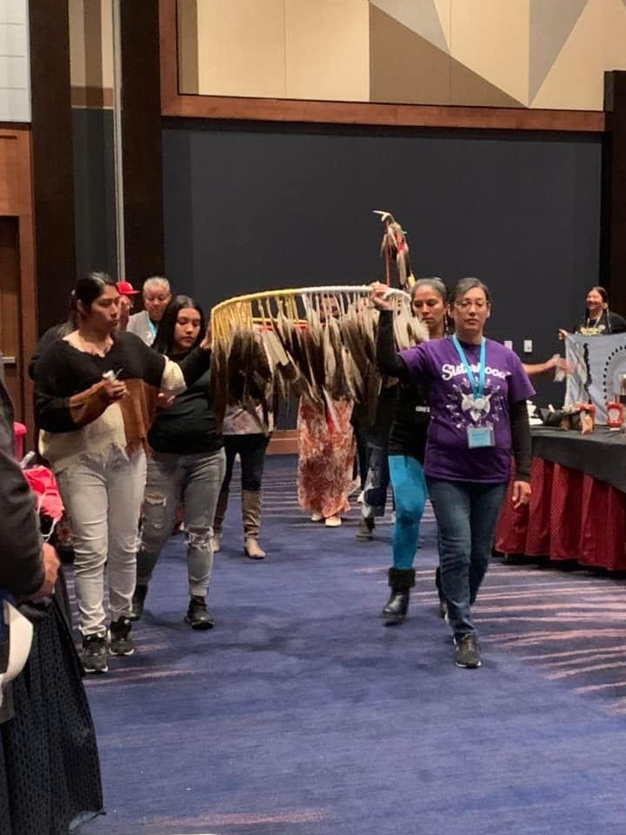
Native Female Perspective

Slide 32
View of Native Women
Help-Delay or Help-Declining
Help-Seeking Motivation
Shame and fear of stigma of “being outed” as user
Fear of child welfare and removal of children
Depth of Addiction
Past abuse and belittling: “not worthy”
No vision or hope for change
Hope for children
Resurgence of self-worth
Mentor or trusted helper
Peer support
Financial assistance
Recognition of innate brilliance and future potential
Notes:
Holly

Slide 34
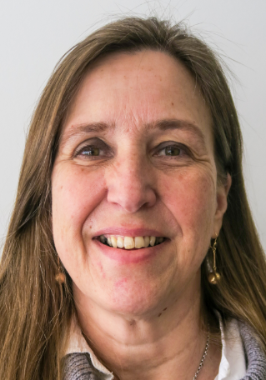
Reflections
What did Mike and Art share that had meaning for you?
What did you hear that will change how you work with Native people?
Facilitator: Livia Davis, MSW
C4 Innovations, Chief Learning Officer
Vice President, Recovery and Behavioral Health

Slide 35

Summary Remarks
Holly Echo-Hawk, MSc
Tribal Behavioral Health Senior Advisor
Mike Duncan
Native Dad Network

Slide 36
Resources
Native Dads Network https://www.nativedadsnetwork.org/
Center for Native Child and Family Resilience https://cncfr.jbsinternational.com/
Journey to Health ECHO Program https://www.indiancountryecho.org/program/journey-to-health-echo-program/
Tribal Law and Policy Institute https://www.home.tlpi.org/about
Reclaiming Native Psychological Brilliance https://www.usetinc.org/event/bhecho/

Slide 37
Closing from Native Dads Network

Slide 38
CEU Information
Don’t forget to complete your survey! https://survey.alchemer.com/s3/6801170/Reclaiming-Native-Psychological-Brilliance-Learner-Evaluation-April-26
Follow-up questions?
  Bernice Youpee-Jordan at bjordan@usetinc.org
  Bryan Hendrix at bhendrix@usetinc.org

Slide 39
See you in May – Same time on the 4th Tuesday
May 24, 2022 Topic:
Native Trauma Layers
and Post Traumatic Growth

