Slide 1

The New Mexico Trauma System
Liana Lujan, RN
Trauma & Time Critical Conditions Program Manager
NMDOH/ERD/EMSB

Slide 2

OBJECTIVES
Identify trauma centers in New Mexico.
Identify where the appropriate trauma center is for your patient.
Explain performance improvement and implementing change for your trauma practice setting.

Slide 3
The New Mexico Trauma System Includes
911 Dispatch
EMS/Fire
Facilities
  Designated
  Non-Designated
Regional Systems
Statewide Systems

Slide 4
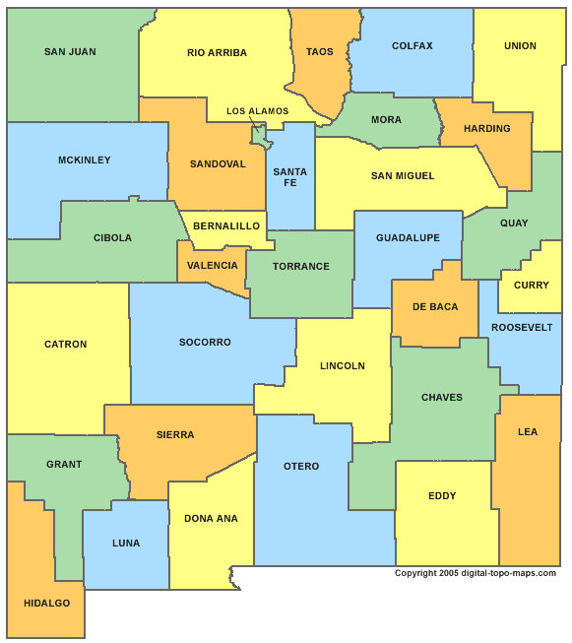






2005 – 3 Trauma Centers
Developing TC
Level I
Level II
Level IIII
Level IV
Level III
Notes:
Re-attach state

Slide 5
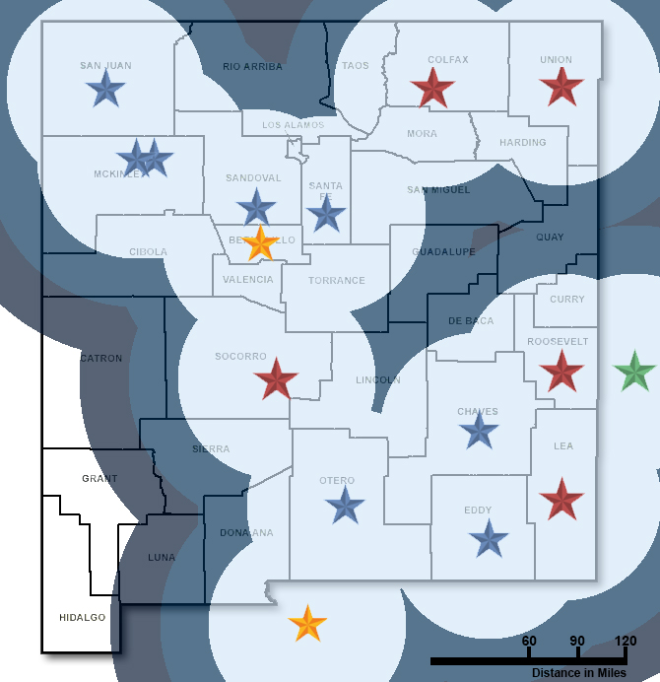
2014 – 16 Trauma centers
Developing TC
Level I
Level II
Level IIII
Level IV
Notes:
Re-attach state

Slide 6
2022 - 19 Trauma Centers
 | Name of Facility | Level |  | Name of Facility | Level
1 | University of New Mexico | Level I | 11 | Miners' Colfax Medical Center | Level IV
2 | University Medical Center of El Paso, TX | Level I | 12 | Nor-Lea General Hospital | Level IV
3 | Del Sol Medical Center of El Paso, TX | Level II | 13 | Sierra Vista Hospital | Level IV
4 | Carlsbad Medical Center | Level III | 14 | Union County General Hospital | Level IV
5 | CHRISTUS St. Vincent Regional Medical Center | Level III | 15 | Memorial Medical Center | Level IV
6 | Eastern New Mexico Medical Center | Level III | 16 | Hobbs Hospital | Developing Level III
7 | Gallup Indian Medical Center | Level III | 17 | Cibola General Hospital | Developing Level IV
8 | Gerald Champion Regional Medical Center | Level III | 18 | Sandoval Regional Medical Center | Level III
9 | Mountain View Regional Medical Center | Level III | 19 | Northern Navajo Medical Center | Level IV
10 | San Juan Regional Medical Center | Level III | 20 | Gila Regional Medical Center | Level IV

Slide 7
Level 1 Trauma Center –
1 In state 1 out of state
Level I Trauma Center is a comprehensive regional resource that is a tertiary care facility central to the trauma system. A Level I Trauma Center is capable of providing total care for every aspect of injury – from prevention through rehabilitation.
Has residents
Has research capability

Slide 8
Level II –
1 out of state
Has specialty coverages, example Ortho, Neuro
Meets a lot of the same criteria as a Level I
Supports the Level I
Not required to have research
Not required to have residents

Slide 9
Level III Trauma Centers - 8
A Level III Trauma Center has demonstrated an ability to provide prompt assessment, resuscitation, surgery, intensive care and stabilization of injured patients and emergency operations.
24-hour immediate coverage by emergency medicine physicians and the prompt availability of general surgeons and anesthesiologists.

Slide 10
Level IV Trauma Center - 7
A Level IV Trauma Center has demonstrated an ability to provide advanced trauma life support (ATLS) prior to transfer of patients to a higher level trauma center. It provides evaluation, stabilization, and diagnostic capabilities for injured patients.
May provide some surgical services, but is not required.

Slide 11
New Mexico
Trauma Center Map

Slide 12
Why and which trauma center to transfer to
Each Trauma Center has undergone rigorous training, developed policies, protocols and procedures specific to trauma
Trauma Centers provide a pre-planned comprehensive approach in an organized manner, facilitation optimal outcomes for injured patients.
  From Dispatch to Discharge

Slide 13
Which Trauma Center?
Based on need
Level
Services available

Slide 14
STATUS QUO
Just because a practice is considered locally accepted does not mean that it is an acceptable practice. Each issue should be vetted through the PI process and vetted through current standards of care.
(e.g., ATLS, TNCC, CALS, The Eastern Association for the Surgery of Trauma (EAST), ACS)

Slide 15
All trauma centers should critically and robustly analyze the care of the traumatically injured patients to:
Identify opportunities for improvement
Improve outcomes
Decrease variations of care
Foster competent, current clinicians
Measure performance
Validate care

Slide 16
Trauma Centers/Programs Track
Complications
System issues
Provider issues
Adverse events
Any opportunity for improvement

