Slide 1
Harm Reduction, SSPs, and Me
Jessica Rienstra BSN, RN
ECHO Case Manager
NPAIHB
Notes:
Introduce previous job, current job, intersection of roles. Thoughts shared are my experience and not reflective of LTHC or NPAIHB
AGENDA
SHARE EXPERIENCE OF WORKING IN A TRIBAL HEALTH FACILITIY AND HOW WE GREW OUR SSP
DISCUSS HOW ECHO IS A KEY PART IN ADVOCATING FOR HEALTH OF PATIENTS AND OFFERING LOW BARRIER ACCESS TO CARE FOR THOSE WHO UTILIZE SSPs

Slide 2
What is Harm Reduction?
Harm reduction refers to interventions aimed at reducing the negative effects of health behaviors without necessarily extinguishing the problematic health behaviors completely.¹
This practice is seen and modeled throughout all of health care.
Notes:
¹https://harmreductionjournal.biomedcentral.com/articles/10.1186/s12954-017-0196-4

Slide 3
HARM REDUCTION
Is a practical strategy that attempts to reduce negative consequences of drug use and other activities.
Accepts that some will engage in dangerous activities, but does not attempt to minimize the harm or dangers involved.
Focuses on the individual and their health and wellness needs.
Places individuals in the greater social context.
Places a value on drug users having a voice in the creation of programs and policies designed to serve them.
Notes:
So just a review….(read slide)
Harm reduction and syringe service programs also allow us to create space to connect with patients that would not normally access health care

Slide 4
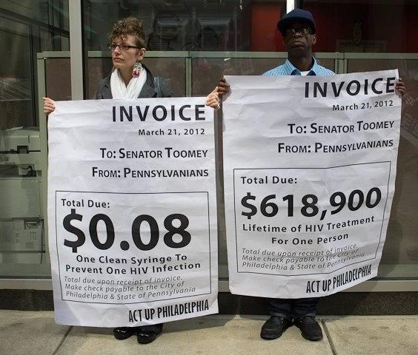
Harm Reduction is Cost Effective
Every dollar invested in SSPs results in
$7 in savings
just by preventing new HIV infections.
Nguyen, T. Q., Weir, B. W., Pinkerton, S. D., Des Jarlais, D.C., & Holtgrave, D. (2014). Syringe Exchange in the United States: A National Level Economic Evaluation of Hypothetical Increases in Investment, AIDS and Behavior November 2014, Volume 18, Issue 11, pp 2144-2155; abstract: http://link.springer.com/article/10.1007/s10461-014-0789-9
Notes:
SSPs reduce health care costs by preventing HIV, viral hepatitis, and other infections, including endocarditis, a life-threatening heart valve infection. The estimated lifetime cost of treating one person living with HIV is more than $450,000.¹⁶ Hospitalizations in the U.S. for substance-use-related infections cost over $700 million each year.¹⁷ SSPs reduce these costs and help link people to treatment to stop using drugs.

Slide 5
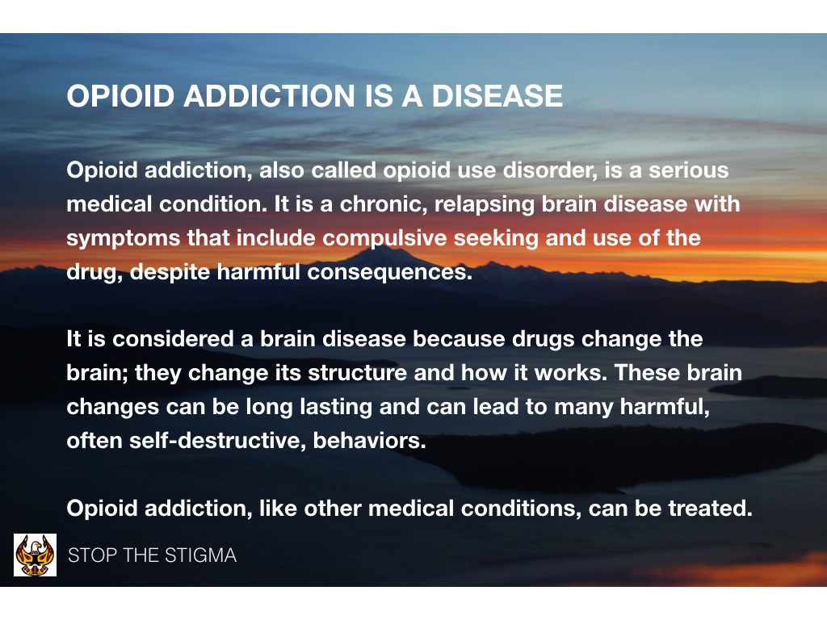

Slide 6
Substance Use Disorder is a Chronic Disease
Notes:
So we’ve established a baseline on what qualifies as a substance use disorder. We know it’s a chronic disease, that can have varying severity and can affect people differently. So now what? How to connect people with substance use disorder to care? How can we offer them help and promote their health and wellness journeys?
I’m so glad you’ve asked!...
CHRONIC DISEASES DO NOT STAY AT A STATIC STATE

Slide 7
What is an SSP?
Syringe services programs (SSPs) are also referred to as syringe exchange programs (SEPs) and needle exchange programs (NEPs). Although the services they provide may vary, SSPs are community-based programs that provide access to sterile needles and syringes, facilitate safe disposal of used syringes, and provide and link to other important services and programs such as
Referral to substance use disorder treatment programs.
Screening, care, and treatment for viral hepatitis and HIV.
Education about overdose prevention and safer injection practices.
Vaccinations, including those for hepatitis A and hepatitis B.
Screening for sexually transmitted diseases.
Abscess and wound care.
Naloxone distribution and education.
Referral to social, mental health, and other medical services.
Syringe Services Programs (SSPs) FAQs | CDC. (2020, December 7). https://www.cdc.gov/ssp/syringe-services-programs-faq.html

Slide 8
Do SSPs help people to stop using drugs?
Yes!
When people who inject drugs use an SSP, they are more likely to enter treatment for substance use disorder and stop injecting than those who don’t use an SSP.
New users of SSPs are five times as likely to enter drug treatment as those who don’t use the programs.
People who inject drugs and who have used an SSP regularly are nearly three times as likely to report a reduction in injection frequency as those who have never used an SSP.
Syringe Services Programs (SSPs) FAQs | CDC. (2020, December 7). https://www.cdc.gov/ssp/syringe-services-programs-faq.html

Slide 9
SSPs reduce infections
Nonsterile injections can lead to transmission of HIV, viral hepatitis, bacterial, and fungal infections and other complications. By providing access to sterile syringes and other injection equipment, SSPs help people prevent transmitting blood borne and other infections when they inject drugs. In addition to being at risk for HIV, viral hepatitis, and other blood-borne and sexually transmitted diseases, people who inject drugs can get other serious, life-threatening, and costly health problems, such as infections of the heart valves (endocarditis), serious skin infections, and deep tissue abscesses. Access to sterile injection equipment can help prevent these infections, and health care provided at SSPs can catch these problems early and provide easy-to-access treatment to a population that may be reluctant to go to a hospital or seek other medical care.
Syringe Services Programs (SSPs) FAQs | CDC. (2020, December 7). https://www.cdc.gov/ssp/syringe-services-programs-faq.html

Slide 10
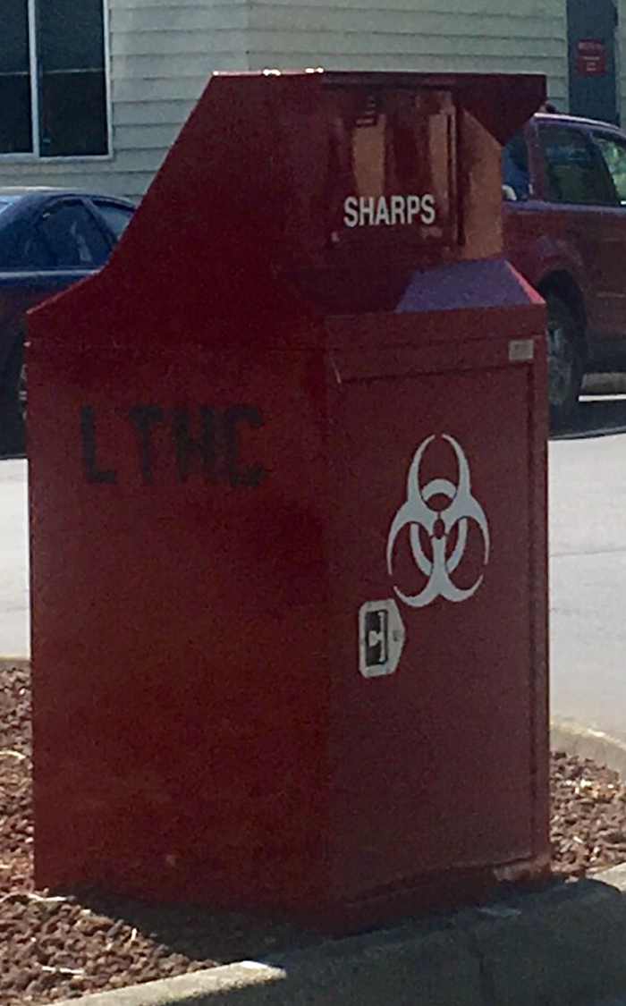
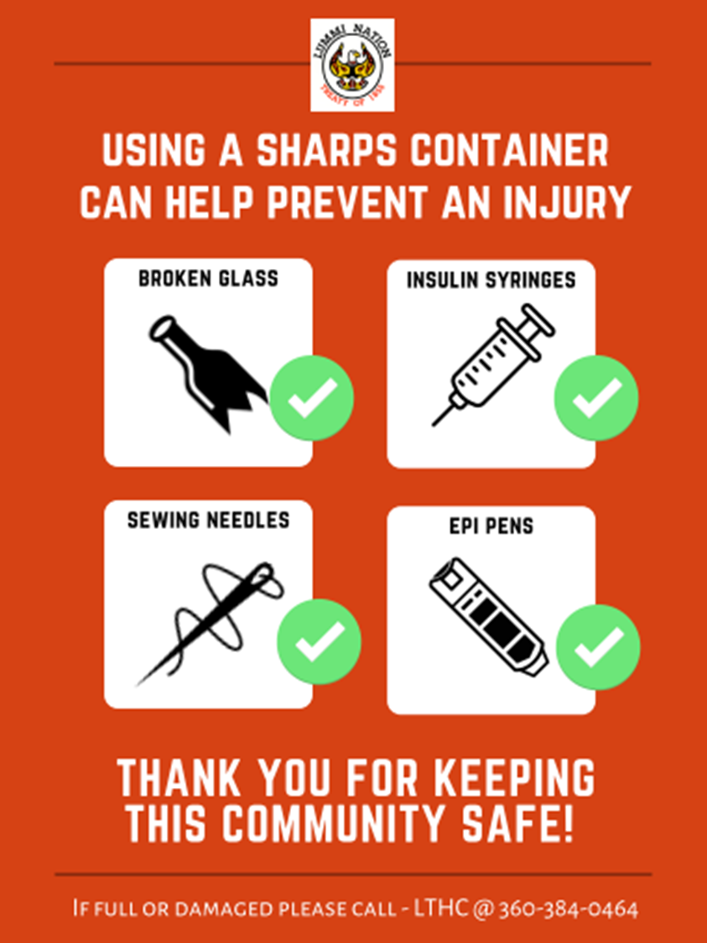
Do SSPs cause more needles in public places?
No! Studies show that SSPs protect the public and first responders by providing safe needle disposal and reducing the presence of needles in the community.
Syringe Services Programs (SSPs) FAQs | CDC. (2020, December 7). https://www.cdc.gov/ssp/syringe-services-programs-faq.html
Notes:
Here are a few pictures of an outdoor sharps container that was placed by a syringe service program that I worked for in the past, and some destigmatizing language that is on each container. Many people may feel ashamed to bring in used syringes and we want to make sure that disposing of them safely is a easy as possible with as few barriers as possible. Many of the peer workers that work with this harm reduction program also gave ideas of other locations that would be useful to have these outdoor containers and now there are many of them in this community!

Slide 11
Richards, J. (n.d.). Harm reduction ToolKit. 18.

Slide 12
Richards, J. (n.d.). Harm reduction ToolKit. 18.
Notes:
Connection fights addiction.

Slide 13
SHATTER STIGMA
What are some thoughts and feelings that you have towards people who use illicit substances?
How do you think substance use should be addressed in your community?
https://www.youtube.com/watch?v=8LFMXPHrtE8
fnhealthcouncil. (2018, June 27). Taking Care of Each Other: Reducing Stigma. https://www.youtube.com/watch?v=8LFMXPHrtE8
Notes:
Here are just a few questions that we you don’t have to answer out loud but I would encourage everyone to think about.
There is an excellent video here as well on stigma and I think I will skip it for now but would highly recommend that you watch it if you have time.

Slide 14


Slide 15
Notes:
Why is it Important to
Use Healing Words?
Research studies show that language matters
when we talk about opioids. When doctors use
stigmatizing language, they are less likely to give
good care to people addicted to opioids. Plus, their
patients do not recover as well.
People with opioid addiction benefit from
community support, non-judgemental healthcare
providers, and a strong circle of relatives and
relations who can walk the path to recovery with
them. In order to be a good support for people with
opioid addiction, it is important to use kind and
respectful language.
Stigmatizing Language:
Clean, dirty
(when refering to drug test results)
These words associate a positive drug test with
filth. Anyone can become addicted to opioids, and
having a problem with opioids does not make a
person (or their test results) dirty.
Recommended Language:
Negative, positive, or substance free
test result.
Stigmatizing Language:
Drug Habit
This term suggests that a person with opioid
addiction simply needs more willpower to stop
using opioids. The problem: opioid use disorder is a
medical condition that impacts the brain. Recovery
often requires medical treatment to help with
cravings and behavior change.
Recommended Language:
Substance use disorder,
opioid use disorder.
There is Hope
We can heal our communities through educating
ourselves and others, supporting each other, and
seeking help when we need it.

Slide 16
Notes:
As mentioned in the last session as well, safety is important. Don’t ever put yourself in a situation that you feel may be unsafe. Work with coworkers or brainstorm ideas with the client on where might be a good meeting place.

Slide 17
ALL PATIENTS DESERVE ACCESS TO TREATMENT
Notes:
Transmission route should not limit patient’s access to appropriate healthcare. Thankfully, many laws have progressed and changed in WA state supporting this, however connection to specialty care is still a difficult barrier for many. Access to ECHO clinics allow for reducing the patient burden to treatment

Slide 18
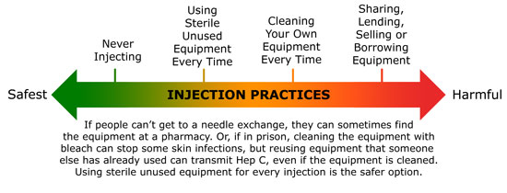
Notes:
Focus on the spectrum of harm, assist patients via motivational interviewing on their readiness for change, partner with your patient and help them achieve THEIR harm reduction goals. Often there is a question of “how do we get this started?” The first person to ask, is your patient. Harm reduction incorporates a spectrum of strategies from safer use, to managed use to abstinence to meet people who inject “where they’re at,” addressing conditions of use along with the use itself. Because harm reduction demands that interventions and policies designed to serve users reflect specific individual and community needs, there is no universal definition of or formula for implementing harm reduction.
Each community will have it’s own specific harm reduction needs and goals

Slide 19
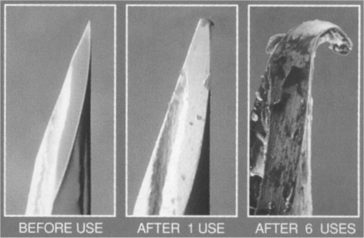
Notes:
A big part of the syringe program is education of our patients. Decreasing abscesses for patients who reuse their own needles. Preventing transmission in patients who previously shared needles.

Slide 20
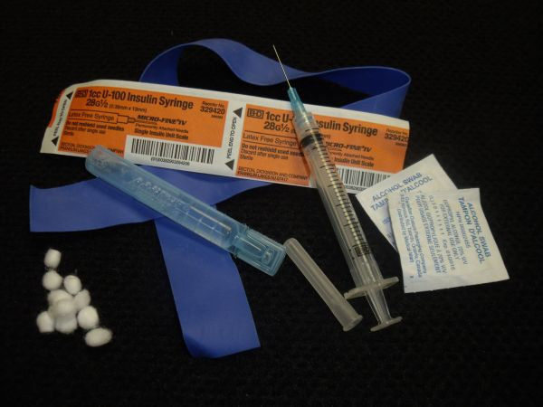
Supplies:
These may include but are not limited to the following prevention items:
-Sterile syringes 1 mL
(generally with 27 g 1/2in
needles)
-Alcohol prep pads
-Cookers
-Cotton filters
-Sterile water
-Bandages
-Condoms
-Tourniquet
Notes:
Address change to Vanish point syringes. Clients can express what works for them. Except in a case that would increase risk of OD (ie large syringe size) or abscess (longer needle length) we try to provide what the client requests to increase access to clean USABLE supplies.
In kind from DOH
NASEN orders through medical budget
Donations
Harm Reduction: $2,007.60/pt/annually
Annual medical expenditures for people diagnosed with diabetes: $13,700 /pt/year
https://www.cdc.gov/diabetes/data/statistics-report/deaths-cost.html

Slide 21
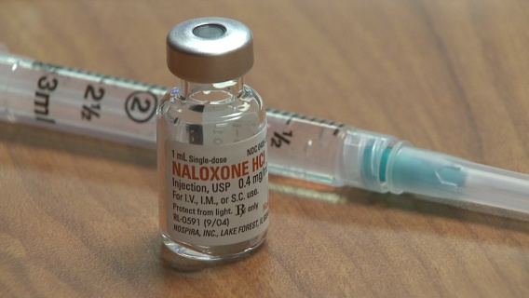
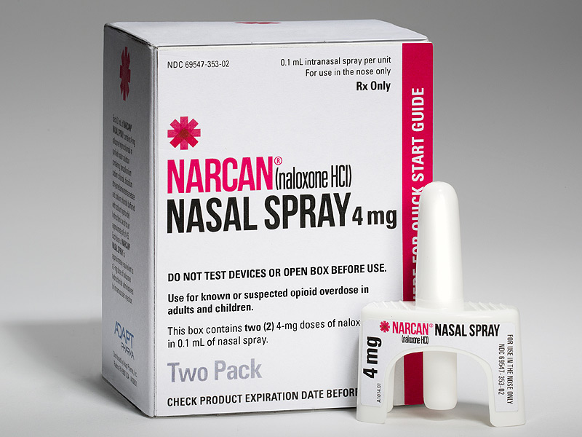
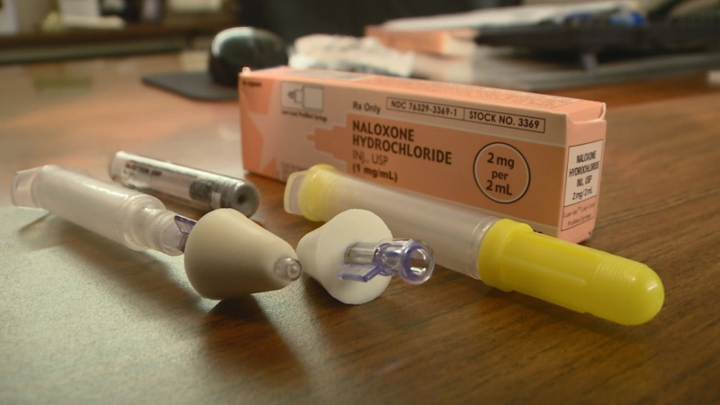
Easy and SAFE access to Narcan
Notes:
Another big focus is Narcan Distribution
Presently we only give our Narcan through MD prescription. However looking at the health departments methods and with WA states liberal rules surrounding Narcan distribution we are working on easier access to narcan through any trained clinic employee.
This must include Overdose prevention and Narcan training for each new patient.
Discuss Training Highlights. (reviewing s/sxs of overdose, both from stimulants and depressants. Identify risk factors. Disspell common myths.

Slide 22
Prevention of injection-related wounds
Prevention of secondary infections (endocarditis, cotton fever)
Safer injection technique
Alternatives to injecting
Overdose prevention and response
Immunization
STI testing
Safer sex supplies
Case management
Addiction treatment
Allows patients access to Primary Care that they previously did not seek out
Connects patients to Recovery and Treatment options
Notes:
Services offered through Harm Reduction Programs

Slide 23
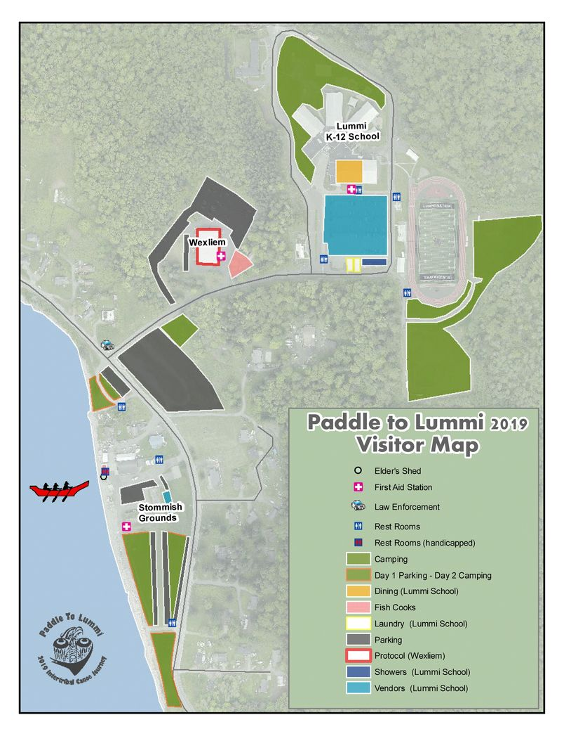
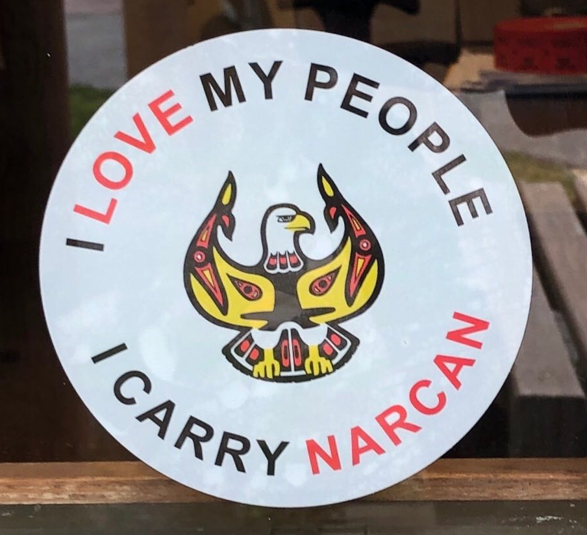
Notes:
community involvement
Recently Lummi hosted Canoe Journey. increased harm reduction services, booths, kiosks and narcan distribution for overdose prevention.
24/7 Crisis outreach for overdose events

Slide 24
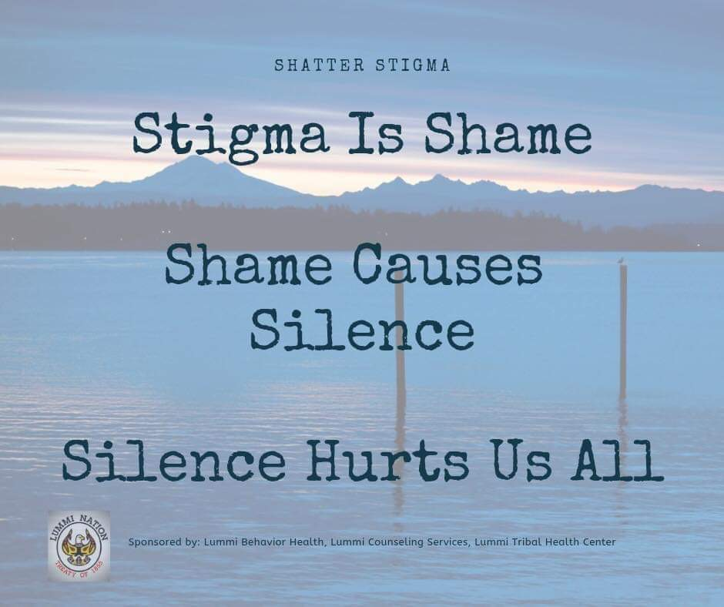
Notes:
Very important to continue conversation with healthcare team and community members to address substance use with a unified vision and unified language around that vision.
When developing your program, what are you goals? Why? How will you as a team (together with your patients) accomplish this?

Slide 25

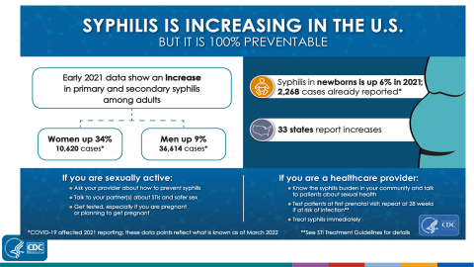

Notes:
Slides are from Dr. Melanie Taylor from the CDC STIs are on the rise. Safe sex supplies are a vital part of HR programs Routine screening is a key part of HR programs (this includes pregnancy testing) Low barrier access to STI treatment and PrEP is a key part of HR programs Expanded screening What is the most common symptom of an STI?

Slide 26
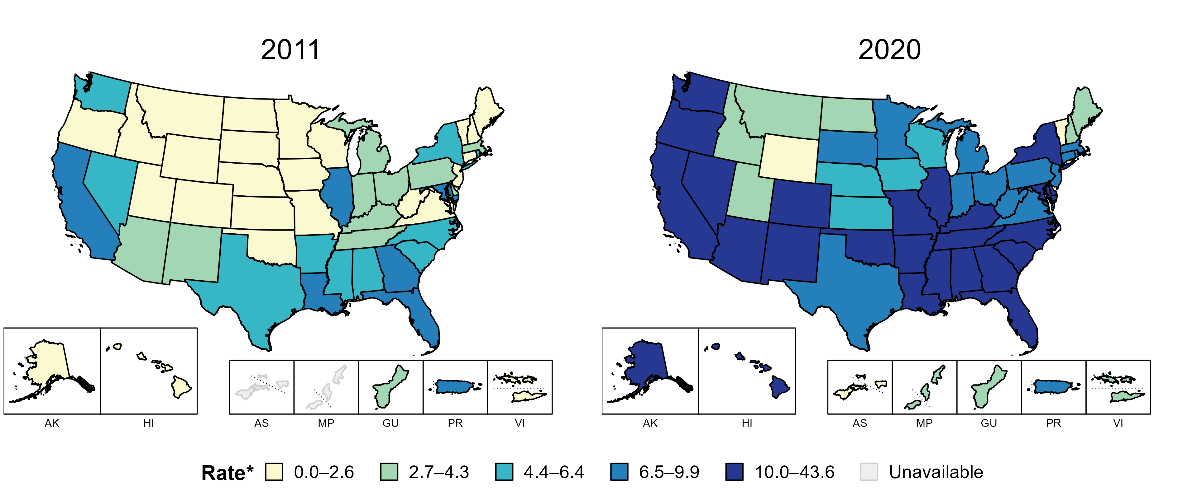
Primary and Secondary Syphilis — Rates of Reported Cases by State, United States and Territories, 2011 and 2020
* Per 100,000
Notes:
In 2011, six states, the District of Columbia (DC), and one US territory (14.3% of available areas) had a rate of reported primary and secondary syphilis greater than or equal to 6.5 cases per 100,000 population. This increased to 38 states, DC, and one US territory (71.4% of available areas) in 2020.
American Samoa and the Commonwealth of the Northern Mariana Islands began reporting data on primary and secondary syphilis cases to CDC in 2018; data are not available for those areas prior to that year.
The COVID-19 pandemic has introduced uncertainty and difficulty in interpreting 2020 case data. See Impact of COVID-19 on STDs (https://www.cdc.gov/std/statistics/2020/impact.htm) for more information.
See Technical Notes (https://www.cdc.gov/std/statistics/2020/technical-notes.htm) for information on syphilis case reporting and on interpreting reported rates in US territories.
Data points are available at: https://www.cdc.gov/std/statistics/2020/data.zip

Slide 27

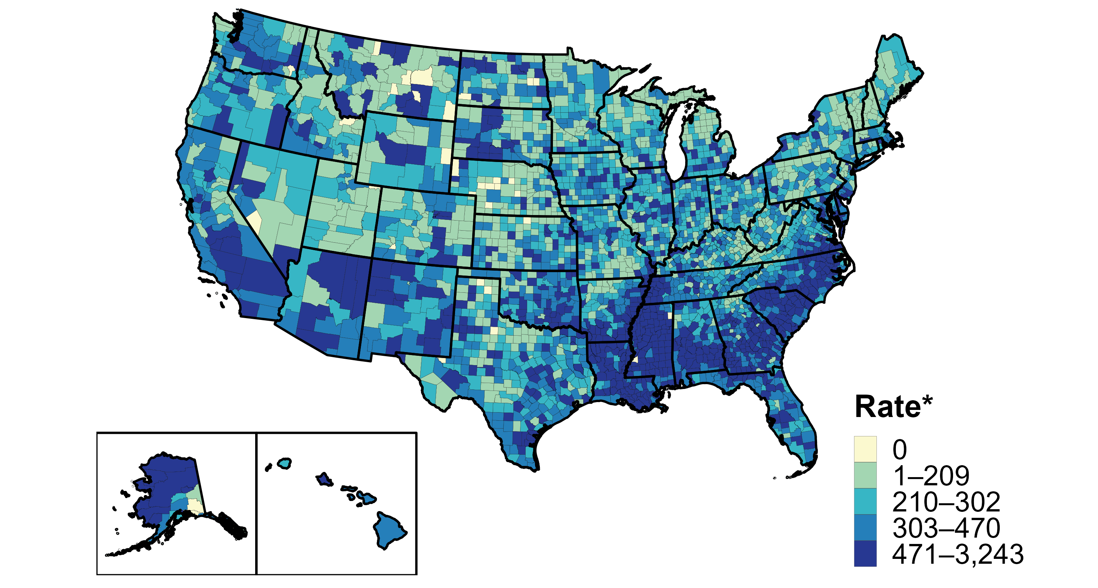
Chlamydia — Rates of Reported Cases by County, United States, 2020
* Per 100,000
Notes:
In 2020, 99% of all counties and county equivalents in the United States reported at least one case of chlamydia. Out of 3,143 counties and county equivalents, 102 (3%) reported over half of all cases of chlamydia.
The COVID-19 pandemic has introduced uncertainty and difficulty in interpreting 2020 case data. See Impact of COVID-19 on STDs (https://www.cdc.gov/std/statistics/2020/impact.htm) for more information.
See Technical Notes (https://www.cdc.gov/std/statistics/2020/technical-notes.htm) for information on chlamydia case reporting.
Data points are available at: https://www.cdc.gov/std/statistics/2020/data.zip

Slide 28
Expanded Screening Based on Local Prevalence
“Clinicians should consider the communities they serve and consult local public health authorities for guidance regarding identifying groups more vulnerable to STDs on the basis of disease prevalence”
STI Treatment Guidelines (cdc.gov)

Slide 29

TALK, TEST, TREAT
STI screening is an important part of overall health
It can and should be part of harm reduction work
Advocating for getting screened for STIs improves healthy outcomes and helps protect us and our loved ones

Slide 30
Overview
Lummi Tribal Health Center started a Needle Exchange Program in 2013, which successfully exchanged 3430 needles, however the program came to a halt during it’s first year.
Restarting in late 2015, the needle exchange program (now Primary Integrated Care Syringe Service Program ) has reformatted to an integrated primary care visit that offers increased privacy as well as access to primary care

Slide 31
Why did LTHC PICSSP begin?
American Indian and Alaska Native alone account for 3.2% of Whatcom County’s population.
In 2012 40% of new HCV cases in Whatcom county were Native American. This identified a significant health disparity.
In an effort to prevent and decrease transmission and acquisition of blood borne infection, a needle exchange program was started at LTHC in 2013. A policy was developed by clinic staff.

Slide 32
Incidence of Acute Hepatitis C by Race/Ethnicity (USA)
https://www.cdc.gov/hepatitis/statistics/2016surveillance/index.htm
Notes:
I know some of these slides are pretty tired and we have seen them all before but until we start to see changes I am going to keep sharing them. So…only you can prevent forest fires at home or whatever.

Slide 33
Purpose
The purpose of the Syringe Services Program (SSP) is to:
Decrease transmission and acquisition of blood borne infections.
Reduce the amount of contaminated syringes and needles in public places.
Reduce the sharing behavior of all parts of the drug preparation and injection process
Promote wellness through individualized education, referrals, medical care, specific testing and treatment
Harm Reduction: Materials, services and strategies that reduce the likelihood of blood borne diseases and negative consequences of substance use
Notes:
Offering HCV treatment to all patients, including those actively or intermittently injecting, requires an optimization of a syringe program to minimize any future exposures.
Lummi Tribal Health Center (LTHC) offers a Primary Integrated Care Syringe Service Program that allows patients to access harm reduction materials while maintaining anonymity.
LTHC offers screening and treatment for Hepatitis C through Primary Care Providers participating in ECHO sessions.

Slide 34
Procedure
1. The syringe services program is open to anyone desiring to exchange syringes on the Lummi reservation
2. The nurses and public health nurses at Lummi Tribal Health Center (LTHC) conduct the PICSSP. Trained volunteers may provide program support.
3. The nurses or trained volunteers provide Harm Reduction materials and education during each point of contact.
4. The PHN or other nurses or trained volunteers will assess and determine the type and quantity of supplies necessary.
LTHC posts signs stating “LTHC Does Not Tolerate Illegal Drug Activity On The Premises”.
Notes:
In the past the program was run on a one to one ratio, however a need based program is much more pragmatic and effective for reduction of risk factors.

Slide 35
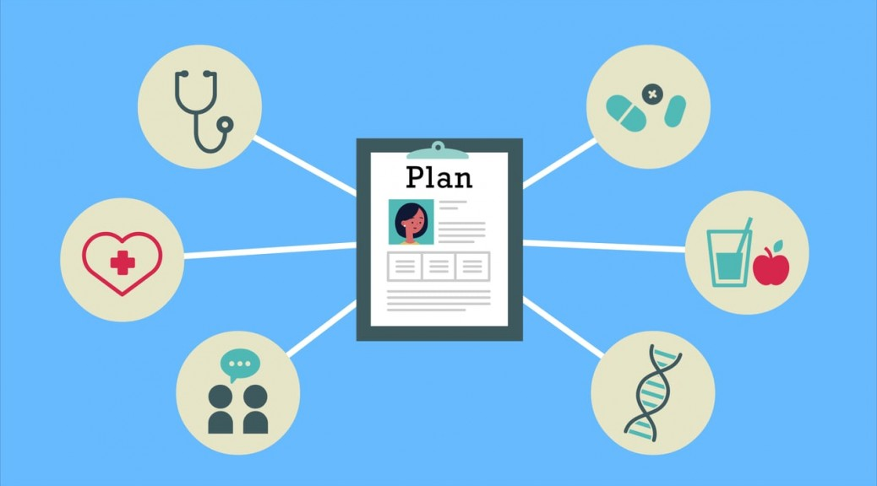
Summary
Integrated primary care SSP offers patients a higher level of anonymity and autonomy
Fostering an individual connection rebuilt trust and relationship with patients with SUD and strengthened the program and allowed for innovative changes.
In Summary
Notes:
Encourage sympathy, avoid burnout. Humanize the patient. Encourage others to pursue harm reduction programs in an integrated healthcare setting.
While it’s important to start with strong framework and structure, it’s equally important to listen to community and add support in the direction it’s growing. Each community is going to have varied needs of it’s own, constant adaptation is critical for a successful and relevant program.

Slide 36


THANK YOU!
Please reach out with any questions
Jrienstra@npaihb.org

Slide 37
Resources
¹https://harmreductionjournal.biomedcentral.com/articles/10.1186/s12954-017-0196-4
www.Harmreduction.org
http://stopoverdose.org/
https://nasen.org/
Local County Health Departments
Good Days Foundation : https://www.mygooddays.org/for-patients/patient-assistance/
Mary Beth Levin “Why Should Anyone Care” Harm Reduction
https://www.npr.org/sections/parallels/2017/04/18/524380027/in-portugal-drug-use-is-treated-as-a-medical-issue-not-a-crime
https://www.bchumanservices.net/2016/11/the-language-of-addiction-updated-guide/
https://trash-cans.com/products/outdoor-sharps-disposal-kiosk-square-38-gallons-ce138-ch-s
Notes:
Questions? Review resources.

