Slide 1
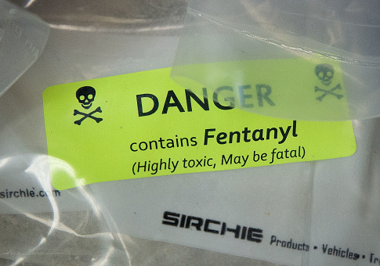
Fentanyl: Facts, Myths, and half truths
Is what you think you know helping or harming the community?
Harm Reduction ECHO 8/2/22
Image from https://www.theatlantic.com/health/archive/2017/05/fentanyl-first-responders/526389/

Slide 2
purpose
The intent of this presentation is to address some of the questions that came up in the last presentation, and also to address frequently asked questions from community members.
Disclaimer: information is evolving quickly, and we are doing our best to stay on top of the most current information that is based in science.
We recognize that people who use drugs are the experts in their own experience, and we can partner with them to reduce harm, help them understand their experience, and have no expectation of abstinence.

Slide 3
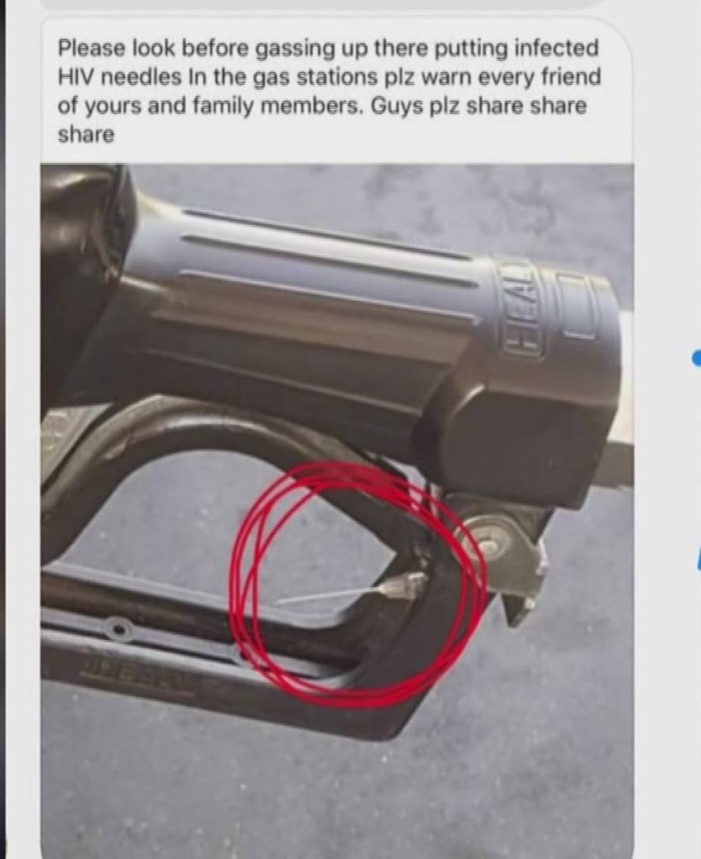
About MYTHS
Often times, myths are created from a lack of information.
A myth may have a “grain of truth”.
A lack of information coupled with fear can create and fuel myths.
Unfortunately, fear is used as a tool to teach facts or lessons.
What are past myths that you have heard about, HIV, hepatitis, the LGBTQ+ community, or injection drug users?
Image from https://www.thv11.com/article/news/local/verify/verify-are-people-hiding-needles-in-gas-pumps/91-581853980

Slide 4
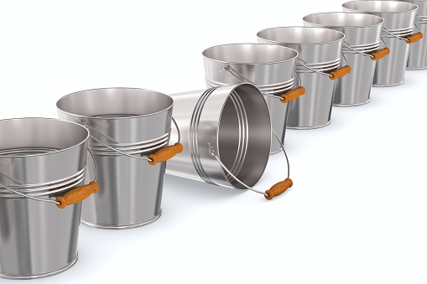
Categorizing scenarios
Not possible; no risk
Potential, but not likely; little risk
Possible; some risk
Likely; high risk
Image from https://unsplash.com/s/photos/bucket

Slide 5
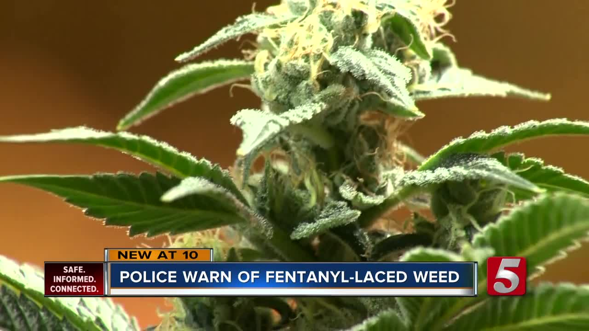
MYTH: overdose from Fentanyl laced Cannabis
In the case of cannabis flower, smoking involves loading the material into a pipe or roll paper, lighting it on fire, and inhaling the smoke. Burning fentanyl with flame destroys it, so even if someone smoked cannabis contaminated with fentanyl, the fentanyl would not be active in the smoke.
In the case of vaping cannabis, fentanyl’s boiling point is 466℃, or about 871℉. The hottest temperature settings on cannabis vape pens are 210-220℃ (or 410-428℉.
Information from https://filtermag.org/fentanyl-marijuana-myth/amp/
Image from https://www.newschannel5.com/news/police-warn-of-marijuana-laced-with-fentanyl

Slide 6

MYTH: Overdose from touching a dollar bill
Someone can not easily overdose by touching something that has fentanyl on it. However, you do need to make sure the opioid does not get into your mouth, nose, or eyes because then it can be dangerous.
Fentanyl cannot penetrate the skin on its own. It needs moisture. That’s why, in clinical care, patients are given fentanyl patches to aid in absorption and relieve pain.
Information from https://www.wcnc.com/article/news/verify/fentanyl-drug-deadly-verify-viral-social-media/275-bbb5fa3b-30d0-44ec-86ec-a334184ab524 and https://www.statnews.com/2017/08/09/fentanyl-falling-ill/
Image from: https://www.pennlive.com/nation-world/2022/06/dont-pick-up-any-folded-money-the-bill-could-be-deadly-tennessee-sheriff-warns.html

Slide 7
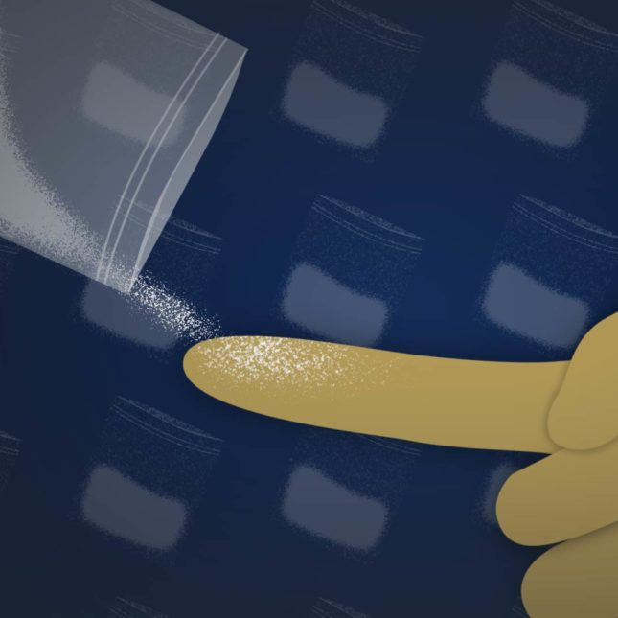
MYTH: Overdose from touching fentanyl
The American College of Medical Toxicology recently issued a position paper concluding that, based on what’s been publicly released, none of the recent incidents involving first responders is consistent with opioid toxicity.
The doctors, who reviewed a handful of cases, said they are not challenging the truthfulness of the officers involved. Rather, they are questioning whether their reports are verified cases of poisonings that carry the hallmarks of opioid exposure.
Image and information from: https://www.statnews.com/2017/08/09/fentanyl-falling-ill/

Slide 8
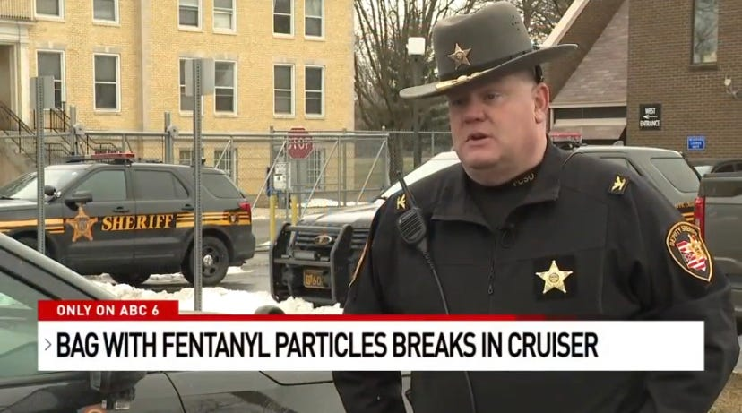
Risk to First Responders
The position of the American College of Medical Toxicology (ACMT) and American Academy of Clinical Toxicology (AACT), is as follows:
Fentanyl and its analogs are potent opioid receptor agonists, but the risk of clinically significant exposure to emergency responders is extremely low.
To date, we have not seen reports of emergency responders developing signs or symptoms consistent with opioid toxicity from incidental contact with opioids. Incidental dermal absorption is unlikely to cause opioid toxicity.
Information from https://www.ncbi.nlm.nih.gov/pmc/articles/PMC5711758/
Image from https://www.columbusmonthly.com/story/entertainment/human-interest/2022/02/03/dispatches-overdose-crisis-fentanyl-exposure-overdose-myth/6648270001/

Slide 9

Touching fentanyl does not lead to intoxication or overdose
If our clients could use fentanyl by simply touching it, they would not have to worry about finding a vein in order to get high.
Nobody is using fentanyl by simply touching it, because it doesn’t work that way.
Information from common sense, think about it.
Image from https://www.syfy.com/movies/et-the-extra-terrestrial

Slide 10

Half truth: Fentanyl Test Strips Tell you if a Substance has Fentanyl in it.
Fentanyl test strips are one tool to have in a harm reduction toolbox, and using them is one way to get a person thinking about safer drug use. It is also a great opportunity to put naloxone in their hands.
User error can occur with the test strips.
People must test all of the drugs they are using, since fentanyl can hide in drugs like chocolate chips in cookies.
Information from https://dancesafe.org/wp-content/uploads/2019/02/2019-fent-strips.pdf
Image from https://www.foodandwine.com/news/sesame-street-cookie-monster-cooking-show

Slide 11
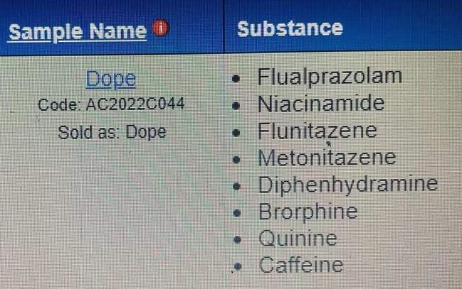
Half truth: Fentanyl Test Strips Tell you if a Substance has Fentanyl in it.
Fentanyl test strips will show a false positive result if diphenhydramine (Benadryl) is in the substance tested.
Fentanyl test strips will show a false positive result if methamphetamine residue is not diluted with 4 ounces (1/2 cup) of water.
You can distribute 4 ounce paper cups for clients to properly dilute meth residue.
Information from https://www.cdph.ca.gov/Programs/CID/DOA/CDPH%20Document%20Library/Fact_Sheet_Fentanyl_Testing_Approved_ADA.pdf
https://www.aacc.org/-/media/Files/Divisions/TDM-TOX/AACC-TDM-CT-Newsletter_Summer_2020_final.pdf?la=en&hash=9AA897EBC6DE9E132FEEB5F070BB8AE45250843F#:~:text=At%203%20h%2C%206%20h,of%20high%20levels%20of%20diphenhydramine. Image from https://www.facebook.com/joltharmreductionpeoria/

Slide 12
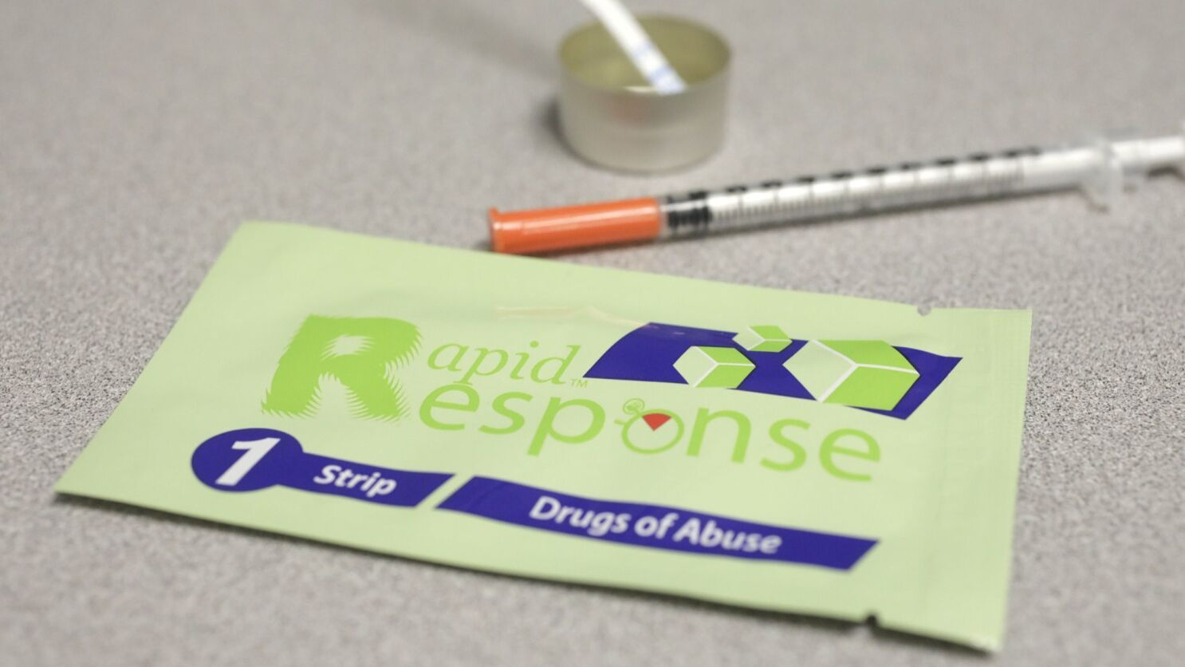
HALF TRUTH: Fentanyl Test Strips Tell you if a Substance has Fentanyl in it.
BTNX Fentanyl test strips are able to detect Fentanyl and many other Fentanyl analogues such as Carfentanil, Acetyl Fentanyl, Butyryl Fentanyl, Remifentanil, Ocfentanil, Sufentanil, p-Fluoro Fentanyl, Furanyl Fentanyl, Valeryl Fentanyl, and 3-Methyl Fentanyl.
Oregon has had fatal overdoses from analogues not detected by test strips, such as Cyclopropyl Fentanyl.
Information from https://en.wikipedia.org/wiki/List_of_fentanyl_analogues
and https://www.ice.gov/news/releases/lake-oswego-man-sentenced-federal-prison-distributing-fentanyl-china-leading-overdose
Image from https://www.latimes.com/health/la-me-ln-fentanyl-test-strips-20180531-story.html

Slide 13
Half truth: Fentanyl is resistant to naloxone
Fentanyl itself is not resistant to naloxone, but fentanyl can cause vocal cord closure, which can lead to death.
Fentanyl will respond to naloxone if someone is overdosing, because it is an opioid.
High doses of the synthetic opioid fentanyl cause rapid and sustained vocal cord closure (VCC) leading to airway obstruction that prevents overdose victims from breathing. This airway effect is not caused by morphine-derived opiates (e.g. heroin), is distinct from respiratory depression, resistant to naloxone, and can be lethal.
Fentanyl can induce chest wall rigidity, or wooden chest syndrome (WCS). Fentanyl induced skeletal muscle rigidity can cause ventilator failure.
Information from https://pubmed.ncbi.nlm.nih.gov/34492557/ and https://www.ncbi.nlm.nih.gov/pmc/articles/PMC8312149/#:~:text=Fentanyl%2Dinduced%20chest%20wall%20rigidity%2C%20otherwise%20known%20as%20wooden%20chest,with%20sedatives%20for%20intubated%20patients

Slide 14
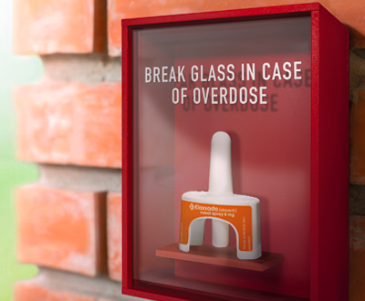
Half truth: Kloxxado should be used to reverse a fentanyl overdose
In a survey of community organizations to which Narcan® Nasal Spray 4mg had been distributed, 34% of attempted reversals used two or more doses.
Additionally, a separate study published in 2019 found that the percent of overdose-related EMS calls in the US requiring multiple doses of naloxone during 2013-2016 had increased to 21%.
Information from https://www.hikma.com/newsroom/article-i5120-hikma-announces-us-fda-approval-of-kloxxado-tm-naloxone-hydrochloride-nasal-spray-8mg/

Slide 15
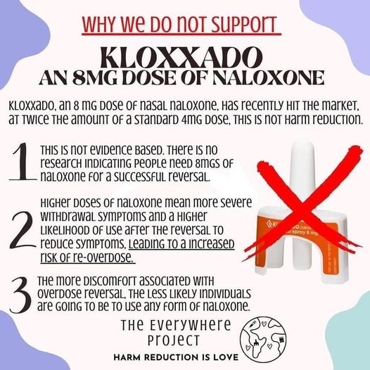
Half truth: Kloxxado should be used to reverse a fentanyl overdose
According to the manufacturer, less than half of all overdoses required 2 or more doses,.
Giving a person more naloxone than needed can put them into withdrawal and make them less likely to use naloxone or call for help if a person is overdosing.
Side effects of overdose reversal include precipitated withdrawal and confusion. Are you waking someone up in a safe environment?
Image from https://www.facebook.com/TheEverywhereProject

Slide 16
References
https://www.statnews.com/2017/08/09/fentanyl-falling-ill/
https://www.wcnc.com/article/news/verify/fentanyl-drug-deadly-verify-viral-social-media/275-bbb5fa3b-30d0-44ec-86ec-a334184ab524
https://filtermag.org/fentanyl-marijuana-myth/amp/
https://www.ncbi.nlm.nih.gov/pmc/articles/PMC5711758/
https://en.wikipedia.org/wiki/List_of_fentanyl_analogues (not a complete list)
https://www.ice.gov/news/releases/lake-oswego-man-sentenced-federal-prison-distributing-fentanyl-china-leading-overdose
https://www.aacc.org/-/media/Files/Divisions/TDM-TOX/AACC-TDM-CT-Newsletter_Summer_2020_final.pdf?la=en&hash=9AA897EBC6DE9E132FEEB5F070BB8AE45250843F#:~:text=At%203%20h%2C%206%20h,of%20high%20levels%20of%20diphenhydramine.
https://dancesafe.org/wp-content/uploads/2019/02/2019-fent-strips.pdf
https://pubmed.ncbi.nlm.nih.gov/34492557/
https://www.ncbi.nlm.nih.gov/pmc/articles/PMC8312149/#:~:text=Fentanyl%2Dinduced%20chest%20wall%20rigidity%2C%20otherwise%20known%20as%20wooden%20chest,with%20sedatives%20for%20intubated%20patients
https://www.hikma.com/newsroom/article-i5120-hikma-announces-us-fda-approval-of-kloxxado-tm-naloxone-hydrochloride-nasal-spray-8mg/

