Slide 1
Rising Congenital Syphilis in the United States
An Update and Review for IHS Providers
Aliza Machefsky, MD &
Melanie Taylor, MD, MPH
CDC Foundation & Centers for Disease Control and Prevention

Slide 2
Disclosures
NONE The findings and conclusions in this report are those of the authors and do not necessarily represent the official position of the Centers for Disease Control and Prevention.

Slide 3

One “who knows syphilis knows medicine.”
- Sir William Osler

Slide 4
One “who knows syphilis knows medicine.”
- Sir William Osler
#SyphilisIsHard
-Everyone

Slide 5

Overview
Syphilis 101
Pathophysiology
Clinical features
Epidemiology
Syphilis in Pregnancy
Diagnosis
Treatment
Cases
Congenital Syphilis Prevention

Slide 6
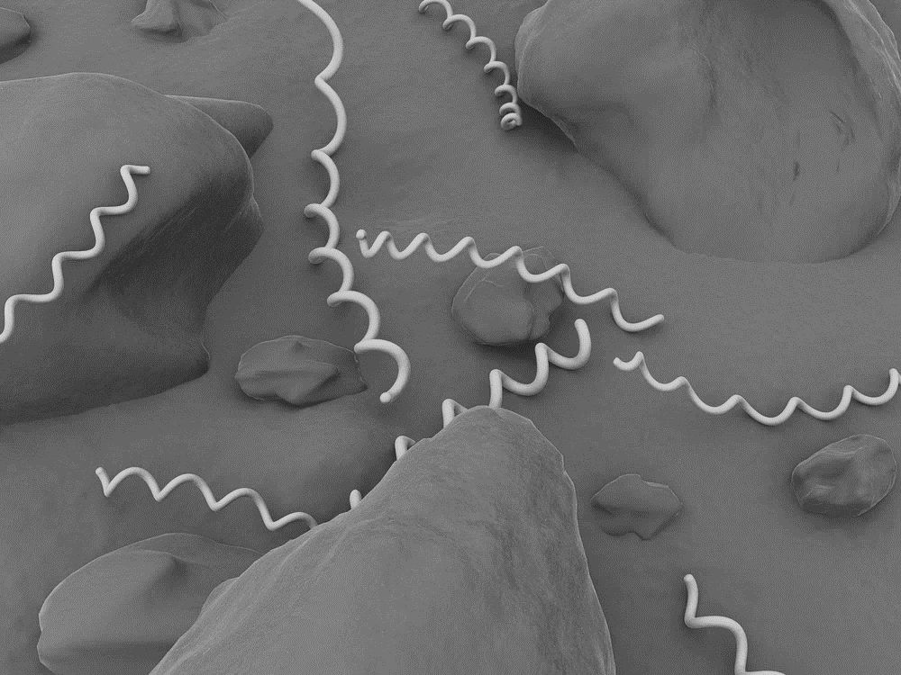
Syphilis 101

Slide 7
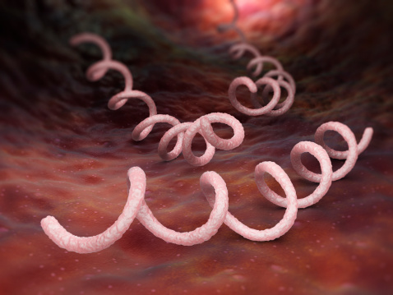
Syphilis
Caused by spirochete bacterium Treponema pallidum
Transmission
Direct contact with a syphilitic lesion during vaginal, anal, or oral sex
Pregnancy

Slide 8

Clinical Stages
Syphilis goes through several stages.
Stages start with primary, then may not progress linearly.
Characterized by episodes of active disease interrupted by periods of latency.
Signs/symptoms and transmission risks vary by stage.

Slide 9
Clinical Stages
Primary
Secondary
Latent
Tertiary
Appears 10 to 90 days after infection
Sore goes away even if person is not treated
Patient may never be aware of a chancre
Painless ulcer (chancre)
Skin rash
Mucocutaneous lesions
Generalized lymphadenopathy
No visible signs/symptoms
Early latent (<1 year)
Late latent (>1 year)
Cardiovascular
Gummatous lesions (skeletal, spinal, mucosal, ophthalmic)

Slide 10
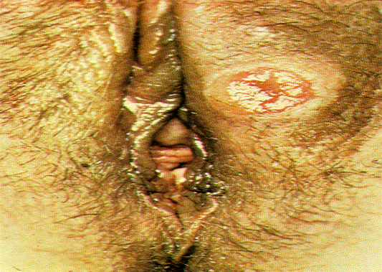
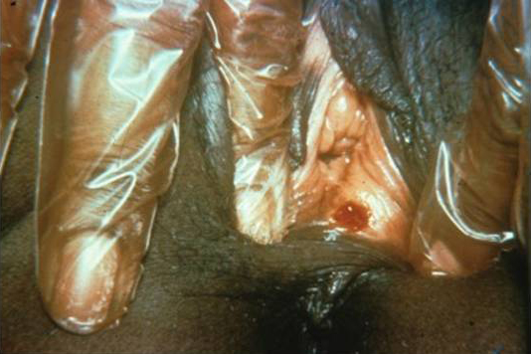
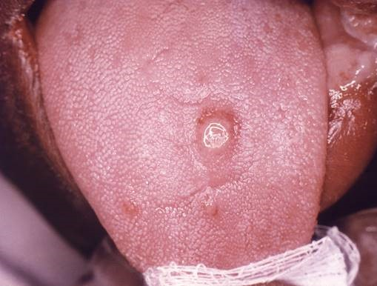
Clinical Stages
Primary
Secondary
Latent
Tertiary
Appears 10 to 90 days after infection
Sore goes away even if person is not treated
Patient may never be aware of a chancre
Painless ulcer (chancre)
Skin rash
Mucocutaneous lesions
Generalized lymphadenopathy
No visible signs/symptoms
Early latent (<1 year)
Late latent (>1 year)
Cardiovascular
Gummatous lesions (skeletal, spinal, mucosal, ophthalmic)

Slide 11
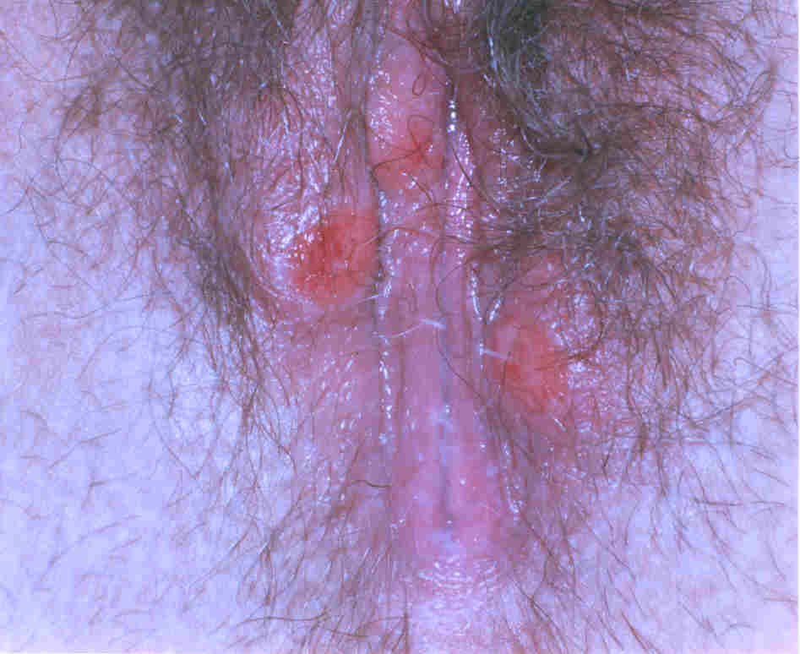
Clinical Stages
Primary
Secondary
Latent
Tertiary
“Kissing” Lesion
Appears 10 to 90 days after infection
Sore goes away even if person is not treated
Patient may never be aware of a chancre
Painless ulcer (chancre)
Skin rash
Mucocutaneous lesions
Generalized lymphadenopathy
No visible signs/symptoms
Early latent (<1 year)
Late latent (>1 year)
Cardiovascular
Gummatous lesions (skeletal, spinal, mucosal, ophthalmic)

Slide 12
Clinical Stages
Primary
Secondary
Painless ulcer (chancre)
Rash
Mucocutaneous lesions
Lymphadenopathy
Usually occurs 3 to 6 weeks after primary syphilis
Patients may only have one subtle skin change
Symptoms also go away even if not treated!

Slide 13
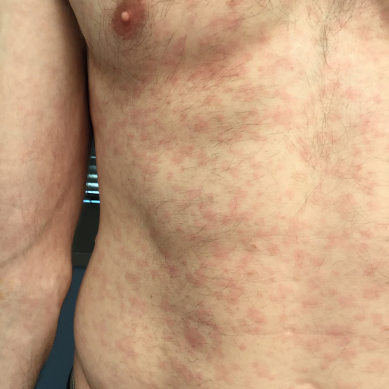
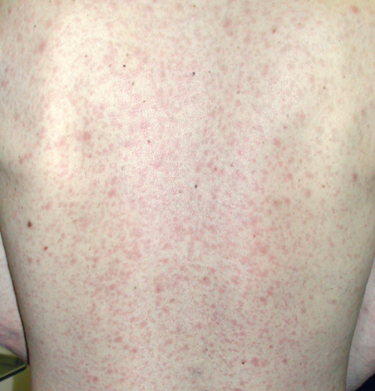
Clinical Stages
Primary
Secondary
Painless ulcer or chancre
Rash
Mucocutaneous lesions
Lymphadenopathy
Usually occurs 3 to 6 weeks after primary syphilis
Patients may only have one subtle skin change
Symptoms also go away even if not treated!

Slide 14
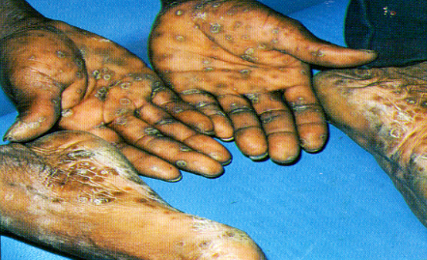
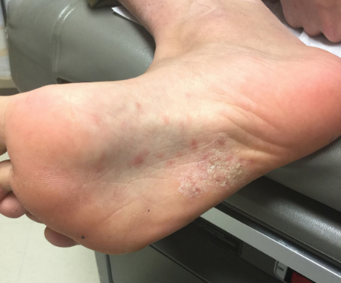
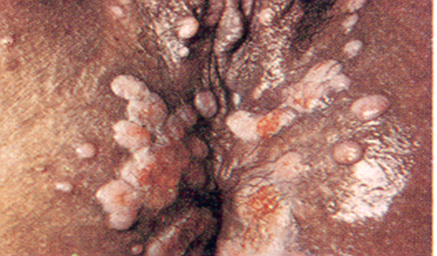
Clinical Stages
Primary
Secondary
Palmar Lesions
Plantar Lesions
Condyloma Lata
Painless ulcer or chancre
Rash
Mucocutaneous lesions
Lymphadenopathy
Usually occurs 3 to 6 weeks after primary syphilis
Patients may only have one subtle skin change
Symptoms also go away even if not treated!

Slide 15
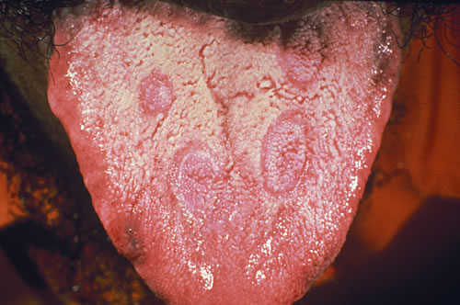
Clinical Stages
Primary
Secondary
Painless ulcer or chancre
Rash
Mucocutaneous lesions
Lymphadenopathy
Usually occurs 3 to 6 weeks after primary syphilis
Patients may only have one subtle skin change
Symptoms also go away even if not treated!

Slide 16
Clinical Stages
Primary
Secondary
Painless ulcer or chancre
Rash
Mucocutaneous lesions
Lymphadenopathy
P&S Syphilis
Most infectious stages
Indicate recent acquisition

Slide 17
Clinical Stages
Primary
Secondary
Latent
Painless ulcer or chancre
Rash
Mucocutaneous lesions
Lymphadenopathy
NO SYMPTOMS

Slide 18
Clinical Stages
Primary
Secondary
Latent
Painless ulcer or chancre
Rash
Mucocutaneous lesions
Lymphadenopathy
NO SYMPTOMS
EARLY LATENT
<=1 year since infection
LATE LATENT
>1 year since infection
Latent Syphilis of Unknown Duration

Slide 19
Clinical Stages
Primary
Secondary
Latent
Painless ulcer or chancre
Rash
Mucocutaneous lesions
Lymphadenopathy
NO SYMPTOMS
EARLY LATENT
<=1 year since infection
LATE LATENT
>1 year since infection
EARLY SYPHILIS
Primary, Secondary, or Early Latent
(greatest potential for vertical transmission)

Slide 20
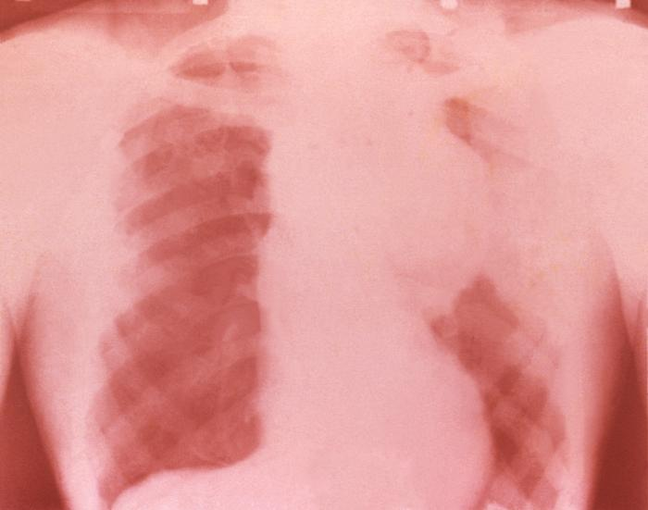
Clinical Stages
Primary
Secondary
Latent
Tertiary
Painless ulcer or chancre
Rash
Mucocutaneous lesions
Lymphadenopathy
NO SYMPTOMS
Cardiovascular
Gummatous lesions (skeletal, mucosal, ophthalmic)

Slide 21
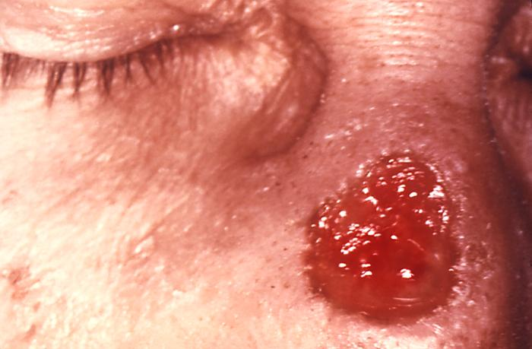
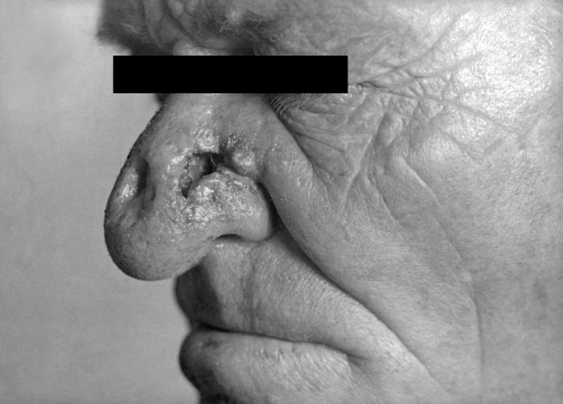
Clinical Stages
Primary
Secondary
Latent
Tertiary
Painless ulcer or chancre
Rash
Mucocutaneous lesions
Lymphadenopathy
NO SYMPTOMS
Cardiovascular
Gummatous lesions (skeletal, mucosal, ophthalmic)

Slide 22
Clinical Stages
Primary
Secondary
Latent
Tertiary
Painless ulcer or chancre
Rash
Mucocutaneous lesions
Lymphadenopathy
NO SYMPTOMS
Cardiovascular
Gummatous lesions (skeletal, mucosal, ophthalmic)
Neurosyphilis can occur at any stage.

Slide 23

Congenital syphilis is an infection with Treponema pallidum in an infant or fetus, acquired when a pregnant person has untreated or inadequately treated syphilis. Placentas often have signs of infection and inflammation.
Cooper, Sanchez. Congenital Syphilis. Seminars in Perinatology. 2018

Slide 24
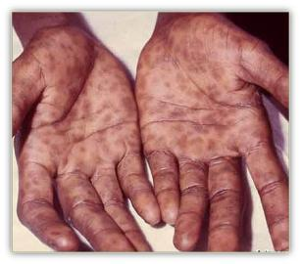
Vertical transmission is highest with early stages of maternal syphilis, specifically secondary syphilis.
Cooper, Sanchez. Congenital Syphilis. Seminars in Perinatology. 2018.

Slide 25

Syphilis during pregnancy is associated with
Miscarriage
Stillbirth
Preterm delivery
Perinatal death
Congenital infection
Gomez et al. Untreated Maternal Syphilis and Adverse Outcomes of Pregnancy. Bulletin of the WHO. 2013.

Slide 26
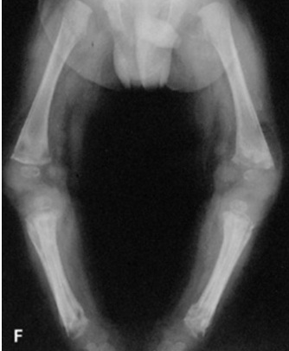
Congenital Syphilis
Early CS (first 2 years of life)
Hepatosplenomegaly
Rash
Snuffles
CNS invasion
Bone abnormalities
Cooper, Sanchez. Congenital Syphilis. Seminars in Perinatology. 2018.

Slide 27
Congenital Syphilis
Early CS (under 2 years old)
Hepatosplenomegaly
Rash
Snuffles
CNS invasion
Bone abnormalities
Late CS (over 2 years old)
Prevent with treatment before 3 months old
Hutchinson’s triad
Cooper, Sanchez. Congenital Syphilis. Seminars in Perinatology. 2018.

Slide 28
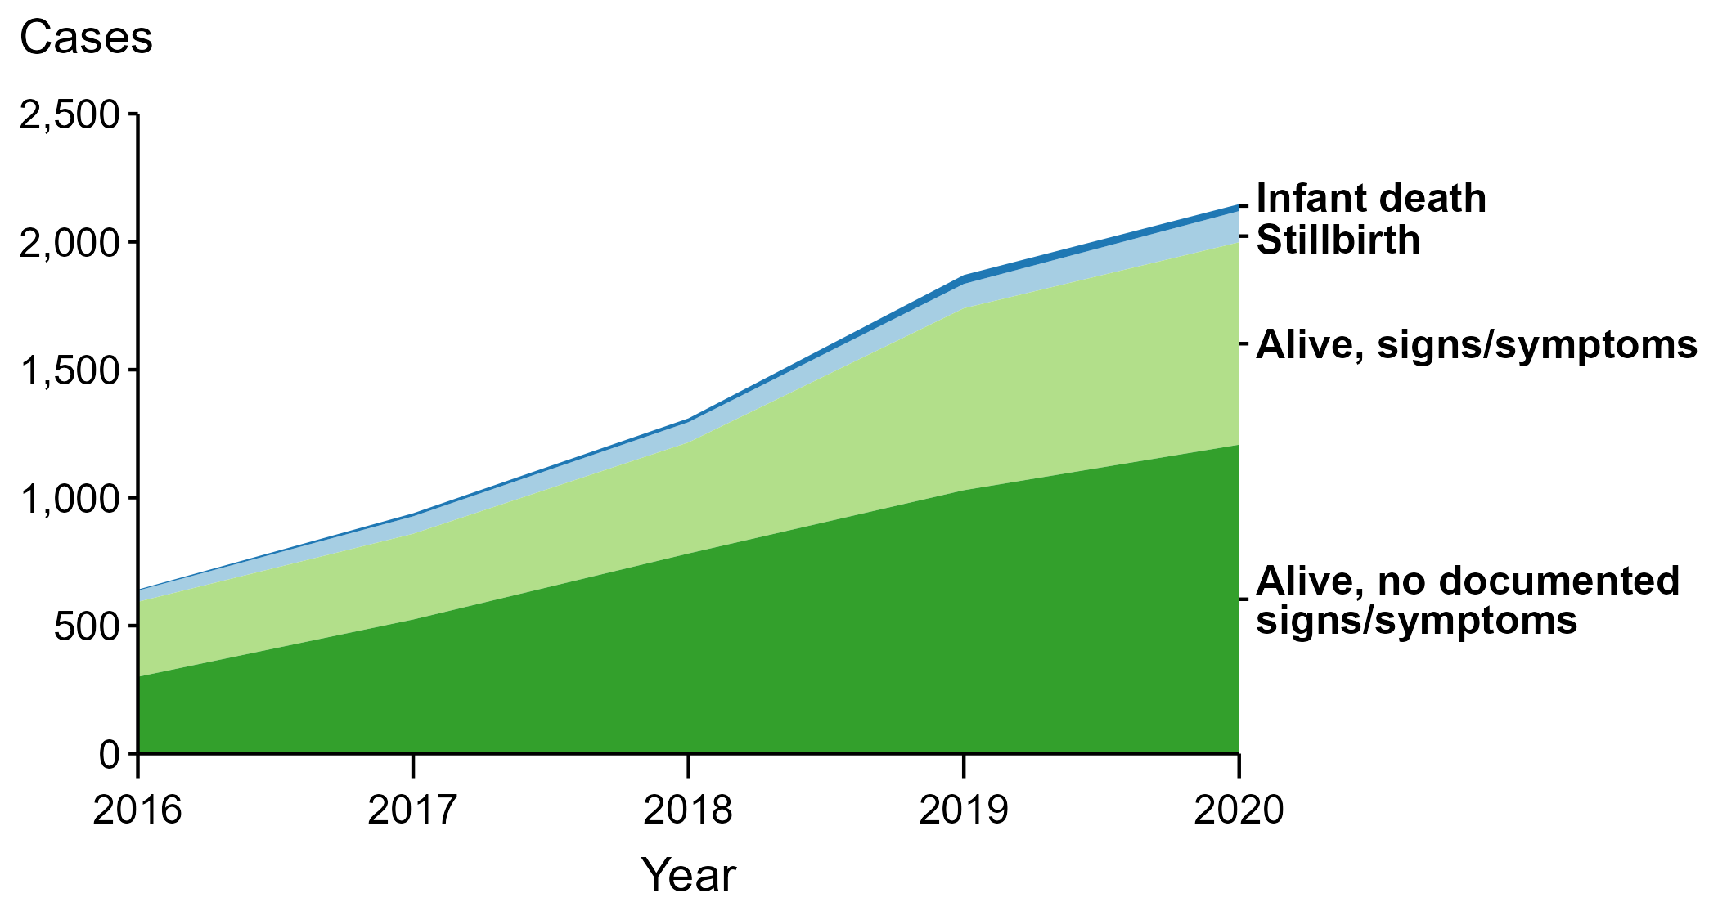
Most neonates with CS have no signs or symptoms.
Sexually Transmitted Disease Surveillance, 2020

Slide 29
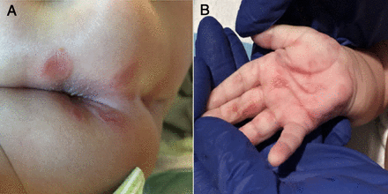
Most neonates with CS have no signs or symptoms.
68 infants were diagnosed with CS after 28 days of life (US, 2014-2018)
2019 Case Reports
No signs or symptoms at birth
Diagnosed at four and six months of age
Dorfman, Glaser. Congenital Syphilis Presenting Beyond the Newborn Period. NEJM. 1990.
Jacobs, et al. Congenital Syphilis Misdiagnosed as Suspected Nonaccidental Trauma. Pediatrics. 2019.

Slide 30

Timely diagnosis and treatment of maternal syphilis can prevent congenital syphilis.
*Timely = initiated at least 30 days before delivery

Slide 31
Epidemiology

Slide 32
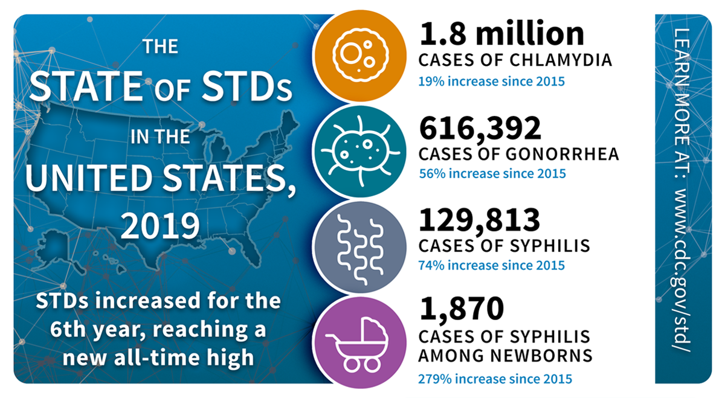

Slide 33
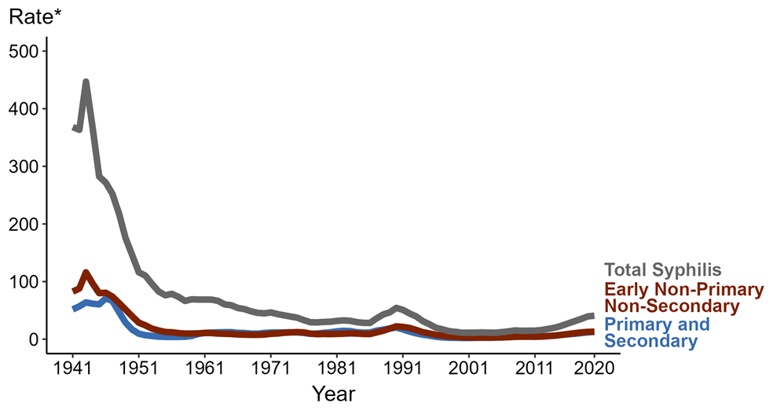
Syphilis rates declined after introduction of penicillin.
PENICILLIN!
33
Syphilis – Rates of Reported Cases by Stage of Infection, United States, 1941-2020

Slide 34

Cocaine likely contributed to increases in syphilis.
34
Syphilis – Rates of Reported Cases by Stage of Infection, United States, 1941-2020

Slide 35

Syphilis Elimination Effort in 1999
35
Syphilis – Rates of Reported Cases by Stage of Infection, United States, 1941-2020

Slide 36

Syphilis Rates Rising
36
Syphilis – Rates of Reported Cases by Stage of Infection, United States, 1941-2020

Slide 37
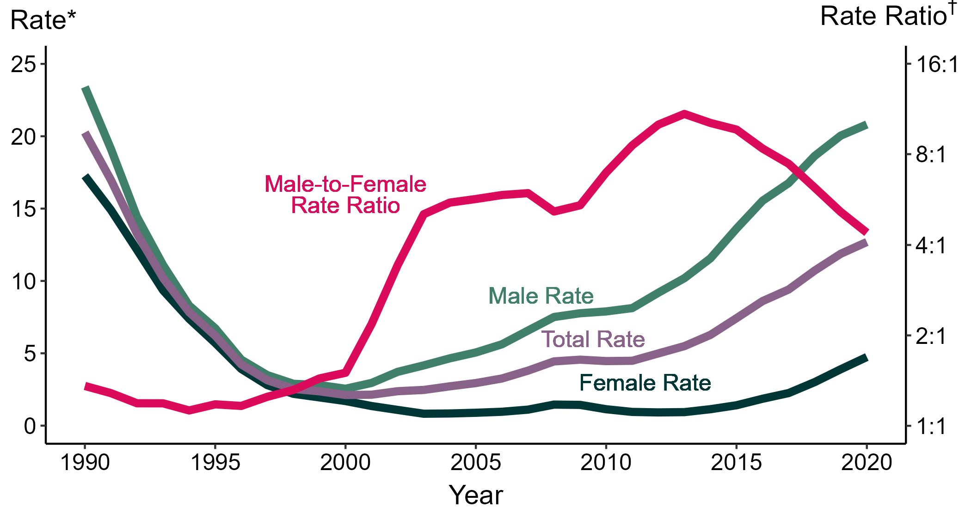
Primary and Secondary Syphilis — Rates of Reported Cases by Sex and Male-to-Female Rate Ratios, United States, 1990–2020
* Per 100,000
† Log scale

Slide 38
Primary and Secondary Syphilis — Rates of Reported Cases by Sex and Male-to-Female Rate Ratios, United States, 1990–2020
* Per 100,000
† Log scale

Slide 39
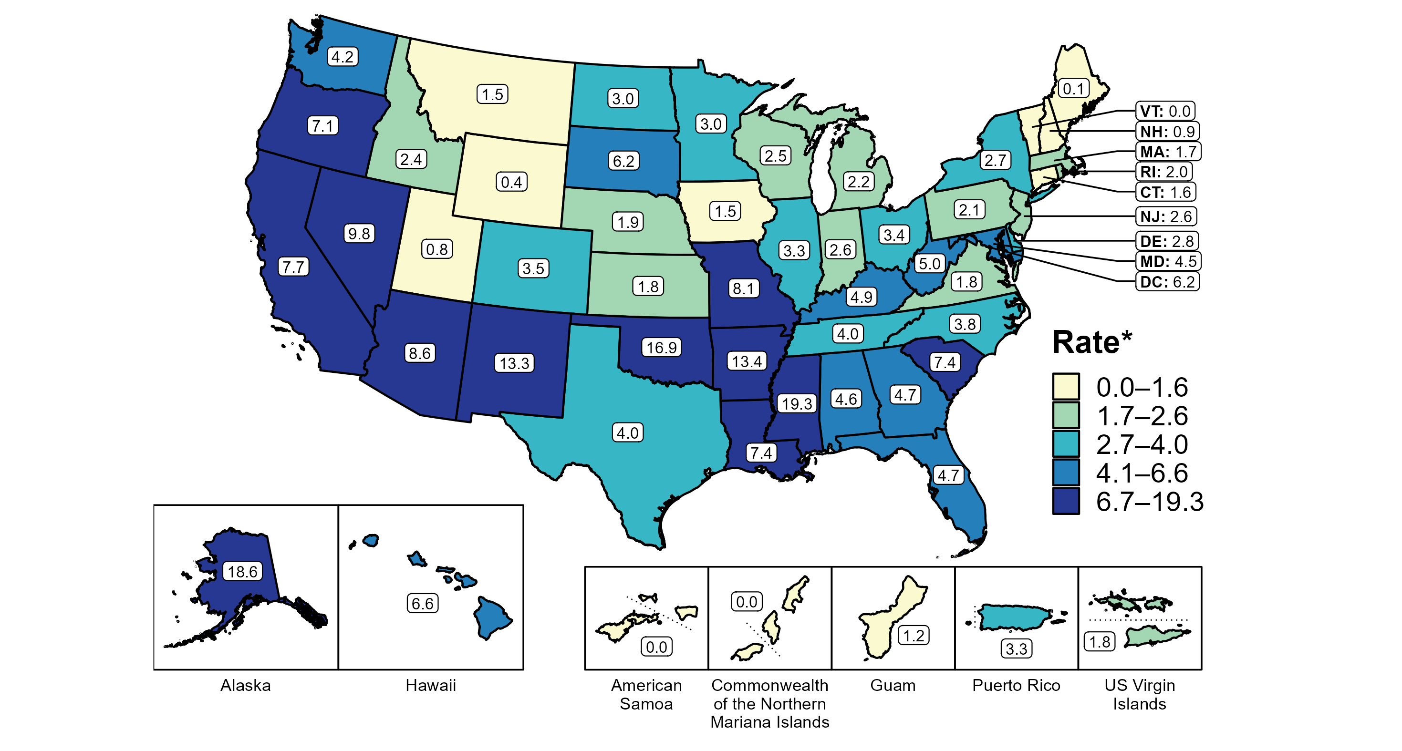
Primary and Secondary Syphilis — Rates of Reported Cases Among Women by State, United States and Territories, 2020
* Per 100,000

Slide 40
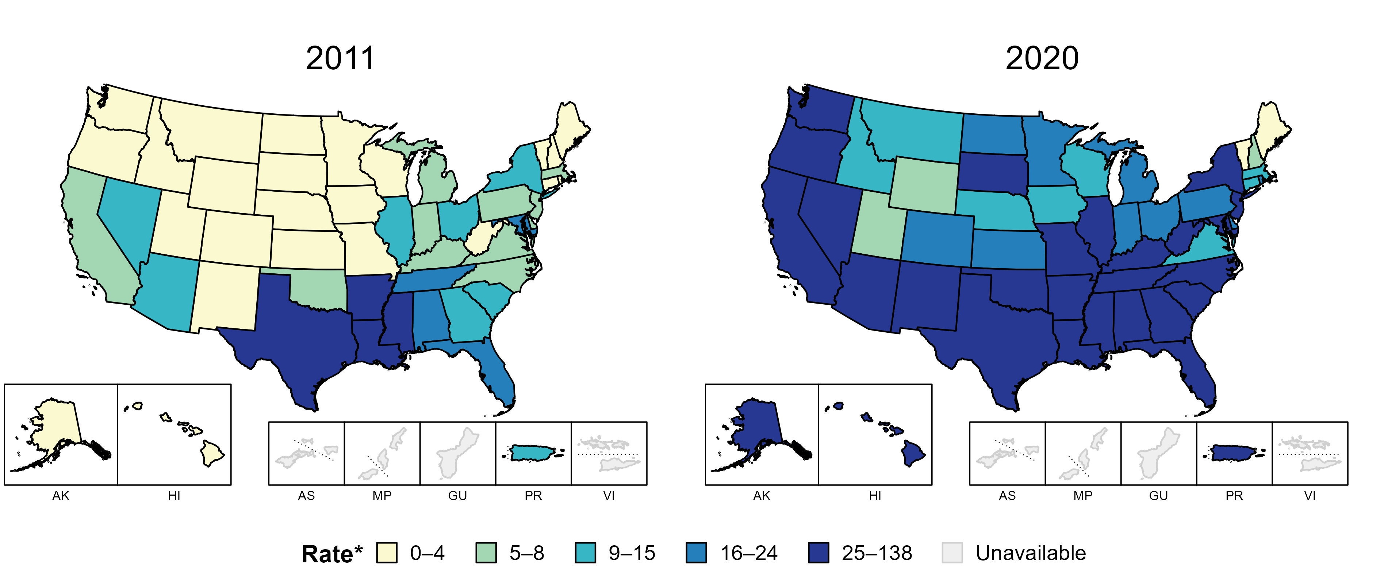
Syphilis (All Stages) — Rates of Reported Cases Among Women Aged 15-44 Years by State, United States and Territories, 2011–2020
* Per 100,000

Slide 41
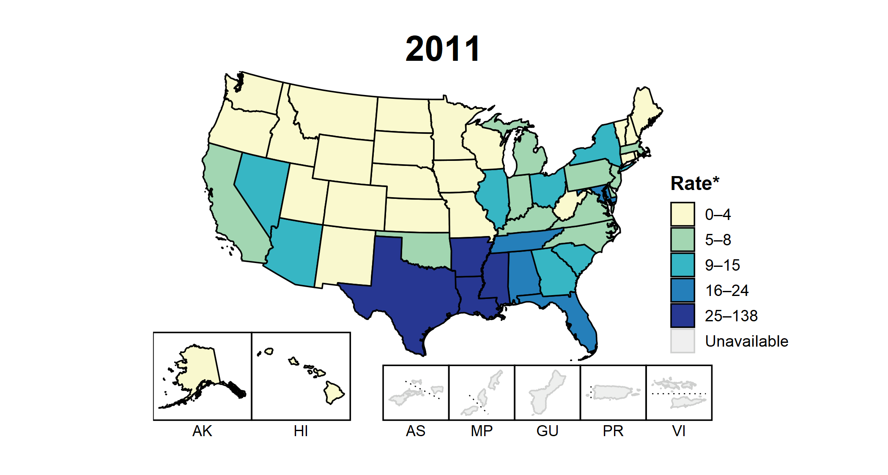
Syphilis (All Stages) — Rates of Reported Cases Among Women Aged 15-44 Years by State, United States and Territories, 2011–2020
* Per 100,000

Slide 42

Congenital syphilis is increasing.

Slide 43
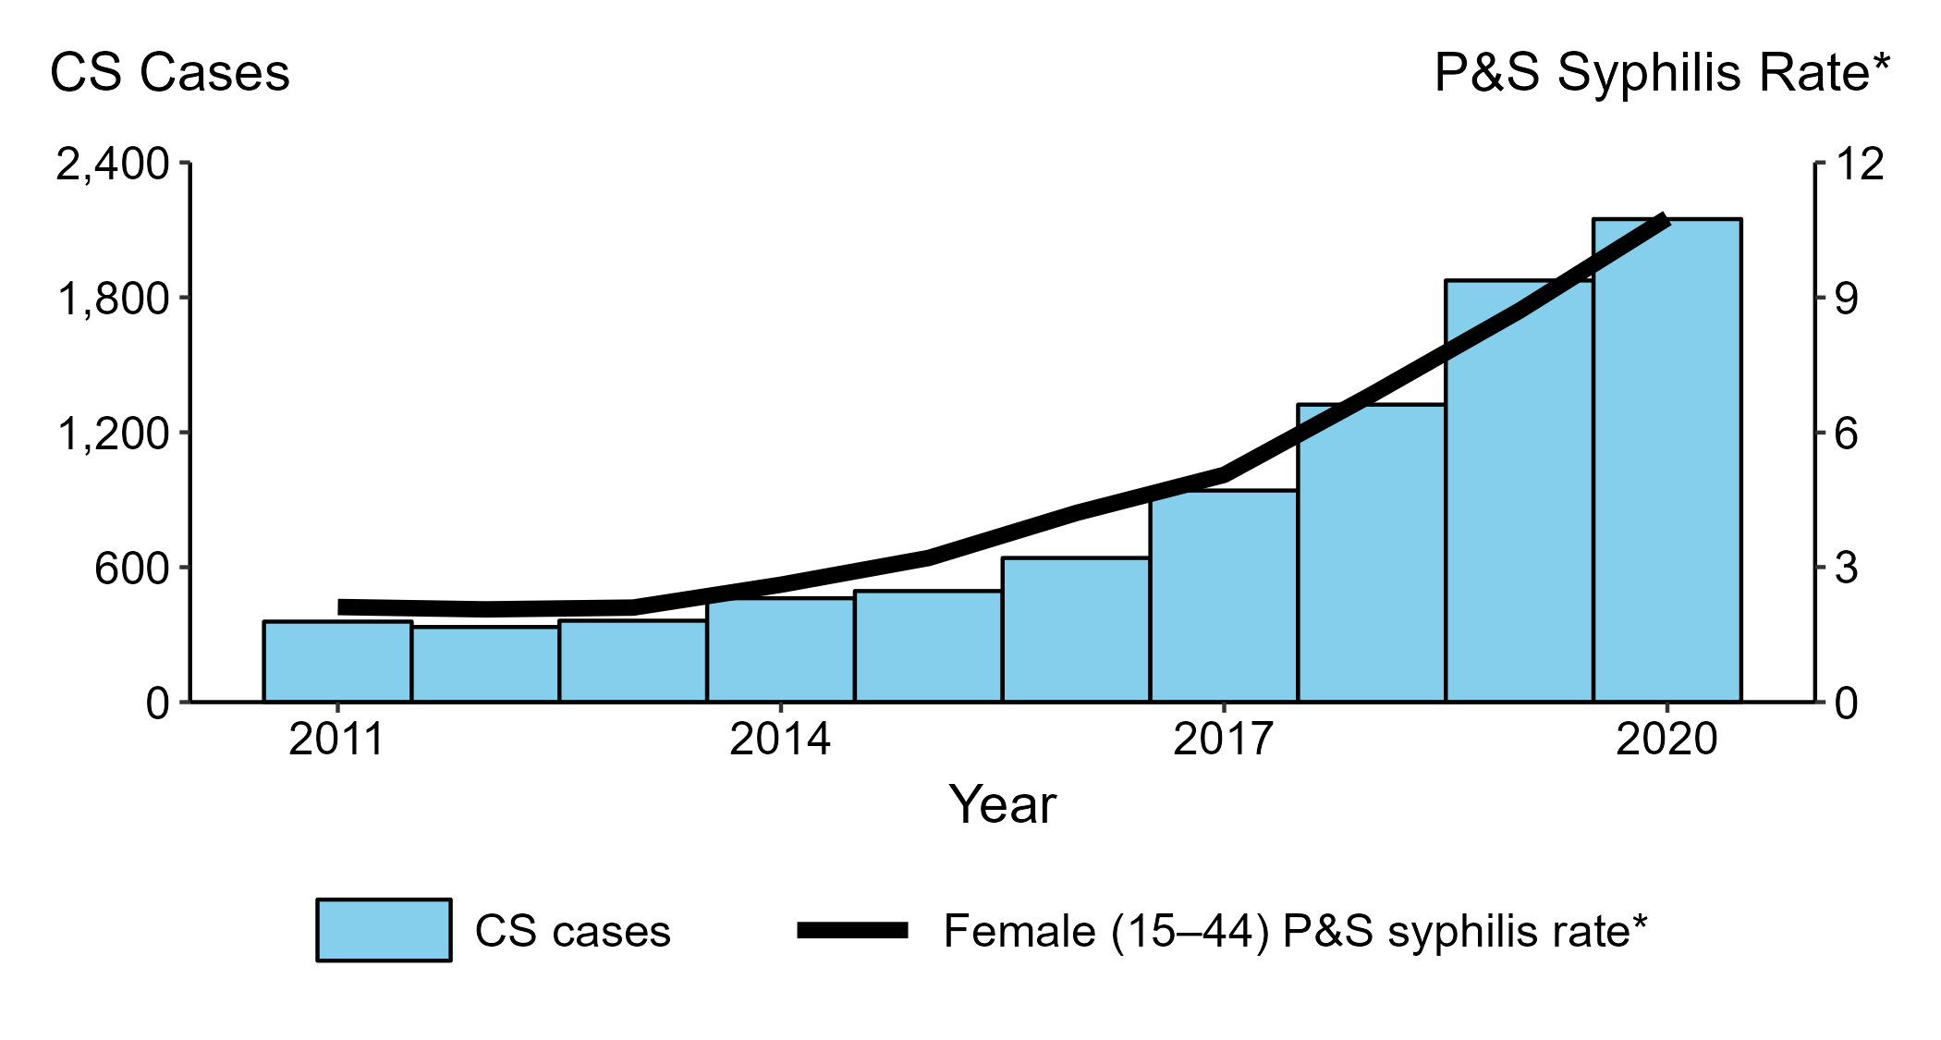
Congenital Syphilis — Reported Cases by Year of Birth and Rates of Reported Cases of Primary and Secondary Syphilis Among Women Aged 15–44 Years, United States, 2011–2020
* Per 100,000
ACRONYMS: CS = Congenital syphilis; P&S = Primary and secondary syphilis

Slide 44
Congenital Syphilis — Reported Cases by Year of Birth and Rates of Reported Cases of Primary and Secondary Syphilis Among Women Aged 15–44 Years, United States, 2011–2020
2,148 Cases
500% increase
358 Cases
* Per 100,000
ACRONYMS: CS = Congenital syphilis; P&S = Primary and secondary syphilis

Slide 45
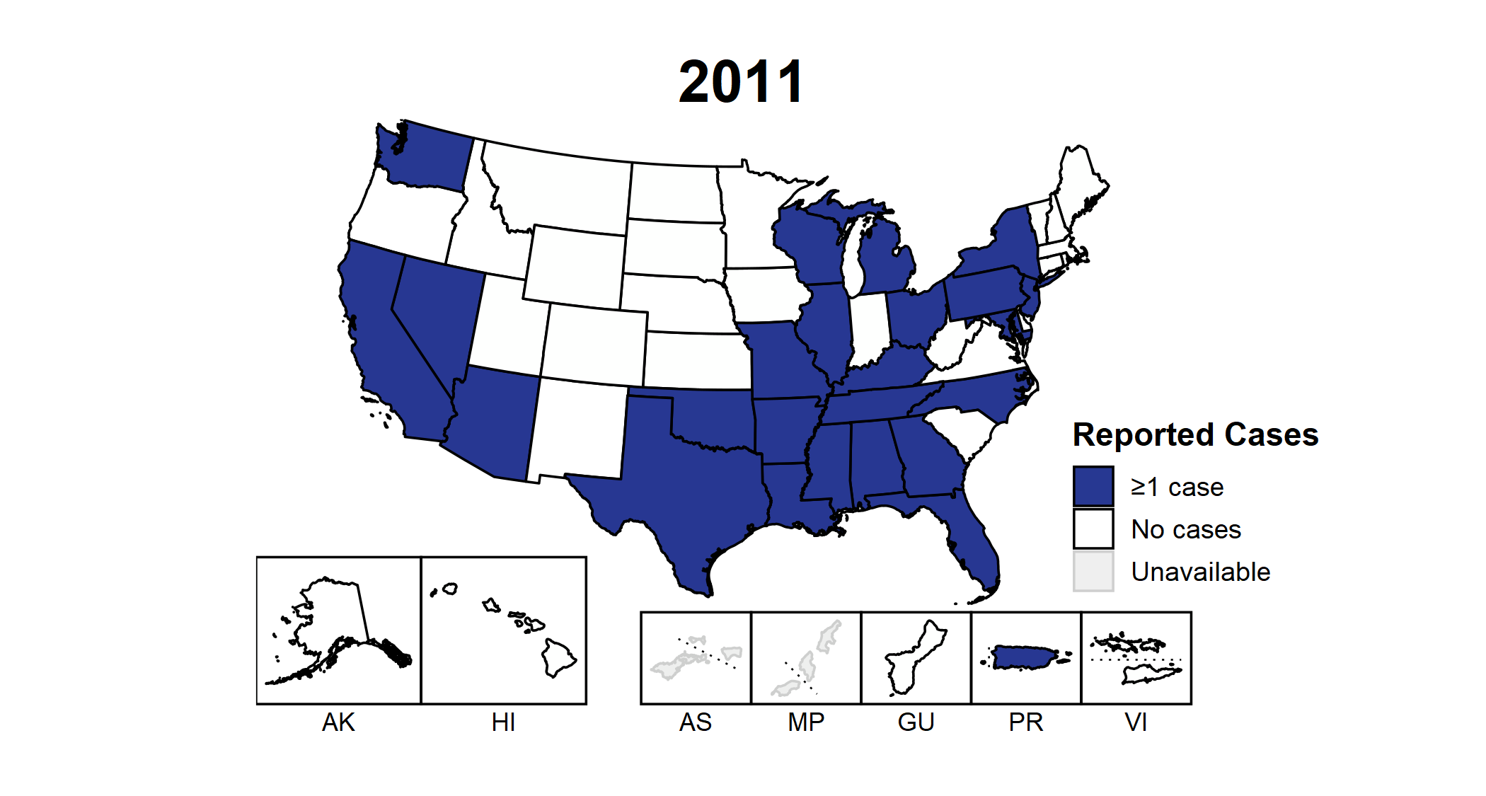
Congenital Syphilis — Reported Cases by State, United States and Territories, 2011–2020

Slide 46
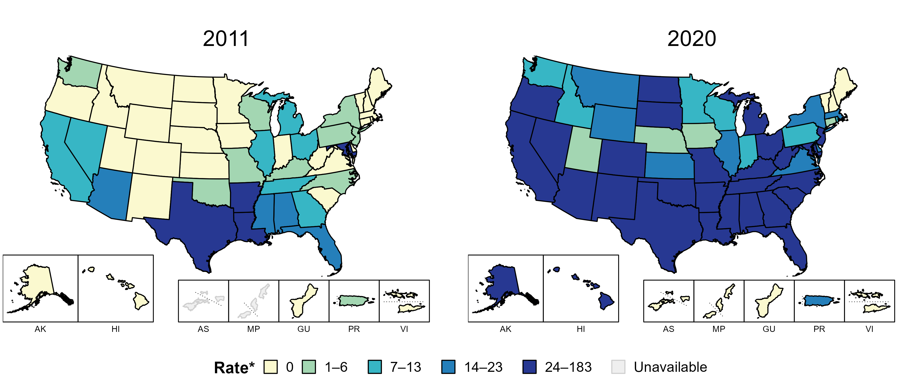
Congenital Syphilis — Rates of Reported Cases by State, United States and Territories, 2011 and 2020
* Per 100,000 live births

Slide 47
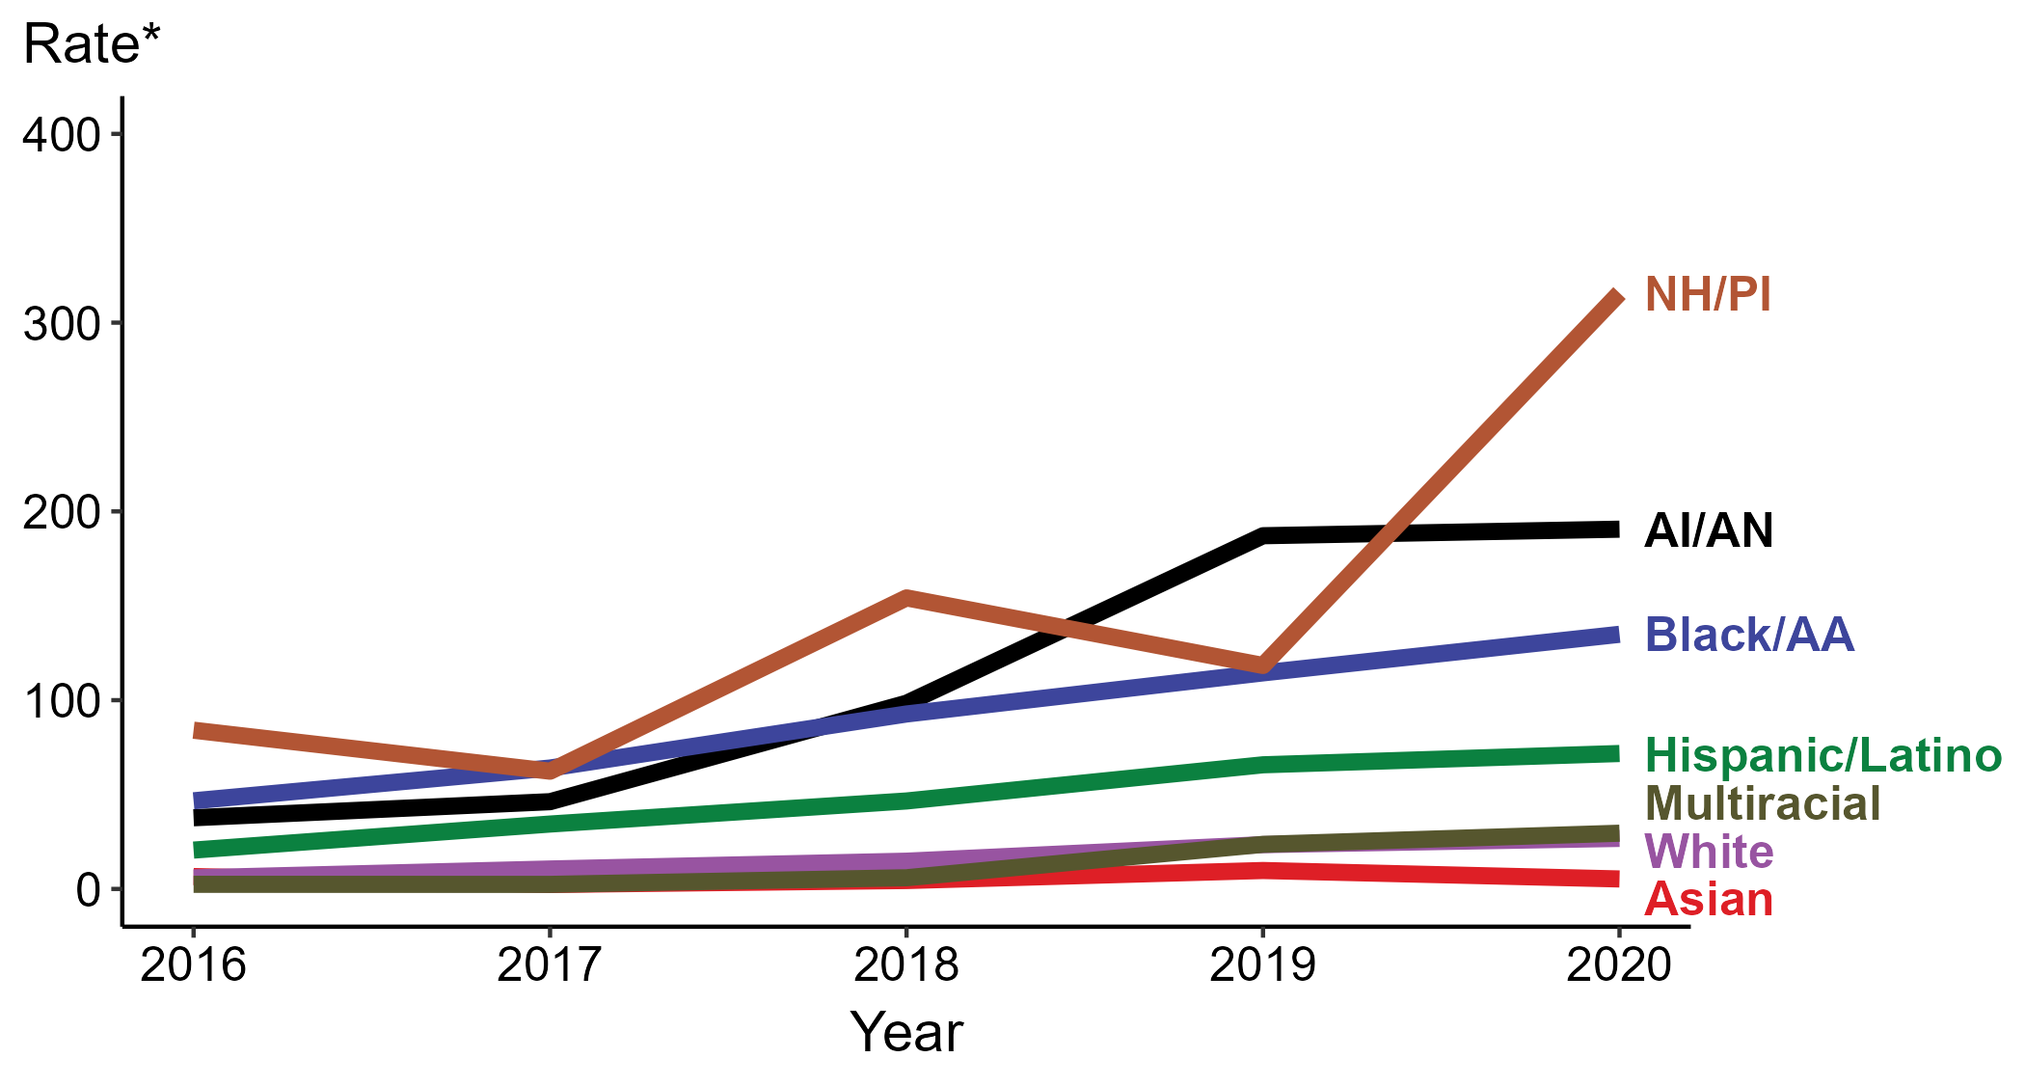
Congenital Syphilis — Rates of Reported Cases by Year of Birth, Race/Hispanic Ethnicity of Mother, United States, 2016–2020
* Per 100,000 live births
ACRONYMS: AI/AN = American Indian/Alaska Native; Black/AA = Black or African American; NH/PI = Native Hawaiian/Pacific Islander

Slide 48
Congenital Syphilis — Rates of Reported Cases by Year of Birth, Race/Hispanic Ethnicity of Mother, United States, 2016–2020
* Per 100,000 live births
ACRONYMS: AI/AN = American Indian/Alaska Native; Black/AA = Black or African American; NH/PI = Native Hawaiian/Pacific Islander

Slide 49
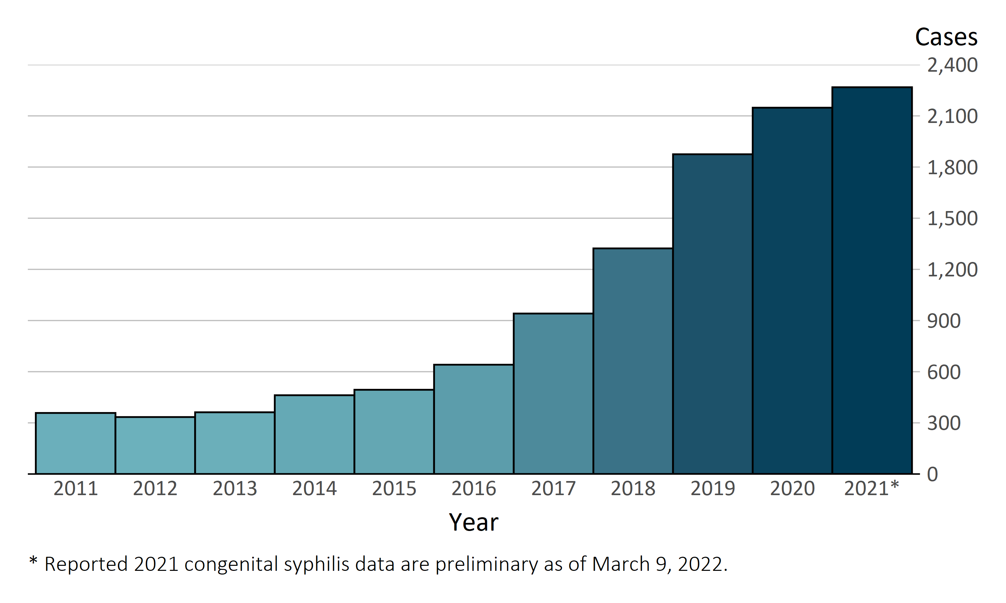
In the United States, 2,268 infants born in 2021* have already been reported as cases of congenital syphilis
Congenital Syphilis — Reported Cases by Year of Birth, United States, 2011–2021*

Slide 50
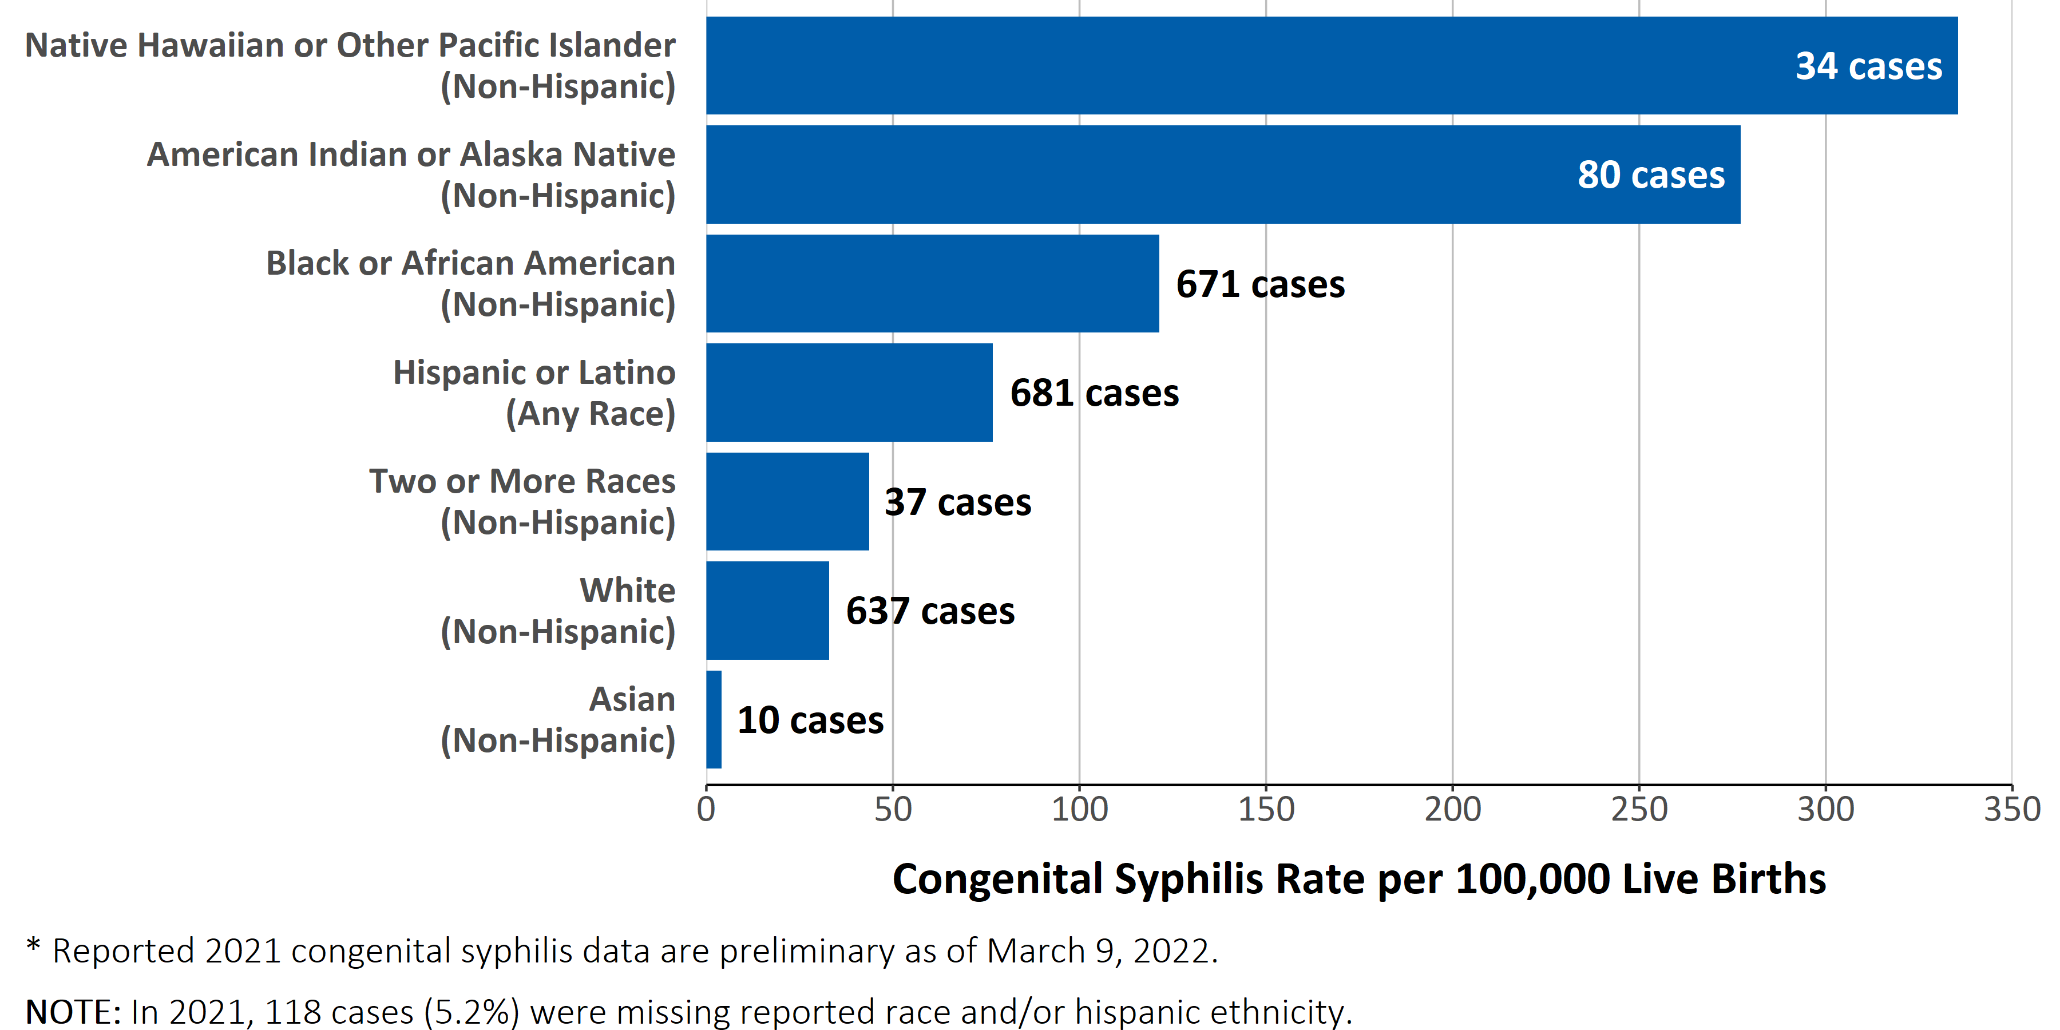
Racial and ethnic disparities in rates of reported congenital syphilis continued to persist in 2021*
Congenital Syphilis — Case Counts and Rates of Reported Cases by Race and Hispanic Ethnicity, United States, 2021*

Slide 51
Racial and ethnic disparities in rates of reported congenital syphilis continued to persist in 2021*
Congenital Syphilis — Case Counts and Rates of Reported Cases by Race and Hispanic Ethnicity, United States, 2021*

Slide 52
Syphilis in Pregnancy

Slide 53
Syphilis in Pregnancy
#SyphilisIsHard

Slide 54
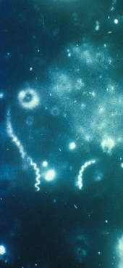
Syphilis Diagnosis
Direct detection tests for syphilis are not widely available.
Darkfield microscopy
Polymerase chain reaction (PCR)
Direct fluorescent antibody test for T. pallidum (DFA-TP)
Syphilis is usually diagnosed with serologic tests.
2021 STI Treatment Guidelines
T. pallidum on Darkfield

Slide 55
There are two types of serologic tests for syphilis.
Tests | Non-Treponemal | Treponemal
Examples | RPR, VDRL | FTA-ABS, TPPA, EIA, CIA
Method | Detects NON-specific antibodies caused by inflammation | Detects specific antibodies against T. pallidum
Results | Quantitative | Qualitative
Positivity | Positive in active disease* | Remains positive forever (85%)
*Can have false negative in early disease
2021 STI Treatment Guidelines

Slide 56
BOTH a treponemal test and a nontreponemal test are needed to confirm the diagnosis of syphilis.
2021 STI Treatment Guidelines

Slide 57
Because early syphilis treatment decreases transmission possibility, public health standards require health-care providers to presumptively treat any patient with a suspected case of infectious syphilis at the initial visit, even before test results are available
2021 STI Treatment Guidelines

Slide 58
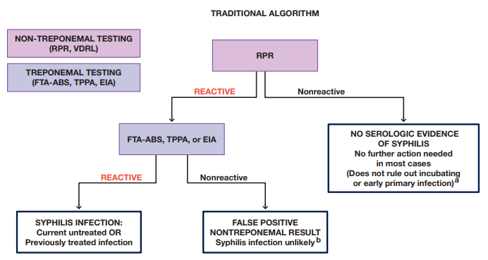
The Diagnosis, Management and Prevention of Syphilis (nycptc.org)

Slide 60
The Diagnosis, Management and Prevention of Syphilis (nycptc.org)

Slide 61
The Diagnosis, Management and Prevention of Syphilis (nycptc.org)

Slide 62
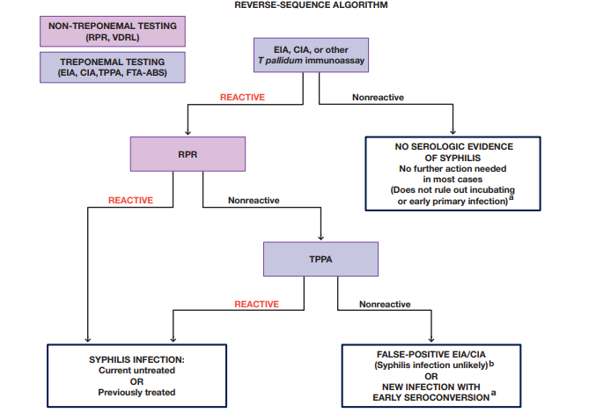
The Diagnosis, Management and Prevention of Syphilis (nycptc.org)

Slide 63
The Diagnosis, Management and Prevention of Syphilis (nycptc.org)

Slide 64
The Diagnosis, Management and Prevention of Syphilis (nycptc.org)

Slide 65
The Diagnosis, Management and Prevention of Syphilis (nycptc.org)

Slide 66
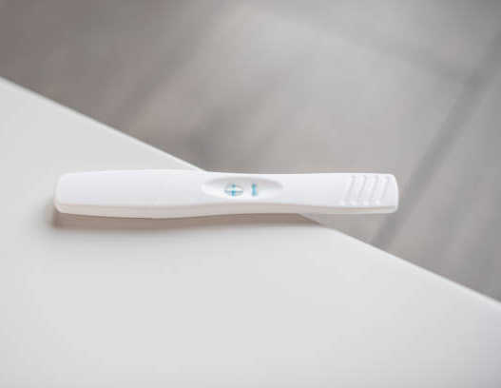
Testing Early in Pregnancy
All pregnant people should be tested for syphilis early in pregnancy.
Most states mandate testing at the first prenatal visit.
Consider testing at the time pregnancy confirmation if follow up may be an issue.
2021 STI Treatment Guidelines

Slide 67
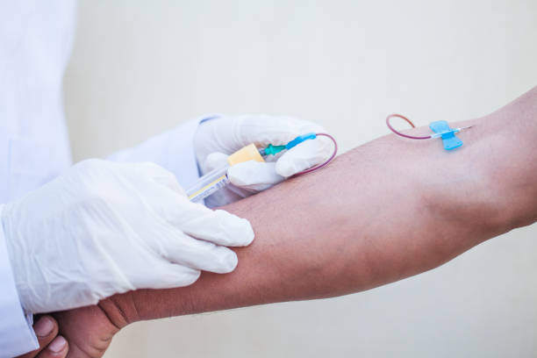
Repeat Testing at 28-Weeks and Delivery
For pregnant people in high prevalence areas or who are at high individual risk, retesting at 28 weeks and delivery is recommended.
Individual risk factors include:
Multiple prior STIs
Recent incarceration
Substance misuse
Homelessness
Transactional sex
CDC STD Treatment Guidelines
USPSTF: Screening for Syphilis infection in Pregnant Women

Slide 68
Repeat Testing at 28-Weeks and Delivery
For pregnant people in high prevalence areas or who are at high individual risk, retesting at 28 weeks and delivery is recommended.
Individual risk factors include:
Multiple prior STIs
Recent incarceration
Substance misuse
Homelessness
Transactional sex
* Consider sexual networks!
CDC 2021 STI Treatment Guidelines
USPSTF: Screening for Syphilis infection in Pregnant Women

Slide 69

Screening at Delivery
All high-risk people should be screened at delivery.
High prevalence or individual risk factors including:
Multiple prior STIs
Recent incarceration
Substance misuse
Homelessness
Transactional sex
2021 STI Treatment Guidelines

Slide 70
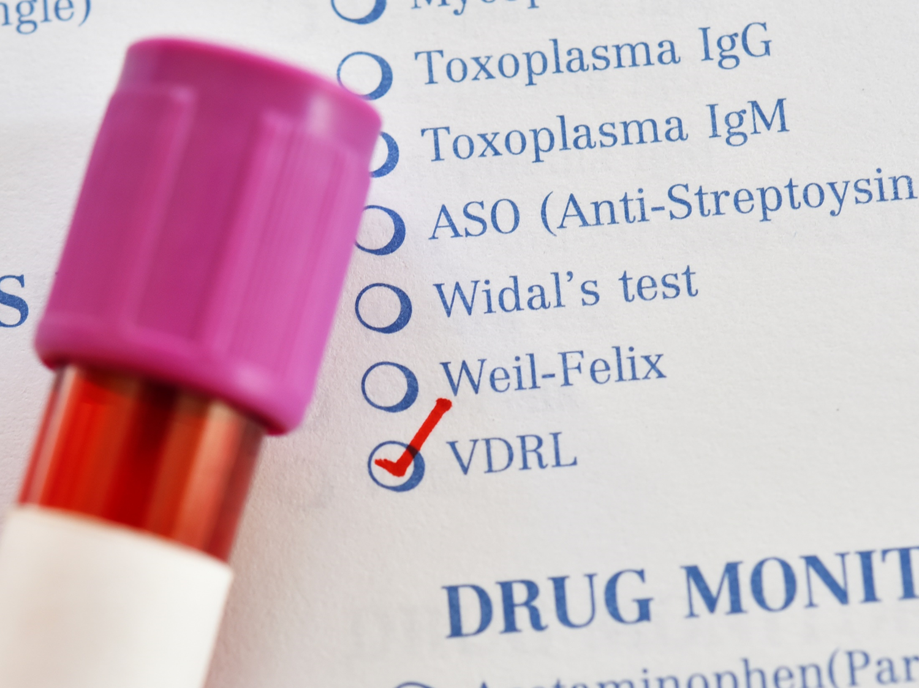
No mother or baby should be discharged from the hospital without documentation of maternal syphilis testing during pregnancy, and again at delivery if high risk.
2021 STI Treatment Guidelines

Slide 71
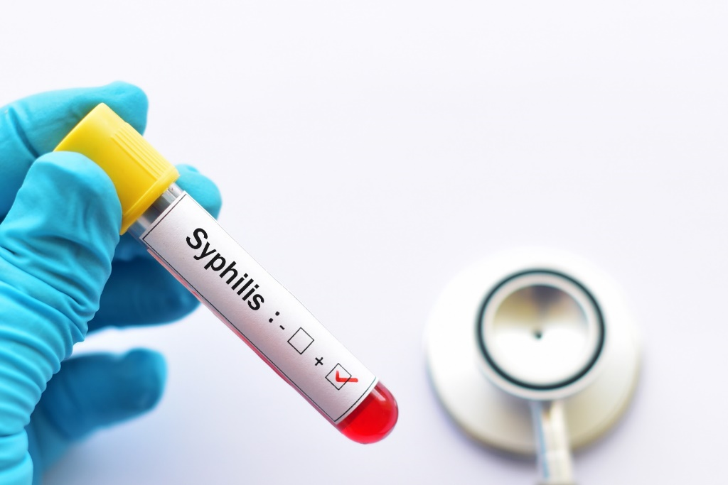
Stillbirth
All people who have a fetal death at ≥20 weeks should be tested for syphilis.
2021 STI Treatment Guidelines

Slide 72
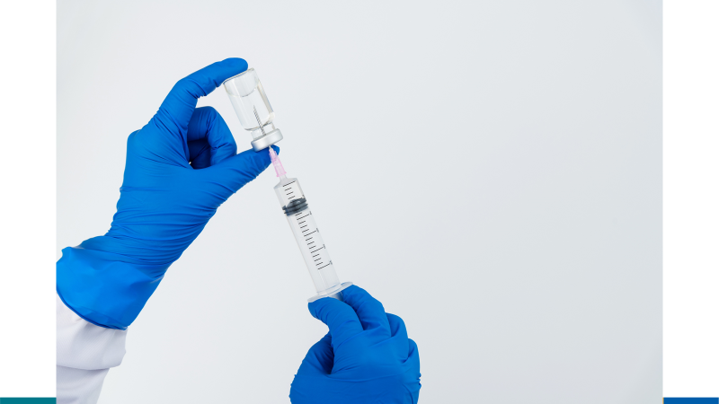
Penicillin G is the only known effective antimicrobial for preventing maternal transmission to the fetus and for treating fetal infection.
2021 STI Treatment Guidelines

Slide 73
Recommended Regimens for Penicillin G in Pregnancy
Early Syphilis (primary, secondary, and early latent)
2.4 million units x 1 dose
Late or Unknown Duration Syphils
2.4 million units x 3 at 1-week intervals
Optimal treatment interval: 7 days
Acceptable treatment interval: up to 9 days
*Treatment must be initiated 30 days before delivery to prevent congenital syphilis.
2021 STI Treatment Guidelines

Slide 74
Recommended Regimens for Penicillin G in Pregnancy
Early Syphilis (primary, secondary, and early latent)
2.4 million units x 1 dose
Late or Unknown Duration Syphils
2.4 million units x 3 at 1-week intervals
Pregnant people who have a history of penicillin allergy should be desensitized and treated with penicillin.
2021 STI Treatment Guidelines

Slide 75
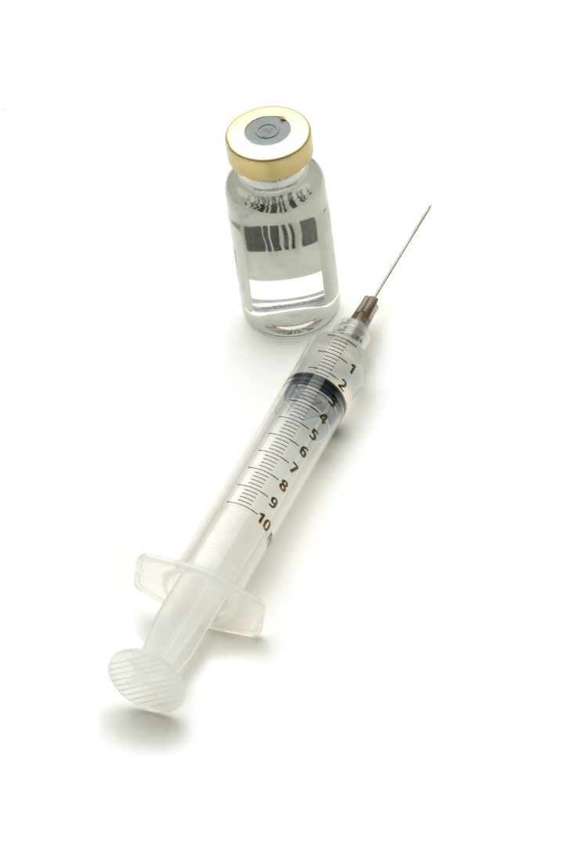
Adequate Maternal Treatment of Syphilis
Completion of a penicillin-based regimen
Appropriate for the mother’s stage of syphilis
Initiated ≥30 days before delivery
Identification of maternal syphilis must occur ≥ 30 days before delivery to prevent congenital syphilis.
2021 STI Treatment Guidelines

Slide 76
Adequate maternal treatment during pregnancy is efficacious in preventing CS.
Alexander JM, Sheffield JS, Sanchez PJ, Mayfield J, Wendel GD, Jr. Efficacy of treatment for syphilis in pregnancy. Obstetrics and gynecology. 1999;93(1):5-8.

Slide 77
Syphilis Treatment Follow-Up
Follow-up titers are compared to the titer obtained on day of treatment
Adequate treatment response is a four-fold decrease in titer
Consult infectious diseases as needed
Having syphilis does not protect a person from getting syphilis again!
Matthias J, Sanon R, Bowen VB, Spencer EC, Peterman TA. Syphilitic Reinfections During the Same Pregnancy - Florida, 2018. Sexually transmitted diseases. 2020.

Slide 78
Congenital Syphilis Prevention
Kimball A, et al. Missed Opportunities for Prevention of Congenital Syphilis — United States, 2018. MMWR, 2020.

Slide 79
Missed Opportunities for CS Prevention - 2018
No timely prenatal care and no timely syphilis testing | 28%
No timely syphilis testing despite receipt of timely prenatal care | 9%
No adequate treatment despite a timely syphilis diagnosis | 30%
Late seroconversion during pregnancy | 11%
Clinical evidence of CS despite adequate maternal treatment | 4%
Insufficient information | 18%

Slide 80
Missed Opportunities for CS Prevention - 2018
No timely prenatal care and no timely syphilis testing | 28%
No timely syphilis testing despite receipt of timely prenatal care | 9%
No adequate treatment despite a timely syphilis diagnosis | 30%
Late seroconversion during pregnancy | 11%
Clinical evidence of CS despite adequate maternal treatment | 4%
Insufficient information | 18%

Slide 81
Missed Opportunities for CS Prevention - 2018
No timely prenatal care and no timely syphilis testing | 28%
No timely syphilis testing despite receipt of timely prenatal care | 9%
No adequate treatment despite a timely syphilis diagnosis | 30%
Late seroconversion during pregnancy | 11%
Clinical evidence of CS despite adequate maternal treatment | 4%
Insufficient information | 18%

Slide 82
Missed prevention opportunities vary by region
136

Slide 83
Recommendations to Address the Missed Opportunities
No timely prenatal care No timely syphilis testing | - Identify pregnant people with syphilis outside of prenatal care - Reduce barriers to prenatal care and family planning
Outside of Prenatal Care:
Emergency departments
Urgent care
Pregnancy crisis centers
Substance use treatment centers
Correctional facilities

Slide 84
Recommendations to Address the Missed Opportunities
No timely prenatal care No timely syphilis testing | - Identify pregnant people with syphilis outside of prenatal care - Reduce barriers to prenatal care and family planning
No timely syphilis testing despite timely prenatal care | - Screen all pregnant people at the first prenatal visit

Slide 85
Recommendations to Address the Missed Opportunities
No timely prenatal care No timely syphilis testing | - Identify pregnant people with syphilis outside of prenatal care - Reduce barriers to prenatal care and family planning
No timely syphilis testing despite timely prenatal care | - Screen all pregnant people at the first prenatal visit
No adequate treatment despite timely syphilis diagnosis | - Immediate follow-up of positive syphilis test results - Reduce barriers to adequate syphilis treatment - Partner with the health department

Slide 86
Recommendations to Address the Missed Opportunities
No timely prenatal care No timely syphilis testing | - Identify pregnant people with syphilis outside of prenatal care - Reduce barriers to prenatal care and family planning
No timely syphilis testing despite timely prenatal care | - Screen all pregnant people at the first prenatal visit
No adequate treatment despite timely syphilis diagnosis | - Immediate follow-up of positive syphilis test results - Reduce barriers to adequate syphilis treatment
Late seroconversion | - Repeat screening at 28 weeks and delivery in high prevalence areas or for people with high risk - Educate patients and encourage condoms

Slide 87
Implications for Public Health
Collaboration between public health and health care
Understand local missed prevention opportunities
Implement tailored prevention efforts

Slide 88
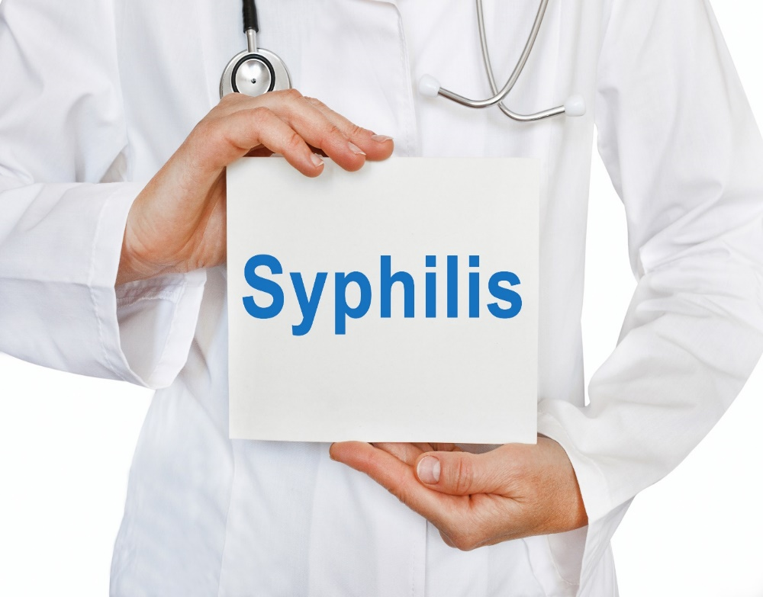
The Clinician’s Role: Personal Practice
Test everyone at first prenatal care visit
Treat people immediately
Encourage partner treatment
Repeat testing at 28 weeks and delivery
Condoms!
Test people outside of prenatal care

Slide 89
The Clinician’s Role: Collaboration
Improve clinical documentation
Report immediately to health department
Understand missed opportunities
Partner with public health

Slide 90

Resources
CDC Division of STD Prevention: cdc.gov/std/default.html
CDC STD Surveillance Report: https://www.cdc.gov/std/statistics/2020/default.htm
2021 STI Treatment Guidelines: https://www.cdc.gov/std/treatment-guidelines/default.htm
National Network of STD Prevention Training Centers: www.nnptc.org www.STDCCN.org
National Coalition for Sexual Health: www.ncshguide.org/providers
National STD Curriculum: www.std.uw.edu

Slide 91
Resources
CDC Division of STD Prevention: cdc.gov/std/default.html
CDC STD Surveillance Report: https://www.cdc.gov/std/statistics/2020/default.htm
2021 STI Treatment Guidelines: https://www.cdc.gov/std/treatment-guidelines/default.htm
National Network of STD Prevention Training Centers: www.nnptc.org www.STDCCN.org
National Coalition for Sexual Health: www.ncshguide.org/providers
National STD Curriculum: www.std.uw.edu

Slide 92
Resources
CDC Division of STD Prevention: cdc.gov/std/default.html
CDC STD Surveillance Report: https://www.cdc.gov/std/statistics/2020/default.htm
2021 STI Treatment Guidelines: https://www.cdc.gov/std/treatment-guidelines/default.htm
National Network of STD Prevention Training Centers: www.nnptc.org www.STDCCN.org
National Coalition for Sexual Health: www.ncshguide.org/providers
National STD Curriculum: www.std.uw.edu

Slide 93
Resources
CDC Division of STD Prevention: cdc.gov/std/default.html
CDC STD Surveillance Report: https://www.cdc.gov/std/statistics/2020/default.htm
2021 STI Treatment Guidelines: https://www.cdc.gov/std/treatment-guidelines/default.htm
National Network of STD Prevention Training Centers: www.nnptc.org www.STDCCN.org
National Coalition for Sexual Health: www.ncshguide.org/providers
National STD Curriculum: www.std.uw.edu

Slide 94
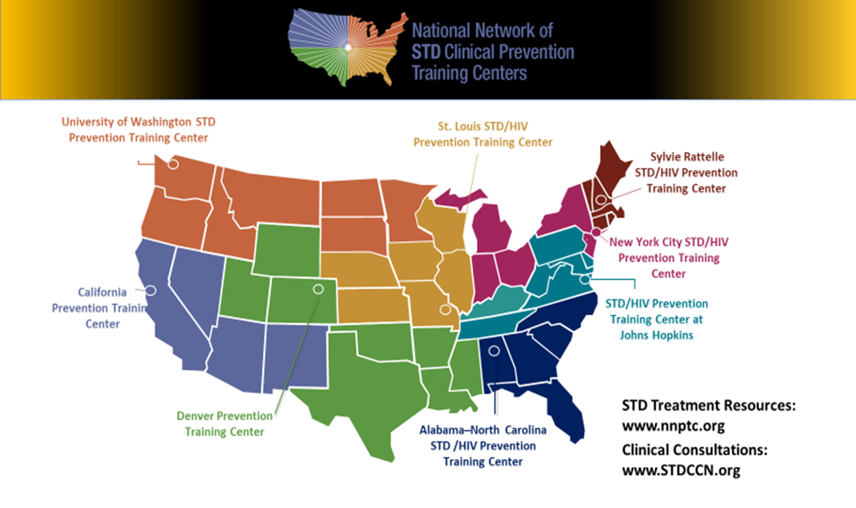

Slide 95
Thank you

