Slide 1
Indian Country Infectious Disease ECHO
COVID-19 Update
Jonathan Vilasier Iralu, MD, FACP, FIDSA
Indian Health Service Chief Clinical Consultant
for Infectious Diseases

Slide 2
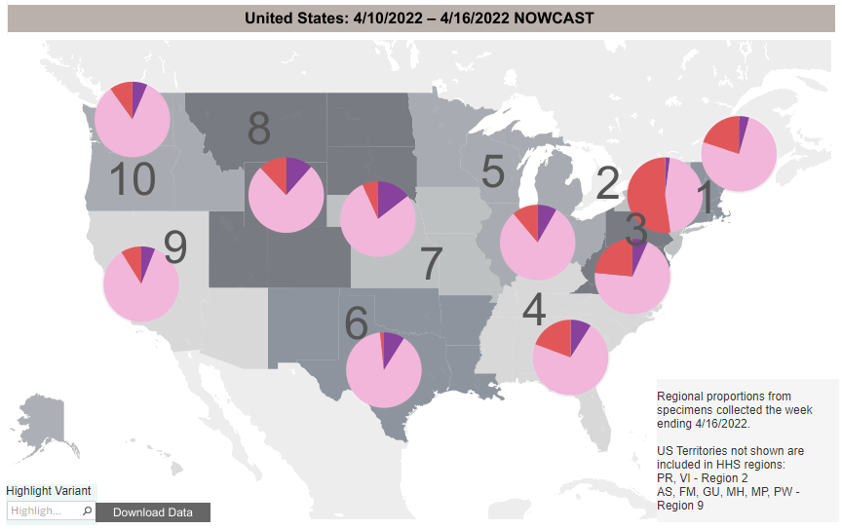
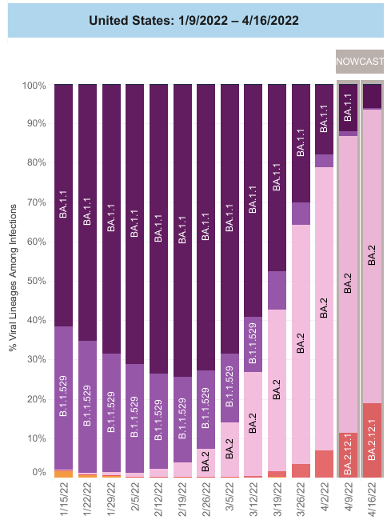
Virology: BA.2 is, unfortunately, in the pink
https://covid.cdc.gov/covid-data-tracker/#variant-proportions

Slide 3
Variant shift therapeutic implications
Sotrovimab no longer authorized for use anywhere in the US
Preferred drugs of choice recommended by NIH 4/1/2022
  Nirmatrelvir/r for 5 days (< 5 days of symptom onset)
  Remdesivir daily for 3 days (< 7 days of symptom onset)
Alternate Rx: (only recommended if preferred options not available
  Bebtelovimab IV x 1 (< 7 days of symptom onset)
  Molnupiravir (< 5 days of symptom onset)
https://www.covid19treatmentguidelines.nih.gov/management/clinical-management/nonhospitalized-adults--therapeutic-management/

Slide 4
Oral Nirmatrelvir for High Risk,
Non-hospitalized adults with Covid-19
EPIC-HR investigators (Hammond et al, NEJM, 4/14/2022)
  Randomized 2246 to Main Protease M^{pro} inhibitor Nirmatrelvir vs placebo
    If within 3 days of symptom onset, RR reduction for hospitalization/death was 89%
    Observed 0 deaths with the drug vs 7 with placebo
    Side effects 22.6% with drug vs 23.9% with placebo
    Dysgeusia and diarrhea were more common with the drug than with placebo
https://www.nejm.org/doi/full/10.1056/NEJMoa2118542

Slide 5
AI/AN Mortality Disparities
In-Hospital Mortality Disparities among AI/AN, Black and White patients with COVID-19.
  Musshafen et al, Jama Network Open, 3/30/2022, University of Mississippi
  Retrospective analysis of the Mississippi Inpatient Outpatient Data System:
    all adults > 18 years old, hospitalized with COVID 3/1/2020-12/31/2020
    18,731. hospitalized: 1.2% AI/AN, 49.1% Black, 48.7% White
    Black patients had a 75% lower odds of in-hospital mortality compared with AI/AN (OR 0.25)
    White patients had a 77% lower odds of in-hospital mortality compared with AI/AN (OR 0.23)
    AI/AN with COVID-19 had lower co-morbidity risk scores that Black or white patients
    “Despite empirical associations between reduced comorbidity risk scores and reduced odds of inpatient mortality, AI/AN patients were significantly more likely to die in the hospital of COVID-19 than Black or White patients at every level of comorbidity risk”
https://jamanetwork.com/journals/jamanetworkopen/fullarticle/2790506?widget=personalizedcontent&previousarticle=347063

Slide 6
Does COVID-19 cause DM in children?
  Risk for Newly Diagnosed Diabetes > 30 Days After SARS-CoV-2 Infection among Persons Aged < 18 year. Barrett et al, MMWR Jan 14, 2022/Vol 71/No.2
  Analyzed claims for patients with COVID-19 in
    IQVIA database: patients with COVID-19 diagnosis 3/1/2020-2/26/2021
    Health Verity database: patients with any encounter possibly related to COVID 2/2020-6/2021
  Hazard ratio for new DM diagnosis was
    2.66 (IQVA) compared with nondiabetics
    1.31 (HealthVerity) compared with nondiabetics
  Hazard ratio for new DM diagnosis was 2.16 in IQVIA cohort c/w pre pandemic non-COVID acute respiratory illness patients
    https://www.cdc.gov/mmwr/volumes/71/wr/mm7102e2.htm

Slide 7
How about in Adults?
Newly diagnosed diabetes vs pre-existing diabetes upon admission for COVID-1
Cromer et al, J of DM and Its Complications, 2022
  Reviewed 1902 adult admissions for COVID at Mass General 3/1/20-9/27/20
  Used A1c > 6.5% or ICD coding to define pre-admission DM and glucose > 300 to define new DM in previously undiagnosed patients
  594 (31.2%) had preexisting DM and 77 had new DM (13% of total)
  42.9% of those with new DM had a history of prediabetes before admission
  New DM were younger, less likely to be non-Hispanic White, and to have HTN, CAD, CHF, and CKD
  New DM patients had lower random glucose and A1c but higher CRP, ferritin, LDH, AST &ALT
  Stress hyperglycemia is suggested as the likely mechanism
  Half had regression of DM at follow-up
  https://pubmed.ncbi.nlm.nih.gov/35148936/

Slide 8
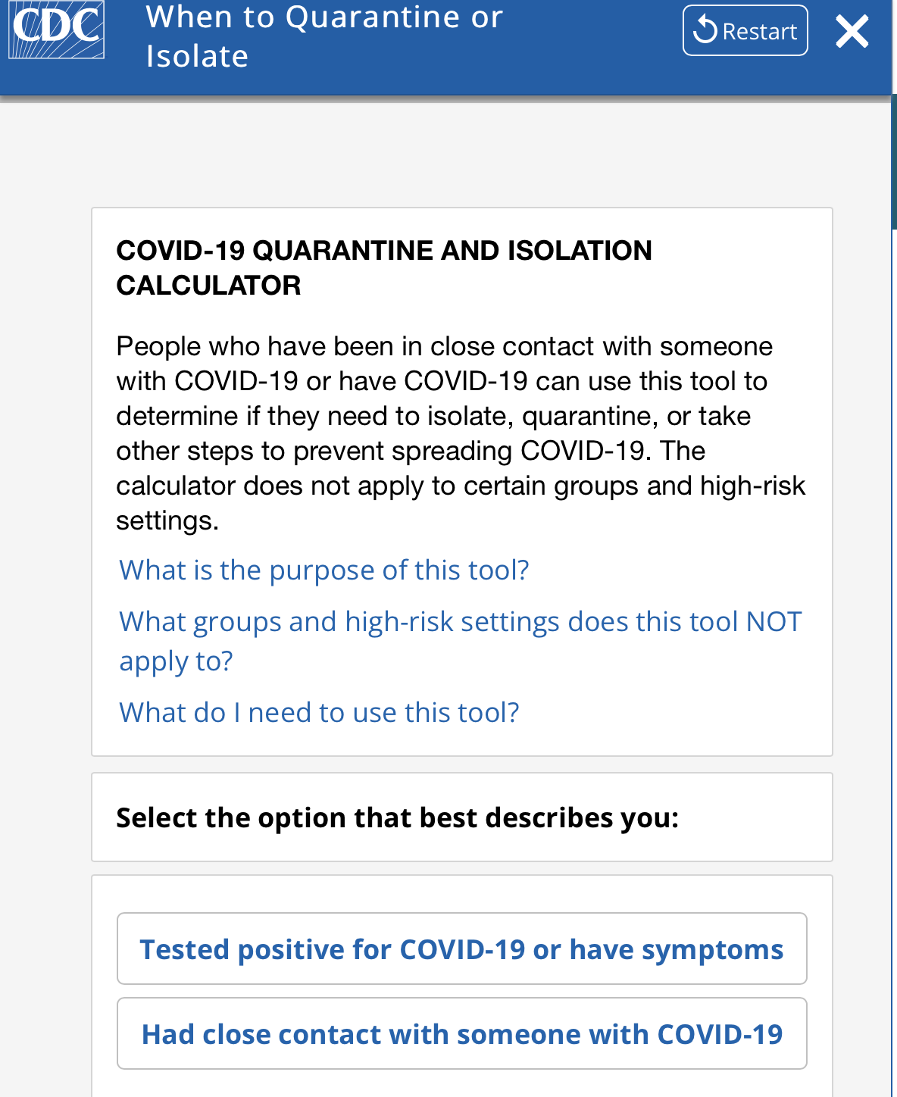
New CDC quarantine/isolation calculator
Designed to help people with COVID-19 quarantine and isolation
https://www.cdc.gov/coronavirus/2019-ncov/your-health/quarantine-isolation.html#

Slide 9
Vaccine Update
Update March 29, 2022
Second mRNA booster allowed for persons over age 50 or who are immunocompromised at least 4 months since the initial booster
Persons who received J and J vaccine and a booster dose at least 4 months ago may receive a second booster with an mRNA vaccine

Slide 10
Vaccine Update:
To boost or not to boost…
Fourth Dose of BNT162b2 mRNA Covid-19 Vaccine in a Nationwide Setting. (Magen et al, NEJM. 4/13/2022)
  Analyzed 182,122 individuals in Israel, age > 60, re-boosted after 4 months
  Only had 30 days of follow up
  Vaccine effectiveness during Omicron wave:
    45% against PCR positive infection
    55% against symptomatic COVID-19
    74% against death
https://www.nejm.org/doi/full/10.1056/NEJMoa2201688

Slide 11


