Slide 1
Pharm SUD ECHO Didactic Presentation: Caring for Dual Diagnosis Patients in Indian Country
CDR Sharyl Trail, PsyD
Deputy Regional Administrator
HRSA Region6 – Dallas
strail@hrsa.gov

Slide 2
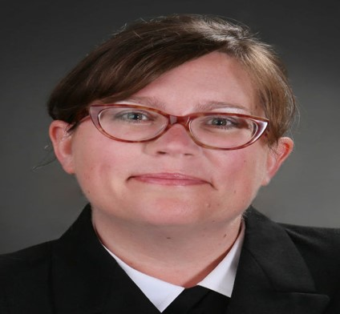
A little bit about your presenter…..
Licensed Clinical Psychologist
HRSA Region 6 Deputy Regional Administrator - May 2021
12 years as a psychologist Officer in the US Public Health Service Commissioned Corps.
Clinician, clinical supervisor, and healthcare administrator at four FQHC look-a-like Indian Health Service PC clinics. NHSC Loan Award Recipient
Deployed multiple times to natural disasters and COVID response providing Force Health Protection
Notes:
Steven C. Richards
Texas, Arkansas, Louisiana state lead
Regional point of contact for behavioral health, HIV and AIDS, COVID-19 HUD/HRSA partnership
Rachel Piotrowski
New Mexico and Oklahoma state lead and lead for the 68 federally recognized tribes in the region
Regional point of contact for rural health, telehealth, MCH, opioids

Slide 3
Learning Objectives
Define dual diagnosis including primary symptoms and treatment options.
Identify treatment models including Medication Assisted Treatment (MAT) & Integrated Care
Learn how to support communities and prevent overdose.

Slide 4

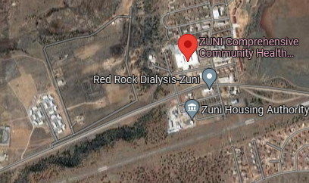




Zuni, NM – Staff Psychologist

Slide 5
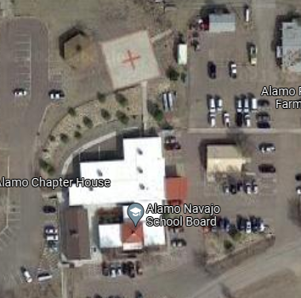

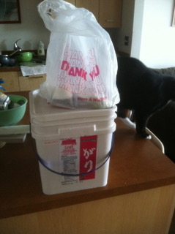


Alamo Navajo, NM – BH Director/Clinician

Slide 6



Klamath Tribal Health, KF OR – BH Director/Clinician

Slide 7
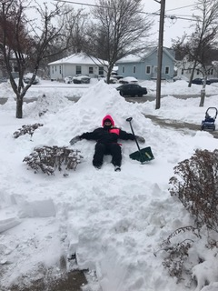


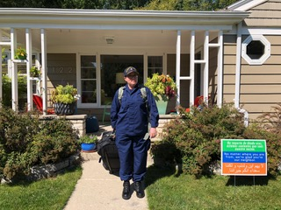
Oneida Nation Green Bay, WI –
Dir. Of Training/Clinician

Slide 8
Dual Diagnosis/Co-occurring Disorders
NAMI Definition: Substance use disorders — the repeated misuse of alcohol and/or drugs — often occur simultaneously in individuals with mental illness, usually to cope with overwhelming symptoms.
Dual-Diagnosis-FS.pdf (nami.org)
NIH: When two disorders or illnesses occur in the same person, simultaneously or sequentially, they are described as comorbid. Comorbidity also implies that the illnesses interact, affecting the course and prognosis of both.
Part 1: The Connection Between Substance Use Disorders and Mental Illness | National Institute on Drug Abuse (NIDA) (nih.gov)

Slide 9
Causality & Directionality
Three main pathways can contribute to the comorbidity between substance use disorders and mental illnesses:
Common risk factors can contribute to both mental illness and substance use and addiction.
Mental illness may contribute to substance use and addiction.
Substance use and addiction can contribute to the development of mental illness.

Slide 10
Dual Diagnosis Facts
About half of those who experience a mental illness during their lives will also experience a substance use disorder and vice versa (including youth)
Drug Use and Mental Health Disorders in Childhood or Adolescence Increases Later Risk
  Some research has found that mental illness may precede a substance use disorder, suggesting that better diagnosis of youth mental illness may help reduce comorbidity.
  Untreated Childhood ADHD Can Increase Later Risk of Drug Problems

Slide 11
Risk Factors for Co-occurring Disorders
Genetic Vulnerabilities (Family History)
Epigenetic Influences (powerful ways that genetic and environmental factors interact at the molecular level.)
  Intergenerational Transmission
Environmental Influences
  chronic stress, trauma, and adverse childhood experiences
Stress
Trauma and Adverse Childhood Experiences

Slide 12
Treatments for comorbid substance use disorder and mental health conditions
Collaboration between clinical providers (integrated care/screening) and organizations that provide supportive services, education, community safety (interdisciplinary & Interagency).
Levels of Care: Detox; Inpatient; Intensive Outpatient; Outpatient; Education
Treatment and Recovery Best Practices | Best Practices in Use (ihs.gov)
DBH Programs | Division of Behavioral Health (ihs.gov)
Information and Tools for Providers | Alcohol and Substance Abuse Program (ihs.gov)

Slide 13
Co-occurring Disorders and Pain
Chronic pain is a physical problem that has a complex relationship with substance use disorders.
Chronic pain and associated emotional distress are thought to dysregulate the brain’s stress and reward circuitry, increasing the risk for opioid use disorder.
Pain Management | Indian Health Service (IHS)
Chronic pain and childhood trauma - Harvard Health
TIP 54: Managing Chronic Pain in Adults With or in Recovery From Substance Use Disorders | SAMHSA

Slide 14
Prevention and Community Support
GONA – Gathering of Native Americans
  Belonging, mastery, interdependence, generosity
Gathering of Native Americans Fact Sheet (samhsa.gov)
Project Venture – Youth primary prevention
  Be here, be safe, speak your truth, let go and move on
Project Venture – Adventure with an Indigenous Mind
Positive Indian Parenting
About PIP » NICWA

Slide 15
THANK YOU!
Reach out any time.
strail@hrsa.gov
CDR Sharyl Trail, PsyD

