Slide 1



Key Updates in the 2021 CDC STI Treatment Guidelines:
Gonorrhea, Chlamydia
Hilary Reno, MD, PhD
Associate Professor, Washington U in St. Louis
Medical Consultant, CDC, DSTDP
Medical Director, StL STI/ HIV PTC
Medical Director, St. Louis County Sexual Health Clinic
@hrenoID

Slide 2
Disclosures
Dr. Reno has grant funding from CDC, St. Louis County DPH, NIH, and is the PI on a Hologic grant to Washington University.

Slide 3

Objectives
Discuss updated STI screening recommendations for special populations
Review new recommended treatments for gonorrhea and chlamydia
Review updated guidelines pelvic inflammatory disease, and trichomonas management
Discuss follow-up care and some aspects of partner services.

Slide 4
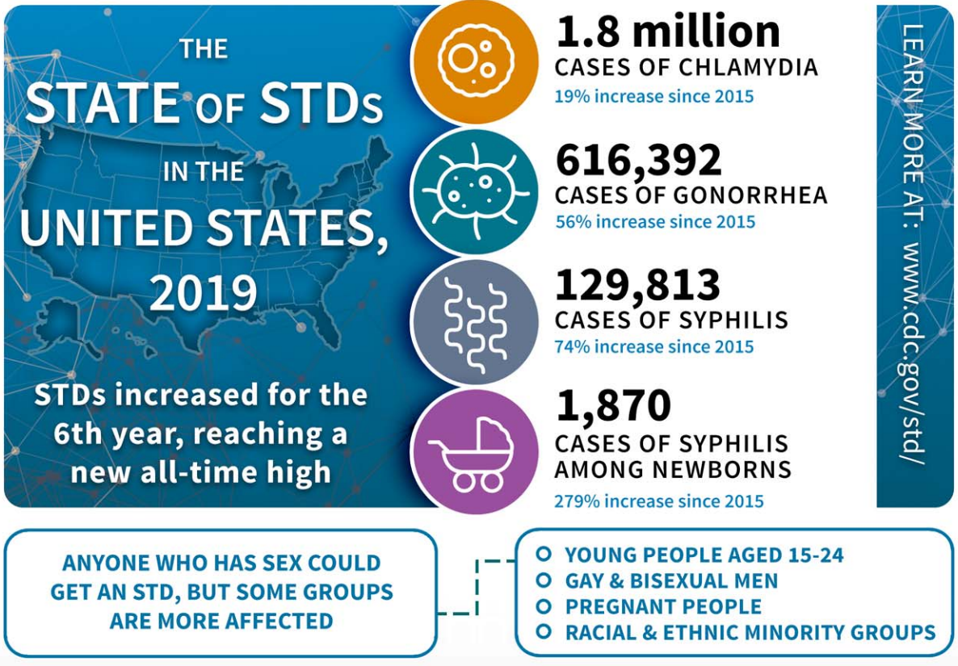
Notes:
Before the pandemic, the US was facing rates of STIs that we had not seen since the 1990s including gonorrhea and congenital syphilis. These can be devastating infections and in the case of congenital syphilis, represent a failure of the public health system.

Slide 5
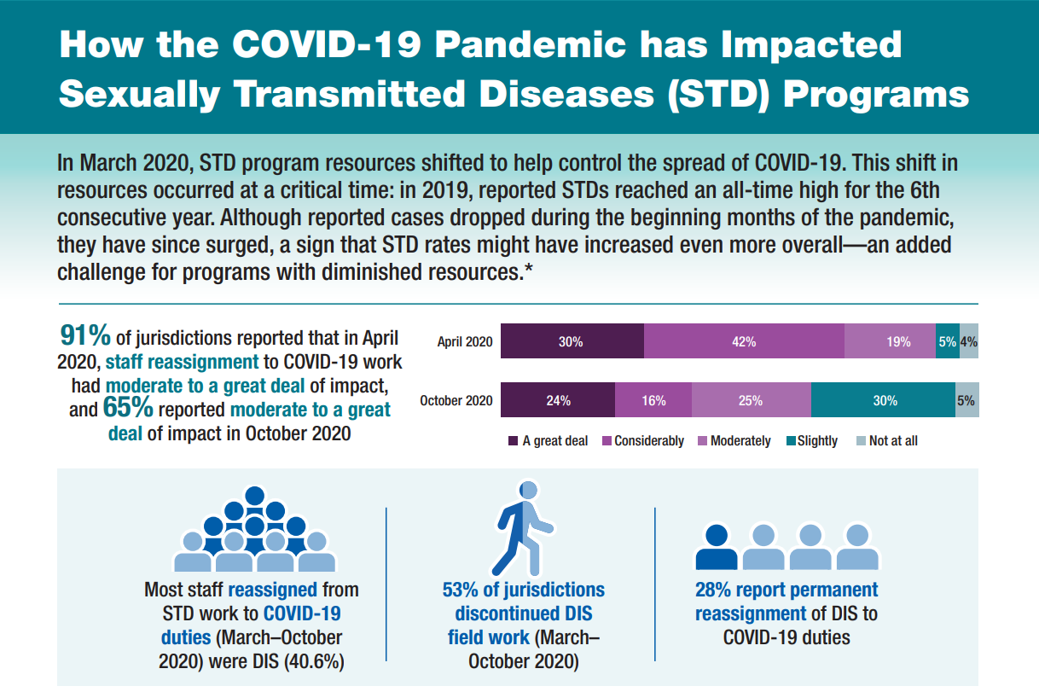

Slide 6
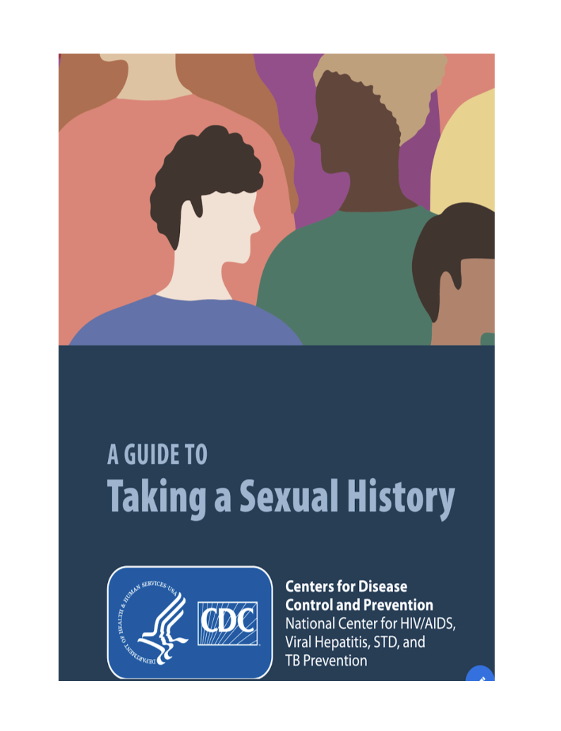
2021 STI Treatment Guidelines—Prevention
Latest on counseling, screening, Expedited Partner Therapy (EPT), vaccination.
Updated 5Ps: Partners, Practices, Past history of STIs, Protection, Pregnancy Preferences + Updated “Taking a Sexual History.”
New sections on multipurpose prevention technologies.
Expanded sections on Special Populations including:
  Cisgender men who have sex with cisgender men
  Transgender and gender diverse persons

Slide 7
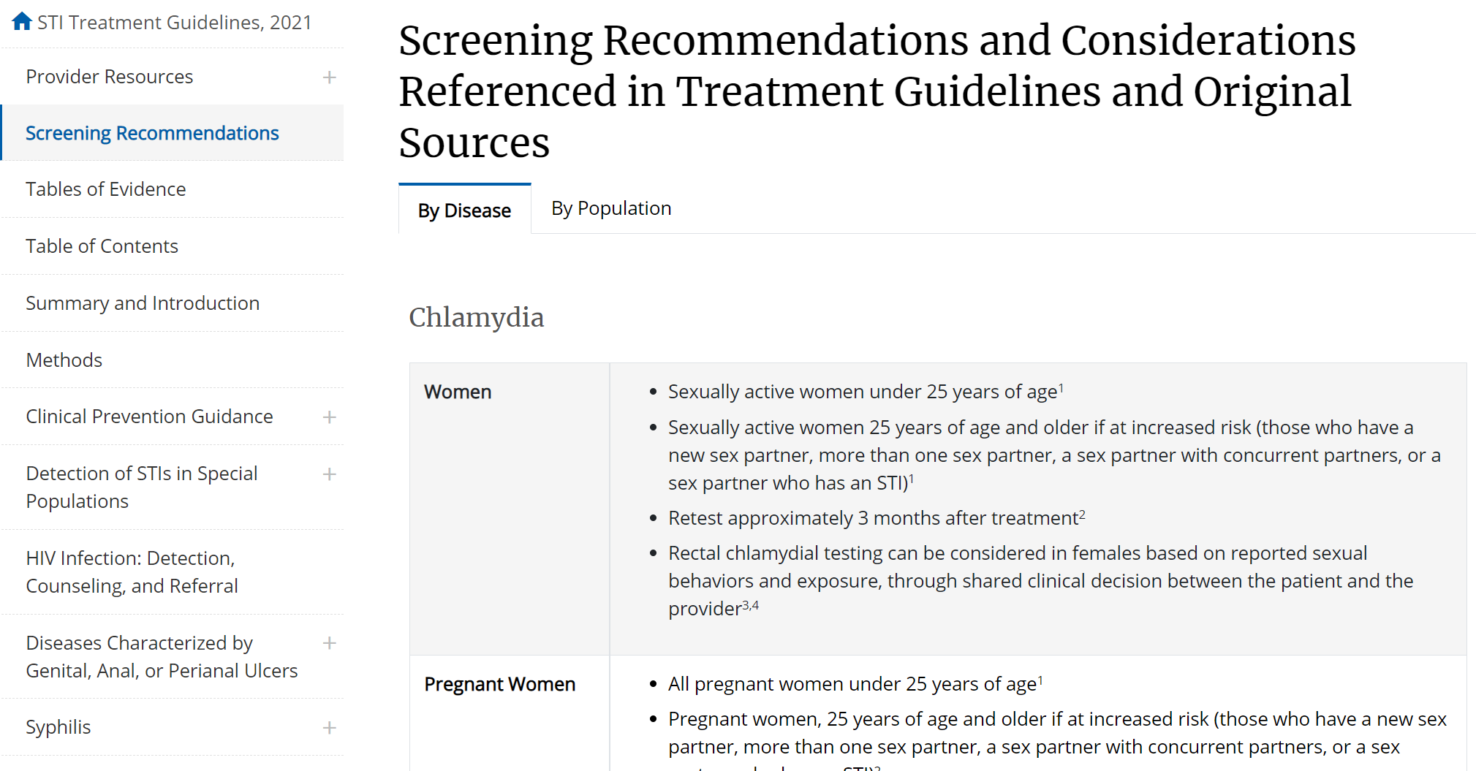
Screening recommendations

Slide 8
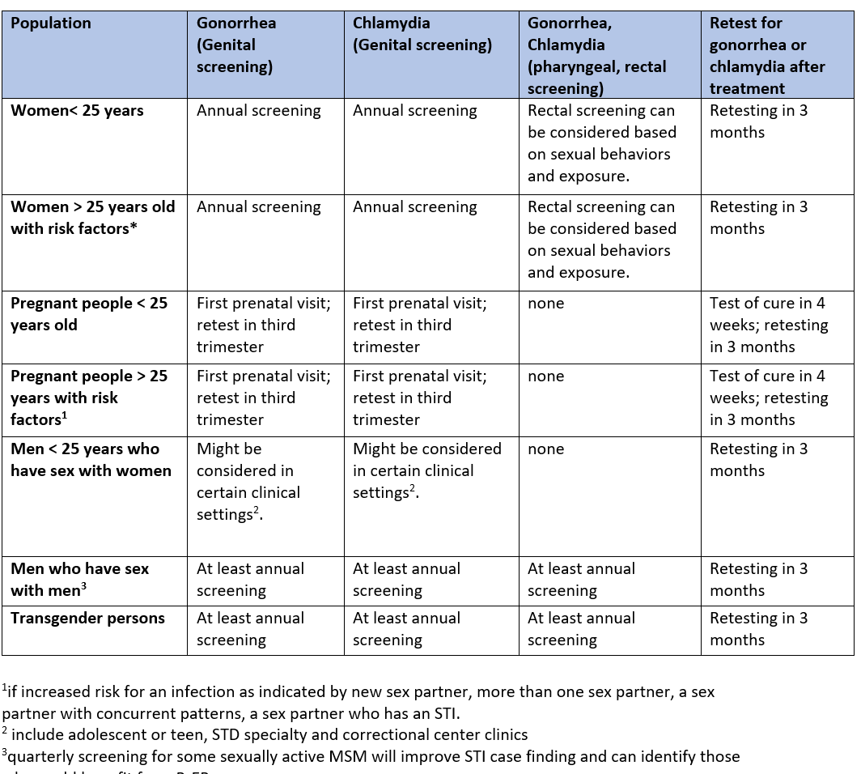
Screening recommendations

Slide 9
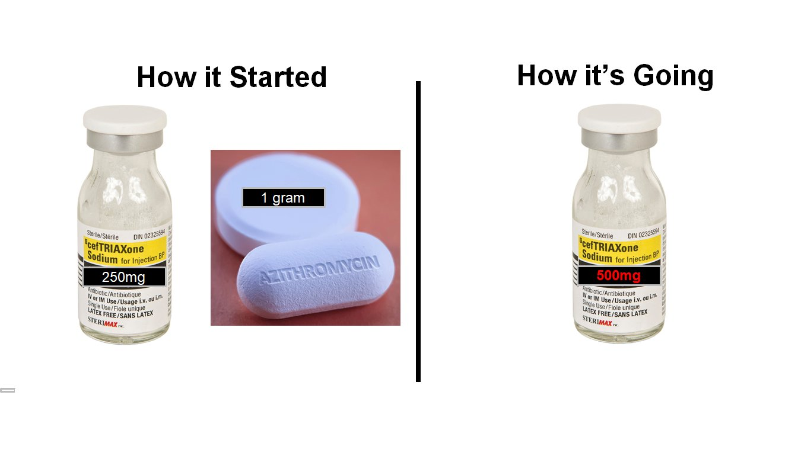
Courtesy of Dr. Jason Zucker, NYC PTC

Slide 10
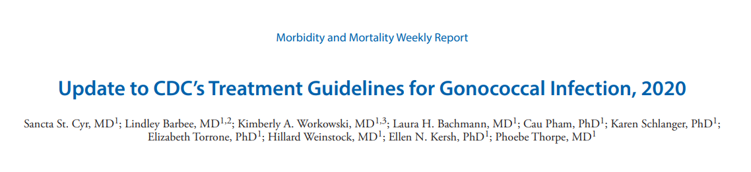
500 mg IM ceftriaxone x 1
  uncomplicated urogenital, anorectal, and pharyngeal gonorrhea
  For patients > 150 kg, ceftriaxone 1 g IM x 1
If chlamydial infection has not been excluded, doxycycline 100 mg orally twice a day for 7 days is recommended.
Test of Cure for all patients with pharyngeal GC (7-14 days).
Retesting for all patients with GC in 3 months.
Not intended to address all clinical situations.

Slide 11
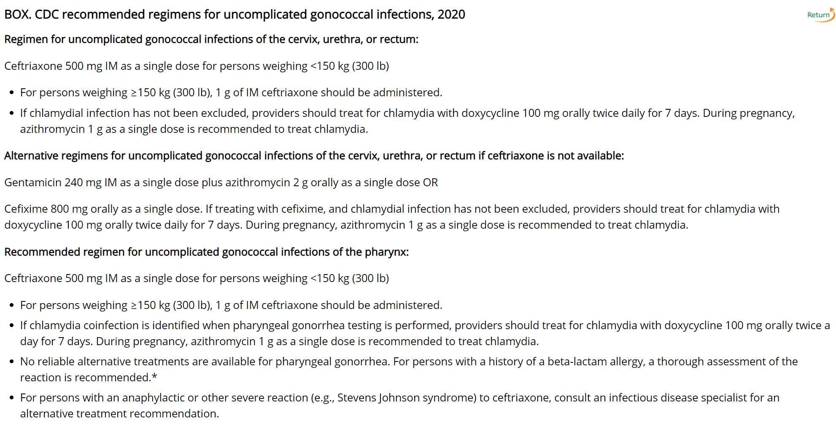

Slide 12
Why were recommendations changed?
  For improved antimicrobial stewardship
  Changes in azithromycin susceptibility in GC
  Pharmacokinetic and pharmacodynamic considerations

Slide 13
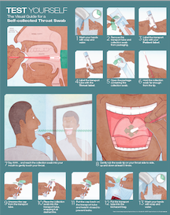
Pharyngeal and rectal sites play important role
GC is harder to eradicate in the pharynx.
The pharynx may allow for exchange of genetic material among bacteria.
Testing and treating extragenital STIs is important for many reasons!
  Increased incidence of HIV (PrEP).
  STIs will be missed if extragenital testing is not performed in some pops.

Slide 14
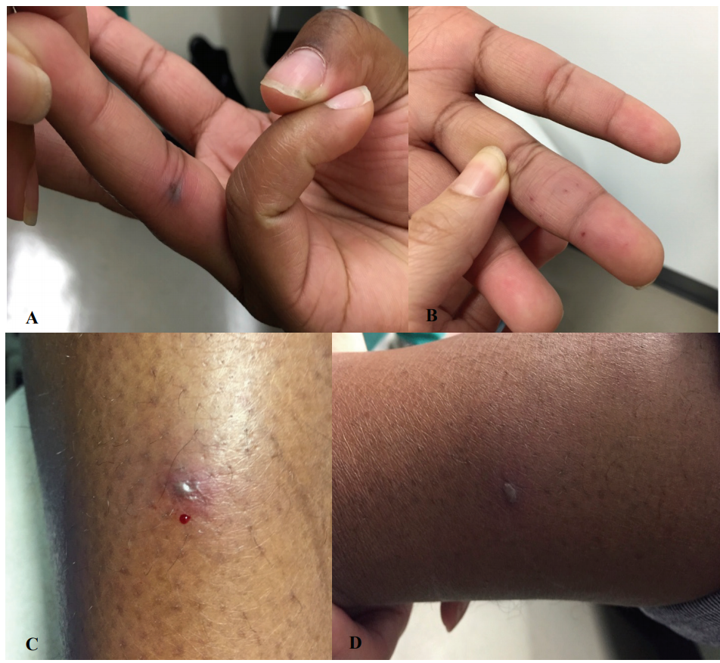
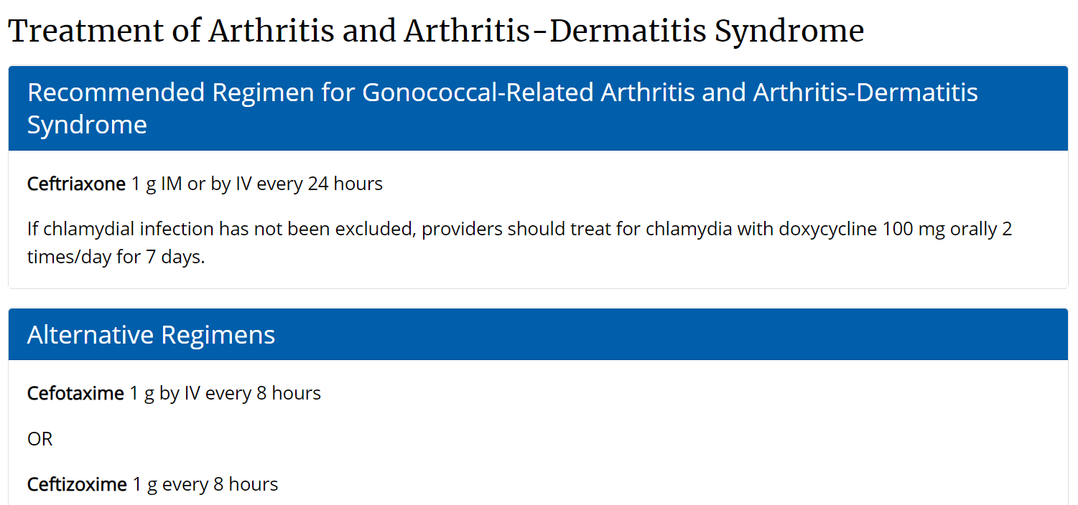
Disseminated GC

Slide 15
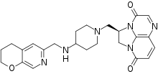
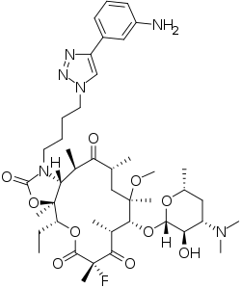
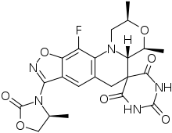
Potential GC treatment agents
Solithromycin – Phase 3
macrolide antibiotic
Zoliflodacin – Phase 3
Inhibits bacterial type II topoisomerases
Gepotidacin – ?Phase 3
triazaacenaphthylene antimicrobial agent
Closthioamide
DNA gyrase inhibitor
Notes:
15

Slide 16
Chlamydia
There are NAAT platforms FDA approved for rectal, pharyngeal sites (CT,GC)
Routine oropharyngeal screening for CT is not recommended
Rectal testing
  MSM, transgender persons
  Consider in cis gender women (behavior), using shared clinical decision-making
Source: CDC STI Treatment Guidelines, 2021

Slide 17
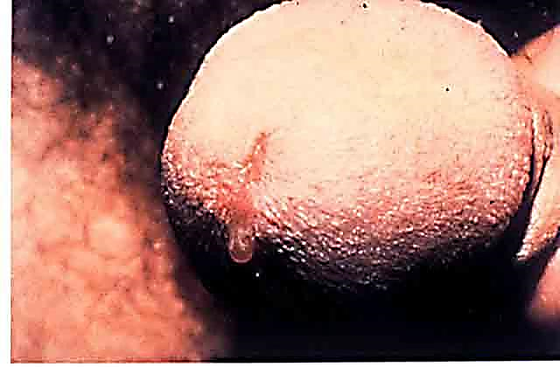
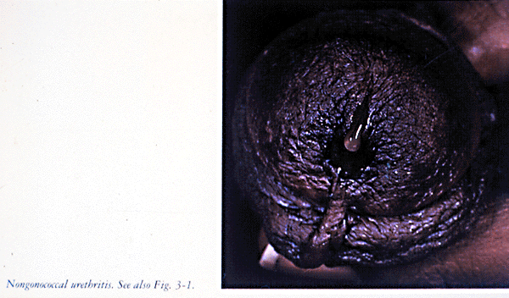
NGU (chlamydia)

Slide 18
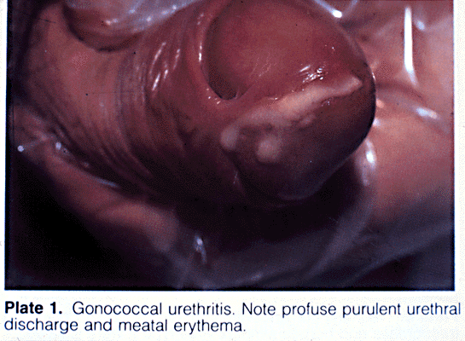
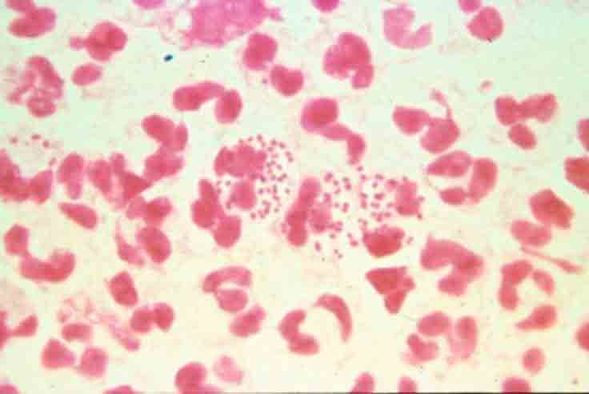
Compared to gonorrhea

Slide 19
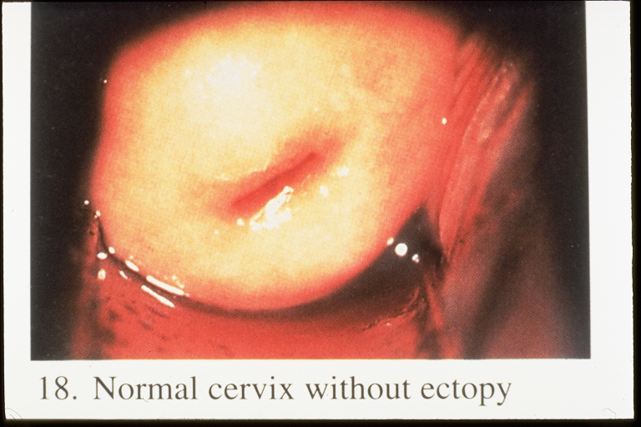
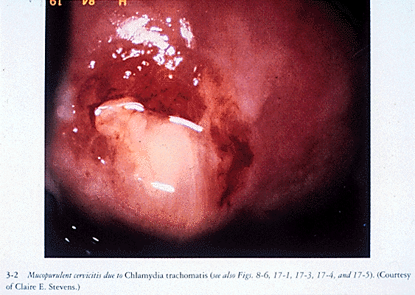
Cervicitis
Normal cervix
Mucopurulent cervicitis

Slide 20
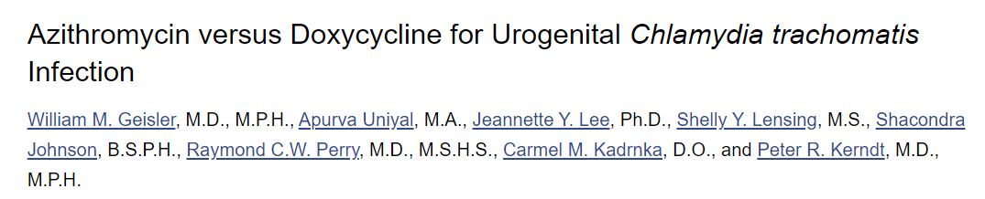
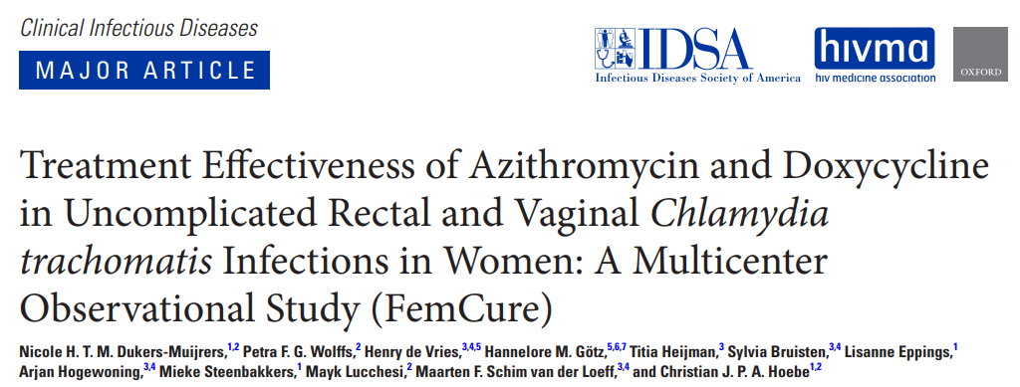
  Of patients with chlamydia, there were 5 treatment failures. All in patients (4=male; 1=female) who received azithromycin.
  Doxy was 100% effective; azithro 97%
  Failure rate of azithro was 3.2%, so did not show non-inferiority.
  Rectal chlamydia:
  Cure: azithro 78.5% vs doxy 95.5%
  Vaginal chlamydia:
  Cure: azithro 93.5% vs doxy 95.4%

Slide 21
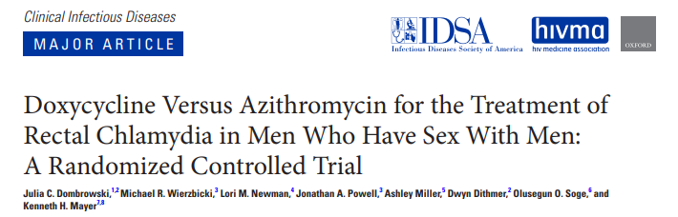
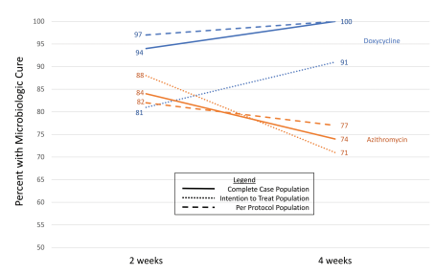
Randomized placebo-controlled trial
177 participants enrolled, 135 (76%) met CC population
7-day course of doxycycline was significantly more effective than a single dose of azithromycin
Source: Dombrowski et al, CID 2021
Notes:
This randomized, double-blind, placebo-controlled trial compared azithromycin (single 1-g dose) versus doxycycline (100 mg twice daily for 7 days) for the treatment of rectal CT in men who have sex with men (MSM) in Seattle and Boston.

Slide 22
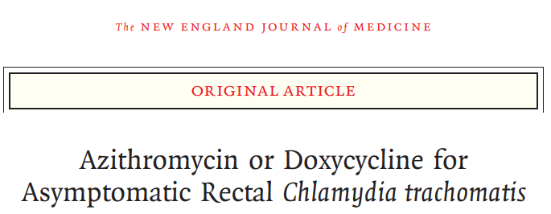
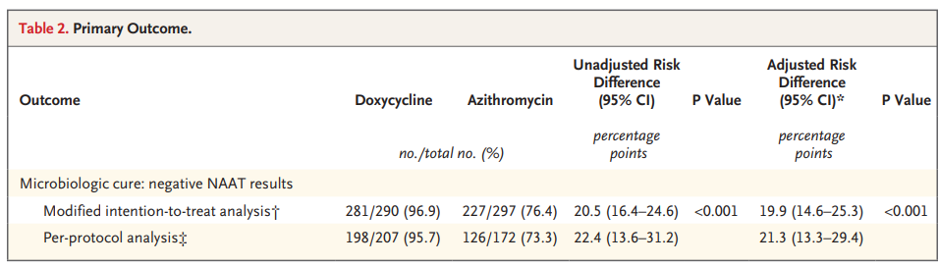
625 cisgender men with asymptomatic rectal chlamydia.

Slide 23
The language of the guidelines is purposeful
Meaning that a recommended treatment is a treatment that is more effective as shown by evidence in observational studies or RCTs.
An alternative treatment would be effective but less so or effectively less so if it is more difficult to take or tolerate.

Slide 24
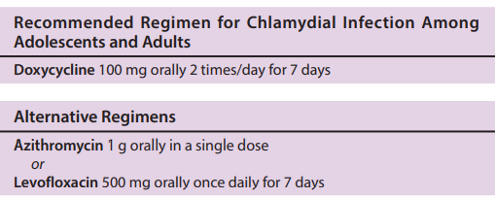
Chlamydia management

Slide 25
Azithromycin has its advantages
Azithro can be dispensed in an ED or clinic, so filling a prescription is not an issue.
Since it is a one-time dose, hiding meds from your guardians is not an issue.
Is thought safer in pregnancy.
Easier to take if unhoused
Cost? $9-$18
^{*St. Louis Region Jan 2022}
doxy monohydrate course $8-$15

Slide 26
Patient Centered Management of Chlamydia
NAAT pending or Ct +
Person who could be pregnant
Person who could have rectal chlamydia
~20-25% higher cure rate
All others, consider shared decision making for treatment:
Doxy is recommended
*****
DOXY 100 mg PO BID x 7 days
~2-3% higher cure rate
AZITHRO 1 g PO x 1 dose

Slide 27
Case for thought…
28 yo cisgender man with HIV, undetectable on ART
Presents to the ED with 2-week history of bright red blood per rectum, tenesmus, pain and constipation.
3 weeks prior to presentation experienced sudden onset of constipation not improved with OTC and prescription laxatives.
Pain and discomfort is consistent; he is unable to pass formed stools.
CT shows rectal mass.

Slide 28
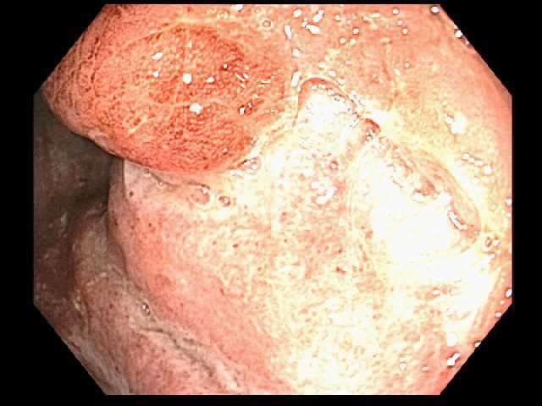
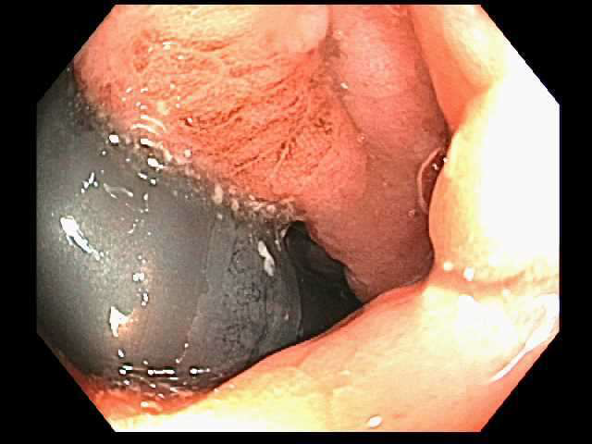
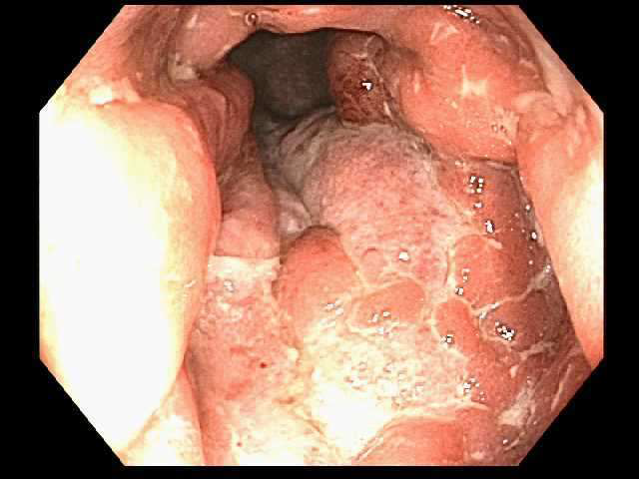
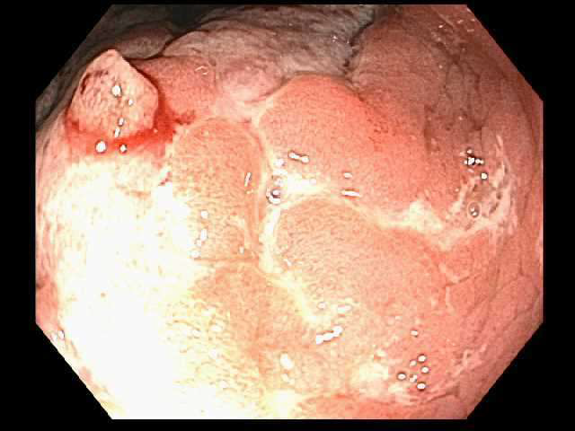
Colonoscopy
“An ulcerated non-obstructing mass was found in the distal rectum. The mass was partially circumferential (involving one third of the lumen circumference). No bleeding was present. Biopsies were taken with a cold forceps for histology. Otherwise, exam without abnormality.”

Slide 29
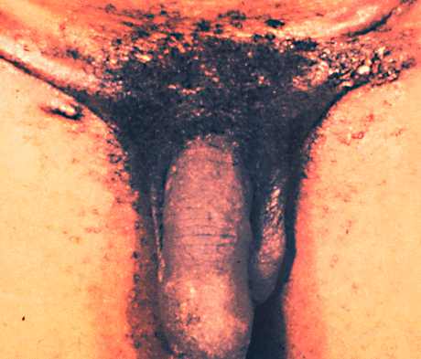
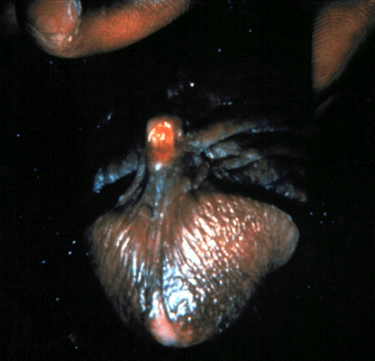
Lymphogranuloma venereum (LGV)
Caused by invasive Chlamydia trachomatis serovars L1, L2, L3
Transient painless genital ulcer, followed by tender heaped-up, matted inguinal lymph nodes (“groove sign”)
Rectal exposure in MSM
    proctocolitis with mucoid or hemorrhagic discharge, tenesmus
    Treatment: doxycycline x 3 wks

Slide 30
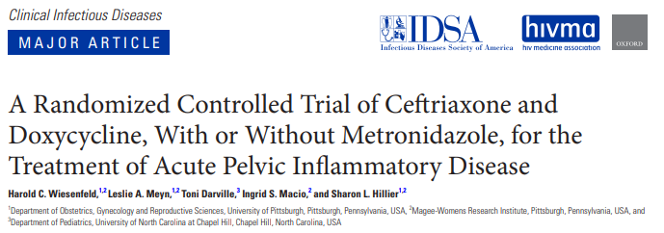
Metronidazole should be used as a component of PID management
Double-blind placebo-controlled trial 233 cis-females
Outcomes: sx improvement 3 days and presence of anaerobic organisms in the endometrium
Findings at d30 post treatment WITH metronidazole vs. placebo:
  Endometrial anaerobes reduced (8% vs 21%, P < .05)
  Pelvic tenderness less common (9% vs 20%, P < .05)
  Decreased cervical M. genitalium (4% vs 14%, P < .05) ?
  Similar AEs
Source: Wiesenfeld et al, CID 2020
Notes:
Double-blind placebo-controlled trial comparing ceftriaxone 250 mg IM single dose and doxycycline for 14 days, with or without 14 days of metronidazole in women with acute PID
Outcome sx improvement at 3 days
30 days reduction in anerobic organisms in the endometrium, clinical cure
More effective coverage of anaerobic endometrial organisms

Slide 31
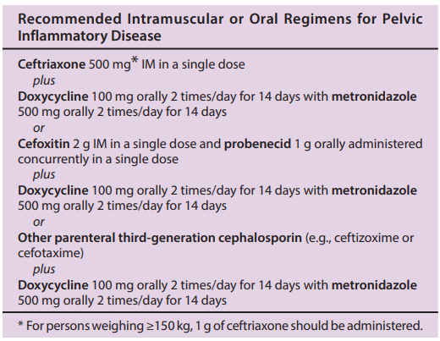


Outpatient Management of PID

Slide 32
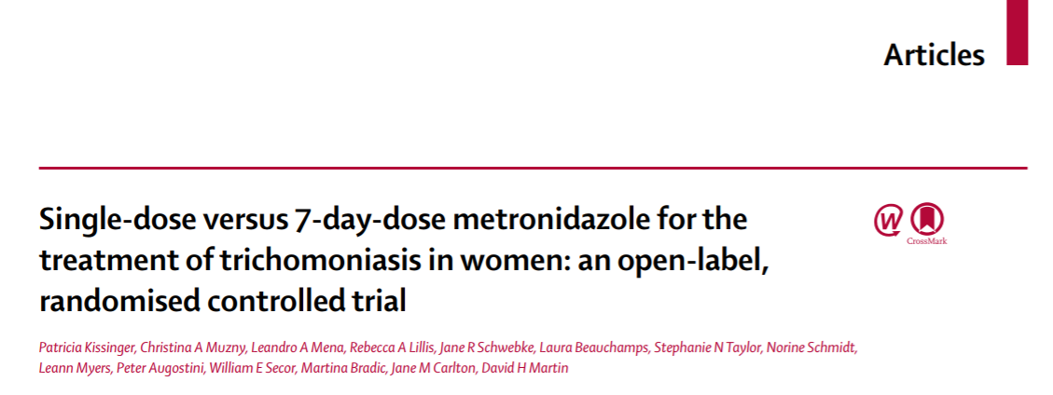
Treatment guideline changes for Trichomonas
  Recognition that T. vaginalis is a risk in pregnant people for PROM, pre-term birth as well as endometritis and HIV infection
  NAAT testing is recommended for diagnosis (and screening when indicated)
  Treatment:
    Metronidazole 500 mg PO BID x 7 days for all patients with a vagina.
    Remains metronidazole 2 g PO x 1 for all patients with a penis whether +testing or a contact.
    Yes, treat contacts and don’t wait for test results.

Slide 33
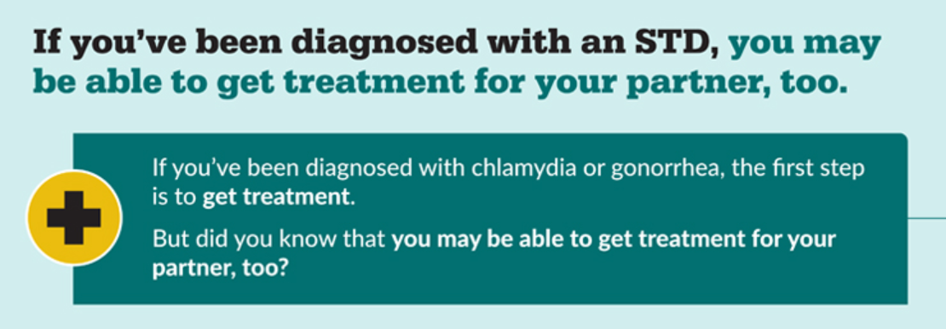
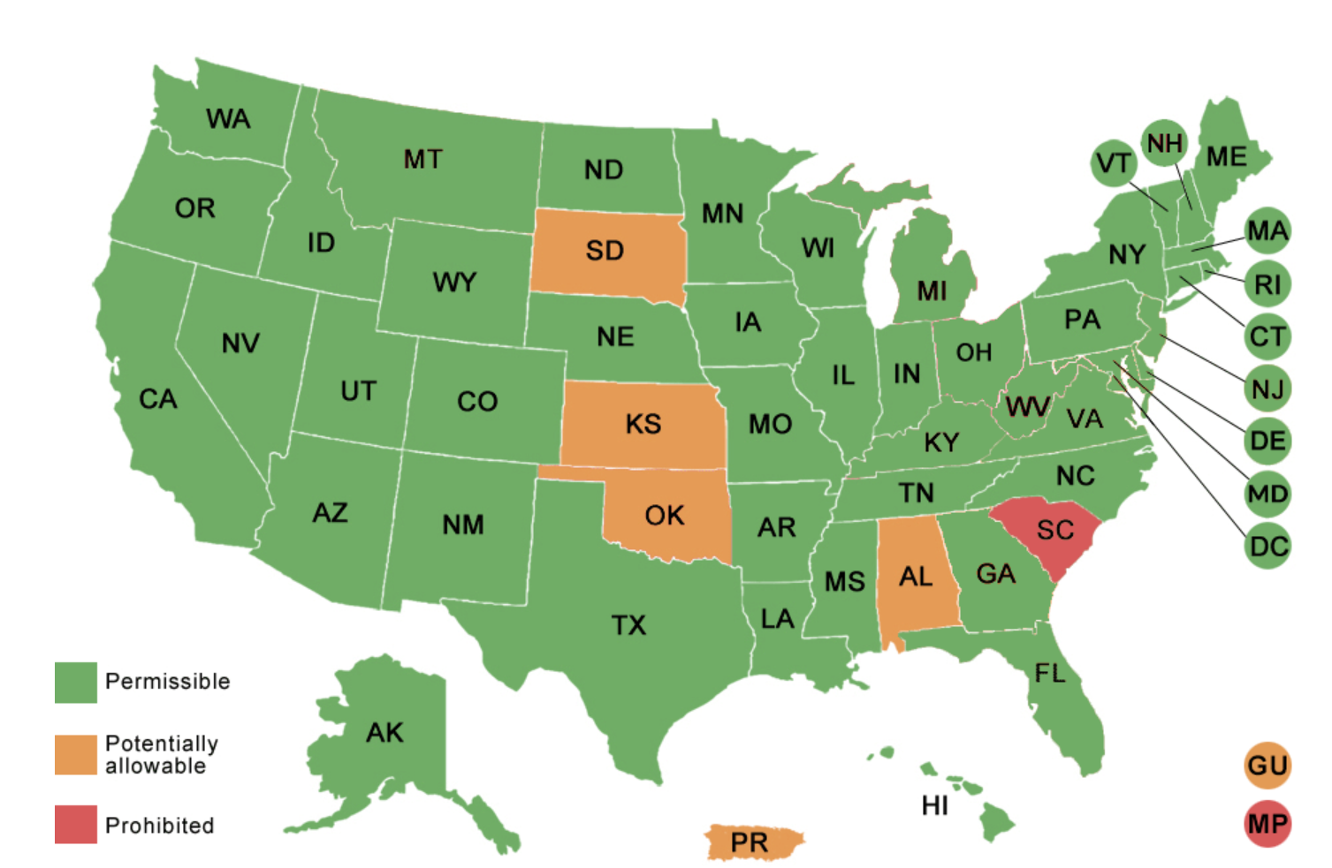
Expedited Partner Therapy
Prescription of STI treatment to partners of patient with STI.
Varies from state to state.
EPT for gonorrhea and chlamydia has been shown to reduce recurrent infection [Ct by 20%, GC by 50%] in patient.

Slide 34
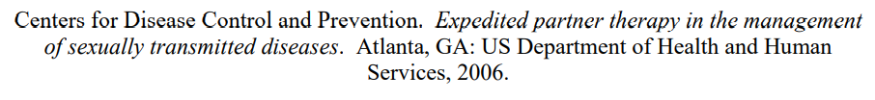
Evidence for EPT
Studies of effectiveness have used azithromycin for chlamydia EPT and pre-packaged medications [Schillinger et al 2003, Golden et al 2005, Kissinger et al 2005].
A 2013 meta-analysis found:
  “moderate-quality evidence that expedited partner therapy is better than simple patient referral for preventing re-infection of index patients when combining trials of STIs that caused urethritis or cervicitis
  (6 trials; RR 0.71, 95% CI 0.56 to 0.89, I(2) = 39%). ”
Chlamydia reduced by 20% and gonorrhea by 50% on follow up testing.
DO health departments provide EPT?
  LHDs: 66.8% for chlamydia; 39.3% for gonorrhea (Cuffe et al. 2021. STD 48(6): 429.)

Slide 35
EPT for MSM
2021 STI Treatment Guidelines: For cisgender men who have sex with cisgender men, shared decision making is recommended.

Slide 36
EPT dosing
Chlamydia
Doxycycline 100 mg PO BID x 7 d
OR
Azithromycin 1g PO x 1 dose
Gonorrhea
Cefixime 800 mg PO x 1 dose

Slide 37
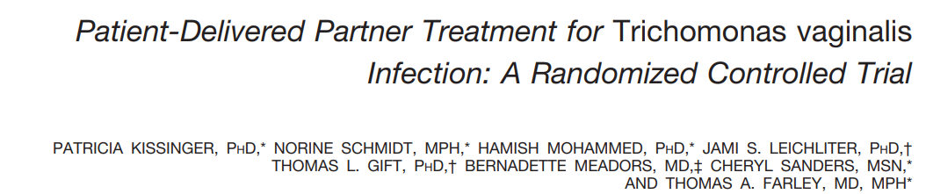

EPT for trichomonas:
Did not result in partners taking the meds or lower rates of re-infection than partner referral.

Slide 38
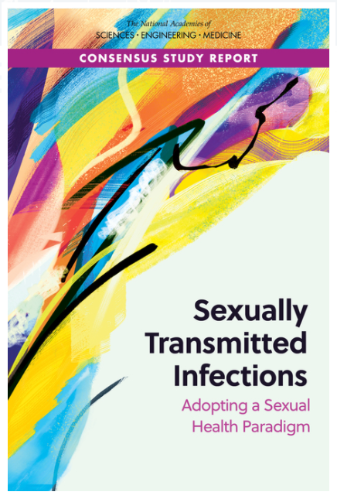


Slide 39


Slide 40


No-cost online clinical consultation on the prevention, diagnosis, and treatment of STIs by your Regional PTC Clinical Faculty
www.STDCCN.org
hreno@wustl.edu

Slide 41
Resources
www.cdc.gov/std
St. Cyr S, Barbee L, Workowski KA, et al. Update to CDC’s Treatment Guidelines for Gonococcal Infection, 2020. MMWR Morb Mortal Wkly Rep 2020;69:1911–1916.
Doan T, Worden L, Hinterwirth A, et al. N Engl J Med 2020;383:1941–50.
Bachmann LH, Kirkcaldy RD, Geisler WM, et al. Clin Infect Dis 2020. Epub March 18, 2020.
Yousfi K, Gaudreau C, Pilon PA, et al. Antimicrob Agents Chemother 2019.
Gaudreau C, Pilon PA, Sylvestre JL, Boucher F, Bekal S.Emerg Infect Dis 2016.
Cuffe et al. 2021. STD 48(6): 429.
Workowski KA, Bachmann LH, Chan PA, et al. Sexually Transmitted Infections Treatment Guidelines, 2021. MMWR Recomm Rep 2021;70(No. RR-4):1–187.
O Mmeje et al. Breakdown in the expedited partner therapy treatment cascade: from reproductive healthcare provider to the pharmacist2020 Sep;223(3):417.e1-417.e8. doi: 10.1016/j.ajog.2020.02.038. Epub 2020 Mar 2.
J Slutsker et al. Do Prescriptions for Expedited Partner Therapy for Chlamydia Get Filled? Findings From a Multi-Jurisdictional Evaluation, United States, 2017-20192020 Jun;47(6):376-382. doi: 10.1097/OLQ.0000000000001163.

Slide 42
HSV
Though over all prevalence is decreasing, HSV is still very common.
IgM testing is inaccurate (poor Se/ Sp).
Screening in asymptomatic people is not recommended (USPSTF)
Should patients at STI clinic be screened for herpes symptoms?
Diagnostic testing can be offered to those with atypical presentations or recurrent symptoms….but with what?

Slide 43
HSV serologic testing
Only 12 weeks after symptoms (if thought to be initial episode).
It should be a 2-step process with EIA testing and then confirmation with Biokit or UW Western Blot.
More info to come!

