Slide 1
HCV and People Who Inject Drugs
Jessica Gregg MD PhD
Chief Medical Officer, De Paul Treatment Centers

Slide 2
Hepatitis C Prevalence is Increased in Baby Boomers
Prevalence of Hepatitis C Antibody Positivity in US Population by Sex by Yr of Birth (NHANES III)^{[1]}
10
8
6
Prevalence of Hepatitis C Positive (%)
Screening recommended
4
Male Female
2
0
1910-19
1920-29
1930-39
1940-49
1950-59
1960-69
1970-79
1980-89
1990-99
Yr of Birth
Iwasaki K, et al. ISPOR 2010. Abstract PG17.
Notes:
For a long time, this was the group we worried about.
In fact, three out of every 100 baby boomers were infected with HCV. This was at least five times higher than in any other group of adults, and accounted for about 75% of HCV cases.

Slide 3
But…
New cases of acute Hepatitis C infection have nearly tripled over last 5 years
Highest overall number of new infections among 20-29 year olds (due to increasing injection drug use)
HCV infections are growing among women of childbearing age
CDC, 2017

Slide 4
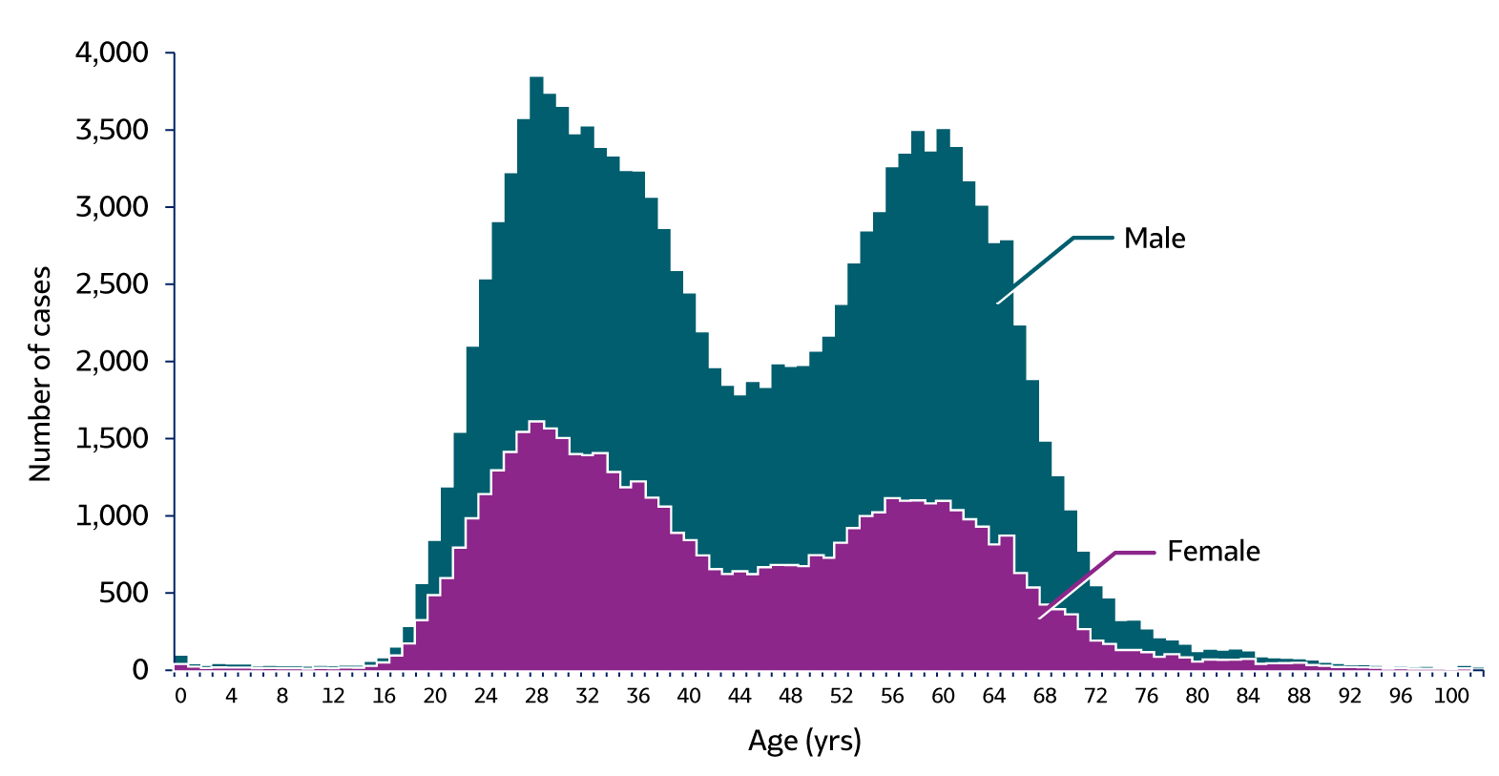
Figure 3.8. Number of newly reported* chronic hepatitis C cases† by sex and age — United States, 2018 (N=137,713)
Newly reported chronic hepatitis C in 2018n
Source: CDC, National Notifiable Diseases Surveillance System.

Slide 5
Injection drug use now accounts for at least 60 percent of HCV transmission in the United States.
75-90% of PWID are HCV Ab positive.
Centers for Disease Control and Prevention. Viral Hepatitis Surveillance—United States, 2014. LINK CDC.GOV¹

Slide 6
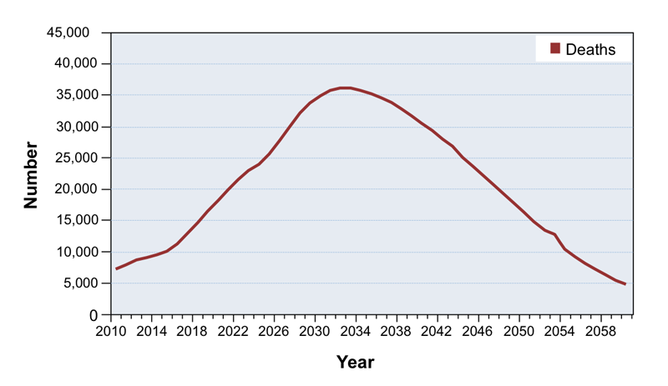
Deaths from prevalent HCV forecasted to peak in 2030s…
Rein et al. Dig Liver Dis. 2011;43:66-72.

Slide 7
Unless something changes

Slide 8
Trifecta of interventions needed
Anti-virals
(treat the infections)
PWID
Needle and syringe programs
(decrease risk of infection)
Medications for OUD
(decrease the risk of injecting)
www.worldhepatitissummit.com

Slide 9
Medications for Opioid Use Disorder (MOUD)
Notes:
So let’s talk about them

Slide 10
Opioid Agonists
Notes:
The most well known medications for opioid use disorder and the ones with the best evidence are the opioid agonists: methadone and buprenorphine (Suboxone, subutex)

Slide 11

Notes:
Methadone: comes in liquid or pill form

Slide 12
Methadone
Full agonist at the opioid receptor
Half life greater than 24 hours
OTP only
Ok to dispense in hospitals

Slide 13
Methadone
Decreases use of illicit opioids
Increases retention in treatment
Decreases incidence of new HIV/Hepatitis C infections
Reduces criminality
Gowing LR, Farrell M, Bornemann R, et al J Gen Intern Med. 2006.
Lawrinson P, Ali R, Buavirat A, et al.. Addiction. 2008.
Nolan S, Dias Lima V, Fairbairn N, et al. Addict Abingdon Engl.
MacArthur, G.J., et al., BMJ, 2012.

Slide 14
Mortality Risk during and after methadone treatment
Mortality Risk during and after opioid substitution treatment: systematic review and meta-analysis
of cohort studies. Sordo, et al. BMJ 2017.
Notes:
Saves lives

Slide 15
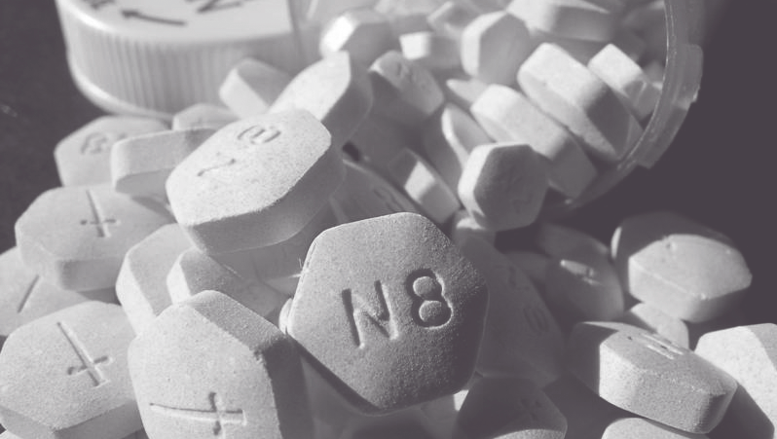

Slide 16
Buprenorphine
Partial agonist at the opioid receptor
Prescribers must have DATA waiver
Patient limits
Ok to dispense in hospitals

Slide 17
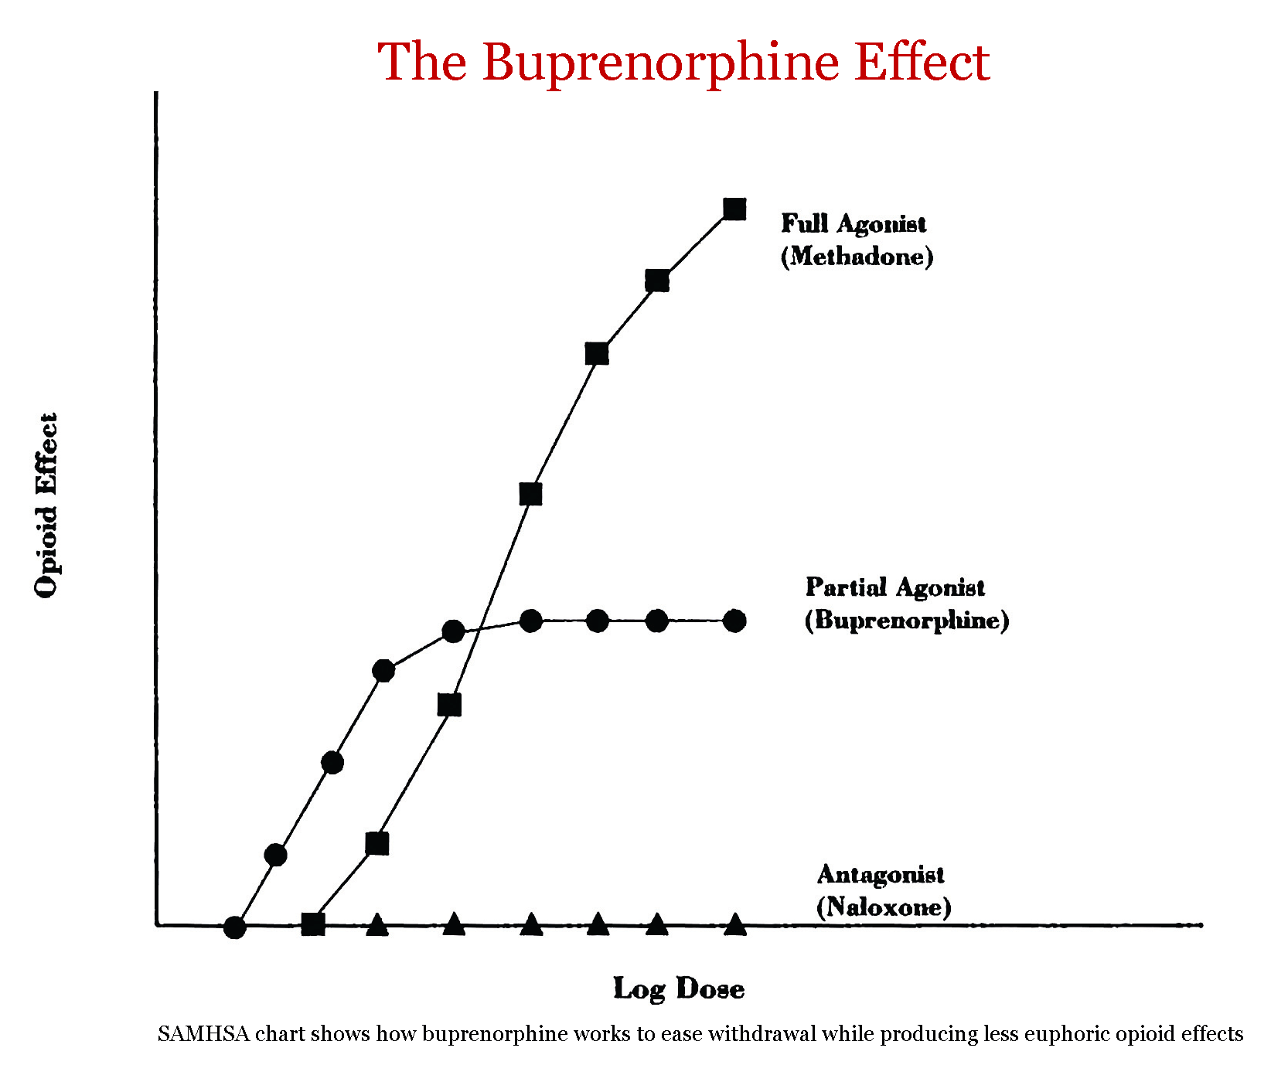
Notes:
Also safer.

Slide 18
Buprenorphine
Decreases use of illicit opioids
Increases retention in treatment
Decreases incidence of new HIV/Hepatitis C infections
Tsui JI, Evans JL, Lum PJ, Hahn JA, Page K. JAMA Intern Med. 2014
MacArthur, G.J., et al., BMJ, 2012.
Lo-Ciganic et al., Addiction 2016
Moreno et al, JAM 2019

Slide 19
Mortality Risk during and after buprenorphine treatment
Mortality Risk during and after opioid substitution treatment: systematic review and meta-analysis
of cohort studies. Sordo, et al. BMJ 2017.
Notes:
Saves lives. The same meta-analysis referenced earlier all affirmed significantly decreased all cause mortality overdose mortality for patients on buprenorphine

Slide 20


XR Naltrexone

Slide 21





XR Naltrexone
Opioids
Extended release Naltrexone
Notes:
Opioid antagoist. Blocks opioid receptors. And it lasts a month. Can’t get high.

Slide 22
XR Naltrexone
One 380 mg deep muscle injection in the buttock every 4 weeks
No special waiver training
Need to be opioid free
¼ patients do not tolerate induction
No good data on mortality or reduction in HIV/Hep C

Slide 23
Summary
To prevent Hepatitis C, treat addiction and emphasize harm reduction
Methadone and buprenorphine use are significantly associated with decreased risk of HIV/Hep C infection
Extended release naltrexone treats opioid use disorder. It is unclear if it also decreases risk of new infections
Also, don’t forget to prescribe naloxone!!!

Slide 24

Thank You

