Slide 1
COVID-19 Update March 2022
Jorge Mera, MD
Whitney Essex, APRN

Slide 2
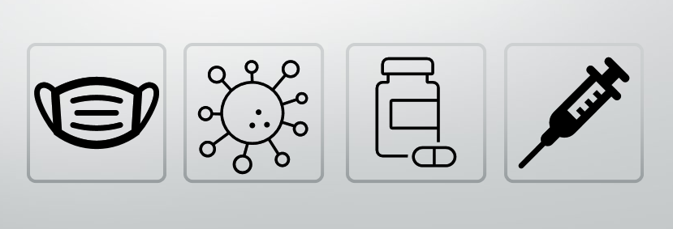
Outline
Mask Updates
Variant Updates
Treatment Updates
Vaccination Updates

Slide 3
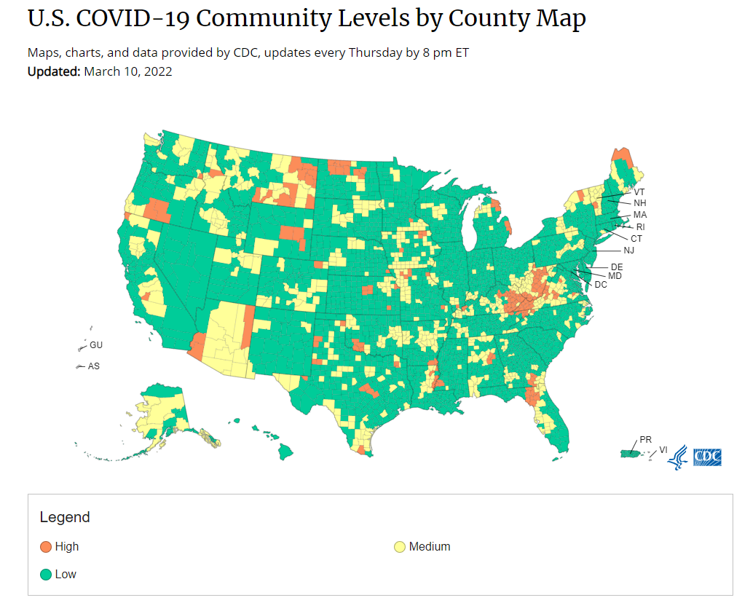
Low | Medium | High
Stay up to date with COVID-19 vaccines Get tested if you have symptoms Wear a mask based on your personal preference, informed by your personal level of risk | If you are at high risk for severe illness, talk to your healthcare provider about whether you need to wear a mask and take other precautions If you live with or have social contact with someone at high risk for severe illness, consider testing yourself for infection before you get together and wearing a mask when indoors with them Stay up to date with COVID-19 vaccines Get tested if you have symptoms | Wear a mask indoors in public, regardless of vaccination status or individual risk Stay up to date with COVID-19 vaccines Get tested if you have symptoms Additional precautions may be needed for people at high risk for severe illness

Slide 4
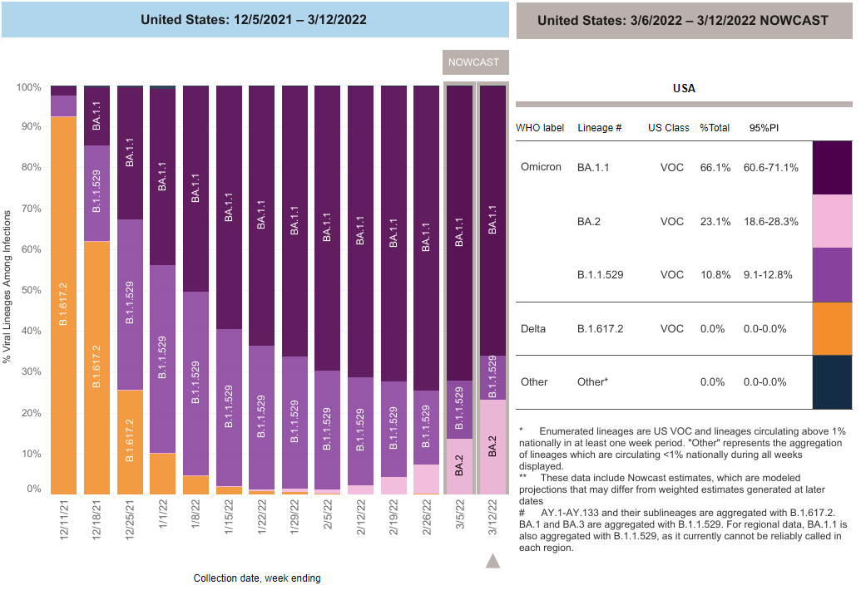

Slide 5
Efficacy of Antiviral Agents against the SARS-CoV-2 Omicron Subvariant BA.2
Omicron is the predominant variant in many countries.
Omicron variants have been divided into four distinct sublineages: BA.1, BA.1.1, BA.2, and BA.3.
Most circulating omicron variants belong to BA.1
In Denmark, India, and the Philippines, BA.2 is now becoming dominant.
BA.2 has 16 amino acid substitutions in the RBD of the spike (S) protein of SARS-CoV-2
The BA.2 and BA.1 variants share 12 of these 16 substitutions
BA.2 has four substitutions in the RBD that differ from those in BA.1.
Are there differences in the effectiveness of monoclonal antibodies against these different omicron sublineages?
NEJM March 9, 2022 DOI: 10.1056/NEJMc2201933

Slide 6
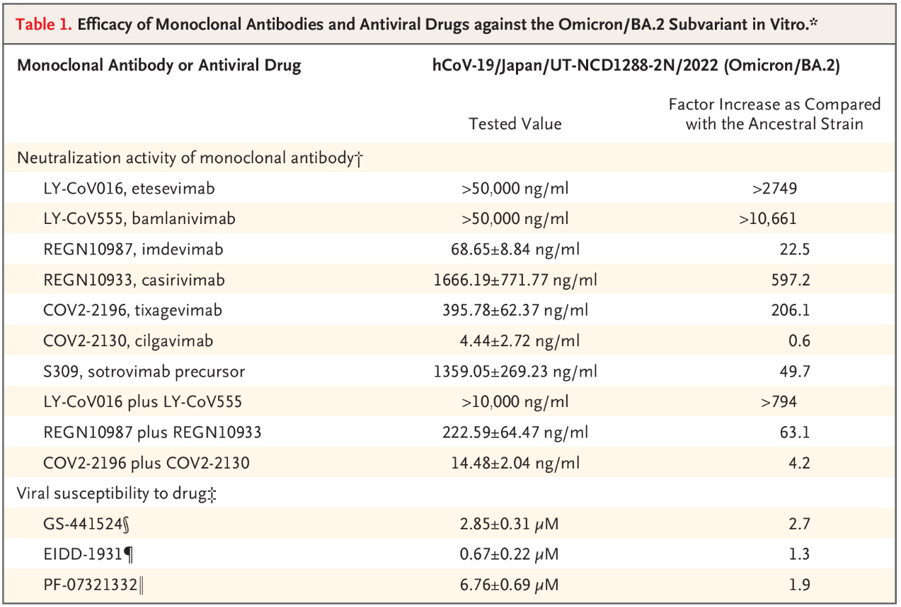
NEJM March 9, 2022 DOI: 10.1056/NEJMc2201933

Slide 7
Efficacy of Antiviral Agents against the SARS-CoV-2 Omicron Subvariant BA.2
Both etesevimab and bamlanivimab individually and in combination, lost neutralizing activity
Imdevimab has neutralizing activity as well as the combination of indevimab and casirivimab
The FRNT₅₀ of this combination was higher by a factor of 43.0 to 143.6 than for an ancestral strain and other VOC
Tixagevimab), and cilgavimab neutralized omicron/BA.2.
FRNT₅₀ values were higher by a factor of 1.4 to 8.1 than for the ancestral strain and other VOC
The precursor of sotrovimab, had even less neutralizing activity against BA.2. than BA.1
The FRNT₅₀ value was higher by a factor of 12.2 to 49.7
The susceptibilities of BA.2 to remdesivir, molnupiravir, and nirmatrelvir were similar to those of the ancestral strain and other variants of concern
CONCLUSIONS
Clinical studies are warranted to determine whether these antiviral therapies are indeed effective against BA.2 infections.
Some monoclonal antibodies have lower neutralizing activity against BA.2 than against earlier variant strains.
NEJM March 9, 2022 DOI: 10.1056/NEJMc2201933

Slide 8
Resistance Mutations in SARS-CoV-2 Delta Variant after Sotrovimab Use
Sotrovimab is thought to neutralizes SARS-CoV-2, by binding to a highly conserved epitope within the receptor-binding domain.
Use of Mab to target a single viral epitope warrants caution because of the risk of rapid development of mutations that confer resistance after exposure to these antibodies.
Mutations at positions S:E340K/A/V and S:P337L/T have been associated with a reduction by a factor of 100 to 297 in neutralization by sotrovimab.
This study reviewed the first 100 consecutive patients who received sotrovimab
At Health care facilities in New South Wales, Australia, during the delta variant outbreak between August and November 2021
This study identified 8 patients that were persistently positive for SARS-CoV-2 and for whom respiratory tract specimens obtained before and after the use of sotrovimab were available.
March 9, 2022. DOI: 10.1056/NEJMc2120219

Slide 9
Resistance Mutations in SARS-CoV-2 Delta Variant after Sotrovimab Use
4 out of 8 patients acquired RBD (S:E340) mutations within 6 to 13 days after hey received sotrovimab.
Cultures remained positive for 23, 24, 12, and 15 days, respectively, after they received sotrovimab
A retrospective review of 11,841 SARS-CoV-2 genomes in the Global Initiative on Sharing All Influenza Data database, identified 4 additional patients with S:E340 mutations.
In 1 patient, the SARS-CoV-2 genome was detected 5 days after sotrovimab treatment, and in another it was detected 11 days after treatment.
CONCLUSIONS
Rapid development of spike gene mutations associated with high-level sotrovimab resistance in vitro and the persistence of viable SARS-CoV-2 in patients after sotrovimab infusions can occur
Postmarketing genomic surveillance of patients who receive monoclonal antibodies for the treatment of SARS-CoV-2 infection is prudent
In order to minimize the risk of both treatment failure and the transmission of potentially resistant SARS-CoV-2 variants in health care settings and the community
March 9, 2022. DOI: 10.1056/NEJMc2120219

Slide 10
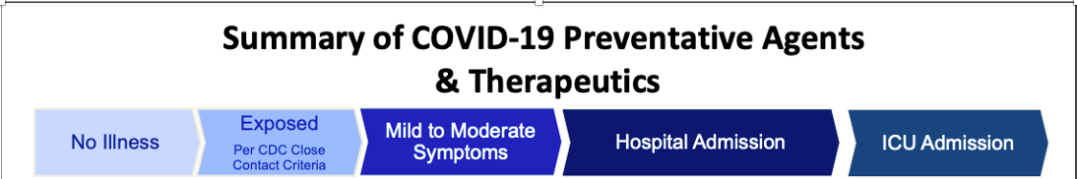
Remdesivir
Vaccines
Pre-Exposure Prophylaxis (Tixagevimab,Cilgavimab)
Masks
Paxlovid
Sotrovimab
Bebtelovimab
Remdesivir
Molnupiravir
Dexamethasone
Tocilizumab
Baricitinib

Slide 11
EVUSHELD
Cardiovascular Events:
A higher proportion of subjects who received EVUSHELD versus placebo reported myocardial infarction and cardiac failure serious adverse events.
May be less active against certain Omicron subvariants (BA.1, BA.1.1)
The dosing regimen was revised, a higher dose may be more likely to prevent infection by the COVID-19 Omicron subvariants than the originally authorized dose.
Dose increased to 300mg of tixagevimab and 300 mg cilgavimab
The volume of each injection for the higher dose will be larger, 3 mL instead of 1.5 mL. Limit injections to large muscles on the body (e.g., the gluteal muscles).
Is expected to have greater neutralizing activity against BA.2 which will become dominant

Slide 12
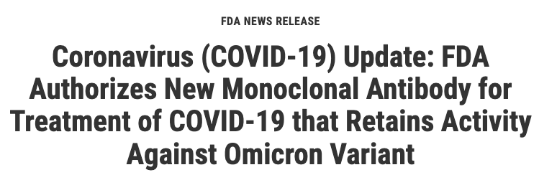
Bebtelovimab may only be used for the treatment of mild-to-moderate COVID-19 in adults and pediatric patients (12 years of age and older weighing at least 40 kg): • With positive results of direct SARS-CoV-2 viral testing, and • Who are at high-risk for progression to severe COVID, including hospitalization or death, and
• For whom alternative COVID-19 treatment options approved or authorized by FDA are not accessible or clinically appropriate.
Fda.gov
Bebtelovimab works by binding to the spike protein of the virus that causes COVID-19
Laboratory testing showed that it retains activity against both the omicron variant and the BA.2 omicron subvariant.
The data supporting the bebtelovimab EUA come from the Phase 2 portion of the BLAZE-4 trial
Conclusions are limited as these data are from different trials that were conducted when different viral variants were circulating, and baseline risk factors varied.
Not studied with Omicron

Slide 13
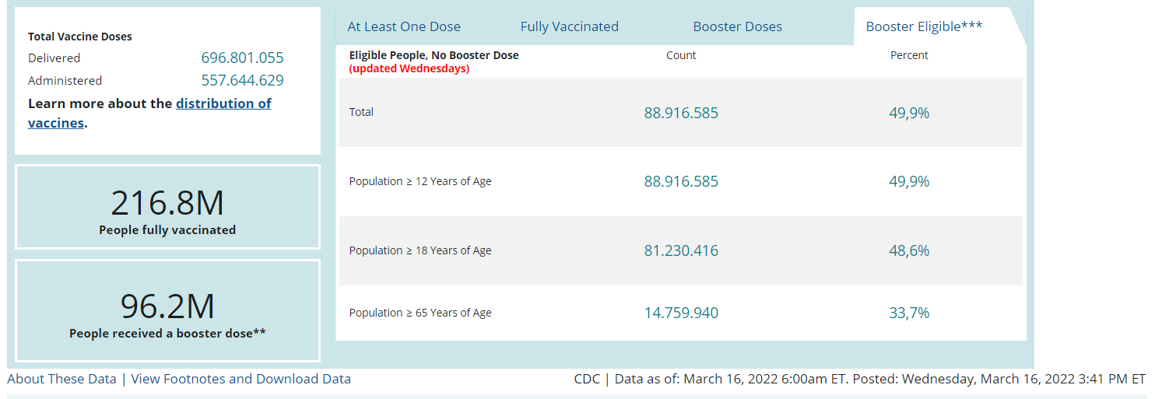
COVID-19 Vaccination in the United States

Slide 14
