Slide 1
Syphilis Case
2/17/22

Slide 2
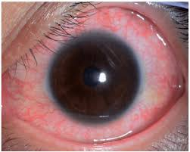
Case
50yo F w DM (A1C 7.2), HTN, anterior uveitis 2018
Presented to optometry clinic with 1 day of R eye redness and light sensitivity
Was given prednisolone/atropine drops empirically and labs sent . . .

Slide 3
Case
PMH
  Anterior Uveitis R eye 8/2018
  DM
  HTN
  Hysterectomy for endometroid adenocarcinoma, 5/2020
SH
  Last sexual activity 2 years ago, had been diagnosed with chlamydia but does not think other labs checked
  Lives with daughter
  Works in administration
Meds
  Aspirin 81mg
  Glargine 25u daily
  Lisinopril 10mg daily
  Metformin 1g BID
  Rosuvastatin 20mg

Slide 4
Case
RPR 1:64
HLA B27 neg
ANA neg
Rheumatoid factor neg
Physical exam other than eye exam was normal
Next steps???

Slide 5
Case
Admitted to start PCN G MU IV every 4 hours
Had LP
  WBC 153 (97% monos)
  RBC 0
  Protein 79
  Glucose 97
  CSF VDRL 1:32
GC/CT urine: neg
HIV neg

Slide 6
Case
After 5 days was changed to
  procaine penicillin G 2.4 units daily
  probenecid 500mg 4x/day
for 14 day course

