Slide 1

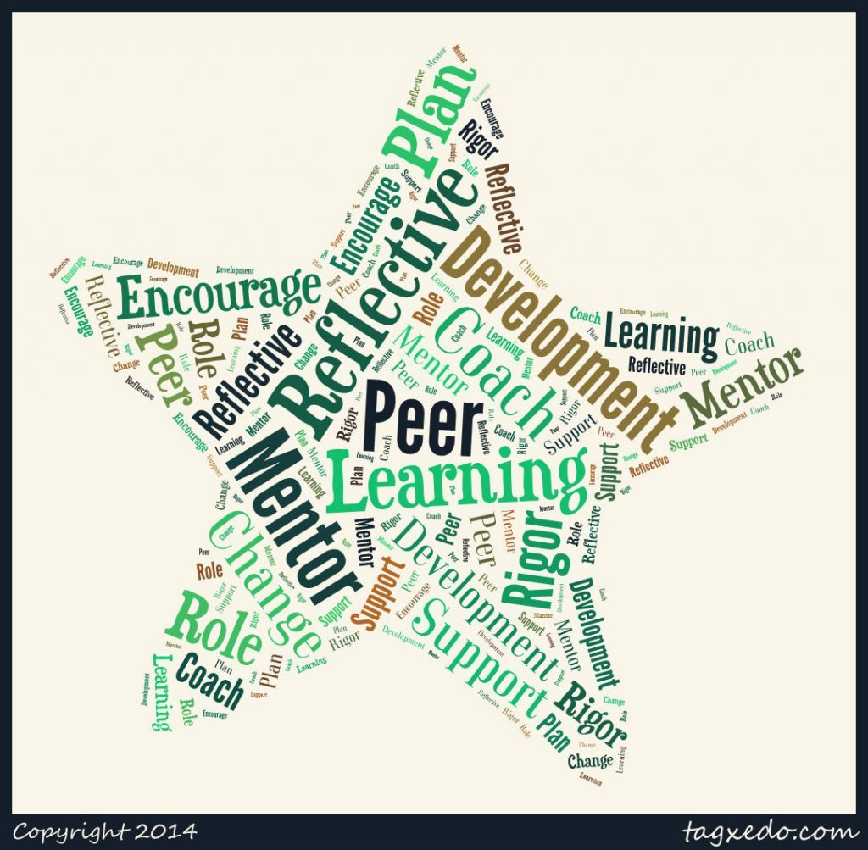
INTRO TO PEER MENTOR SERVICES
NORTHWEST PORTLAND AREA INDIAN HEALTH BOARD
Debra BuffaloBoy, CADC II, PWS, CRM

Slide 2
LEARNING OBJECTIVES
Review
Review the Guiding Principles of Recovery
Increase
Increase knowledge of current Peer roles and Certification categories
Understand
Understand the diverse duties of Addiction Peer Staff
Compare
Compare Native American Indigenous and Dominant Culture
Enhance
Enhance networking touchstones

Slide 3
GUIDING PRINCIPLES OF RECOVERY
There are many pathways to recovery
Recovery
..is self-directed and empowering
..involves a personal recognition of the need for change and transformation
..is holistic
..has cultural dimensions
..exists on a continuum of improved health and wellness

Slide 4
GUIDING PRINCIPLES OF RECOVERY
Recovery
...is supported by peers and allies
…emerges from hope and gratitude
…involves a process of healing and re-definition
…involves (re)joining and (re)building a life in the community
…involves addressing discrimination and transcending shame and stigma
…is a reality. It can, will and does happen.
CSAT White Paper: Guiding Principles and Elements of Recovery-Oriented Systems of Care

Slide 5

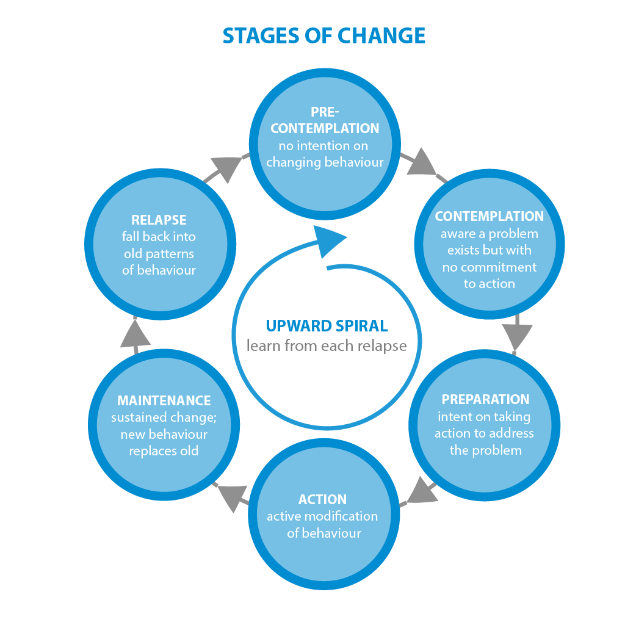
Stages of Change Prochaska & DiClemente

Slide 6
In Oregon
The Oregon Health Authority’s Traditional Health Worker is an umbrella term for frontline public health workers who work in a community or clinic under the direction of a licensed health provider. There are five specialty types of THW’s:
Birth Doulas
Personal Health Navigators (PHN)
Peer Support Specialists (PSS)
Peer Wellness Specialist (PWS) which includes;
Family Support and Youth Support Specialists

Slide 7
MENTAL HEALTH AND ADDICTION CERTIFICATION BOARD OF OREGON MHACBO
Certifies and maintains the Registry for:
Certified Recovery Mentors
Certified Gambling Mentors
Peer Recovery Counselors certified by:
IC/RC International Certification & Reciprocity Consortium

Slide 8
WHAT DO ADDICTION PEER RECOVERY STAFF DO ?
Outreach Worker
Motivator
Sober Companion
Resources
Role-model and mentor
Planner
Problem Solver
Community organizer (ROSC)
Lifestyle Coach

Slide 9
Old Model of Care
Residential Tx
Outpatient Tx
12-Step/Halfway House

Slide 10
New Model of “ROSC” Recovery Oriented Systems of Care
Staffed by Peers in Recovery
Primary Care SBIRT/Residential SAT/ Outpatient Tx
Coordinated Phys/MH Services supporting lifestyle changes
Coordinated Educational or Occupational services
Community Recovery Centers or other Peer Support
Sober Housing
12 Step Meetings or other recovery & spiritual support programs

Slide 11
ENHANCING OUR RAPPORT with NATIVE AMERICAN CLIENTS
Native American
Dominant Culture
Emphasis placed on age
Contributions to the group are emphasized; personal glory discouraged
Children participate in adult activities
Family life includes extended family
Clock time is whenever people are ready; when everyone arrives
People express their ideas and feelings through actions
Present orientation
Emphasis is placed on youth
Competition, winning & individual status is emphasized
Adults participate in youth activities
Family is nuclear
Clock time is exactly that
_ People express themselves through speech
Future orientation
Robert A. Hallowwell

Slide 12
MORE COMPARISONS
NATIVE AMERICAN
DOMINANT CULTURE
Giving/sharing
Patience
Listening skills
Religion is a way of life
Modesty
Work is limited to meeting the needs of the Family
Harmony with Nature
Taking and saving
Aggression
Verbal skills
Religion is a part of life
Self-attention
Work is focused on getting ahead or getting rich
Mastery over Nature

