Slide 1

Innovative Strategies in Harm Reduction: Text-Based Care
Samantha Gustafson, PharmD, BCACP, NCPS
LCDR, United States Public Health Service
Red Lake, MN

Slide 2
Disclosures
I have no conflict of interest to disclose.
I do intend to talk about an off-label use of fentanyl test strips (FTS).

Slide 3
Objectives
Describe the impact of the COVID pandemic on harm reduction resources.
Identify promising practices in text-based, contactless care to meet people where they’re at.

Slide 4
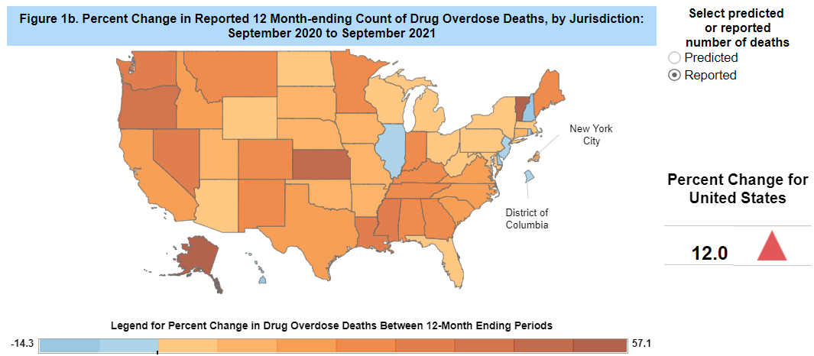
Background:
Provisional
Drug
Overdose
Deaths
During the
Pandemic
https://www.cdc.gov/nchs/nvss/vsrr/drug-overdose-data.htm

Slide 5


Interruptions in recovery services
Disrupted routines
Stress
Loss of work
Limited access to support services

Slide 6
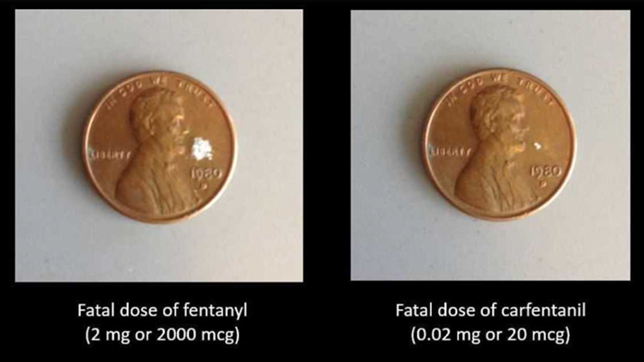
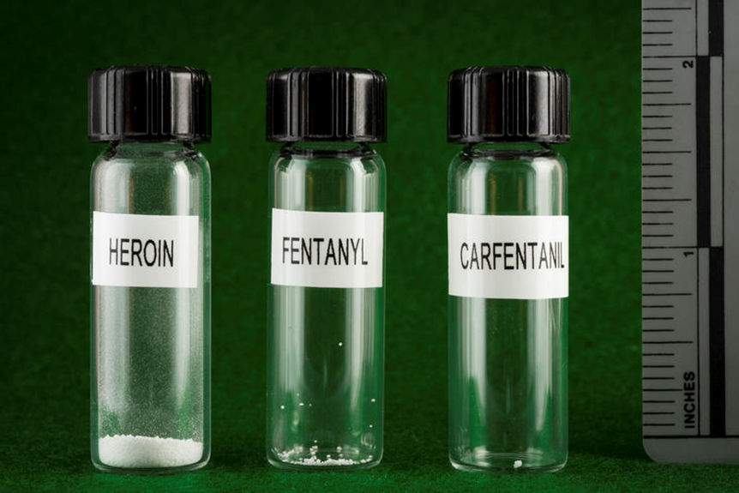
Increased Risk
Changing drug supply
Longer gaps between use
Drug potency
Overdosing alone

Slide 7

Impact on Services
The National Council for Mental Wellbeing completed a brief review
Findings:
  Increased health and social harms to people who use drugs
  Significant reductions to harm reduction services
  Many programs came up with innovative solutions to serve their clients
https://www.thenationalcouncil.org/covid-19-pandemic-impact-on-harm-reduction-services-an-environmental-scan/
Notes:
Like many people during the pandemic I worried how lack of support services and outreach programs would impact harm reduction as a whole. I learned that the National Council for Mental Wellbeing was curious about the same, and had completed a brief review to illustrate what many of us were experiencing in our communities. In it they noted an increase in health and social harms for folks that used substances and significant decreases in harm reduction services. Health fairs weren’t happening, community naloxone deployment events were put on pause, and so many of the outlets we had previously used to reach people were no longer available. This was something happening in communities all across the country with the full impact yet to be seen. Conversely, this review also noted that many programs had started addressing these concerns by finding innovative solutions to serve their clients and that is a big part of what we will be discussing today.

Slide 8


Slide 9
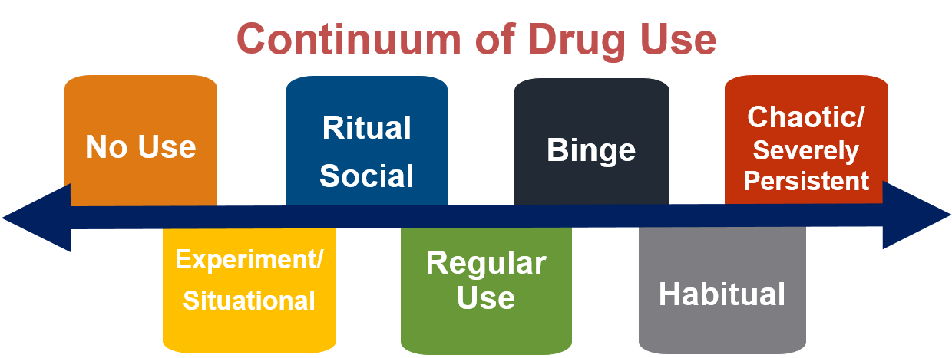
Opportunity in Red Lake
Partnership with the Northwest Portland Area Indian Health Board
  Potential to pilot contactless text-based strategy discussed?
  What would that look like?
    What harm reduction tools were needed?
    How could we get them to people in the community?
    How could it be marketed?

Slide 10
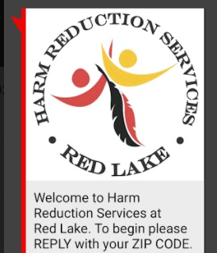
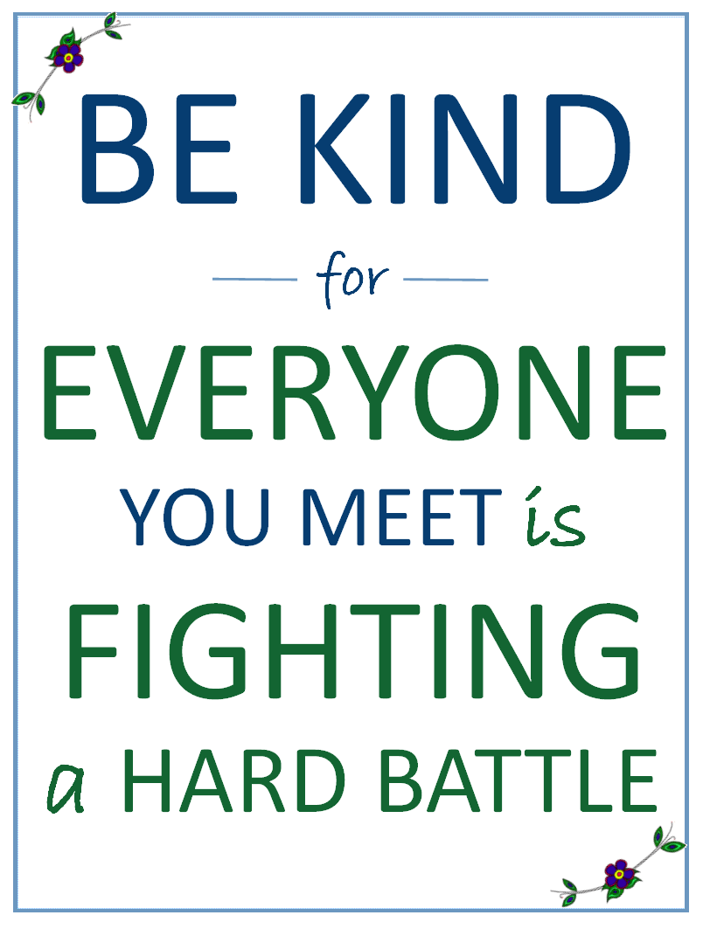
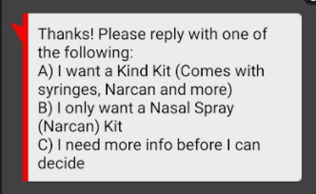
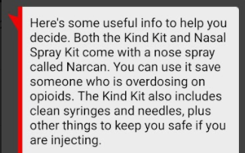
Where We Started
Text-based requests for harm reduction kits
  Titled ‘Kind Kits’
  Text ‘KIND’ to 97779
  Participants prompted through series of questions
  Option given for narcan kit or kind kit
  May be mailed (name not required) or picked up at Red Lake Pharmacy

Slide 11
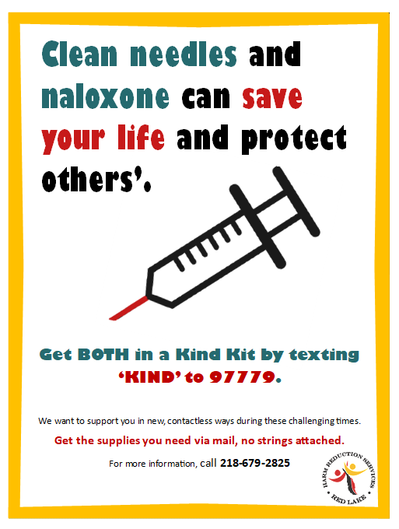
Where We Are Now
Currently limited to Beltrami County residents
Kits include:
  Clean syringes/needles
  Sharps containers
  Tourniquets
  Cookers
  Cotton
  Alcohol swabs
  Naloxone
  Condoms
  Fentanyl Test Strips
  LOTS of education
Often requested at pharmacy window
  Nearly 300 kits deployed in first 5 months

Slide 12

Challenges
Lack of face-to-face education
May not reach all tribal members if living outside of Beltrami County
Kits discarded in hospital restrooms, which can be alarming to staff
Image Credit: https://www.acuitysolutions.co.uk/accounting-software-challenges-financial-project-services/

Slide 13

Next Steps
Expanded education efforts
  Most kits requested at pharmacy window
Consideration for expanding access to other counties
Image Credit: https://www.ptsd.va.gov/apps/craftptsd/lesson16/16_014.htm

Slide 14
Summary
Contactless, text-based harm reduction services provide valuable resources to people in need
Meaningful relationships can still be built by providing a safe space to meet people where they’re at

Slide 15
Success Story

Slide 16

Questions?
Thank you!

