Slide 1

Syphilis in the ED: Why it Matters and What to Know
Erin Tromble, MD
Medical Officer
CDC Division of STD Prevention
lzn6@cdc.gov
March 3, 2022

Slide 2
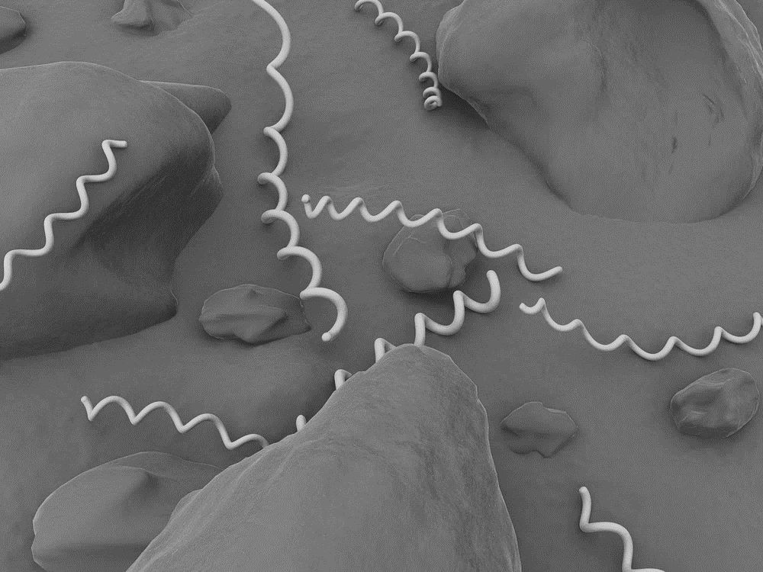
What is syphilis

Slide 3
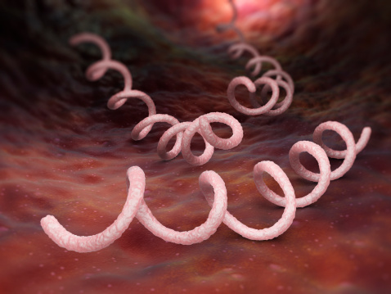
What is syphilis?
Treponema pallidum
Transmission:
  Sexual
  Vertical
  Non-sexual contact

Slide 4
Syphilis is on the rise

Slide 5
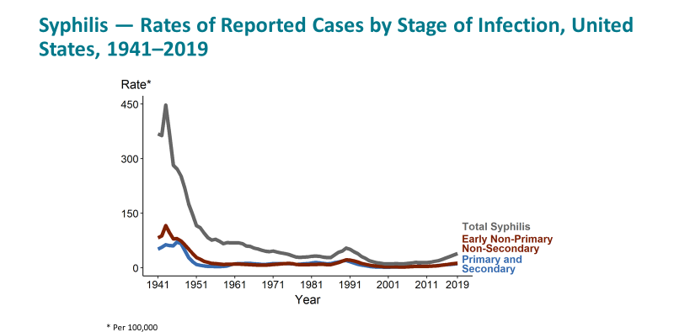
We thought syphilis was on its way out…

Slide 6
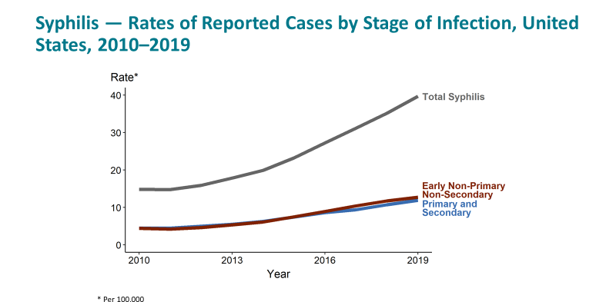
Syphilis has re-emerged

Slide 7
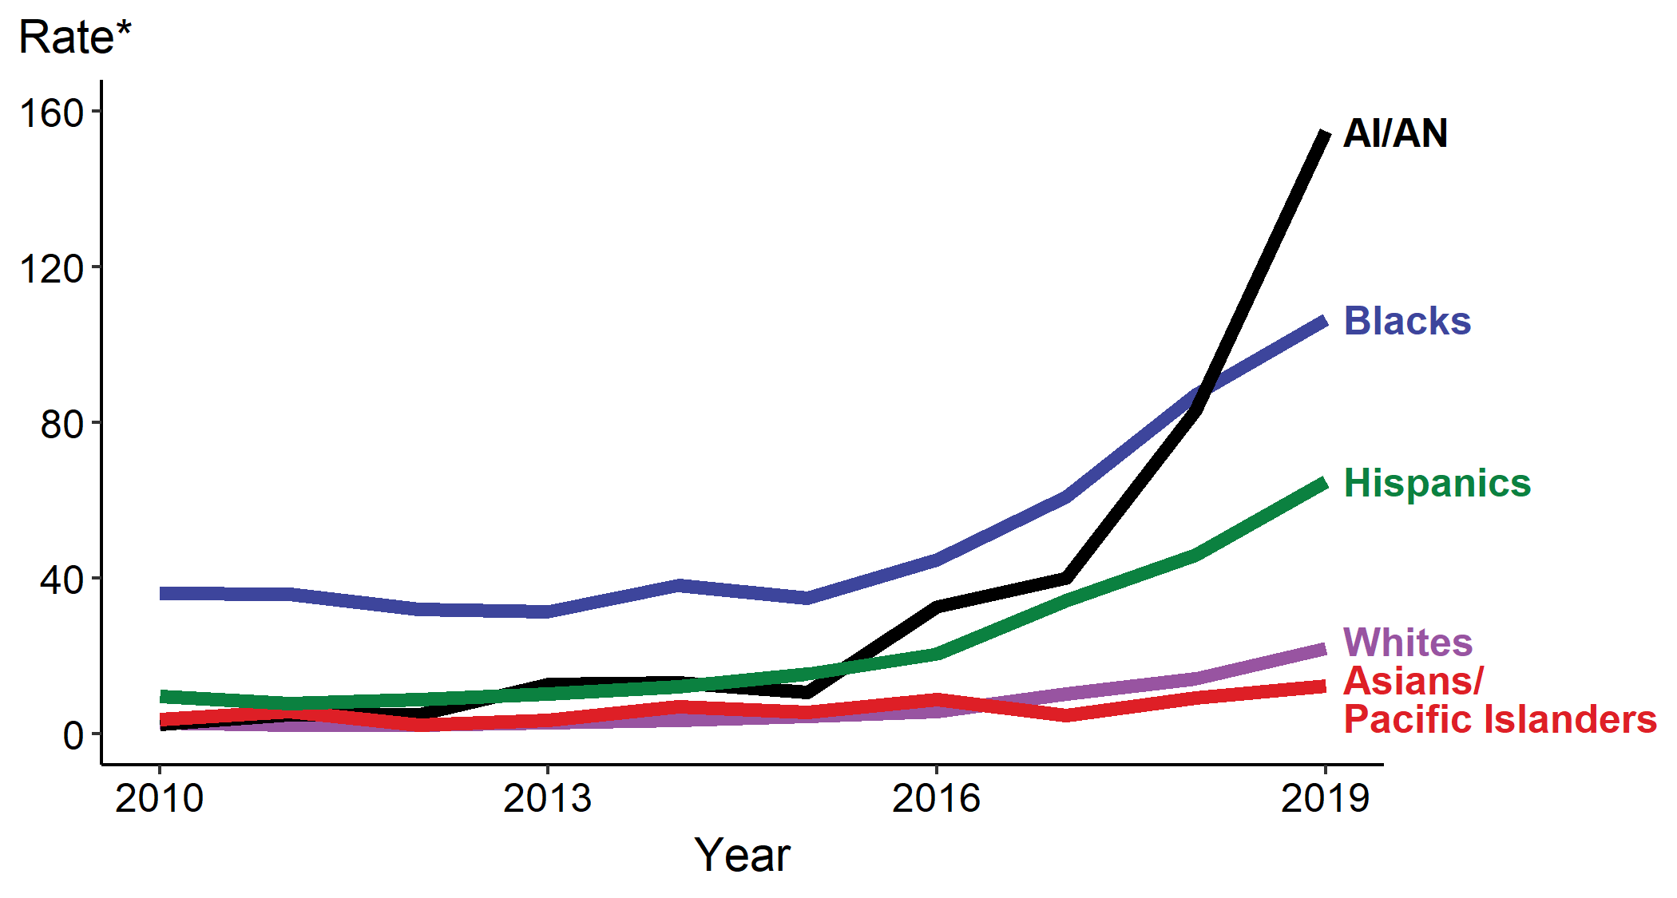
Congenital Syphilis — Rates of Reported Cases by Year of Birth, Race, and Hispanic Ethnicity of Mother, United States, 2010–2019
* Per 100,000 live births
ACRONYMS: AI/AN = American Indians/Alaska Natives

Slide 8
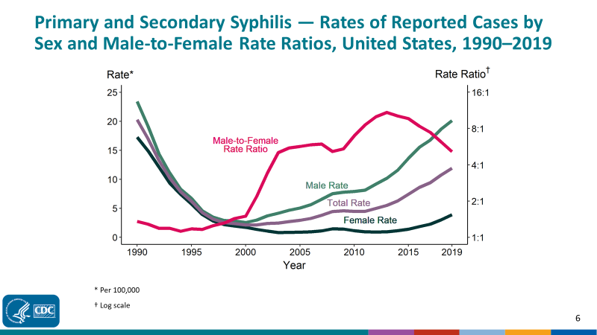
Proportion of syphilis cases in women is rising

Slide 9
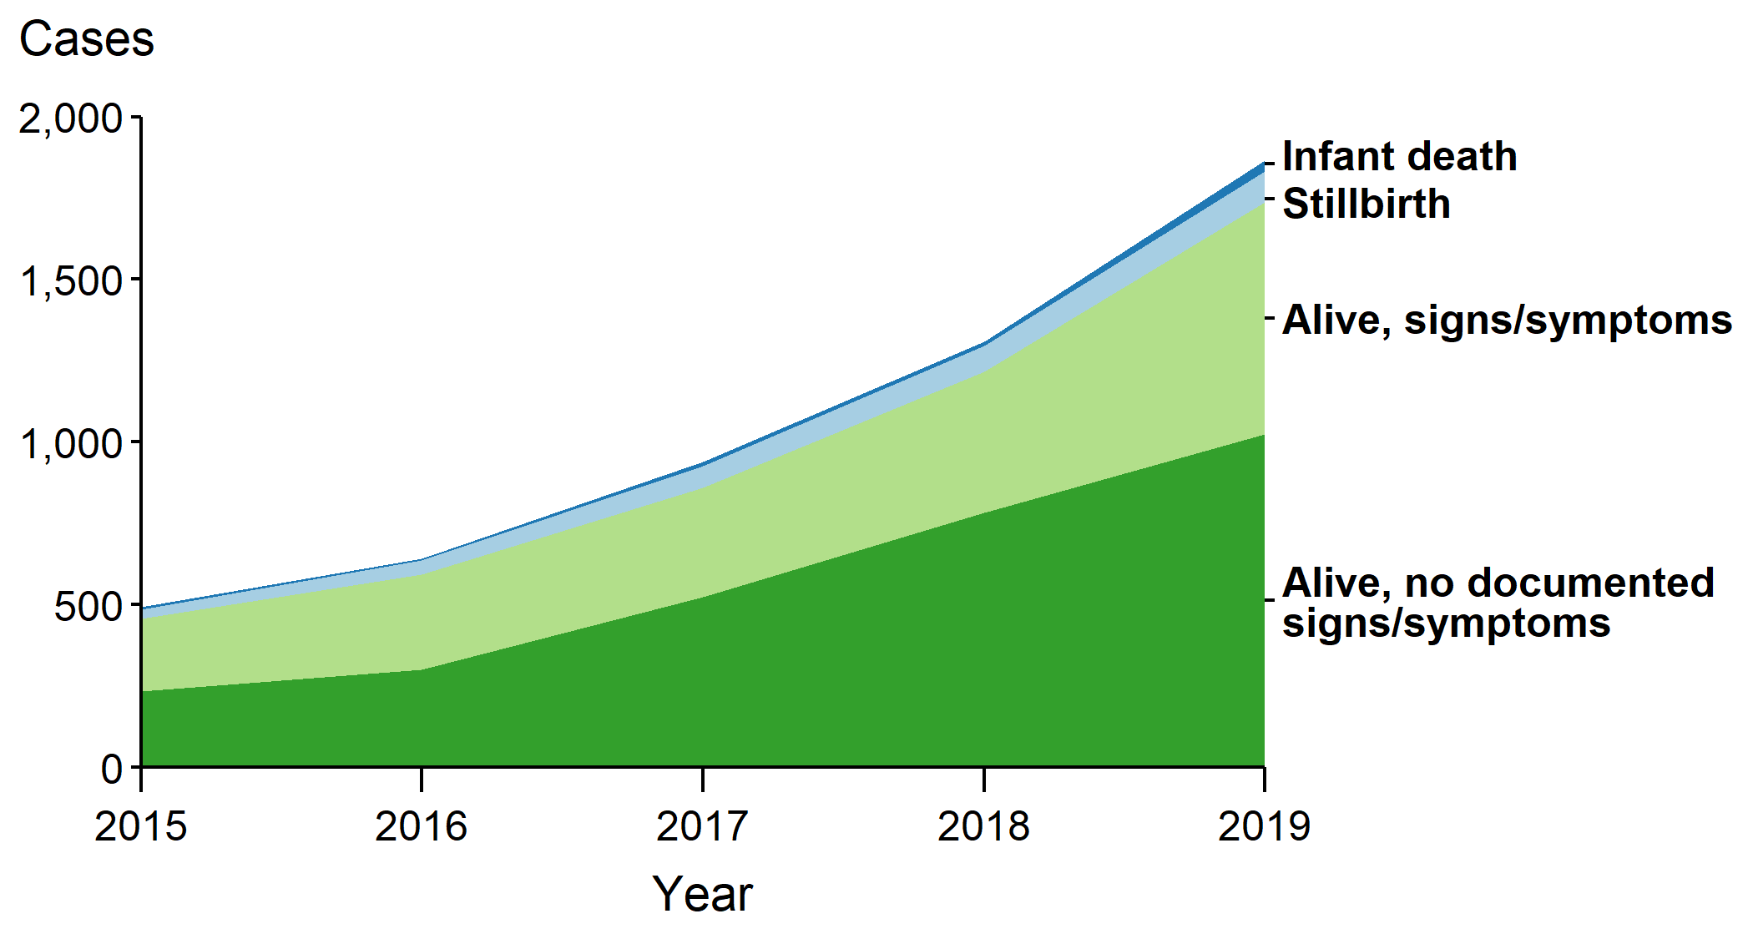
Congenital Syphilis — Number of Reported Cases by Vital Status and Clinical Signs and Symptoms* of Infections, United States, 2015–2019
* Signs/symptoms include long bone changes, snuffles, condyloma lata, syphilitic skin rash, pseudoparalysis, hepatosplenomegaly, edema, jaundice, hepatitis, reactive CSF-VDRL, elevated CSF WBC or protein, or evidence of direct detection of T. Pallidum.
NOTE: Of the 5,269 congenital syphilis cases reported during 2015–2019, 22 (0.4%) did not have sufficient information to be categorized
https://www.cdc.gov/std/statistics/2019/overview.htm#Syphilis

Slide 10
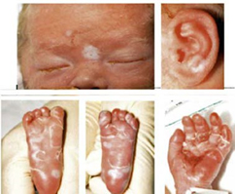
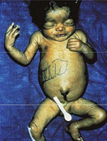
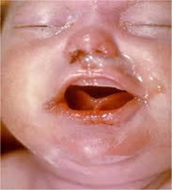
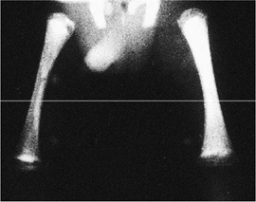
Congenital Syphilis (CS)
https://www.cdc.gov/ncbddd/birthdefects/surveillancemanual/quick-reference-handbook/congenital-syphilis.html

Slide 11
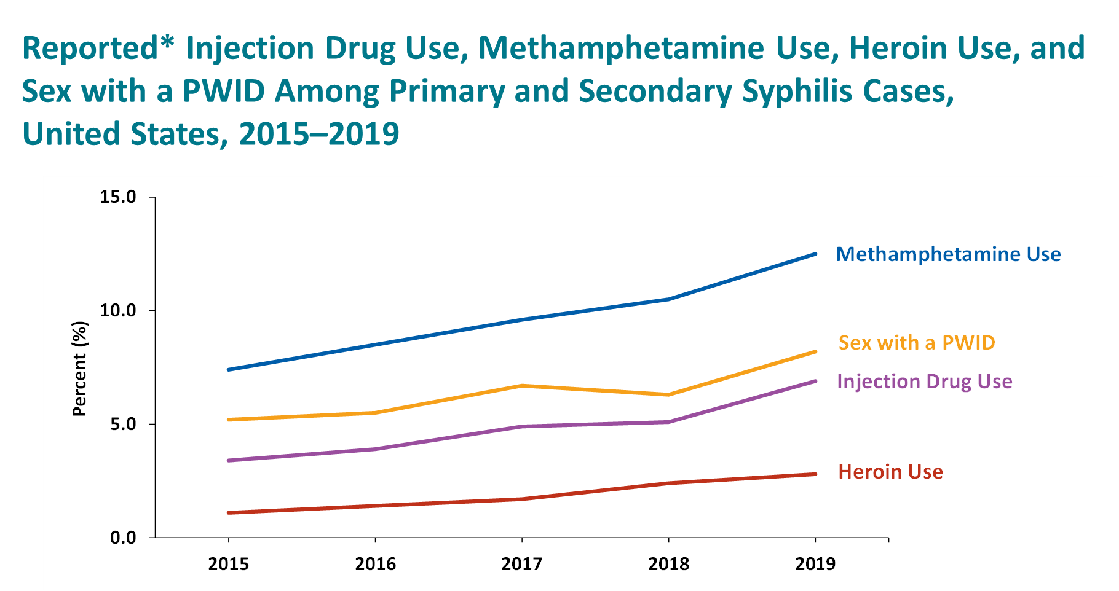
Heroin
~3%

Slide 12
Injection Drugs
>8%

Slide 13
Methamphetamine
>10%

Slide 14
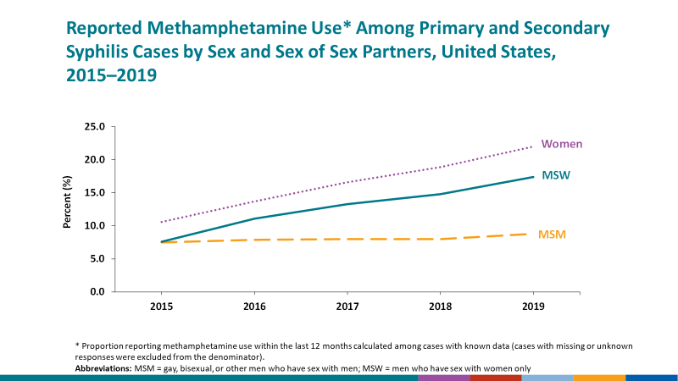
Methamphetamine
in Women
> 20%

Slide 15
Diagnosis

Slide 16
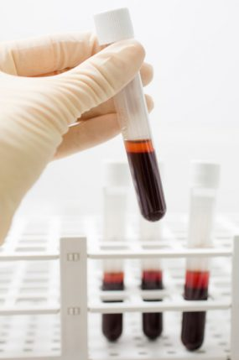

Who should you test in the ED?

Slide 17
Risk factors

Slide 18

Risk factors
Multiple sex partners & Men who have Sex with Men (MSM)

Slide 19


Risk factors
+
Sex + Drugs

Slide 20
Risk factors
Meth or Heroin Use

Slide 21

Risk factors
Incarceration

Slide 22


Risk factors
Homelessness

Slide 23
Anyone tested for HIV or other STI
Syphilis symptoms (especially with risk factors)
Pregnant women not linked to prenatal care
In high prevalence or outbreak settings:
  All pregnant women
  Persons with certain risk factors

Slide 24
Anyone tested for HIV or other STI
Syphilis symptoms (especially with risk factors)
Pregnant women not linked to prenatal care
In high prevalence or outbreak settings:
  All pregnant women
  Persons with certain risk factors
Consider testing as part of your differential diagnosis

Slide 25
Anyone tested for HIV or other STI
Syphilis symptoms (especially with risk factors)
Pregnant women not linked to prenatal care
In high prevalence or outbreak settings:
  All pregnant women
  Persons with certain risk factors
Consider testing as part of ED-based screening

Slide 26
How do you test in the ED?

Slide 27
There are 2 syphilis screening algorithms
Traditional

Slide 28
There are 2 syphilis screening algorithms
Non-Treponemal Test
Traditional

Slide 29
There are 2 syphilis screening algorithms
Non-Treponemal Test
Treponemal Test
Traditional

Slide 30
There are 2 syphilis screening algorithms
Non-Treponemal Test
Treponemal Test
Traditional
Reverse

Slide 31
There are 2 syphilis screening algorithms
Non-Treponemal Test
Treponemal Test
Traditional
Treponemal Test
Reverse

Slide 32
There are 2 syphilis screening algorithms
Non-Treponemal Test
Treponemal Test
Traditional
Treponemal Test
Non-Treponemal Test
Reverse

Slide 33
There are 2 syphilis screening algorithms
Non-Treponemal Test
Treponemal Test
Traditional
If discordance
Treponemal Test
Non-Treponemal Test
TPPA
Reverse

Slide 34
2 types of serologic tests for syphilis
Non-treponemal
RPR, VDRL
Titers – manual, slow
May not results before disposition

Slide 35
2 types of serologic tests for syphilis
Non-treponemal
RPR, VDRL
Titers – manual, slow
May not results before disposition
Treponemal
EIA, TPPA, FTA-ABS
Automated – faster results
Remain positive for life

Slide 36
There are 2 syphilis screening algorithms
Non-Treponemal Test
Treponemal Test
Traditional
Treponemal Test
Non-Treponemal Test
Reverse

Slide 37
There are 2 syphilis screening algorithms
Non-Treponemal Test
Treponemal Test
Traditional
Missed treatment opportunities

Slide 38
There are 2 syphilis screening algorithms
Overtreatment
Treponemal Test
Non-Treponemal Test
Reverse

Slide 39
Case #1
32-year-old man comes to the ED with methamphetamine intoxication. He is agitated and resisting efforts to examen or talk to him. ED staff is eventually able to draw basic labs, including syphilis serologies. The laboratory uses the reverse algorithm, and the EIA returns positive. You plan to begin presumptive treatment in this patient once he clears his intoxication. Which of the following is needed to complete his therapy?
A single dose of penicillin IM
Multiple doses of penicillin IM
IV penicillin
2 weeks of doxycycline
Don’t know

Slide 40
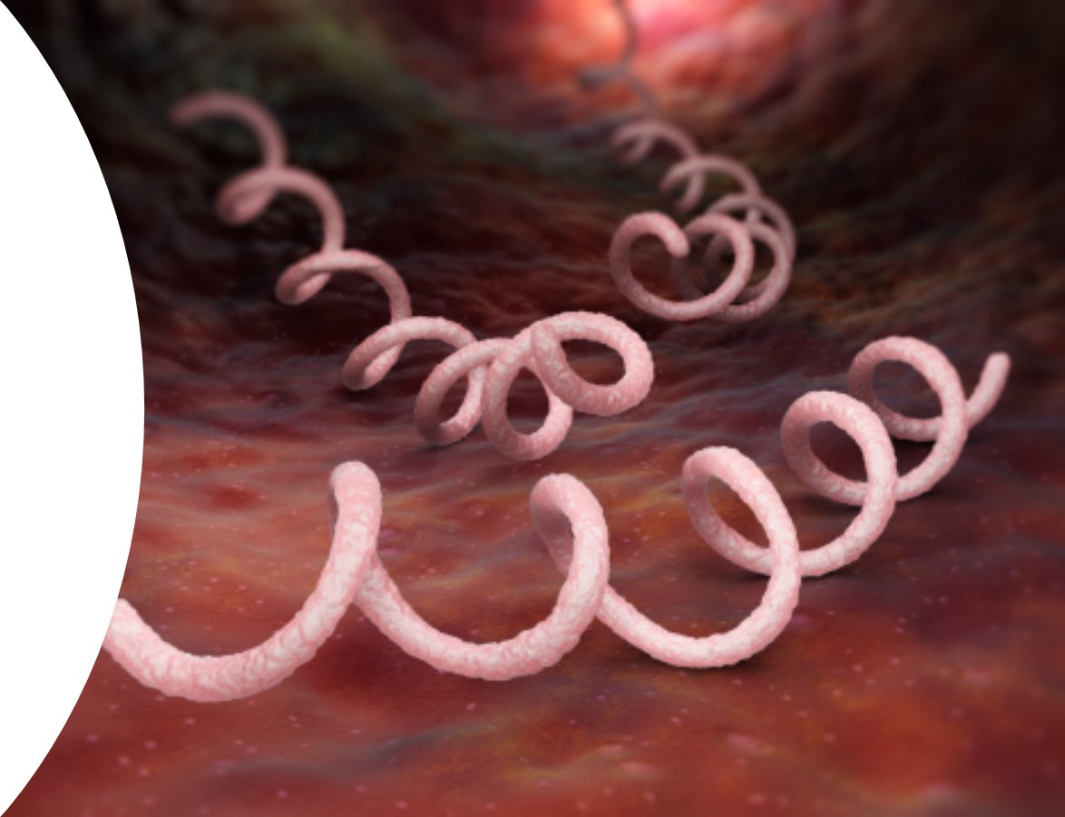
You can’t treat syphilis until you stage syphilis

Slide 41
Symptoms & Clinical
stages

Slide 42
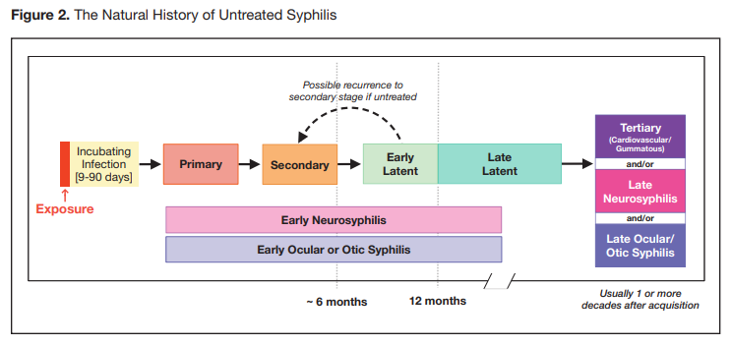
Clinical Stages
Source: Center, Prevention Training. "The Diagnosis, Management and Prevention of Syphilis." (2019). https://www.nycptc.org/x/Syphilis_Monograph_2019_NYC_PTC_NYC_DOHMH.pdf

Slide 43
Clinical Stages
Source: Center, Prevention Training. "The Diagnosis, Management and Prevention of Syphilis." (2019). https://www.nycptc.org/x/Syphilis_Monograph_2019_NYC_PTC_NYC_DOHMH.pdf

Slide 44
Primary
~ 3 weeks incubation
Chancre stage (localized signs of infection)
Highly infectious

Slide 45
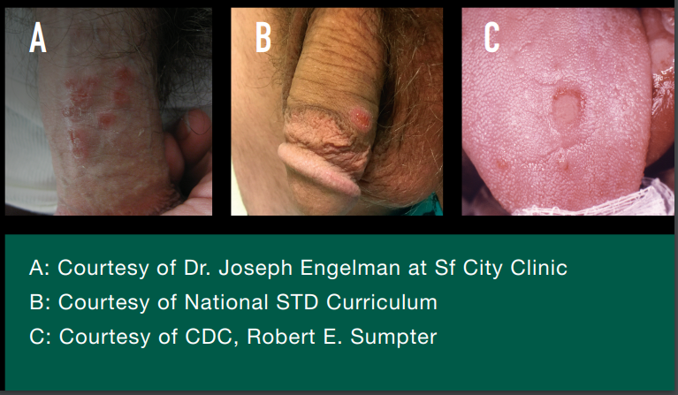
Primary - Chancre

Slide 46
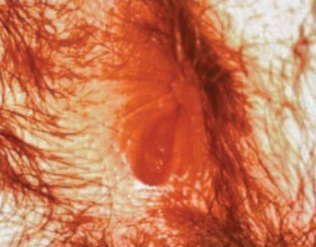
Primary - Chancre

Slide 47
Primary – Atypical Chancre

Slide 48
Primary –
Atypical Chancre

Slide 49
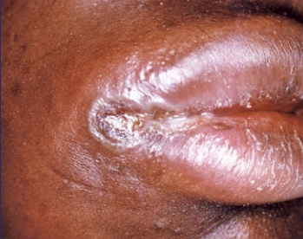
Primary –
Atypical Chancre

Slide 50
Clinical Stages
Source: Center, Prevention Training. "The Diagnosis, Management and Prevention of Syphilis." (2019). https://www.nycptc.org/x/Syphilis_Monograph_2019_NYC_PTC_NYC_DOHMH.pdf

Slide 51
Clinical Stages
Source: Center, Prevention Training. "The Diagnosis, Management and Prevention of Syphilis." (2019). https://www.nycptc.org/x/Syphilis_Monograph_2019_NYC_PTC_NYC_DOHMH.pdf

Slide 52
~6 weeks after infection
Disseminated, systemic form of infection
Highly infectious
Rash stage (mucocutaneous lesions)
Secondary

Slide 53
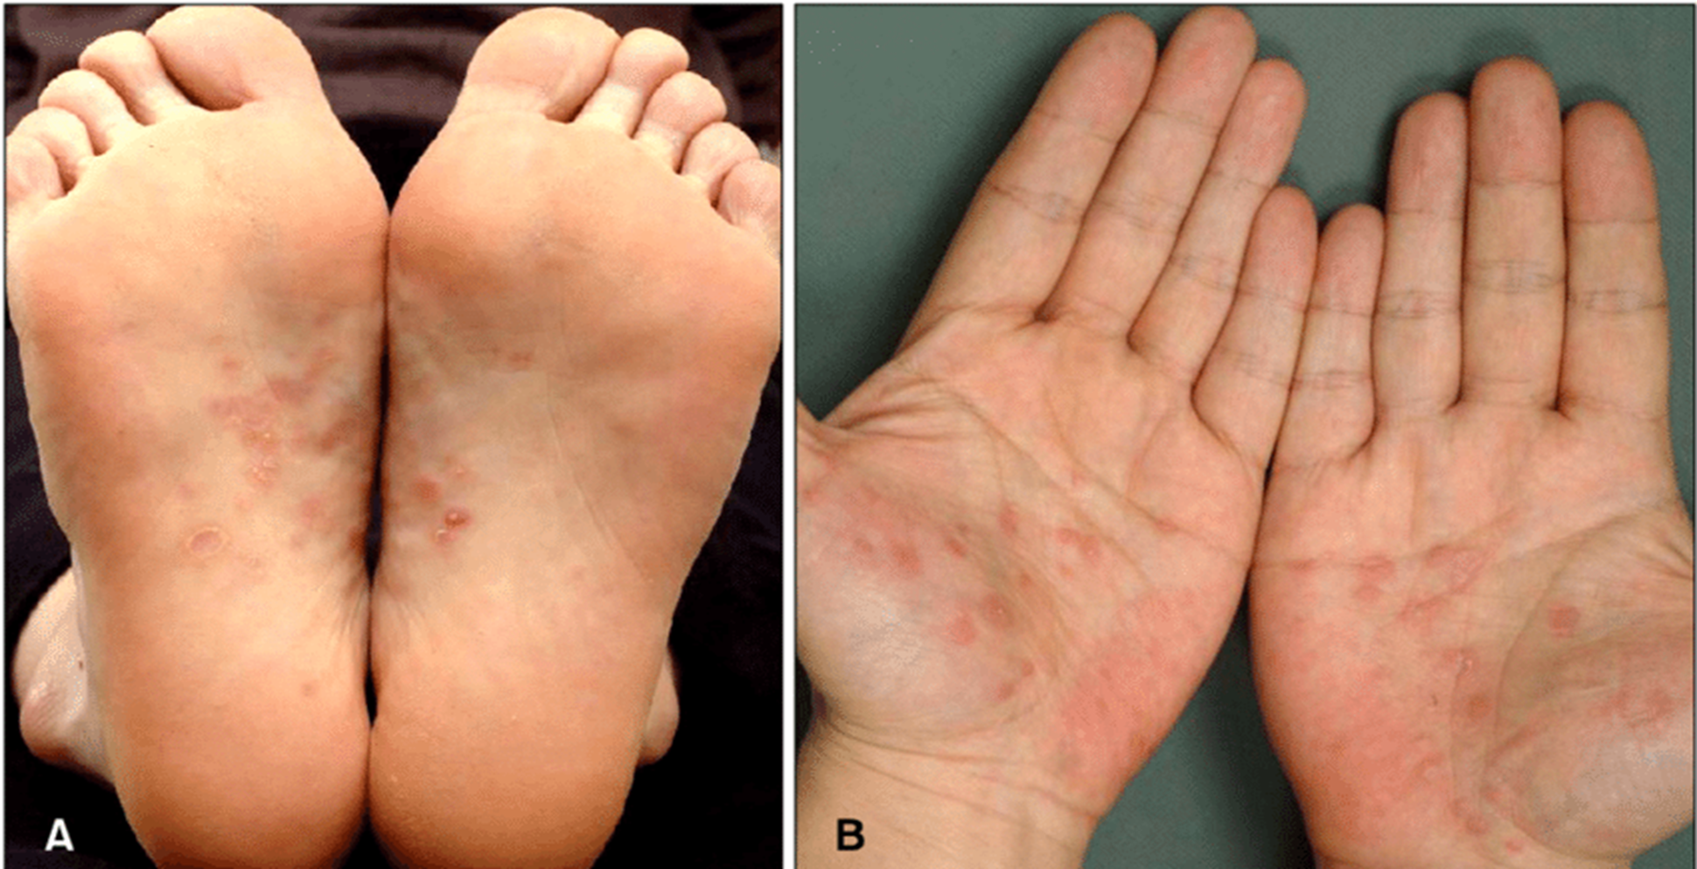
Secondary

Slide 54
Secondary

Slide 55
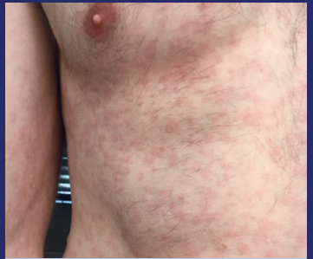
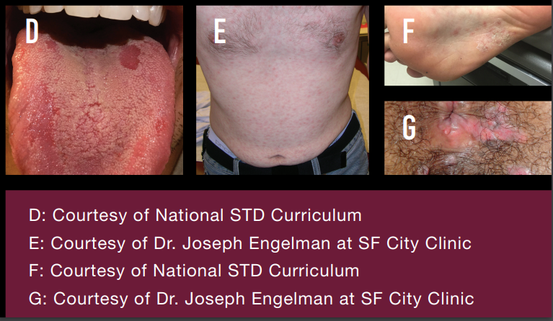
Secondary

Slide 56
Secondary – Condyloma lata

Slide 57
Secondary – Mucous patch

Slide 58
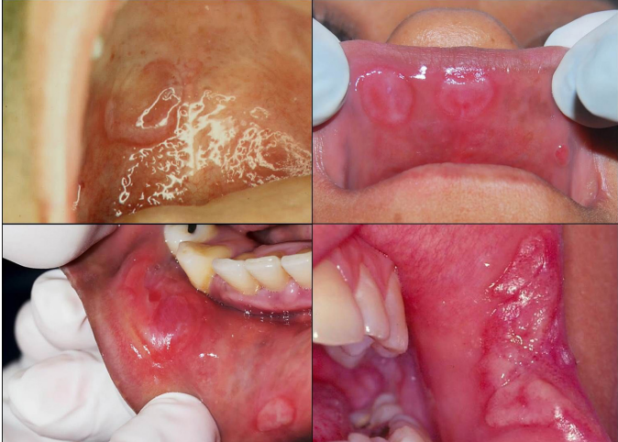
Secondary – Mucous patch
Source: De Paulo, L. F. B., Servato, J. P. S., Oliveira, M. T. F., Durighetto Jr, A. F., & Zanetta-Barbosa, D. (2015). Oral manifestations of secondary syphilis. International Journal of Infectious Diseases, 35, 40-42.

Slide 59
Clinical Stages
Source: Center, Prevention Training. "The Diagnosis, Management and Prevention of Syphilis." (2019). https://www.nycptc.org/x/Syphilis_Monograph_2019_NYC_PTC_NYC_DOHMH.pdf

Slide 60
Clinical Stages
Source: Center, Prevention Training. "The Diagnosis, Management and Prevention of Syphilis." (2019). https://www.nycptc.org/x/Syphilis_Monograph_2019_NYC_PTC_NYC_DOHMH.pdf

Slide 61
Partial clearance
Asymptomatic
Possible relapse into earlier stages
< 12 months from infection
Early Latent

Slide 62
Clinical Stages
Source: Center, Prevention Training. "The Diagnosis, Management and Prevention of Syphilis." (2019). https://www.nycptc.org/x/Syphilis_Monograph_2019_NYC_PTC_NYC_DOHMH.pdf

Slide 63
Clinical Stages
Source: Center, Prevention Training. "The Diagnosis, Management and Prevention of Syphilis." (2019). https://www.nycptc.org/x/Syphilis_Monograph_2019_NYC_PTC_NYC_DOHMH.pdf

Slide 64
≥ 12 months after infection
Asymptomatic
Late latent, not infectious
Unknown duration, may be infectious
Late Latent
&
Latent, Unknown Duration

Slide 65
Clinical Stages
Source: Center, Prevention Training. "The Diagnosis, Management and Prevention of Syphilis." (2019). https://www.nycptc.org/x/Syphilis_Monograph_2019_NYC_PTC_NYC_DOHMH.pdf

Slide 66
Clinical Stages
Source: Center, Prevention Training. "The Diagnosis, Management and Prevention of Syphilis." (2019). https://www.nycptc.org/x/Syphilis_Monograph_2019_NYC_PTC_NYC_DOHMH.pdf

Slide 67
Tertiary
Years to decades after infection
Chronic, persistent infection
e.g., cardiovascular system, skin, bones
Not infectious

Slide 68
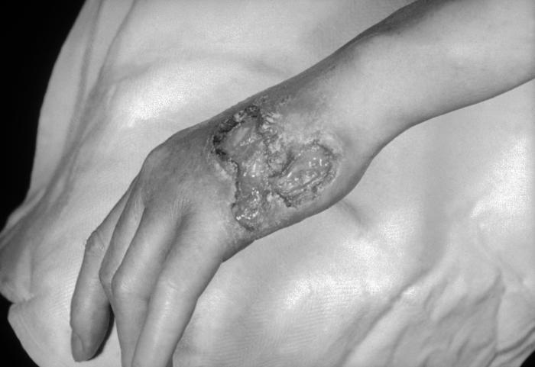
Tertiary - Gumma

Slide 69
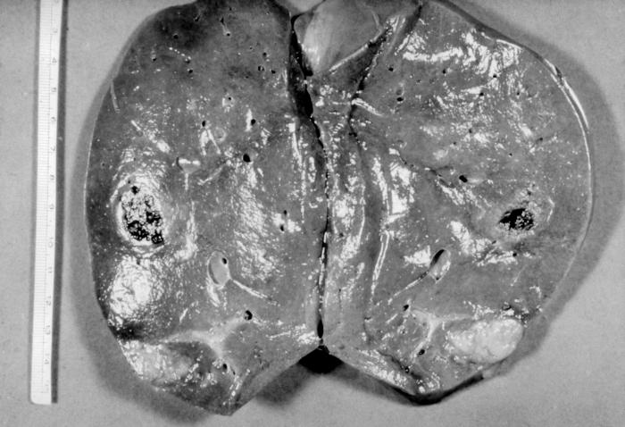
Tertiary - Gumma

Slide 70
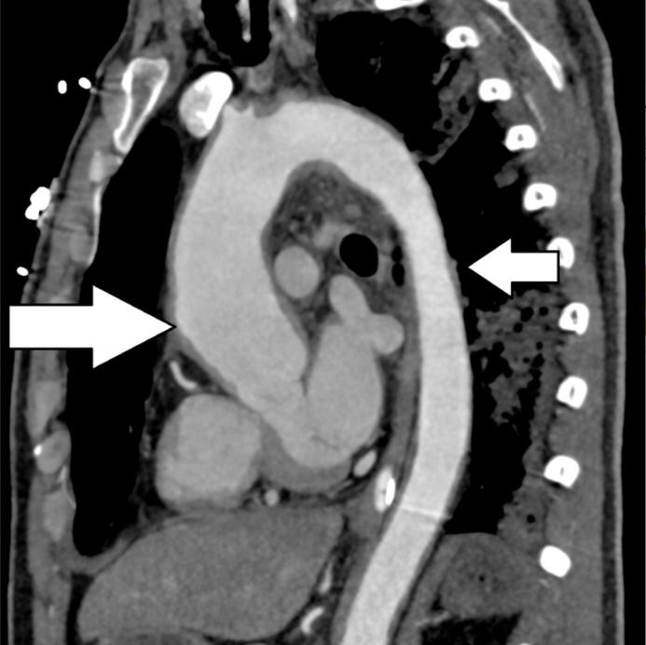
Tertiary –
Aortitis
Source: Lian, K., Lee, L., & Machan, L. (2017). Syphilitic aortitis with coronary ostial involvement: AIRP best cases in radiologic-pathologic correlation. RadioGraphics, 37(2), 407-412.

Slide 71
Sites of Infection

Slide 72
Source: Center, Prevention Training. "The Diagnosis, Management and Prevention of Syphilis." (2019). https://www.nycptc.org/x/Syphilis_Monograph_2019_NYC_PTC_NYC_DOHMH.pdf

Slide 73
Neurosyphilis
Source: Center, Prevention Training. "The Diagnosis, Management and Prevention of Syphilis." (2019). https://www.nycptc.org/x/Syphilis_Monograph_2019_NYC_PTC_NYC_DOHMH.pdf

Slide 74
Early Neurosyphilis
Weeks to years after infection
Meningitis affecting cranial nerves
Meningovascular syphilis, stroke-like symptoms
Late Neurosyphilis
10 – 30 years after infection
Tertiary stage
General paresis or tabes dorsalis

Slide 75
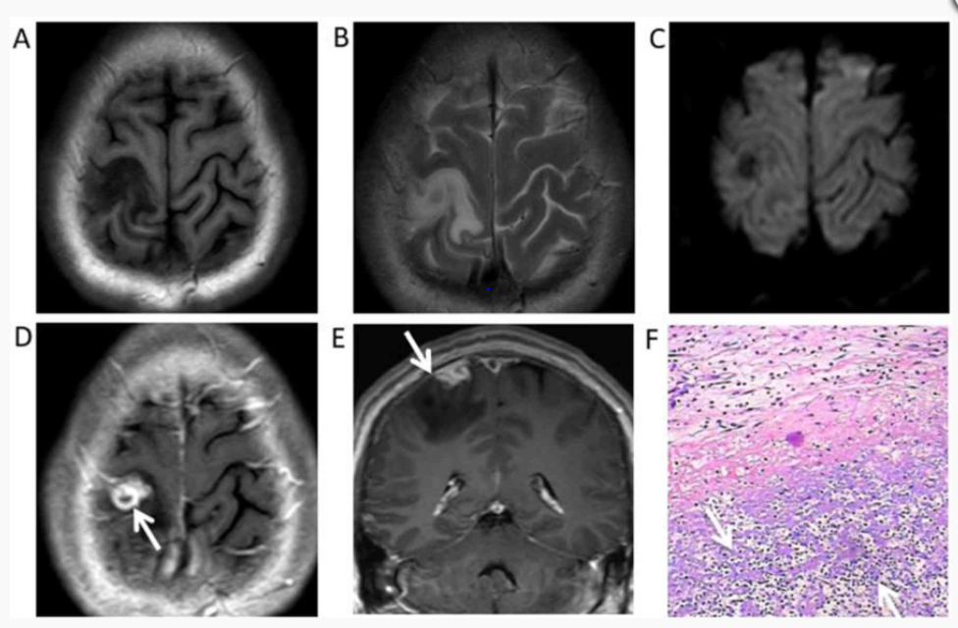
Late Neurosyphilis
Source: Li, C., Wang, S., Tang, G., Liu, L., & Chen, G. (2019). Neuroimaging findings of cerebral syphilitic gumma. Experimental and Therapeutic Medicine, 18, 4185-4192. https://doi.org/10.3892/etm.2019.8089

Slide 76
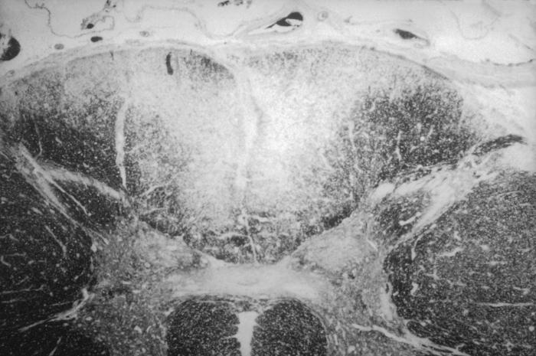
Late Neurosyphilis

Slide 77
Any stage
Symptoms of posterior or panuveitis
Occular Syphilis
Any stage
Sensorineural hearing loss, tinnitus, or vertigo
Otic Syphilis

Slide 78
Neurosyphilis of any stage
Can result in permanent neurologic damage
Requires immediate treatment
And complete neurologic exam including LP

Slide 79
Case #2
A 24-year-old female presents to the ED with a complaint of irregular vaginal bleeding. During her pelvic exam, you note a small ulcer near the vaginal introitus. On further exam it appears painless. The patient hasn’t noticed it. She doesn’t know when how long it’s been there. Which of the following appropriate describe the syphilis stage and most appropriate ED management?
Primary syphilis - Order syphilis serologies, pregnancy test, and presumptively treat with IM BIC.
Primary syphilis - Order syphilis serologies, pregnancy test, and presumptively treat with IM BIC. Take a sexual history and conduct a neuro exam
Secondary syphilis - Order syphilis serologies, pregnancy test, and presumptively treat with IM BIC. Take a sexual history and conduct a neuro exam
Primary syphilis - Order syphilis serologies, pregnancy test, wait to treat until both results return. Take a sexual history and conduct a neuro exam

Slide 80
Treatment

Slide 81
3 Treatment Categories
Source: Center, Prevention Training. "The Diagnosis, Management and Prevention of Syphilis." (2019). https://www.nycptc.org/x/Syphilis_Monograph_2019_NYC_PTC_NYC_DOHMH.pdf

Slide 82
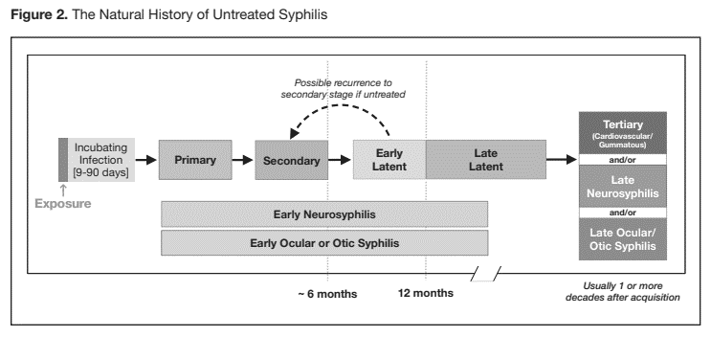
3 Treatment Categories
Early Syphilis
Source: Center, Prevention Training. "The Diagnosis, Management and Prevention of Syphilis." (2019). https://www.nycptc.org/x/Syphilis_Monograph_2019_NYC_PTC_NYC_DOHMH.pdf

Slide 83
3 Treatment Categories
Late Syphilis
Source: Center, Prevention Training. "The Diagnosis, Management and Prevention of Syphilis." (2019). https://www.nycptc.org/x/Syphilis_Monograph_2019_NYC_PTC_NYC_DOHMH.pdf

Slide 84

3 Treatment Categories
Neurosyphilis
Source: Center, Prevention Training. "The Diagnosis, Management and Prevention of Syphilis." (2019). https://www.nycptc.org/x/Syphilis_Monograph_2019_NYC_PTC_NYC_DOHMH.pdf

Slide 85
Early Syphilis
Treatment
Single dose of 2.4 million units of Benzathine Penicillin G

Slide 86
Late Syphilis
Treatment
3 doses of 2.4 million units of Benzathine Penicillin G one week apart

Slide 87
Neurosyphilis
OR
Treatment
Aqueous crystalline penicillin G 18 – 24 million units/day

Slide 88

Pregnant Women
Treatment
According to Stage

Slide 89
Pregnant Women
Treatment
If you treat the mother, you treat the baby

Slide 90



In summary:
Early syphilis = 1 dose IM
Late syphilis = 3 doses IM a week apart
Neurosyphilis = IV + LP + admission
+
+
+

Slide 91
ED Management

Slide 92
Anyone tested for HIV or other STI
Syphilis symptoms (especially with risk factors)
Pregnant women not linked to prenatal care
In high prevalence or outbreak settings:
  All pregnant women
  Persons with certain risk factors

Slide 93
Anyone tested for HIV or other STI
Syphilis symptoms (especially with risk factors)
Pregnant women not linked to prenatal care
In high prevalence or outbreak settings:
  All pregnant women
  Persons with certain risk factors
Symptomatic - syphilis on differential diagnosis

Slide 94
Early Syphilis
Consider syphilis for:
Any genital or perianal ulcer
Any unexplained rash or oral sore
- Especially with risk factors
Management:
Collect serologies
Conduct a neuro exam
Take a sexual history
Consider presumptive treatment
Get a pregnancy test

Slide 95
Late Syphilis
Consider syphilis for:
Cardiovascular disease including, aortic and valve disease
Atypical soft tissue masses
Especially with risk factors
Management:
Collect serologies
Conduct a neuro exam + LP
Take a sexual history
Consider presumptive treatment
Get a pregnancy test

Slide 96
Neurosyphilis
OR
Consider neurosyphilis:
Meningitis
Stroke-like symptoms
Vision changes or eye pain
Dementia, paresis
especially with risk factors or other syphilis hallmarks
Management:
Collect serologies
Conduct a neuro exam + LP
Take a sexual history
Initiate treatment
Get a pregnancy test

Slide 97
Anyone tested for HIV or other STI
Syphilis symptoms (especially with risk factors)
Pregnant women not linked to prenatal care
In high prevalence or outbreak settings:
  All pregnant women
  Persons with certain risk factors
Consider testing as part of ED-based screening

Slide 98
Non-Treponemal Test
Treponemal Test
Traditional
Treponemal Test
Non-Treponemal Test
Reverse

Slide 99
Early syphilis = 1 dose IM
Late syphilis = 3 doses IM a week apart
Neurosyphilis = IV + LP + admission
+
+
+

Slide 100
Early syphilis = 1 dose IM
Late syphilis = 3 doses IM a week apart
Neurosyphilis = IV + LP + admission
+
+
+

Slide 101
Early syphilis = 1 dose IM
Late syphilis = 3 doses IM a week apart
Neurosyphilis = IV + LP + admission
+
+
+

Slide 102
What you actually care about:
Includes any patient with unknown duration
Early syphilis = 1 dose IM
Late syphilis = 3 doses IM a week apart
Neurosyphilis = IV + LP + admission
+
+
+

Slide 103
If you have one positive test, at least try…
A skin, GU, and neuro exam
  if abnormal, you can stage and impact treatment
A history of genital, perianal ulcers, unexplained rashes, or other skin sores in the past 9-11 months
A sexual history
  recent partners, any known exposures
Presumptive treatment

Slide 104
If screening in the ED…
Get a pregnancy test on any woman of reproductive age who is screened
Consider a syphilis test on any pregnant woman, especially if you know they have no prenatal care
Remember that treating the mother, treats the baby

Slide 105
Case #2
28-year-old pregnant female to STI clinic for complaints of abnormal vaginal discharge. She has not been linked to prenatal care, so you decide to add a syphilis screening to your work-up. Three days later, results come back with an RPR value of 1:16. How do you interpret these results?
This patient has syphilis and should receive treatment
This patient has a biologic false positive and nothing more is needed
More information is needed to interpret these results
This is a problem for the ID docs and OBs

Slide 106
Summary
Syphilis is back - Raise your index of suspicion
  At least consider syphilis for any patient with:
    Neurologic complaints (including vision and otic complaints)
    Any genital ulcer
    Unexplained rashes or sores
The epidemiology of syphilis is shifting
  Think of syphilis outside of the classic risk categories (men and MSM)

Slide 107
Summary
You can’t treat syphilis if you don’t stage syphilis
Before discharge do your best to get:
  History of genital lesions, unexplained rashes, or neuro symptoms in the prior 9 - 11 months
  Skin, GU, and neurologic exam
  History of sexual partners
All women tested for syphilis need a pregnancy test

Slide 108
Provider Education Resources
CDC STD Treatment Guidelines: https://www.cdc.gov/std/treatment-guidelines/default.htm
Indian Country Infectious Disease ECHO: www.IndianCountryECHO.org
New York City Monograph: https://www.nycptc.org/x/Syphilis_Monograph_2019_NYC_PTC_NYC_DOHMH.pdf
CDC Syphilis Pocket Guide: https://www.cdc.gov/std/syphilis/syphilis-pocket-guide-final-508.pdf
National STD curriculum: https://www.std.uw.edu/
STD podcast: https://www.std.uw.edu/podcast
National Network of STD Prevention Training Centers: https://www.cdc.gov/std/training/default.htm

Slide 109
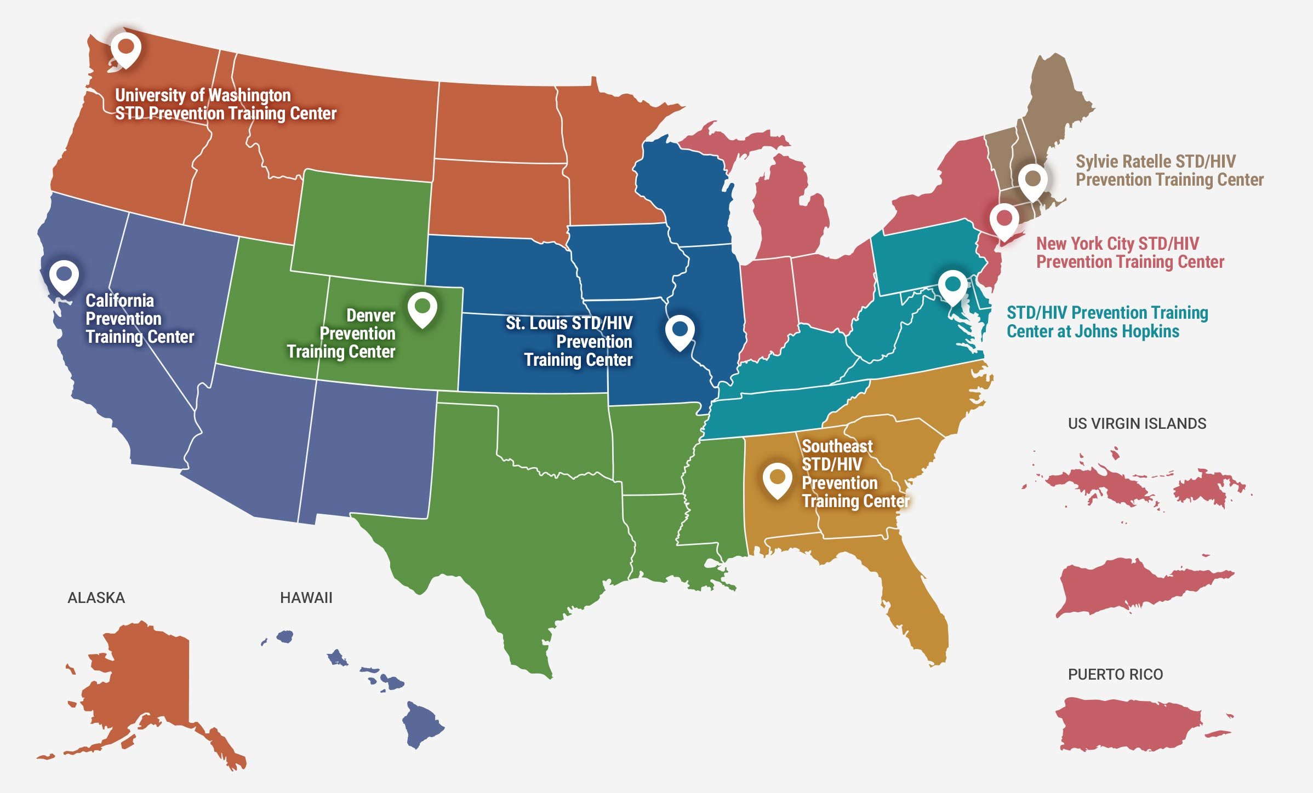


Slide 110



Slide 111
Thank you!

Slide 112
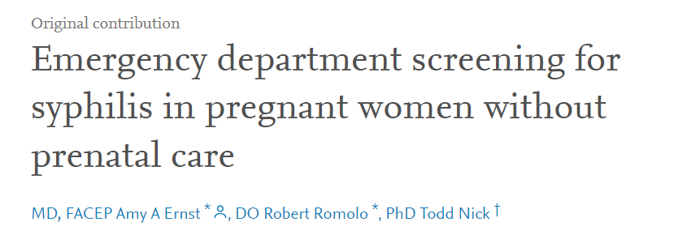
An opportunity for ED providers to intervene:
Source: Ernst, A. A., Romolo, R., & Nick, T. (1993). Emergency department screening for syphilis in pregnant women without prenatal care. Annals of emergency medicine, 22(5), 781-785.

Slide 113
An opportunity for ED providers to intervene:
72 pregnant women without prenatal care screened
11.1%
newly detected syphilis
Source: Ernst, A. A., Romolo, R., & Nick, T. (1993). Emergency department screening for syphilis in pregnant women without prenatal care. Annals of emergency medicine, 22(5), 781-785.

Slide 114
https://www.cdc.gov/ncbddd/birthdefects/surveillancemanual/quick-reference-handbook/congenital-syphilis.html

