Slide 1
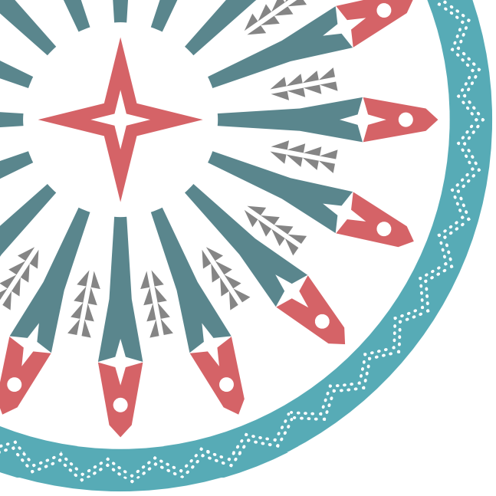


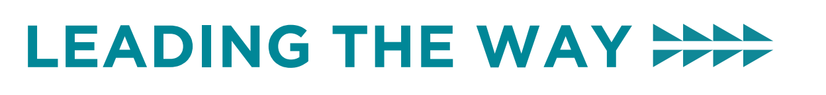
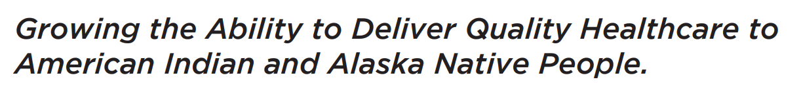
Moral Injury, Resilience, and Post-Traumatic Growth Amidst the COVID Response
March 1, 2022
Nomi Levy-Carrick, MD, MPhil

Slide 2
Upcoming Grand Rounds
Wednesday, March 23rd, 2022 @ 10am PT:
  Hepatitis B Vaccinations: Update on Recommendations
    Dr. Mark Weng, MD, MSc and CAPT Holly Van Lew, PharmD, BCPS

Slide 3


Disclosures
This activity is jointly provided by Northwest Portland Area Indian Health Board and Cardea Services​​
​​
Cardea Services is approved as a provider of nursing continuing professional development by Montana Nurses Association, an accredited approver with distinction by the American Nurses Credentialing Center’s Commission on Accreditation.​​
​​
This activity has been planned and implemented in accordance with the accreditation requirements and policies of the California Medical Association (CMA) through the joint providership of Cardea and Northwest Portland Area Indian Health Board . Cardea is accredited by the CMA to provide continuing medical education for physicians.​​
​​
Cardea designates this live web-based training for a maximum of 1 AMA PRA Category 1 Credit(s)TM on March 1, 2022, Physicians should claim credit commensurate with the extent of their participation in the activity.

Slide 4

Disclosures
The Washington State Pharmacy Association is accredited by the Accreditation Council for Pharmacy Education as a Provider of continuing pharmacy education.​​
​
March 1, 2022, ACPE UAN# | 0130-9999-22-071-L01-P, 1 ACPE CPE hrs. | Activity Type: Knowledge

Slide 5
Disclosures
There are no relevant financial relationships with ineligible​ companies for those involved with the ability to control​ the content of this activity.​ ​
​​

Slide 6
Disclosures
COMPLETING THIS ACTIVITY​​
Upon successful completion of this activity 1 contact hour will be awarded​​
​
Successful completion of this continuing education activity includes the following: ​​
Attending the entire CE activity; ​​
Completing the online evaluation; ​​
Submitting an online CE request.​​
​
Your certificate will be sent via email. If you have any questions about this CE activity, contact Kat McLaughlin at kmclaughlin@cardeaservices.org

