Slide 1
Vaccine Update
Indian Country COVID-19 ECHO Presentation
January 5, 2022
Harry J Brown, MD
USET Tribal Epidemiology Center

Slide 2
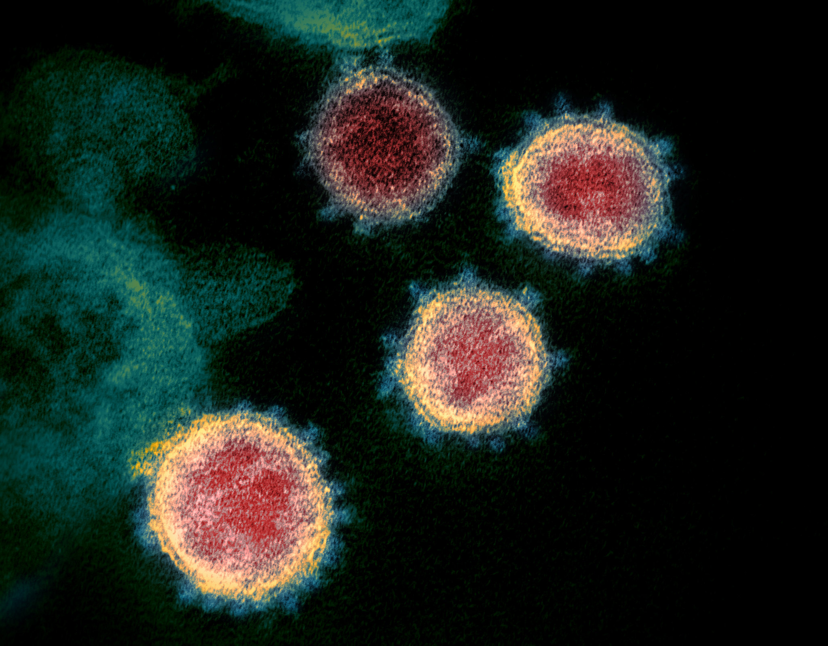
Happy 12th Day of Christmas!
New Covid-19 vaccine recommendations
Vaccine efficacy, including vs. Omicron VOC
Interesting things on the horizon

Slide 3
Recent New Recommendations
EUA for Pfizer-BioNTech vaccine for children 5 – 11
Booster doses for everyone 12 years and older
3rd doses for children 5 - 11 with immunocompromising conditions (28 days after second dose)
Pfizer-BioNTech booster dose 5 months after second dose rather than 6 months after second dose (Moderna is still 6 months)
CDC ACIP recommends mRNA vaccines over Janssen/J&J
https://www.cdc.gov/coronavirus/2019-ncov/vaccines/index.html

Slide 4
Vaccine Comparison Chart
 | Pfizer-BioNTech (BNT162b2) | Moderna (mRNA-1273) | Janssen – J&J (Ad26.COV2.S)
Vaccine Type | mRNA | mRNA | Viral Vectored (Adenovirus 26)
Age | 5 years and above | 18 years and above | 18 years and above
Primary Series | 2 doses 21 days apart 30 mcg 12 yrs+ (0.3 mL) 10 mcg 5 – 11 yrs (0.2 mL) | 2 doses 28 days apart 100 mcg (0.5 mL) | 1 dose 50B viral particles (0.5 mL)
Immunocompromised | 3rd dose 28 days after 2nd (5 yrs+, same dose as primary) | 3rd dose 28 days after 2nd (18 yrs+, same dose as primary) | Not recommended for immunocompromised
Booster Doses | 30 mcg 5 months or more after 2nd dose (12 yrs+) | 50 mcg (0.25 mL) 6 months after 2nd (18+) | 0.5 mL 2 months or more after 2nd dose
https://secure.medicalletter.org/downloads/1621g_table.pdf

Slide 5
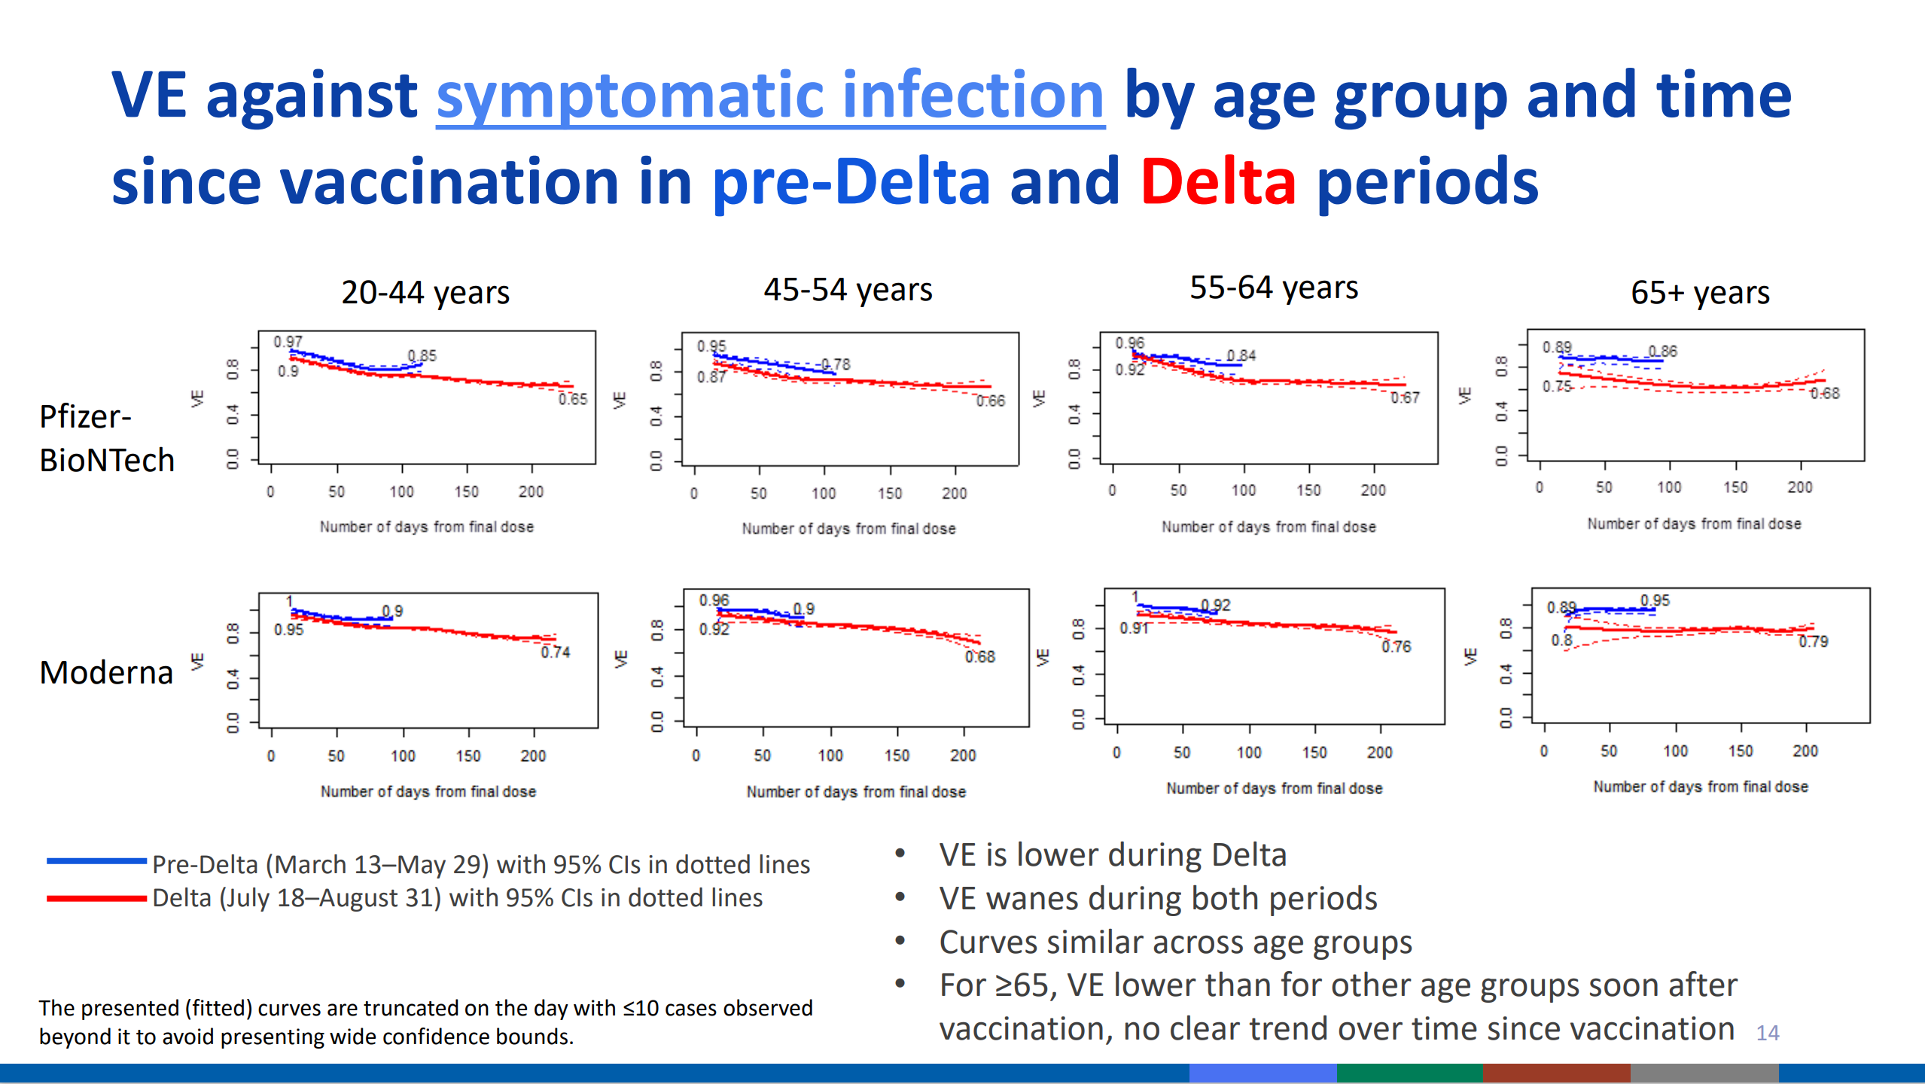
Vaccine Efficacy Over Time

Slide 6
Factors in Vaccine Efficacy and Immunity
Neutralizing Antibodies
Innate Immune System
Memory B Cells
T Cells (Cellular Immunity)
Mucosal Immunity

Slide 7
Vaccine Efficacy vs Omicron Variant
Mounting evidence that only having the primary series of Covid vaccination gives little protection against Omicron infection, but still protects against severe disease
Booster doses raise protection against both infection and severe disease
There is more data on the Pfizer-BioNTech vaccine than any others regarding the Omicron Variant

Slide 8
Some References for Vaccine Effectiveness Against Omicron
“Effectiveness of BNT162b2 Vaccine against Omicron Variant in South Africa” Collie et al. New England Journal of Medicine. DOI: 10.1056/NEJMc2119270
“Plasma Neutralization of the SARS-CoV-2 Omicron Variant” Schmidt et al. New England Journal of Medicine. DOI: 10.1056/NEJMc2119641
“Third BNT162b2 Vaccination Neutralization of SARS-CoV-2 Omicron Infection” Nemet et al. New England Journal of Medicine. DOI: 10.1056/NEJMc2119358
“Protection against Covid-19 by BNT162b2 Booster Across Age Groups” Bar-On et al. New England Journal of Medicine. DOI: 10.1056/NEJMoa2115926
“BNT162b2 Vaccine Booster and Mortality Due to Covid-19” Arbel et al. New England Journal of Medicine. DOI: 10.1056/NEJMoa2115624
“SARS-CoV-2 Omicron VOC Transmission in Danish Households” Lyngse et al. MedRxiv preprint:
https://www.medrxiv.org/content/10.1101/2021.12.27.21268278v1

Slide 9
Preview of Things to Come
Novavax has submitted data package to FDA in order to apply for EUA for their protein subunit vaccine
Nasal vaccines are in development – hope is for mucosal immunity

Slide 10
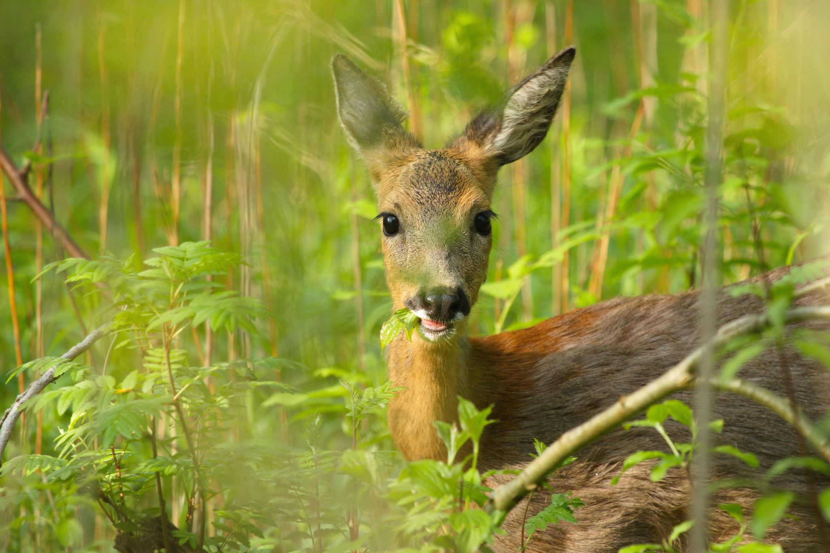
Something I Found Inspiring
“Trust, Faith, and Covid”
Eve Rittenberg, MD
New England Journal of Medicine 2021; 385: 2504 – 2505
DOI: 10.1056/NEJMp2114695

Slide 11
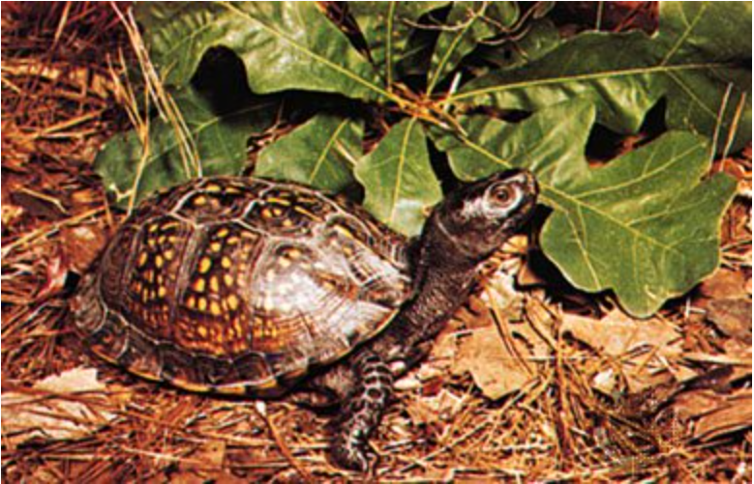
Thanks for your time and attention
Gulf Coast Box Turtle
Questions?
Harry J Brown
Medical Epidemiologist
USET Tribal Epidemiology Center
hbrown@usetinc.org
615-467-1547

