Slide 1
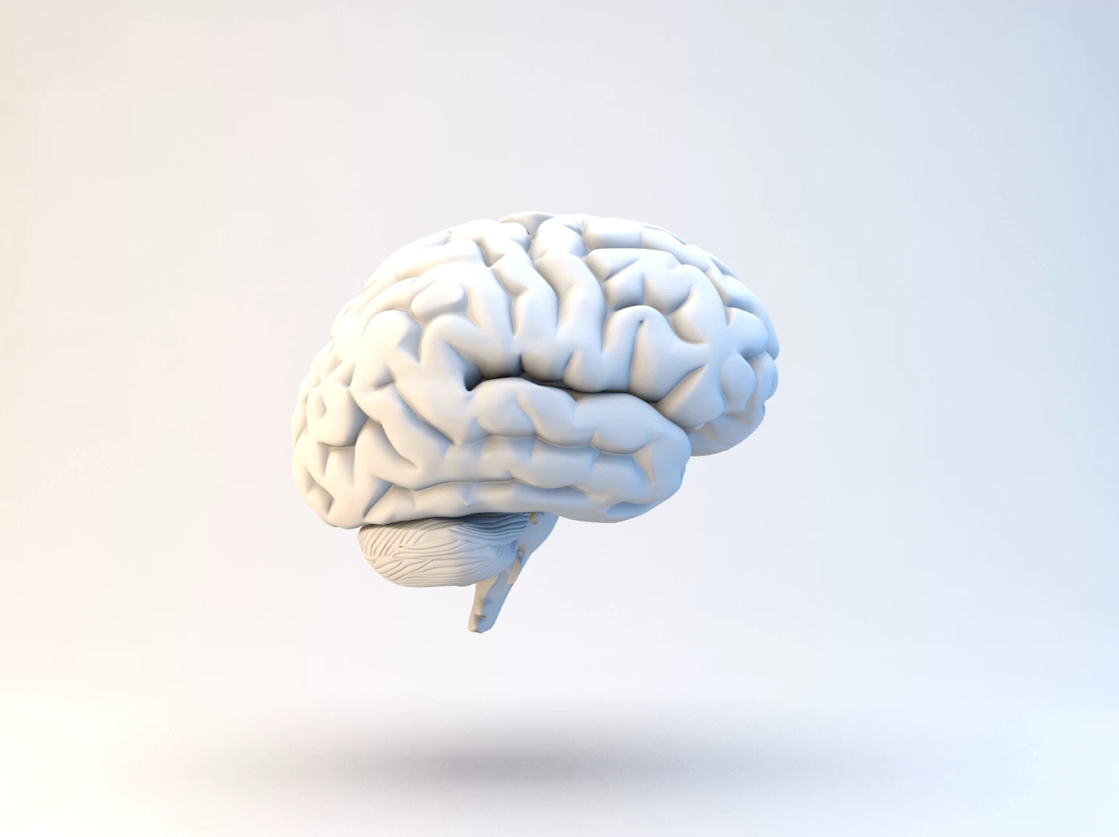
Substance Use Disorders:
Brains, Behavior, Diagnosis, Treatment

Slide 2
Objectives
1. Review the diagnostic criteria for substance use disorders
2. Understand (some of) how substance use disorders develop
3. Discuss medications that treat OUD: who, what, when

Slide 3
DSM 5
Diagnostic and Statistical Manual of Mental Disorders
11 criteria
Craving/Compulsion/Consequences/Loss of Control
Notes:
The DSM V. American Psychiatric Association's (APA) classification and diagnostic tool and it provides a standardized way to understand substance disorders and mental illness. According to the DSM V there are 11 critieria that determine whether use is disordered.

Slide 4
DSM 5: Substance Use Disorder
Taking in larger amounts or for longer than intended
Unsuccessful efforts to cut down
Spending a lot of time obtaining the substance
Craving or a strong desire to use the substance
Notes:
Craving/Compulsion

Slide 5
DSM 5: Substance Use Disorder
Continued use despite recurring social or interpersonal problems due to use
Important activities given up or reduced
Recurrent use in physically hazardous situations
Persistent / Recurrent physical or psychological difficulties from use
Recurrent use resulting in a failure to fulfill major role obligations
Notes:
Consequences, and using the substance repeatedly despite those consequences. Loss of control.

Slide 6
DSM 5: Substance Use Disorder
Tolerance*
Withdrawal*
Notes:
Some substances, like opioids, when used appropriately, still lead to tolerance and withdrawal. In those cases, these two critieria don’t count.

Slide 7
Substance Use Disorder
2—3
4—5
6+
mild disorder
moderate disorder
severe disorder
Notes:
Knowing those 11 criteria, it possible to diagnose.

Slide 8
Addict
Substance Use Disorder
Diagnosis
Label/Accusation
The words we use to describe our clients/patients affects the care they get
Kelly JF Int J Drug Policy 2010

Slide 9
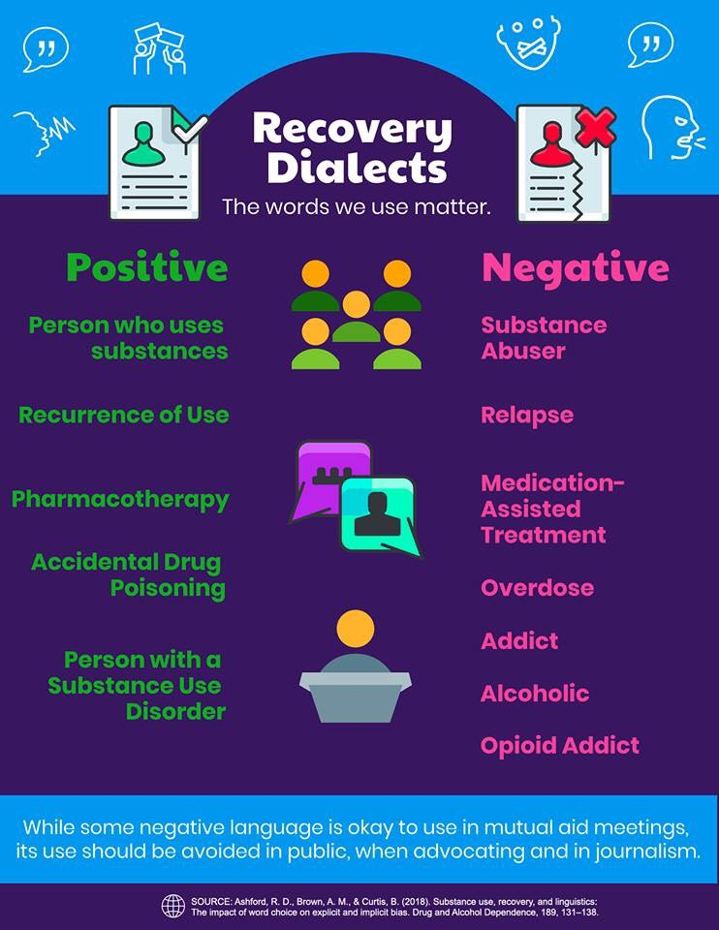
Notes:
1,288 participants were recruited from ResearchMatch. Participants were assigned into one of seven groups with different hypothesized stigmatizing and non-stigmatizing terms. Participants were asked questions about their willingness to associate with people depicted in fictional vignettes who were described with such terms.

Slide 10
Objectives
1. Review the diagnostic criteria for substance use disorders
2. Understand (some of) how substance use disorders develop
3. Discuss medications that treat OUD: who, what, when

Slide 11
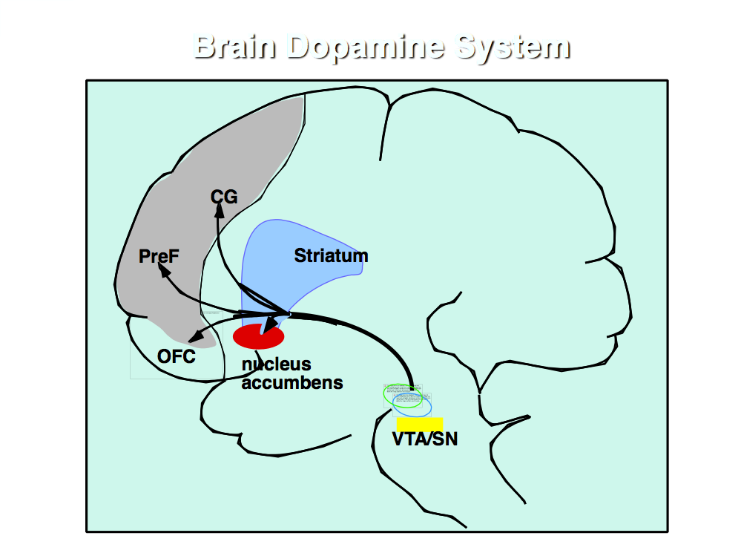
Mesolimbic Dopamine System
Notes:
Mesolimbic dopamine system: This track is where addiciton does its work. This red area, the nucleus accumbens, is at the center of all of it.

Slide 12
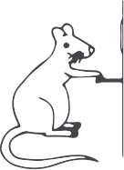
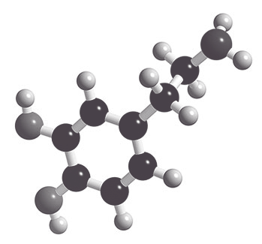
1950s : electrodes
1970s: Dopamine
Desire and Drives
Notes:
Scientists in the 1950s found that if implanted electrodes in NA and send a current through it whenever a lever was pressed, rats will enjoy the stimulation so much they will hit the lever up to 2,000/hr. In the 1970s scientists discovered that dopamine was the neurotransmitter responsible for pleasurable sensations that the rats experienced. Pushing the lever caused dopamine to be released in the NA. Later work clarified that the DA release was responsible for the feeling of desire, for drive and motivation in the face potential reward

Slide 13
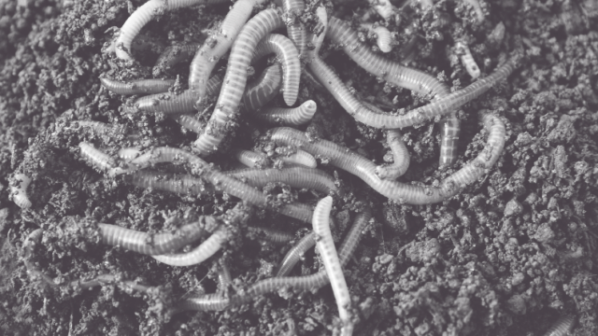
The use of dopamine neurons to shape responses to rewards is seen in simple organisms like worms and flies.
It evolved millions of years ago.
Dopaminergic impulses tell organisms to move toward reward (warmth, food, moisture)

Slide 14
In humans, those dopaminergic impulses travel through the NAC
Mediates responses to food, sex, social interactions
DA projections from VTA to NA release DA and tell the NA to go for it!
Connects with memory and emotional centers so it can be repeated in the future
Notes:
When we seem something rewarding, dopaminergic projections from the VTA to the NAc, release dopamine and tell the NAC to go for it. Activation of the pathway also connects with memory and emotional centers in the brain so that an individual will pay particular attention to all features of that rewarding experience, so it can be repeated in the future.

Slide 15
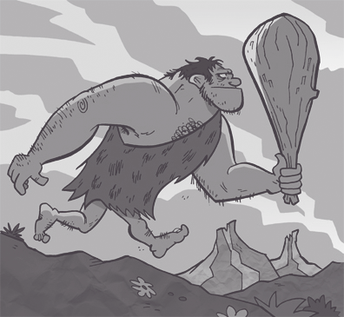

Hungry caveman eats berry. It is sweet and pleasurable
2. Brain pays very close attention to what he had to do to get that berry
3. Sees the berry bush again, more likely to remember the berry, even craves the berry. Eats the berry.
4. Lives
Notes:
So, when hungry OGG eats a berry and it is sweet and its pleasurable and he doesn’t starve, the brain pays very very close attention to what he had to do to get that berry. When he sees the kind of plant that grows the berry, more likely to remember the berry, think about looking for berry, to potentially crave the berry, find the berry and to stay alive.

Slide 16
So, Part of Addiction is Craving
Addiction taps into this normal brain process
All addictive drugs activate this pathway
Drug experience is deeply linked to memory and emotion
Notes:
All addictive drugs activate that pathway Drug experience is also then deeply linked to memory and emotion.

Slide 17
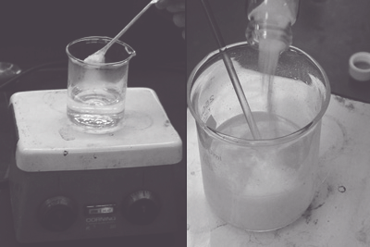
People, places, things associated with drug use can trigger cravings
Even when images associated with drug use are shown too rapidly to be “seen” they still trigger cravings
Notes:
As a result, when a person addicted to a drug tries to quit, all things associated with the drug (the neighborhood, the spoon, the cooker, the boyfriend) activate the pathway. It is just like seeing the bush associated with the berries – but this time it isn’t necessary for survival. It just feels like it is. Studies have even found when images associated with drug use (a cooker, a syringe) are flashed in front of a drug user too rapidly to be consciously processed, the brain ”sees” those images anyway, and the persons cravings are triggered.

Slide 18
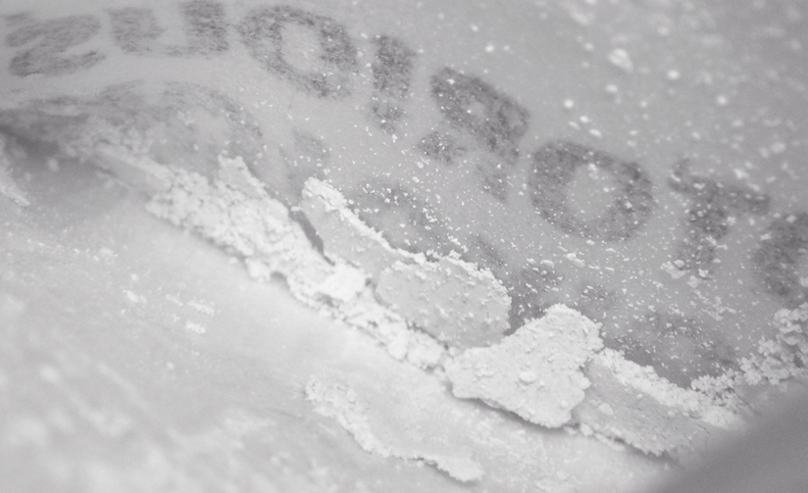
Another Part is Liking
Opioids: activate DA receptors
Also activate opioid receptors in NA and produce feeling of satiety, soothing, comfort.
Notes:
So part of addiction is craving. Another part is liking. Opioids are particularly good at activating these feelings. Yes, they increase the activity of the dopamine-containing neurons of the VTA (craving) to the NA. But they also act DIRECTLY on a dfiferent set of receptors, opioid receptors, in the nucleus accumbens and produce feeling of satiety, soothing, comfort. So a lot of addiction involves craving and and some also involves lliking and it all involves desire.

Slide 19
Dysregulation
Dysregulation: impaired ability of the front of the brain to regulate what is going on in the older regions of the brain.
Prefrontal cortex helps determine the risks and benefits of behaviors and make rational choices.
Notes:
Finally, addiction also involves dysregulation, specifically, impaired ability of the front, or newer part of the brain, to regulate what is going on in the older regions of the brain. Regulation of entire system is the responsibility of the prefrontal cortex, which is charged with keeping the rest of the brain apprised of the consequences of harmful actions.

Slide 20
Prefrontal cortex is newer and more complicated. It needs a little time to weigh in.
Repeated activation of the VTA to NAC track slowly strengthens those connections. Habits get hard wired, fast and automatic

Slide 21
1. Hungry caveman eats berry. It is sweet and pleasurable and he doesn’t starve.
2. The berry gives him a headache the next day so he can’t hunt well.
3. He has to weigh the benefits and drawbacks of the berries each time he thinks about eating them.
4. If his berry eating habit has become “hard-wired”, he may eat them even on days when it is a really, really bad idea
Notes:
So to go back to OG... Benefits and drawbacks Prefrontal cortex: determine the risks and benefits of behaviors and make rational choices. Here is what is tricky: the BUT Repeated activation of the VTA to NAC track slowly strengthens those connections. Habits get hired wired, fire fast and automatically

Slide 22
Another complicating factor:
D1: Activate the nucleus accumbens, cause us to act & are responsive to big pleasure surges.
D2: Slow down decision making, allow the frontal cortex to step in. Responsive to smaller pleasures.
Notes:
D1 receptors , these are the receptors that respond to the big surges in pleasure.
And D2 receptors, that tell us to slow down, hold on a minute.

Slide 23
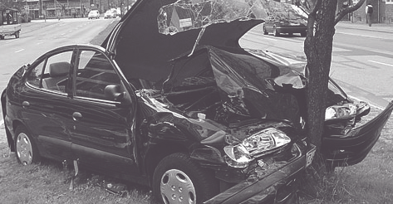
Budget: what is it?
Big dopamine surges activate the D1 receptors and cause the D2 receptors to be reabsorbed.
Repeated drug use speeds up the Go! in the nucleus accumbens and inhibits the stop.
Like stepping on brakes of car barreling down a hill only to discover that brakes have been disconnected.
Notes:
But big dopamine surges, like what you get with drug use, actually cause the D2 receptors, the slow down receptors, to be reabsorbed. So with repeated drug use, you speed up the Go! In the nucleus accumbens and inhibits the stop impulses. Nora Volkow, the head of NIDA has said the for people addicted to drugs it is like stepping on brakes of car barreling down a hill only to discover that brakes, while there, have been disconnected. In this case, no brakes means that someone who is habituated to drug use is unable to tell herself quickly enough that what she is about to do is a really, really bad idea. So it is terrible situation.

Slide 24

Little pleasures like family, friends, jobs well done, tasks accomplished, provide just enough dopamine to activate the D2 receptors and strengthen the impulses that slow things down.
Medications to decrease craving and attenuate withdrawal symptoms
Behavioral interventions that entrain different habits
Notes:
But it is not a hopeless situation. First, little pleasures like family, friends, jobs well done, task accomplished, provide just enough dopamine to activate the D2 receptors and strengthen the impulses that slow things down. So, we need just enough DA to activate D2 receptors but not too much. That is possible. Second, for patients with OUD, we have medications that help with craving and withdrawal and that give patients a time to pause, take a look around and get their lives back on track. Do the things that give meaning. Remainder of ECHO: medications, Peers for connection, other behavioral interventions

Slide 25
Little pleasures like family, friends, jobs well done, tasks accomplished, provide just enough dopamine to activate the D2 receptors and strengthen the impulses that slow things down.
Medications to decrease craving and attenuate withdrawal symptoms
Behavioral interventions that entrain different habits
Notes:
But it is not a hopeless situation. First, little pleasures like family, friends, jobs well done, task accomplished, provide just enough dopamine to activate the D2 receptors and strengthen the impulses that slow things down. So, we need just enough DA to activate D2 receptors but not too much. That is possible. Second, for patients with OUD, we have medications that help with craving and withdrawal and that give patients a time to pause, take a look around and get their lives back on track. Do the things that give meaning. Remainder of ECHO: medications, Peers for connection, other behavioral interventions

Slide 26
Objectives
1. Review the diagnostic criteria for substance use disorders
2. Understand (some of) how substance use disorders develop
3. Discuss medications that treat OUD: who, what, when

Slide 27
Notes:
Three different mechanisms

Slide 28
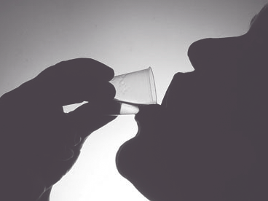
Notes:
We have the most data on methadone, which was FDA approved to treat addiction in 1972

Slide 29
Methadone: efficacy
Cochrane review 2009
methadone v treatment without medication
Patients on methadone significantly less likely to have positive urine drug screen
Decreased new infections with Hep C/HIV
Decreased criminality
Mattick RP, et al. Cochrane Database of Systematic Reviews 2009
Notes:
Bottom line: it is very effective. A Cochrane review in 2009 showed that patients on methadone maintenance compared to patients in non-medication associated treatments were significantly less likely to use drugs and also lived longer and had lower levels of criminality – though not to levels of signifciantce.

Slide 30
Mortality Risk during and after methadone treatment
Mortality Risk during and after opioid substitution treatment: systematic review and meta-analysis
of cohort studies. Sordo, et al. BMJ 2017.
Notes:
During methadone treatment, both all cause and overdose mortality were substantially and significantly lower than during periods of treatment disengagement

Slide 31
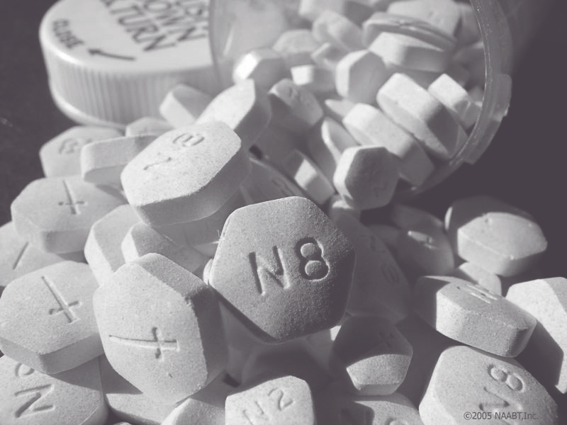
Notes:
Buprenorphine is the other opioid agonist we use to treat addiction. Approved in 2002 for the treatment of opioid use disorder. How does it compare to methadone?

Slide 32
Buprenorphine: efficacy
Cochrane review 2014
Buprenorphine was equivalent to methadone for suppression of illicit drug use except at very low doses
Mattick RP, et al. Cochrane Database of Systematic Reviews 2014
No difference in mortality
Notes:
Bottom line: it is very effective. A Cochrane review in 2009 showed that patients on methadone maintenance compared to patients in non-medication associated treatments were significantly less likely to use drugs and also lived longer and had lower levels of criminality – though not to levels of signifciantce.

Slide 33
Mortality Risk during and after buprenorphine treatment
Mortality Risk during and after opioid substitution treatment: systematic review and meta-analysis
of cohort studies. Sordo, et al. BMJ 2017.

Slide 34
New kid in town: buprenorphine XR
2019 randomized control trial compared three groups over 6 months:
Six injections of 300mg
Two injections of 300mg then four of 100mg
Placebo injections
Results:
Mean abstinence: 41% for 300mg group;
42.7% for 300/100mg group
5% for placebo
Haight et al The Lancet 2019

Slide 35
New kid in town: buprenorphine XR
Patient Centered Outcomes
Improved physical and mental health measures
Increased employment
Increased medication satisfaction
Decreased health care utilization
Ling et al JAM 2019

Slide 36


XR Naltrexone

Slide 37
Naltrexone ER: efficacy
Efficacious compared to placebo
Comer: 60 U.S. heroin users, 8 weeks (retention in tx and opioid negative urines)
Krupitsky: 250 Russian heroin users, 24 wks (retention in tx without relapse)
Efficacious compared to buprenorphine
Tanum: Non-inferior to buprenorphine for decreasing opioid use at 12 wks
Lee: Non-inferior to buprenorphine for decreasing opioid use at 24 weeks
Comer Arch Gen Psych 2006
Krupitsky Lancet 2011 Tanum JAMA Psychiatry 2017
Lee Lancet 2017

Slide 38
Outcome | XR-NXT (n=283) | BUP-NX (n-287) | Treatment Effect
Inducted to study medication (ITT) | 204 (72%) | 270 (94%) | OR 0.16, 0.09-0.28; P<0.0001
Relapse-free survival (weeks) | 8.4 (3-23.4) 20.4 (5.4-23.4) | 14.4 (5.1-23.4) 15.2 (5.7-23.4) | HR 1.36, 1.10-1.68; p=0.0040 HR 0.92, 0.71-1.18, p=0.49
Opioid relapse, weeks 3-24 | 185 (65%) 106/204 (52%) | 163 (57%) 150/270 (56%) | OR 1.44, 1.02-2.01; p=0.036 OR 0.87, 0.60-1.25; p=0.44
Lee JD, et al. Lancet 2017
Notes:
For patients on naltrexone er v bup.nx

Slide 39
Efficacy: conclusions
All three medications are efficacious once a patient is on the medication
Buprenorphine is equivalent to methadone in terms of decreased illicit drug at clinically useful doses
Extended release naltrexone is equivalent to buprenorphine in terms of decreased illicit drug use.
Both buprenorphine and methadone decrease mortality significantly

Slide 40

Notes:
So they all work. How do you kn which one is best for your patient?

Slide 41
Do they want it?
Can you provide it?
Will they start it?
Other clinical variables

Slide 42
Methadone
Do they want it?
Can you provide it?
Will they/can they start it?
Other clinical variables

Slide 43
HIGHLY REGULATED!!!!
Attend clinic daily for a minimum of 3 months.
After 90 days, may take home one dose if:
attending groups
participating in educational, vocational, or homemaking activities
employment, education, or homemaking responsibilities are hindered by daily attendance may take home an extra dose.
Not using
No criminal activity
Stable home environment
Safe storage
Counselor feels this will be beneficial to the patient
Notes:
Extremely strict regulations

Slide 44
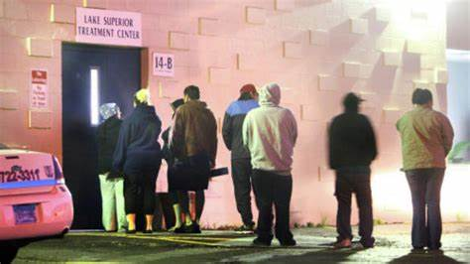
Notes:
Lines and other kinds of trouble – whether or not someone is looking for it. Set up to create stigma and once get take home doses just want to disappear

Slide 45
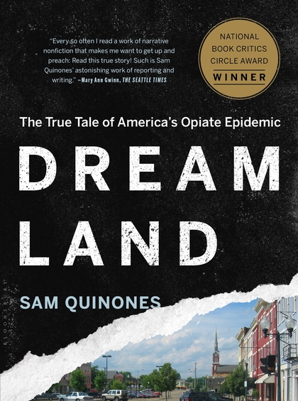
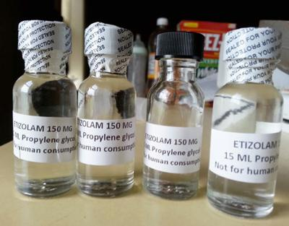

Slide 46
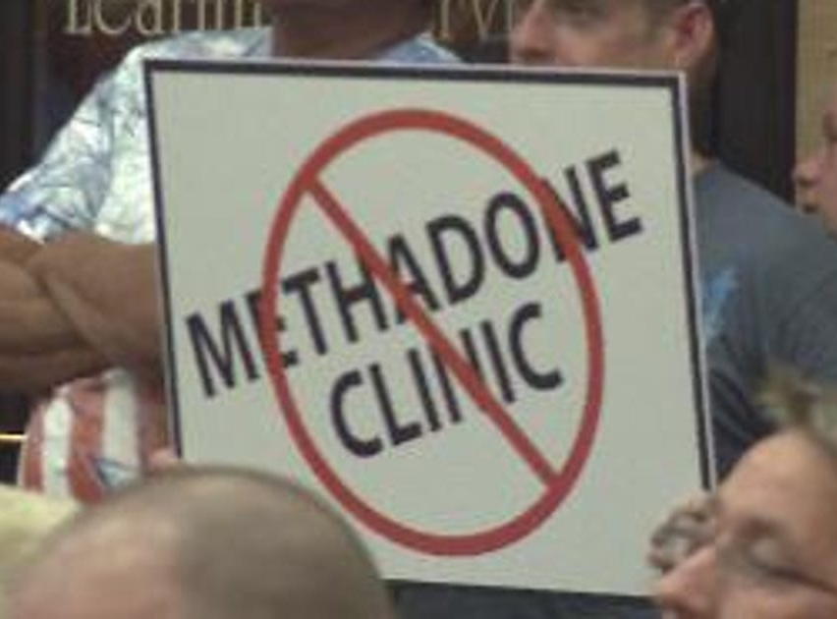

Slide 47
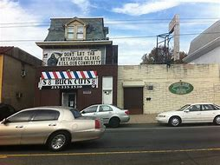

Slide 48
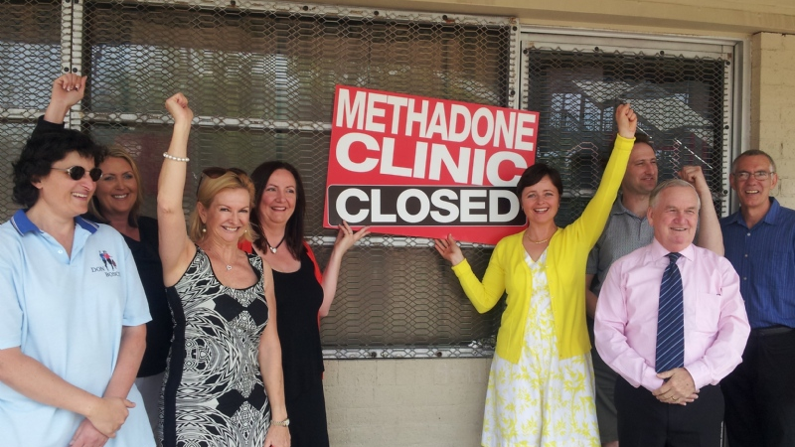

Slide 49
People who get through those first months, who are stable on methadone, and who drive that data, don’t talk about methadone. We don’t see them.
The stigma is too great
Others stop taking it. Again, the stigma is too great.

Slide 50
Methadone
Can you provide it?
Only able to dispense from an OTP or hospital setting. Cannot prescribe from an outpatient setting

Slide 51
Methadone
Will they/can they start it?
No need for withdrawal
BUT the risk of death while on methadone is highest during the initial four weeks of treatment, the induction phase
Start low/go slow, which can be difficult

Slide 52
Methadone
Other variables
Prolonged QT
Need to show up daily x 90 days minimum
Safe place to store meds
Drug-Drug interactions

Slide 53
Buprenorphine
Do they want it?
Can you provide it?
Will they/can they start it?
Other clinical variables

Slide 54
Buprenorphine
Can you provide it?
Provider with an X-waiver
Patient limits

Slide 55
Buprenorphine
Will they/can they start it?
Requires a brief period of withdrawal (usually 8 – 18 hours off opioids)
XR buprenorphine: recommend 7 days SL first (8-24 mg)
Subcutaneous abdominal injection that HURTs
No increased mortality during induction

Slide 56
Buprenorphine
Other variables
Safe place to store meds
Some patients have nausea/headaches with naloxone component

Slide 57
XR- naltrexone
Do they want it?
Can you provide it?
Will they/can they start it?
Other clinical variables

Slide 58
XR-naltrexone
Can you provide it?
No special training or license
Expensive, not always covered by insurance

Slide 59
XR-naltrexone
Will they/can they start it?
Requires abstinence from opioids 4 – 7 days
About 25% of patients will not complete induction

Slide 60
Outcome | XR-NXT (n=283) | BUP-NX (n-287) | Treatment Effect
Inducted to study medication (ITT) | 204 (72%) | 270 (94%) | OR 0.16, 0.09-0.28; P<0.0001
Relapse-free survival (weeks) | 8.4 (3-23.4) 20.4 (5.4-23.4) | 14.4 (5.1-23.4) 15.2 (5.7-23.4) | HR 1.36, 1.10-1.68; p=0.0040 HR 0.92, 0.71-1.18, p=0.49
Opioid relapse, weeks 3-24 | 185 (65%) 106/204 (52%) | 163 (57%) 150/270 (56%) | OR 1.44, 1.02-2.01; p=0.036 OR 0.87, 0.60-1.25; p=0.44
Lee JD, et al. Lancet 2017
Notes:
That is a big deal. Let’s look at the study oomparing naltrexone to bup again.

Slide 61
XR-naltrexone
Other variables
Known need for opioids in the future (surgery, sickle cell) – Naltrexone contraindication
Safe place to store medication - methadone, buprenorphine consideration
Other use disorders

Slide 62
 | Methadone | Buprenorphine | Naltrexone ER | Buprenorphine ER
Patient needs daily dispense | + | +/- | + | +
Daily dispense is problematic (illness, geography) | X | + | + | +
Patient does not have a place to store medication | +/- | +/- | + | +
Patient will require opioids in the future | + | + | X | +
A period of abstinence unlikely/difficult | + | + | X | +
Patient want this medication | + | + | + | +
Other clinical variables | + | + | + | +

Slide 63
Conclusion
Diagnose substance use disorders with the DSM V criteria
Addiction taps into normal brain processes
Stigma can kill
Substance use disorders are treatable.

Slide 64
Questions?

Slide 65
Buprenorphine Microinduction
Day 1: 0.5 mg (1/4 tab)
Day 2: 0.5 mg BID
Day 3: 1 mg BID (1/2 tabs)
Day 4: 2 mg BID
Day 5: 4 mg BID
Stop or taper full agonists

