Slide 1
ECHO Diabetes
Preserving Renal Function
January 13, 2022
Carol Greenlee MD

Slide 2
Pre-Question
Diabetic Kidney Disease
  Can be diagnosed based on one elevated urinary-albumin-creatine ratio result
  Progression can be slowed by appropriate treatment
  Is most often associated with a rapid decline in eGFR
  Increases the risk of cardiovascular disease
  B & D

Slide 3
Diabetic Kidney Disease (DKD)
Chronic Kidney Disease (CKD) attributed to Diabetes
Occurs in 20-40% of patients with diabetes (<10% are aware)
  In type 1 diabetes, usually develops after diabetes duration of 10 years
  In type 2 diabetes, may be present at diagnosis
Can lead to end-stage renal disease (ESRD) requiring dialysis or kidney transplantation
  Is the leading cause of ESRD (ESKD) in the US (HTN is second leading cause)
Markedly increases cardiovascular risk and health care costs
  Even in early stages, CKD has been associated with an increased cardiovascular morbidity and mortality
  Therefore, early detection of CKD is essential to
    retard the progression of kidney disease
    reduce cardiovascular morbimortality
    reduce the economic burden caused by kidney disease.
Notes:
ADA Standards of Care 2021

Slide 4
Screening for DKD
American Diabetes Association Standards of Care
Recommendations
11.1a At least annually , urinary albumin (e.g., spot urinary albumin-to-creatinine ratio (UACR)) and estimated glomerular filtration rate (eGFR) should be assessed
  in patients with type 1 diabetes with duration of =/>5 years and
  in all patients with type 2 diabetes regardless of treatment. B
11.1b Patients with diabetes and urinary albumin >300 mg/g Cr and/or an estimated GFR 30-60 ml/min/1.73 m2 should be monitored twice annually to guide therapy. B
A = clear evidence from well conducted trials
B = supportive evidence from well conducted trials
C = supportive evidence from poorly controlled or uncontrolled studies

Slide 5

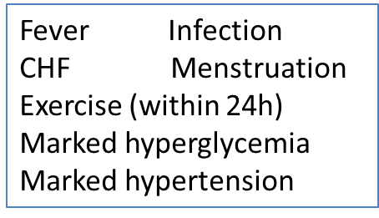
ADA Standards of Care – Screening for Nephropathy
“Screening for albuminuria can be most easily performed by urinary albumin-to-creatinine ratio (UACR) in random spot urine collection.”
  Measurement of spot urine sample for albumin alone without simultaneously measuring urine creatinine (Cr) is less expensive but susceptible to false-negative and false-positive determination
  Timed or 24-h collections are more burdensome & add little to accuracy
Normal UACR is defined as <30 mg/g Cr (high UACR is defined as =/>30 mg/g Cr)
  Because of high biologic variability of >20% between measurements in urinary albumin excretion, two of three UACR specimens collected within a 3-to-6-month period should be abnormal before considering a patient to have high or very high albuminuria.
  UACR can be elevated independently of kidney damage by
    Exercise within 24-hour
    Infection
    Fever
    Congestive Heart Failure
    Marked hyperglycemia
    Marked hypertension
    Menstruation
Causes of False Positive UACR

Slide 6
ADA Standards of Care – additional comments re screening
An eGFR persistently <60 ml/min/1.73 m2 is considered abnormal
  For older adults, optimal thresholds for clinical diagnosis are debated (age related decline vs CKD – some suggest <45 ml/min/1.73m2)
    Still may have need to adjust medications for renal dosing
DKD is a clinical diagnosis
  Based on the presence of albuminuria &/or reduced eGFR in the absence of signs or symptoms of other primary causes of kidney damage
  Typical presentation included
    long-standing duration of diabetes (but can be present at diagnosis),
    albuminuria without hematuria (reduced eGFR without albuminuria increasingly common in DKD)
    retinopathy (but can be present without retinopathy, especially in T2D)
    gradual progressive loss of eGFR

Slide 7
ADA Standards of Care – additional comments re screening
Presentations suggestive on an alternative or additional cause of kidney disease (consider referral to a nephrologist for further diagnosis including possible kidney biopsy)
  An active urinary sediment (containing red or white cells or cellular casts)
  Rapidly increasing albuminuria or nephrotic syndrome
  Rapidly decreasing eGFR
  Absence of retinopathy in T1D
At any eGFR, the degree of albuminuria is associated with risk of
  Cardiovascular disease (CVD)
  CKD progression
  Mortality
Both albuminuria & eGFR must be quantified to guide treatment decisions
  eGFR levels are essential to modify drug dosages or restrictions of use

Slide 8
CKD KDOQI Classification
The National Kidney Foundation Kidney Disease Outcomes Quality Initiative (NKF KDOQI) CKD classification:
  normal eGFR ≥ 90 mL/min (stage 1 CKD if albuminuria is increased);
  mildly reduced eGFR 60–89 mL/min (stage 2 CKD if albuminuria is increased);
  moderately reduced eGFR 30–59 mL/min (stage 3 CKD);
  severely reduced eGFR > 15–29 mL/min (stage 4 CKD);
  end stage renal failure or stage 5 CKD if eGFR < 15 mL/min

Slide 9
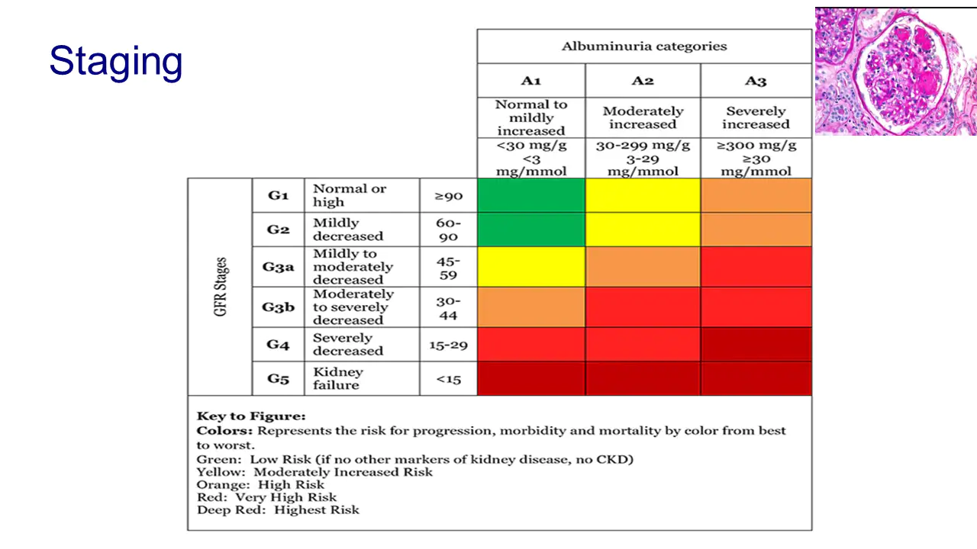
Notes:
KDIGO

Slide 10
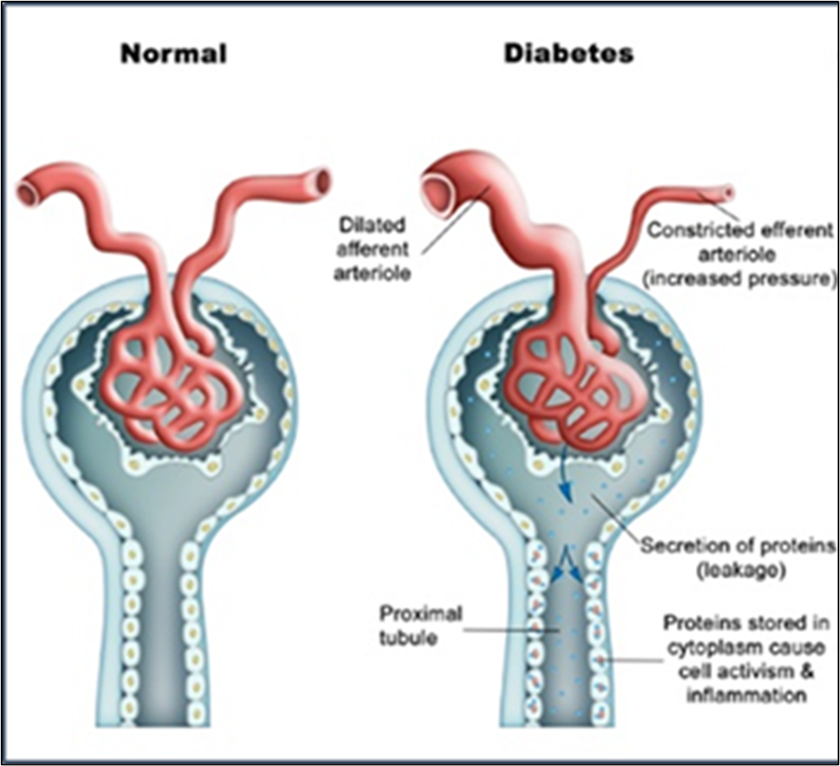
Glomerular Hyperfiltration
Glomerular hyperfiltration can be caused by afferent arteriolar vasodilation as seen in patients with diabetes or after a high-protein meal, and/or by efferent arteriolar vasoconstriction owing to activation of the renin-angiotensin-aldosterone system, thus leading to glomerular hypertension.
A physiological state of glomerular hyperfiltration occurs during pregnancy and after consumption of high-protein meals.
The various diseases that have been associated with glomerular hyperfiltration, either per nephron or per total kidney, include:
  diabetes mellitus,
  polycystic kidney disease,
  secondary focal segmental glomerulosclerosis
  sickle cell anemia,
  high altitude renal syndrome
  obesity
Notes:
Nat Rev Nephrol. 2012 Feb 21;8(5):293-300. Glomerular hyperfiltration: definitions, mechanisms and clinical implications. Helal I1, Fick-Brosnahan GM, Reed-Gitomer B, Schrier RW

Slide 11
Is hyperfiltration [itself] associated with the future risk of developing diabetic nephropathy? A meta-analysis (2009)
Conclusions/interpretation: In published studies, individuals with glomerular hyperfiltration were at increased risk of progression to diabetic nephropathy
  patients with hyperfiltration are 2.7 times more likely to progress to incipient nephropathy than those with normo-filtration and that patients who progressed had a higher baseline GFR
Further larger studies are required to explore this relationship and the role of potential confounding variables (e.g., Hyperglycemia can cause an increase in GFR, so the role of glycemic control and diabetes treatment is important)
Glomerular Hyperfiltration in Diabetes: Mechanisms, Clinical Significance, and Treatment (2017)
  Accumulating evidence suggests a prognostic and pathogenic role of glomerular hyperfiltration in the initiation and progression of DKD.
  However, especially as hyperfiltration and albuminuria are renal hemodynamically linked, dedicated prospective studies are needed to confirm whether targeting hyperfiltration improves clinically relevant end points (i.e., 30% or 40% eGFR decline, ESRD, and/or renal death).
  Several antihyperglycemic (including SGLT2i and GLP1 RA) and nonhyperglycemic interventions are associated with ameliorated hyperfiltration.
    Whether these treatments add benefit in the ongoing search for renal risk reduction in diabetes is worth investigating in specifically designed (renoprotection) trials using active comparators, especially in patients with hyperfiltration at baseline.
Notes:
Magee, G.M., Bilous, R.W., Cardwell, C.R. et al. Is hyperfiltration associated with the future risk of developing diabetic nephropathy? A meta-analysis. Diabetologia 52, 691 (2009). https://doi.org/10.1007/s00125-009-1268-0
J Am Soc Nephrol. 2017 Apr; 28(4): 1023–1039.
Published online 2017 Jan 31. doi: 10.1681/ASN.2016060666
PMCID: PMC5373460
PMID: 28143897
Glomerular Hyperfiltration in Diabetes: Mechanisms, Clinical Significance, and Treatment
Lennart Tonneijck,* Marcel H.A. Muskiet,* Mark M. Smits,* Erik J. van Bommel,* Hiddo J.L. Heerspink,† Daniël H. van Raalte,* and Jaap A. Joles‡

Slide 12
ADA Standards of Care – additional comments re screening
Acute Kidney Injury (AKI) – diagnosed by a 50% or greater increase in serum creatinine (reflected as a rapid decrease in eGFR) over a short period of time.
  AKI is associated with increased risk of progressive CKD & poor health outcomes – timely identification & treatment is critical
  Risk factors for AKI
    Diabetes
    Preexisting CKD
    Use of medications that cause kidney injury (e.g., non-steroidal anti-inflammatory drugs, iodinated contrast agents)
    Use of medications that alter renal blood flow & intrarenal hemodynamics(e.g., diuretics, ACE inhibitors, ARBs) (studies show SGLT2i meds protect against, not cause AKI)
      Small elevations of serum Cr (up to 30% from baseline) with RAS blockers (ACEIs & ARBs) must not be confused with AKI – usually begins 3-5 days after start of ACEI or ARB
        Studies found a strong association between acute increases in serum creatinine of up to 30% that stabilize within the first two months of ACE-inhibitor therapy and long-term preservation of renal function—even for those patients with a baseline creatinine >1.4 mg/dL
      A more severe acute decline in renal function can be seen in patients with already reduced intrarenal perfusion pressure- such as from bilateral renal artery stenosis or congestive heart failure or volume depletion
        dose reduction or withdrawal of ACE-inhibitor therapy only with a rise in serum creatinine >30% from baseline in the first two months of medication use
        avoid diuretics for edema from CCBs (vascular dilation, not volume overload)
Notes:
(Am J Kidney Dis. 2004;43[5 Supp1]:S1-S290).
(Arch Intern Med. 2000;160:685-693).

Slide 13
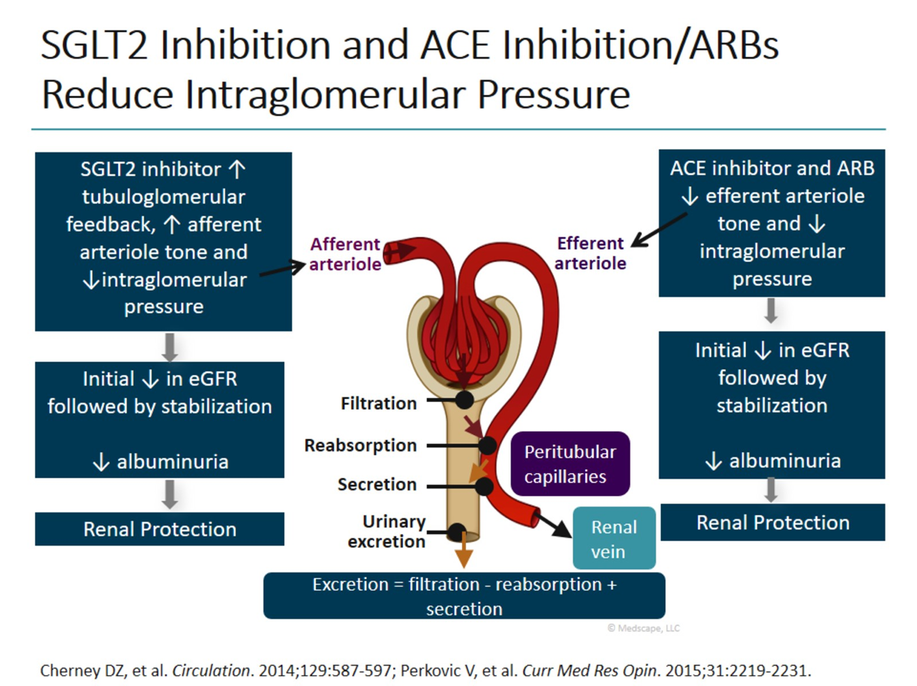
Multiple additional
renal protective
effects, including:
Reduced fibrosis
Reduced oxidative stress
Reduced sympathetic tone
Diuretic sparing

Slide 14
ADA Standards of Care – additional comments re screening
Regular monitoring (surveillance) of albuminuria & eGFR allows
  Timely diagnosis of CKD (and treatment)
  Monitoring progression of CKD
  Detect superimposed kidney disease, including AKI
  Assess risk of CKD complications (often earlier onset in DKD than other causes of CKD)
    Elevated Blood Pressure >140/90
    Volume overload
    Electrolyte abnormalities
    Metabolic acidosis
    Anemia
    Metabolic bone disease
    Secondary hyperparathyroidism
  Dose drugs appropriately (“renal dosing”)
  Determine whether a nephrology referral is needed
Notes:
(Am J Kidney Dis. 2004;43[5 Supp1]:S1-S290).
(Arch Intern Med. 2000;160:685-693).

Slide 15
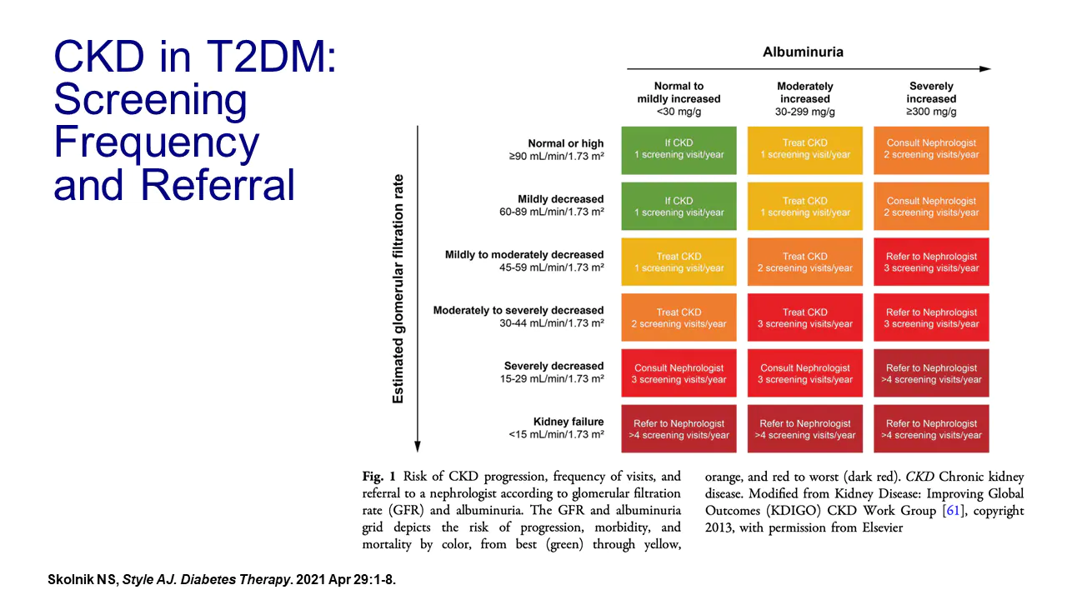

Slide 16
Treatment (ADA Standards of Care)
11.2 Optimize glucose control to reduce the risk or slow the progression of chronic kidney disease. A
11.3a For patients with type 2 diabetes and diabetic kidney disease, consider use of a sodium-glucose cotransporter 2 inhibitor (SGLT2i) in patients with an eGFR > 30 ml/min/1.73 m2 and urinary albumin >300 mg/g Cr. A
11.3b In patients with type 2 diabetes and diabetic kidney disease consider use of SGLT2i additionally for cardiovascular risk reduction when eGFR >30 or urinary albumin >300 mg/g. A
11.3c In patients with chronic kidney disease who are at increased risk for cardiovascular events, use of a glucagon-like peptide 1 receptor agonist (GLP1RA) reduces renal end point, primarily albuminuria, progression of albuminuria, and cardiovascular events. A

Slide 17
ADA Standards of Care – additional comments re treatment
Effects of glucose-lowering medications
  Glycemic effects (intensive glucose control) on renal outcomes
    Intensive glucose control (near-normoglycemia) can delay onset & progression of DKD
    Lag time of 2-10 years for intensive glucose control to manifest as improved eGFR outcomes
    ACCORD trial – adverse effects of intensive control (hypoglycemia & mortality) increased in people with diabetes & kidney disease
  Direct renal effects (not mediated through glycemia)
    SGLT2 inhibitors
    GLP1 RA agents
ADA: within the constraints of renal dosing “metformin should be considered the first-line treatment for all patients with T2D, including those with CKD.”
Multiple mechanisms, including improved renal hemodynamics and
reduced fibrosis, inflammation & oxidative stress
Notes:
ADA Standards of Care 2021

Slide 18
Metformin in CKD
The dosing recommendations suggested by the FDA target eGFR - new recommendations are as follows:
  Patients with an eGFR ≥60 require no dose adjustments and are able to safely use metformin with annual monitoring.
  Patients with an eGFR between 45 and 60 may continue treatment but require more frequent renal function monitoring every 3 to 6 months.
  Patients with moderate chronic kidney disease (eGFR between 30 and 45) aren’t candidates for initiation of metformin, but patients currently maintained on the medication may continue cautiously.
    The FDA suggests assessing the appropriateness of continuing metformin in this patient population and considering a 50% dose reduction with renal function monitoring every 3 months.
  The FDA still recommends a contraindication in advanced kidney disease (eGFR <30 mL/min/1.73m²).
Metformin should be temporarily discontinued at the time of or before iodinated contrast imaging procedures in patients with eGFR 30-60 mL/min/1.73 m2

Slide 19
KDIQO guidelines for clinicians caring for patients with diabetes and CKD
Glycemic control in patients with diabetes and CKD not receiving dialysis should be monitored with an individualized HbA1c target ranging from less than 6.5% to less than 8.0% depending on hypoglycemia risk.
When eGFR is less than 30 mL/min/1.73 m2, A1c measurements may be lower [falsely low] because of shortened erythrocyte lifespan; continuous glucose monitoring is unaffected by CKD and may be used as an alternative.
Patients with T2DM, CKD, and eGFR at least 30 mL/min/1.73 m2 should receive metformin and an SGLT2i, or a long-acting glucagon-like peptide-1 receptor agonist if they have not achieved individualized glycemic targets on these medications or cannot use them.

Slide 20
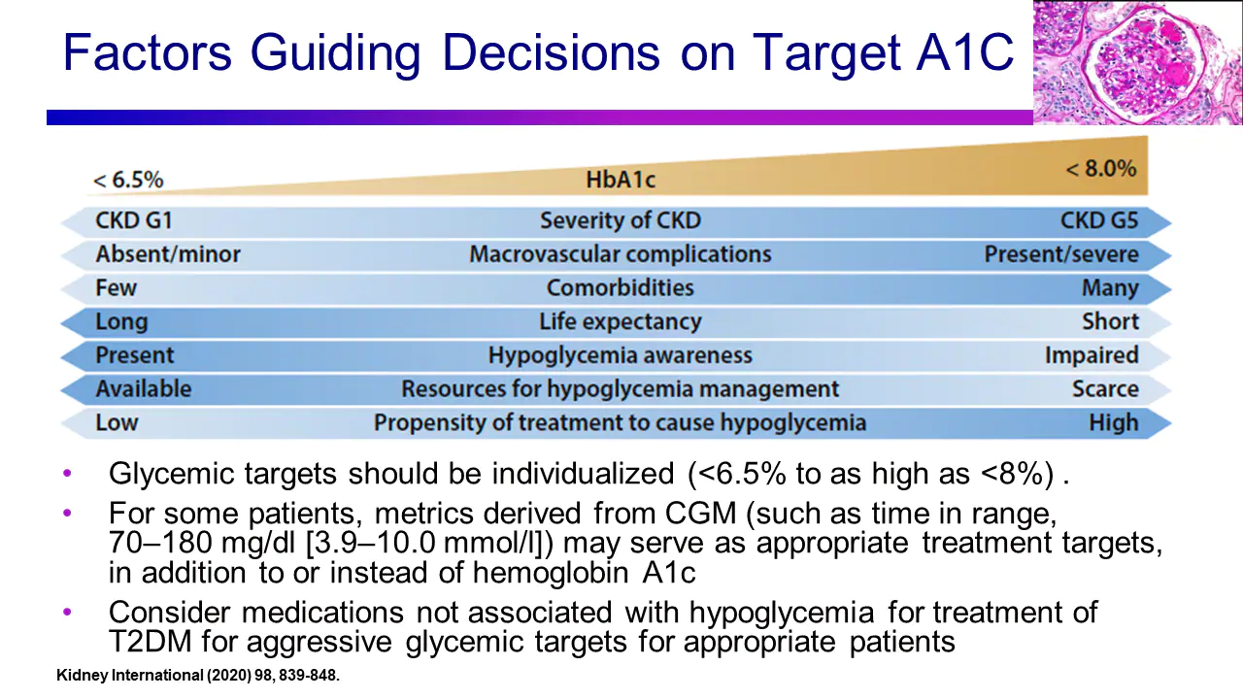

Slide 21
Treatment (ADA Standards of Care)
11.4 Optimize blood pressure control to reduce the risk or slow the progression of chronic kidney disease. A
11.5 Do not discontinue renin-angiotensin system blockade for minor increases in serum creatinine (<30%) in the absence of volume depletion. A
11.6 For people with nondialysis-dependent CKD, dietary protein intake should be approximately 0.8 g/kg body weight per day (the recommended daily allowance). A
  For patients on dialysis, higher levels of dietary protein intake should be considered, since malnutrition is a major problem in some dialysis patients. B

Slide 22
Treatment (ADA Standards of Care)
11.7 In non-pregnant patients with diabetes and hypertension, either an ACE inhibitor or an angiotensin receptor blocker (ARB) is recommended for those with modestly elevated UMACR (30-299 mg/g creatinine) Optimize blood pressure control to reduce the risk or slow the progression of chronic kidney disease. A
11.8 Periodically monitor serum creatinine and potassium levels for the development of increased creatinine or changes in potassium when ACE inhibitors, angiotensin receptor blockers or diuretics are used. B
11.9 An ACE inhibitor or an ARB is not recommended for the primary prevention of chronic kidney disease in patients with diabetes who have normal blood pressure, normal UMACR and normal eGFR. A

Slide 23
Optimize blood pressure control to reduce the risk or slow the progression of chronic kidney disease.
ACC/AHA
  Diabetes mellitus (DM) and hypertension: Antihypertensive drug treatment should be initiated at a BP ≥130/80 mm Hg with a treatment goal of <130/80 mm Hg.
    In adults with DM and hypertension, all first-line classes of antihypertensive agents (i.e., diuretics, ACE inhibitors, ARBs, and CCBs) are useful and effective.
    ACE inhibitors or ARBs may be considered in the presence of albuminuria.
  CKD: BP goal should be <130/80 mm Hg.
    In those with stage 3 or higher CKD or stage 1 or 2 CKD with albuminuria (>300 mg/day), treatment with an ACE inhibitor is reasonable to slow progression of kidney disease.
    An ARB is reasonable if an ACE inhibitor is not tolerated
KDIQO
  No albuminuria and eGFR >60 – keep BP <140/90
  Any albuminuria and/or eGFR <60 – keep BP <130/80
Notes:
https://www.acc.org/latest-in-cardiology/ten-points-to-remember/2017/11/09/11/41/2017-guideline-for-high-blood-pressure-in-adults
Kidney International; supplement 2012; 2, 377

Slide 24
Optimize blood pressure control to reduce the risk or slow the progression of chronic kidney disease.
ADA
  10.3 For patients with diabetes and HTN, BP targets should be individualized through a shared decision-making process that addresses CV risk, potential adverse effects of anti-hypertensive medications & patient preference. C
  10.4 For individuals with diabetes & HTN at higher CV risk (existing ASCVD or 10 y ASCVD risk >15%), a BP target of <130/90 mmHg may be appropriate if it can be safely attained. C
“Patients with older age, chronic kidney disease, and frailty have been shown to be at higher risk of adverse effects of intensive BP control. In addition, patients with orthostatic hypotension, substantial comorbidity, functional limitations, or polypharmacy may be at high risk for adverse effects.
Patients with a history of or at risk for such adverse effects should have a higher BP target. In such patients, a BP target of <140/90 mmHg is recommended, if it can be safely attained.”
Notes:
ADA Standards of Care 2021

Slide 25
Optimize blood pressure control to reduce the risk or slow the progression of chronic kidney disease.
ADA
Potential adverse effects of anti-hypertensive therapy
  Hypotension
  Syncope
  Acute kidney injury
  Electrolyte abnormalities
“Postural changes in blood pressure and pulse may be evidence of autonomic neuropathy and therefore require adjustment of blood pressure targets.
Orthostatic blood pressure measurements should be checked on initial visit and as indicated”
“The combined use of ACE inhibitors and ARBs should be avoided.” (Two clinical trials found no benefits on CVD or CKD and the combination had higher adverse event rates [hyperkalemia and/or AKI])
Notes:
ADA Standards of Care 2021

Slide 26
Treatment – Referral (ADA Standards of Care)
11.10 Patients should be referred for evaluation by a nephrologist if they have an eGFR <30 mL/min/1.73 m2. A
11.11 Promptly refer to a physician experienced in the care of kidney disease for
  uncertainty about the etiology of kidney disease
  difficult management issues* (anemia & secondary hyperparathyroidism may occur earlier in DKD vs other causes of CKD)
  rapidly progressing kidney disease. A
*Difficult management issues
  Anemia
  Metabolic Bone Disease
  Secondary Hyperparathyroidism
  Resistant Hypertension
  Electrolyte Disturbances

Slide 27
ADA Standards of Care – 2022 Update
The updated guidelines now suggest that certain individuals who have stage 4 CKD to take SGLT-2 inhibitors to preserve kidney function.
  In the past, ADA recommended that after progressing to stage 4 kidney disease (eGFR 15-29), people should stop using SGLT-2s - the updated guidelines changed this threshold, suggesting that more people in advanced stages of CKD can now safely use an SLGT-2 inhibitor (many nephrologists continue until start of dialysis)
Finerenone can be used to treat CKD when SGLT-2 inhibitors are not well-tolerated
  Some people, however, may not respond well to treatment with an SGLT-2 inhibitor. In this case, finerenone (Kerendia), a recently approved non-steroidal mineralocorticoid receptor agonist (MRA) drug, can alternatively be used to improve both kidney and heart outcomes.
    Less gynecomastia, less hyperkalemia

Slide 28
Post-Question
Diabetic Kidney Disease
  Can be diagnosed based on one elevated urinary-albumin-creatine ratio result
  Progression can be slowed by appropriate treatment
  Is most often associated with a rapid decline in eGFR
  Increases the risk of cardiovascular disease
  B & D

Slide 29
Extra Slides

Slide 30
For Patients & Families
https://www.kidneyfund.org/kidney-disease/chronic-kidney-disease-ckd/stages-of-chronic-kidney-disease/

Slide 31
In Depth Article (also available as 2-hour Webinar)
Expert Insights for Primary Care Physicians in Managing Chronic Kidney Disease in T2DM (medscape.org)

Slide 32
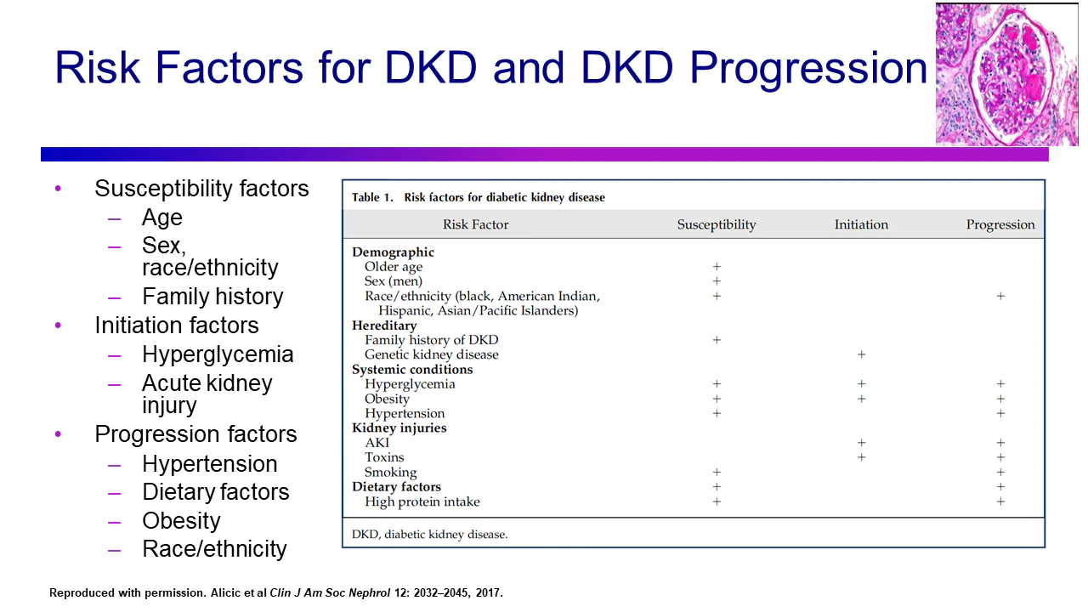

Slide 33
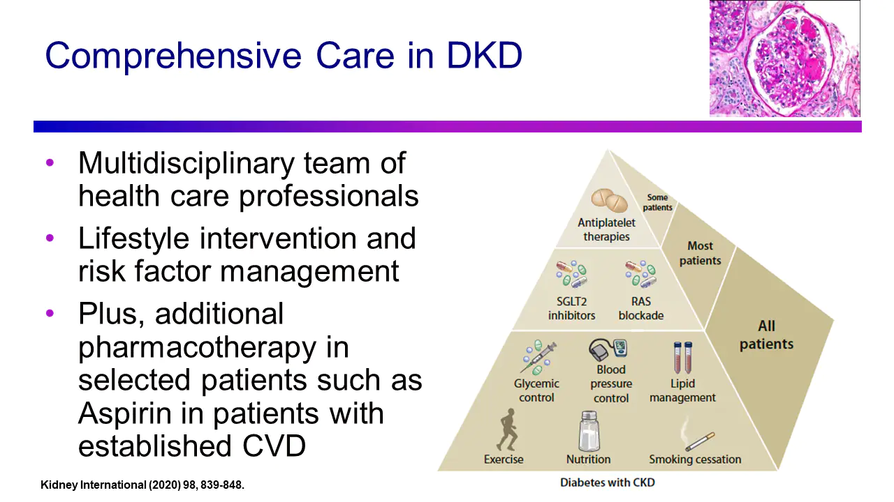

Slide 34
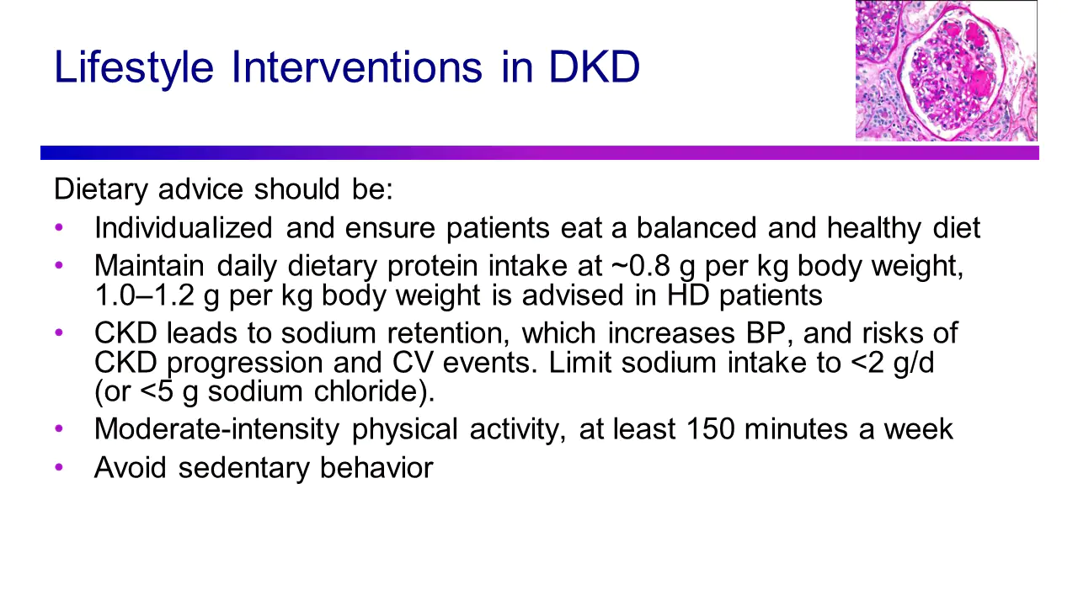

Slide 35
KDIQO guideline for clinicians caring for patients with diabetes and CKD
Patients with diabetes, CKD, hypertension, and albuminuria should be treated with an angiotensin-converting enzyme inhibitor or angiotensin II receptor blocker,
  titrated to the highest approved tolerated dose,
  with close monitoring of serum potassium and serum creatinine levels within 2 to 4 weeks of initiation or change in dose.
Patients with diabetes and CKD who use tobacco should quit.
For patients with diabetes and CKD not receiving dialysis, protein intake should be 0.8 g/kg/day,
  or 1.0 to 1.2 g/kg/day for those receiving dialysis, to offset catabolism and negative nitrogen imbalance.
Sodium intake should be less than 2 g/day (<90 mmol sodium/day; <5 g sodium chloride/day) in patients with diabetes and CKD.

Slide 36
KDIQO guideline for clinicians caring for patients with diabetes and CKD
These patients should undertake moderate-intensity physical activity for a cumulative duration of at least 150 minutes/week, or to cardiovascular and physical tolerance, and should be counseled to avoid sedentary behavior.
People with diabetes and CKD should have a structured self-management educational program.
For comprehensive care of patients with diabetes and CKD, policy makers and institutional decision-makers should implement team-based, integrated care highlighting risk evaluation and patient empowerment.

Slide 37
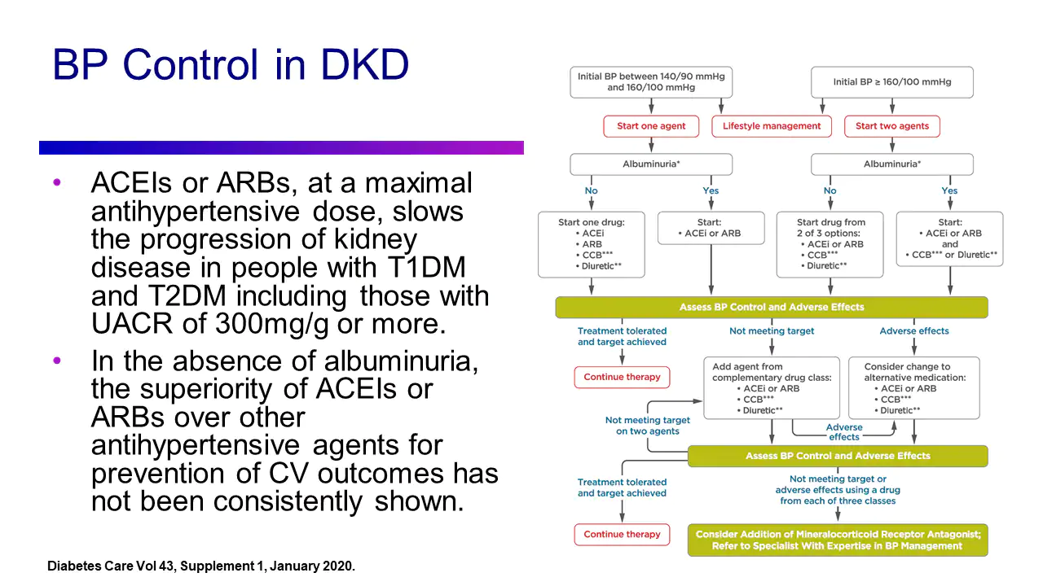

Slide 38
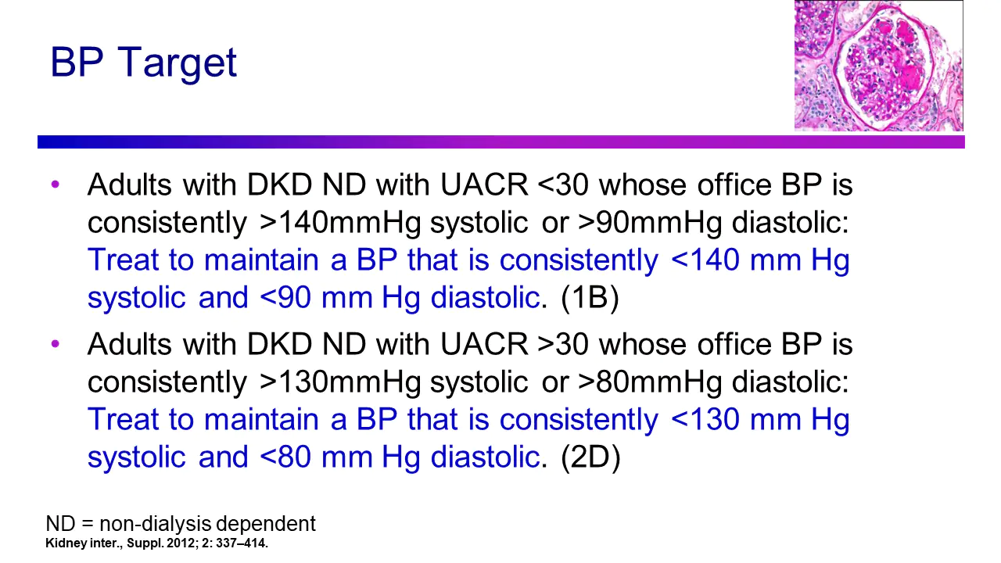

Slide 39
