Slide 1

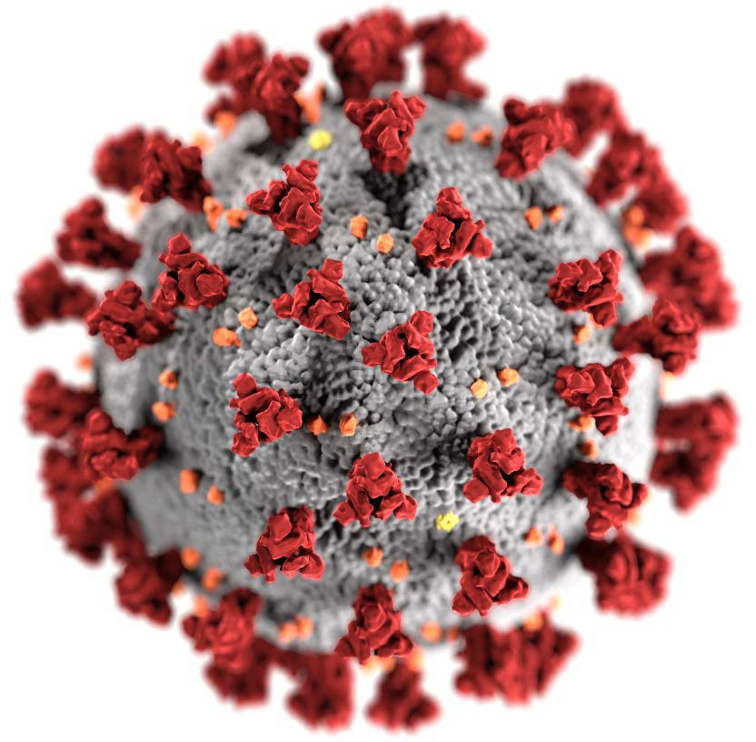

Epidemiology of COVID-19 in Children Aged 5 – 11 years
Fiona Havers, MD, MHS, FIDSA
Medical Officer Epidemiology Task Force CDC COVID-19 Public Health Response
VRBPAC Meeting October 26, 2021
cdc.gov/coronavirus

Slide 2

Overview of COVID-19 in Children Aged 5 – 11 years
Incidence and burden estimates
COVID-19-associated hospitalization rates and mortality
Multisystem Inflammatory Syndrome in Children (MIS-C)
Post-COVID conditions
Transmission
Lost in-person learning and other impacts

Slide 3
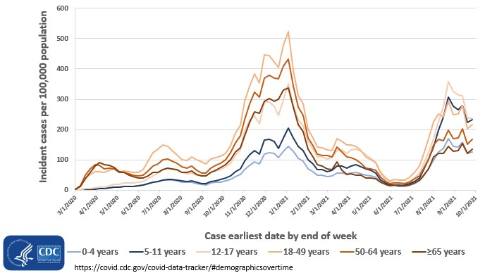

COVID-19 Weekly Cases per 100,000 Population by Age — March 1, 2020–October 10, 2021
>1.9 million cases among children 5-11 years of age

Slide 4
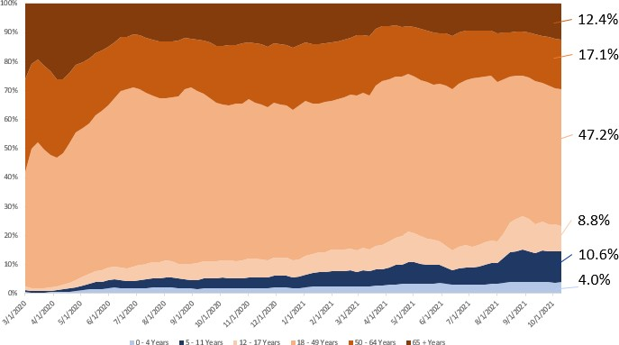
Proportion of Total COVID-19 Cases by Age Group
— March 1, 2020–October 10, 2021
Children 5-11 years are making up a greater proportion of total cases:
10.6% of cases
the week of October 10, 2021
https://covid.cdc.gov/covid-data-tracker/#demographicsovertime

Slide 5
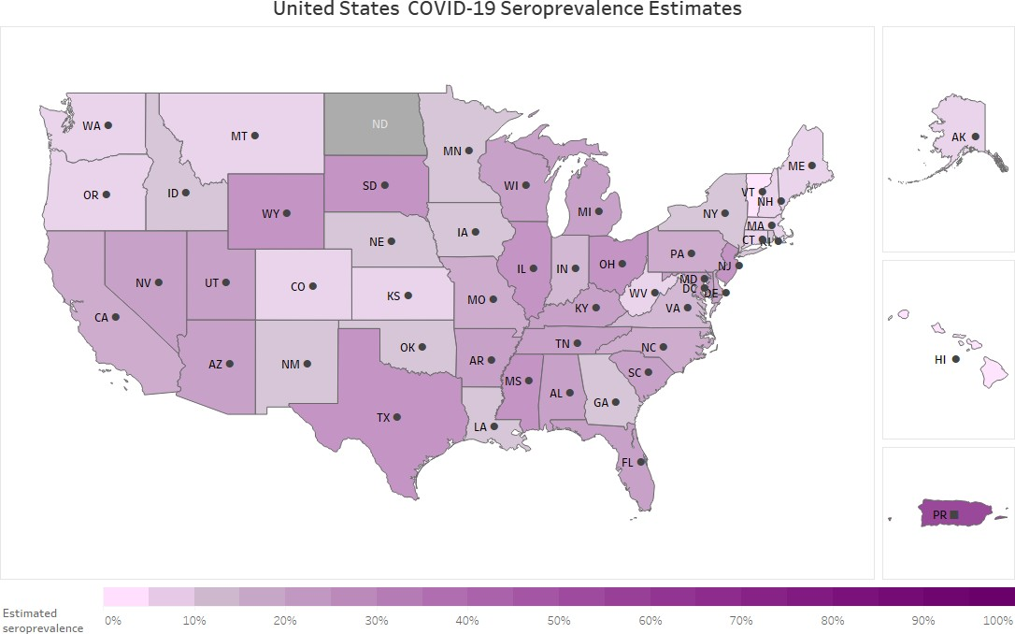
Nationwide Commercial Laboratory SARS-CoV-2 Seroprevalence Survey
Every 2 weeks, ~50,000 specimens tested for SARS-CoV-2 antibodies
De-identified residual sera from commercial laboratories
Limited pediatric specimens
For age-stratified analysis:
Restricted to 15 jurisdictions that include ≥100 specimens from children aged 5– 11 years per 2 months
Restricted to a total antibody anti-N assay
https://covid.cdc.gov/covid-data-tracker/#national-lab
https://www.cdc.gov/coronavirus/2019-ncov/cases-updates/geographic-seroprevalence-surveys.html

Slide 6
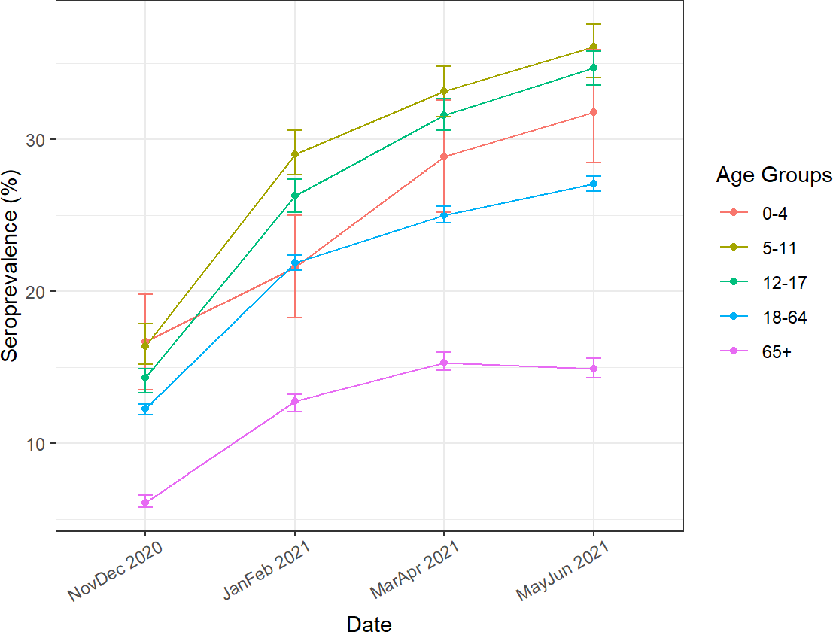
Weighted SARS-CoV-2 Infection-Induced Seroprevalence: 15 U.S. jurisdictions by Age Group, Nov 2020–Jun 2021
Children consistently have higher seroprevalence estimates than adults
Age 5–11 have the highest seroprevalence, but confidence intervals overlap with other pediatric age groups
Age 5–11 seroprevalence increased from 13% in Nov–Dec 2020 to 42% in May–June 2021
Number of infections per reported case*:
General population: Median 2.4
(Range: 2.0–3.9)
Ages 0–17 years: Median 6.2
(Range: 4.7–8.9)
* Restricted to jurisdictions that provided age data for >90% of individual cases: CA, IL, NV, NJ, NC, OH, SC, and TN

Slide 7
Seroprevalence Findings
Seroprevalence data suggest infections in children less likely to be reported compared with adults
Children are at least as likely as adults to be infected with SARS-CoV-2
Seroprevalence in children continues to increase
– Estimates in children 5–11 years were >40% in May–June 2021
Limitation: Seroprevalence estimates may not be representative of the general pediatric population

Slide 8
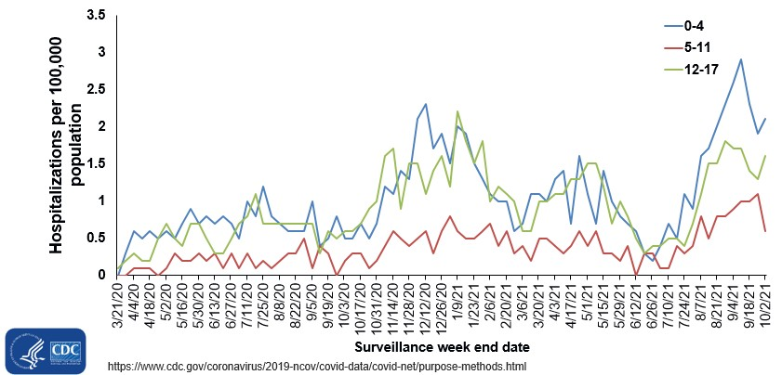
COVID-19-Associated Weekly Hospitalizations per 100,000 — COVID-NET by age group, March 21, 2020–October 2, 2021

Slide 9
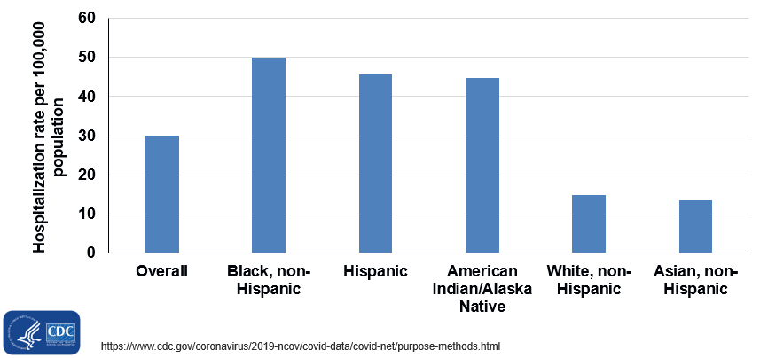
Cumulative COVID-19-Associated Hospitalization Rates by Race and Ethnicity among Children 5-11 Years of Age — COVID-NET, March 1, 2020–October 2, 2021

Slide 10
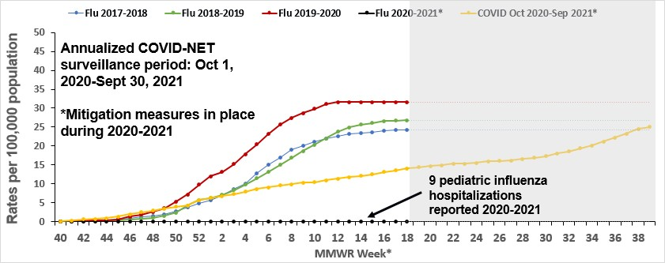
Cumulative Influenza- and COVID-19-Associated Hospitalizations, Ages 5-11
Notes: Influenza seasons: MMWR week 40 of the earlier year to MMWR week 18 of the later year. The COVID period: Oct 2020-Sep 2021 goes from MMWR week 40 of year 2020 to MMWR week 39 of year 2021. MMWR Week 53 for MMWR Year 2020 is combined with MMWR Week 52 for consistency with other years.
COVID-NET-California, Colorado, Connecticut, Georgia, Iowa, Maryland (entire state), Michigan, Minnesota, New Mexico, New York, Ohio, Oregon, Tennessee, and Utah.
FluSurv-NET: California, Colorado, Connecticut, Georgia, Maryland (Baltimore Metropolitan Area), Michigan, Minnesota, New Mexico, New York, Ohio, Oregon, Tennessee, and Utah.

Slide 11
Clinical Interventions and Outcomes of Children Aged 5-11 years with COVID-19 or Influenza-Associated Hospitalizations, COVID-NET¹ and FluSurv-NET²
FluSurv-NET 2017-2018, 2018-2019, and 2019-2020 (N = 1,874),³ n (%) |  | COVID-NET March 1, 2020–August 31, 2021 (N = 696),⁴ n (%)
Hospital length of stay (median, IQR) | 2 (1-4) | 3 (2-6)
ICU admission | 398 (21.2) | 222 (31.9)
Invasive mechanical ventilation | 87 (4.6) | 50 (7.2)
Died during hospitalization | 11 (0.6) | 4 (0.6)
COVID-NET-California, Colorado, Connecticut, Georgia, Iowa, Maryland (entire state), Michigan, Minnesota, New Mexico, New York, Ohio, Oregon, Tennessee, and Utah.
FluSurv-NET: California, Colorado, Connecticut, Georgia, Maryland (Baltimore Metropolitan Area), Michigan, Minnesota, New Mexico, New York, Ohio, Oregon, Tennessee, and Utah. Surveillance conducted from October 1-April 30 each season
Includes those with complete clinical data (~97% of pediatric cases) on hospital length of stay, ICU admission, invasive mechanical ventilation, and disposition discharge (i.e., discharged alive or died in-hospital).
Includes those with complete clinical data (~90% of pediatric cases) on hospital length of stay, ICU admission, invasive mechanical ventilation, and disposition discharge (i.e., discharged alive or died in-hospital).

Slide 12
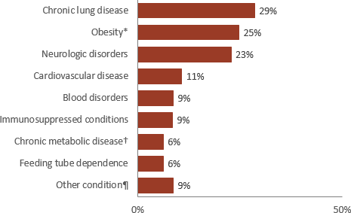
Children Aged 5–11 Years Hospitalized with COVID-19— COVID-NET, March 2020–August 2021
Demographic and clinical characteristics Prevalence of underlying medical conditions
 | N | (%)
Total | 562 | (100)
Age (yrs) ‒ median (IQR) | 8 | (6–10)
Sex – Male | 320 | (57)
Race/ethnicity
Black, non-Hispanic | 207 | (37)
Hispanic | 177 | (31)
White, non-Hispanic | 124 | (22)
Asian, non-Hispanic | 23 | (4)
Other, non-Hispanic | 31 | (6)
Severe disease§ | 200 | (36)
≥1 underlying condition | 381 | (68)
§Requiring intensive care unit admission or mechanical ventilation
*BMI (kg/m²) ≥95th percentile for age and sex based on CDC growth charts, ICD-10 codes for obesity, or obesity selected on case report form
†Includes type I and type II diabetes mellitus
¶Includes gastrointestinal or liver disease; renal disease; rheumatologic, autoimmune, inflammatory conditions; abnormality of the airway
COVID-NET is a population-based surveillance system that collects data on laboratory-confirmed COVID-19-associated hospitalizations among children and
adults through a network of over 250 acute-care hospitals in 14 states. Methods described in: Woodruff RC, et al. Risk factors for Severe COVID-19 in Children.
Pediatrics. ePub October 2021.

Slide 13
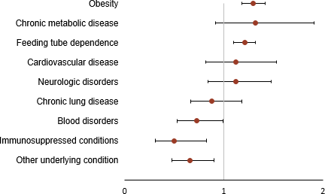
Underlying Conditions as Risk Factors in Hospitalized Children 5–11 Years—COVID-NET, March 2020–August 2021
Underlying medical conditions associated with severe disease:
Adjusted risk ratio and 95% confidence interval for select underlying medical conditions:
Obesity*
aRR=1.3 (95% CI: 1.2–1.4)
Feeding tube dependence
aRR=1.2 (95% CI: 1.1–1.3)
*BMI (kg/m²) ≥95th percentile for age and sex based on CDC growth charts, ICD-10 codes for obesity, or obesity selected on case report form
†Includes type I and type II diabetes mellitus
¶Includes gastrointestinal or liver disease; renal disease; rheumatologic, autoimmune, inflammatory conditions; abnormality of the airway Methods described in: Woodruff RC, et al. Risk factors for Severe COVID-19 in Children. Pediatrics. ePub October 2021.

Slide 14
Clinical Interventions and Outcomes of Children Aged 5-11 Years with COVID-19–Associated Hospitalizations – COVID-NET, 14 states,* March 1, 2020–June 19, 2021 and June 20–August 31, 2021
Characteristics | March 1, 2020–June 19, 2021 (N = 565)† n (%) | June 20–August 31, 2021 (N = 131)† n (%) | p-value
Hospital length of stay (median, IQR) | 3 (2–6) | 3 (1–6) | 0.66
ICU admission | 182 (32.2) | 40 (30.5) | 0.71
Vasopressor support | 79 (14.0) | 12 (9.2) | 0.14
Died during hospitalization | 4 (0.7)
Highest level of respiratory support required
High flow nasal cannula§ | 42 (7.4) | 8 (6.1) | 0.60
BIPAP/CPAP§ | 29 (5.1) | 9 (6.9) | 0.43
Invasive mechanical ventilation§ | 35 (6.2) | 15 (11.5) | 0.04
Abbreviations: ICU = intensive care unit; IQR = interquartile range; BIPAP = bilevel positive airw ay pressure; CPAP = continuous positive airw ay pressure
*California, Colorado, Connecticut, Georgia, Iow a, Maryland, Michigan, Minnesota, New Mexico, New York, Ohio, Oregon, Tennessee, and Utah.
†Includes those w ith complete clinical data on hospital length of stay, ICU admission, highest level of respiratory support (invasive mechanical ventilation, BIPAP/CPA P, or high flow nasal cannula), vasopressor support, and disposition discharge (i.e., discharged alive or died in-hospital).
§Highest level of respiratory support for each patient that needed respiratory support.
Reference: Delahoy et al. Hospitalizations Associated w ith COVID-19 Among Children and Adolescents — COVID-NET, 14 States, March 1, 2020–August 14, 2021; MMWR. September 10,
2021 / 70(36);1255–1260.

Slide 15
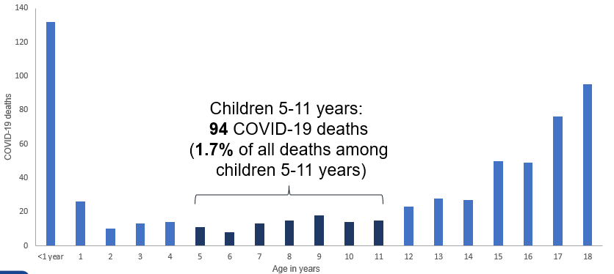
COVID-19 Deaths by Age Group, NCHS
— January 1, 2020–October 16, 2021
https://data.cdc.gov/NCHS/Provisional-COVID-19-Deaths-Counts-by-Age-in-Years/3apk-4u4f/data

Slide 16
Leading Causes of Death in Children 5-11 Years of Age,
NCHS, 2019
 |  | Causes of Death | Death (n) | Crude rate per 100,000
 |  | Accidents (unintentional injuries) | 969 | 3.4
 |  | Malignant neoplasms | 525 | 1.8
 |  | Congenital malformations, deformations and chromosomal abnormalities | 274 | 1.0
 |  | Assault (homicide) | 207 | 0.7
 |  | Diseases of the heart | 115 | 0.4
 |  | Chronic lower respiratory diseases | 107 | 0.4
66 COVID-19 associated deaths in children 5-11 10/3/20-10/2/2021
 |  | Influenza and pneumonia | 84 | 0.3
 |  | Intentional self-harm (suicide) | 66 | 0.2
 |  | Cerebrovascular diseases | 56 | 0.2
 |  | Septicemia | 48 | 0.2
Total population 5-17 years, 2019: 52,715,248
CDC NCHS WONDER Online Database. Accessed at http://wonder.cdc.gov/ucd-icd10.html on May 6, 2021

Slide 17
Multisystem Inflammatory Syndrome in Children (MIS-C)
Severe hyperinflammatory syndrome occurring 2-6 weeks after acute SARS-CoV-2 infection, resulting in a wide range of manifestations and complications
60-70% of patients are admitted to intensive care, 1-2% die^{1,2}
5,217 MIS-C cases have been reported to national surveillance as of October 4, 2021³
Median age of 9 years, 39% of cases occurred in children 6-11 years
61% occurred in children who are Hispanic/Latino or Black, Non-Hispanic
Adjusted incidence estimates ~100-600 cases per million SARS-Cov-2 infections⁴
Feldstein LR, et al. Characteristics and Outcomes of US Children and Adolescents With Multisystem Inflammatory Syndrome in Children (MIS-C) Compared With Severe Acute COVID-19. JAMA. 2021;325(11):1074-1087. doi:10.1001/jama.2021.2091
Belay ED, et al. Trends in Geographic and Temporal Distribution of US Children With Multisystem Inflammatory Syndrome During the COVID-19 Pandemic
[published online ahead of print, 2021 Apr 6]. JAMA Pediatr. 2021;e210630. doi:10.1001/jamapediatrics.2021.0630
https://covid.cdc.gov/covid-data-tracker/#mis-national-surveillance
Payne AB, et al. Incidence of Multisystem Inflammatory Syndrome in Children Among US Persons Infected With SARS-CoV-2. JAMA Netw Open. 2021;4(6):e2116420. Published
2021 Jun 1. doi:10.1001/jamanetworkopen.2021.16420

Slide 18
Post-COVID Conditions in Children
Post-COVID conditions do occur in children
Appears to be less common in children than in adults
A national survey in the UK found 7-8% of children with COVID-19 reported continued symptoms >12 weeks after diagnosis¹
Can appear after mild to severe infections, and after MIS-C
Most common symptoms: Similar to adults and include fatigue, headache, insomnia, trouble concentrating, muscle and joint pain, and cough^{2,3}
Impact on quality of life: Limitations of physical activity, feeling distressed about symptoms, mental health challenges, decreased school attendance/participation²
¹Office for National Statistics United Kingdom. (2021) Prevalence of ongoing symptoms follow ing coronavirus (COVID-19) inf ection in the UK. Retrieved on September 17, 2021 from Office for National Statistics’ w ebsite. https://w ww.ons.gov.uk/peoplepopulationandcommunity/he althandsocialcare/conditionsand diseases/bulletins/prevalenceof ongoingsymptomsfollow ingcoronavirus covid19inf ectionintheuk/1april2021
²Buonsenso D, Munblit D, De Rose C, et al. Preliminary evidence on long COVID in children. Acta Paediatr. 2021;110(7):2208-2211. doi:10.1111/apa.15870.
³Molteni E, Sudre CH, Canas LS, et al. Illness duration and symptom profile in symptomatic UK school-aged children tested for SARS-CoV-2. Lancet Child Adolesc Health 2021; 5: 708–18. https://w ww.thelancet.com/action/show Pdf ?pii=S2352-4642%28 21%29 00198-X

Slide 19
Children and Transmission of SARS-CoV-2
Transmission of SARS-CoV-2 virus is influenced by presence and type of symptoms, type and timing of exposure, viral load, and variant
Some studies observed similar infection rates between children, adolescents and adults, while others found lower infection rates among children and adolescents compared with adults^{1,2}
Secondary transmission from children can and does occur in both household³ and school settings^{2,4,5}
Bi Q et al. Lancet Infect Dis. 2020;20(8):911-919
CDC Science Brief: Transmission of SARS-CoV-2 in K-12 schools. https://www.cdc.gov/coronavirus/2019-ncov/science/science- briefs/transmission_k_12_schools.html
Chu VT, Yousaf AR, Chang K, et al. Household Transmission of SARS-CoV-2 from Children and Adolescents. N Engl J Med. 2021;NEJMc2031915.
Goldstein E et al. On the Effect of Age on the Transmission of SARS-CoV-2 in Households, Schools, and the Community. J Infect Dis. 2021 Feb 13;223(3):362-
369.
Larosa E et al. Secondary transmission of COVID-19 in preschool and school settings in northern Italy after their reopening in September 2020. Euro Surveill.
2020;25(49):2001911.

Slide 20
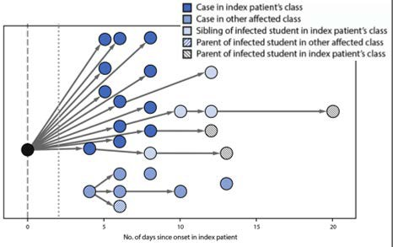
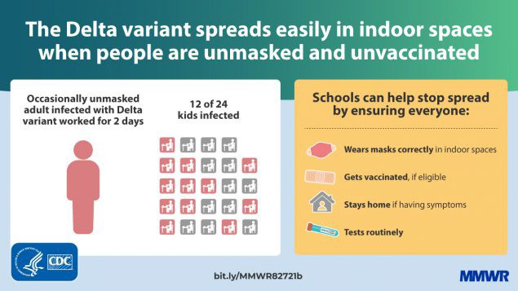
Children and Transmission of SARS-CoV-2
Outbreak investigations have demonstrated efficient transmission among children and adults
Lam-Hine et al. MMWR Morb Mortal Wkly Rep ePub: 27 August 2021.

Slide 21
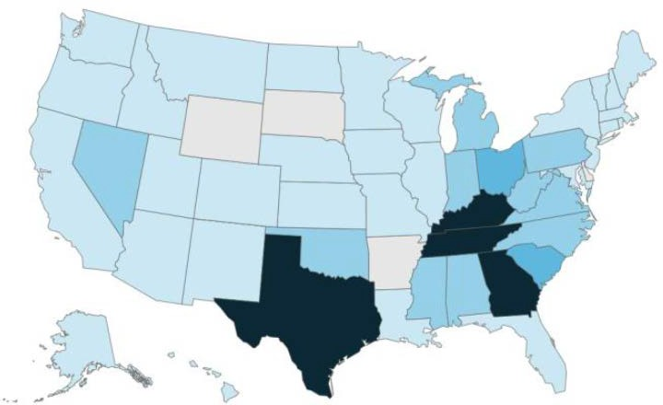
COVID-19 Related K-12 School Closures by State, August 2, 2021 – October 8, 2021
School districts closed | Total # schools closed* | Estimated # students affected* | Estimated # teachers affected*
272 | 2,074 | 1,069,116 | 68,718
Data from the Unplanned School Closure Monitoring Project (DGMQ/CDC), ongoing research that uses systematic daily media searches (methods explained in https://doi.org/10.1371/journal.pone.0248925).
* Number of schools closed in district-wide closures, total number of students, and total number of teachers are estimated by matching the public school district ID or school ID with the district/school data for school year 2019/20 and private school ID with school data for year 2017/18 as obtained from the National Center for Education Statistics (https://nces.ed.gov/ccd/elsi/tableGenerator.aspx, accessed on Apr 20, 2021). Due to missing information in 2019/20 data, the total number of public school teachers in California is estimated using 2018/19 NCES data.

Slide 22
Summary: COVID-19 Epidemiology in Children Aged 5-11 years
Children 5-11 years of age are at least as likely to be infected with SARS-CoV-2 as adults
Over 1.9 million reported cases; seroprevalence estimates of >40% in May – June 2021
Seroprevalence data suggests that children less likely to be reported as cases than adults
Children 5-11 years of age are at risk of severe illness from COVID-19
>8,300 hospitalizations to date
Hospitalization rates 3x times as high for non-Hispanic Black, non-Hispanic American Indian/Alaska Native, and Hispanic children as for non-Hispanic White children
Cumulative hospitalization rates similar to pre-pandemic influenza-associated hospitalization rates, despite mitigation measures
Severity comparable among children hospitalized with influenza and COVID-19
Approximately 1/3 of hospitalized children 5-11 years require ICU admission
MIS-C most frequent among children 5-11 years
Post-COVID conditions have been seen in children
Secondary transmission from young school age children can and does occur in both household and school settings
COVID-19 in children leads to lost in-person learning and other adverse outcomes

Slide 23
Acknowledgements
CDC
Mass-C participating laboratories and state health departments
Site PIs and staff for COVID-NET and FluSurv-NET
Many others…
Kate Woodworth
Jefferson Jones
Hannah Kirking
Melissa Rolfes
Angela Campbell
Melissa Briggs-Hagen
Sara Oliver
Alexia Couture
Kristie Clarke
Tina Benoit
John Glasser
Myrna Charles
Brendan Flannery
Carrie Reed
Casey Lyons
Farida Ahmad
Nicole Zviedrite
CDC COVID-NET team
CDC FluSurv-NET Team:
Christopher Taylor
Huong Pham
Michael Whitaker
Kadam Patel
Jenny Milucky
Rebecca Woodruff
Anita Kambhampati
Shikha Garg
Dawud Ujamaa
Alissa O’Halloran
Charisse Cummings
Rachel Holstein
23

