Slide 1

VIRTUAL CARE IMPLEMENTATION ECHO
Nov 16, 2021

Slide 2
Welcome!
Please sign in using the link in the chat

Slide 3
Announcements
We are offering Continuing Education for our sessions
We will post evaluation link near end of our discussion today
Please submit a case or reach out to use if you would like our expert panel to review your case

Slide 4
Our Team
Dr Megan Ballew
Dr Paula Cook
Dr Angad Singh
Dr Bud Vana
Dr Justin Iwasaki
Dr Jessica Whitfield

Slide 5


DISCLOSURES
This activity is jointly provided by Northwest Portland Area Indian Health Board and Cardea Services
Cardea Services is approved as a provider of continuing nursing professional development by Montana Nurses Association, an accredited approver with distinction by the American Nurses Credentialing Center’s Commission on Accreditation.
This activity has been planned and implemented in accordance with the accreditation requirements and policies of the California Medical Association (CMA) through the joint providership of Cardea and Northwest Portland Area Indian Health Board. Cardea is accredited by the CMA to provide continuing medical education for physicians.
Cardea designates this live web-based training for a maximum of 1 AMA PRA Category 1 Credit(s)TM on November 16 and December 21, 2021, Physicians should claim credit commensurate with the extent of their participation in the activity.

Slide 6

Disclosures
The Washington State Pharmacy Association is accredited by the Accreditation Council for Pharmacy Education as a Provider of continuing pharmacy education.
November 16, 2021 ACPE UAN# | 0130-9999-21-327-L01-P
December 21, 2021 ACPE UAN# | 0130-9999-21-328-L01-P
1 ACPE CPE hrs. | Activity Type: Knowledge

Slide 7
DISCLOSURES
COMPLETING THIS ACTIVITY
Upon successful completion of this activity 1 contact hour will be awarded
Successful completion of this continuing education activity includes the following:
Attending the entire CE activity;
Completing the online evaluation;
Submitting an online CE request.
Your certificate will be sent via email
If you have any questions about this CE activity, contact Paige O'Sullivan at posullivan@cardeaservices.org or 206-729-4773

Slide 8
Disclosures
The planners and presenters of this CE activity have no relevant financial relationships with any commercial entities pertaining to this activity.

Slide 9
Remote Teams for Patient Care: Moving towards Best Practices
Dr Jessica Whitfield, MD MPH
Nov 16, 2021

Slide 10
Disclosures
None

Slide 11
Objectives
Define virtual care/telehealth
Describe benefits of telehealth generally and in I/T/U communities
Name benefits and challenges associated with building and sustaining effective remote teams in medical care
Identify approaches to mitigating challenges in remote teams

Slide 12
What is virtual care?
Multiple names: telemedicine, telehealth, virtual care
  2007 review found 104 terms
“Telemedicine uses telecommunication systems to deliver health care at a distance … Examples include the provision of specialist consultations via video‐conferencing, remote monitoring of patients with chronic conditions and the provision of clinical information for self‐management. Telemedicine applications may also be linked to electronic patient records.”
Variety of mediums: from in-person, videoconferencing, telephone, email, patient-portals, text-based applications, digital apps, remote monitoring
Flodgren et al 2015; Shore J et al 2019; Sood S et al 2007
Notes:
This article will define telepsychiatry as live interactive video conferencing and when discussing other technologies (e.g., email, telephone, electronic health records (EHRs), patient-portals, mobile devices) will specifically indicate these

Slide 13
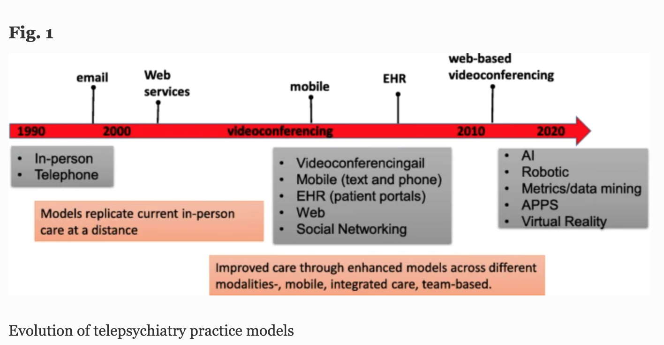
Shore J et al 2019

Slide 14
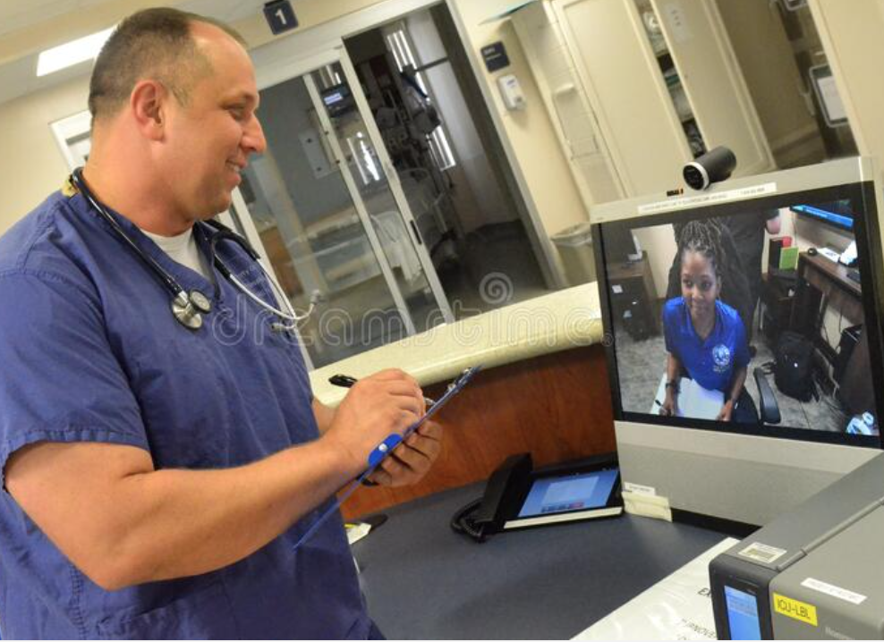
Benefits to telehealth in general
Improve outcomes
Decrease travel time and increase communication with providers
Increase access to care
Decrease missed appointments
Decrease wait times
Cruse CS et al 2017; Shore J et al 2019

Slide 15
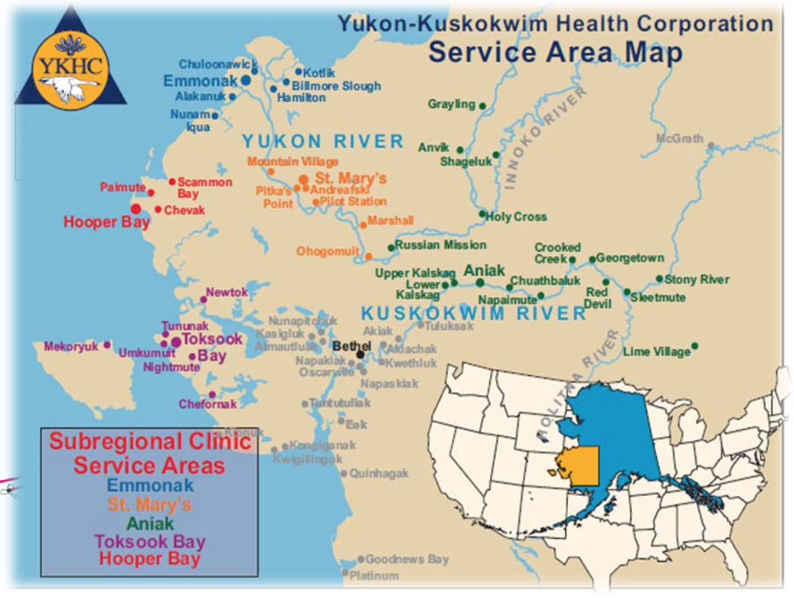
Telehealth in tribal communities
I/T/U clinics long at the forefront of telehealth delivery
  The Alaska Tribal Health System (ATHS) has utilized telehealth programs to deliver care since mid 1990s. (Hays et al 2014)
  Teleopthomology in Arizona in 2000 (Hays et al 2014)
Xiomara Owens, MS; Alaska Native Tribal Health Consortium
Notes:
SUD residential: Introduction:Alaska Native communities experience high rates of alcohol and substance abuse and face challenges accessing quality, culturally appropriate treatment. Telepsychiatry could help bridge this gap, but no publications have examined its impacts for alcohol and substance abuse treatment directed at Alaska Native communities. This study explores one telepsychiatry clinic's impact on a residential substance abuse treatment serving the Alaska Native community in Anchorage, Alaska.
Methods:Using a matched case–control design, 103 cases receiving telepsychiatry services between 2007 and 2012 were matched with 103 controls who did not. Outcome measures included length of stay, discharge plans, emergency room visits, and hospital admissions; clinical history, including previous suicide attempts, history of violence, and trauma history; social stressors such as current legal issues, unemployment, and homelessness; mental health, medical, and substance abuse diagnoses; and number of telepsychiatry appointments and nature of telepsychiatry services rendered.
Results:Both groups exhibited high rates of mental and medical illness, socioeconomic challenges, and substance abuse. However, the telepsychiatry group demonstrated a significantly higher rate of post-traumatic stress disorder, history of violence, ongoing legal issues, and children in outside custody. It also remained engaged in treatment longer, had fewer discharges against medical advice, and was more likely to complete treatment.

Slide 16
Telehealth in tribal communities
In I/T/U settings, studies have shown good outcomes and/or feasibility for:
  Residential SUD treatment (Legha R et al 2020)
  Tele-behavioral health (Hays et al 2014) and suicide prevention (Pruitt Z et al 2021)
  Tele-dermatology (Morenz et al 2019)
  Tele-ENT (Ear, Nose, Throat) (Hays et al 2014)
  Tele-Cardiology (Hay et al 2014)
  Tele-opthomology (Hays et al 2014)
  Rheumatoid Arthritis (Ferrucci ED et al 2020)
  Cancer pain management (Hazousos E 2012)
Notes:
SUD residential: Introduction:Alaska Native communities experience high rates of alcohol and substance abuse and face challenges accessing quality, culturally appropriate treatment. Telepsychiatry could help bridge this gap, but no publications have examined its impacts for alcohol and substance abuse treatment directed at Alaska Native communities. This study explores one telepsychiatry clinic's impact on a residential substance abuse treatment serving the Alaska Native community in Anchorage, Alaska.
Methods:Using a matched case–control design, 103 cases receiving telepsychiatry services between 2007 and 2012 were matched with 103 controls who did not. Outcome measures included length of stay, discharge plans, emergency room visits, and hospital admissions; clinical history, including previous suicide attempts, history of violence, and trauma history; social stressors such as current legal issues, unemployment, and homelessness; mental health, medical, and substance abuse diagnoses; and number of telepsychiatry appointments and nature of telepsychiatry services rendered.
Results:Both groups exhibited high rates of mental and medical illness, socioeconomic challenges, and substance abuse. However, the telepsychiatry group demonstrated a significantly higher rate of post-traumatic stress disorder, history of violence, ongoing legal issues, and children in outside custody. It also remained engaged in treatment longer, had fewer discharges against medical advice, and was more likely to complete treatment.

Slide 17
Telehealth caveats
Barriers:
  Internet access (Graves JM et al 2021)
  Patient acceptability
    “Studies reported Indigenous people tend to be satisfied with telehealth, but are sceptical about its cultural safety” (Fraser S et al 2017)
  Provider acceptability
  Adjusting to new technology (Flodgren G et al 2015)
  Creating new workflows
Notes:
Aside from barriers to access, the acceptability and effectiveness of telemedicine among tribal communities must be considered
To illustrate this concern, we summarized broadband Internet service data from the 2018 American Community Survey estimates11 for census tracts within the Navajo Nation, the largest American Indian tribe in the US. We found that 58.1%-87.7% of households in Navajo Nation census tracts reported not having broadband Internet service, compared to 19.6% nationally (Figure 1). Access to broadband Internet service is not only a concern for the Navajo Nation; it is a challenge facing most tribal communities in the US. 12,13 Even if tribal members can access the Internet at public spaces (eg, local library or school), these locations are far from ideal for telemedicine visits, especially telemental health

Slide 18
Telehealth can be highly effective
Cochrane analysis in 2015
  93 eligible trials (N = 22,047 participants)
  The effectiveness of telehealth delivered in addition to (32% of studies), as an alternative to (57% of studies), or partly substituted for usual care (11%)
  A wide rage of clinical conditions:
    cardiovascular disease (36)
    diabetes (21)
    respiratory conditions (9)
    mental health or substance abuse conditions (7)
    conditions requiring a specialist consultation (6), co morbidities (3)
    urogenital conditions (3)
    neurological injuries and conditions (2)
    gastrointestinal conditions (2)
    neonatal conditions requiring specialist care (2)
    solid organ transplantation (1)
    and cancer (1).
Flodgren G et al 2015

Slide 19
Telehealth can be highly effective
Main findings and conclusions:
  Heart failure: telehealth had similar health outcomes as face‐to‐face or telephone
  Evidence for telehealth in improved diabetes management.
  Limited data on cost and acceptabiilty.
  Telehealth effectiveness may depend on:
    Severity/trajectory of disease
    The function of the intervention (monitoring a chronic condition, or access to diagnostic services)
    the healthcare provider and healthcare system involved in delivering the
    intervention.
Flodgren G et al 2015

Slide 20

Telehealth: Why now?
Long history of telehealth, but rapid implementation and acceptance of telehealth with the COVID-19 pandemic
Telehealth best practices are evolving
  A main tenet is team organization and communication
Re-envisioning approaches to health care delivery
Shore J et al 2020

Slide 21


What is an off-site, remote or tele-team?
From Providers located in Clinic/Hospital to Patient Home
From Off-site Provider(s) to Clinic/Hospital/Patient Home
https://healthtechmagazine.net/article/2020/08/why-providers-should-address-disparities-telehealth-access

Slide 22
What is an off-site, remote or tele-team?
From Providers located in Clinic/Hospital to Patient Home
From Off-site Provider(s) to Clinic/Hospital/Patient Home
https://healthtechmagazine.net/article/2020/08/why-providers-should-address-disparities-telehealth-access

Slide 23
What is an off-site team, remote or tele-team?
Off-site Clinical Team
Separate locations
Team members
Clinical team work
Communication across virtual space
Shore J et al 2019; https://healthtechmagazine.net/article/2020/08/why-providers-should-address-disparities-telehealth-access
Notes:
Clinical teams composed of:
members (frequently interdisciplinary; providers and staff)
in separate locations
Engaging in teamwork around patient care
occurring across virtual space through a range of communication (e.g., videoconferencing, email, phone/mobile, EHRs).

Slide 24
Benefits to off-site teams
Can be just as effective as clinic-based teams
  Early comparisons show remote integrated behavioral health care is effective, and as effective as clinic-based models (Fortney J et al 2013; Fortney J et al 2018)
Can expand hiring pool
  Wider range of skills/training possible
Can increase access and integrate more specialties
Shown to increase team productivity and reduce stress/burnout (less commute)
Shore J et al 2019; Gardner et al 2020;
Fortney J et al 2018
https://healthtechmagazine.net/article/2020/08/why-providers-should-address-disparities-telehealth-access

Slide 25
“The model is only as
successful as the team.”
- Child/adolescent psychiatric consultant
who works off-site
“The ability of a telepsychiatry team to work effectively in virtual/hybrid environments has significant implications for treatment outcomes.”
– Shore J et al 2019
Notes:
Dr Jennifer Purses

Slide 26
Remote Clinical Team Challenges
Team cohesion challenges (“Out of sight, out of mind”, isolation)
Team miscommunication, difficulty closing communication loops
Privacy and security
Technology snafus
Shore J et al 2019; Ackerman B et al 2009

Slide 27
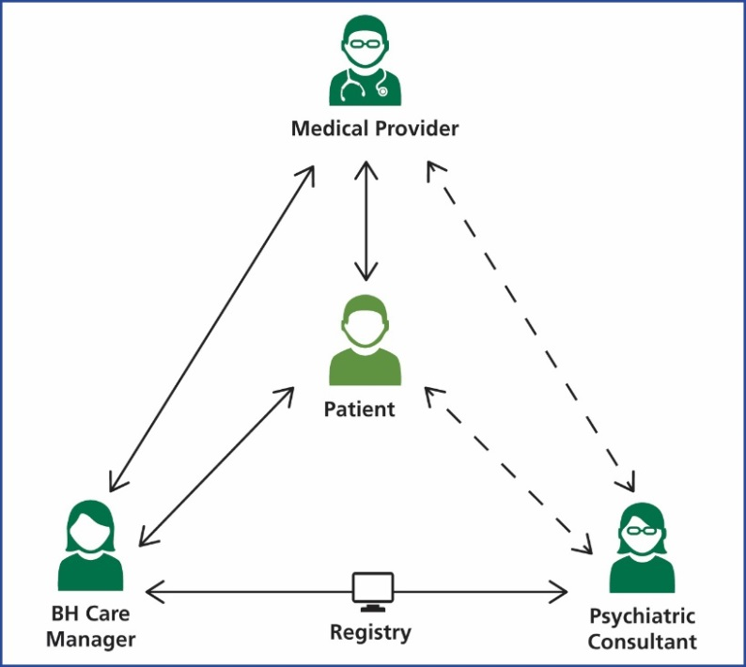
Telepsychiatry and Collaborative Care as an Example
A form of integrated behavioral health care that incorporates a psychiatric consultant (PC) and behavioral care manager (BHCM) into team with PCP
Psychiatric consultant is often/traditionally off-site
With advent of changes in telehealth/policy, more remote CoCM teams with several members off-site
www.aims.uw.edu

Slide 28
Best Practices in Tele-teaming Literature
  Medical literature suggests tele-teaming impacts patient-provider relationship, patient experience, clinical outcomes
  Not much about tele-teaming in medicine
  Current understanding drawn from fields of applied psychology and business
  Overarching themes:
    (1) rapid growth/deployment of virtual teams across medical fields
    (2) evolution of studies from initialing examining in-person vs. virtual teams to strengths/challenges in virtual teaming
    (3) delineation of best practices for virtual teams
Shore J et al 2019
Notes:
While there is scant literature in psychiatry or medicine to illuminate the impact of tele-teaming on the patient-provider relationship, patient experience, or clinical outcomes, there is a growing literature on virtual teaming in the fields of applied psychology and the business [27,28,29,30,31,32,33]. Caution is warranted when drawing inferences for telepsychiatry given the differing content and significant limitations within these literatures [28]. Overarching themes of this literature comprise (1) continued rapid growth and deployment of virtual teams across fields, (2) evolution of studies from initialing examining in-person vs. virtual teams to strengths and challenges in virtual teaming, (3) delineation of best practices for virtual teams, (4) impact of organization and process on virtual teams, and (5) shortcomings of research including controversies around generalization of findings from in vitro vs. in vivo research [27,28,29,30,31,32,33].
Jay shore 2019
More pragmatic perspectives in this area involve a host of recommended best practices for virtual teaming that can be found on the web and in the mass market business literature including “Virtual Teams for Dummies” [30, 32,33,34]. A re-occurring theme across these sources is that best practices for in-person team management apply to virtual teams but often require further adaption to a virtual environment.

Slide 29
Best Practices: Tele-teaming in Psychiatry
Team Composition and Culture
Team Communication
Leadership
Shore J et al 2019
Notes:
Team Composition and Culture
1.Think broadly and strategically about team member selection and composition. The type of clinical service will have significant influence on the clinical providers on the team (e.g., psychiatry, social work, psychology, nurse practitioners) and mix of expertise/specialization (e.g., general psychiatry, addiction, medicine, case management). In addition to providers selecting what administrative staff (e.g., schedulers, IT support, remote presenters, program managers) will be a part of, the core team is important. At times, administrative staff may not be part of a core telepsychiatry team but rather part of the larger services in which telepsychiatry is embedded. For example, a scheduler for an outpatient mental health clinic that has a telepsychiatry component may work with both telepsychiatry and in-person teams. Being clear about teams members roles, responsibilities, and expectations is critical, more so for those team members working across teams and services.
2.Diversify telepsychiatry team membership. Diversity of backgrounds of team members, including professional background, gender, age, and culture, enhances overall team knowledge and ability to service a broader range of patients, settings, and conditions. Having representation from team members located at the patient site and members of the patient site’s organization, local cultural groups, and communities, instills important local knowledge and competence to the team. Illustrating this are telehealth services targeting rural American Indian veterans with posttraumatic stress disorder, which employ telehealth facilitators at the patient site who are rural American Indian veterans [35].
3.Balance the team composition between virtual and in-person/patient site team membership. Telepsychiatry tele-teams by their nature have both virtual/remote team members and team members located at the patient site. Often teams are heavily weighted with remote providers and patient site administrative staff. As clinical models, resources, and staffing allows attempting to achieve a degree of balance between virtual and in-person team members and member roles is desirable.
4.Foster shared team culture. Team culture is a result of team composition, setting, team communication, and team leadership (discussed below). Core team principles should be clearly articulated. In addition to inculcating the program mission and values, general principles valuable across all telepsychiatry services include the following:
Positive team dynamics, cultural, and communication are the responsibility of all team members
Value diversity (e.g., background, profession, remote/in-person) within the team
Adherence to core mission and values while fostering tactical flexibility to achieve team goals
Ongoing team building activities including regular team meetings, team socializing, and ongoing re-occurring in-person site visits (recommended at least quarterly for the initial stages of a services) to develop a team culture.
Team Communication
1.Clearly define processes and methods for team communications and interactions. Guidelines in telepsychiatry [36] address the importance of having written protocols and procedures for telepsychiatry services. When developing protocols focusing on the both process (e.g., team meetings, treatment planning, 1:1,) and methods of communication including timing (synchronous/asynchronous) and median (Video, EHR, telephone, email, communications, scheduling procedures) provides guidance to team members, the “when, who and how,” on team communications.
2.Attend to roles and responsibilities of interfacing with patients. It is also important to define roles and responsibilities of different team members for interfacing with patients. These include, who is doing the communication, the timing and the median of communication. Without a consistent team process the risk of miscommunication increases especially if the patient is receiving multiple communications from different team members.
3.Nurture an iterative approach to refining team communication. Teams should periodically discuss team communication processes and effectiveness and refine processes and methods to continue to enhance communication among the team.
Psychiatric Leadership in Tele-Teaming
1.Utilize a robust but egalitarian and supportive leadership style. Psychiatrist through the nature of their training, prominent role in telebehavioral health services, physician leadership and clinical experience are in a unique position to serve important leadership functions in tele-teaming. A leadership style that allows a psychiatrist to direct the telepsychiatric team while building a collaborative interdisciplinary approach can be a challenging balance to achieve. Familiarity with complex adaptive leadership [37••] can aid a psychiatrist in developing an appreciation of the value of role shifting within a team, changing one’s role to fit with current team function. To be a successful tele-team leader, a psychiatrist must be able to be both non-hierarchal and consensus building without ceding central leadership roles and responsibilities.
2.Understand and disseminate best practices to the team. Psychiatrists should be familiar with both the best practice in telepsychiatry as well as the specific clinical setting and models in which they are working. They should work to help other team members become aware of and implement these.
3.Challenges in team dynamics may not be your responsibility but they are your problem. Psychiatric leadership needs to be monitoring team dynamics and communication. When significant issues arise, regardless of fault or direct involvement, psychiatrists should be prepared to lead the team into proactively problem-solving of these issues.
4.Model the cultivating of relationships within hybrid settings. Psychiatrists can play a vital role in demonstrating by example how to successfully cultivate hybrid relationships among the team and with patients. Best practices include proactive communication and relationships building, working to build relationships with virtual teammates through official as well as unofficial communication. Examples of this include acknowledging important events (e.g., team anniversaries), making sure some communication occurs synchronously and in real time with team members, expressing interest in events/activities occurring at the patient site, and seeking clarification when communication appears unclear.

Slide 30

Tele-teaming Best Practices: Team Composition and Culture
Challenge: harder to team build when off-site
  “out of sight, out of mind”
    Fewer referrals
  Detachment
  Isolation
  Less opportunity for support, education, spontaneous team building
Shore J et al 2019
Notes:
Team Composition and Culture
1.Think broadly and strategically about team member selection and composition. The type of clinical service will have significant influence on the clinical providers on the team (e.g., psychiatry, social work, psychology, nurse practitioners) and mix of expertise/specialization (e.g., general psychiatry, addiction, medicine, case management). In addition to providers selecting what administrative staff (e.g., schedulers, IT support, remote presenters, program managers) will be a part of, the core team is important. At times, administrative staff may not be part of a core telepsychiatry team but rather part of the larger services in which telepsychiatry is embedded. For example, a scheduler for an outpatient mental health clinic that has a telepsychiatry component may work with both telepsychiatry and in-person teams. Being clear about teams members roles, responsibilities, and expectations is critical, more so for those team members working across teams and services.
2.Diversify telepsychiatry team membership. Diversity of backgrounds of team members, including professional background, gender, age, and culture, enhances overall team knowledge and ability to service a broader range of patients, settings, and conditions. Having representation from team members located at the patient site and members of the patient site’s organization, local cultural groups, and communities, instills important local knowledge and competence to the team. Illustrating this are telehealth services targeting rural American Indian veterans with posttraumatic stress disorder, which employ telehealth facilitators at the patient site who are rural American Indian veterans [35].
3.Balance the team composition between virtual and in-person/patient site team membership. Telepsychiatry tele-teams by their nature have both virtual/remote team members and team members located at the patient site. Often teams are heavily weighted with remote providers and patient site administrative staff. As clinical models, resources, and staffing allows attempting to achieve a degree of balance between virtual and in-person team members and member roles is desirable.
4.Foster shared team culture. Team culture is a result of team composition, setting, team communication, and team leadership (discussed below). Core team principles should be clearly articulated. In addition to inculcating the program mission and values, general principles valuable across all telepsychiatry services include the following:
Positive team dynamics, cultural, and communication are the responsibility of all team members
Value diversity (e.g., background, profession, remote/in-person) within the team
Adherence to core mission and values while fostering tactical flexibility to achieve team goals
Ongoing team building activities including regular team meetings, team socializing, and ongoing re-occurring in-person site visits (recommended at least quarterly for the initial stages of a services) to develop a team culture.
Team Communication
1.Clearly define processes and methods for team communications and interactions. Guidelines in telepsychiatry [36] address the importance of having written protocols and procedures for telepsychiatry services. When developing protocols focusing on the both process (e.g., team meetings, treatment planning, 1:1,) and methods of communication including timing (synchronous/asynchronous) and median (Video, EHR, telephone, email, communications, scheduling procedures) provides guidance to team members, the “when, who and how,” on team communications.
2.Attend to roles and responsibilities of interfacing with patients. It is also important to define roles and responsibilities of different team members for interfacing with patients. These include, who is doing the communication, the timing and the median of communication. Without a consistent team process the risk of miscommunication increases especially if the patient is receiving multiple communications from different team members.
3.Nurture an iterative approach to refining team communication. Teams should periodically discuss team communication processes and effectiveness and refine processes and methods to continue to enhance communication among the team.
Psychiatric Leadership in Tele-Teaming
1.Utilize a robust but egalitarian and supportive leadership style. Psychiatrist through the nature of their training, prominent role in telebehavioral health services, physician leadership and clinical experience are in a unique position to serve important leadership functions in tele-teaming. A leadership style that allows a psychiatrist to direct the telepsychiatric team while building a collaborative interdisciplinary approach can be a challenging balance to achieve. Familiarity with complex adaptive leadership [37••] can aid a psychiatrist in developing an appreciation of the value of role shifting within a team, changing one’s role to fit with current team function. To be a successful tele-team leader, a psychiatrist must be able to be both non-hierarchal and consensus building without ceding central leadership roles and responsibilities.
2.Understand and disseminate best practices to the team. Psychiatrists should be familiar with both the best practice in telepsychiatry as well as the specific clinical setting and models in which they are working. They should work to help other team members become aware of and implement these.
3.Challenges in team dynamics may not be your responsibility but they are your problem. Psychiatric leadership needs to be monitoring team dynamics and communication. When significant issues arise, regardless of fault or direct involvement, psychiatrists should be prepared to lead the team into proactively problem-solving of these issues.
4.Model the cultivating of relationships within hybrid settings. Psychiatrists can play a vital role in demonstrating by example how to successfully cultivate hybrid relationships among the team and with patients. Best practices include proactive communication and relationships building, working to build relationships with virtual teammates through official as well as unofficial communication. Examples of this include acknowledging important events (e.g., team anniversaries), making sure some communication occurs synchronously and in real time with team members, expressing interest in events/activities occurring at the patient site, and seeking clarification when communication appears unclear.

Slide 31

Challenge 1: Team Building and Culture
    Strategies
1) Bake team building into implementation from Step 1
  Remote providers visit clinic initially and at regular intervals
  Be strategic about team member/composition
  Consider support staff needed for type of clinical service
Shore J et al 2019

Slide 32
Building local knowledge with onboarding
With increased telehealth capacity and uptake, wider range of partnerships might be available
Orient staff/providers with no prior experience working in geographic location or with tribal health centers/communities
“Culturally specific care through culturally knowledgeable providers, onsite tribal outreach workers, and collaboration with community services has proven essential in operating the clinics, as well as building rapport, trust, and engagement with the target patient population. ”
Shore J et al 2012
Notes:
Examples:
American Indian Health Commission of Washington State: Tribal Sovereignty and the Indian, Tribal and Urban Health System in Washington State
Tribal Learning Series: What Non-Tribal Providers Need to Know
Rural American Indian veterans have unique healthcare needs and face numerous barriers to accessing healthcare services. Over the past decade, the Department of Veterans Affairs in conjunction with the University of Colorado Denver has turned to the promising field of telemental health to develop a series of videoconferencing-based clinics to reach this vulnerable population and improve mental healthcare services. The ongoing development, implementation, and expansion of these clinics have been assessed as part of a program improvement. The outcomes of these assessments have been documented in a series of published articles, controlled studies, program and case reports, and model descriptions. This article summarizes a decade of experience with the American Indian Telemental Health Clinics, the clinic model, and the literature arising from these clinics and presents lessons learned while establishing, maintaining, and evaluating these clinics. The ability to tailor the clinics to individual sites and cultures and to provide various services has been critical to the operation of the clinics. Culturally specific care through culturally knowledgeable providers, onsite tribal outreach workers, and collaboration with community services has proven essential in operating the clinics, as well as building rapport, trust, and engagement with the target patient population. It is hoped that the lessons learned and practices presented here can not only assist others working to improve the care for rural Native veterans but also serve as a model in the use of telemental health services for improving care and access to rural veteran and non-veteran populations.

Slide 33
Challenge 1: Team Building and Culture
    Strategies
2) Creative ways for off-site providers to remain involved and address isolation
  “Office hours”
  Going to provider meetings
3) Returning to building team basics
  Be especially clear about team member roles
  Have plan to regularly review team building
Shore J et al 2019

Slide 34
Learning to Be a Clinical Team
Tuckman’s Model of Team Building
Principles of Effective Teams
Perform
Clear Roles
Measurable Processes and Outcomes
Effective Communication
Shared Goals
Mutual Trust
Norm
Form
Storm
Slides by Dr Raman Toor

Slide 35

Tele-teaming Best Practices: Team Communication
Challenge: Fewer face-to-face interactions and ”hallway curbsides”, more opportunities for miscommunication
Shore J et al 2019
Notes:
Team Communication
1.Clearly define processes and methods for team communications and interactions. Guidelines in telepsychiatry [36] address the importance of having written protocols and procedures for telepsychiatry services. When developing protocols focusing on the both process (e.g., team meetings, treatment planning, 1:1,) and methods of communication including timing (synchronous/asynchronous) and median (Video, EHR, telephone, email, communications, scheduling procedures) provides guidance to team members, the “when, who and how,” on team communications.
2.Attend to roles and responsibilities of interfacing with patients. It is also important to define roles and responsibilities of different team members for interfacing with patients. These include, who is doing the communication, the timing and the median of communication. Without a consistent team process the risk of miscommunication increases especially if the patient is receiving multiple communications from different team members.
3.Nurture an iterative approach to refining team communication. Teams should periodically discuss team communication processes and effectiveness and refine processes and methods to continue to enhance communication among the team.
Psychiatric Leadership in Tele-Teaming
1.Utilize a robust but egalitarian and supportive leadership style. Psychiatrist through the nature of their training, prominent role in telebehavioral health services, physician leadership and clinical experience are in a unique position to serve important leadership functions in tele-teaming. A leadership style that allows a psychiatrist to direct the telepsychiatric team while building a collaborative interdisciplinary approach can be a challenging balance to achieve. Familiarity with complex adaptive leadership [37••] can aid a psychiatrist in developing an appreciation of the value of role shifting within a team, changing one’s role to fit with current team function. To be a successful tele-team leader, a psychiatrist must be able to be both non-hierarchal and consensus building without ceding central leadership roles and responsibilities.
2.Understand and disseminate best practices to the team. Psychiatrists should be familiar with both the best practice in telepsychiatry as well as the specific clinical setting and models in which they are working. They should work to help other team members become aware of and implement these.
3.Challenges in team dynamics may not be your responsibility but they are your problem. Psychiatric leadership needs to be monitoring team dynamics and communication. When significant issues arise, regardless of fault or direct involvement, psychiatrists should be prepared to lead the team into proactively problem-solving of these issues.
4.Model the cultivating of relationships within hybrid settings. Psychiatrists can play a vital role in demonstrating by example how to successfully cultivate hybrid relationships among the team and with patients. Best practices include proactive communication and relationships building, working to build relationships with virtual teammates through official as well as unofficial communication. Examples of this include acknowledging important events (e.g., team anniversaries), making sure some communication occurs synchronously and in real time with team members, expressing interest in events/activities occurring at the patient site, and seeking clarification when communication appears unclear.

Slide 36
Challenge 2: Minimizing Miscommunication
    Strategies
1) Highly intentional communication workflows for team communication and patient-facing communication
  Focus on ”when, who and how”:
    1) process (e.g., team meetings, treatment planning, 1:1,)
    2) methods of communication including timing (synchronous/asynchronous)
    3) medium (Video, EHR, telephone, email, communications, scheduling procedures)
  2) Iterate and review communication successes/pitfalls
    When review will happen, who is responsible
Shore J et al 2019

Slide 37
Challenge 3: Privacy and Security
Challenge: Vulnerability to security issues when not on-site
Communication workflows: Check HIPAA compliance with legal and IT
  Using regular work email for PHI may not be HIPAA compliant
  Risks accidentally sending information to unintended recipients
Hardware: Consider work computer vs personal computer
  More control over programming security parameters
https://healthtechmagazine.net/article/2020/08/why-providers-should-address-disparities-telehealth-access

Slide 38
Challenge 4: Technology Snafus
Challenge: Bandwidth issues or internet outages
Always have a plan B!
  If patients are struggling with access: consider screening for tech savviness and providing troubleshooting ahead of time
  In clinic: Have someone available to assist in troubleshooting for telehealth clinic appts
    Ex: Medical Assistant assigned to psychiatric consultant

Slide 39
Take Homes
Off-site teams can provide opportunities for bringing new specialties, training and highly effective care to your clinic
Full benefit requires intentionality around building teams and troubleshooting from day one!

Slide 40
Take Homes: Adapting to Challenges
More intentional workflows around communication
Challenge | Adaptation
Loss of cohesion, harder to team build | Intentional team formation and relationship building
Difficulty closing team communication loops | Structured communication workflows
Privacy and security | HIPAA compliant platforms Clear expectations when onboarding
Technology snafus | Plan B (phone, etc)

Slide 41
References
Ackerman B, Pyne JM, Fortney JC. Challenges associated with being an off-site depression care manager. J Psychosoc Nurs Ment Health Serv. 2009 Apr;47(4):43-9. doi: 10.3928/02793695-20090401-01. PMID: 19437931.
Webb M, Hurley SL, Gentry J, Brown M, Ayoub C. Best Practices for Using Telehealth in Hospice and Palliative Care. J Hosp Palliat Nurs. 2021 Jun 1;23(3):277-285. doi: 10.1097/NJH.0000000000000753. PMID: 33911060.
Flodgren G, Rachas A, Farmer AJ, Inzitari M, Shepperd S. Interactive telemedicine: effects on professional practice and health care outcomes. Cochrane Database Syst Rev. 2015 Sep 7;2015(9):CD002098. doi: 10.1002/14651858.CD002098.pub2. PMID: 26343551; PMCID: PMC6473731.
Kruse CS, Krowski N, Rodriguez B, Tran L, Vela J, Brooks M. Telehealth and patient satisfaction: a systematic review and narrative analysis. BMJ Open. 2017 Aug 3;7(8):e016242. doi: 10.1136/bmjopen-2017-016242. PMID: 28775188; PMCID: PMC5629741.
American Indian Health Commission of Washington State: Tribal Sovereignty and the Indian, Tribal and Urban Health System in Washington State
Tribal Learning Series: What Non-Tribal Providers Need to Know
Horton MB, Brady CJ, Cavallerano J, Abramoff M, Barker G, Chiang MF, Crockett CH, Garg S, Karth P, Liu Y, Newman CD, Rathi S, Sheth V, Silva P, Stebbins K, Zimmer-Galler I. Practice Guidelines for Ocular Telehealth-Diabetic Retinopathy, Third Edition. Telemed J E Health. 2020 Apr;26(4):495-543. doi: 10.1089/tmj.2020.0006. Epub 2020 Mar 25. PMID: 32209018; PMCID: PMC7187969.
Shore JH, Schneck CD, Mishkind MC. Telepsychiatry and the Coronavirus Disease 2019 Pandemic-Current and Future Outcomes of the Rapid Virtualization of Psychiatric Care. JAMA Psychiatry. 2020 Dec 1;77(12):1211-1212. doi: 10.1001/jamapsychiatry.2020.1643. PMID: 32391861.

Slide 42
References
Fortney JC, Pyne JM, Kimbrell TA, Hudson TJ, Robinson DE, Schneider R, et al. Telemedicine-based collaborative care for posttraumatic stress disorder: a randomized clinical trial. JAMA Psychiatry. 2015;72(1):58–67.
Fortney JC, Pyne JM, Mouden SB, Mittal D, Hudson TJ, Schroeder GW, Williams DK, Bynum CA, Mattox R, Rost KM. Practice-based versus telemedicine-based collaborative care for depression in rural federally qualified health centers: a pragmatic randomized comparative effectiveness trial. Am J Psychiatry. 2013 Apr;170(4):414-25. doi: 10.1176/appi.ajp.2012.12050696. PMID: 23429924; PMCID: PMC3816374.
Howland M, Tennant M, Bowen DJ, Bauer AM, Fortney JC, Pyne JM, Shore J, Cerimele JM. Psychiatrist and Psychologist Experiences with Telehealth and Remote Collaborative Care in Primary Care: A Qualitative Study. J Rural Health. 2021 Sep;37(4):780-787. doi: 10.1111/jrh.12523. Epub 2020 Oct 6. PMID: 33022079; PMCID: PMC8518862.Cruse CS Et al 2016 Systematic Review of telemed in Alaska Natives
Gardner JS, Plaven BE, Yellowlees P, Shore JH. Remote Telepsychiatry Workforce: a Solution to Psychiatry's Workforce Issues. Curr Psychiatry Rep. 2020 Jan 27;22(2):8. doi: 10.1007/s11920-020-1128-7. PMID: 31989417.
Sood S, et al. What is telemedicine? A collection of 104 peer-reviewed perspectives and theoretical underpinnings. Telemed e-Health. 2007;13(5):573–90
Shore JH. Best Practices in Tele-Teaming: Managing Virtual Teams in the Delivery of Care in Telepsychiatry. Curr Psychiatry Rep. 2019 Jul 8;21(8):77. doi: 10.1007/s11920-019-1052-x. PMID: 31286277.
Stockdill ML, Barnett MD, Taylor R, Dionne-Odom JN, Bakitas M. Telehealth in Palliative Care: Communication Strategies From the COVID-19 Pandemic. Clin J Oncol Nurs. 2021 Feb 1;25(1):17-22. doi: 10.1188/21.CJON.17-22. PMID: 33480883.

Slide 43
References
I/T/U Telehealth
Legha RK, Moore L, Ling R, Novins D, Shore J. Telepsychiatry in an Alaska Native Residential Substance Abuse Treatment Program. Telemed J E Health. 2020 Jul;26(7):905-911. doi: 10.1089/tmj.2019.0131. Epub 2019 Dec 4. PMID: 31804905.
Haozous E, Doorenbos AZ, Demiris G, Eaton LH, Towle C, Kundu A, Buchwald D. Role of telehealth/videoconferencing in managing cancer pain in rural American Indian communities. Psychooncology. 2012 Feb;21(2):219-23. doi: 10.1002/pon.1887. Epub 2010 Dec 22. PMID: 22271543; PMCID: PMC3193883.
Hays H, Carroll M, Ferguson S, Fore C, Horton M. The Success of Telehealth Care in the Indian Health Service. Virtual Mentor. 2014 Dec 1;16(12):986-96. doi: 10.1001/virtualmentor.2014.16.12.stas1-1412. PMID: 25493368.
Pruitt Z, Chapin KP, Eakin H, Glover AL. Telehealth During COVID-19: Suicide Prevention and American Indian Communities in Montana. Telemed J E Health. 2021 Jun 3. doi: 10.1089/tmj.2021.0104. Epub ahead of print. PMID: 34085870.
Morenz AM, Wescott S, Mostaghimi A, Sequist TD, Tobey M. Evaluation of Barriers to Telehealth Programs and Dermatological Care for American Indian Individuals in Rural Communities. JAMA Dermatol. 2019 Aug 1;155(8):899-905. doi: 10.1001/jamadermatol.2019.0872. PMID: 31215975; PMCID: PMC6584892.

Slide 44
References
I/T/U Telehealth con’t
Graves JM, Mackelprang JL, Amiri S, Abshire DA. Barriers to Telemedicine Implementation in Southwest Tribal Communities During COVID-19. J Rural Health. 2021 Jan;37(1):239-241. doi: 10.1111/jrh.12479. Epub 2020 Jun 30. PMID: 32506685; PMCID: PMC7300815.
Fraser S, Mackean T, Grant J, Hunter K, Towers K, Ivers R. Use of telehealth for health care of Indigenous peoples with chronic conditions: A systematic review. Rural Remote Health. 2017;17(3):4205. doi:10.22605/RRH4205.
Stephens D, Leston J, Terrault NA, Gailloux K, Mera J, Essex W, Reilley B. An Evaluation of Hepatitis C Virus Telehealth Services Serving Tribal Communities: Patterns of Usage, Evolving Needs, and Barriers. J Public Health Manag Pract. 2019 Sep/Oct;25 Suppl 5, Tribal Epidemiology Centers: Advancing Public Health in Indian Country for Over 20 Years:S97-S100. doi: 10.1097/PHH.0000000000001061. PMID: 31348196.
Ferucci ED, Day GM, Choromanski TL, Freeman SL. Outcomes and quality of care in rheumatoid arthritis with or without video telemedicine follow-up visits. Arthritis Care Res (Hoboken). 2020 Oct 14. doi: 10.1002/acr.24485. Epub ahead of print. PMID: 33053261.
Shore J, Kaufmann LJ, Brooks E, Bair B, Dailey N, Richardson WB Jr, et al. Review of American Indian veteran telemental health. Telemed e-Health. 2012;18(2):87–94.

Slide 45
Best practices in telehealth
Guidelines across multiple specialties
  Palliative Care (Webb M et al 2021)
  Diabetes management (Fitzner K and Moss 2013)
  Ocular Telehealth-Diabetic Retinopathy (Horton M et al 2020)
https://healthtechmagazine.net/article/2020/08/why-providers-should-address-disparities-telehealth-access

Slide 46

Tele-teaming Best Practices: Leadership
Shore J et al 2019
Notes:
Psychiatric Leadership in Tele-Teaming
1.Utilize a robust but egalitarian and supportive leadership style. Psychiatrist through the nature of their training, prominent role in telebehavioral health services, physician leadership and clinical experience are in a unique position to serve important leadership functions in tele-teaming. A leadership style that allows a psychiatrist to direct the telepsychiatric team while building a collaborative interdisciplinary approach can be a challenging balance to achieve. Familiarity with complex adaptive leadership [37••] can aid a psychiatrist in developing an appreciation of the value of role shifting within a team, changing one’s role to fit with current team function. To be a successful tele-team leader, a psychiatrist must be able to be both non-hierarchal and consensus building without ceding central leadership roles and responsibilities.
2.Understand and disseminate best practices to the team. Psychiatrists should be familiar with both the best practice in telepsychiatry as well as the specific clinical setting and models in which they are working. They should work to help other team members become aware of and implement these.
3.Challenges in team dynamics may not be your responsibility but they are your problem. Psychiatric leadership needs to be monitoring team dynamics and communication. When significant issues arise, regardless of fault or direct involvement, psychiatrists should be prepared to lead the team into proactively problem-solving of these issues.
4.Model the cultivating of relationships within hybrid settings. Psychiatrists can play a vital role in demonstrating by example how to successfully cultivate hybrid relationships among the team and with patients. Best practices include proactive communication and relationships building, working to build relationships with virtual teammates through official as well as unofficial communication. Examples of this include acknowledging important events (e.g., team anniversaries), making sure some communication occurs synchronously and in real time with team members, expressing interest in events/activities occurring at the patient site, and seeking clarification when communication appears unclear.

Slide 47
Clear Clinical Team Roles
All members
Major Depressive Disorder
Anxiety
Somatic Symptoms or Fatigue
Suicide or Violence
Child Psychiatry
Evidence-based medication approaches
Ratzliff A et al. Perceived Educational Needs of the Integrated Care Psychiatric Consultant. Acad Psychiatry. 2015.
Slides by Dr Raman Toor

