Slide 1
Indian Country Infectious Disease ECHO
COVID-19 Update
Jonathan Vilasier Iralu, MD, FACP, FIDSA
Indian Health Service Chief Clinical Consultant
for Infectious Diseases

Slide 2
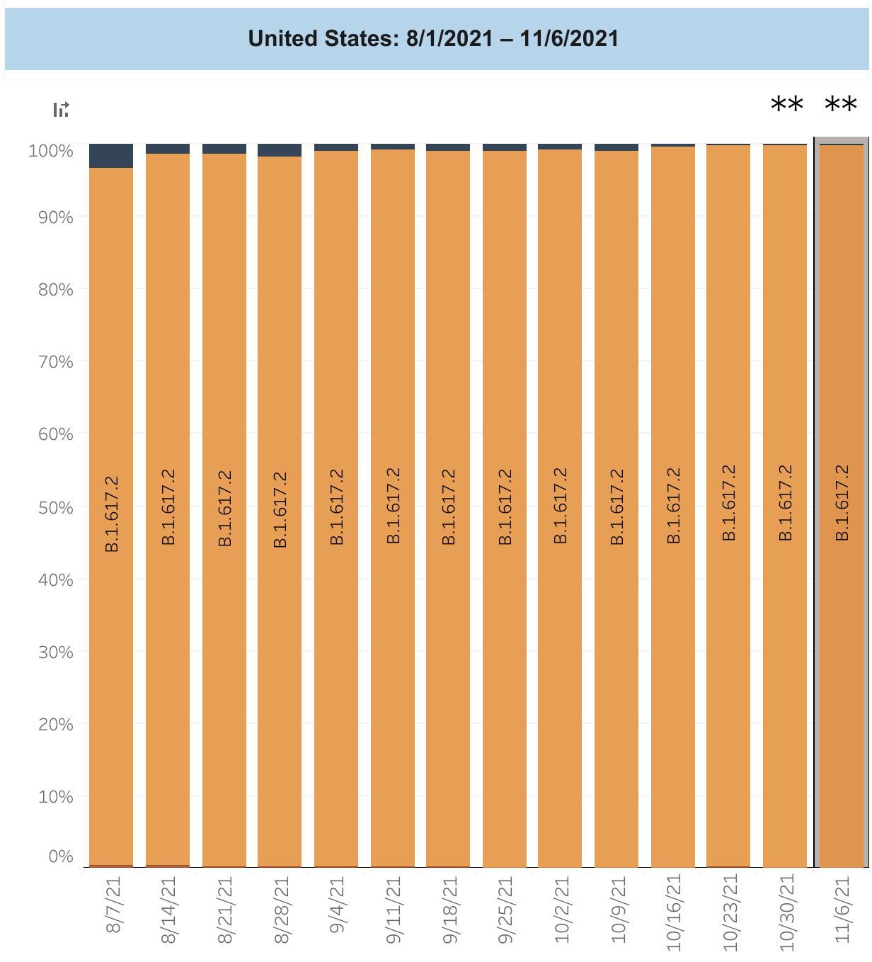
Virology
Delta Variant
  Makes up 99.9% of USA variants
AY.4.2 Variant Under Investigation
    Derived from Delta; first seen in UK
    Transmits in UK better than parent Delta
    Should transmit in the USA
    Does not evade vaccines or monoclonal Abs
https://www.cdc.gov/coronavirus/2019-ncov/variants/delta-variant.html
https://www.idsociety.org/science-speaks-blog/2021/ay.4.2-delta-subvariant-spreading-in-uk--15000-cases-and-found-in-usa-get-vaccinated/

Slide 3
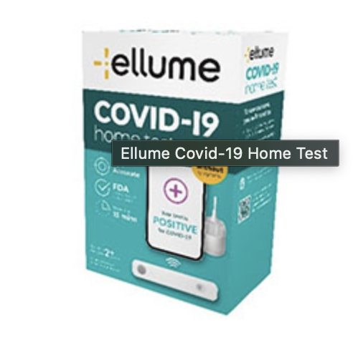
Diagnosis
  Ellume Home Kit Class 1 Recall: (THE WORST KIND of RECALL!)
    Higher than acceptable False Positive rate (35 total)
      Negative tests not affected
    Delayed diagnosis of non-COVID illness
    Transmission when presumed (+) are patients cohorted
    Inappropriate treatments
    Inappropriate isolation and missed work/school
    https://www.fda.gov/medical-devices/medical-device-recalls/ellume-recalls-covid-19-home-test-potential-false-positive-sars-cov-2-test-results

Slide 4
Treatment
REGEN-COV Phase 3 Prophylaxis trial
  1200 mg given (4 subcutaneous injections) to COVID-19 uninfected persons
  586 enrolled and randomized
  81.4% COVID-19 risk reduction already reported in NEJM article at one month
  At 2-8 months, there is a persistent 81.6% risk reduction of laboratory confirmed COVID-19
  Among those who got the Infusion, there were…
    Zero Hospitalizations (vs 6 in controls)
    Zero Deaths
    Zero Safety signals
  https://newsroom.regeneron.com/news-releases/news-release-details/new-phase-3-analyses-show-single-dose-regen-covr-casirivimab-and

Slide 5
Treatment
  Pfizer’s new oral drug: PAXLOVIDTM (PF-07321332; ritonavir)
    EPIC-HR Phase 2/3 study evaluated non-hospitalized adults with COVID-19 at high risk to progress to severe illness
    Drug given within three days of symptom onset
    Risk of hospitalization and death was decreased 89% in those who received the drug
      0.8% who received drug were hospitalized (3/389) vs 7% placebo ( 27/385 hospitalized, 7 died)
    Risk reduction was similar if drug given 5 days after symptom onset (1% vs 6.7%)
    Severe adverse events requiring treatment were fewer in PAXLOVID vs placebo
    https://www.pfizer.com/news/press-release/press-release-detail/pfizers-novel-covid-19-oral-antiviral-treatment-candidate

Slide 6
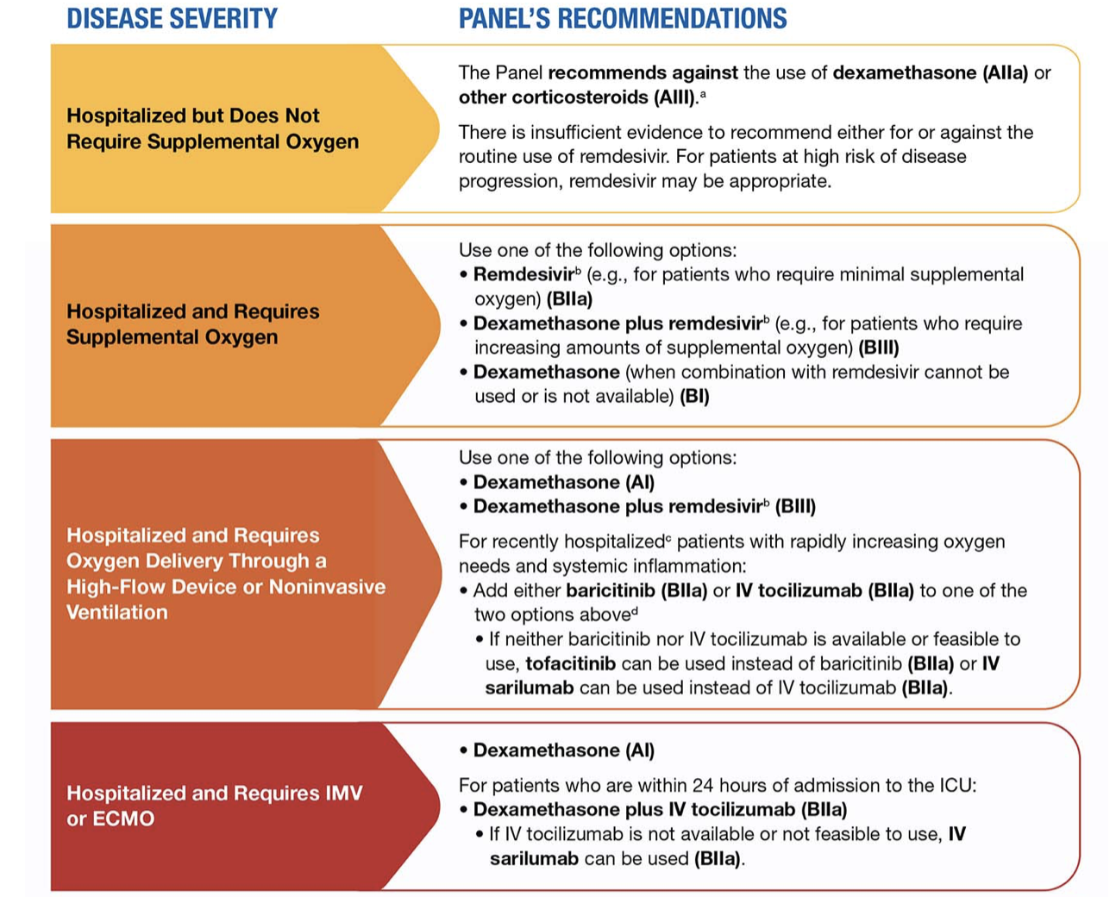
NIH Treatment Guidelines
NIH Treatment Guidelines Update
Post Exposure Prophylaxis
  Favor BAM/ETE or CAS/IMD PEP
Clinical management
  No antibiotics up front (0-6% have CAP); look out for UTI, CLABSI, C diff, HAP /VAP later on and treat with antibiotics
  Proning trials are a good idea but are not a substitute for intubation!
ID Complications
  TB and Hep B reactivation with immunomodulator Rx
  Strongyloides superinfection: Ivermectin may finally have a role if locally endemic!
  Aspergillus and Mucor risk present for patients on steroids
https://files.covid19treatmentguidelines.nih.gov/guidelines/covid19treatmentguidelines.pdf

Slide 7
Prevention with vaccines
Pfizer vaccine is now recommended for COVID prevention in children aged 5 to 11
Moderately and Severely immunocompromised persons should receive an additional primary dose 1 month after their primary series (Pfizer and full dose Moderna, not J and J)
  They may receive a booster 6 months after completing the three dose primary series
Boosters are given after at least 6 months after primary series
  Should: Age 65 and up, LTC residents over 18, aged 50-64 with underlying conditions
  Can: Age 18-49 with underlying conditions, age 18-64 with occupational or institutional risks
Mix and Match is permitted for boosters but not additional primary doses
https://www.cdc.gov/vaccines/covid-19/clinical-considerations/covid-19-vaccines-us.html

Slide 8
Prevention with vaccines
COVID-19 and SARS-CoV-2 Infection
  Recommended for everyone previously infected aged 5 years and older
    Vaccinate when recovered and off isolation
  Multisystem Inflammatory Syndrome: MIS-C or MIS-A
    Vaccinate when recovered and cardiac function is normal
    Wait 90 or more days since diagnosis of MIS-C
    Vaccinate if in an area of high or substantial community transmission
    Vaccinate if MIS-C began before any COVID-19 vaccination
Don’t vaccinate people as post exposure prophylaxis
Vaccinate people getting non-COVID-19 medical care ( no symptoms and no close contact)
Vaccinate all people who are pregnant or are lactating
https://www.cdc.gov/vaccines/covid-19/clinical-considerations/covid-19-vaccines-us.html

Slide 9
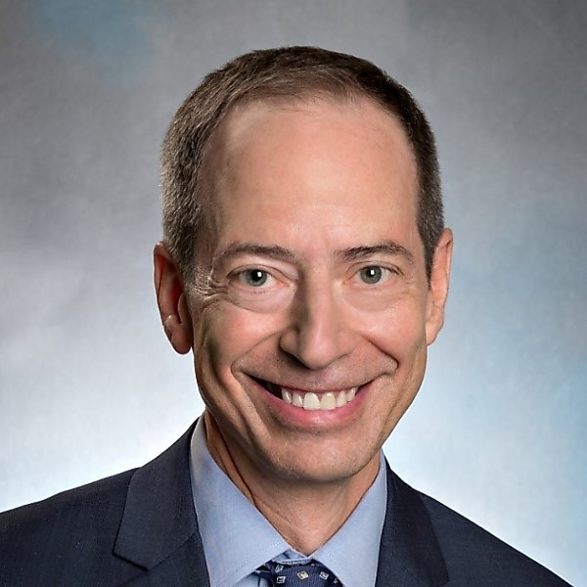
Coming soon…
FDA and CDC are slated to review and approve Pfizer vaccine boosters for all adults by Friday.
Paul Sax from Brigham and Women’s Hospital’s blog November 12:
“Time to Simplify the COVID-19 Vaccine Policy — Authorize a Booster Dose for Anyone Who Wants One”

Slide 10


