Slide 1
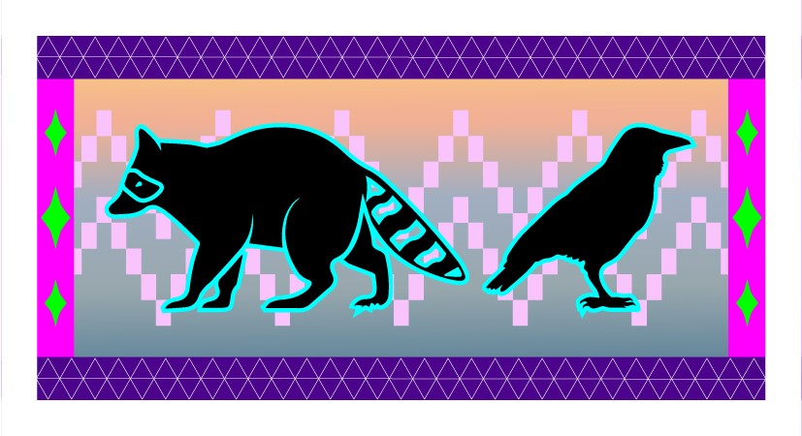
Trickster Spirits and the Opioid Response: Cultural Considerations in Addressing Substance Misuse
  Danica Love Brown, PhD, MSW, CACIII
  Choctaw Nation of Oklahoma
  Northwest Portland Area Indian Health Board
  Behavioral Health Manager

Slide 2
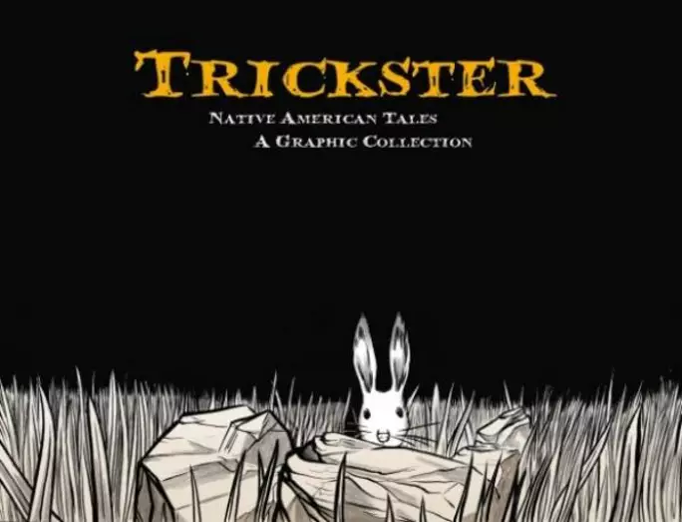
“Meet the Trickster, a crafty creature or being who disrupts the order of things, often humiliating others and sometimes himself in the process. Whether a coyote or a rabbit, raccoon or raven, tricksters use cunning to get food, steal precious possessions, or simply cause mischief.”
Notes:
This presentation is an attempt to help us to understand WHY Natives respond and react to service providers the way they do. If you are triggered by what is being shared in this workshop, I suggest that you take the time to assess this to look at your biases and where and why this is affecting you they way it is. Unfortunately, we will not have time in this workshop to process all the feelings that tend to come up for people. I ask that you please be respectful of this process. If you need to talk after the workshop, please let me know.
For tribal people on Turtle Island, current and past political and social events help shape the context of their lives in ways that many other Americans do not experience. The study of trauma, historical and present, has connected historical genocide, assimilation, oppression and disparate treatment to such symptoms as depression, suicidal thoughts, anger, anxiety, low self-esteem and difficulty in both recognizing and expressing emotions and impact substance misuse
A culturally responsive mental health system must recognize the broader social and political factors that underlie mental health issues for communities of color. For example, data57 show that therapy cannot be successful unless it recognizes the range of social and political issues that contribute to client distress, instead of only identifying the individual issues that result from attempts to adjust to the social and political conditions.
Even the American Psychological Association (APA) guidelines recognize the importance of sociopolitical factors in a client’s treatment, such as the generational history, the history of migration, the citizenship status, English fluency, the extent of support from the family and community, and the level of stress resulting from acculturation.58
A successful mental health system must find ways to integrate mainstream services with culturally-traditional services to address the mental health needs of communities of color within the broader context of their lives

Slide 3
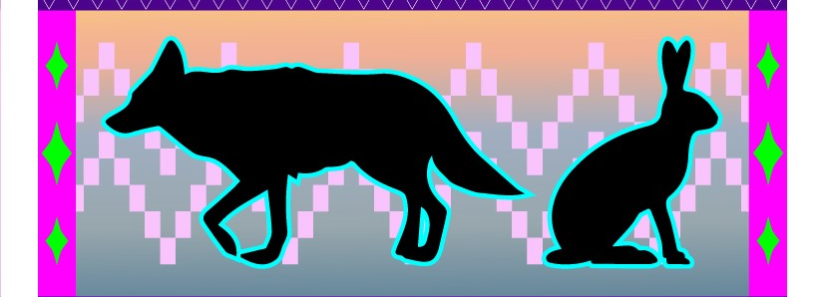
Trickster Spirits and the Opioid Response
Coyote wanders into your life...he'll lend you a pair of eyes ...he'll burn a hole in the darkness.... He is the smoking mirror, night and sorcery, ancestral memory, the enemy on both sides, the crossroads, the compass, the silent wind and thunderous war inside you. ... He holds up the mirror relentlessly until you staring back at yourself....that seems alright to him - Diary of a Dog
Notes:
SUD can impact anyone, because it is a chronic health condition and not a moral failing. As a community, we can look towards the story of the Trickster or “The Tricky One” to learn how SUD can impact Native communities in similarly sneaky and cunning ways. In oral tradition, Trickster is a scared being that assumes many forms. He can be old-man coyote among some tribes, raven in Northwestern tribes, or, more generically, "The Tricky One" (such as Wakdjunkaga among the Winnebago or Manabozho among the Menomini), to mention just a few of his manifestations.
Trickster scandalizes, disgusts, amuses, disrupts, chastises, and humiliates (or is humiliated by) the animal-like proto-people of pre-history, yet he is also a creative force transforming their world, sometimes in bizarre and outrageous ways, with his instinctive energies and cunning. Eternally scavenging for food, he represents the most basic instincts, but in other narratives, he is also the father of the Native people and a strong conductor of spiritual forces in the form of sacred dreams. In respect to substance use disorders, the substances we use are first medicines meant to cure and heal. At some point this transforms into misuse of the medicine, then moves into dependency.
We can imagine that there is a Trickster spirit that is the culprit in this. A spirit that is attempting to teach us important lessons; lesson of humility, compassion, of living in balance with the natural world, respect for the spirit in the medicines we use. The use of the word medicine is not in the Western context of prescription, but rather the energy that traditional medicines carry.
So, there are multiple aspects to consider when looking at opioid misuse and SUD.
First, the essence of opioids and other medicines is a powerful spirit or a prescription to be used.
Second, the current perception of SUD stigmatizes and produces shame or guilt.
In order to help heal and learn the lessons that Trickster has to offer, we need to address our relationships to medicines rather than SUD processes by shifting our understanding and relationship with medicine.

Slide 4

Trauma
“Using trauma terminology implies that the individual is responsible for the response, rather than the broader systemic force caused by the state’s abuse of power”
Linklater, 2014
Notes:
Is an extraordinary psychological experience caused by treats to life and body or personal encounters with violence or death
Disasters: natural
Atrocities: human
It is important to acknowledge that the term “trauma” comes from a western medical context.
Alternative terms, centered in an Indigenous world view, to consider would be “parallel realities” or “multiple realities”, which “recognize the value and legitimacy of these experiences, which often revel important content that is vital to one’s healing process (Linklater, 2014, pg 24).
Developing an Indigenous or decolonial understanding of trauma helps eliminate the stigma that is tied to western understanding and helps us to create space of growth and healing.

Slide 5
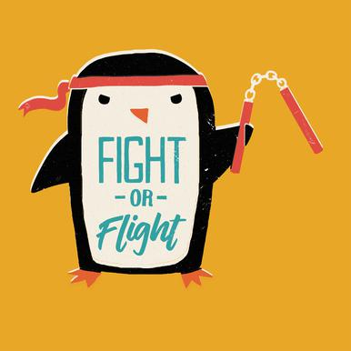
Our bodies are designed to remember danger
Each of us begins to maintain a database of threats in the environment.
Notes:
Fight can be seen as anger, anxiety and adrenaline rushes. Being short with people and ourselves.
Flight can be seen as overexcitement and anger. Focusing on work and other activities.
Freeze can been seen as depression, sadness and ambivalence. Not able to focus on anything, executive functioning is compromised.
Fawn-In a nutshell, “fawning” is the use of people-pleasing to diffuse conflict, feel more secure in relationships, and earn the approval of others. It's a maladaptive way of creating safety in our connections with others by essentially mirroring the imagined expectations and desires of other people.
During a pandemic: As we gather new information, all the time and constantly, the limbic system again decides we are in danger and cycles through the fight, flight freeze options. As providers we are both expected to gather data and interpretive this data for our communities. This "Infodemic" is also contributing to our trauma experience and it is hard to get away from all the information that is out there right now.
Trauma and fear create detachment, and the antidote is attachment and connection, in this pandemic we are asked to social distance, which then impacts our ability to stabilize in crisis. Which then impacts the trauma response. It’s a vicious cycle.

Slide 6
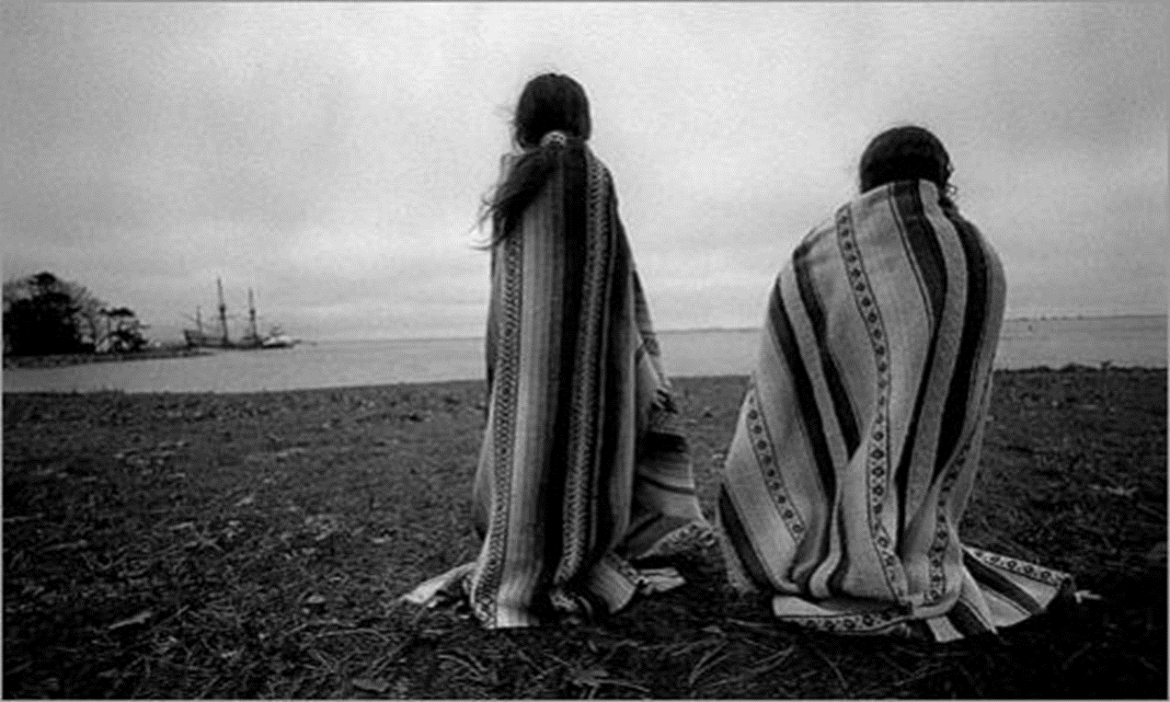
Historical Trauma
Historical trauma - Cumulative emotional and psychological wounding from massive group trauma across generations, including lifespan.
(Brave Heart, 2004)
Notes:
Historical trauma results from the long-term effects of the oppressive traumatizing policies, attitudes, and beliefs of the colonizer towards AI; the lack of resources and opportunities for AI; and current treatment of AI in this country. Brave Heart Yellow Horse (2004) defines historical trauma as “…cumulative emotional and psychological wounding over the lifespan and across generations, emanating from massive group trauma” (pg. 4), and Duran (2006) refers to this a “soul wounding.” These “soul wounding” symptoms of historical loss are interconnected; each one affecting the other to varying degrees. Historical trauma “can often produce complex and profound individual and collective bio-psycho-social-cultural-spiritual responses” related to significant health disparities (Beltrán & Begun, 2014, pg. 160). There is a direct connection between colonization to the effects of historical trauma - depression, substance abuse, and suicidal ideation and other health risk factors. The negative impact of broad social factors that have been influenced by colonization, such as racism, acculturation, poverty, are translated into everyday physical and emotional distress experienced by American Indian’s. This trauma is epigenetically transferred from generation to generation and is expressed in many ways that are connected to the disproportionate rates of poverty, chronic physical and mental health issues, mortality rates, and substance abuse/dependency rates.
Historical trauma response (HTR) is a constellation of features in reaction to massive group trauma, includes historical unresolved grief (similar to Child of Survivors Complex re: Jewish Holocaust survivors and descendants, Japanese American internment camp survivors and descendants)
There is an epigenetic transfer of the trauma.
Trauma can be passed down to offspring due to epigenetic changes in DNA. But positive experiences seem able to correct that. ... In recent years researchers have learned that trauma can be inherited—passed down due to changes in DNA, what's known as epigenetics.

Slide 7
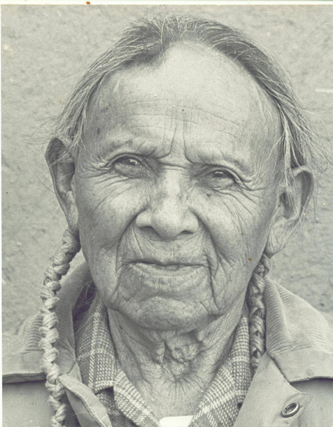
Epigenetic transfer of the trauma
“The memories of our ancestors are passed down on our blood”
Little Joe Gomez
Hamby, Sherry, Elm, Jessica H L, Howell, Kathryn H, & Merrick, Melissa T. (2021). Recognizing the cumulative burden of childhood adversities transforms science and practice for trauma and resilience. The American Psychologist, 76(2), 230–242. https://doi.org/10.1037/amp0000763
Notes:
There is some evidence of an epigenetic transfer of the trauma. Trauma can be passed down to offspring due to epigenetic changes in DNA. But positive experiences seem able to correct that. ... In recent years researchers have learned that trauma can be inherited—passed down due to changes in DNA, what's known as epigenetics.
Severe stress doesn’t just affect one generation: it is passed down, both socially — affecting parenting — and physiologically, by actually changing how children’s genes are read, which can alter both brain and body, a phenomenon known as epigenetics.

Slide 8
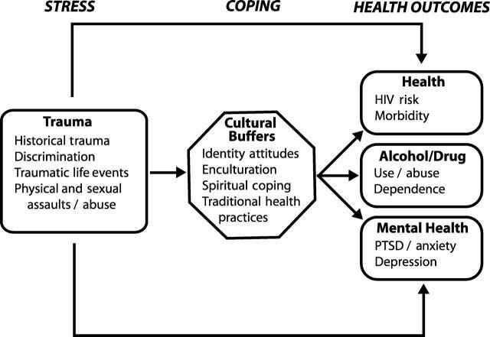
Indigenist Stress Coping Model
Walters, Karina L, Simoni, Jane M, & Evans-Campbell, Teresa. (2002). Substance Use Among American Indians and Alaska Natives: Incorporating Culture in an "Indigenist" Stress-Coping Paradigm. Public Health Reports (1974), 117(Suppl 1), S104–S117.
Notes:
Particularly powerful is the process by which colonization has become internalized among AI peoples and serves to shape health outcomes. Genocide against the indigenous people in the Americas is one of the most massive and longest lasting campaigns in human history.
Historical traumatic events have contributed to these disparities related to social and behavioral factors, such as, resulting in increased younger female headed households, significantly higher poverty rates, larger families, lower median income, lower education, etc., including substance misuse (CDC, 2013).
A significant body of robust research (Brave Heart Yellow Horse, 1998 and 2004; Brown, 2007; Duran, E., 2006; Duran and Duran, 1995; Evan-Campbell, 2008; Stites, 2001, Walters, 1999; Walters et al, 2002a) demonstrates the harmful impact of colonialism on indigenous cultures in the America’s and its continued impact on indigenous peoples across the planet, manifesting through cultural and historical trauma which has been shown to have a direct relationship to the internalized and lateral oppression seen in AI communities that impacts the quality of life for indigenous peoples and health outcomes in this generation.
These scholars have theorized that there is a connection between historically anchored traumatic events and current health inequities among American Indians”. This connection is relational as highlighted by the indigenous people’s relationship with the land, each other and spirit. Including substance misuse

Slide 9
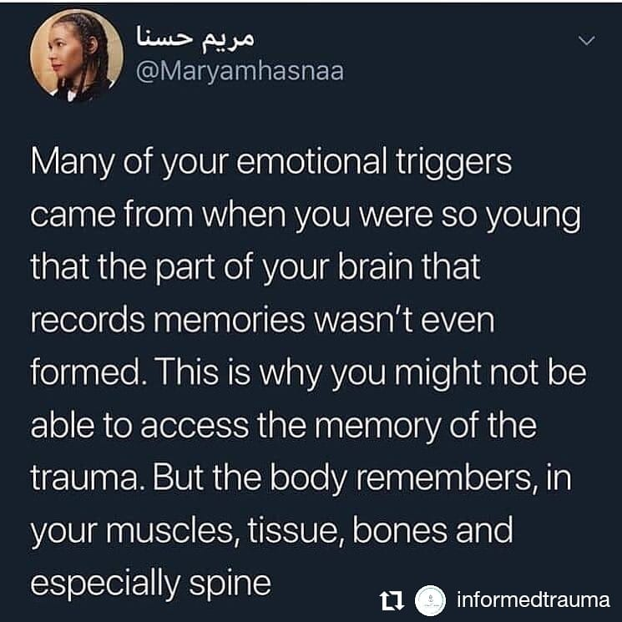
Notes:
Trauma is stored in the limbic system which is not connected to language
Memory is stored in the cerebral cortex with language
Bring the limbic system back to health communicating with the cerebral cortex

Slide 10

Gabor Mate’, MD
The question is never
‘why the addiction’
but
‘why the pain’
In the Realm of the Hungry Ghosts: Close Encounters with Addiction
Notes:
Substance dependence always originate in pain, The very same brain centers that interpret and feel physical pain and become activated during the experience of emotional rejection: on brain scans they “light up” in response to social ostracism just as they would when triggered by physical stimuli. The hurt is at the center of all addictive behaviors.

Slide 11

Notes:
And in fact, there is Hope. We know that trauma reactions may occur when there is a substantial perceived or actual threat. However, we also know that people often experience the same event and react very differently- where one may be traumatized, others are able to demonstrate greater resilience. In other words, it is not the traumatic event itself that causes humans distress, but rather the reactions to that traumatic event. (Denham, 2008; Duran, 2006; Brave Heart Yellow Horse, 1998 and 2004).

Slide 12

Resilient Responses to Trauma
Increased bonding with family and community.
Redefined or increased sense of purpose and meaning.
Increased commitment to a personal mission.
Revised priorities.
Increased charitable giving and volunteerism.
Center for Substance Abuse Treatment , issuing body, publisher. (2014). Trauma-Informed care in behavioral health services : A treatment improvement protocol. (Treatment improvement protocol (TIP) series ; 57). Rockville, MD: U.S. Department of Health and Human Services, Substance Abuse and Mental Health Services Administration, Center for Substance Abuse Treatment.
Notes:
Many people find healthy ways to cope with, respond to, and heal from trauma. Often, people automatically reevaluate their values and redefine what is important after a trauma. Such resilient responses include:

Slide 13
Using Information About Biology and Trauma
Frame
Frame reexperiencing the event(s)
Communicate
Communicate that treatment and other wellness
Refer
Refer certain clients to a psychiatrist
Discuss
Discuss traumatic stress symptoms and their physiological components.
Explain
Explain links between traumatic stress symptoms and substance use disorders
Normalize
Normalize trauma symptoms.
Notes:
Support your clients and provide a message of hope—that they are not alone, they are not at fault, and recovery is possible and anticipated.
Trauma is something that happens to them, it is not who they are “You are having a normal response to and extraordinary event”
Frame reexperiencing the event(s), hyperarousal, sleep disturbances, and other physical symptoms as physiological reactions to extreme stress.
Communicate that treatment and other wellness activities can improve both psychological and physiological symptoms (e.g., therapy, meditation, exercise, yoga).
You may need to refer certain clients to a psychiatrist who can evaluate them and, if warranted, prescribe psycho-tropic medication to address severe symptoms.
Discuss traumatic stress symptoms and their physiological components.
Explain links between traumatic stress symptoms and substance use disorders, if appropriate.
Normalize trauma symptoms. For example, explain to clients that their symptoms are not a sign of weakness, a character flaw, being damaged, or going crazy.

Slide 14
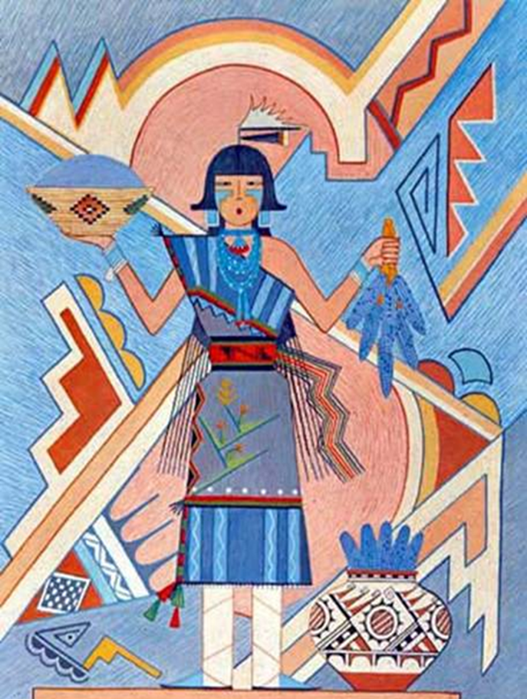
What works
Those who are fluent in many theories and models of treatment.
Who are client centered/counselor driven.
Focus on strengths and protective factors
Who are able to develop trusting therapeutic relationships.
Who are work within their area of expertise.
Culture as prevention

Slide 15


Notes:
Health and wellness from a traditional Indigenous perspective is centered in a holistic model, whereas western perspectives are based in illness/disease. This includes philosophies that equally consider the spiritual, emotional, mental, and physical aspects of the person. Linklater (2014) adds “the mind body-body split has influenced much of psychiatric thinking” (pg. 21). Jennings and Lowe (2013) sought to define health and wellness indicating that wellness involves multiple facets of life including the environment, space, and health of the earth. Lowe and Struthers (2001) further developed a conceptual framework for treating health among AI/AN groups including the dimensions of caring, traditions, respect, connection, holism, trust, and spirituality (p. 280). Moffitt and Vollman (2004) defined wellness as “aesthetic dimension to knowledge transmission, it may enhance the identity and visibility of past traditions” (Moffitt & Vollman, 2004, p. 195). Many AI/AN traditions look to the medicine wheel to define wellness, seeking balance in the physical, mental, emotional, and spiritual intersections of life.
Indigenous philosophies are holistic in nature, which consider equally the physical, mental, emotional and spiritual aspects of the human condition in relation to Mother Earth (land and resources) and Father Sky (natural law and ancestral wisdom). This is in contrast to western philosophies, which compartmentalize these aspects, and rarely address or consider the spiritual aspect of the human condition. Indigenous models are based in wellness, while western models are concerned about disease (Brown, 2016 and 2019; Linklater, 2014). The Diagnostic and Statistical Manual of Mental Health Disorders, 4th Edition (DSM-IV) (2000) defines mental health as “a state marked by the absence of illness”. Whereas, Indigenous philosophies understand mental health as a “broad spectrum, of challenges that [Indigenous] people face in the life walk” (Stevens & St. Germaine, 2003, pg. 160). AI/AN elders and developers of the 49 Days of Ceremony conceptual framework, Doug Modig and Amy Modig (2020) note that balance comes from “wakening the will” within one’s self, while restoring balance with our relationships with others, Mother Earth and Father Sky.
Wellness is related to our understanding of balance to one’s self, family, and community. Linklater (2014) identifies several themes in understanding AI/AN wellness, including balance and harmony, being in Creation, care and compassion, and challenges that AI/AN communities contend with in the pursuit of wellness. Specifically, Linklater (2014) states that the “core of the human experience is spiritual. The core of human wellness is Spirit and spiritual” (pg. 74, see also Hodge, Limb and Cross, 2009, pg. 213). Many AI/AN programs address issues related to balance and harmony. Acknowledging that human beings are in relationship with everything, including Mother Earth and Father Sky, that we are also a part of Creation. This is an ever-changing experience. Hart (2002) states “the reality that life is ever-changing requires all beings to readjust in the constant pursuit to regain a sense of balance” (pg. 41). This is a process which we need to learn to be flexible and adaptive to the world around us.
Linklater (2014) also discusses the concept of “Being in Creation” is relation to wellness. “Indigenous people often maintain a strong relationship with Creation”, and our ancestors past, present and future.. Linklater (2014) included “a connection with the Creator, as well as an understanding of one’s place and purpose within the universe” (pg. 75). This can be interpreted as “being enough” and “having enough”. Linklater adds, being able to know who you are, this is echoed by our Tribal elders, Doug Modig and Amy Modig. AI/AN people learn this from our Creation stories, which are Tribal interpretations of Father Sky, ancestral wisdom, natural law, and cultural expectations. Creation stories explain to AI/AN people what our responsibilities and expectations are for us in relationship to our communities. “In some senses, it may be understood that relations with the spiritual realm, including relationship with the Creator, encourage a person to see themselves as part of a larger network - the network of Creation” (Linklater, 2014, pg. 76). This can be a powerful experience of healing for many people.

Slide 16
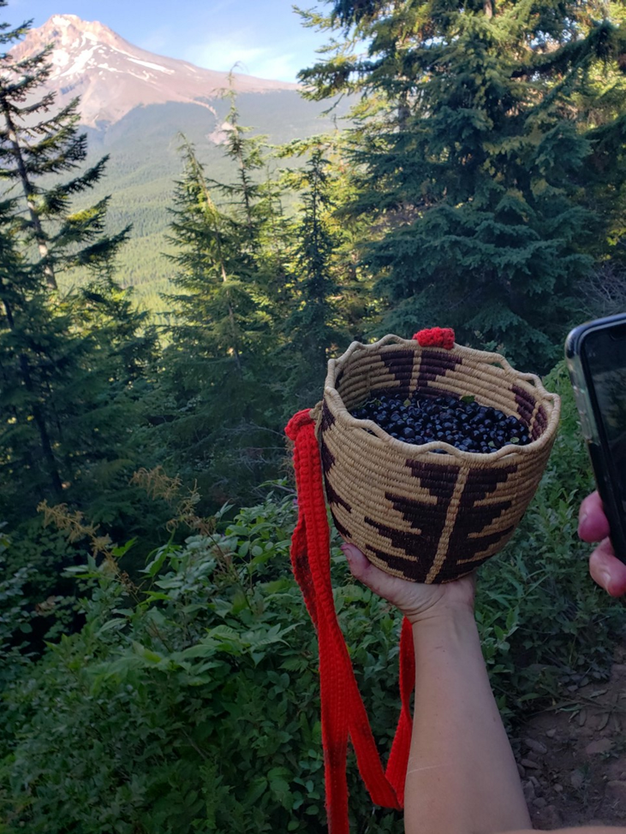
Relationship with Medicine
Reestablish our relationship with medicine
Change our relationship with medicine people
Develop a relationship with the spirit of substances and substance misuse

Slide 17
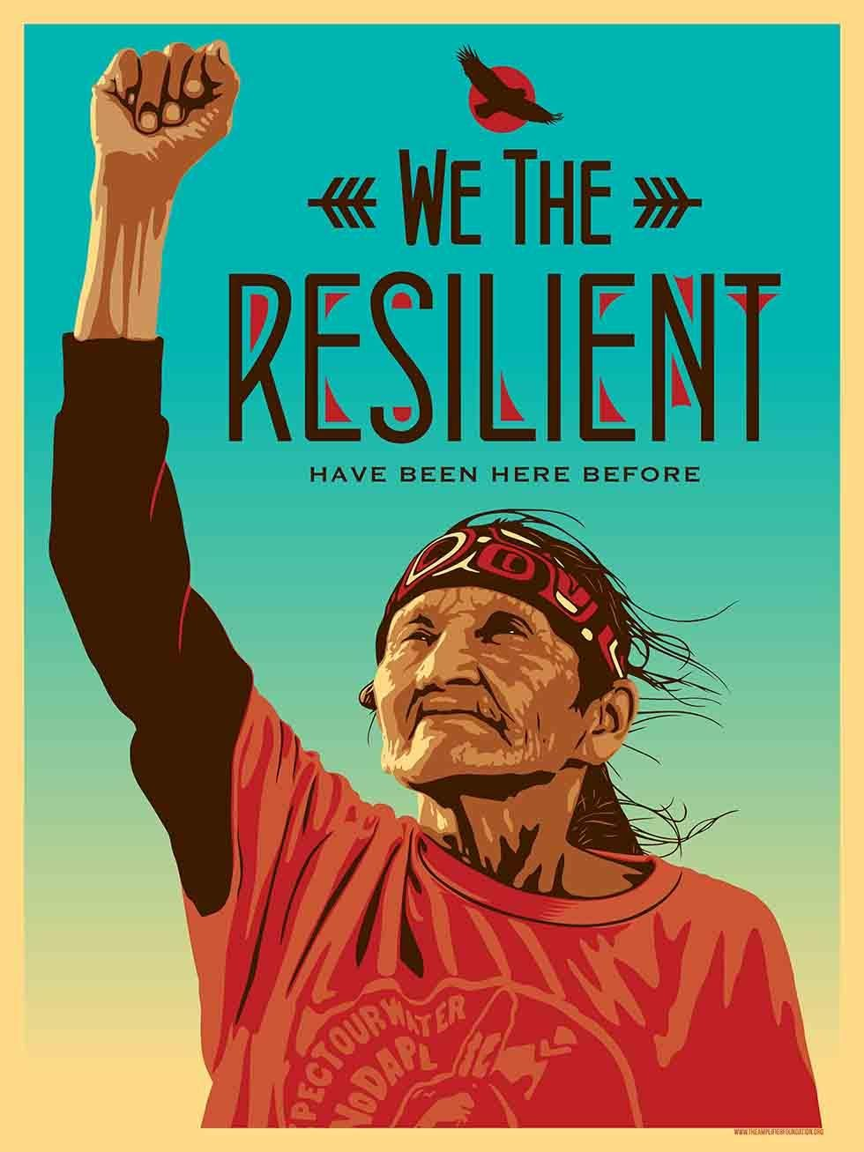
If trauma impacts the epigenetic transfer of trauma, culture and connection can mitigate these affects. If we want to prevent substance misuse we need to focus more on stress, trauma, and poverty while providing intervention options that are grounded on Traditional Indigenous Knowledge. (Brown, 2020)
Notes:
We can heal our communities through culture, connection, and developing interventions and policies that are grounded in traditional indigenous knowledge, tribal best practices, and evidence-based practice. This is not just true in the case of SUD, but in other conditions as well.

Slide 18


Slide 19
Adverse Childhood Experiences Study: https://www.cdc.gov/violenceprevention/childabuseandneglect/acestudy/index.html
Mate, G. (2009). In the realm of the hungry ghosts: Close encounters with addiction. Berkeley, CA: North Atlantic Books.
Prochaska, J. O., & DiClemente, C. C. (1983). Stages and processes of self-change of smoking: Toward an integrative model of change. Journal of Consulting and Clinical Psychology, 51(3), 390-395.
Rollnick, S., Miller, W. R., & Butler, C. (2008). Motivational interviewing in health care: helping patients change behavior. Guilford Press.
Brave Heart Yellow Horse, M. (2004). The historical trauma response among Natives and its relationship to substance abuse: A Lakota illustration. In E. Nebelkopf & M. Phillips (Eds.), Healing and mental health for Native Americans: Speaking in red. (pp. 7-18). Walnut Creek: Alta Mira Press. Also in Journal of Psychoactive Drugs, 35(1), 7-13.
Suggested Resources:
Danica Love Brown, MSW, CACIII, PhD
dbrown@npaihb.org
NPAIHB Resources: http://www.npaihb.org/opioid/#SUDTraining

