Slide 1
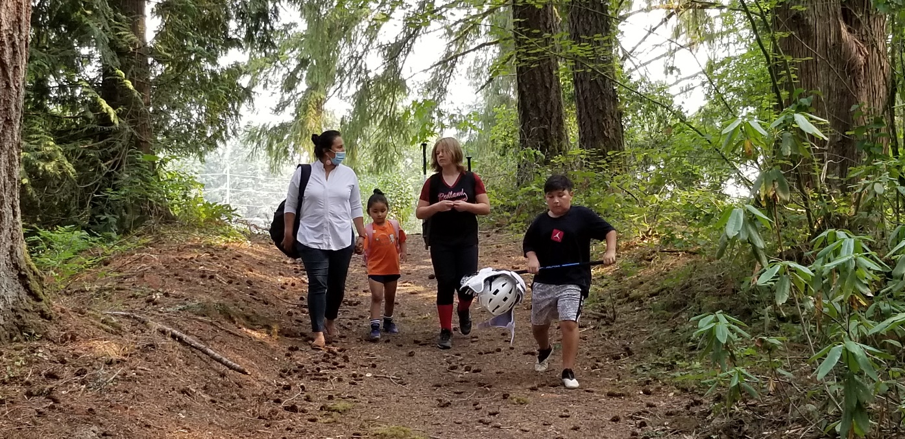
How to talk to friends and family
Listen with empathy
Ask Open-ended questions
Ask permission to share information
Help them find their “Why”
Help make their vaccination happen
https://www.cdc.gov/coronavirus/2019-ncov/vaccines/talk-about-vaccines.html

Slide 2

Contact us:
Tyanne Conner, Native Boost Coordinator
tconner@npaihb.org
If you still have questions you would like answered, please use the link below:
https://www.surveymonkey.com/r/COVIDVaccineforChildrenQuestions

Slide 3

Thank You

